Slide 1
Micro Patterning Techniques on μ-PIC (and MM etc.)
Atsuhiko Ochi
Kobe University
RCGD2019@Bari 13/05/2019

Slide 2
Micro patterning technique
The m-PIC has very precise pattern, and there are many HV line connections.
In this talk, two type of micro patterning techniques are shown for DLC
Liftoff patterning
Connection from metal electrodes to DLC

Slide 3
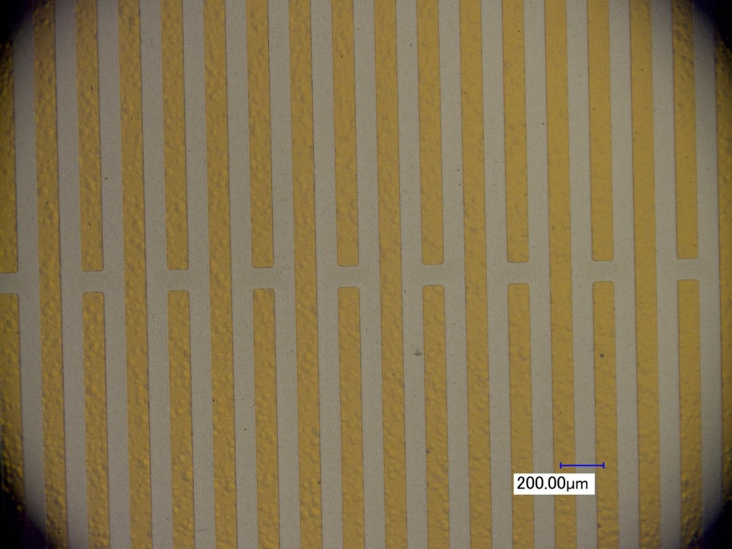
Liftoff process using sputtering
Very fine structure (a few tens micro meter) can be formed using photo resist. (same as PCB)
Surface resistivity can be controlled by sputtering material and their thickness
Photo resist
@PCB company
(Laytech inc.)
Substrate (polyimide)
Carbon sputtering
@Sputtering
company
(Be-Sputter inc.)
Substrate (polyimide)
Developing the resists
@PCB company
(Laytech inc.)
Substrate (polyimide)

Slide 4
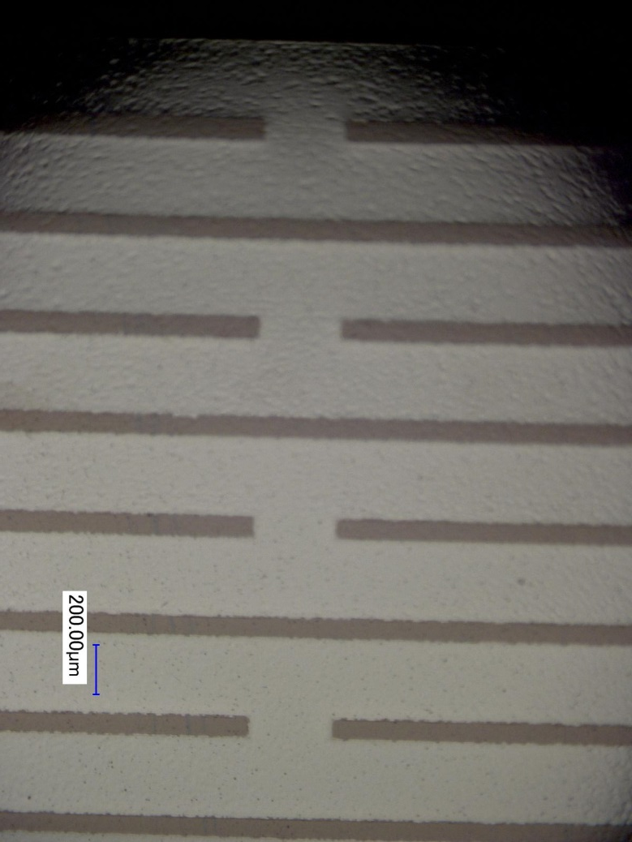
Enlarged picture of resistive strip foil
10 mm
0.3 mm
1 mm

Slide 5
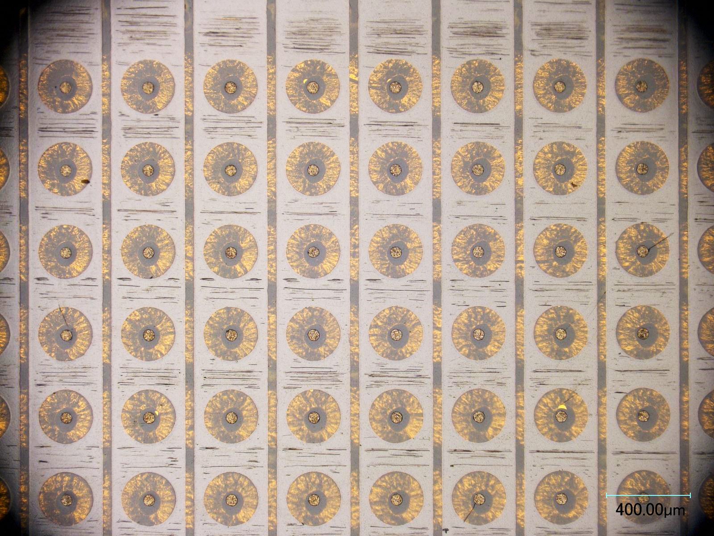
DLC u-PIC in previous production
Fine patterning … μ-PIC with resistive cathode
Drift plane
Resistive cathode (-HV)
400 μm
Anode
Thin
substrate
Pickup electrode
Thick substrate
50 μm

Slide 6
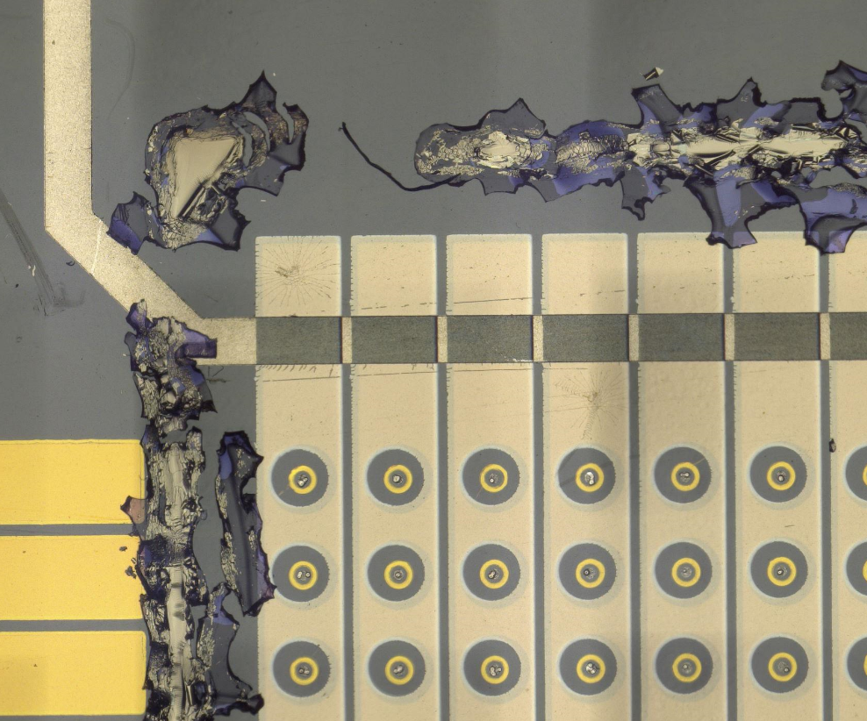
The problem in liftoff method
The etching for remained resist is effected only from side
For large area (> 5mm) of masked area, those mask cannot be removed
→ DLC remained
Etching the resist from side
Substrate (polyimide)
DLC and resist can be remained
In thick (negative) pattern
Substrate (polyimide)

Slide 7
Manufacturing process of resistive m-PIC (2017-2018)
Liftoff using metal

Slide 8
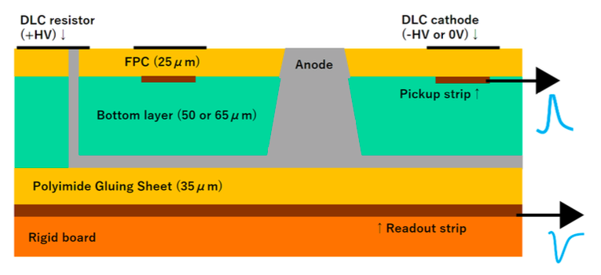
Connection between metal & DLC
DLC cathode
Cathode Pickup
Anode
Anode readout

Slide 9
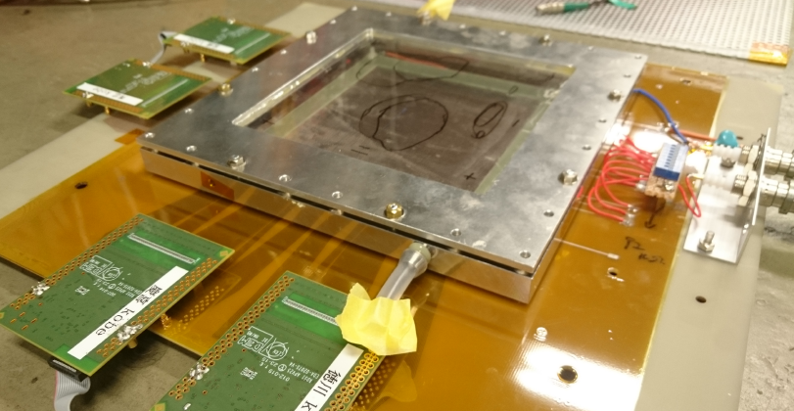
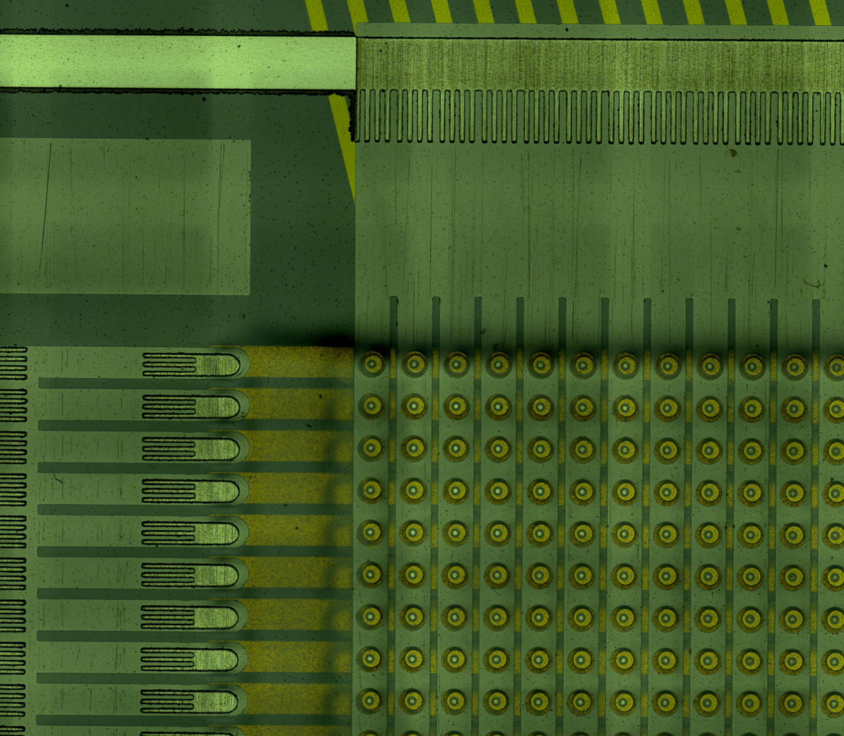
Prototype Chamber
Detection area: 10 cm X 10 cm
2-dimensional, 400 μm spacing
Cathode: φ270 μm
Anode: φ50 μm
256 x 256 readout
With APV25 + SRS
2mm

Slide 10
Signals with / without zigzag connection (HV bias)
Channel number
Channel number

Slide 12
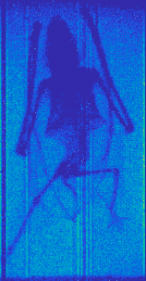
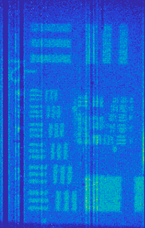
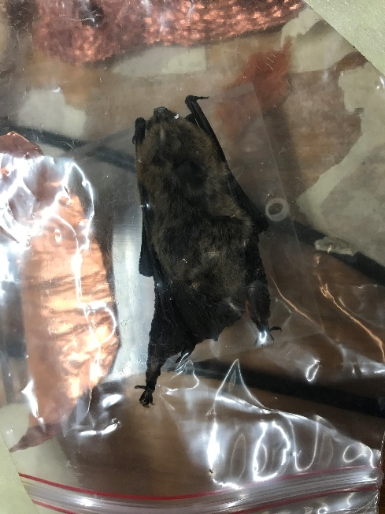
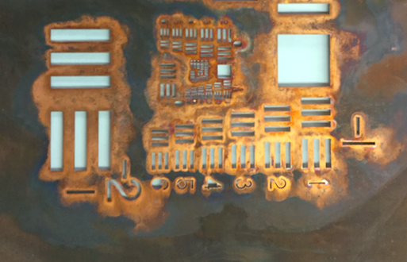
Imaging using u-PIC

Slide 13
Summary
For investigating DLC patterning for μ-PIC,
Liftoff process using metal mask
Zigzag connection between DLC and metal
has been tested and worked well
Liftoff using photo-sensitive resist is still important technique for large size patterning

