Slide 1

Characterization and Optimization of the
PMQDs for the SIDDHARTA-2 IR
C. Milardi
January 11th 2019

Slide 2
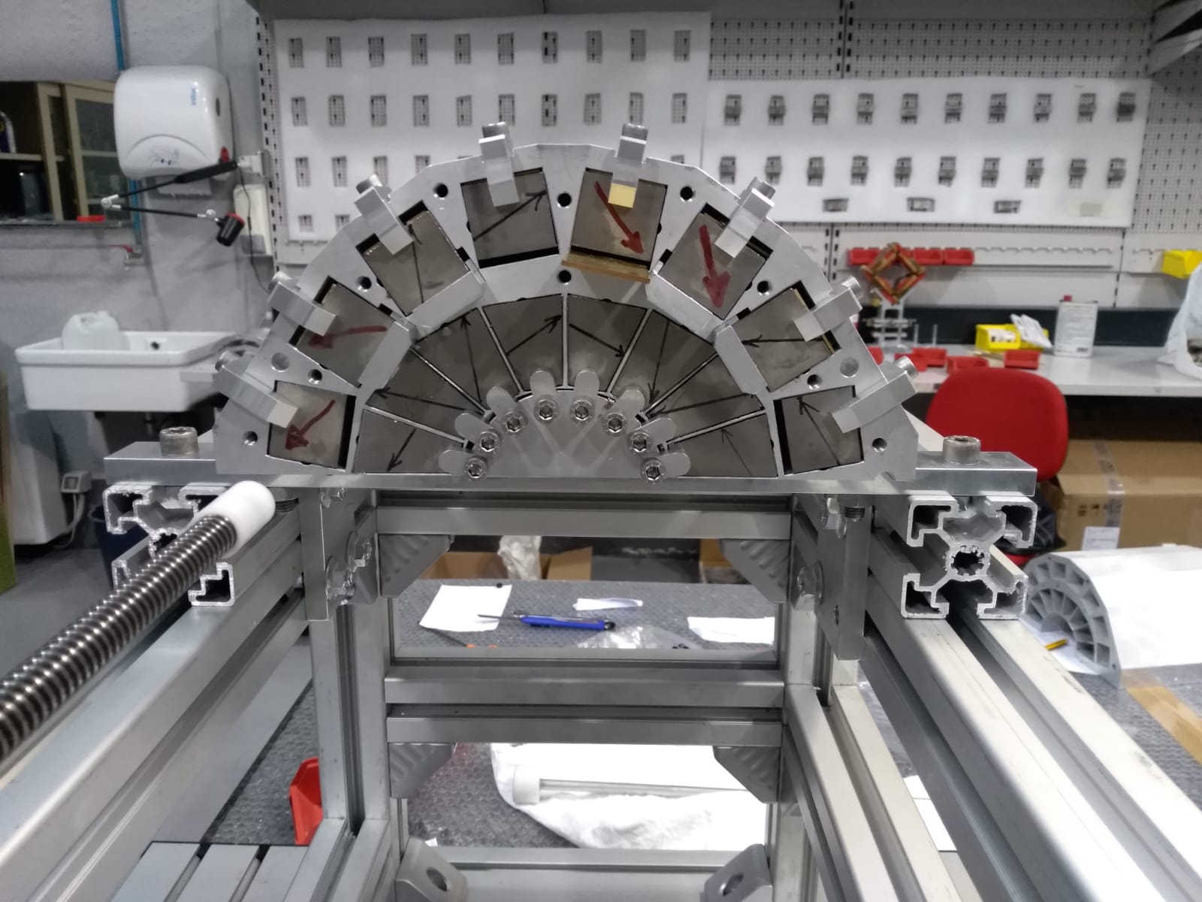
PMQD Assembly
L. Pellegrino, G. Sensolini, and all the member of the Mechanical Engineering Group
Cases start to arrive at LNF on Jan 15th 2019
Mechanical measurements
Assembly
PMQD1 upper half completed on Jan 24th 2019
PMQD1 closed on Jan 30th 2019
Feb. 1st 2019 both PMQDs ready for preliminary magnetic characterization

Slide 3
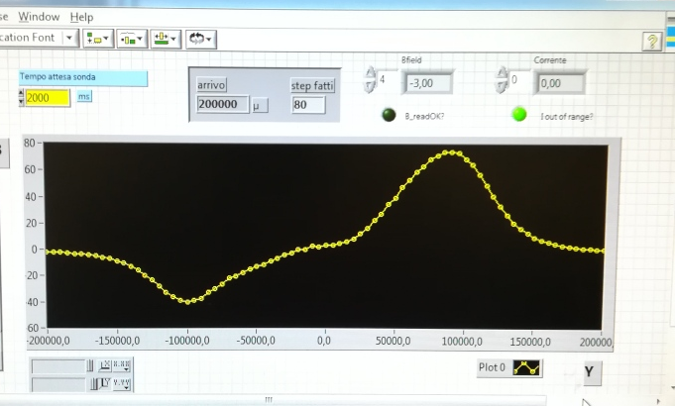
Magnetic Characterization at LNF
F. Iungo, A. Vannozzi, L. Sabbatini and all the member of the Electrotechnical Engineering Group
Hall probe preliminary measurements

Slide 4


Leaving for Grenoble (on Feb. 5th)

Slide 5
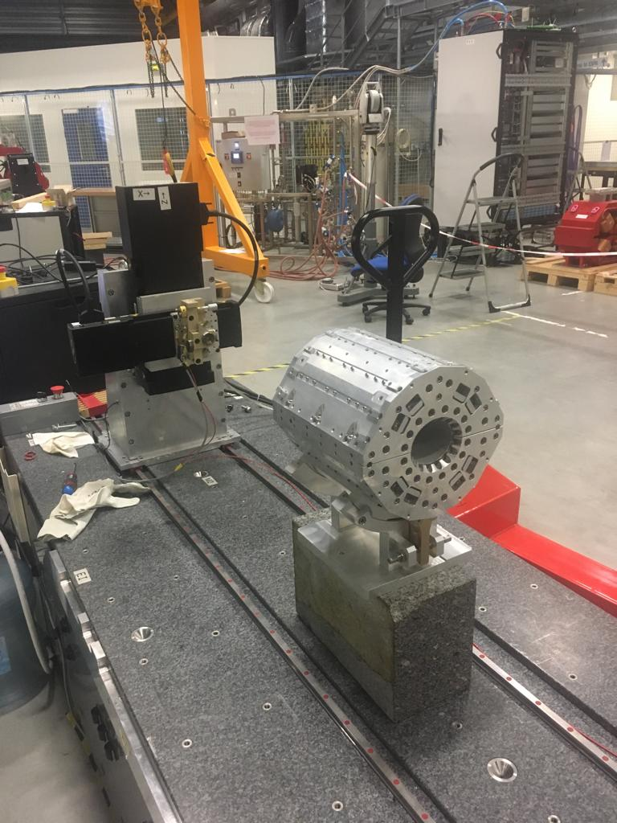
Magnetic Characterization at Grenoble
G. Le Bec, J. Chavanne, C. Milardi, L. Pellegrino, G. Sensolini, A. Vannozzi
Stretched wire measurement outlined:
  a slight difference in the integrated gradient strength wrt the nominal value 6.55 T (6.71 T)
  some multipole strength out of specification
multipole terms are comparable in the two PMQDs:
  Skew Sextupole
  Octupole
  Dodecapole
Measurements done on two different benches analyzed by different approaches returned the same results
Benchmark the RADIA code with measurements

Slide 6
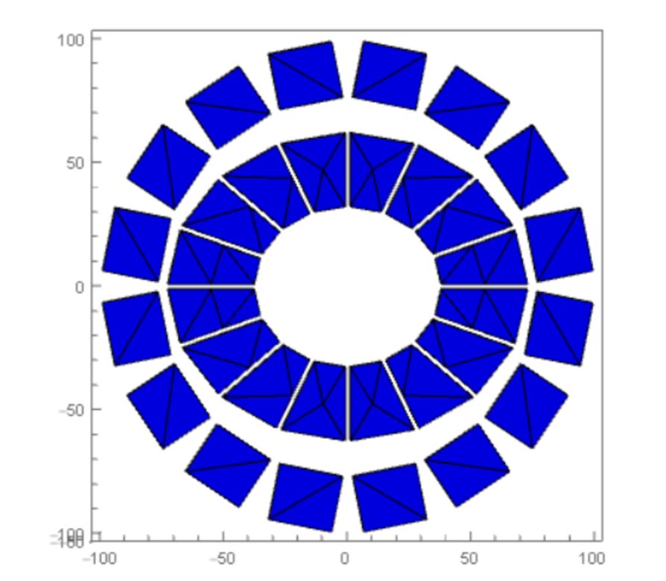
Magnetic Characterization at Grenoble
G. Le Bec, J. Chavanne, C. Milardi, L. Pellegrino, G. Sensolini, A. Vannozzi
Largest part of the imperfection can be recovered by:
machining the two halves of the PMQD cases in order to remove 200 micron of Al from the bottom of each half case
shimming four lines, the first and the last for each PMQD half, in the inner wedge ring by adding 200 μ thick shims in order to move the wedges inward
Fine optimization can be done by tuning the position of the outer blocks

Slide 7
Plan (under way)
Mechanical finish
Wedge shimming
Provide shims with progressive variable thickness
Revise shift organization
The idea is to go back to Grenoble, at last by February 25th, in order to measure the PMQDs and al least one PMQF

