Slide 1



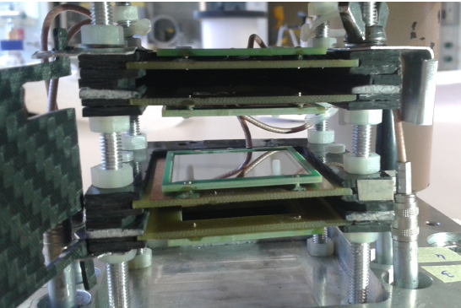
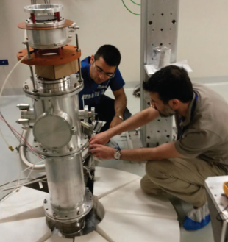
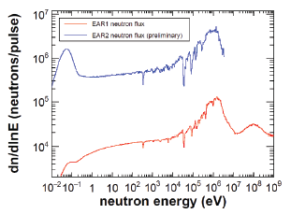
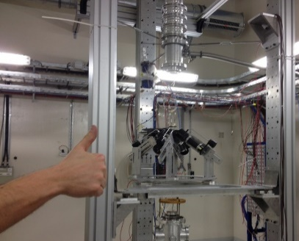
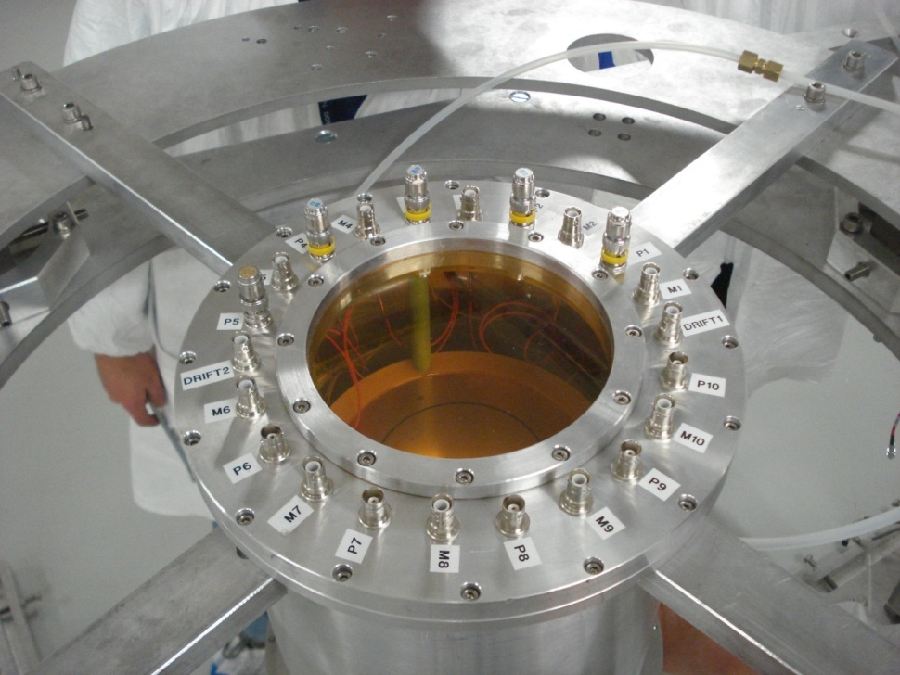
15th International Conference on Nuclear Reaction Mechanisms
Recent results at the n_TOF facilty (CERN)
Giuseppe Tagliente
Istituto Nazionale Fisica Nucleare, Sezione di Bari, Italy
on behalf of n_TOF Collaboration

Slide 2
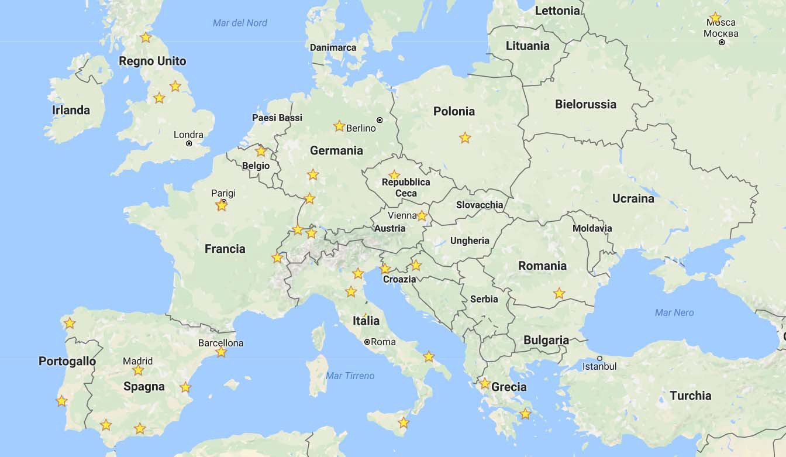


n_TOF Collaboration
38 Participating Institues: EU (34), Japan (2), India (1), Australia (1)
120 Participating researchers
15th International Conference on Nuclear Reaction Mechanisms Varenna 11-15/6/2018
G. Tagliente
Notes:
Nuclear Technology
Nuclear Astrophysics
Medical Physics
Fundamental Nuclear
Physics

Slide 3
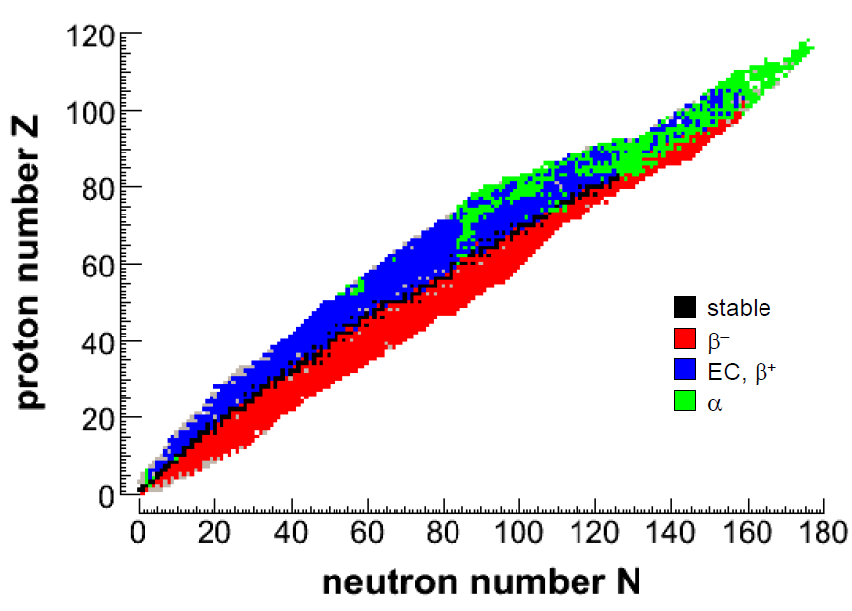
Scientific motivations
Goal: High accuracy data on useful parameters of neutron induced reactions for:
Nuclear Technology
(fission products &
structural material)
Nuclear Astrophysics
(stellar nucleosynthesis)
Advanced nuclear reactors
(actinides)
Astrophysics
Fission: (n,f)
(actinides)
Capture: (n,γ)
(medium-mass – actinides)
Charged particle: (n,cp)
Medical Physics
15th International Conference on Nuclear Reaction Mechanisms Varenna 11-15/6/2018
G. Tagliente
Notes:
Nuclear Technology
Nuclear Astrophysics
Medical Physics
Fundamental Nuclear
Physics

Slide 4
Abundances beyond Fe
α-nuclei
¹²C,¹⁶O,²⁰Ne,²⁴Mg, …. ⁴⁰Ca
Gap
B,Be,Li
Elements heavier than Fe are the result of neutron capture processes
NEUTRONS
H 30 000
C 10
Fe 1
Au 2 10⁻⁷
r-process peaks (nuclear shell closures)
s-process peaks (nuclear shell closures)
Fe peak
Th, U
Au
Pb
15th International Conference on Nuclear Reaction Mechanisms Varenna 11-15/6/2018
G. Tagliente

Slide 5
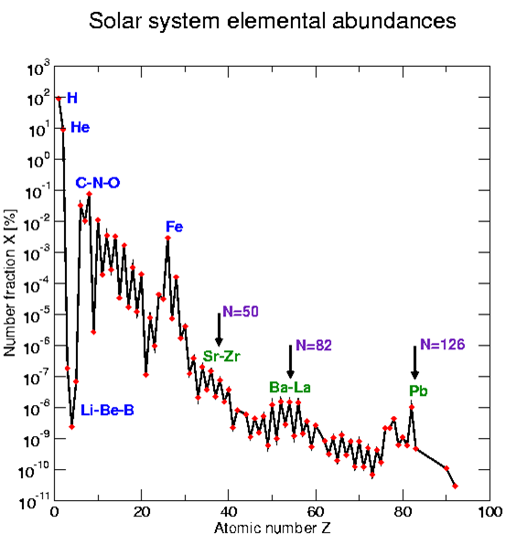
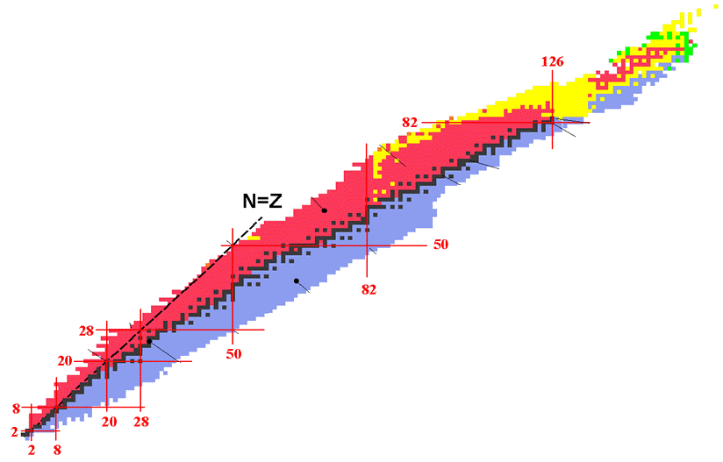
The Stellar Nucleosynthesis
s-process lifetime 10⁴ years n_{n}≈10⁶⁻¹² n/cm³
r-process lifetime μs n_{n}≈10²⁰⁻³⁰ n/cm³
β-decay lifetime: few hours to few years
The canonical s-process
neutrons

Slide 6
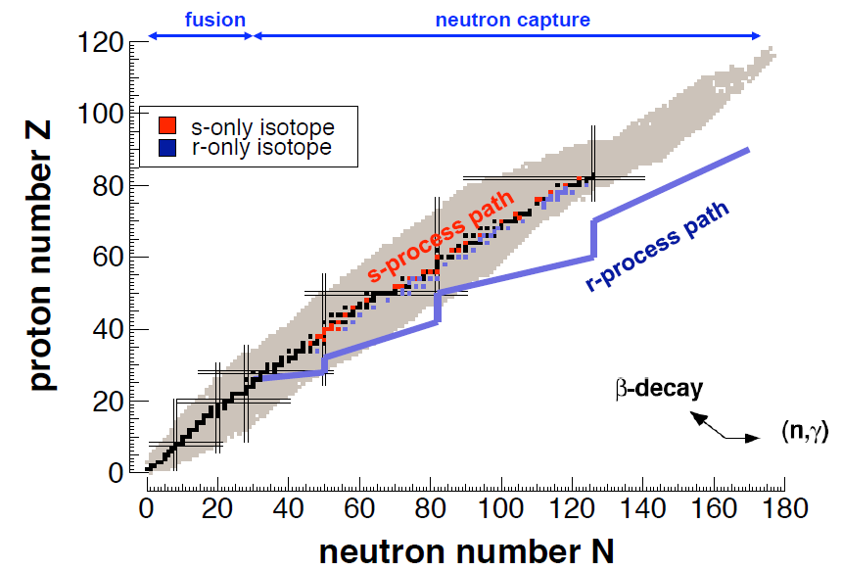
The Stellar Nucleosynthesis
Neutron beams
s-process (Red Giants)
Radioactive beam facilities
r-process (Supernovae)
s-process (slow process):
  Capture times long relative to decay time
  Involves mostly stable isotopes
  N_{n} = 10⁸⁻¹² n/cm³ , kT = 8 – 90 keV
r-process (rapid process):
  Capture times short relative to decay times
  Produces unstable isotopes (neutron-rich)
  N_{n} = 10²⁰⁻³⁰ n/cm³
15th International Conference on Nuclear Reaction Mechanisms Varenna 11-15/6/2018
G. Tagliente

Slide 7
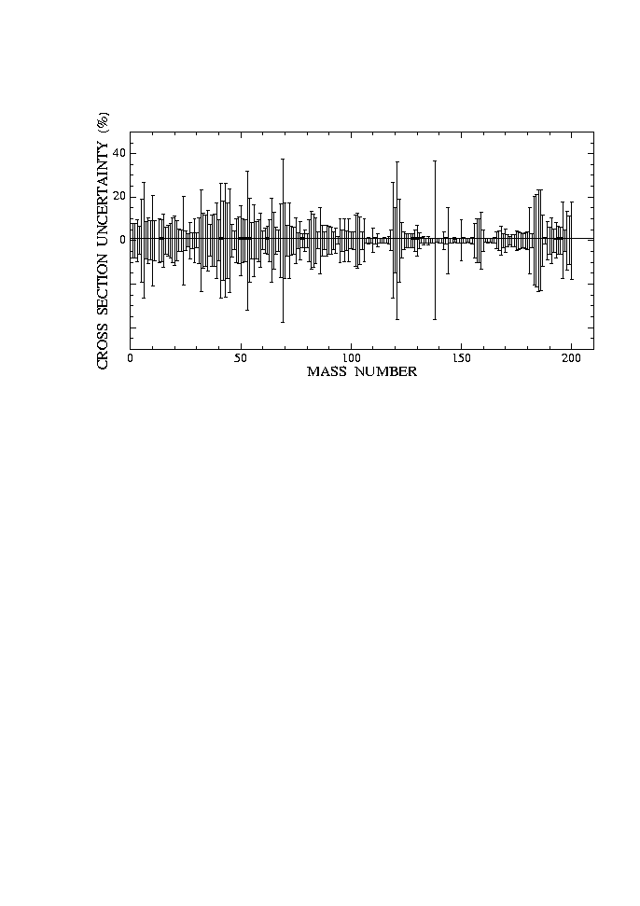
The neutron capture cross section
Huge amount of data collected on many isotopes, mostly stable. Main features of s-process now well understood.
However, cross-section uncertainties in some cases remain high, in particular if compared with progresses in:
observations of abundances
models of stellar evolution
Bao et al. ADNDT 76 (2000)
For three classes of nuclei data are lacking or need substantial improvements:
  1. Nuclei with low cross-section, in particular neutron magic nuclei (s-process bottleneck)
  N=50 ⁸⁶Kr, ⁸⁷Rb, ⁸⁸Sr, ⁸⁹Y, ⁹⁰Zr
  N=82 ¹³⁸Ba, ¹³⁹La, ¹⁴⁰Ce
2. Isotopes unavailable in large amount, such as rare or expensive isotopes:
  ^{186,187}Os, ¹⁸⁰W, etc…
3. Radioactive branching isotopes:
  ⁶³Ni,⁷⁹Se, ⁸⁵Kr, ⁹⁵Zr,¹⁵¹Sm, ¹⁶³Ho, ²⁰⁴Tl, ²⁰⁵Pb
15th International Conference on Nuclear Reaction Mechanisms Varenna 11-15/6/2018
G. Tagliente

Slide 8
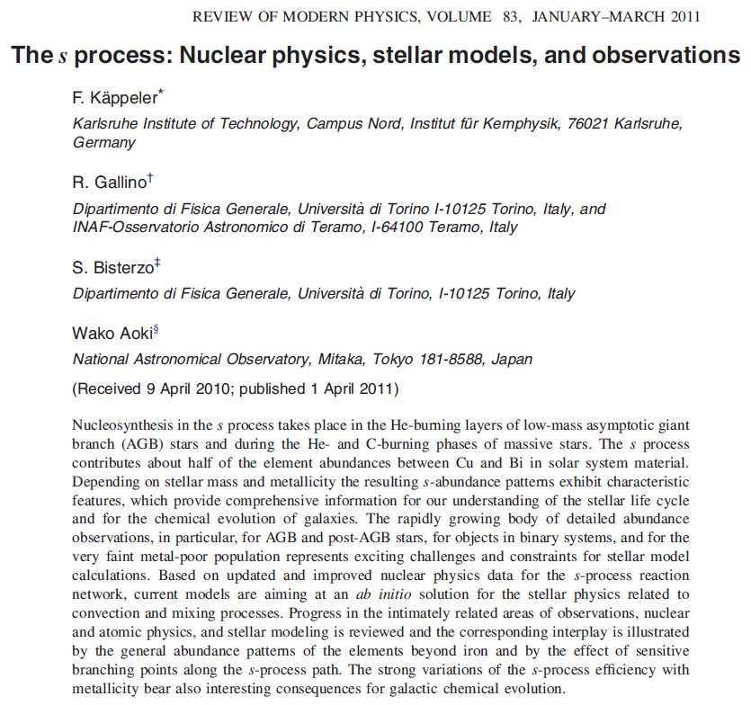
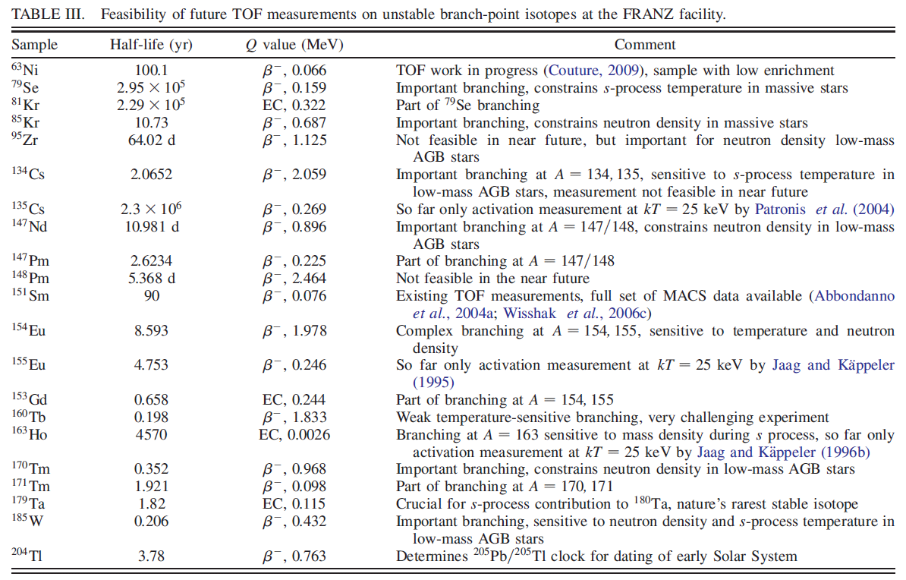
n_TOF Goals

Slide 9
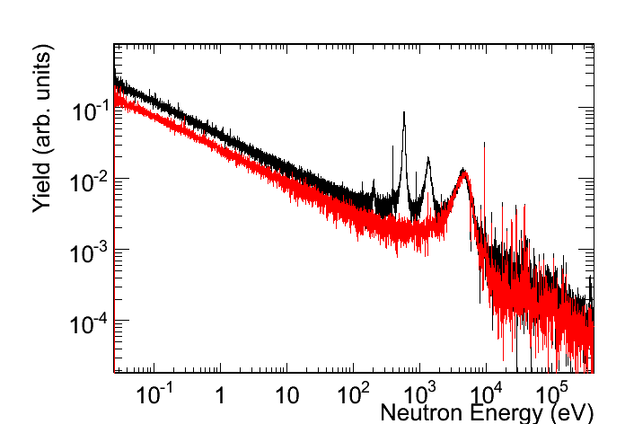
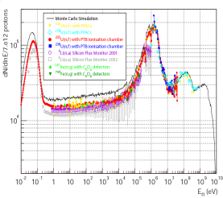
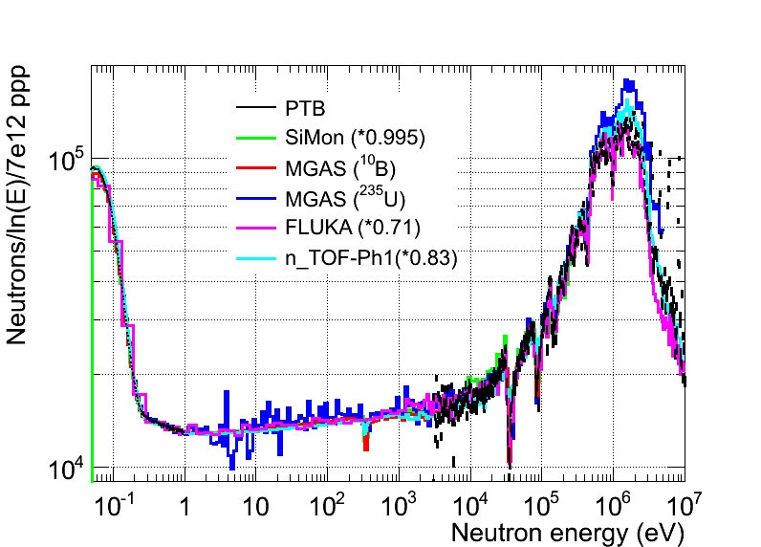
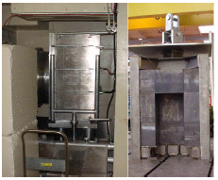
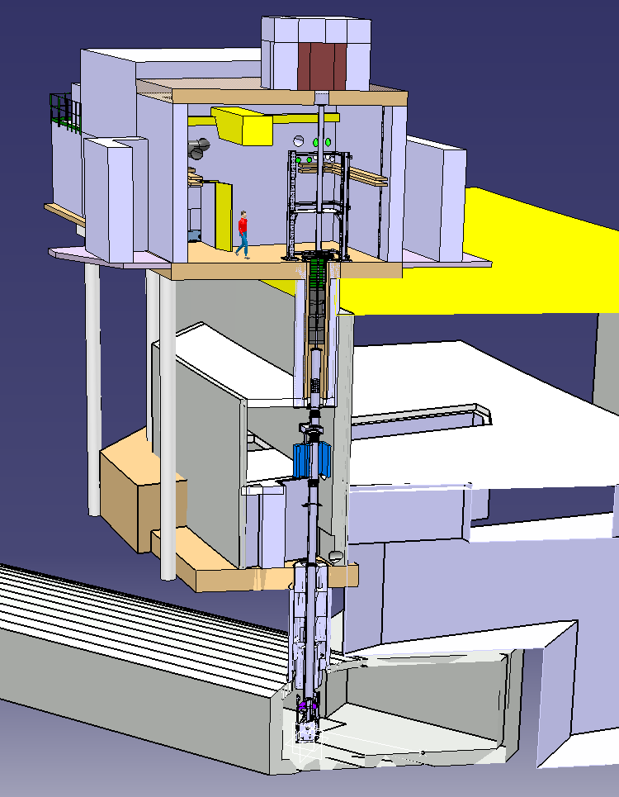
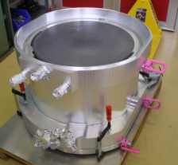
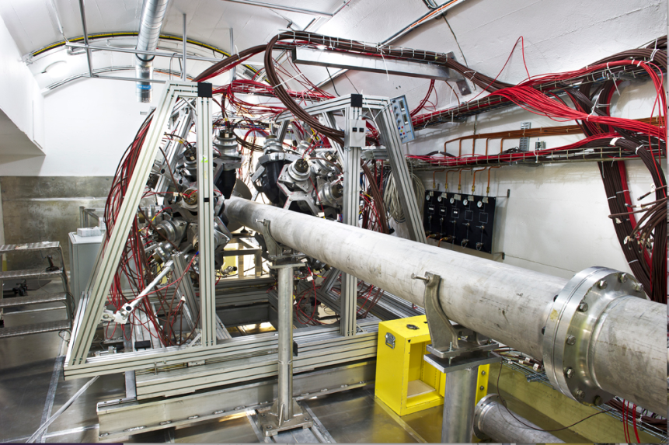
n_TOF Time Line
2001-2004
2009-2012
⁶³Ni
⁶²Ni
Commissioning
Commissioning
2000
2009
Phase I
Measurement campaign
Phase II
Measurement campaign
Phase III
1997
2012
2018
Construction
started
2nd Exp. area
1999
New Target
installed
2014
2008
Upgrades
¹⁰B-water
Class-A area
2010
Concept
by C.Rubbia
CERN/ET/Int. Note 97-19
1997
15th International Conference on Nuclear Reaction Mechanisms Varenna 11-15/6/2018
G. Tagliente

Slide 10

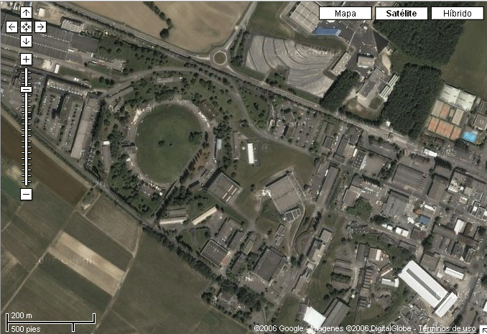
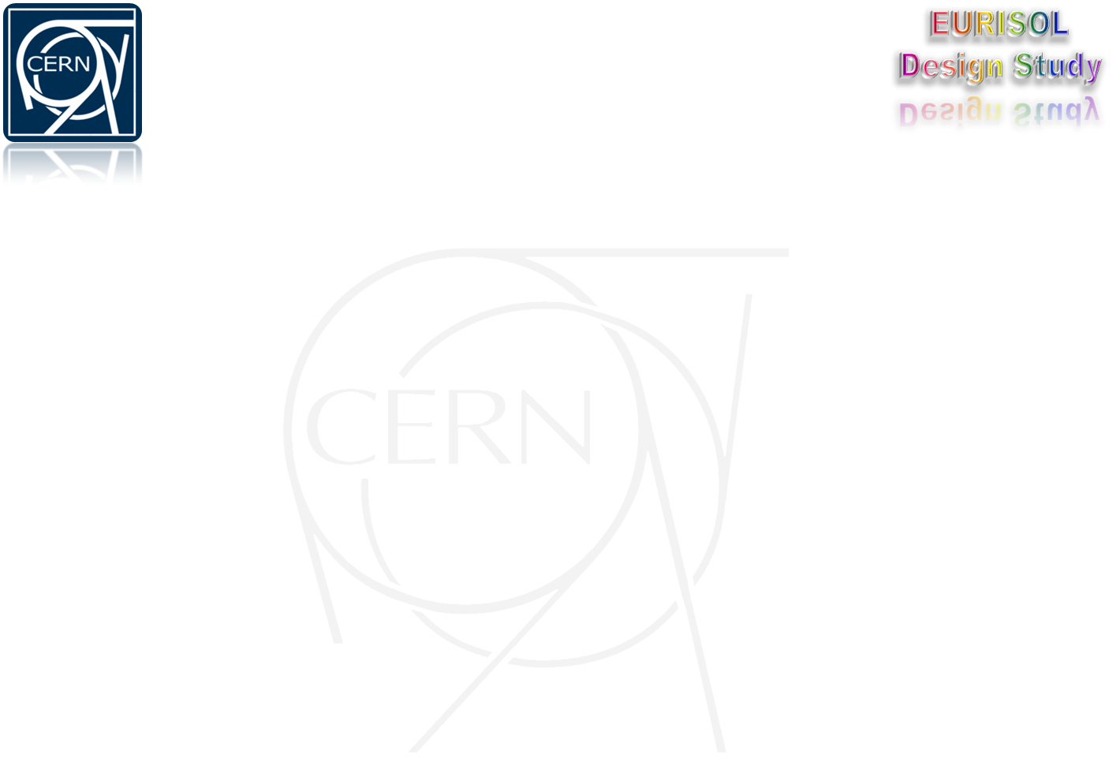
The n_TOF Facility at CERN
n_TOF is a spallation neutron source based on the 20 GeV/c proton beam from the CERN PS hitting a massive Pb block.
185 m flight path
Nominal proton Intensity:
7x10¹² p/pulse
Proton pulse width:
7 ns (r.m.s.)
Low repetition rate:
< 0.8 Hz
Wide energy spectrum:
< 25 meV – 1 GeV
High instantaneous flux:
10⁵-10⁷ n/cm²/pulse
Booster
1.4 GeV
PS 20 GeV
Linac
50 MeV
The innovative features of n_TOF come from the characteristics of the proton beam: high energy, high peak current (50 A over 20 ns), low duty cycle (< 1 Hz).
15th International Conference on Nuclear Reaction Mechanisms Varenna 11-15/6/2018
G. Tagliente

Slide 11
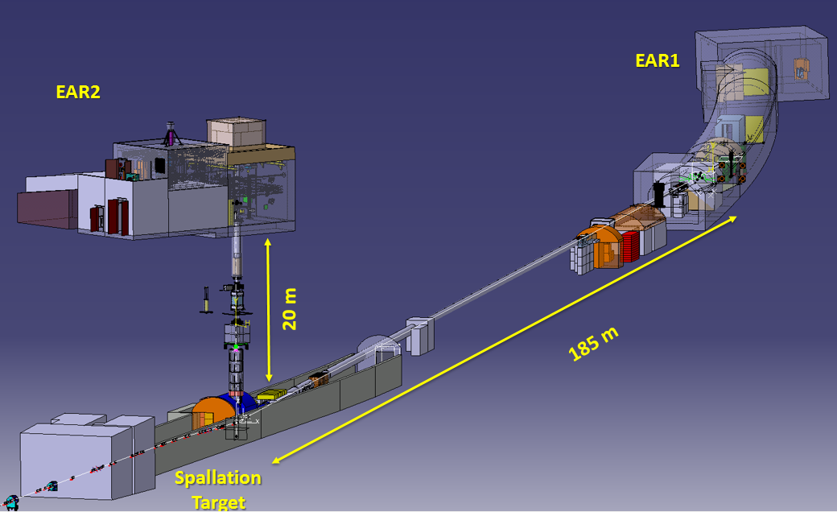
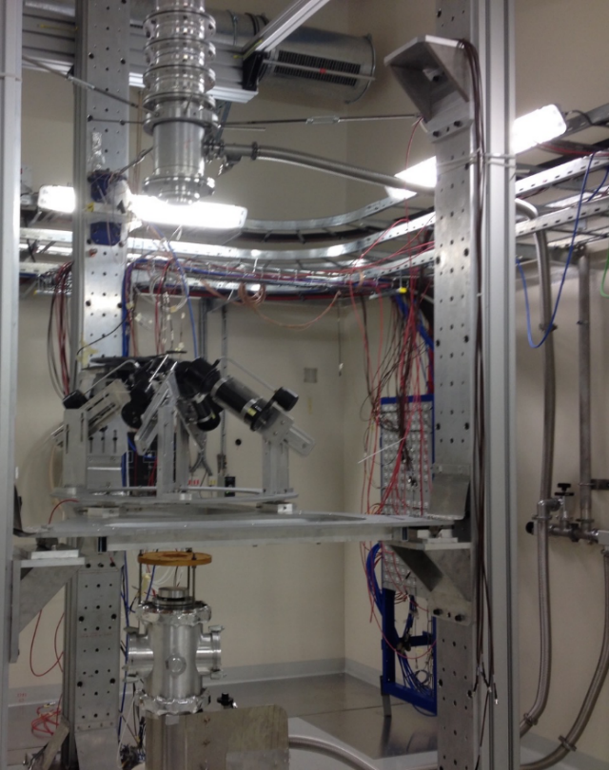
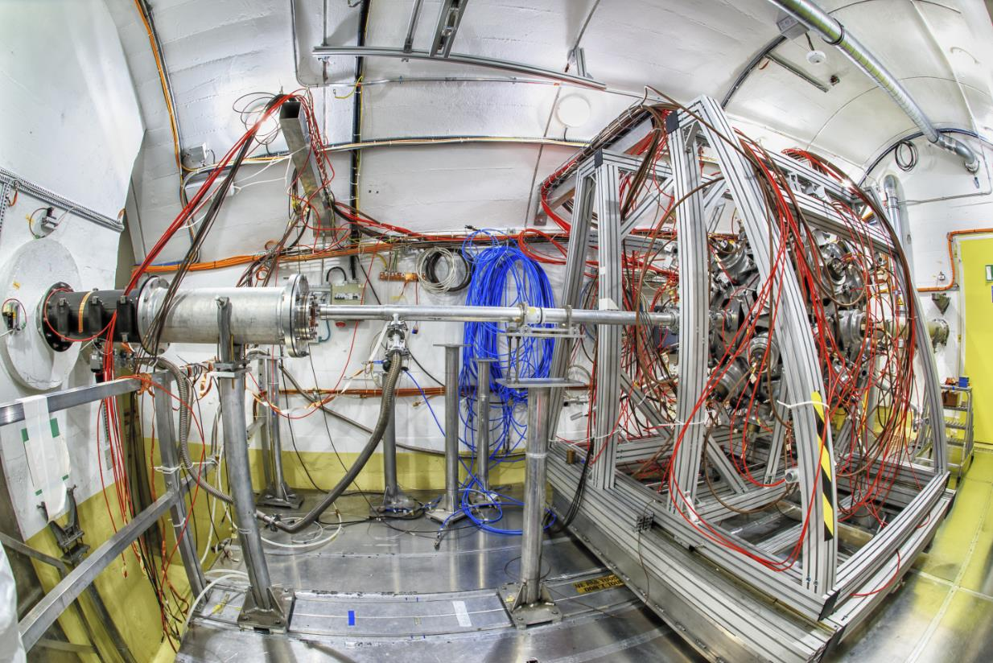
n_TOF EAR1 & EAR2
Proton beam line
15th International Conference on Nuclear Reaction Mechanisms Varenna 11-15/6/2018
G. Tagliente
Notes:
With greater accuracy

Slide 12
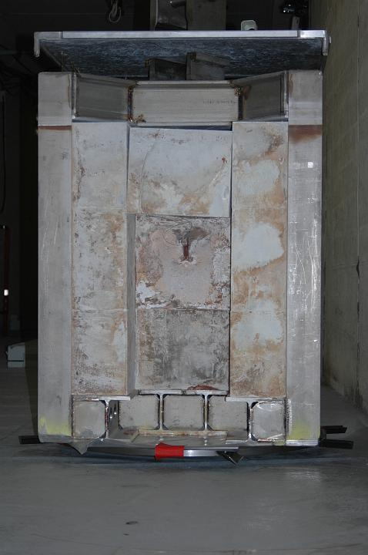
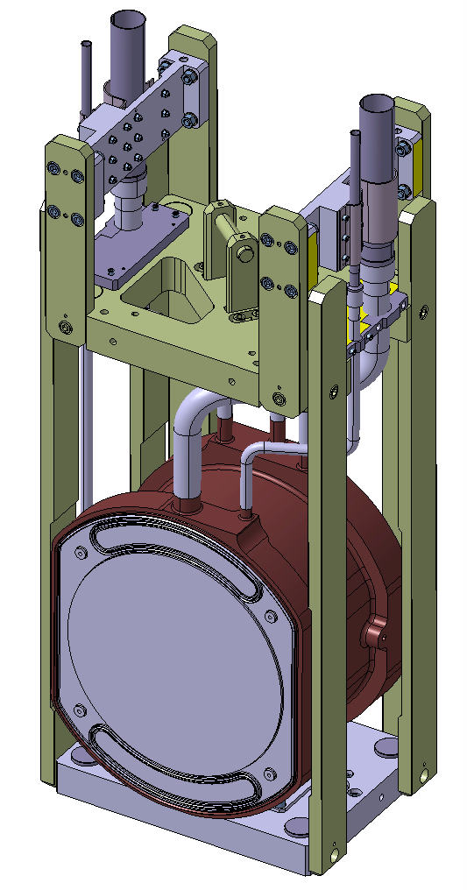
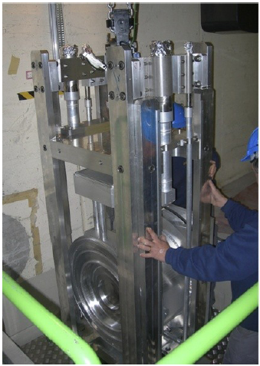
The spalation Target(s)
Phase I: 2001 – 2004
Phase II: 2008 – today
15th International Conference on Nuclear Reaction Mechanisms Varenna 11-15/6/2018
G. Tagliente

Slide 13
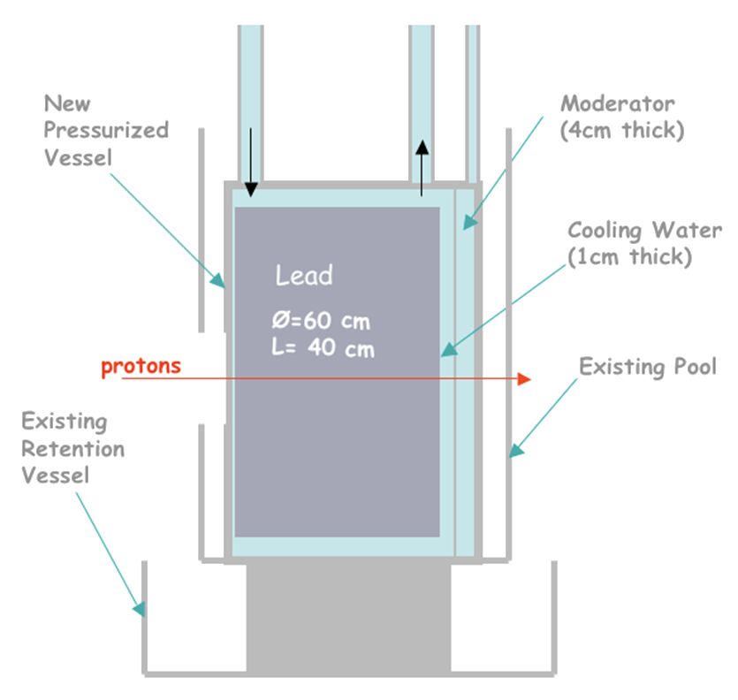
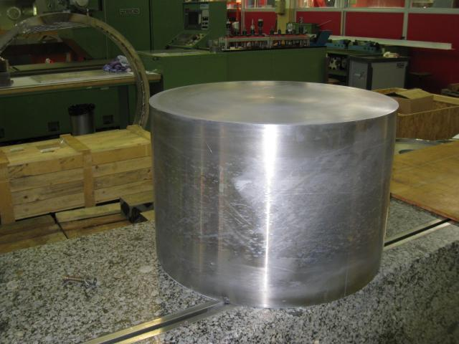
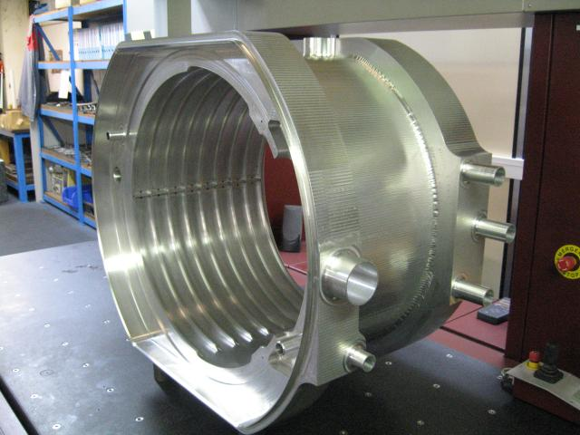
The spallation Target
The cooling and the moderator systems in the target are separated, so to optimize neutron spectrum or minimize background
Vessel
Moderator (4 cm)
Cooling water
(1 cm)
Pb
Ø = 60 cm
L = 40 cm
protons
Retention vessel
15th International Conference on Nuclear Reaction Mechanisms Varenna 11-15/6/2018
G. Tagliente

Slide 14
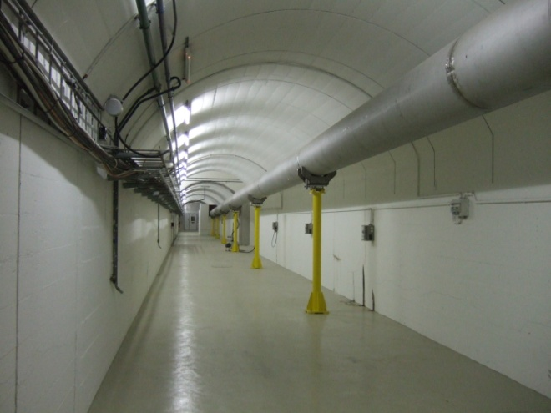
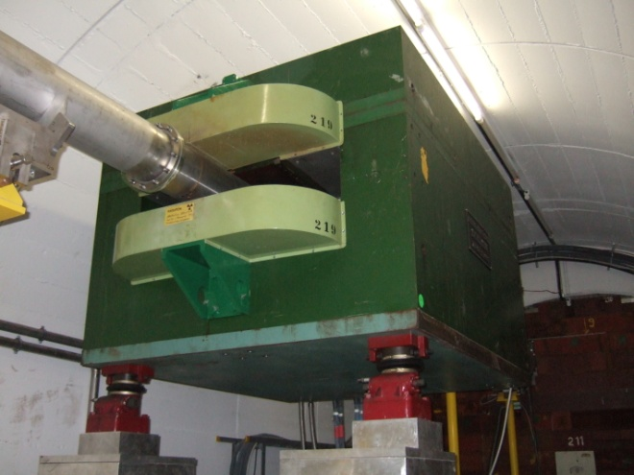
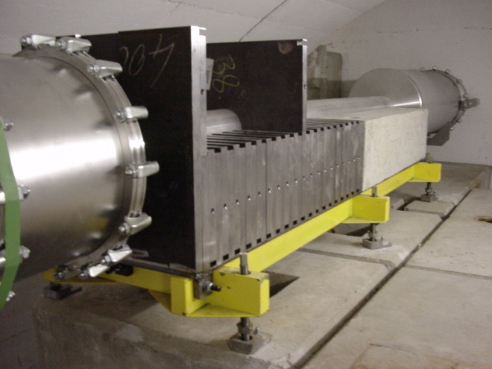
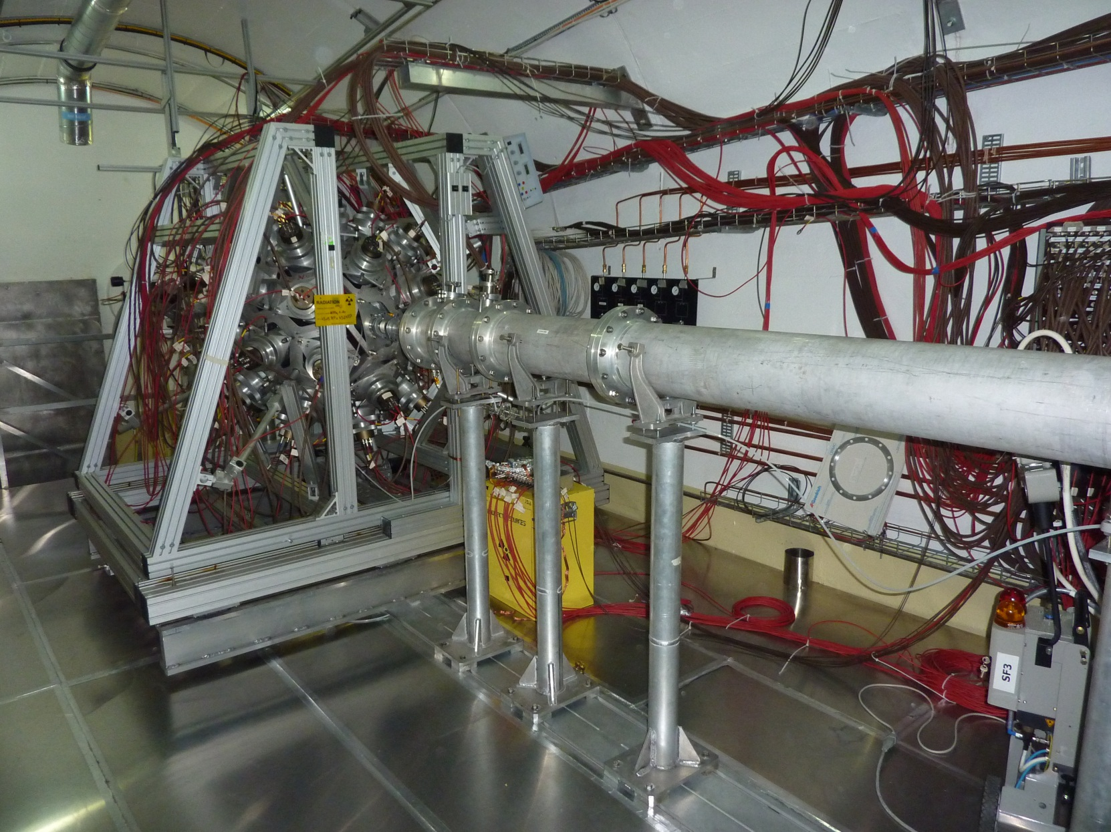
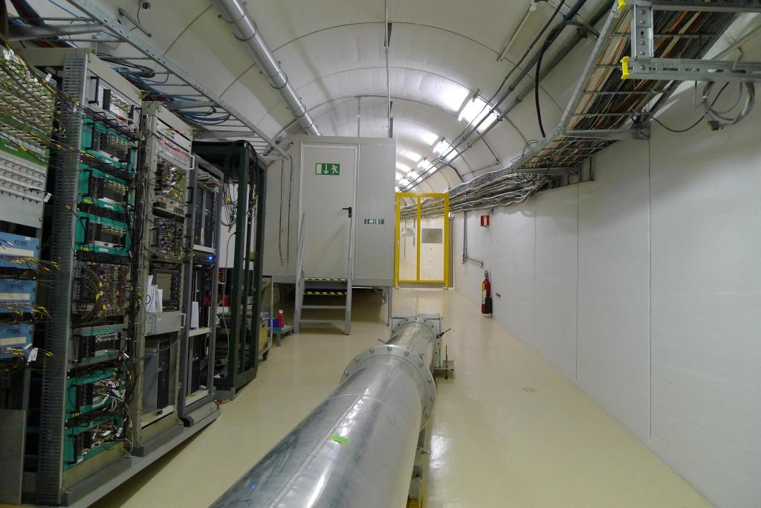
The Facilty
15th International Conference on Nuclear Reaction Mechanisms Varenna 11-15/6/2018
G. Tagliente

Slide 15
h [m]
24.5
Beam Dump
EAR-2 Exp. Hall
18.2
2nd Collimator
ISR Tunnel
Shielding
Service Gallery
Filter Box
9.8
Magnet
1st Collimator
Pit Shielding
EAR1
0
15th International Conference on Nuclear Reaction Mechanisms Varenna 11-15/6/2018
G. Tagliente

Slide 16
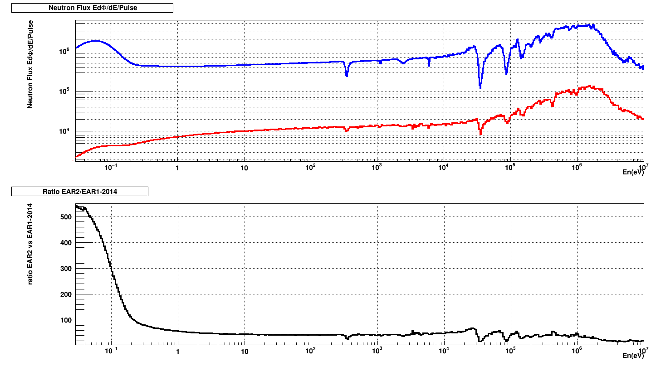
Ratio Evaluated Flux EAR1 vs EAR2
EAR2
EAR1
40
15th International Conference on Nuclear Reaction Mechanisms Varenna 11-15/6/2018
G. Tagliente

Slide 17
High accuracy results
Together with innovative neutron beams, accurate nuclear data for Nuclear Astrophysics require:
  High performance detectors
  High purity and well characterized samples (targets)
  Improvements in analysis and simulation techniques
Background
Efficiency
Neutron flux
15th International Conference on Nuclear Reaction Mechanisms Varenna 11-15/6/2018
G. Tagliente

Slide 18
n_TOF measurements (2001 to date)
Capture
Fission
char part
EAR2
²³⁴U
²³⁶U
²³²Th
²³⁷Np
²³⁵U
STEFF
FIC0
²³⁶U
FIC0
EAR2
²³⁷Np
MGAS
²⁴⁵Cm
²³³U
²⁴¹Am
²⁴³Am
²³⁵U
²⁴⁵Cm
²³³U
²⁴¹Am
²⁴³Am
^{3S}S
STEFF
²⁴⁴Cm
²⁴⁶Cm
FIC1
MGAS
⁷Be
C6D6
FIC1
Si
⁵⁹Ni
^{3S}S
⁷Be
²⁶Al
EAR2
CVD
MGAS
Si
²⁴⁴Cm
²⁴⁶Cm
²³⁵U
²³⁸U
MGAS
²⁴⁰Pu
²⁴²Pu
C6D6
¹⁸⁶Os
¹⁸⁷Os
¹⁸⁸Os
⁹⁰Zr
⁹¹Zr
⁹²Zr
⁹³Zr
⁹⁴Zr
⁹⁶Zr
²⁴Mg
²⁵Mg
²⁰⁸Pb
¹²⁹La
FIC2
¹⁷¹Tm
⁷²Ge
²³²Th
²³⁷Np
EAR1
²³⁴U
PPAC
²³²Th
²³⁴U
C6D6
²³⁶U
¹⁴N
³⁵Cl
FIC0
²³⁷Np
²³³U
²³⁴U
²⁰⁹Bi
^{nat}Pb²
²³²Th
FIC0
MGAS
PPAC
²³²Th
²³⁴U
²³⁸U
⁸⁷Sr
EAR1
²³⁵U
PPAC
TAC
²³⁵U
²³⁷Np
Si
EAR1
PPAC
²³²Th
²³⁷Np
PPAC
²³⁷Np
C6D6
PPAC
TAC
EAR2
PPAC
⁸⁹Y
⁸⁸Sr
^{nat}Gd
¹⁵⁴Gd
⁶⁹Ga
⁷¹Ga
²⁴⁴Cm
¹⁵¹Sm
²⁰⁴Pb
²⁰⁶Pb
²⁰⁷Pb
²⁰⁹Bi
²³²Th
²³⁶U
²³⁸U
⁶³Ni
⁶²Ni
⁵⁷Ni
⁵⁸Ni
MGAS
²⁴⁰Pu
¹⁴⁷Pm
²⁸²Pu
²⁰⁴Tl
⁷⁶Ge
⁷⁴Ge
⁷⁰Ge
²³⁵U
¹²C
TAC
²³³U
²³³U
²⁴⁰Pu
²³⁷Np
²⁴³Am
TAC
²³⁸U
²⁵Mg
⁹²Zr
⁹³Zr
C6D6
C6D6
EAR1
C6D6
C6D6
C6D6
¹⁵⁵Gd
¹⁵⁷Gd
⁷²Ge
TAC
⁵⁶Fe
⁶²Ni
⁵⁴Fe
²⁴¹Am
¹⁷¹Tm
⁷²Ge
C6D6
C6D6
C6D6
C6D6
Phase I
Phase II
Phase III
EAR-2

Slide 19
The n_TOF Astrophysics pogram
The combination of excellent resolution, unique brightness and low background has allowed to collect high-accuracy data, in some cases for the first time ever.
n_TOF measurements relevant for Nuclear Astrophysics
    Capture cross sections (s-process)
    branching point isotopes
      ¹⁵¹Sm, ⁶³Ni, ¹⁴⁷Pm, ¹⁷¹Tm, ²⁰⁴Tl
    magic nuclei and end-point
      ⁸⁸Sr, ⁸⁹Y,^{91,92, 93,94,96}Zr,¹³⁹La,¹⁴⁰Ce, ^{204,206,207,208}Pb,²⁰⁹Bi
    seeds isotopes
      ^{54,56,57}Fe, ^{58,60,62}Ni
    Cosmocronometer, neutron poison, etc.
      ^{186,187,188}Os, ^{24,25,26}Mg
    (n,cp) reactions
    Big Bang Nucleosynthesis
      ⁷Be(n,a) and ⁷Be(n,p)
    Various
      ⁵⁹Ni(n,a), ²⁶Al(n,α), ³³S(n,α)
15th International Conference on Nuclear Reaction Mechanisms Varenna 11-15/6/2018
G. Tagliente

Slide 20
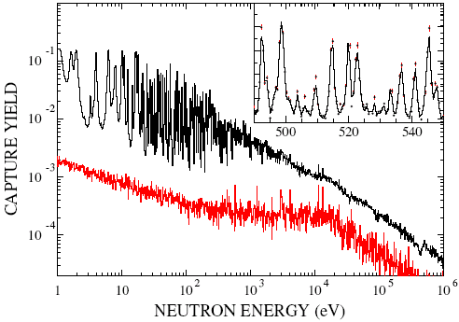
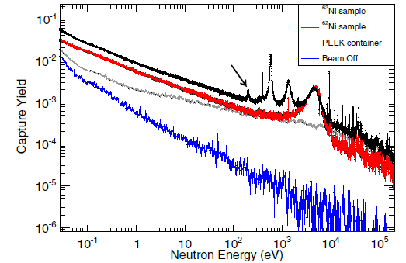
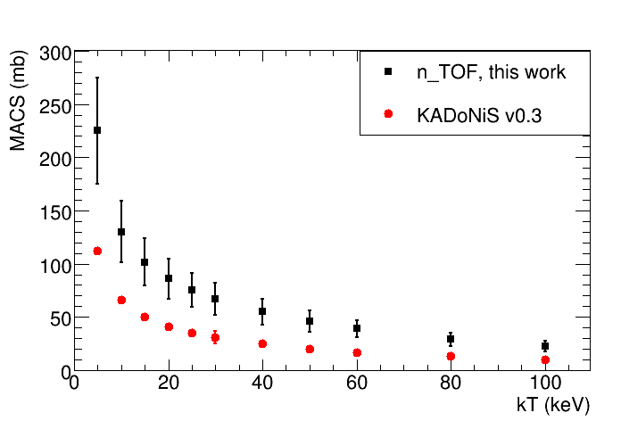
Branching points at n_TOF: ¹⁵¹Sm and ⁶³Ni
¹⁵¹Sm (t_{1/2}=93 y), determines abundance of ^{152,154}Gd
⁶³Ni (t_{1/2}=100 y) first branching point determines abundance of ^{63,65}Cu
200 mg
130 mg
3500
First, strong evidence of thermal pulsing in low mass AGB stars
U. Abbondanno et al., PRL 93, 161103 (2004)
S. Marrone et al., PRC 73, 036604 (2006)
Strong constraints on Cu, Ni and Zn production in massive AGB stars and subsequent supernovae
C. Lederer et al., PRL 110, 022501 (2013)
3000
n_TOF
Models
MACS [mb]
2500
2000
1500
1000
1970
1975
1980
1985
1990
1995
2000
2005
Year
15th International Conference on Nuclear Reaction Mechanisms Varenna 11-15/6/2018
G. Tagliente

Slide 21
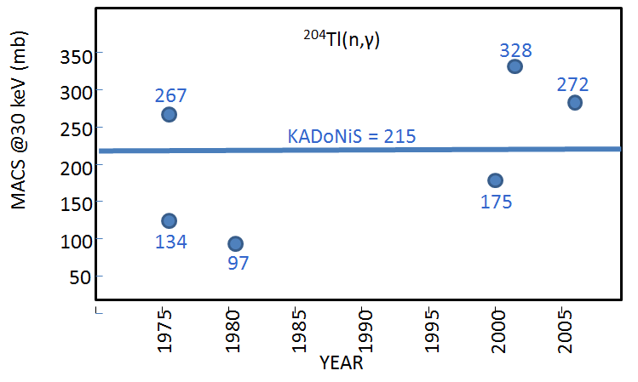
Branching points at n_TOF: ¹⁴⁷Pm,¹⁷¹Tm,²⁰⁴Tl
²⁰⁴Tl(n,γ)
Short-lived branching isotopes (a few years) have either never been measured before or have been measured only by activation (a few tens of ng) at a fixed temperature.
¹⁷¹Tm(n,γ)
¹⁴⁷Pm(n,γ)
Theoretical predictions scattered all over the place.
15th International Conference on Nuclear Reaction Mechanisms Varenna 11-15/6/2018
G. Tagliente

Slide 22
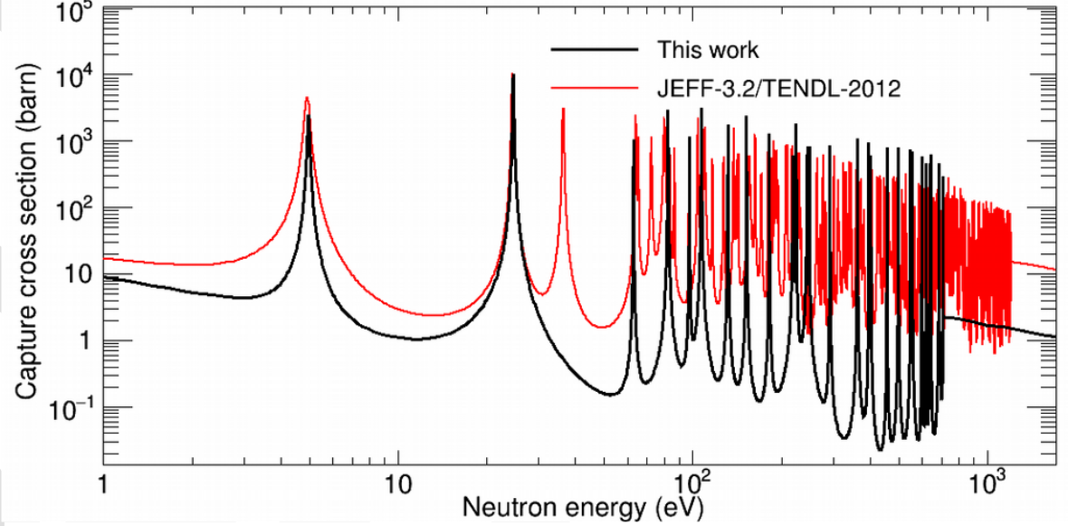
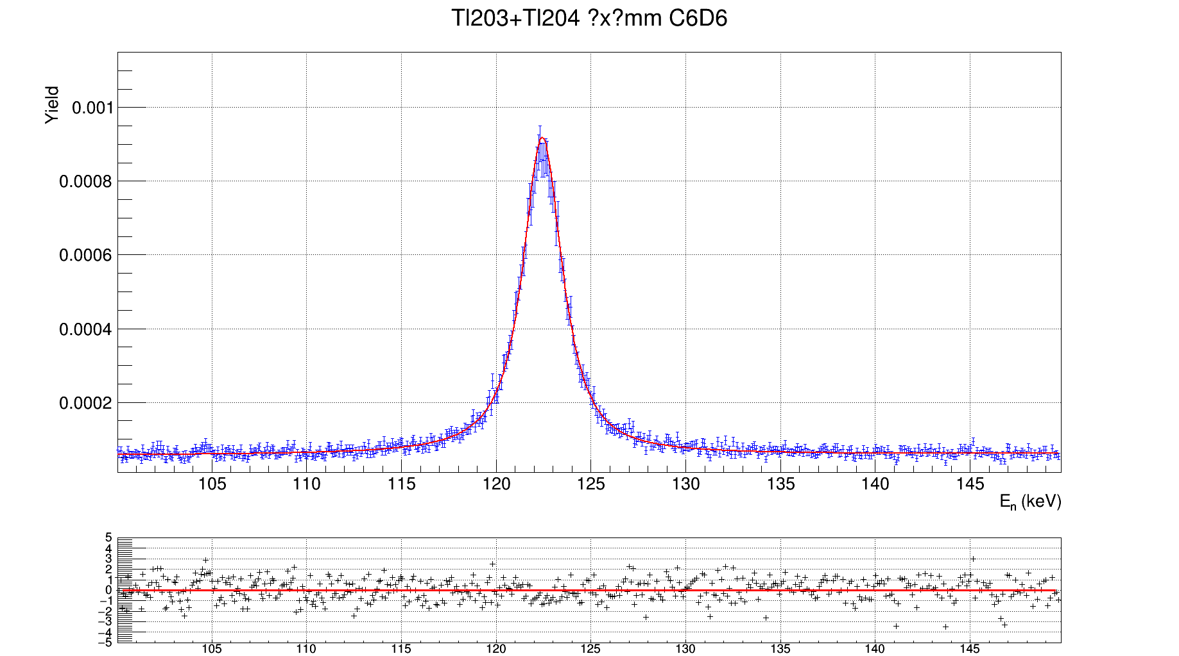
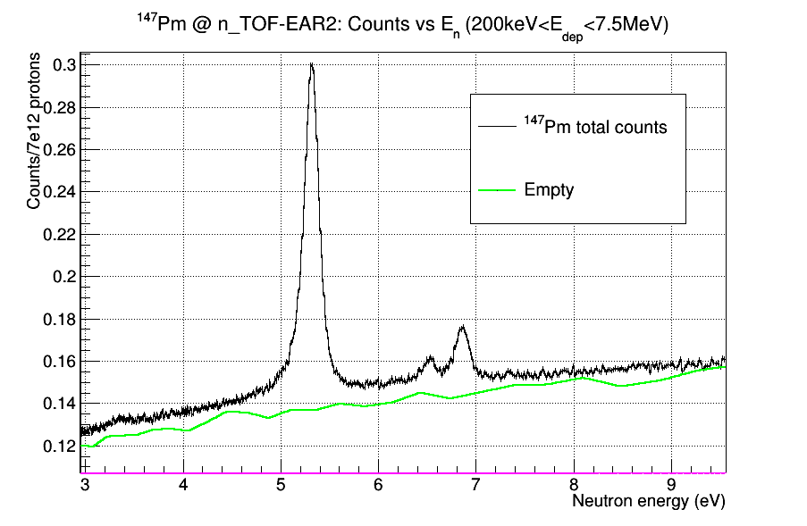
Branching points at n_TOF: ¹⁴⁷Pm,¹⁷¹Tm,²⁰⁴Tl
Isotope production by neutron irradiation at @ ILL (Grenoble)
Chemical separation and sample preparation by AC group @ PSI
¹⁷¹Tm (1.9 y) - 3.6 mg sample
²⁰⁴Tl (3.8 y) – 11 mg sample
Preliminary
A. Casanovas et al., in preparation
C. Guerrero et al., in preparation
¹⁴⁷Pm (2.6 y) - 80 μg sample
Preliminary results indicate important differences in the MACS relative to calculations and (very few) previous integral measurements (confirmed by complementary measurements at SARAF).
J. Lerendegui et al., in preparation
15th International Conference on Nuclear Reaction Mechanisms Varenna 11-15/6/2018
G. Tagliente

Slide 23
The ²²Ne(α,n)²⁵Mg neutron source
Neutron spectroscopy of ²⁶Mg levels provide information on the ²²Ne(α,n) neutron source.
Levels not easily accessible in α+²²Ne studied via ²⁵Mg capture and total cross section.
For free: MACS of ²⁵Mg(n,γ) neutron poison.
The ²²Ne(α,n)²⁵Mg neutron source
High accuracy, high resolution measurements of:
  capture XS at n_TOF
  Total XS at GELINA
  highly enriched sample.
For various levels high accuracy determination of:
  energy
  spin and parity
  Neutron and gamma widths
15th International Conference on Nuclear Reaction Mechanisms Varenna 11-15/6/2018
G. Tagliente

Slide 24
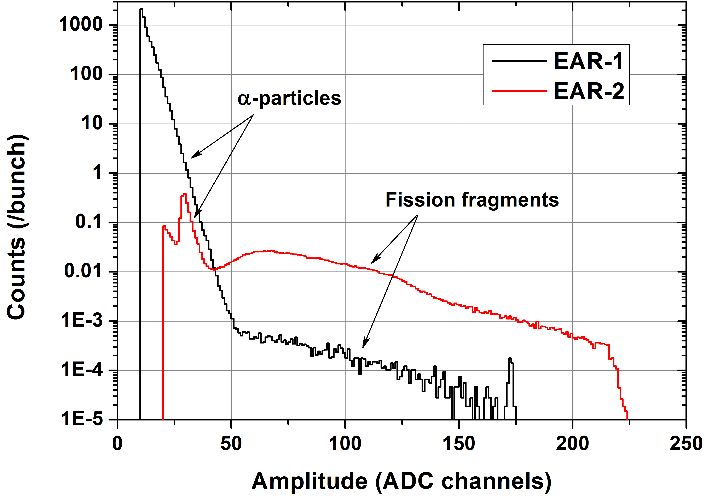
Measurements (n,cp) in EAR2
²⁴⁰Pu(n,f)
EAR2 flux 40 times larger than in EAR1, but reaction rate 400 times higher (due to shorter TOF).
For radioactive samples, huge gain in signal-to-background ratio.
Possible to measure isotopes with half-life of a few years.
Thanks to the very high flux, small-mass samples (< 1mg) can be used:
  Very thin deposits => minimal energy loss of emitted charged particles
  short-lived radionucleides with still reasonable total activity (low background and meneagible radioprotection issues)
Ideal for measuring (n,cp) reactions on short-lived radioisotopes, available in small amount, with low cross section.
See talk by M. Barbagallo
The ⁷Be(n,α) and ⁷Be(n,p) reactions are all of the above: very challenging measurements
15th International Conference on Nuclear Reaction Mechanisms Varenna 11-15/6/2018
G. Tagliente

Slide 25
²⁶Al(n,p),(n,α)
Observation of the cosmic ray emitter ²⁶Al is proof that nucleosynthesis is ongoing in our galaxy.
The neutron destruction reactions ²⁶Al(n, p) and ²⁶Al(n, α) are the main uncertainties to predict the galactic ²⁶Al abundance.
There are only few experimental data on these reactions and they exhibit severe discrepancies.
15th International Conference on Nuclear Reaction Mechanisms Varenna 11-15/6/2018
G. Tagliente

Slide 26
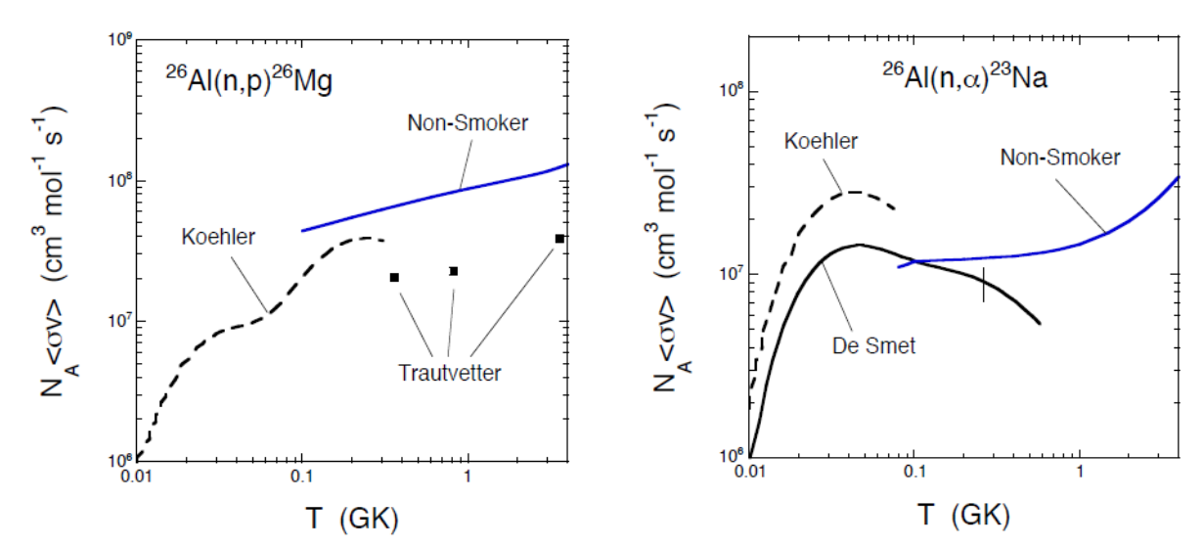
²⁶Al(n,p),(n,α):Status
15th International Conference on Nuclear Reaction Mechanisms Varenna 11-15/6/2018
G. Tagliente
Reduce uncertainties in the stellar neutron cross-section.
Investigate possible anisotropic charged-particle emission.
Resolve existing discrepancies in literature.
Expand resonance information to higher neutron energies (hundreds of keV).
Figure shows factor of two discrepancies in both ²⁶Al (n,p) reaction (left) and ²⁶Al (n,⍺) reaction (right) ³.
Notes:
EXPLAIN more- theoretical vs exp, scale
Reaction rates
Possible anisotropy
Factor of two difference in published rates (BOTH reactions)
Strip detectors to investigate anisotropic particle emission

Slide 27
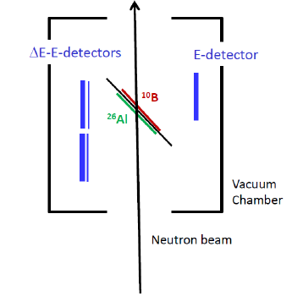
²⁶Al(n,p),(n,α):Detectors
The sample was produced by JRC-Geel, in collaboration with LANSCE
The p and α were detected by double sided silicon strip detectors arranged as E –ΔE telescope
The neutron fluence was monitored by a ¹⁰B sample
15th International Conference on Nuclear Reaction Mechanisms Varenna 11-15/6/2018
G. Tagliente

Slide 28
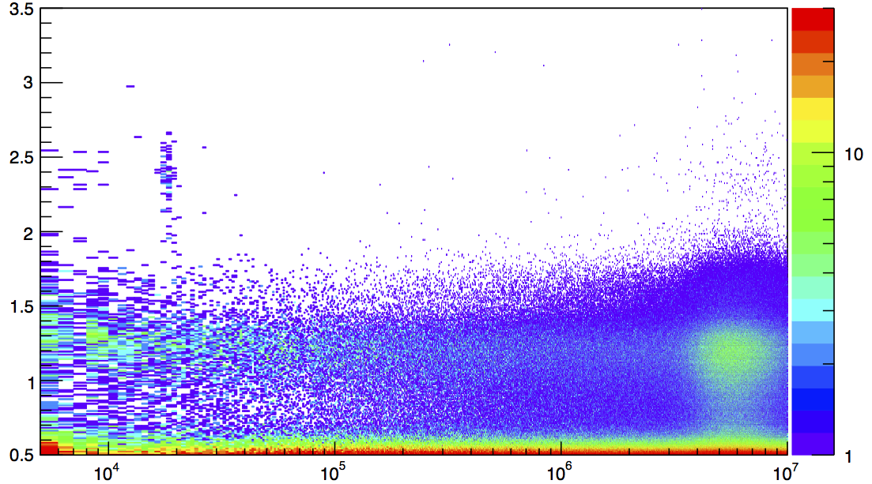
Time Of Flight vs Energy_{CP}
²⁶Al(n,α):Analysis
10% of 10 week beam-time
²⁶Al: ⍺ ∼ 2.2 MeV
¹⁰B: ⍺ ∼ 1 MeV
Charged Particle Energy, MeV
5 keV ²⁶Al(n, alpha) resonance
72 COUNTS
Preliminary
5 keV ²⁶Al(n, α) resonance
¹⁰B(n, α) reaction
(sample impurity)
¹⁰B(n, alpha)
(sample impurity)
Neutron Time of Flight, ns
15th International Conference on Nuclear Reaction Mechanisms Varenna 11-15/6/2018
G. Tagliente
Notes:
Boron cross section is higher, so seen throughout, whilst 26Al only seen at the resonances.
Make sure to explain what time of flight is; t-t(gamma_flash)
AND explain what is the ”gamma flash”.

Slide 29
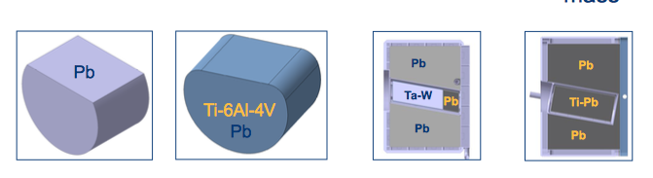
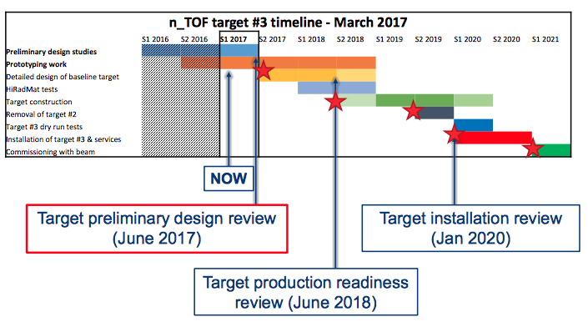


n_TOF long-range plan
n_TOF Target #3 Project
Working Group
15th International Conference on Nuclear Reaction Mechanisms Varenna 11-15/6/2018
G. Tagliente

Slide 30
New Spallation Target (Target 3)
Characteristics:
«Core» in Pb is encapsulated in Ti6Al4V container, water cooled
The core is inserted in a Pb block gas cooled
The external Pb block is shaped in order to maximize the neutron flux in EAR2
Target 3 vs Target 2:
The new target
avoids the direct contact of the Pb core with water (erosion and corrosion), minimizing the radioprotection problems
allows an higher proton beam power (almost double compared to target 2), without cooling problem
optimizes the flux in EAR 2, it increases of more than a factor 2 (in EAR1 the flux will stay the same of target 2)
improves the beam resolution in EAR2
15th International Conference on Nuclear Reaction Mechanisms Varenna 11-15/6/2018
G. Tagliente

Slide 31


n_TOF long-range plan
Vertical
moderator
Stainless steel
tank
Horizontal
moderator
Water cooling
system
Ti-Pb core
Beam
SS vessel
Be stiffeners
External Pb block
Anticreep
structure
Gas cooling
system
15th International Conference on Nuclear Reaction Mechanisms Varenna 11-15/6/2018
G. Tagliente

Slide 32
n_TOF Phase IV: Fission recycling
The neutron-induced fission can open a new frontier on the study of r-process.
It has been demonstrated (Panov & Thielemann 2003, 2004; Martínez-Pinedo et al. 2007) that neutron-induced fission is more important than beta-delayed fission in r-process nucleosynthesis.
15th International Conference on Nuclear Reaction Mechanisms Varenna 11-15/6/2018
G. Tagliente

Slide 33

r-process: Fission recycling
Neutron Capture
β-decay, fission, etc.
Neutron Freeze out
α-decay, fission, etc.
15th International Conference on Nuclear Reaction Mechanisms Varenna 11-15/6/2018
G. Tagliente
Notes:
Neutron capture, Neutron freeze out, beta decay, fission, other stuff. Alpha decay, beta decay, fission.

Slide 34

n_TOF Phase IV: Fission recycling
The neutron-induced fission can open a new frontier on the study of r-process.
It has been demonstrated (Panov & Thielemann 2003, 2004; Martínez-Pinedo et al. 2007) that neutron-induced fission is more important than beta-delayed fission in r-process nucleosynthesis.
Consequences:
modification of the A~130 r-process abundance peak
fission products can be seed for additional r-processing up to A~250 fission again
Fission recycling

Slide 35
Conclusion
There is need of accurate new data on neutron cross-section for Nuclear Astrophysics.
The combination of excellent resolution, unique brightness and low background allows to collect at n_TOF high-accuracy data, in some cases for the first time ever.
Since 2001, n_TOF@CERN has provided an important contribution on capture cross section measurements for stellar nucleosynthesis. https://twiki.cern.ch/twiki/bin/view/NTOFPublic/DataDissemination
A second experimental area (EAR2) at 20 m flight path has made possible to perform very challenging measurements of interest for Nuclear Astrophysics, on short-lived radionuclides, on sub-mg samples, and on low cross section reactions.
A new spallation target will be installed before 2020, for the experimental program in Nuclear Astrophysics (and more) in the next decade.
15th International Conference on Nuclear Reaction Mechanisms Varenna 11-15/6/2018
G. Tagliente

