Slide 1
Scanning status in Japan
2019.02.1
Atsuhiro UMEMOTO

Slide 2
Contents
Improvement of scanning speed
Evaluation of elliptical fitting analysis
Detector study for calculating DM cross-section
Surface run at Nagoya with Equatorial telescope

Slide 3
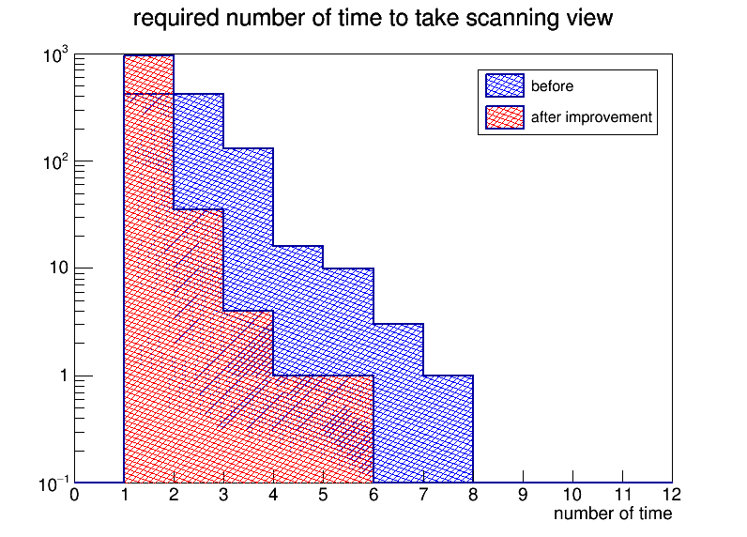
Improvement of Scanning speed
Kobayashi developed a new algorithm for improving the PTS3 scanning speed.
( the detailed was shown in previous kobayashi’s slide)
And the algorithm was installed in PTS2.
① Optimization of surface recognition
Our scanning uses surface recognition using Au40nm. If the surface is recognized, the scanning goes next
Step(elliptical fitting and image saving). If not, scanning repeats surface recognition at same position.
In new algorithm, the surface position of next view
is predicted by using the current surface position.
The starting Z position can be tuned and
the slope of sample surface is corrected.
992 view scanning by PTS2
 | N of all trial | 1 | 2
before | 1778 | 415 | 417
after | 1042 | 951 | 35
Total scanning time 992view | before | 76min 10sec
 | after | 58min 30sec

Slide 4
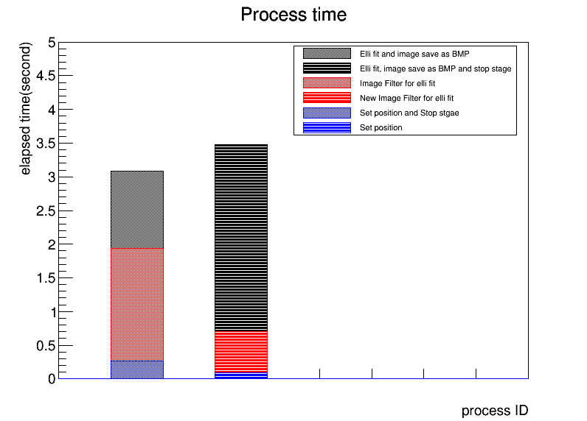
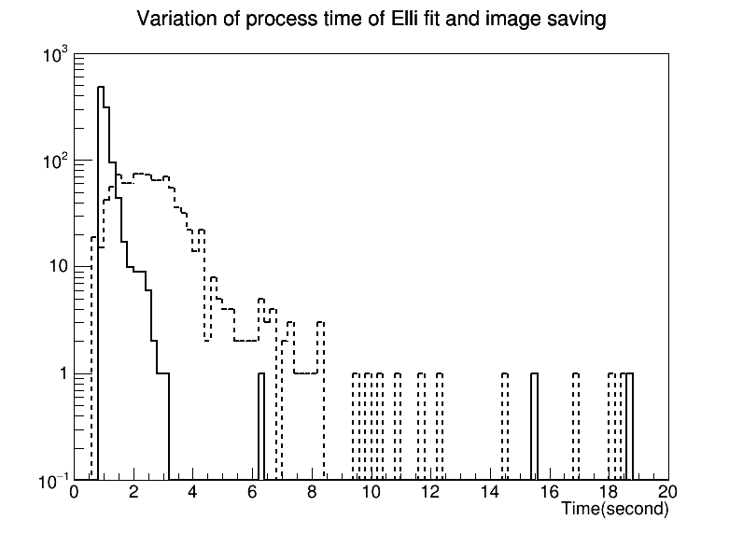
Improvement of Scanning speed
Each image filter processing before elliptical fit was speed up with GPU stream.
③ Stage control and elliptical fitting (w/ image saving) were parallelized.
Scan condition: 4MB image × 96 layer. Sample: FAN113gf 0day after MAA (F.D. = 0.12/(10um)^3 w shrink)
Same area was selected for scanning speed check.
Process time when surface recognition is success
before
after
before
+ 1.62 s
The difference of two
scanning methods is
only stage movement.
After
-1 s
-0.15s
Estimation: the number of retake (surface recognition) is reduced In the new method.
The size of scanning data access to HDD per unit time is increased.
⇒ HDD always needs to work, the treatment efficiency will be worse.

Slide 5
Improvement of Scanning speed
Process time when surface recognition is success
*PNG image
= 1.4 MB/layer
Because it has
enough time to
move and wait stage
Before
Image save
As BMP
After
Image save
As BMP
After
Image save
As PNG
After
w/o Image save

Slide 6
 | Ready to scan | Image filter | Elliptical fit and image save | Total/view
Before | 0.26 ±0.01 (s) | 1.67 ±0.09 (s) | 1.15±0.79 (s) | 3.08 ± 0.79(s)
After BMP | 0.09 ±0.14 (s) | 0.61 ±0.01 (s) | 2.78±1.64 (s) | 3.48 ± 1.65(s)
After PNG | 0.09 ±0.15 (s) | 0.61 ±0.01 (s) | 1.81±0.23(s) | 2.51 ± 0.28(s)
After wo image | 0.26 ±0.11 (s) | 0.62 ±0.03 (s) | 0.63±0.03 (s) | 1.50 ± 0.12(s)
 | Effective scan speed include surface recognition
Before | 76min 10sec / 992views
After BMP | 58min 30sec / 992views
After PNG | 42min 30 sec / 992views
After wo image | 26min 10sec / 992views
Current scanning, the image is required for eye-check, additional image solution etc..
We decide to save scanning image as PNG.
⇒ SSD is better for speed up of image saving than HDD.
The scanning will be changed that does not save images
after understanding the both signal and noise characteristics. (April or May)

Slide 7
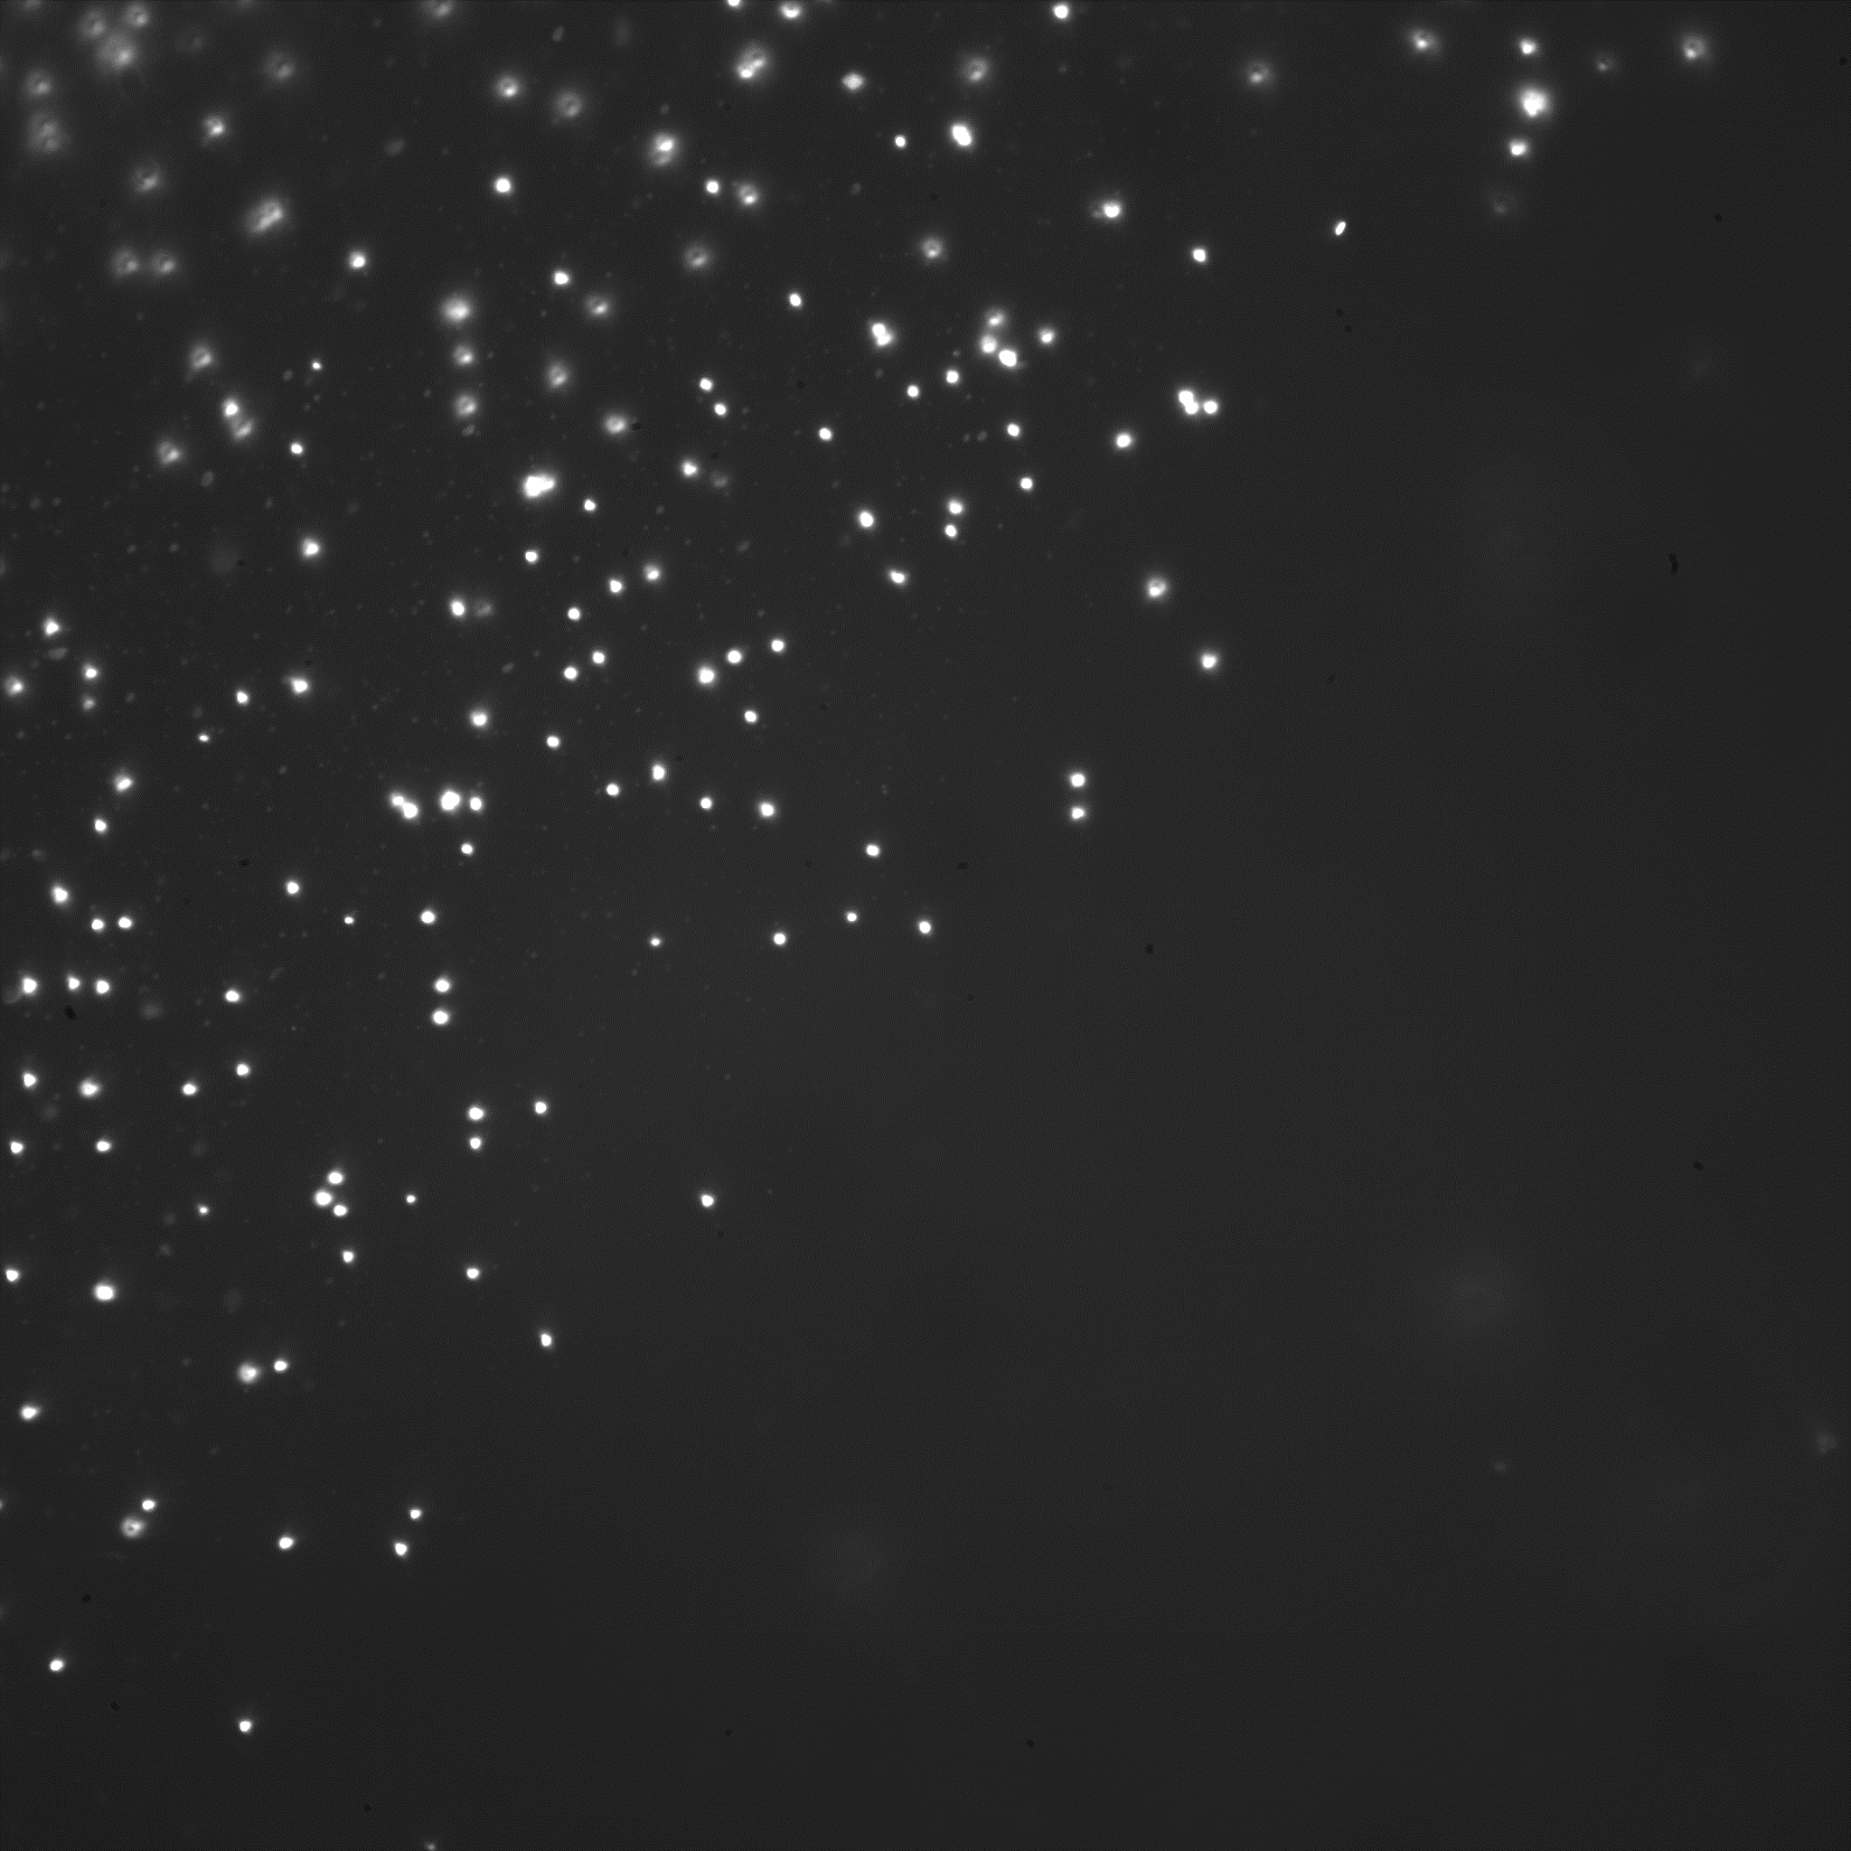
Current scanning
PTS2 scanning. Data is being analyzed now.
FAN113gf (DM search at surface lab -20℃ for 1month)
Image of Optical mark
Optical mark by 400 nm Au
3
①
②
③
④
23
112 um
y(mm)
1
31
The position of optical mark was recorded.
The scanning area was separated into four
(to save each scanning image to different HDDs)
-15
0
2
12
26
27
47
59
X(mm)
area1 | 9.9×17 mm2 =17200 views | *2.3 TB PNG Image and txt file
area2 | 14.9×17 mm2 =25800 views
area3 | 20.9×17 mm2 =36120 views
area4 | 12×18 mm2 =18381 views
Total=97501 views

Slide 8
Time log
12/9 19:36
18381 views
12/9 15:45
12/10 9:57
36120 views
12/8 13:30
12/9 15:25
25800 views
12/7 15:00
12/8 10:30
17200 views
12/7 0:03
12/7 14:03
area1 | 14 hours / 17200 views | 2.93 sec/view
area2 | 19.5 hours / 25800 views | 2.72 sec/view
area3 | 25.92 hours /36120 views | 2.59 sec/view
area4 | 14.5 hours /18381 views | 2.84 sec/view
Total = 81hours and 54 minutes（loss time 8hours and 7minutes）
Effective Scanning time= 73 hours 47min /97501 views.
If all area of views (except surface) are available for data analysis
(112um)^2×（64 layer×0.3125um/0.6）×10^-12×97501×3.44 = 0.14 g / 3.07 days ⇒ 1 g /22days

Slide 9
PTS2 and PTS3
 | Maximum Speed (w image saving) | Maximum Speed (w/o image saving)
PTS2 | <16.6 g/year | <27.0g/year
PTS3 | <22.0 g/year | <32.0g /year
PTS2+3 | <38.6 g/year | <59.0 g/year
We need more study to use scanning data of both PTS2 and PTS3.
The difference of detection efficiency, angular resolution and fog density should be understood.
We are going to operate PTS2 and PTS3 scanning in this May.

Slide 10
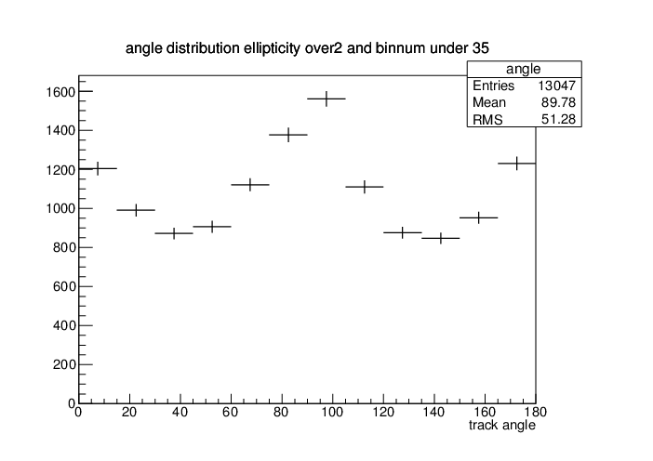
Elliptical fitting
We used a Image filtering and “rectangle recognition method” to get minor, major, ellipticity and track angle in previous, but this was much affected by the digitized pixel.
2017/02~04 BG run in LNGS
0.035 g Scanning data of FAN085gf4
- Ellipticity cut >=2.0
Anisotropic angular distribution
We developed a new elliptical fitting method using image frequency .

Slide 11
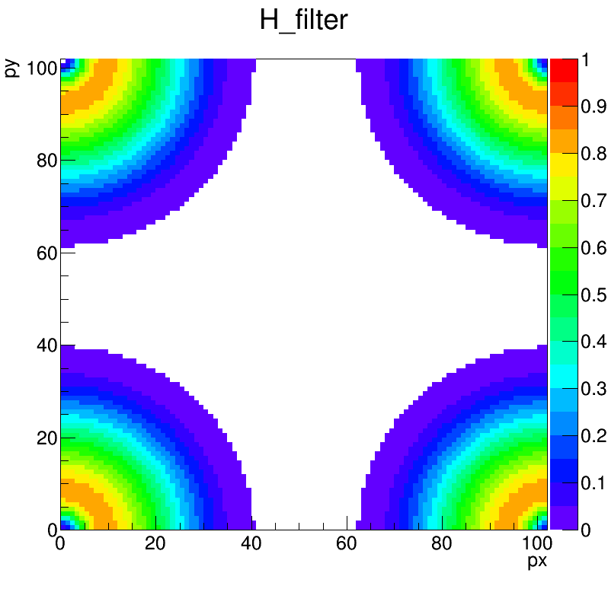
Elliptical Fitting by FFT
51 pixel ( 2.8 um)
Not online
Bicubic
DFT
Filtering
102 pixel ( 2.8 um)
Elliptical Fitting
by using brightness
distribution
IDFT
(Minor, Major, Ellipticity) =
(4.1506 9.59089 2.31072)

Slide 12
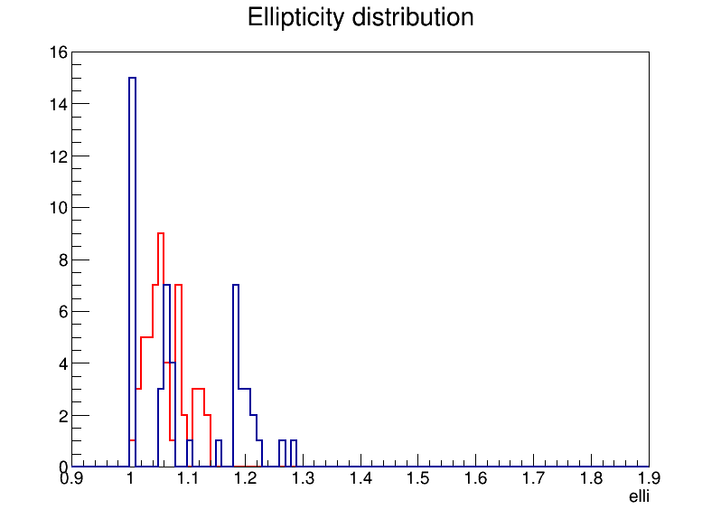
Ag40 nm spherical
Brighter event was selected by brightness parameters and image eye-check was done.
52 events selected by Max brightness 160<=Max<=200, Mean brightness 65<=mean<=105
rectangle
FFT
rectangle
digitized
FFT

Slide 13
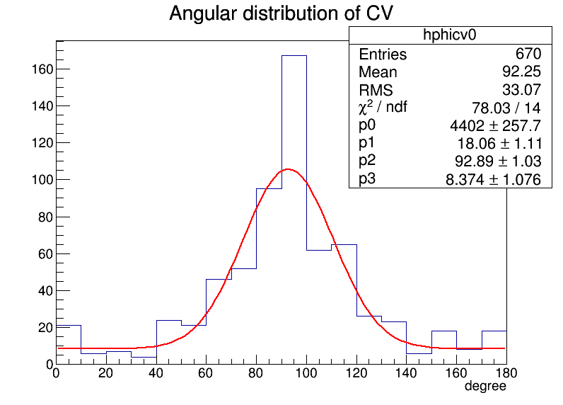
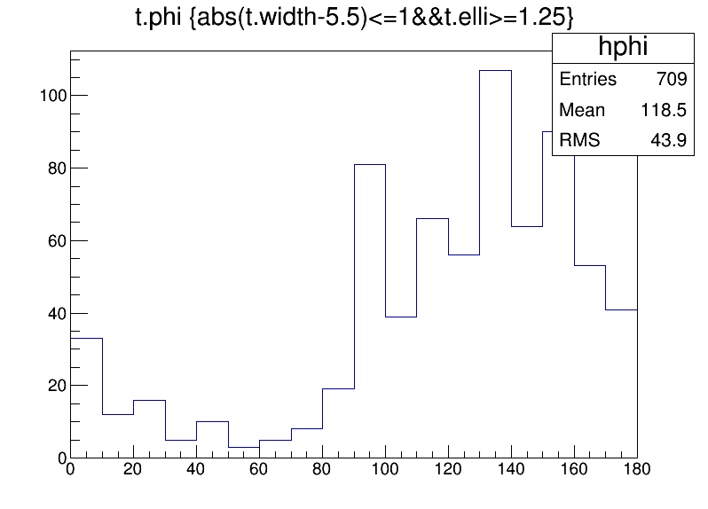
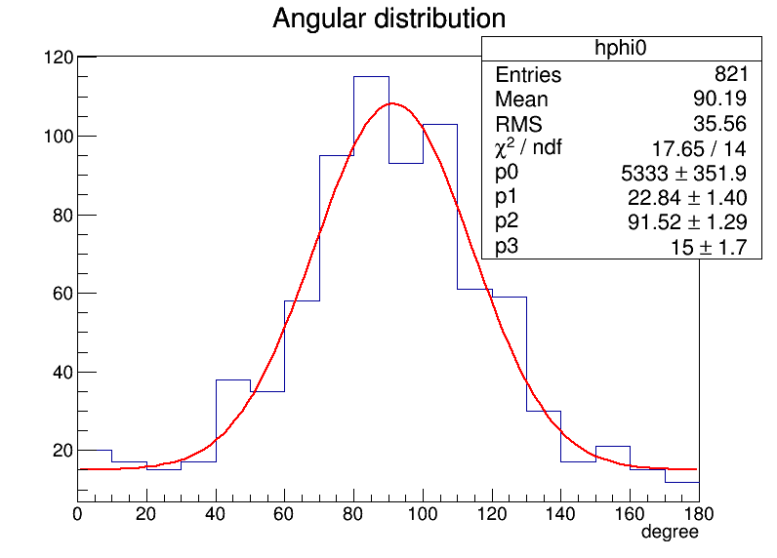
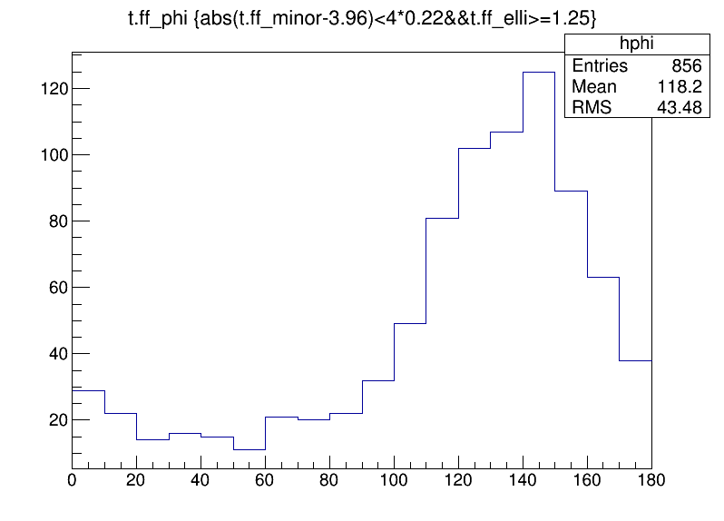
Carbon 100 keV ion w 10 degree implant
FAN113gf NIT-70nm
Camera X-axis pixel arrangement was beam direction(90d)
Camera was rotated about 45d by manually.
⇒beam direction became 135d
rectangle
Elli>=1.25
rectangle
Elli>=1.25
FFT
Elli>=1.25
FFT
Elli>=1.25

Slide 14
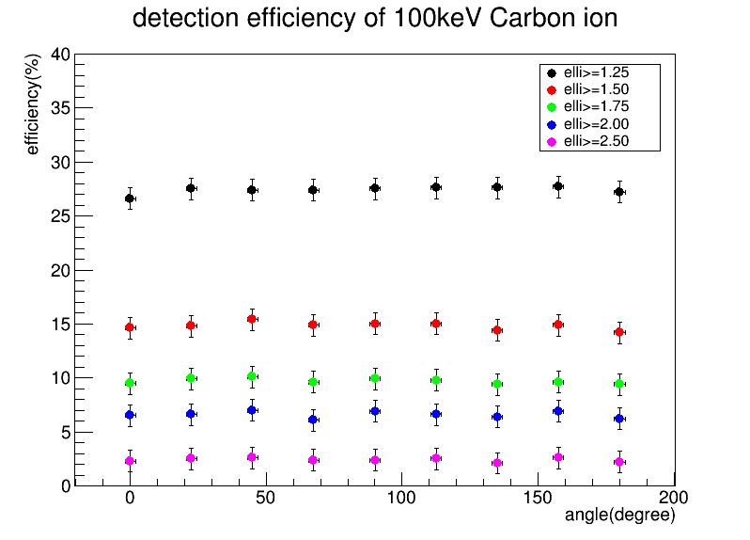
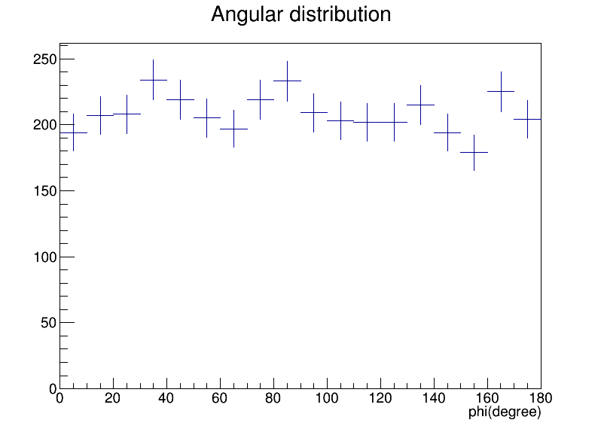
Detection efficiency and angle by FFT
FAN113gf NIT-70nm
FAN113gf DM search area1
Selection parameter
- Absolute (minor - 3.89) < 4 × 0.24
- elli>= 1.75
- 100<=Max –BG brightness <= 150
- 30<=Mean –BG brightness <= 75
- 35<=number of Pixel<=75
Selection parameter
- Absolute (minor - 3.89) < 4 × 0.24

Slide 15
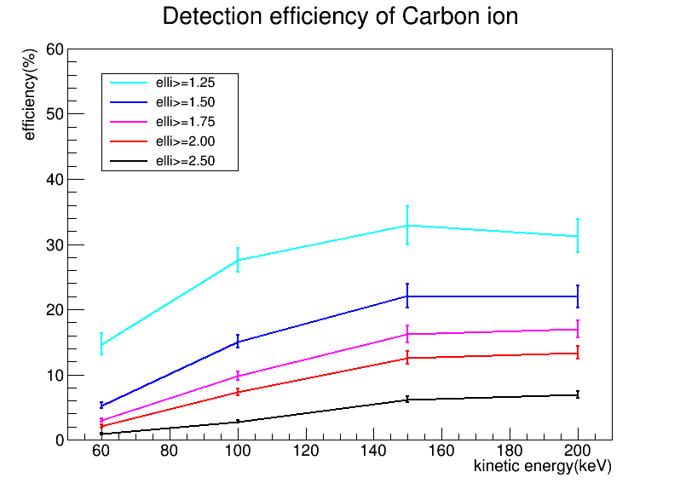
Carbon ion efficiency by FFT
200 keV carbon track
2.8 um
The event was recognized as two separated grain, then in current system
it was judged as noise (like a dust).
The higher kinetic energy, those events got increased ⇒ need a tracking method.
Signal_{ellicut} – Mask_{ellicut}
Effi=
Signal_{all} – Mask_{all}

Slide 16
Carbon ion efficiency by FFT
I estimated the efficiency
if tracking methods was available
It is not easy to develop a tracking program soon.
After finishing the current data analysis, I will try developing .

Slide 17
Detection efficiency of Nuclear recoil
It is important to understand the relation between Ellipticity and track length.
We evaluated the detection efficiency of only Carbon ion with Elliptical fitting.
Our DM target nuclei are {C,N,O,Ag,Br}.
⇒ we will estimate the detection efficiency of all target nuclei from the result of
carbon efficiency using the relation between track length and ellipticity.
The systems between DM search and ion implantation are different.
⇒ Ion data has the tracks which are scattered out from NIT. Those events are negligible in the case of DM search ( interaction is occurred inside of NIT)
Detection efficiency should be converted to DM search system.

Slide 18
Cross-section Limit
To calculate the DM cross-section, we have to understand the “Recoil Energy”, “Emulsion track length”, and “Ellipticity”.
Recoil Energy E_{Recoil}
calculation can be done
when DM mass and velocity
are assumed.
Recoil track length
Converted from the relation
track length and recoil energy
by SRIM.
↓
Emulsion track length is decided by
the crystal formation and crystal
sensitivity of NIT.
NIT Param..
Crystal size = 44 nm
Crystal density = 10000 /um3
Crystal sensitivity ~ 100% (30keV Carbon)
Detectable in experiment
Ellipticity , event rate
E_{Recoil}⇔R_{emulsion}
R_{emulsion}⇔ Ellipticity

Slide 19
Our detection process
Optical simulation by PSF
Optical observation
After development
Recoil track
E_{recoil}
R_{recoil}
R_{emulsion}
Ellipticity
Add
Crystal formation
Comparison
R_{recoil}
R_{emulsion}
Elli_{experiment}

Slide 20
Our detection process
Optical simulation by PSF
Optical observation
After development
Recoil track
E_{recoil}
R_{recoil}
R_{emulsion}
Ellipticity
Add
Crystal formation
R_{recoil}
R_{emulsion}
Elli_{experiment}
PSF
Comparison
Elli_{simulation}

Slide 21
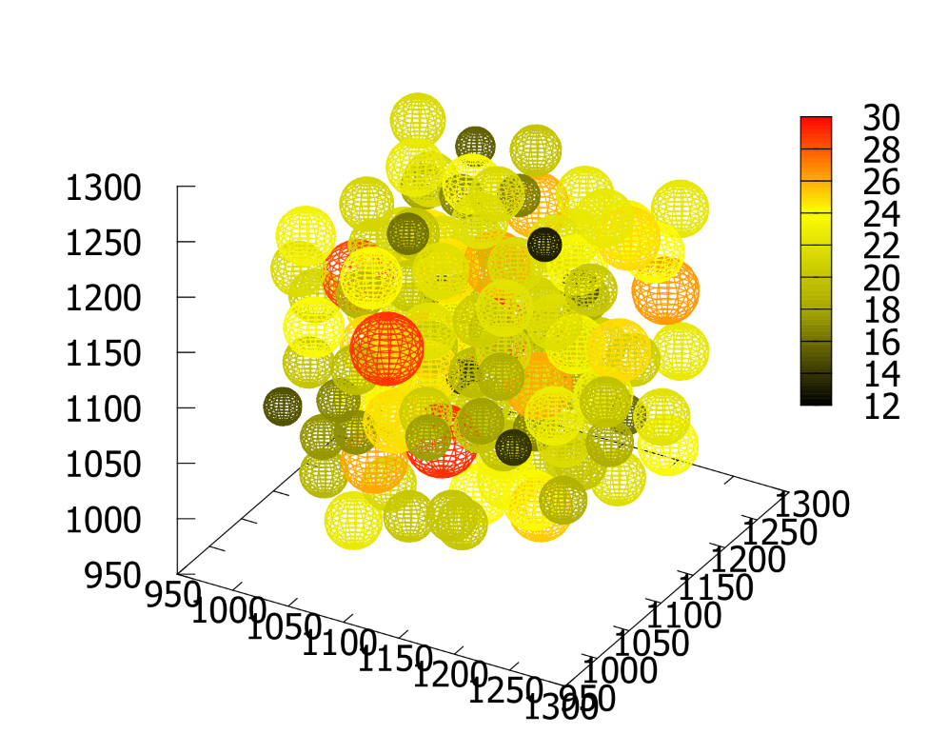
SRIM+NIT+Optical Simulation
The relation between track length and ellipticity is studied using SRIM simulation with a virtual emulsion detector and optical simulation.
The virtual emulsion and SRIM calculation were done by Asada.
- the size of crystal has a distribution like actual AgBr crystal.
- track range by SRIM is determined as the length from start point to end point.
Optical image was calculated by Fresnel equation by Shiraishi.
⇒elliptical fit and get parameters.
NIT. face-centered cubic lattice and random walk
SRIM calculation
Y
start
ion
end
X

Slide 22
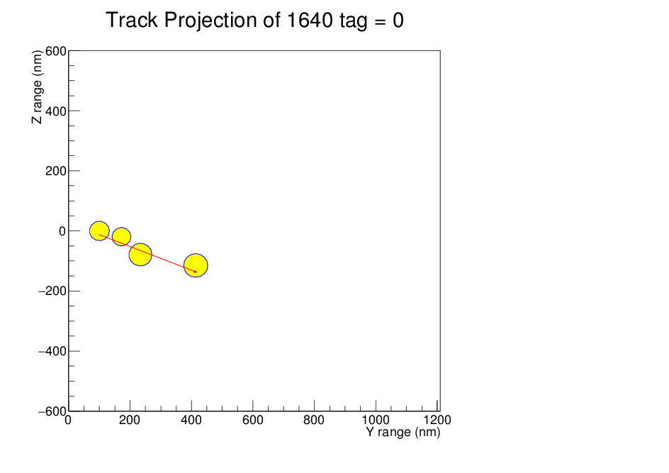
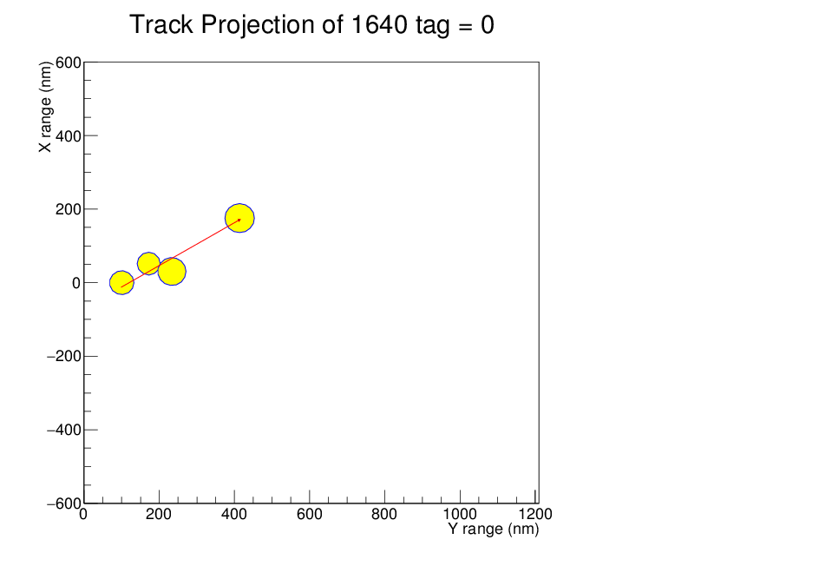
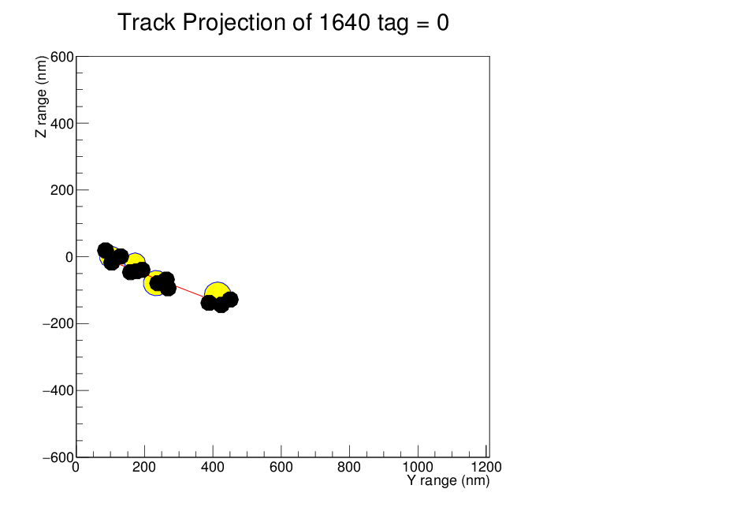
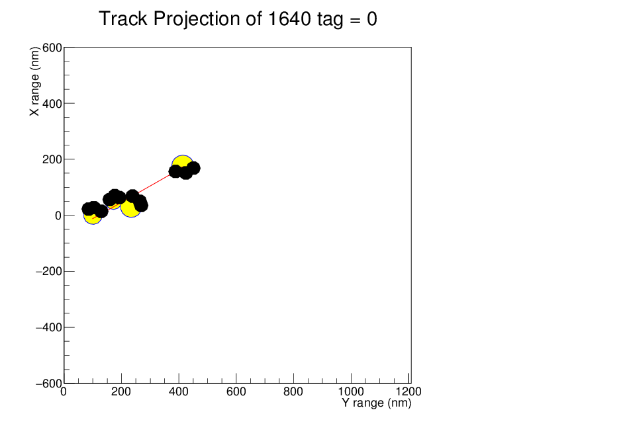
NIT70 nm C100 keV 10degree implantation
0 degree
X(depth)
Z
2D track length
ー SRIM = 340 nm
● Crystal = 334 nm
90 degree
2D track angle
ー SRIM = 112 degree
● Crystal = 112 degree
180 degree
Y(beam angle)
Y(beam angle)
As a first test, 3 latent image specs were generated at random point in each AgBr crystal
X(depth)
Z
2D track length
ー SRIM = 340 nm
● grain = 394 nm
2D track angle
ー SRIM = 112 degree
● grain = 112 degree
All grain diameter are same
= 48 nm
4/3*(24)^3*pi = 1/3* 70nm Volume

Slide 23
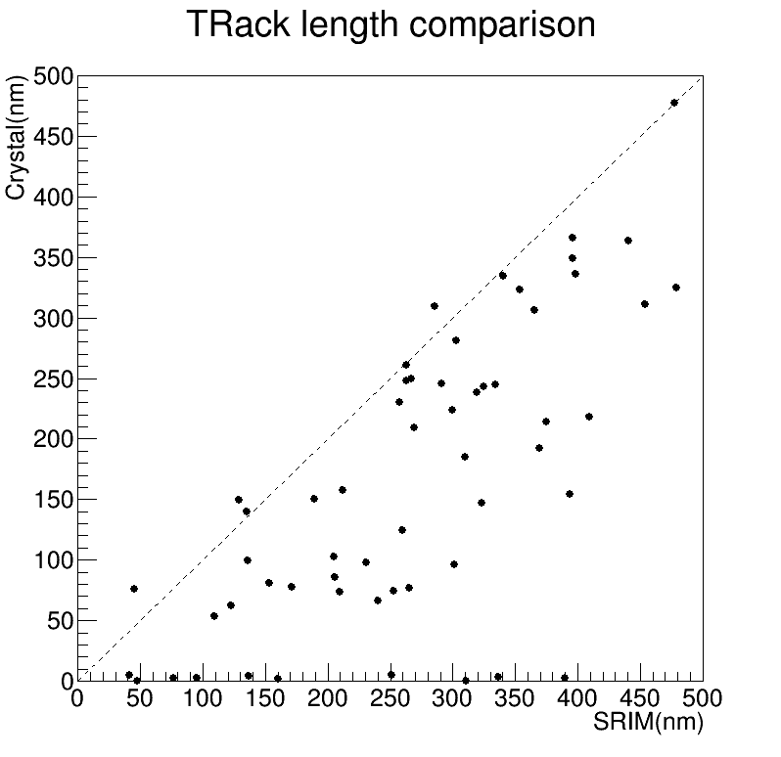
Track length
SRIM and the end of crystal
SRIM and the end of grain

Slide 24
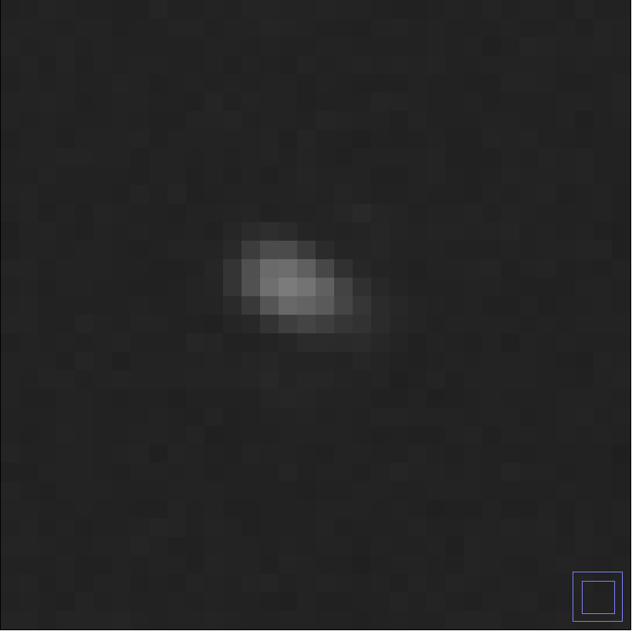
NIT70 nm
0 degree
2D track length
ー SRIM = 340 nm
● Crystal = 334 nm
2D track length
ー SRIM = 340 nm
● grain = 394 nm
90 degree
2D track angle
ー SRIM = 112 degree
● Crystal = 112 degree
2D track angle
ー SRIM = 112 degree
● grain = 112 degree
180 degree
Each grain was set as apertures with R=48 nm.
The optical image was generated (NA1.4 and λ=510 nm)
FFT elliptical fitting
Minor : 3.50747
Major : 5.70059
Elli : 1.62527
Track angle : 112.721
1.87 um

Slide 25
C100 keV ion comparison
ー PTS2data
ー simulation
The fog event was subtracted using mask in PTS2 data.
The relation between track range(kinetic energy ) and ellipticity seems to be found.

Slide 26
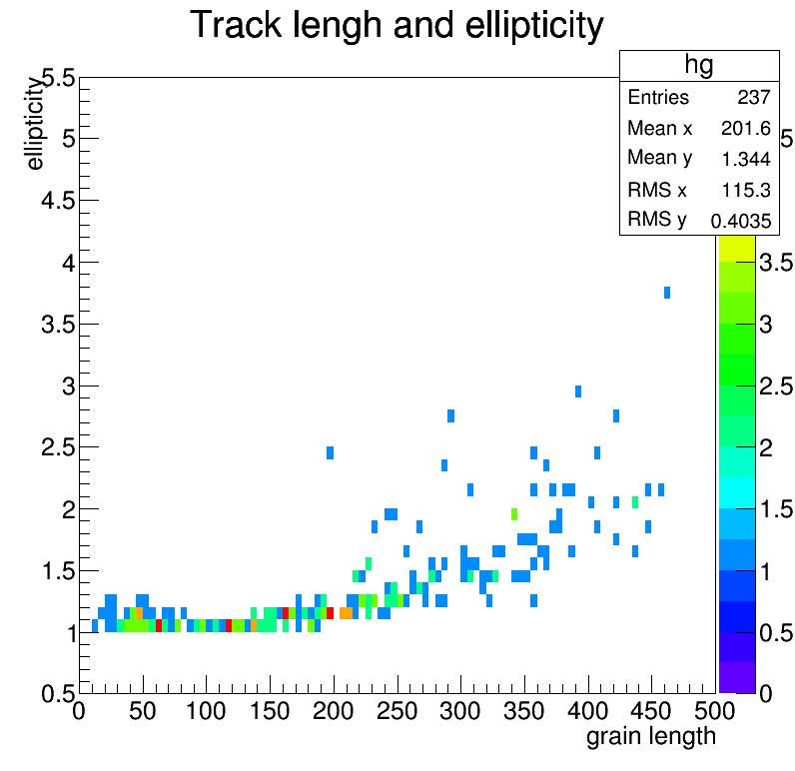
Ellipticity and SRIM ,grain length

Slide 27
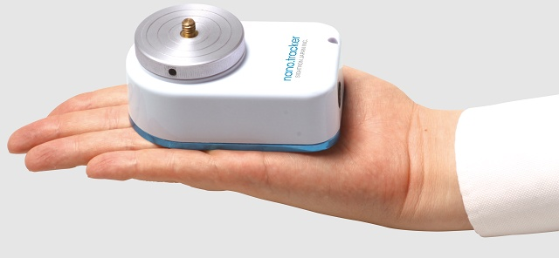
Equatorial telescope
We tested a prototype of equatorial telescope for DM directional detection.
New nano. tracker (SIGHTRON company) was used.
http://www.sightron.co.jp/sightron/sightron_products25/
New nano. tracker
Portable equatorial telescope
60×98×44 mm , 400g
Power supplied from socket with USB
Guaranteed temperature -10 ~ 40℃
From WEB page

Slide 28
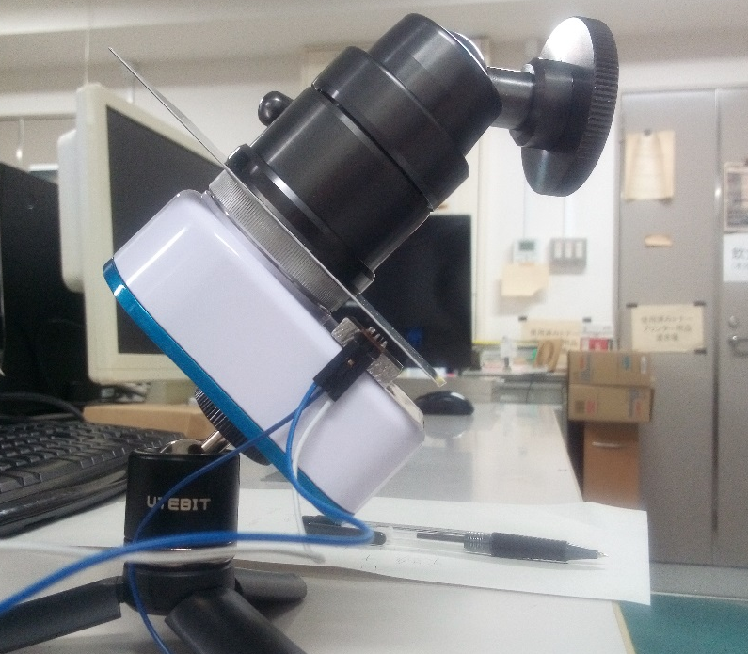
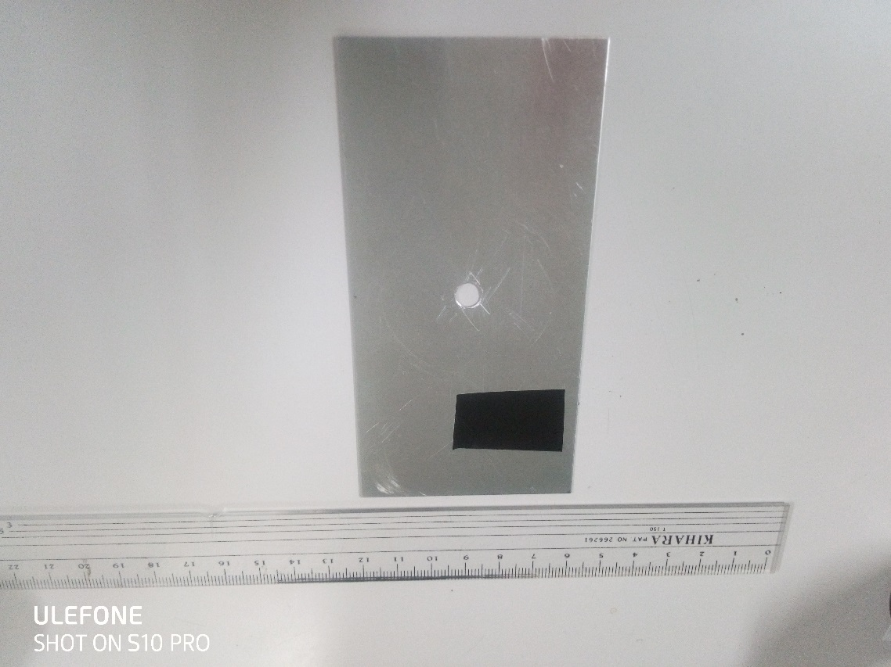
Equatorial telescope setup
Earth axis
Camera platform
Turntable
CYGNUS
QTR-1A
6 cm
Reflector plate
Light absorber (black tape)
Our telescope consists of
- Camera platform for setting NIT toward CYGNUS
- Reflector plate and photoreflector (QTR-1A) to
monitor telescope running
- Microcomputer for data taking of photo reflector

Slide 29
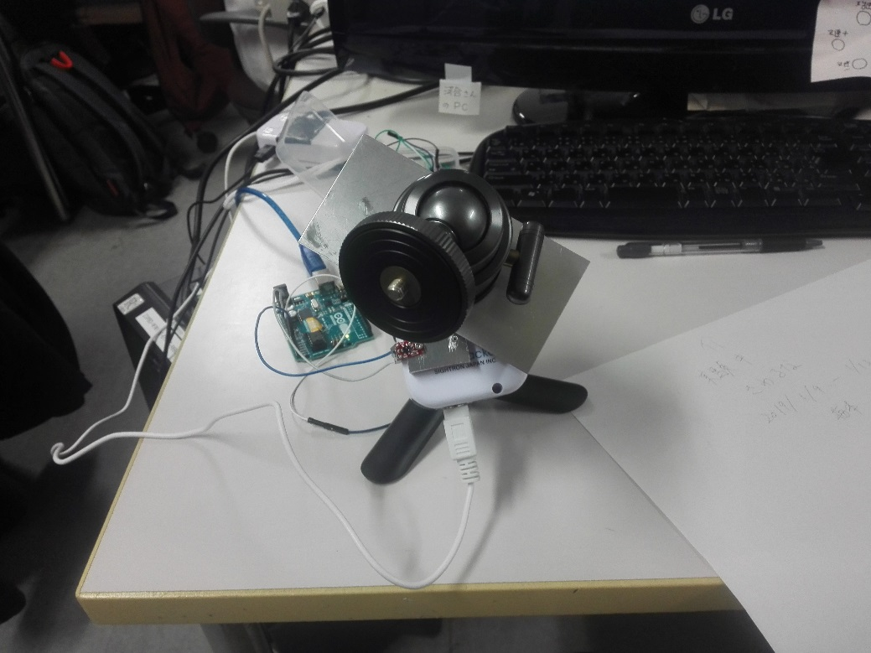
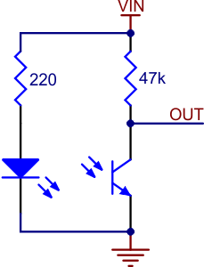
QTR-1A circuit
Arduino
2019/01/11/15:03
2019/01/11/17:01
Equatorial telescope rotates the camera platform with reflector plate.
QTR-1A catches emitted light by itself when the reflector plate comes upward of QTR-1A.
Then the output voltage of QTR-1A becomes lower.
- Reflector plate is not square in this test, so we can get the time difference of output voltage
and it has the relation with the telescope movement.
“arduino” (a kind of microcomputer) operates QTR-1A and also records output voltage in time as a text file.

Slide 30
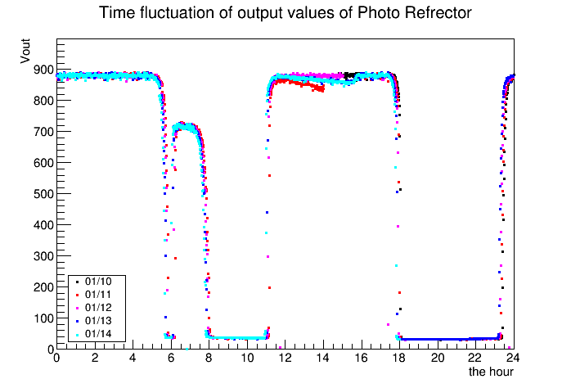
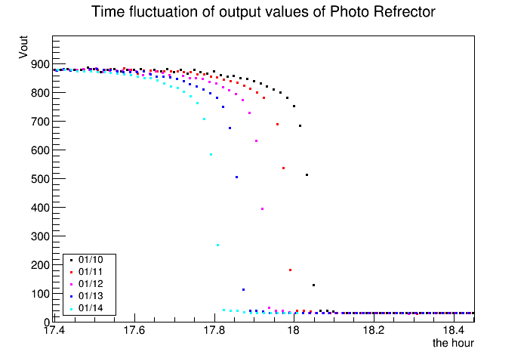
Test at room temperature
Data taking in a minute
Light absorber (black tape)
I checked if the tape
worked as light absorber
in this test .
The tape was come
upward of QTR-1A in
this time region.
As day passes,
the reflector plate came
3~4 minutes earlier.
⇔ relation with the
earth diurnal rotation
I checked the reflector plate
came on the QTR-1A sensor by eyes.

Slide 31
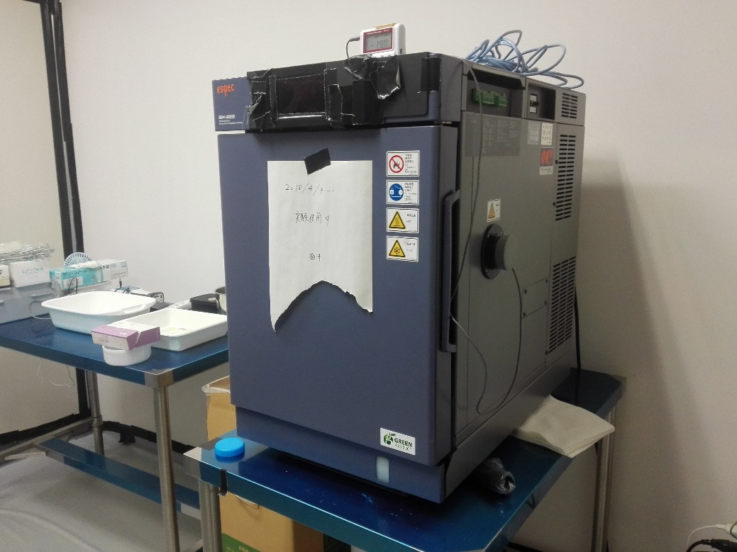
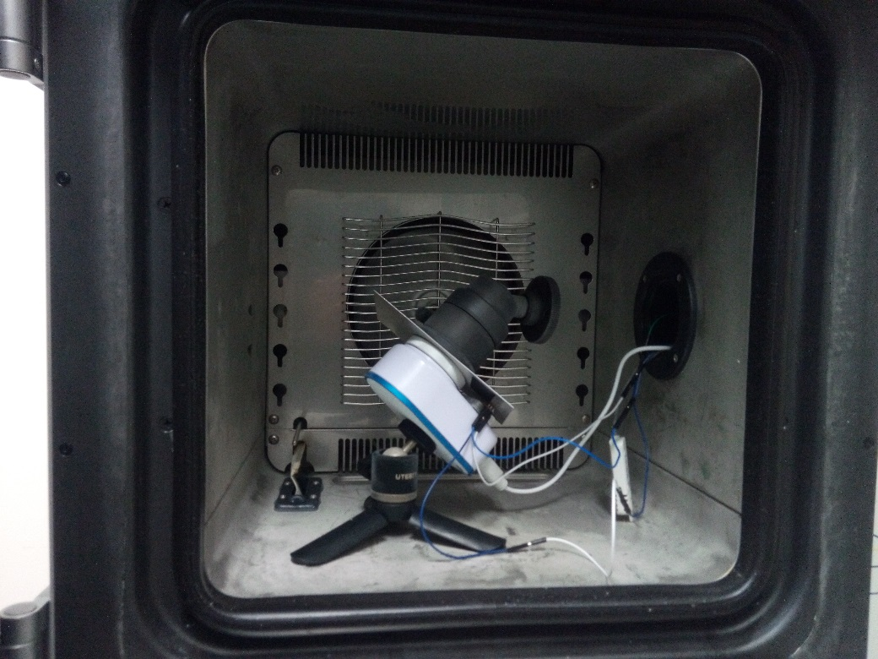
Test at -10 degree
Thermostatic chamber
electronics
Temperature sensor

Slide 32
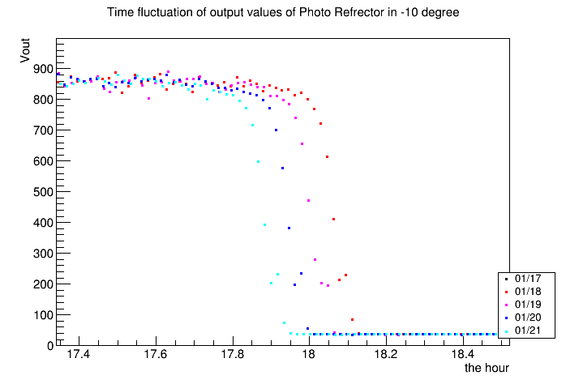
Room temperature
-10℃
The shape of Vout in -10 degree was almost same as that of room test.
Room temperature
-10℃

Slide 33
Plan and summary
Scanning speed is enough to do 1 gram DM search. (Only PTS2)
The angular resolution was improved by FFT elliptical fitting and DM directional search can be done with equatorial telescope(⇒ BG event has flat distribution).
DM cross-section will be calculated using ellipticity and SRIM.
Our important task is rejecting dust events.
The number of dust event generated by development process can be reduced by tuning the pAg in NIT gel production. I would like to produce this NIT and set it on the equatorial telescope at surface-lab.
Brightness and Phase-contrast information
NIT70 should be better than NIT40 for rejecting dust (it has to be evaluated )

