Slide 1
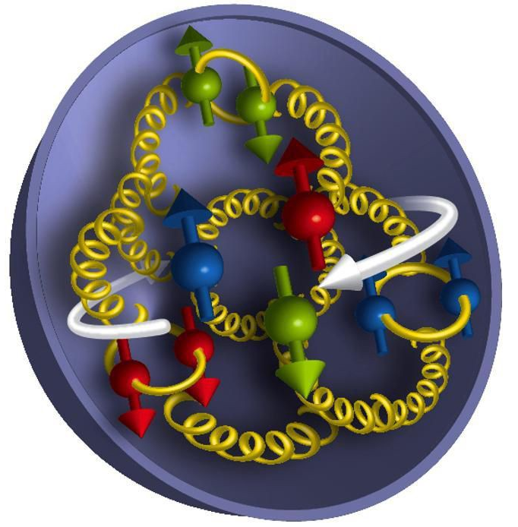
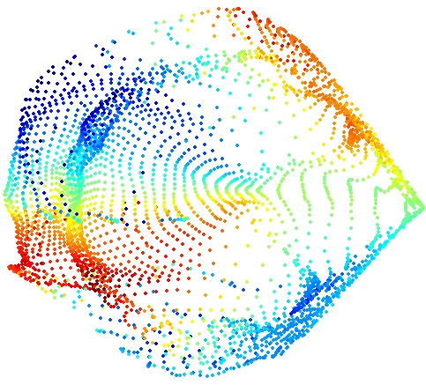
Dmitry Romanov for EIC Software Consortium
ML for the EIC
+
Machine Learning
EIC Physics
20 May 2019

Slide 2
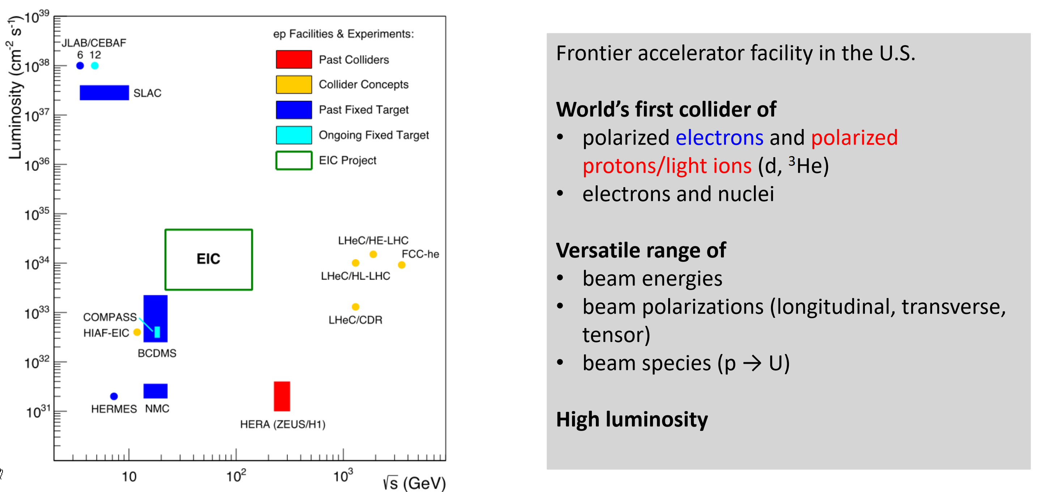
Electron Ion Collider

Slide 3
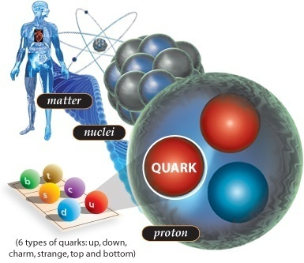
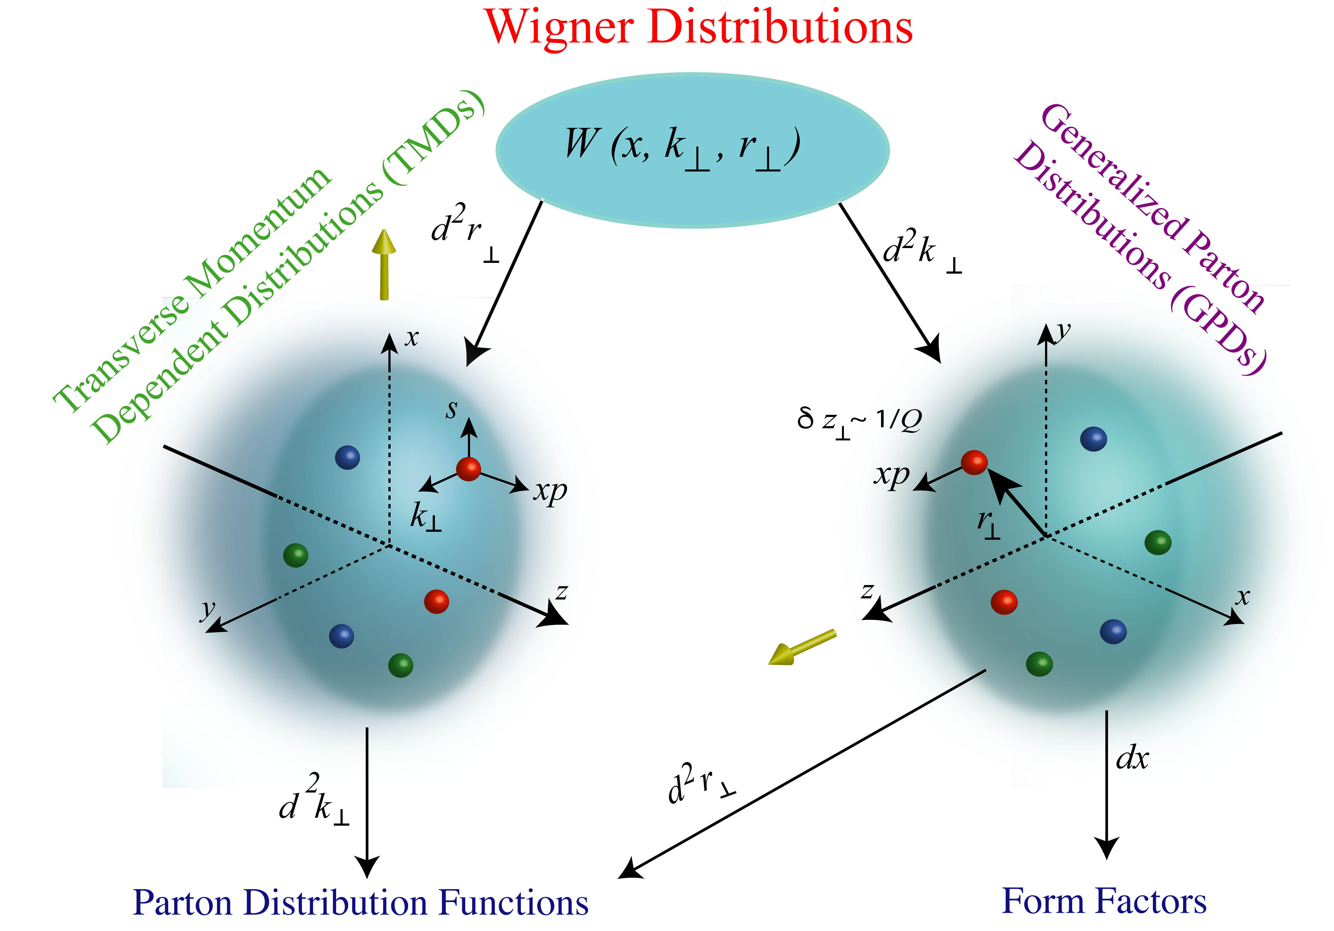
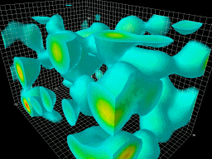
EIC for DIS
The QCD
vacuum
https://www.eiccenter.org/
https://www.bnl.gov/eic/
http://www.eicug.org/web/
Long-distance gluonic fluctuations

Slide 4
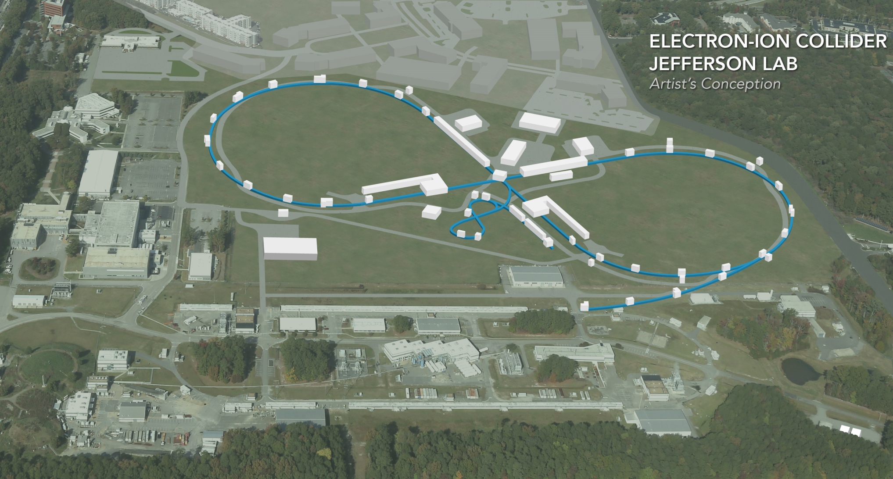
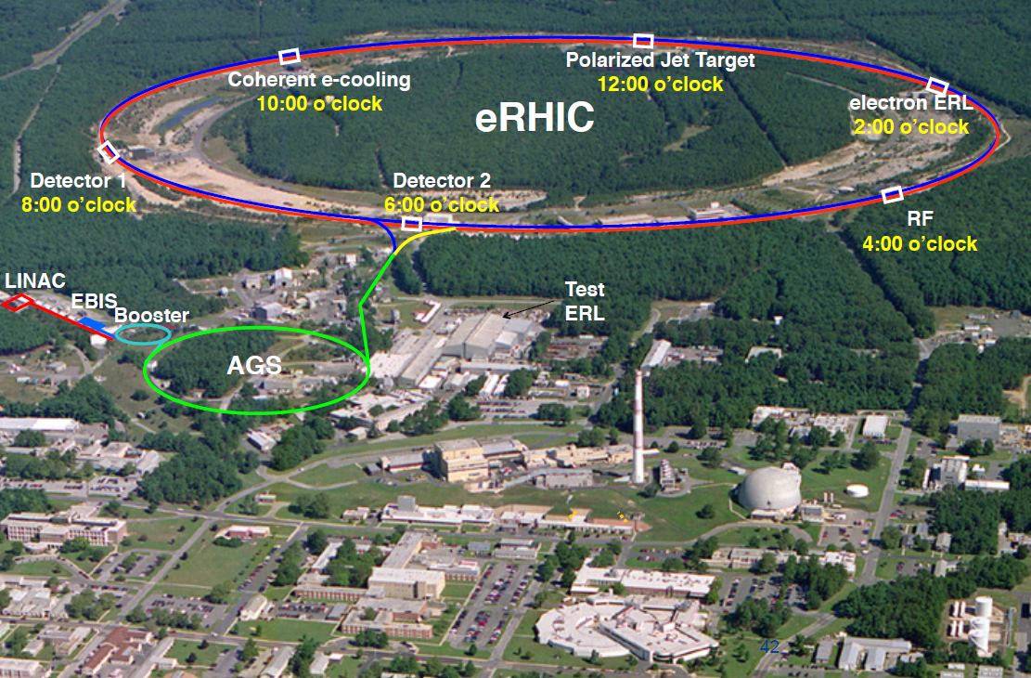
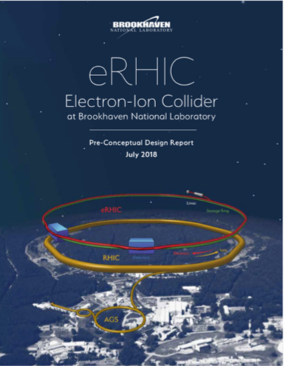
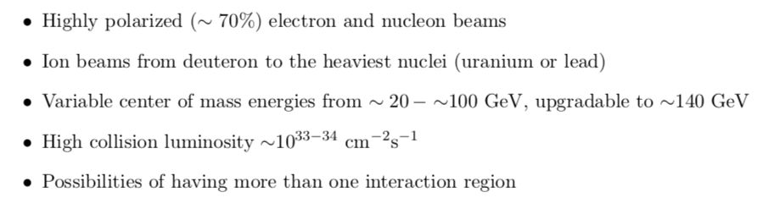
Two EIC concepts
(JLEIC Parameters Updated April, 2019)
Two realization concepts being developed

Slide 5
Lets look at out data processing chain

Slide 6
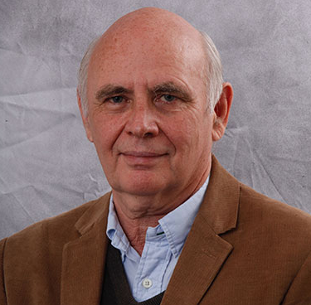
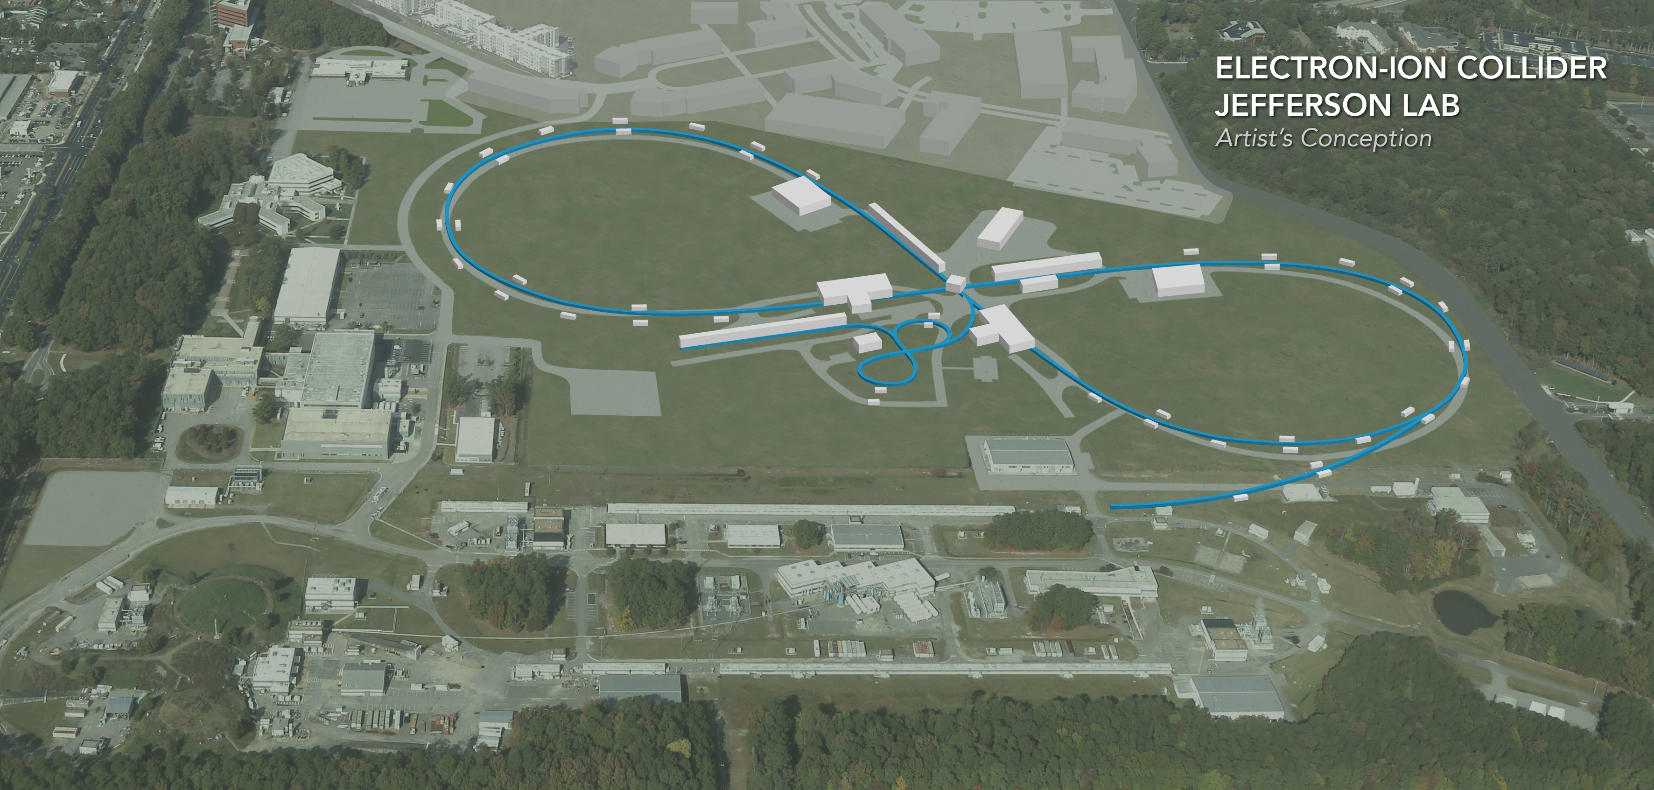
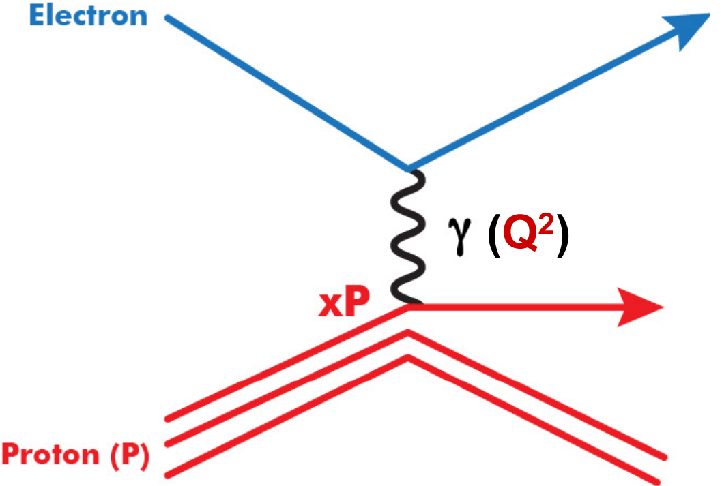
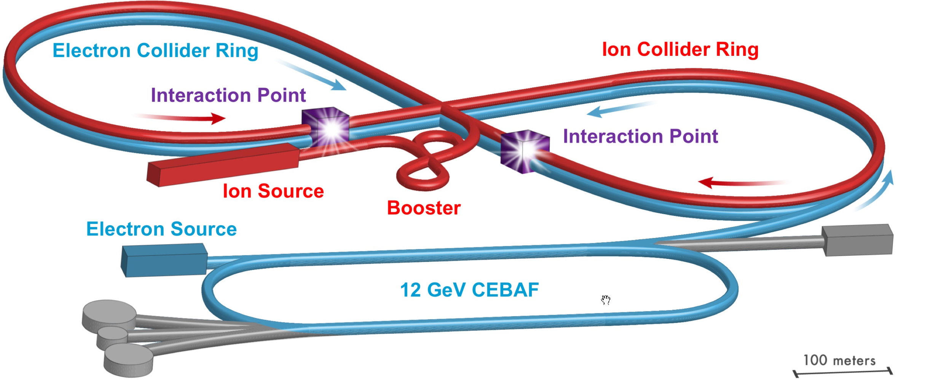
Experimental data workflow
Theorists

Slide 7
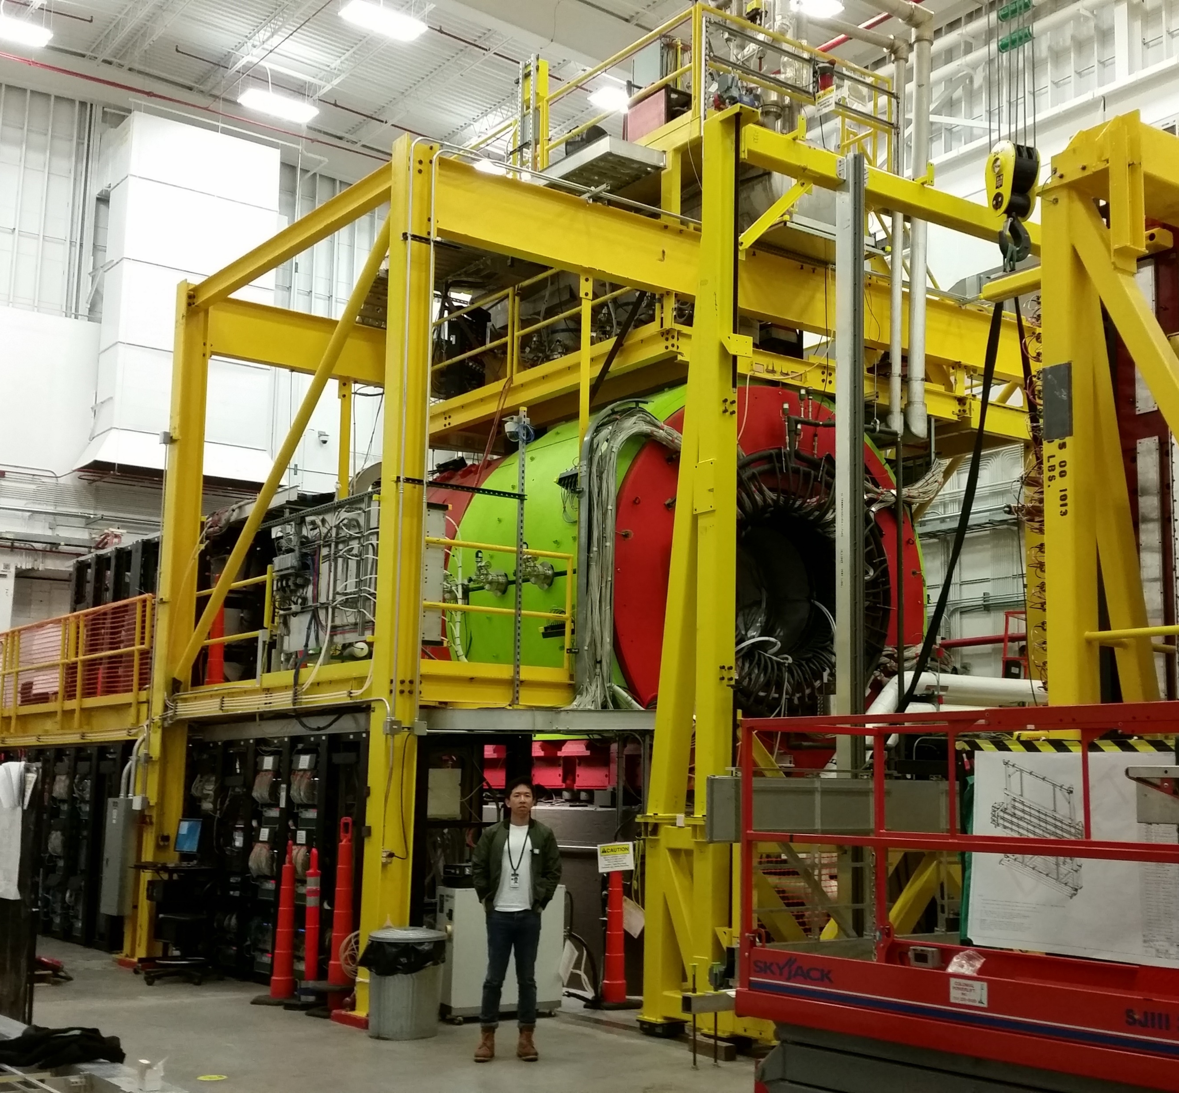
Experimental data workflow
Theorists
Experimental setup
Detector
Detector
Detector
Detector

Slide 8
Experimental data workflow
Theorists
DAQ
Data - a stream of “raw values”
estimated EIC event rates 450 kHZ
Jleic bunch crossing at 2nsmachine
learning in real-time: calibration, reconstruction, analysis
Experimental setup
Detector
Detector
Detector
Detector

Slide 9
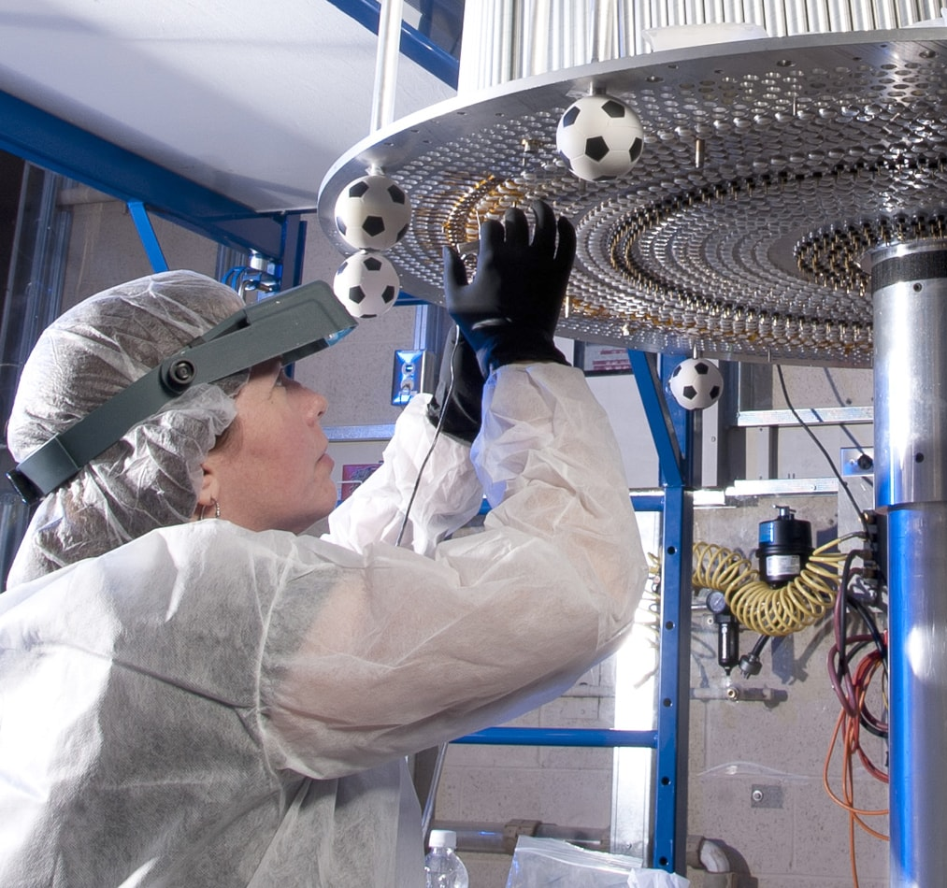
Experimental data workflow
Theorists
Experimental setup
Detector
Detector
Detector
Detector
Calibrations & alignment

Slide 10
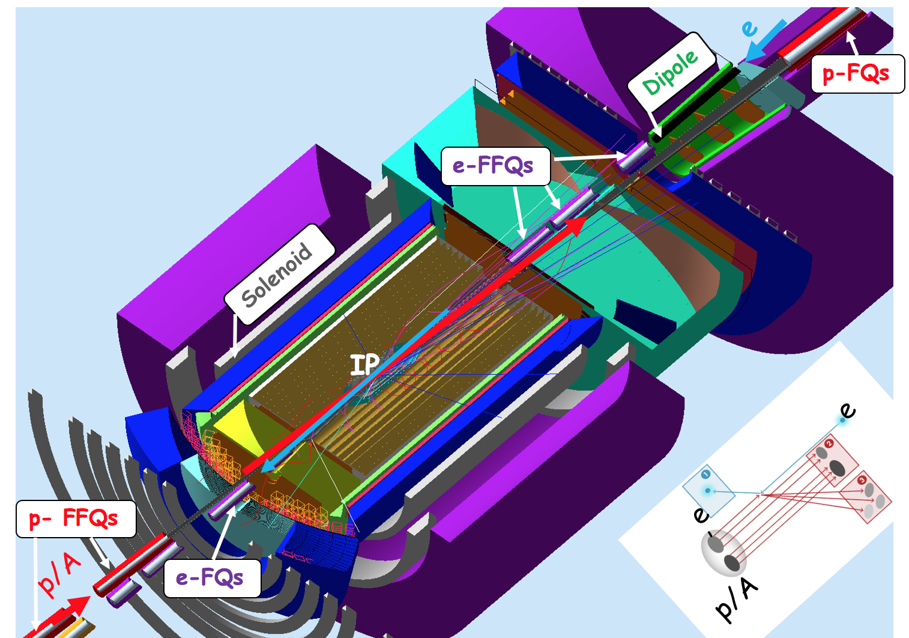
Experimental data workflow
Theorists
GEANT simulation
Detector
Detector
Detector
Detector
Experimental setup
Detector
Detector
Detector
Detector
Calibrations & alignment

Slide 11
Experimental data workflow
Theorists
GEANT simulation
EVENT RECONSTRUCTION
Detector
Detector
Detector
Detector
Experimental setup
Detector
Detector
Detector
Detector
Calibrations & alignment

Slide 12
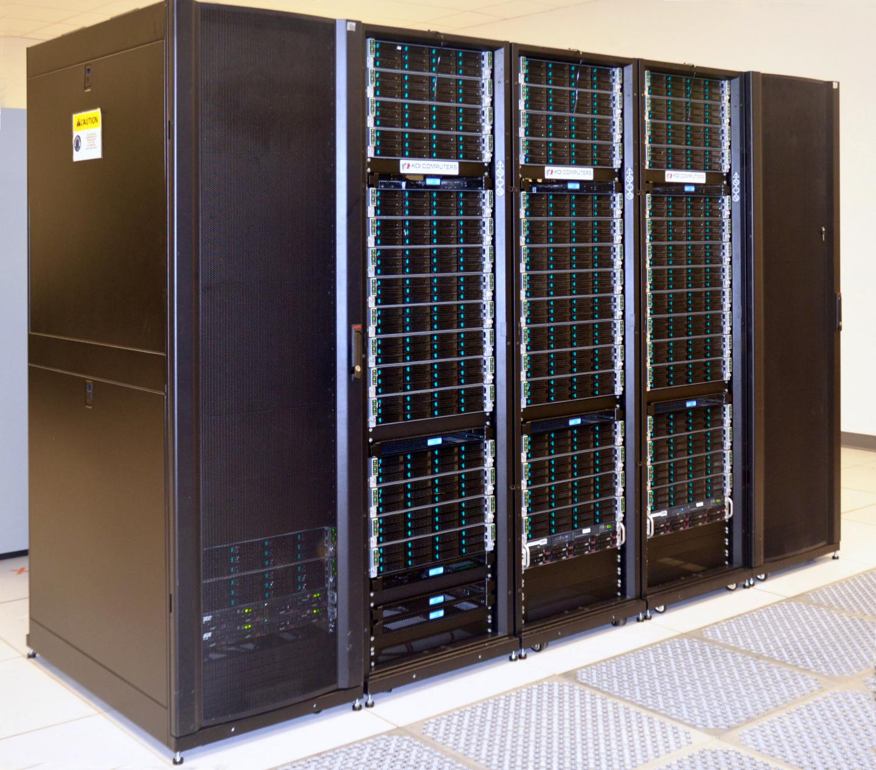
High performance computing for reconstruction
Theorists
GEANT simulation
EVENT RECONSTRUCTION
Detector
Detector
Detector
Detector
Experimental setup
Detector
Detector
Detector
Detector
Calibrations & alignment

Slide 13
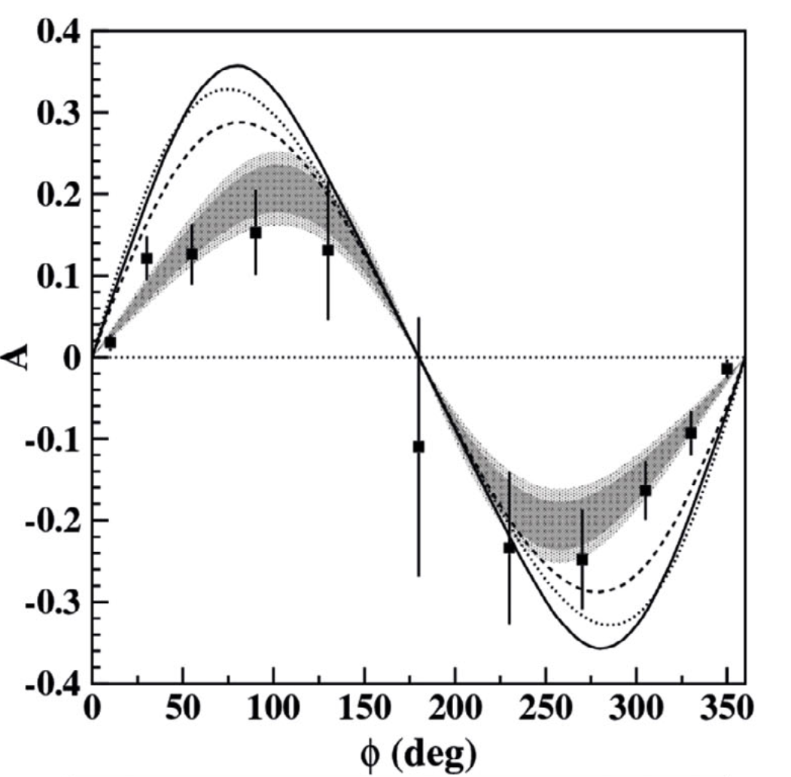
Many places for ML application
Theorists
GEANT simulation
EVENT RECONSTRUCTION
Analysis
Detector
Detector
Detector
Detector
Analysis
Analysis
Experimental setup
Detector
Detector
Detector
Detector
Calibrations & alignment

Slide 15
Experimental data workflow
Theorists
GEANT simulation
EVENT RECONSTRUCTION
Analysis
Detector
Detector
Detector
Detector
Analysis
Analysis
Experimental setup
Detector
Detector
Detector
Detector
Calibrations & alignment

Slide 16
Can machine learning make
theory – experiment delivery
shorter?
Theory to experiment
Experiment to theory

Slide 17
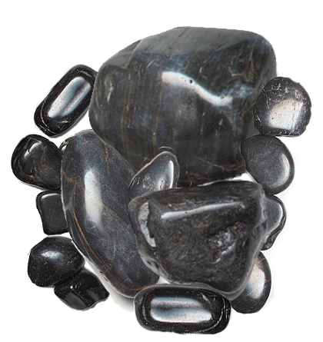
Big rocks, small rocks
Can we learn from machine learning which knows unknown?
… that detector is Bayesian optimized …
… this NN for part of tracking …
Most of the current ML & HEP projects are “small rocks” with aim to solve “medium rocks” problems
If we Bayesian optimize single subsystems can we Bayesian optimize whole machine?

Slide 18
EIC center & JLab
projects

Slide 19
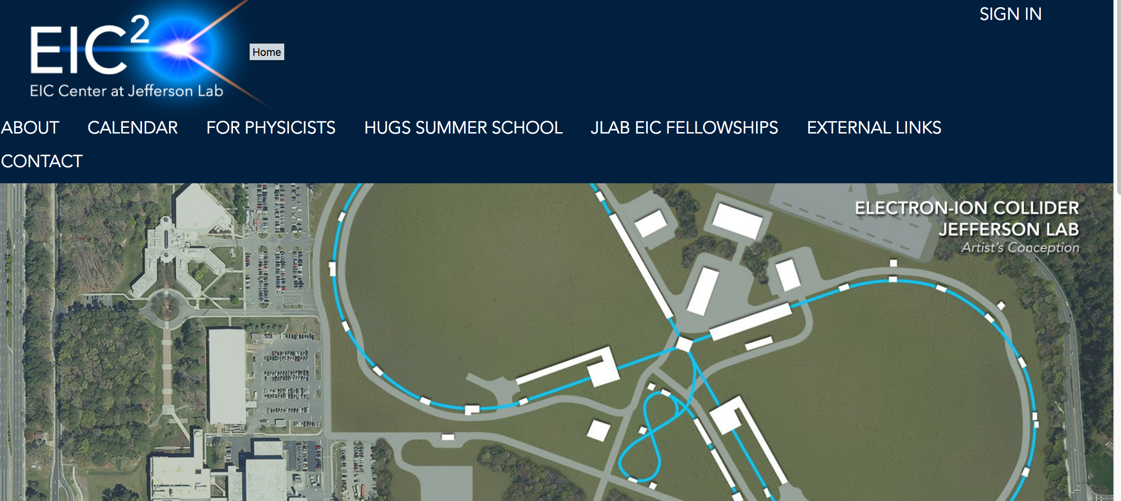
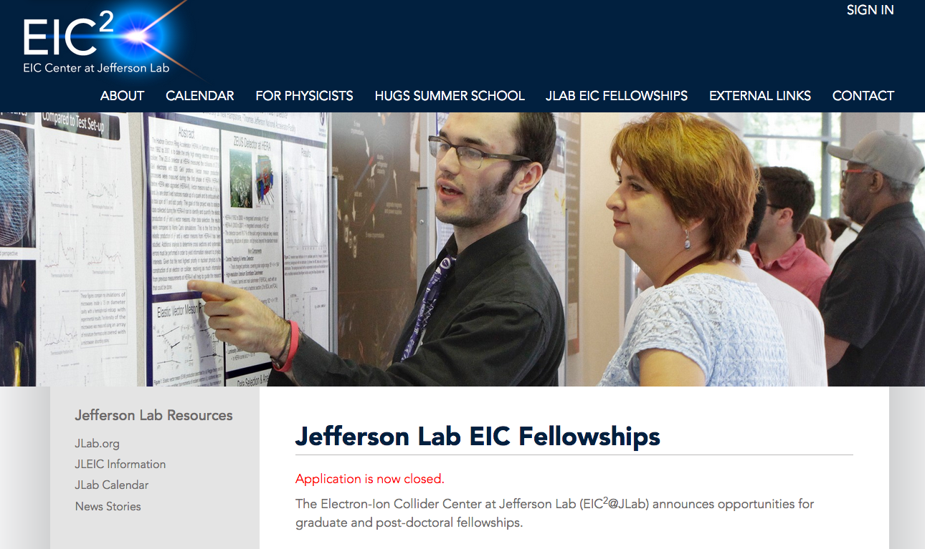

The Electron-Ion Collider Center (EIC²@JLab) is an organization to advance and promote the science program at a future electron-ion collider (EIC) facility.
Weekly meetings, ad-hoc meetings (workshops)
Lab Directed R&D (LDRD)
Summer school, visitors, etc..
Graduate student and postdocs fellow program
www.
eiccenter.org
Machine learning initiative
Contact person Rik Yoshida

Slide 20
Tracking
rewarding and challenging

Slide 21
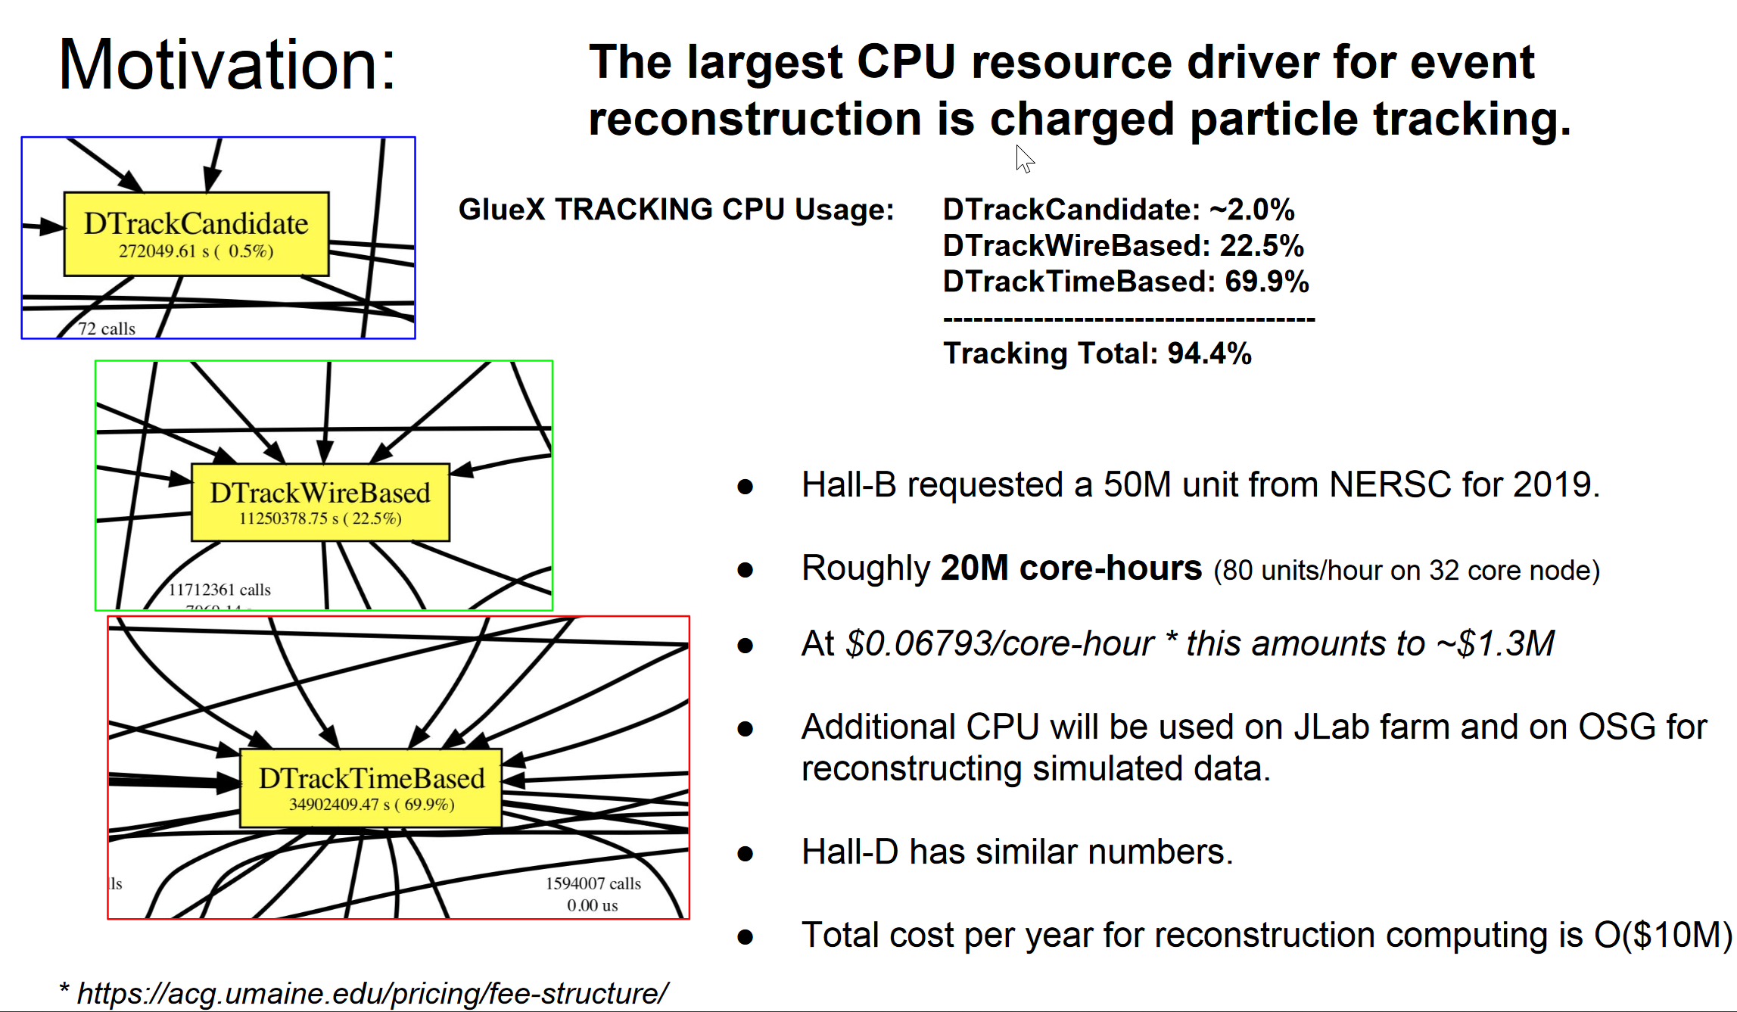
Tracking rewards

Slide 22
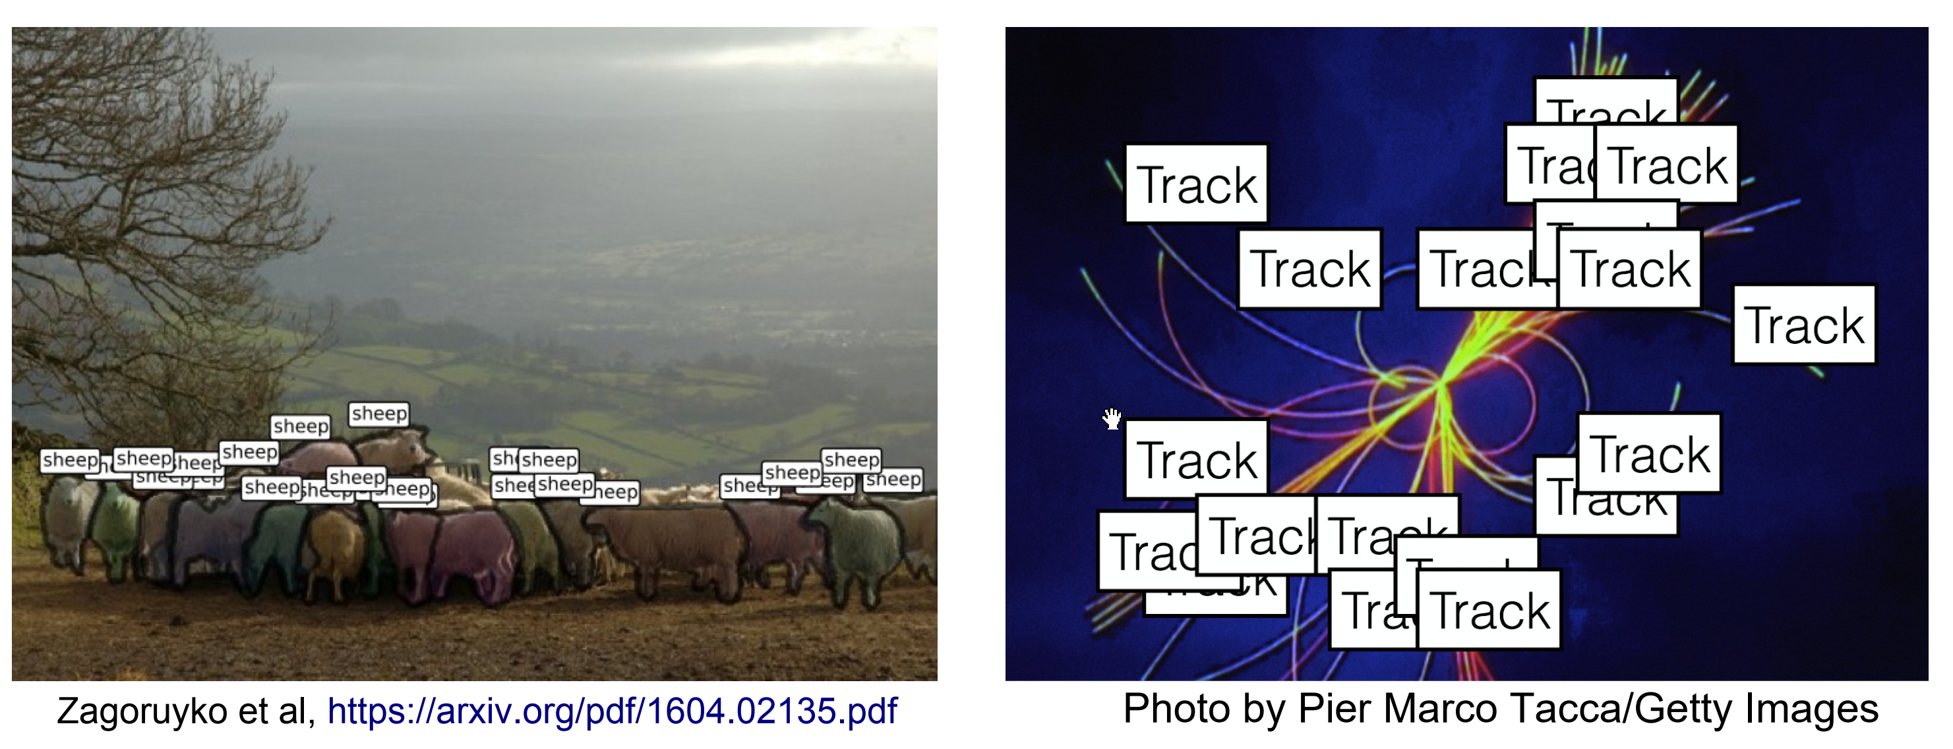
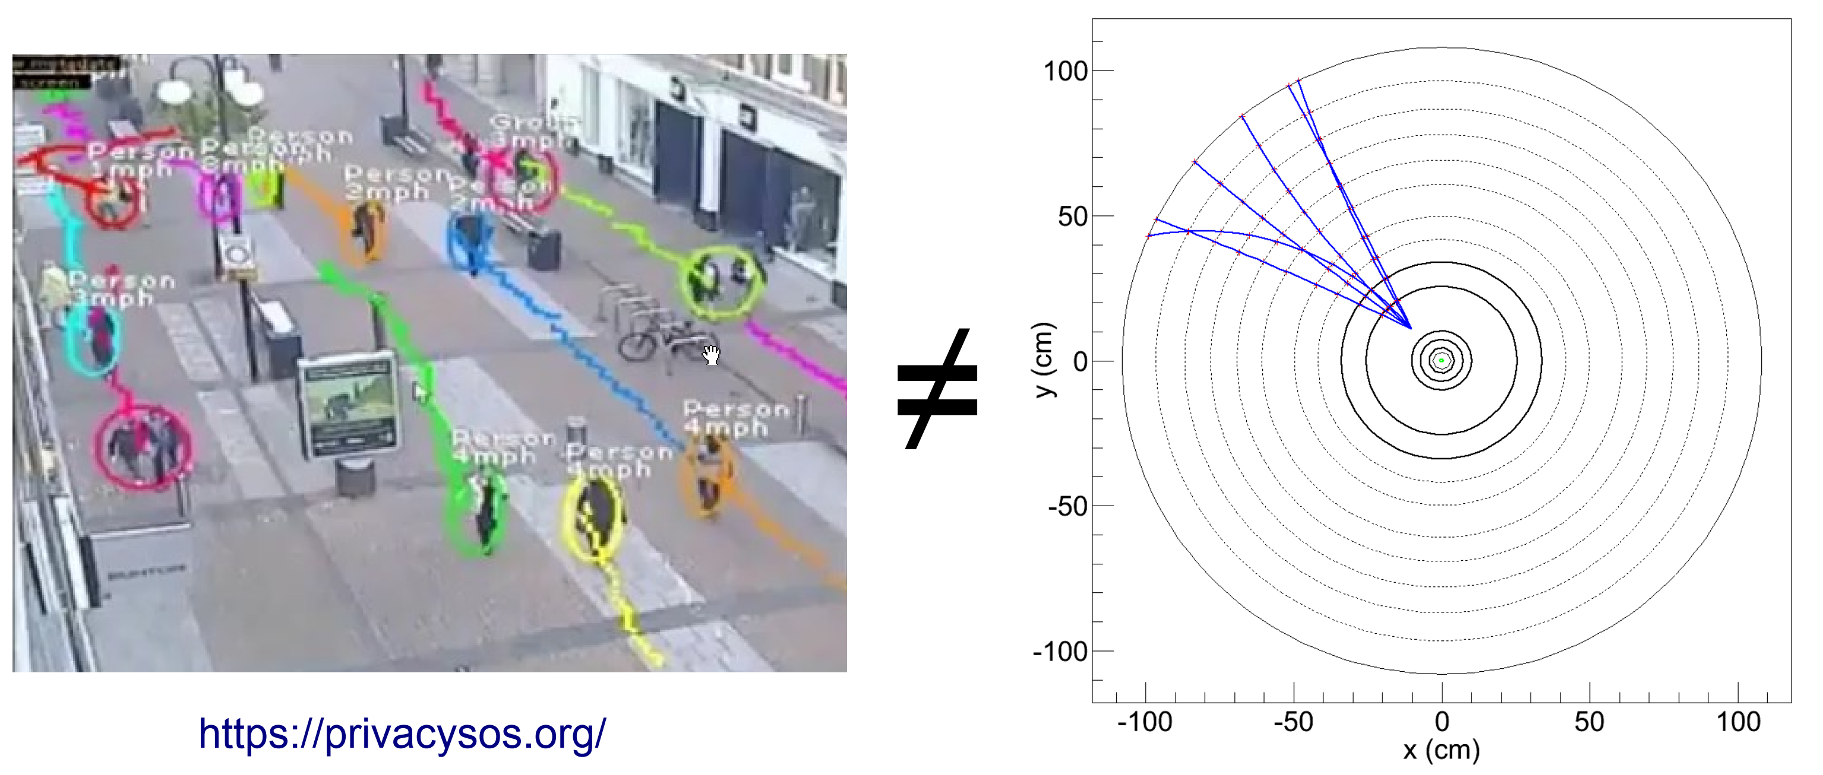
Tracking challenges
Jean-Roch Vlimant
(Caltech)
[1] Tracking at Hadron Colliders with Machine Learning (video) https://cds.cern.ch/record/2672711?ln=en
Scene Labeling
Data sparsity
It is now understood, that realistic detector images have high dimensionality and sparsity and are difficult to construct from the irregular geometries of complex experimental setup. Not all detector information and not all tracks are equal and not all features matter, giving a rise to high dimensionality of the cost function.

Slide 23
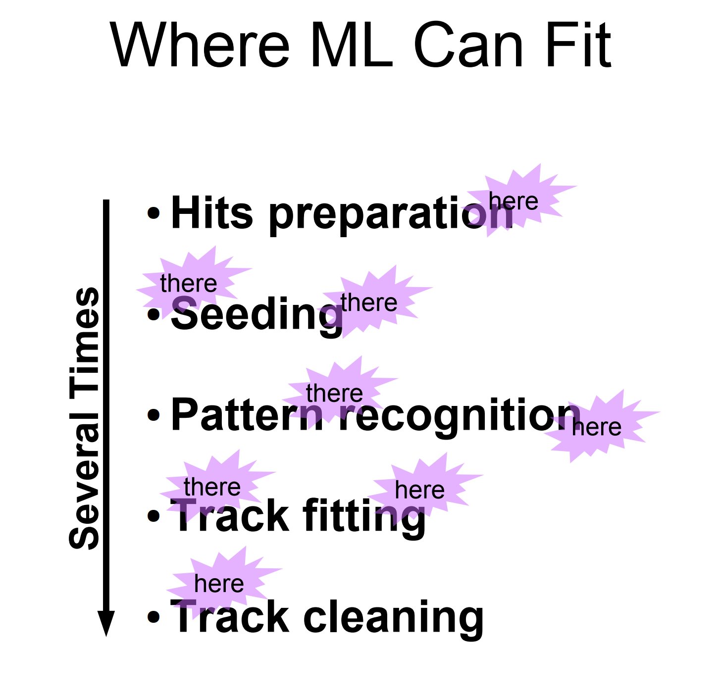
Jean-Roch Vlimant
(Caltech)

Slide 24
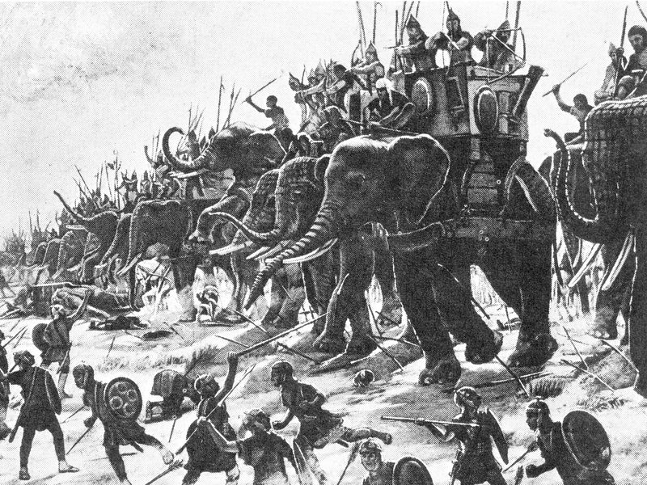
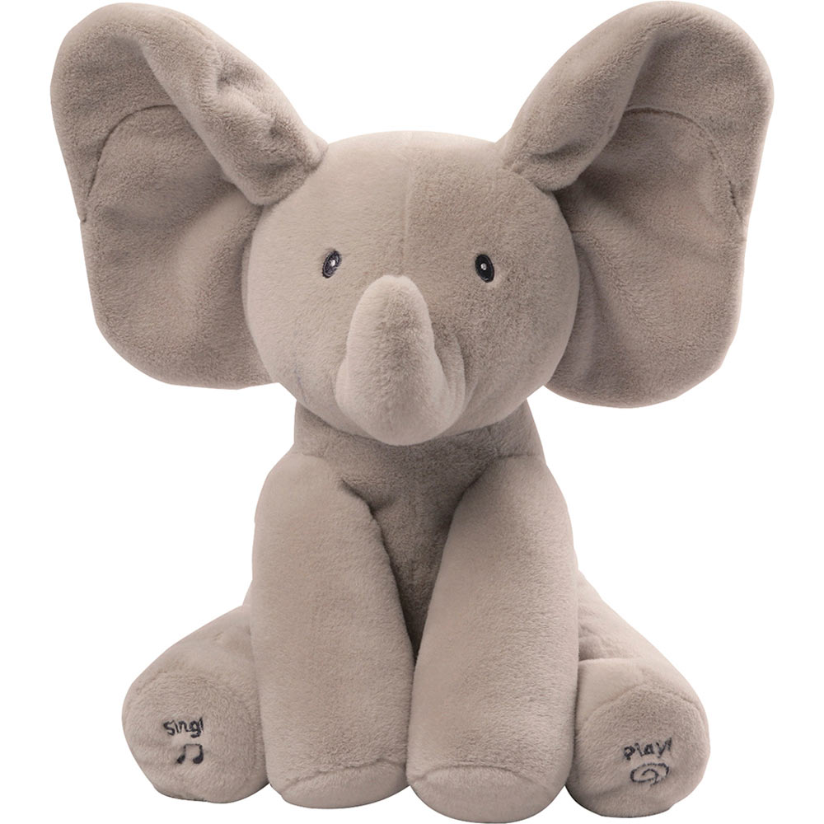
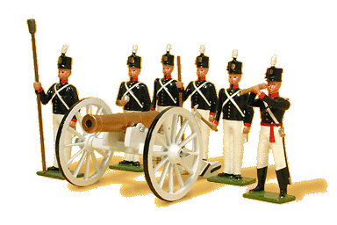
Real problem vs toy problem
VS
Start with Real (or very close to real data)
Start with toy model and scale from that to real examples
http://www.hep.ph.ic.ac.uk/seminars/slides/2018/backhouse_imperial_2018.pdf
https://www.kaggle.com/c/trackml-particle-identification

Slide 25
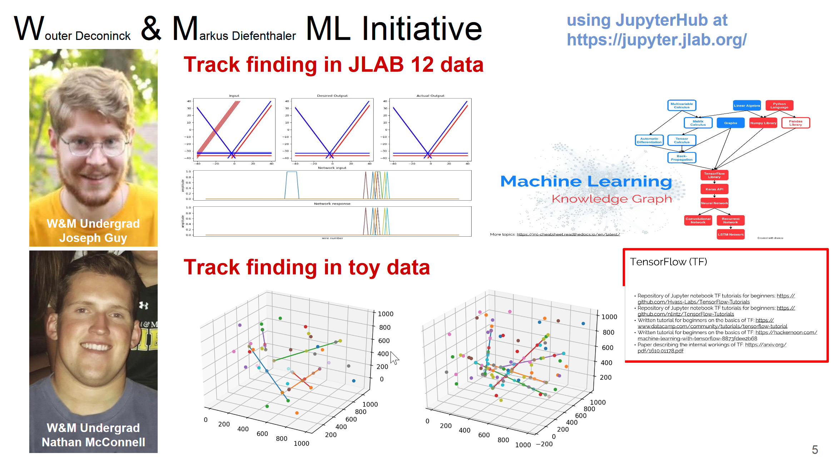
WMML Tracking initiative

Slide 26
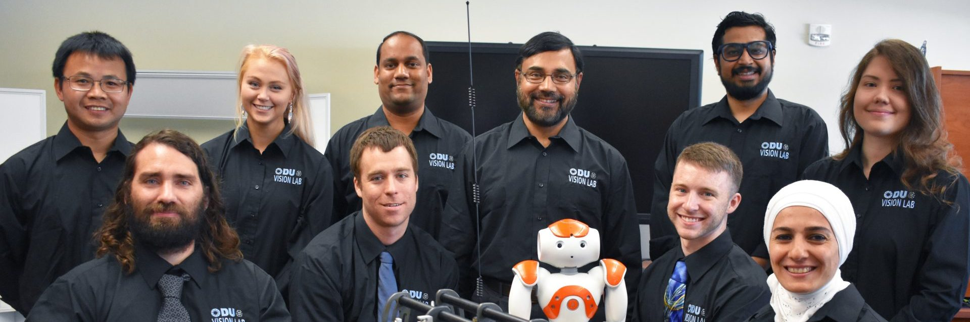
Tracking ML in collaboration with vision lab @ ODU
The right combination of different ML methods to exploit their strongest properties for different tracking subtasks. Few of such subtasks and proposed ML approaches include:
  Activity segmentation using feature-based and featureless DNN learning;
  Pattern recognition using deep simultaneous recurrent network (DSRN);
  Track quality estimation using DNN learning;
  Multitrack prediction using long-short term memory (LSTM) NN;
  NN classifier to distinguish good and bad clusters in the Hough space;
https://sites.wp.odu.edu/VisionLab/research/

Slide 27
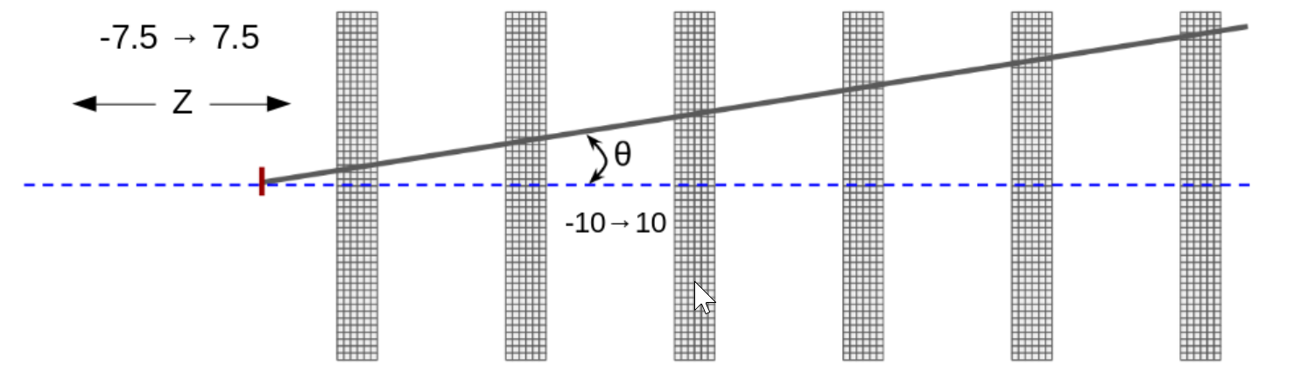
Jefferson Lab tracking ML initiative
Collaboration between HallD, CLAS12, EIC (JLab group)
1. https://github.com/JeffersonLab/trackingML
(Project to have common data model and solutions)
2. Toy task challenges
https://halldweb.jlab.org/talks/ML_lunch/May2019/
3. ML Lunch series
(come each Wednesday when you are in Jlab)

Slide 28
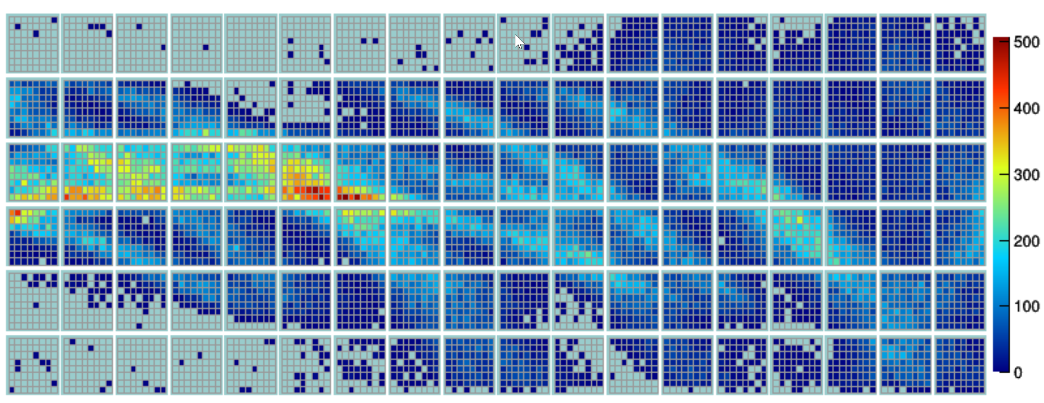
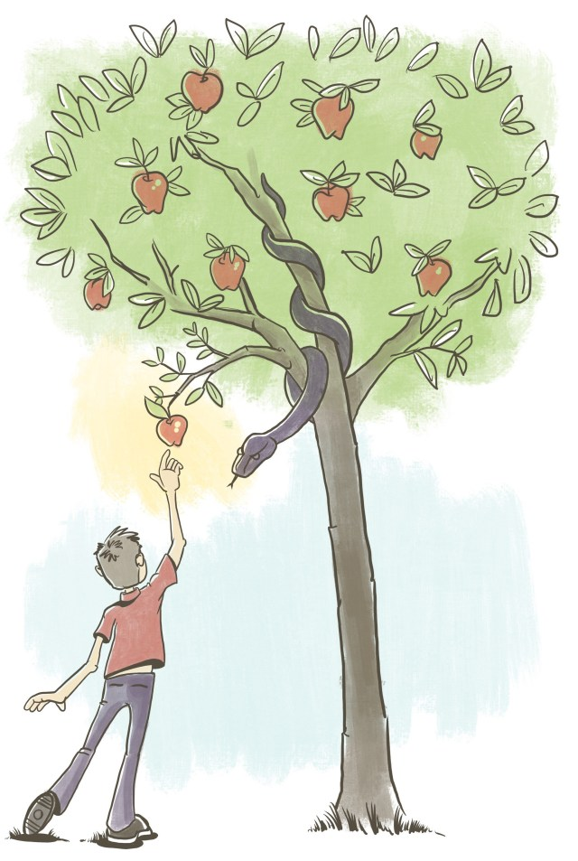
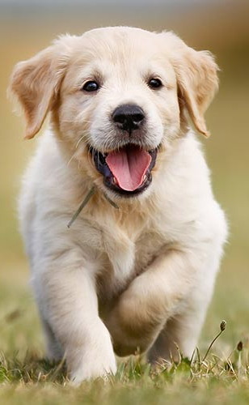
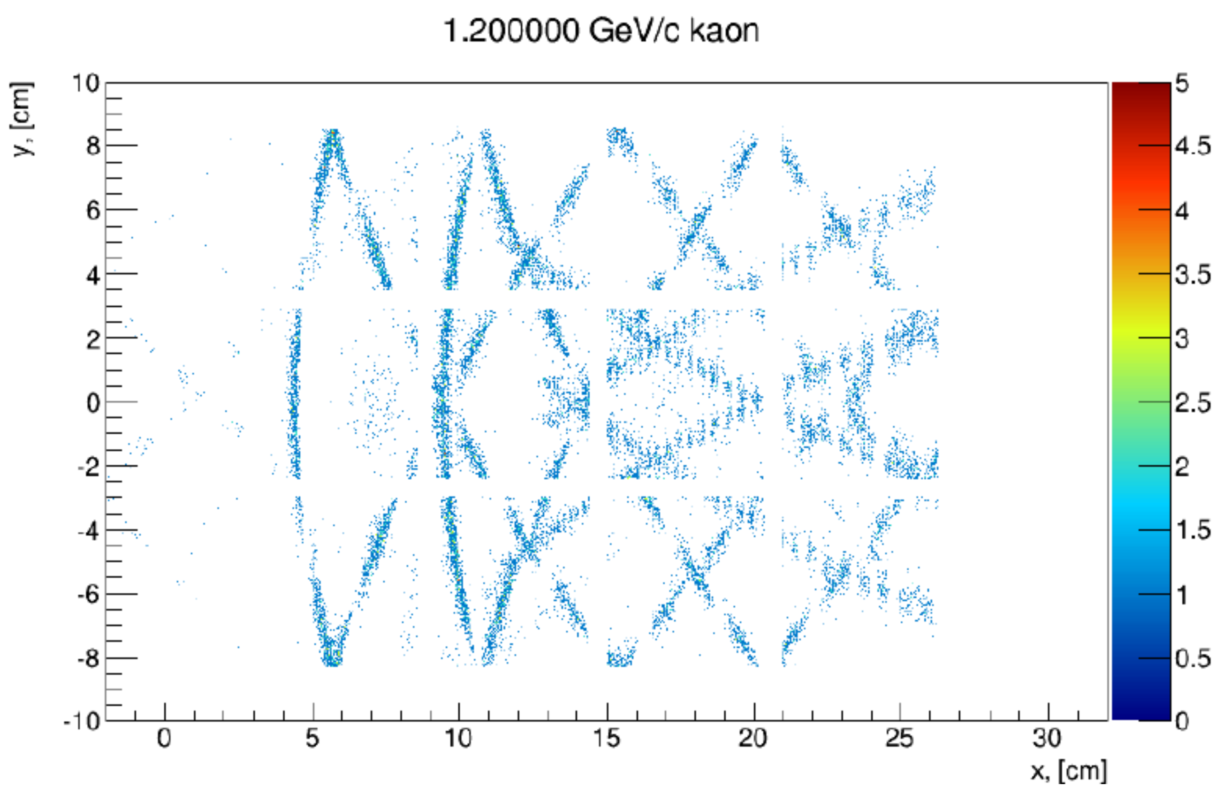
Novel ML methods for detectors
Pixelated detectors!
Hit pattern for different polar and azimuthal
angle of the charge track for DIRC detector

Slide 29
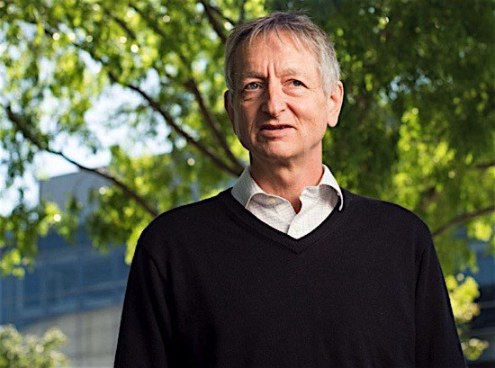
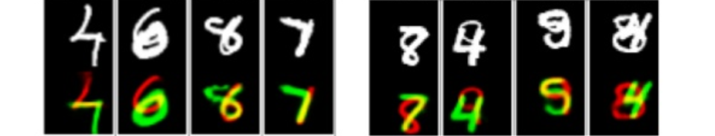
Novel ML methods for detectors
Capsule networks for pixelated detectors
It is capable to optimize classification and regression simultaneously
It can detect overlapped objects in image/overlapping clusters in detector data.
“The pooling operation used in convolutional neural networks is a big mistake and the fact that it works so well is a disaster.”
© Geoffrey Hinton
https://pechyonkin.me/capsules-1/

Slide 30
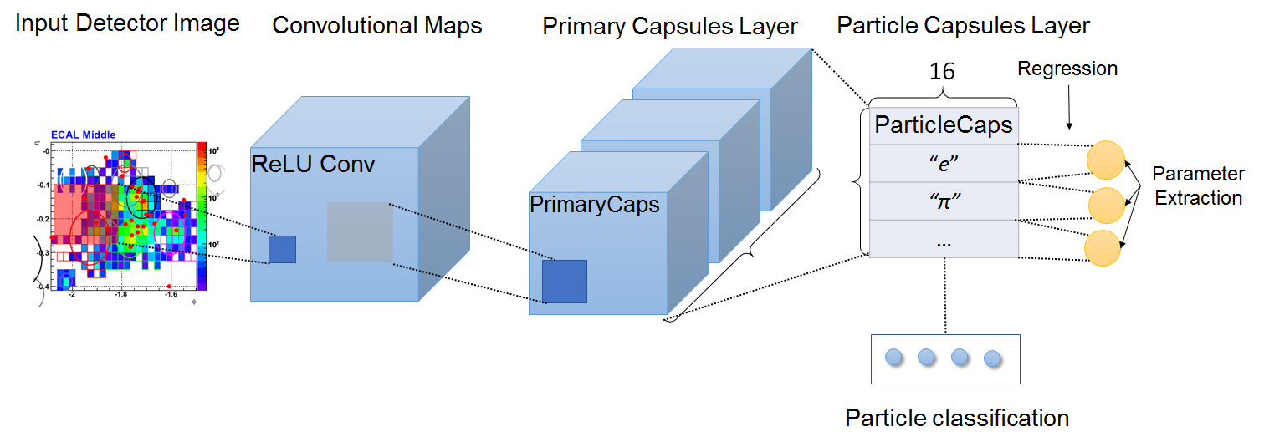
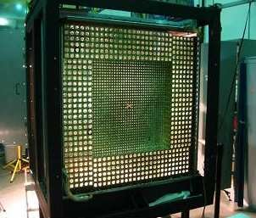
Capsule networks for wall standing calorimeter
Aim to start with a calorimeter and get a
General framework for pixelated detectors
Tasks for calorimeter:
Working with noisy and overlapping clusters
Extracting both incidence parameters and PID estimation

Slide 31
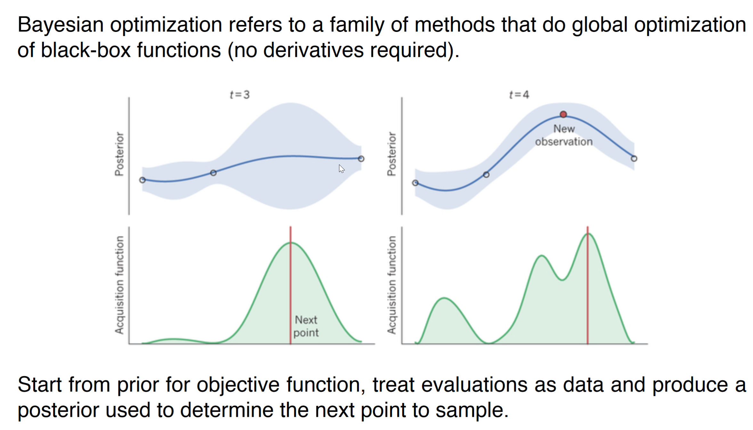
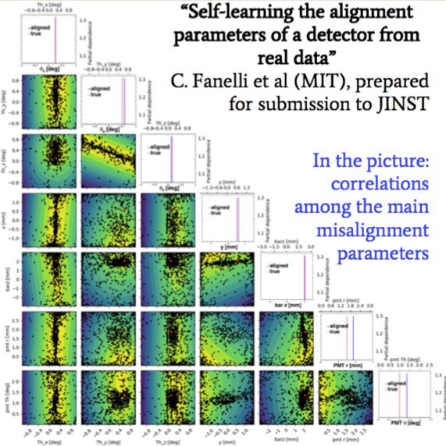
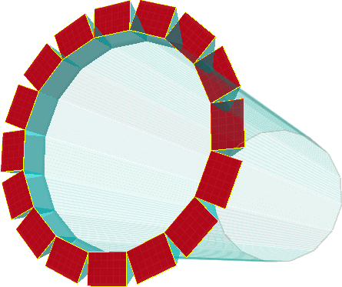
Machine learning application for Detector
Bayesian optimization for DIRC detector
EIC Barrel: DIRC
C. Fanelli (MIT)
DIRC optimization for HallD

Slide 32
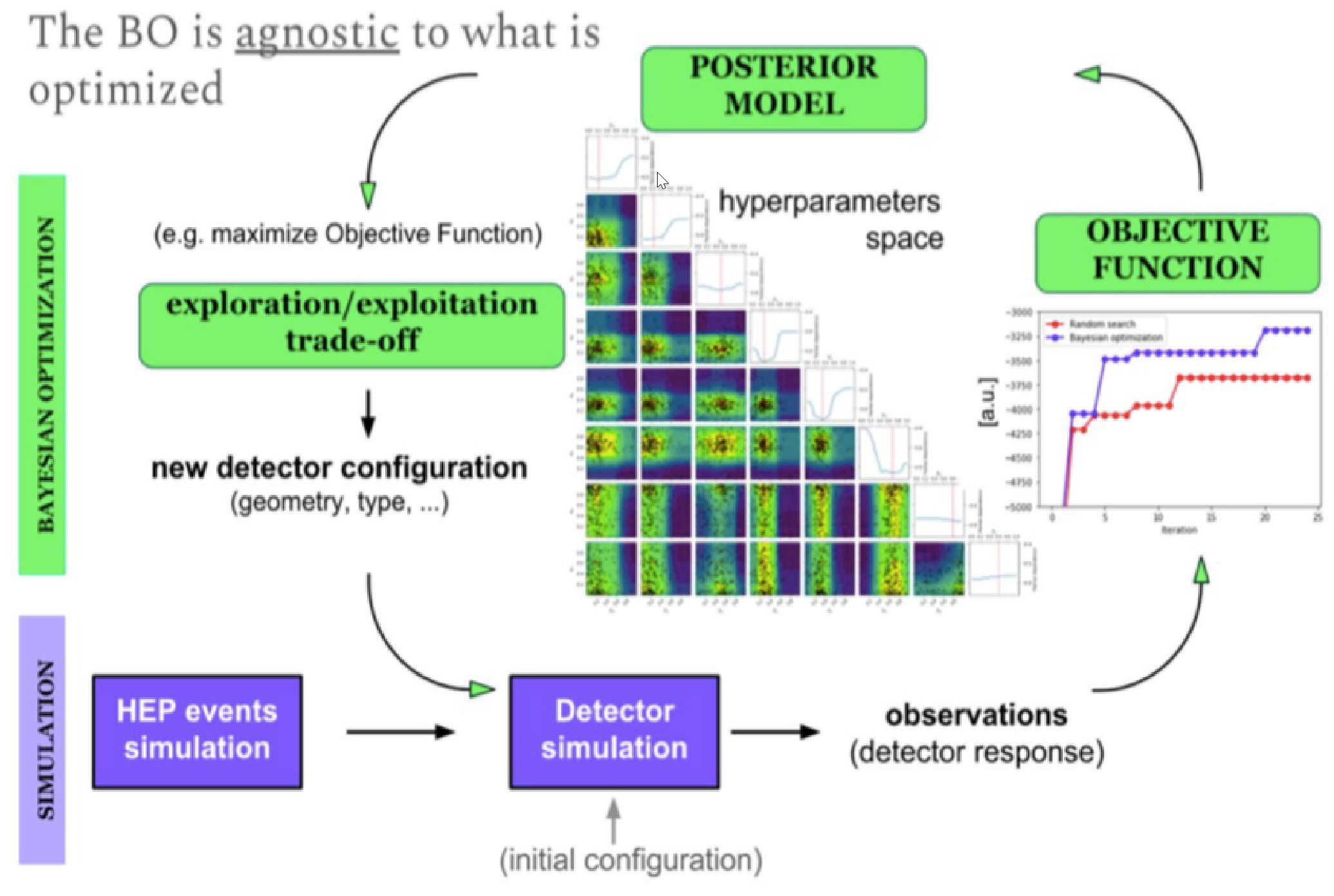
Can we Bayesian optimize everything?
Bayesian optimization for DIRC detector
Barrel DIRC optimization is a short term goal with a deliverable
Using Bayesian optimization in as a tool for detector design – in general

Slide 33
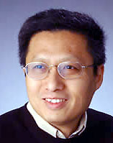
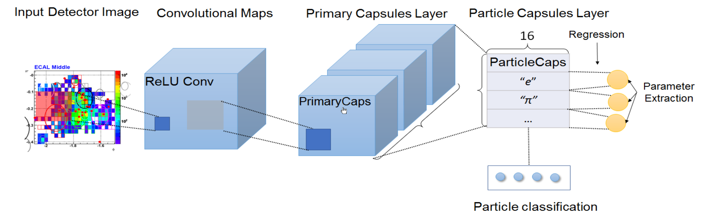
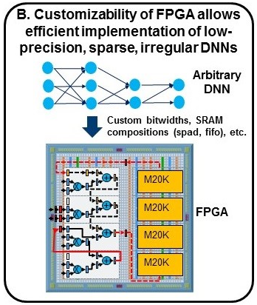
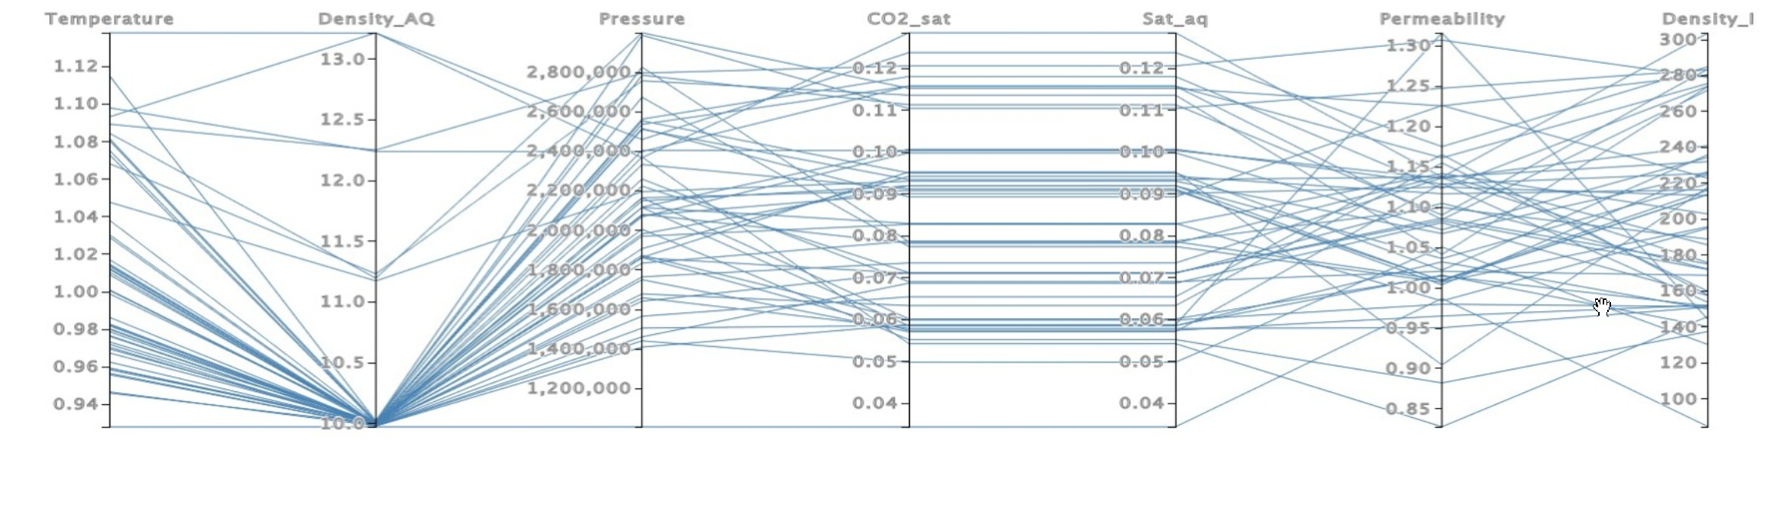
Other ML and data science projects of EIC center
Capsule networks for pixelated detectors
Looking for DIS correlations
in physical data with
Machine Learning
(JLab + ODU)
prof. Yuesheng xu
GEM neural networks to FPGA
Visual Analysis Workspace for Nuclear Femtography Data (JLab + VTech)
(JLab + ODU)

Slide 34
Weekly meetings, ad-hoc meetings (workshops)
Lab Directed R&D (LDRD)
Summer school, visitors, etc..
Graduate student and postdocs fellow program
The Electron-Ion Collider Center (EIC²@JLab) is an organization to advance and promote the science program at a future electron-ion collider (EIC) facility.
www.
eiccenter.org
Contact person Rik Yoshida

Slide 35
Collaboration of NP & ML
+
EIC
Machine Learning
Thank you!

Slide 36
Backup slides
Thank you!

Slide 37
Experimental data workflow
Theorists
GEANT simulation
EVENT RECONSTRUCTION
Analysis
Detector
Detector
Detector
Detector
Analysis
Analysis
Experimental setup
Detector
Detector
Detector
Detector
Calibrations & alignment

Slide 38
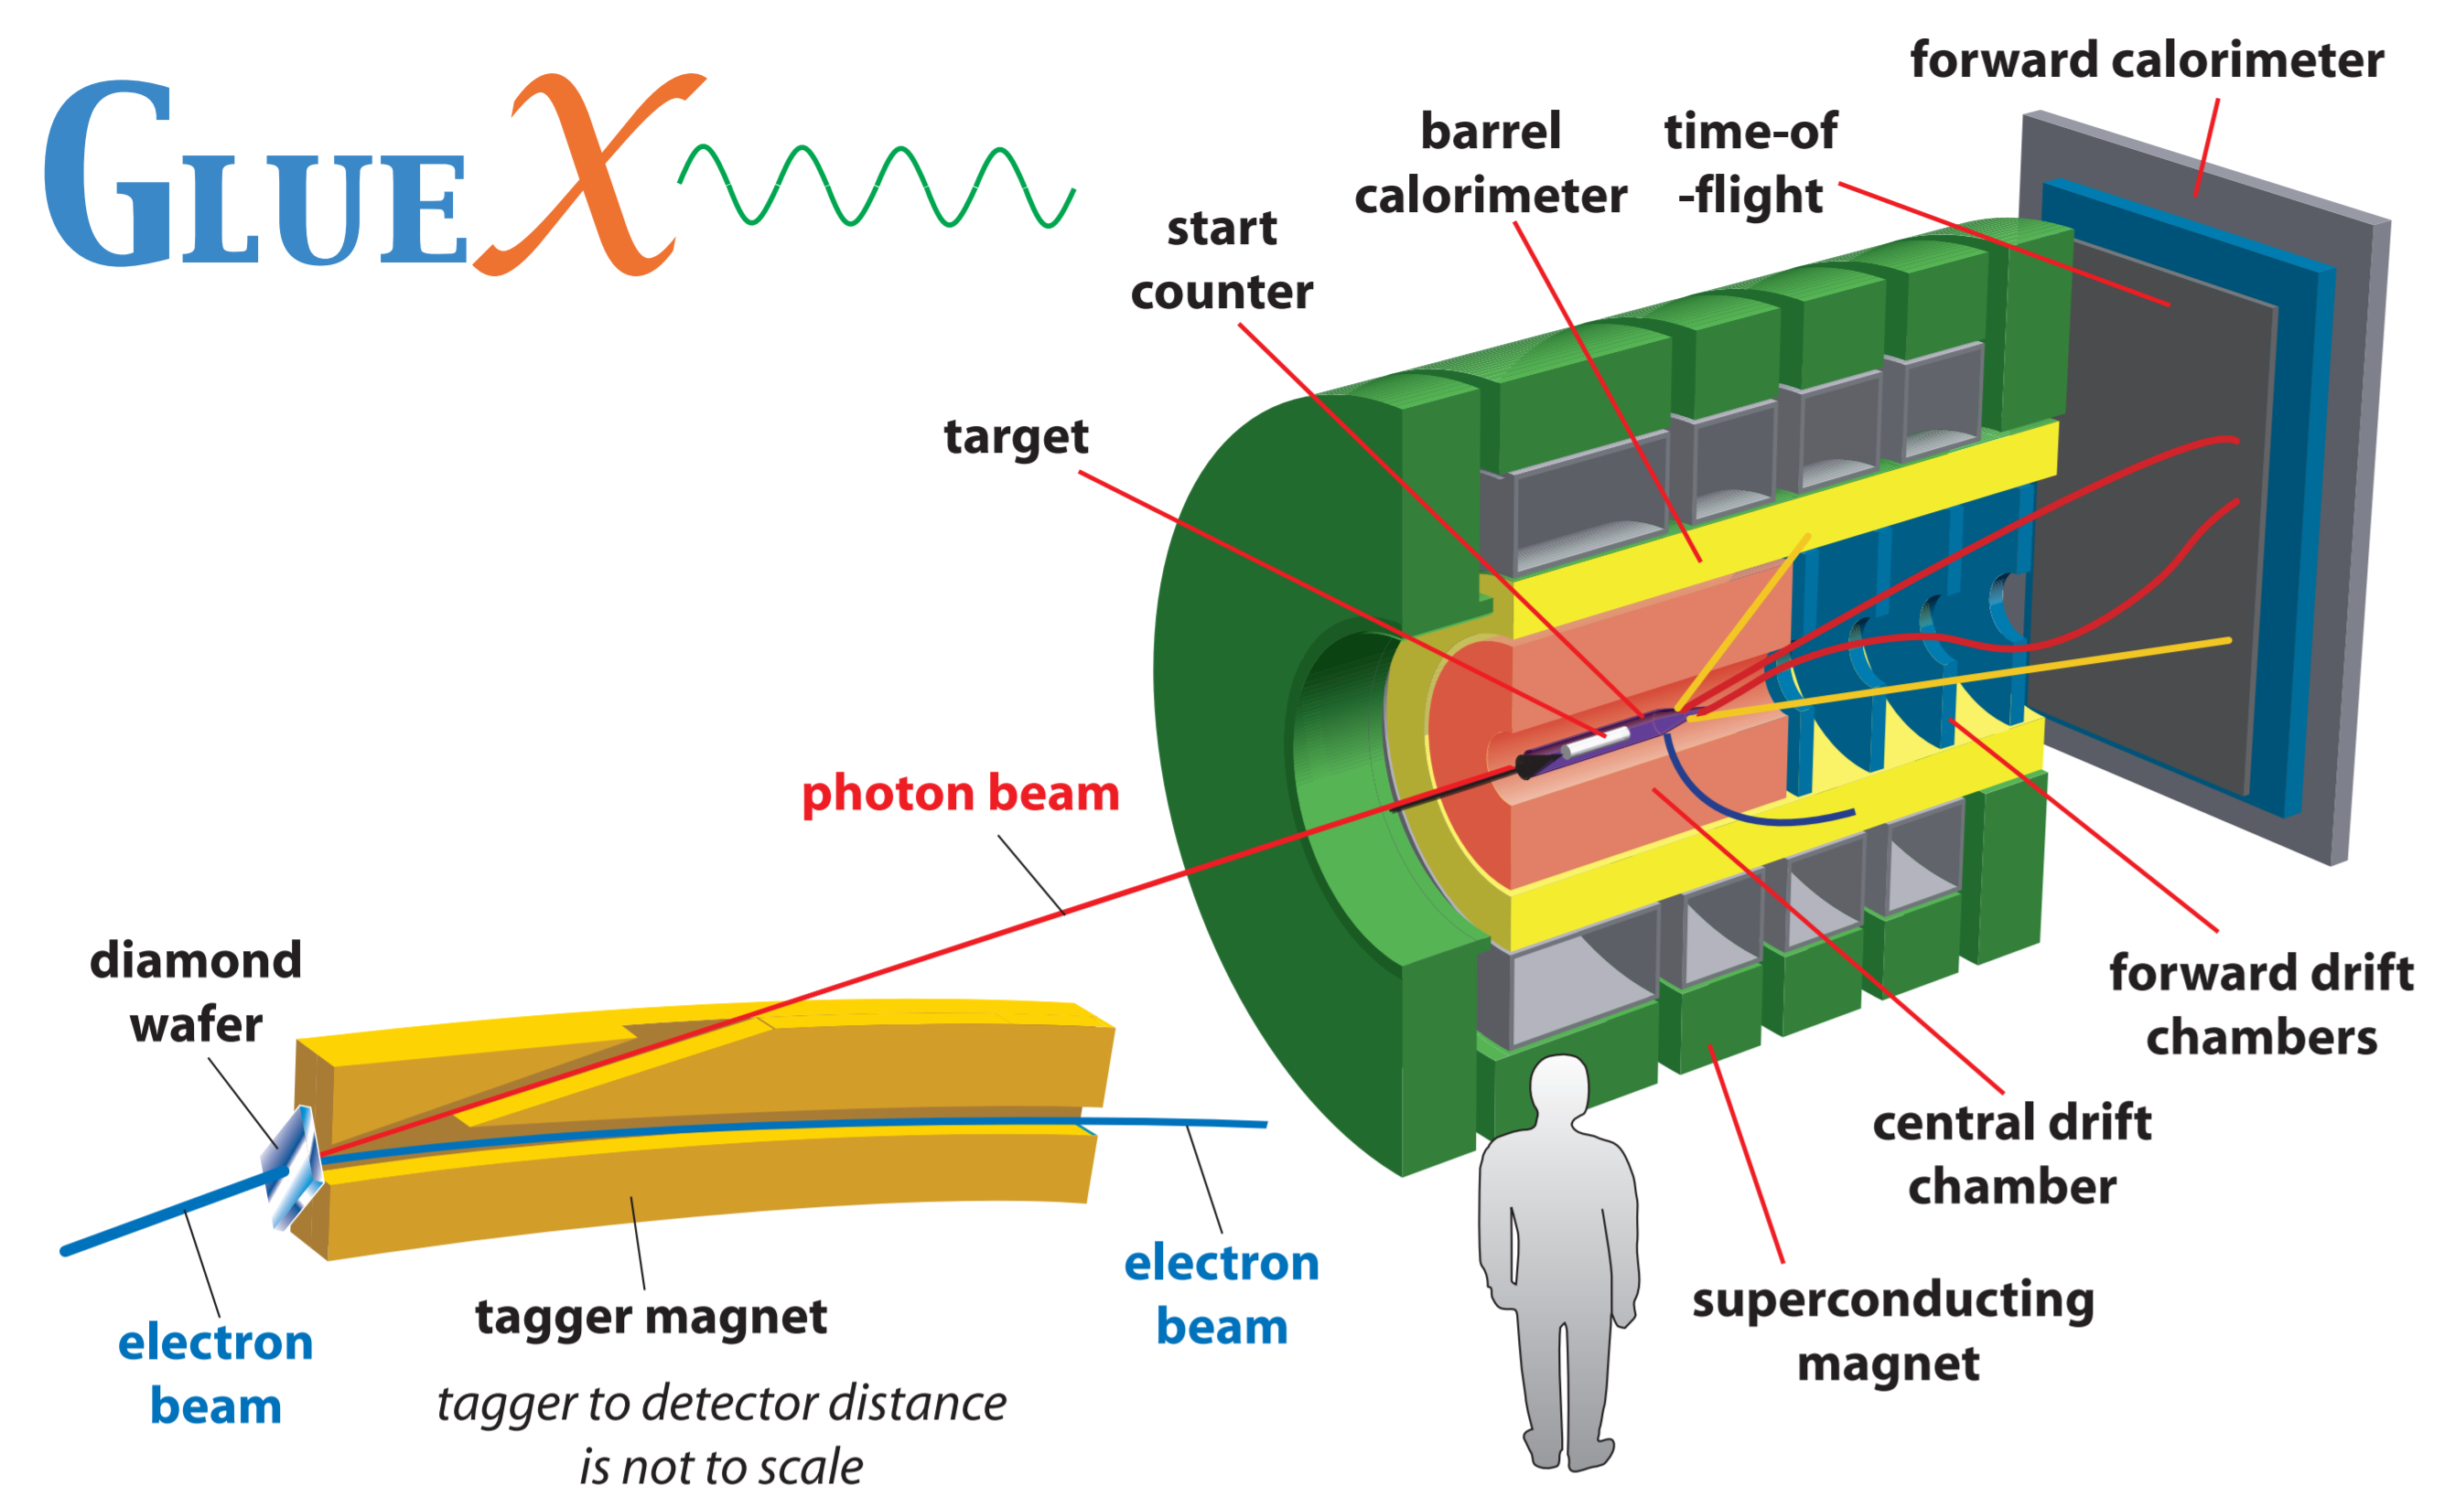

Slide 39
Experiments workflow
Theorists
GEANT simulation
EVENT RECONSTRUCTION
Analysis
Detector
Detector
Detector
Detector
Analysis
Analysis
Experimental setup
Detector
Detector
Detector
Detector
Calibrations & alignment

