Slide 1
PANGEA FORMAZIONE
COMPANY PROFILE
SME in Rome, active since 2009
Innovative SME
Research institute recognized by
Certified UNI EN ISO 9001:2015 (development of informatic tools for predictive models)
Partner of CNR
Beneficiary of
OUR MISSION
Helping other companies to use data as a support to Decision Making
DISCOVER
DATA
UNDERSTAND
IDEAS
ACTIONS
IMPROVE

Slide 2
PANGEA FORMAZIONE
Projects
Data science solutions to different business and industrial problems, supporting enterprises in data-driven decision making
Research & Development
Advanced Training
Projects
Advanced Training
Training activities on
key importance of data-driven decisions
methodologies to integrate data science in BI
R & D
Internal development of advanced algorithmic and software solutions, ready to be applied in projects and training activities

Slide 3
DATA SCIENCE PROJECTS
Our data science solutions are customized on clients’ needs.
05
04
Data Visualization:
Reporting
Best Actions
Our solutions are based on open source technologies: R, Python, Scala, Apache Spark, etc.
03
Predictive Models:
Forecasting
Optimization
Simulation
02
Algorithms and Methods:
Classification
Regression
Clustering
Deep/Machine Learning
Image Recognition
Text Mining
01
Data analysis:
Cleaning
Wrangling
Integration
Statistical report
Variable selection
Data collection:
Internal
External
Open
Social
We apply advanced techniques to business problems: bayesian networks, MCMC simulations and deep learning neural networks.

Slide 4
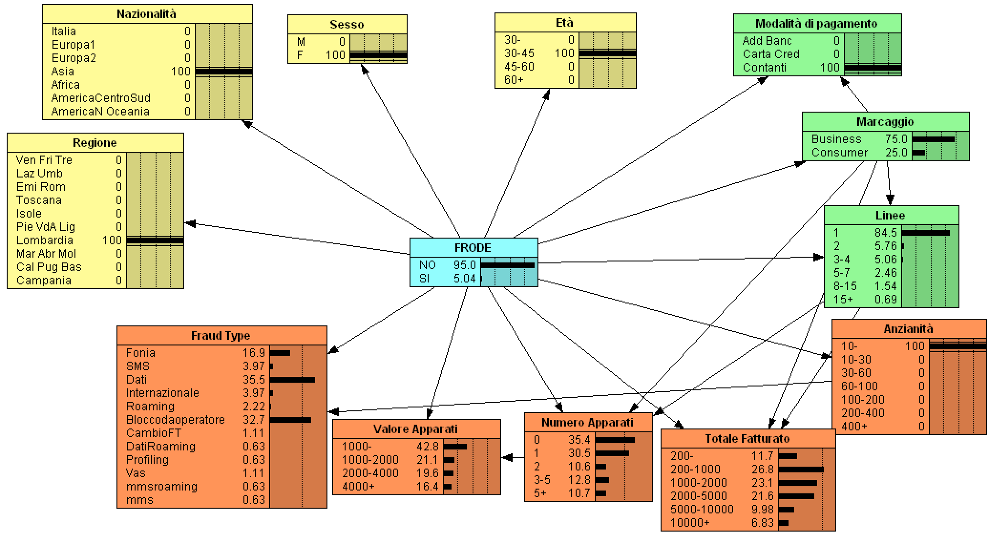
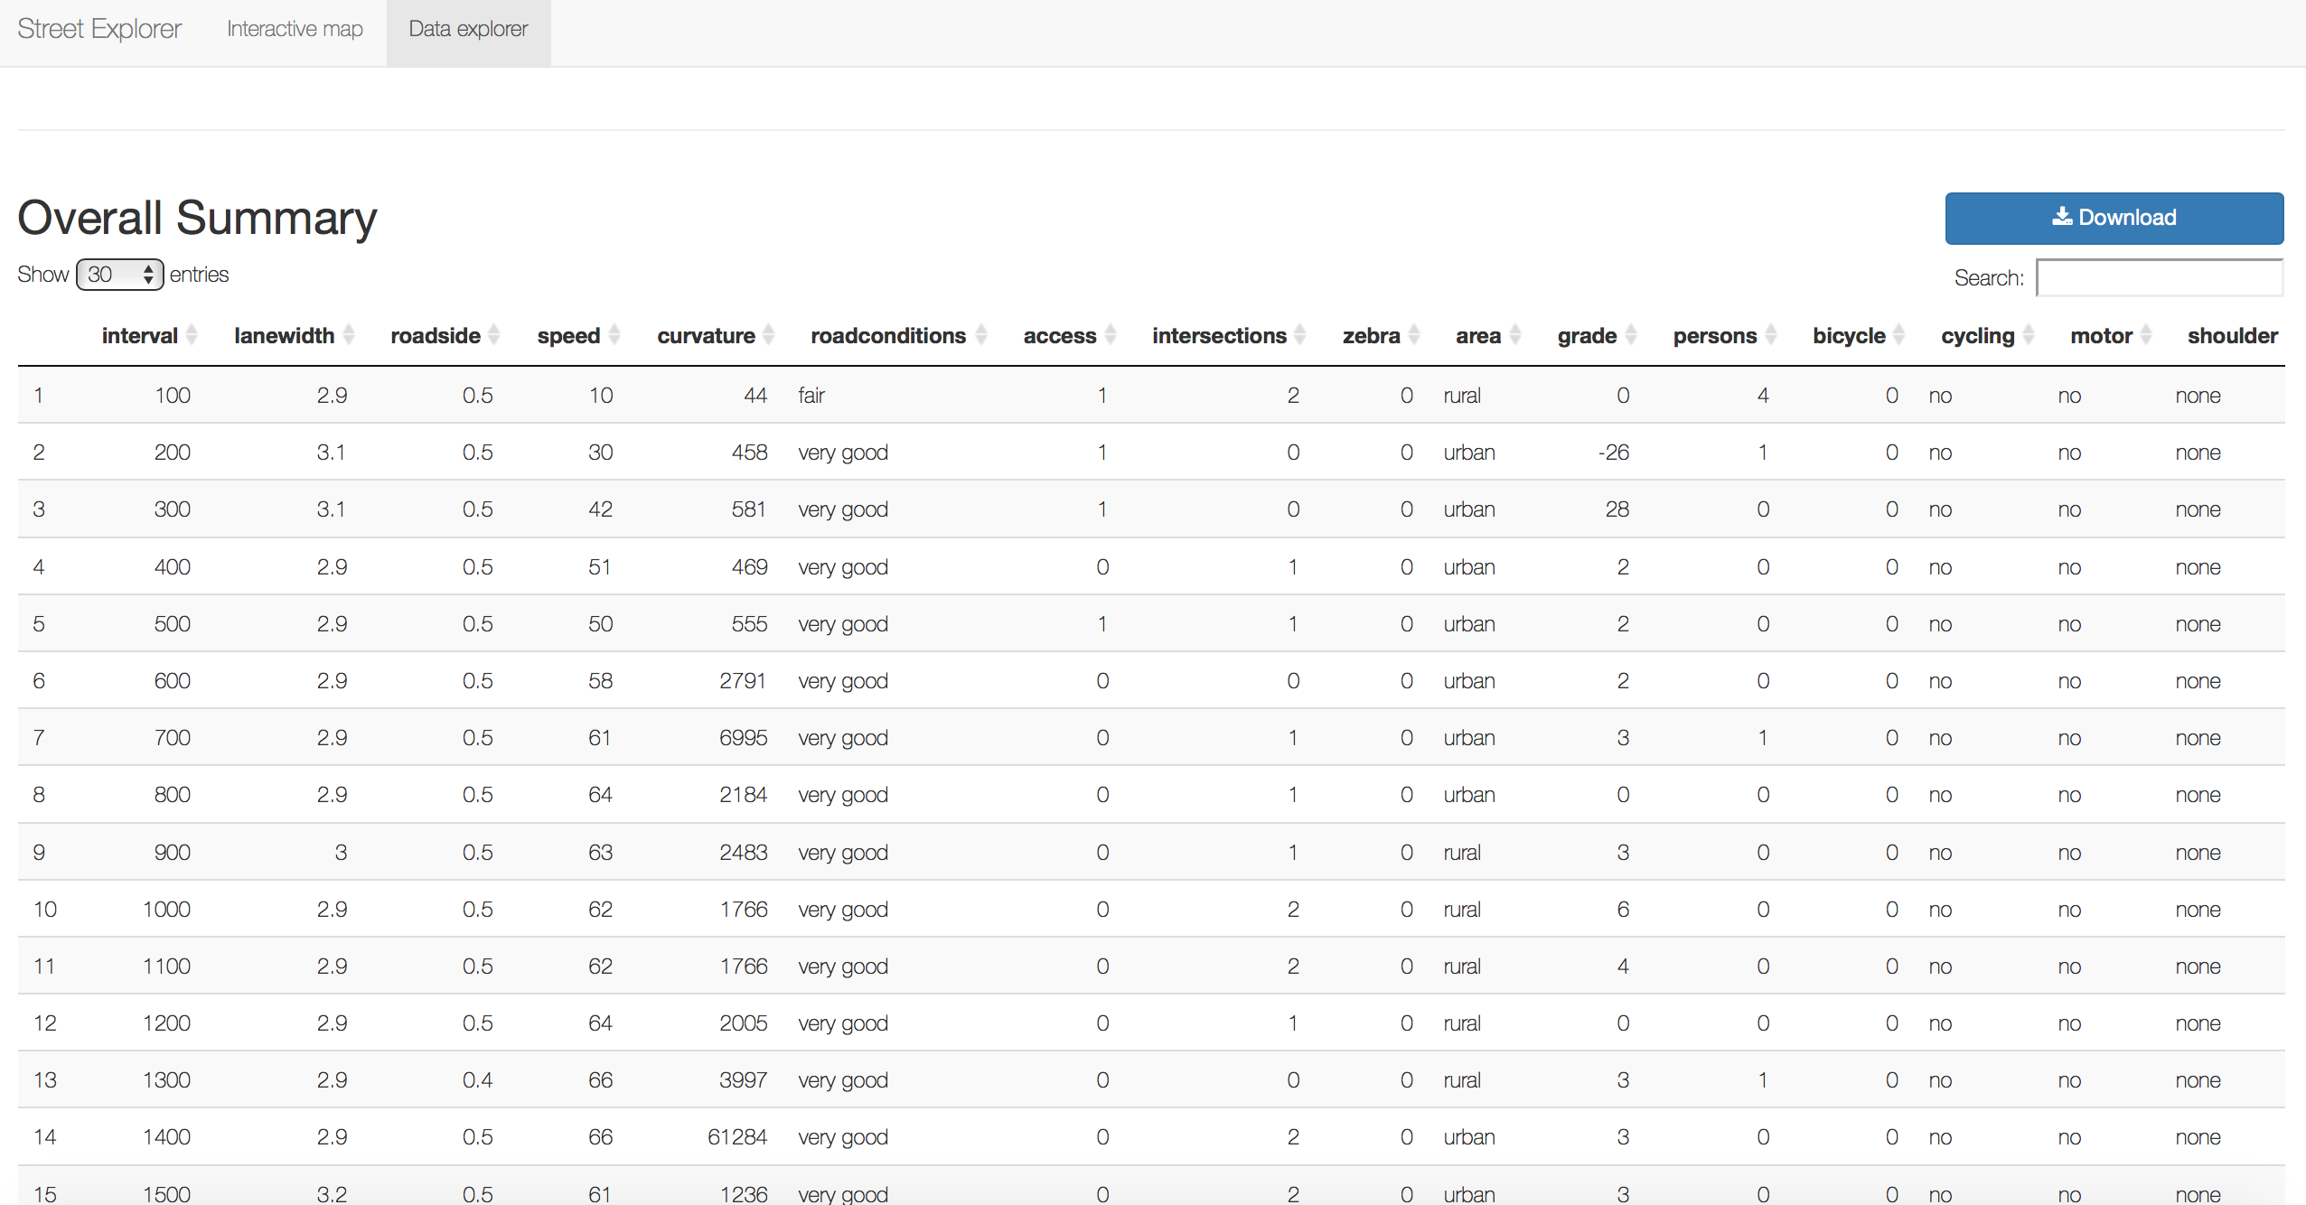
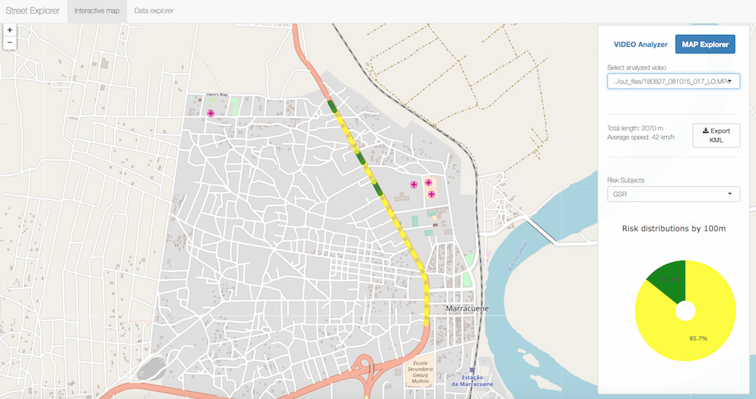
DATA SCIENCE PROJECTS
Using predictive models to support capacity planning and reliability estimate processes
Using smartphone camera + advanced signal filters + deep learning network to reconstruct ECG and spot arrhythmia
Using bayesian network for profiling in fraud management and predictive maintenance
Using automated object detection and recognition from movie input to assess risks on highways
and much more…

Slide 5
CLIENTS & credentials

Slide 6
TRAINING & RESEARCH
Data-supported decision making
Twice per year 2011-2018 (from 2019, part of MBDA leadership training from 2019)
Data science & machine learning
8 courses x 2 editions (2017-2018)
14+ courses x 12+ editions (2018-2020)

Slide 7
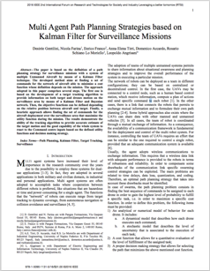
TRAINING & RESEARCH
Research papers on industry journals and peer-reviewed journals
Scientific partnership with universities and research centers
Part of EC-founded H2020-MSCA-ITN-2017 network project INSIGHTS

Slide 8
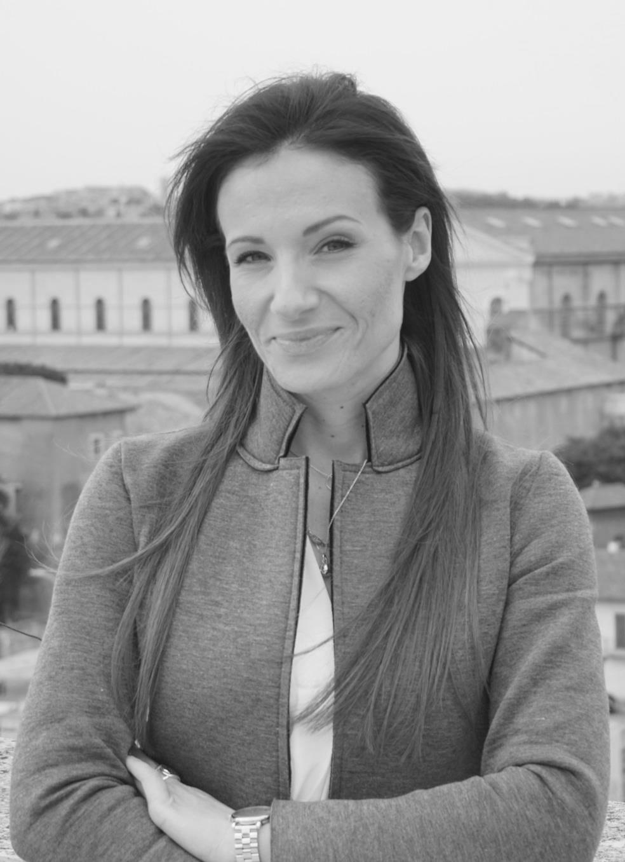
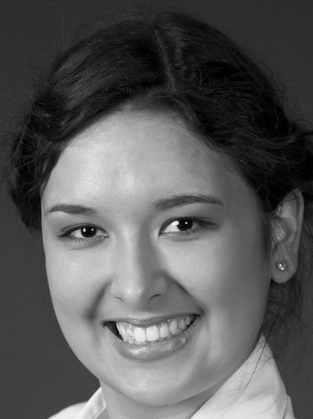
OUR TEAM
Paolo Agnoli
CO-FOUNDER & DIRECTOR
Francesco Piccolo
CO-FOUNDER & SOLE ADMINISTRATOR
Desirée Gentilini
RESPONSIBLE FOR PRE-SALES
Nicola Farina
RESPONSIBLE FOR INNOVATION
CONSULTING TEAM
Fabio S. Priuli
RESPONSIBLE FOR TRAINING + DATA SCENTIST
Maria Luisa Greco
RESPONSIBLE FOR ADMINISTRATION
70% Ph.D.
Sara Borroni
DATA SCIENTIST
Cinzia Di Porto
DATA SCIENTIST
Filippo Orio
DATA SCIENTIST
Erika Cerasti
DATA SCIENTIST
Andrea Romualdi
DATA SCIENTIST
Daria Morozova
INSIGHTS ESR8 + DATA SCIENTIST
Lorenzo Riggio
DATA SCIENTIST

Slide 9
Thanks for your attention

