Slide 1



Physics at the
Large Hadron Collider
Albert De Roeck
CERN, Geneva, Switzerland
Antwerp University Belgium
UC-Davis California USA
NTU, Singapore
31th Mai 2019

Slide 2
Lecture Plan
Overview of the 2 lectures in the next days
Lecture 1: Introduction to Experimental Techniques at the LHC & Measurements and test of the Standard Model
Lecture 2: The Higgs boson and Searches beyond the Standard Model, and a short outlook to the future at the LHC

Slide 3
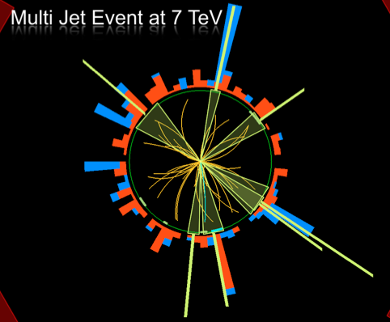
Outline Lecture I
Introduction: Experimental
Particle Physics
The Large Hadron Colider
Experiments at the LHC
Experimental Challenges
Experimental Objects
Basics of experimental pp
collisions
Standard Model Measurements
Summary
Disclaimer:
ATLAS & CMS have very
similar results
Typically one chosen
for illustration

Slide 4

What is the world made of?
What holds the world together?
Where did we come from?

Slide 5

The “Standard Model”
Over the last 100 years: combination of
Quantum Mechanics and Special Theory of relativity
along with all new particles discovered has led to the
Standard Model of Particle Physics.
The new (final?) “Periodic Table” of fundamental elements:
Fermions
Bosons
The most basic mechanism of the SM, that of granting mass to particles remained a mystery for a long time
A major step forward was made in July 2012 with the discovery of what could be the long-sought Higgs boson!!
Matter particles
Force particles
Fermions: particles with spin ½
Bosons: particles with integer spin

Slide 6
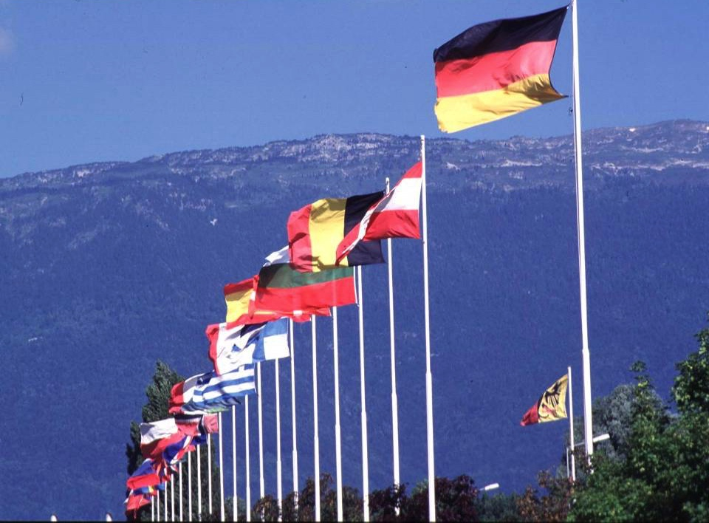

CERN: founded in 1954: 12 European States
“Science for Peace”
Today: 23 Member States
~ 2500 staff
~ 1800 other paid personnel
~ 13000 scientific users
Budget (2018) ~ 1150 MCHF
Member States: Austria, Belgium, Bulgaria, Czech Republic, Denmark, Finland, France, Germany, Greece, Hungary, Israel, Italy, Netherlands, Norway, Poland, Portugal, Romania, Slovak Republic, Spain, Sweden, Switzerland and
United Kingdom, Serbia
Associate Members in the Pre-Stage to Membership: Cyprus, Slovenia
Associate Member States: India, Lithuania, Pakistan, Turkey, Ukraine
Applications for Membership or Associate Membership:
Brazil, Croatia
Observers to Council: Japan, Russia, United States of America;
European Union, JINR and UNESCO
5
Notes:
5
----- Meeting Notes (09/01/2013 14:16) -----
nnn

Slide 7
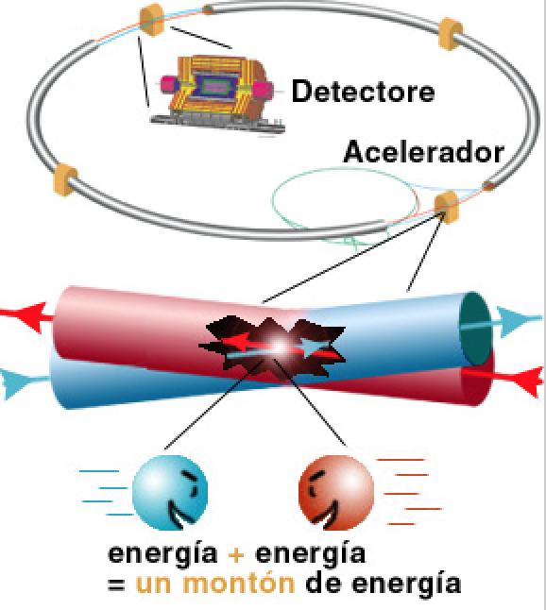
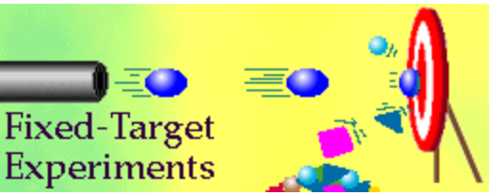
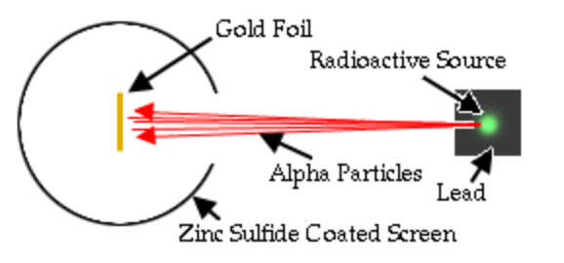
High Energy Physics Experiments
First High Energy Physics
Experiments:
Beam on fixed target!
High Energy Physics
Experiments since mid 70’s:
Colliding beams!
Rutherford experiment (1909)
Centre of mass energy squared s=2E₁m₂
Centre of mass energy squared s=4E₁E₂
…plus secondary beams such as neutrinos…

Slide 8

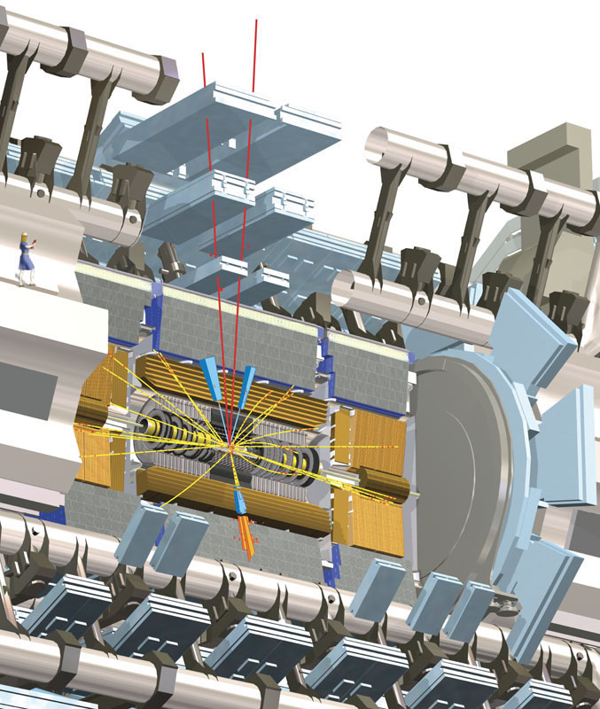
LHC: The Higgs Particle
Technique: Produce and detect Higgs Particles at Particle Colliders
E=mc²
proton
proton
Experimental view…

Slide 9
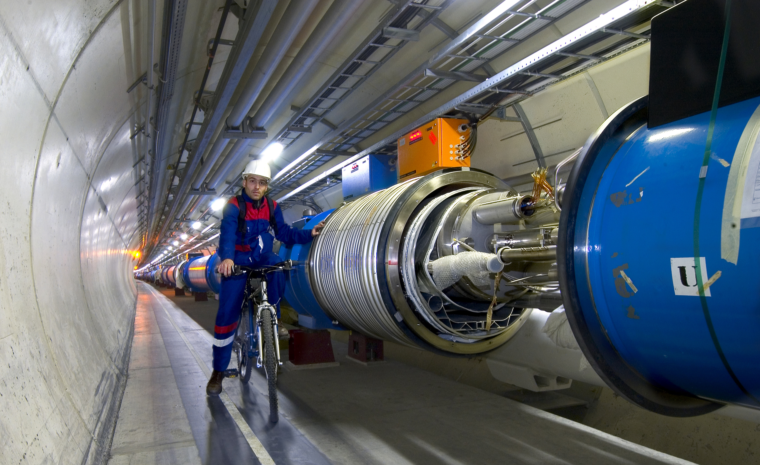
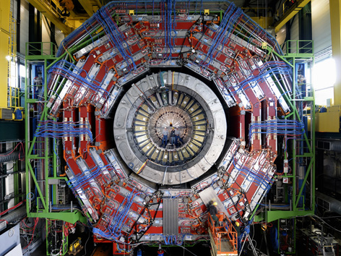

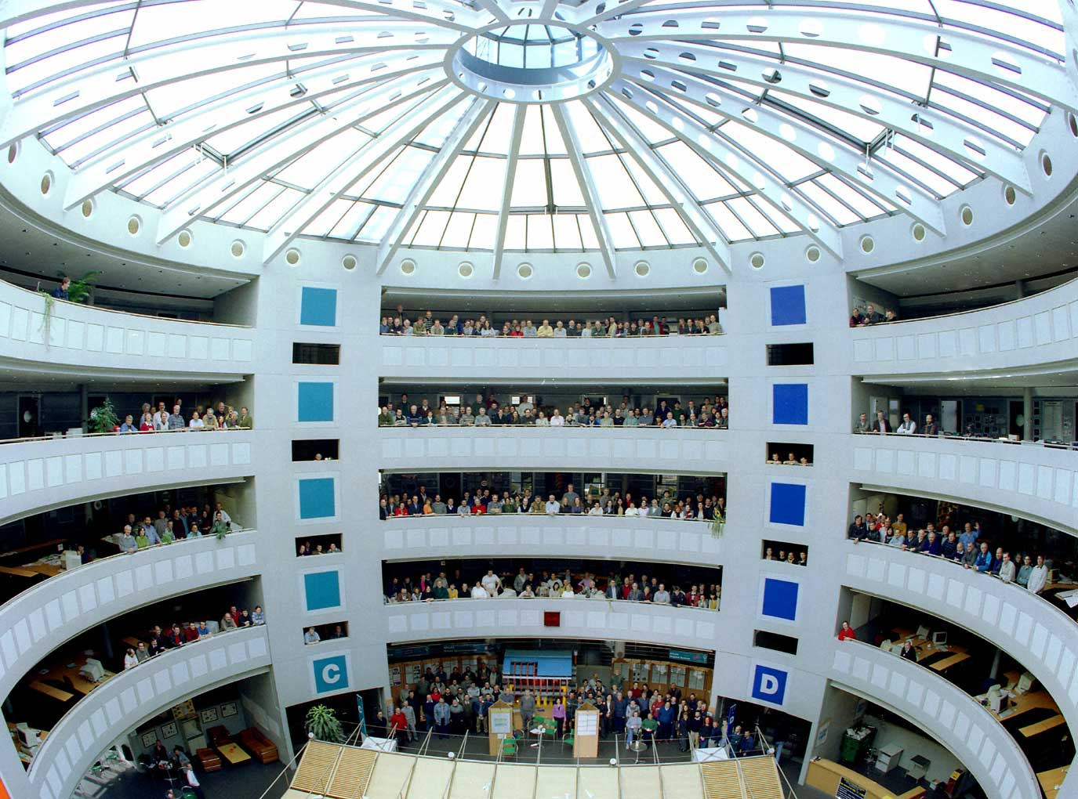
This Search Requires…….
1. Accelerators : powerful machines that accelerate particles to extremely high energies and bring them into collision with other particles
2. Detectors : gigantic instruments that record the resulting particles as they “stream” out from the point of collision.
3. Computing : to collect, store, distribute and analyse the vast amount of data produced by these detectors
4. Collaborative Science on Worldwide scale : thousands of scientists, engineers, technicians and support staff to design, build and operate these complex “machines”.

Slide 10
The Large Hadron Collider…

Slide 11
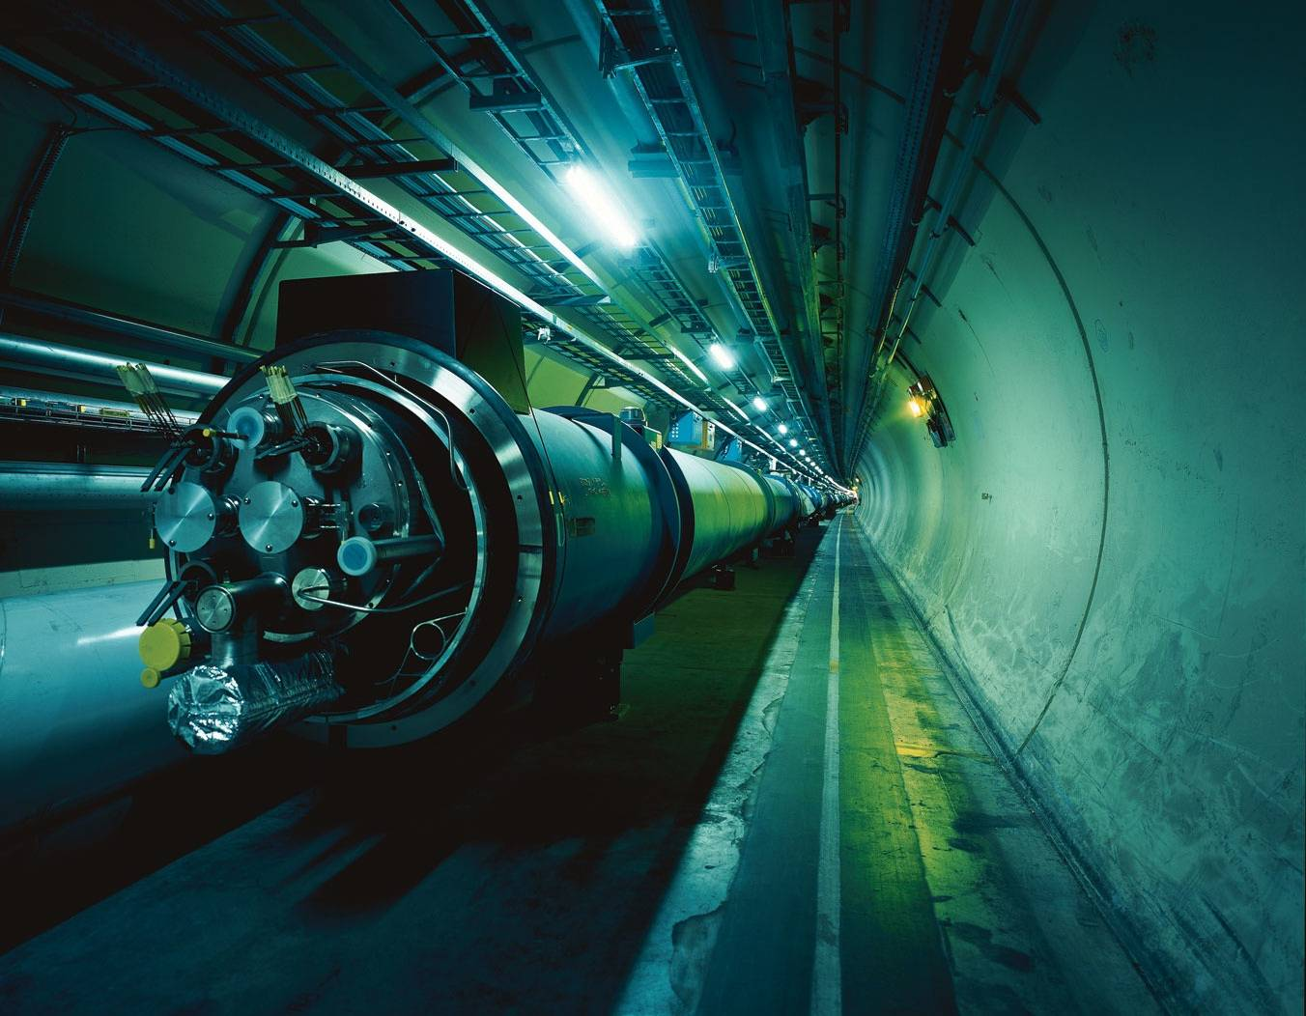

The Large Hadron Collider = a proton proton collider
Also a heavy ion collider
7 TeV + 7 TeV
6.5 TeV + 6.5 TeV
(4/3.5 TeV + 4/3.5 TeV)
1 TeV = 1 Tera electron volt
= 10¹² electron volt
Primary physics targets
• Origin of mass
• Nature of Dark Matter
• Understanding space time
• Matter versus antimatter
• Primordial plasma
The LHC is a Discovery Machine
Will LHC determine the future course of High Energy Physics?
Notes:
.999999991 % speed of light
At near light-speed, a proton in a beam will make 11 245 turns per second. A beam might circulate for 10 hours, traveling more than 10 billion kilometers – far enough to get to the planet Neptune and back again.

Slide 12
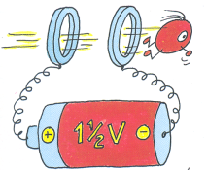
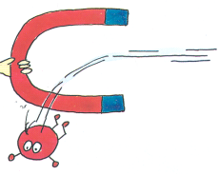
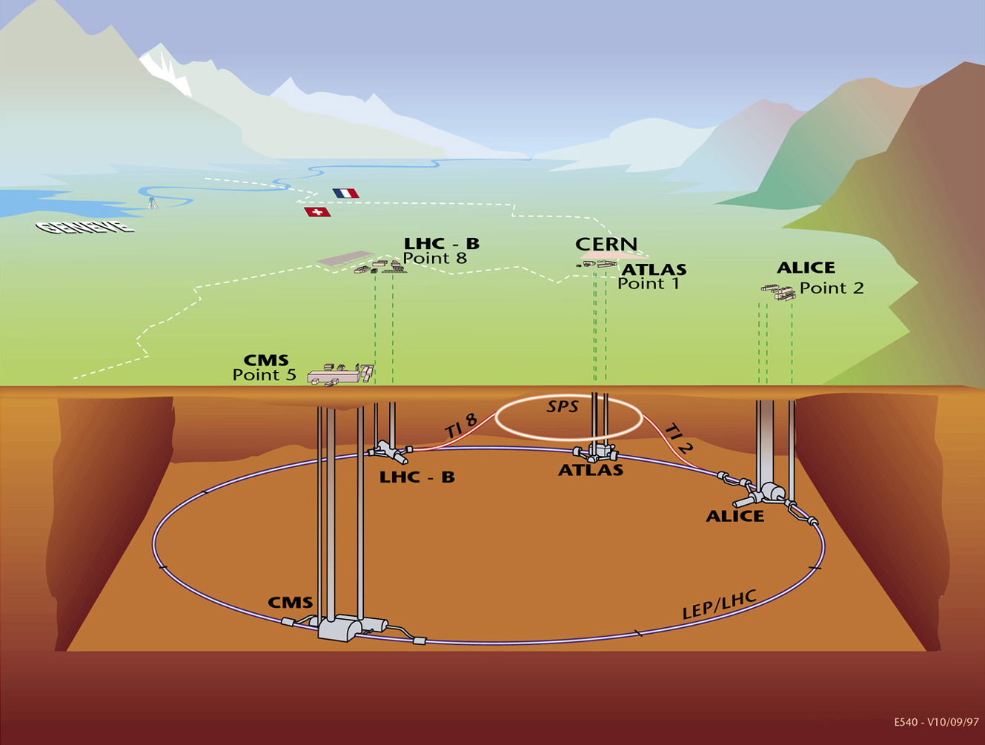
The LHC Machine and Experiments
LHC is 100m underground
LHC is 27 km long
Magnet Temperature is 1.9 Kelvin = -271 Celsius
LHC has ~ 9000 magnets
LHC: 40 million proton-proton collisions per second
LHC: Luminosity 10-100 fb⁻¹/year (after start-up phase)
moedal
LHCf
totem
•High Energy ⇒ factor 7 increase w.r.t. past accelerators
•High Luminosity (# events/cross section/time) ⇒ factor 100 increase

Slide 13
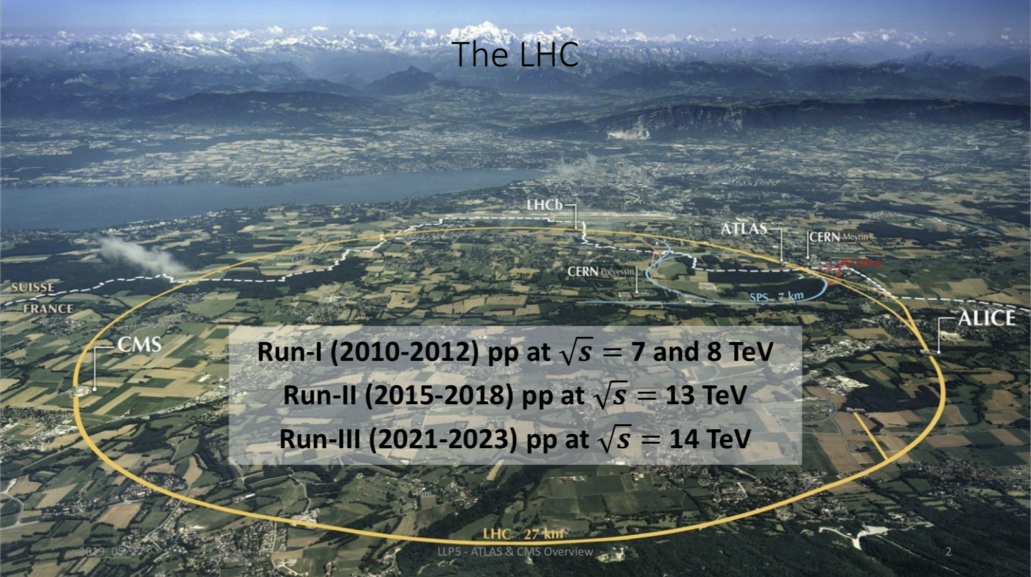
LHC Running

Slide 14
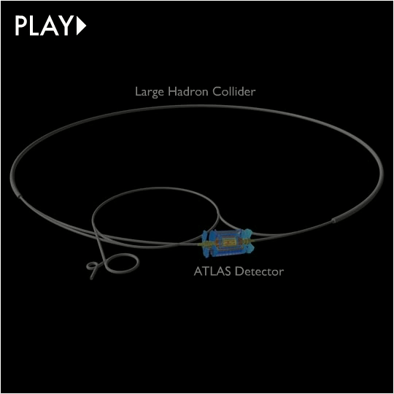

Slide 15
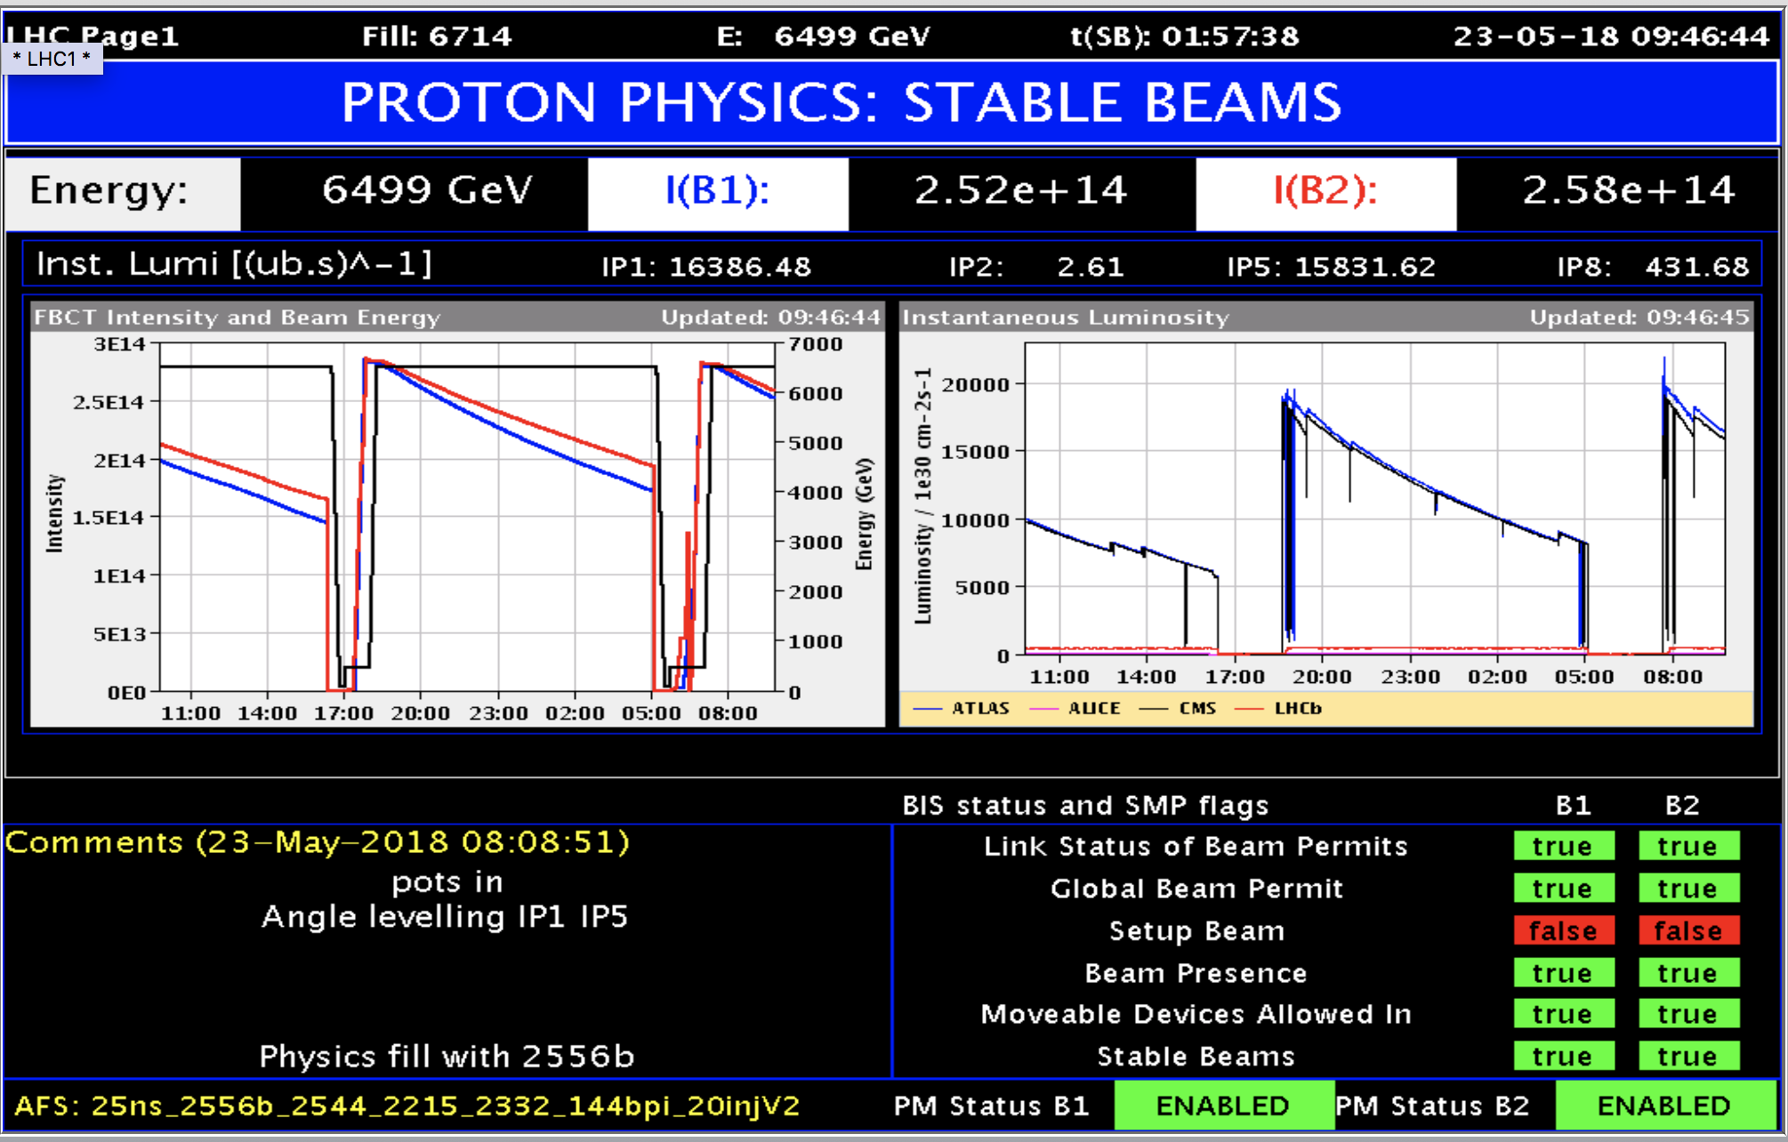
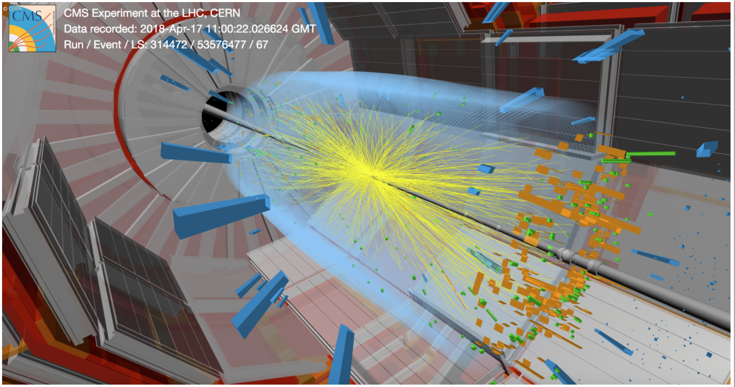
Example: LHC Operation 2018:

Slide 16
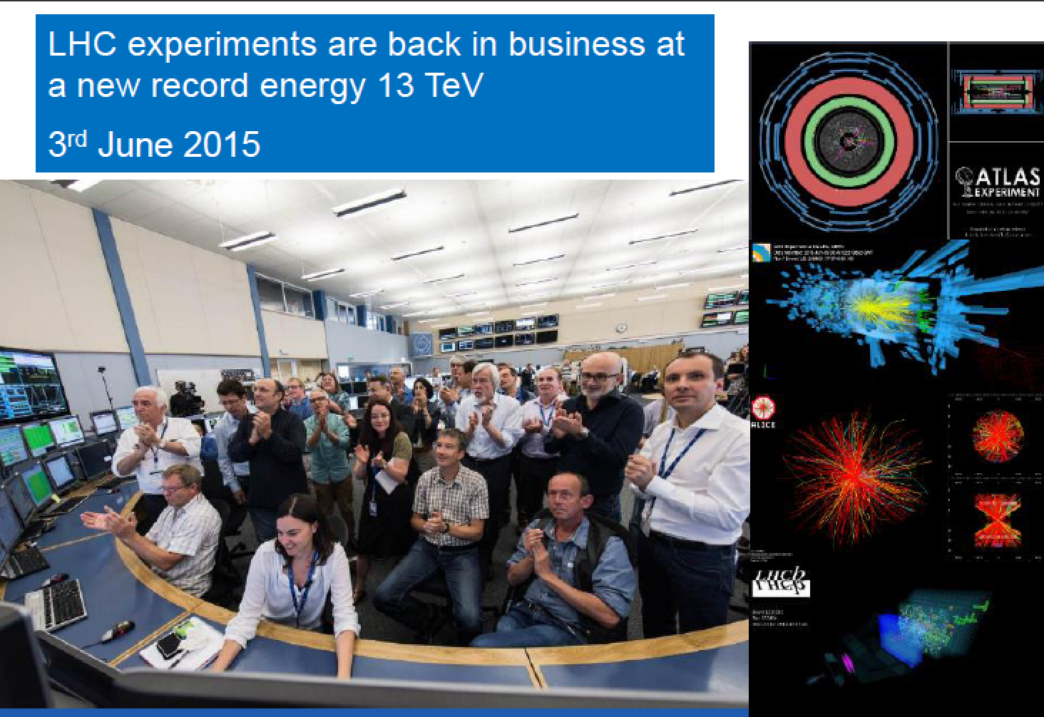
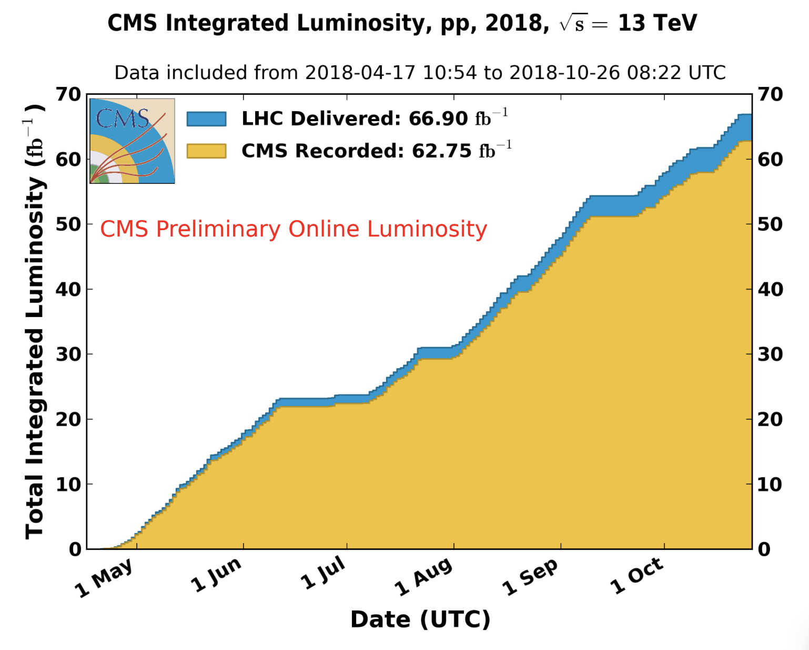
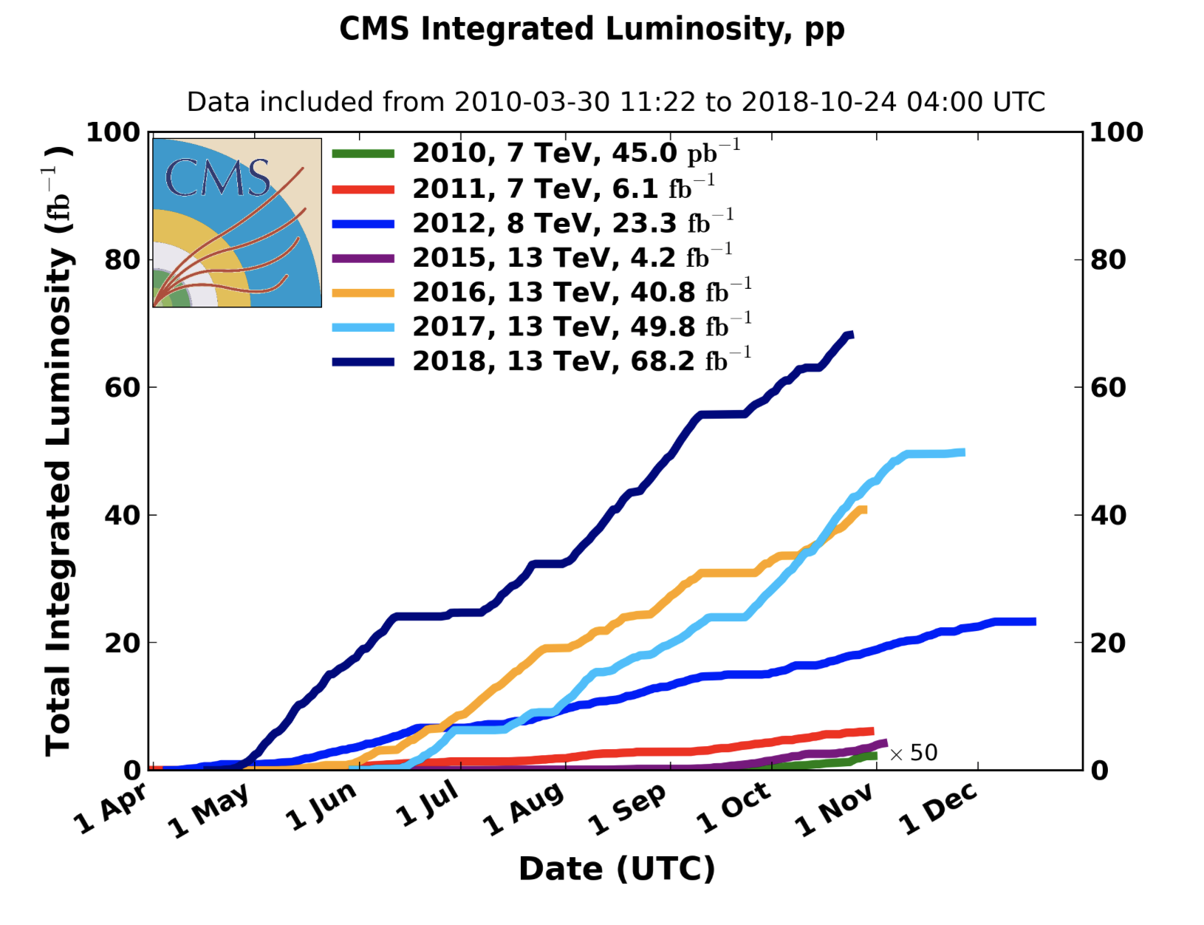
Run-2 starts
proton-proton Run-2 finished 24/10/18 6:00am
2018
•2010-2012: Run-1 at 7/8 TeV CM energy
•Collected ~ 27 fb⁻¹
•2015-2018: Run-2 at 13 TeV CM Energy
•Collected ~ 150 fb⁻¹

Slide 17
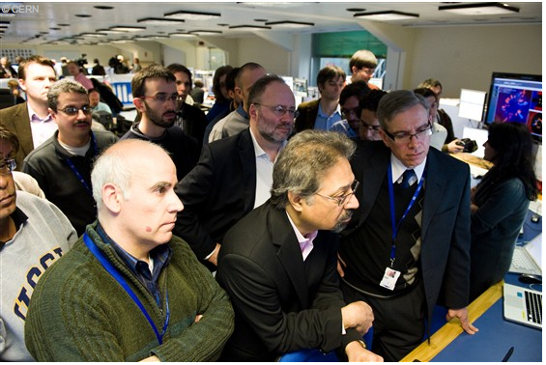
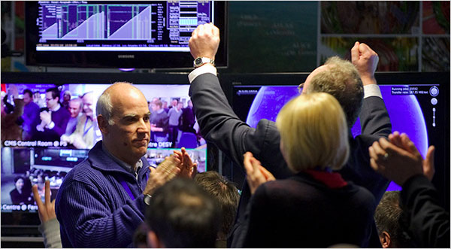
LHC Highlights
LHC switched on at 7 TeV in March 2010
->The highest energy in the lab!
LHC @ 13 TeV from 2015 onwards
Most important highlight so far:
The discovery of a Higgs boson
Many results on Standard Model process measurements, top-physics, b-physics, heavy ion physics, searches, Higgs physics
Waiting for the next discovery… -> Searching beyond the Standard Model
March 30 2010 …waiting..
…since 4:00 am
12:58 7 TeV collisions!!!

Slide 18
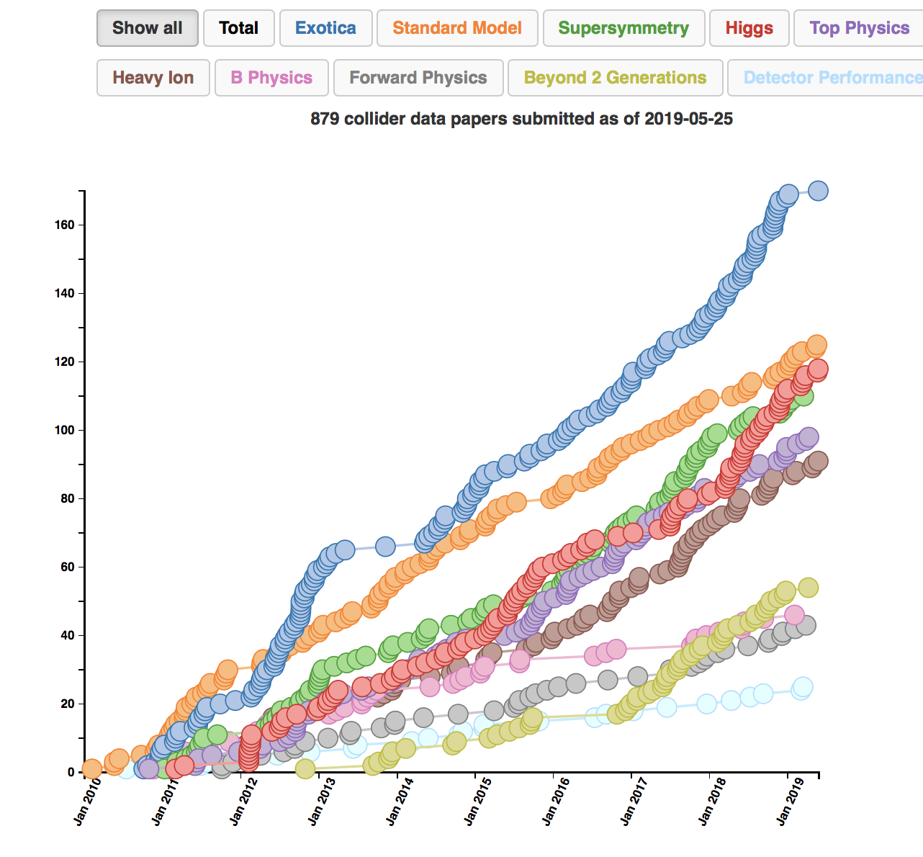
LHC Publications: Example CMS
~ 880 publications on
pp (and pPb/PbPb)
physics since 1/2010
About 100 papers on
Higgs studies!!
Paper 16 was the
discovery paper!
http://cms-results.web.cern.ch/cms-results/public-results/publications-vs-time/
>9250 citations

Slide 19
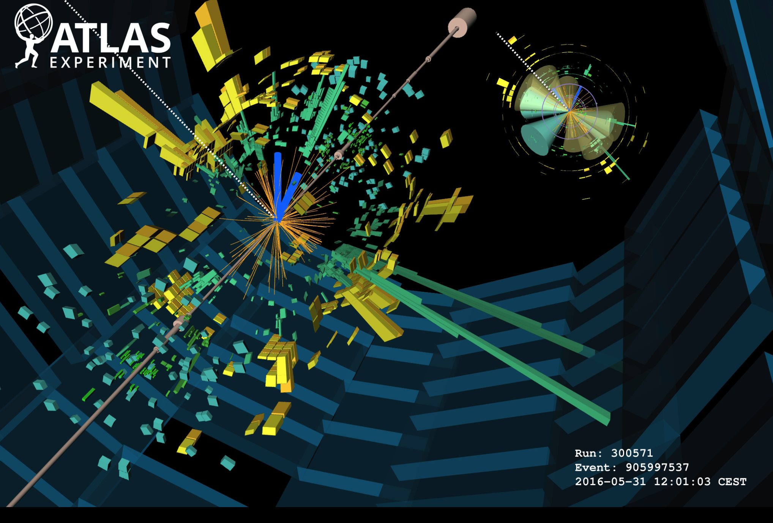
Collision in the ATLAS Detector

Slide 20








Experiments at the LHC

Slide 21
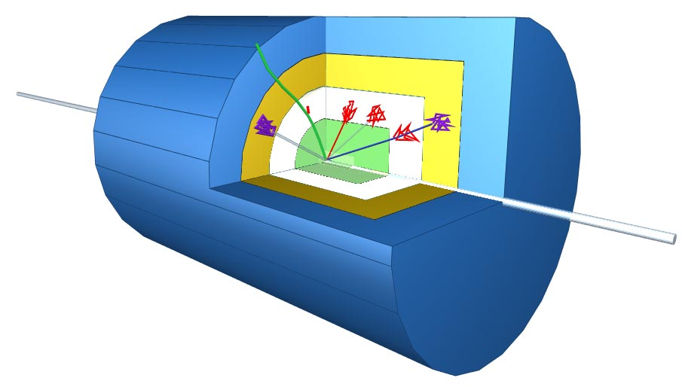
Schematic of a LHC Detector
Physics requirements drive the design!
Analogy with a cylindrical onion:
Technologically advanced detectors comprising many layers, each designed to perform a specific task.
Together these layers allow us to identify and precisely measure the energies and directions of all the particles produced in collisions.
Such an experiment
has ~ 100 Million
read-out channels!!

Slide 22
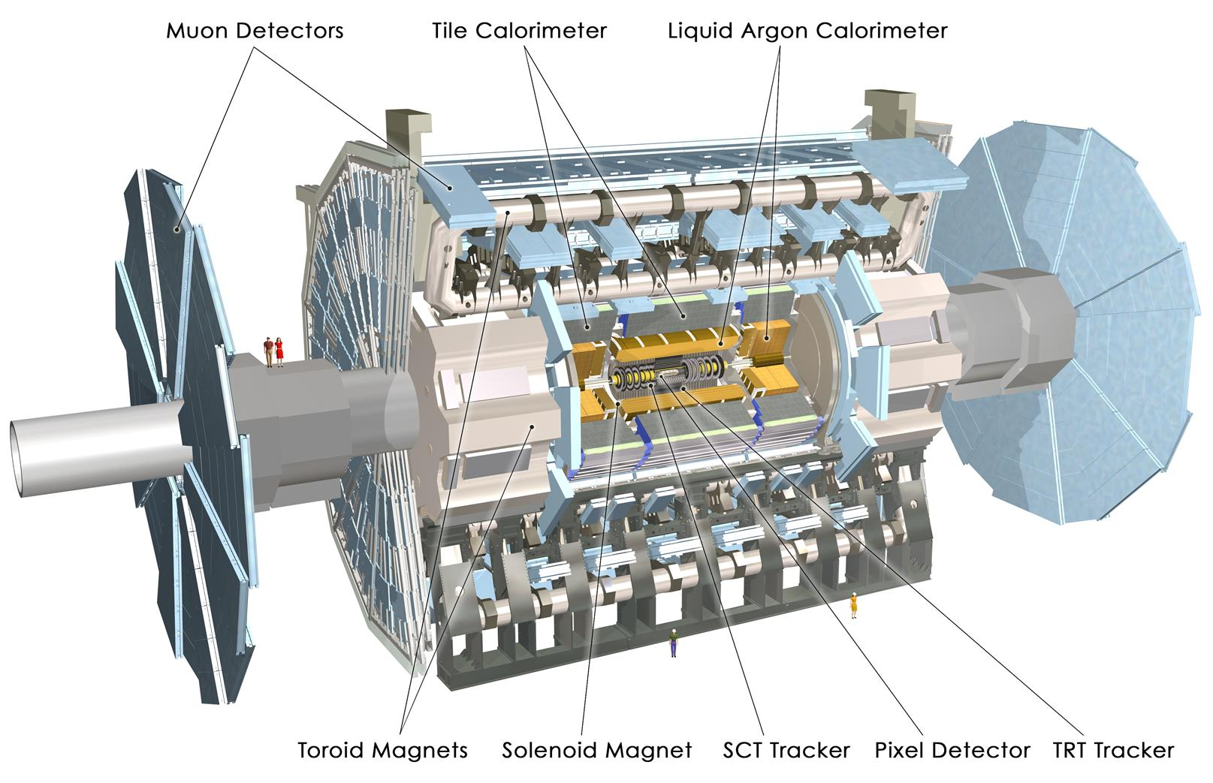
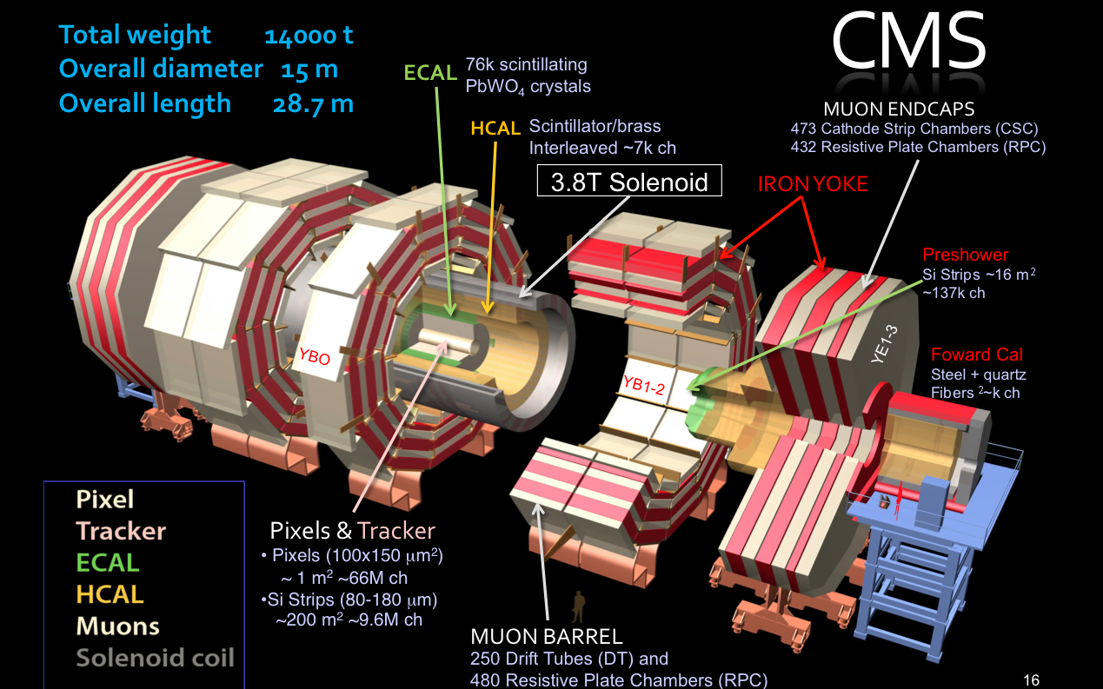
The Higgs Hunters @ the LHC
The ATLAS experiment
The CMS experiment
These experiments use different
technologies for their detector
components

Slide 23
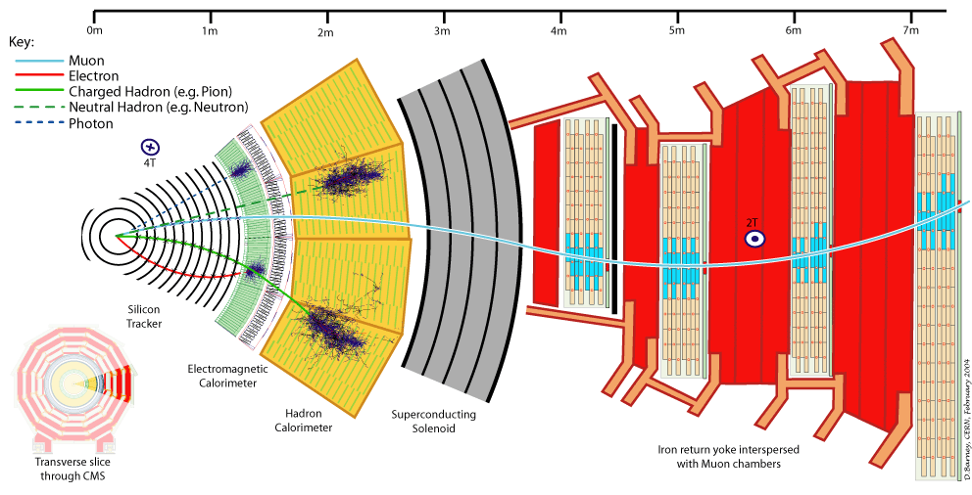
Particles in Detectors
Electromagnetic Calorimeter
Muon Spectrometer
Hadron Calorimeter
Inner Tracker
Magnet
Return flux
22
Notes:
22

Slide 24
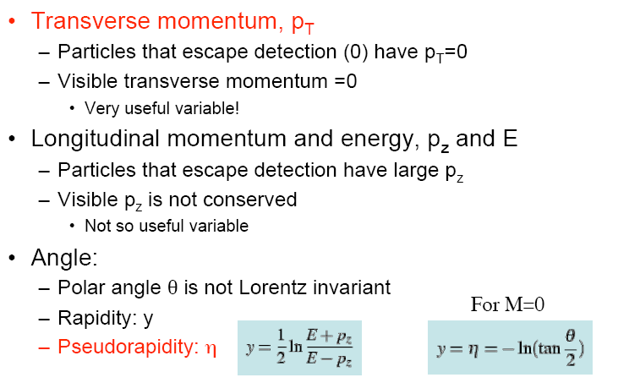
Kinematic Variables for pp Scattering
and E_{T}=E sinθ
p
p_{T}
θ
• Missing E_{T} and P_{T:} : Vectorial sum of all transverse momenta

Slide 25


Slide 26
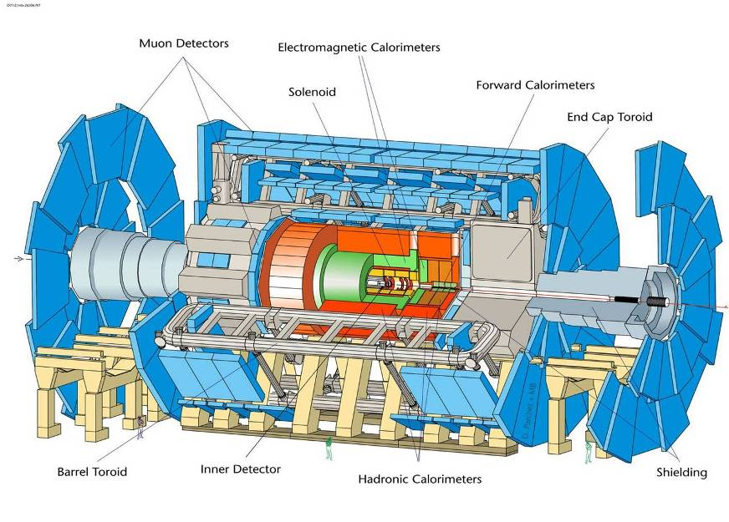
Length = 55 m; Width = 32 m; Height = 35 m; but spatial precision ~ 100 μm

Slide 27
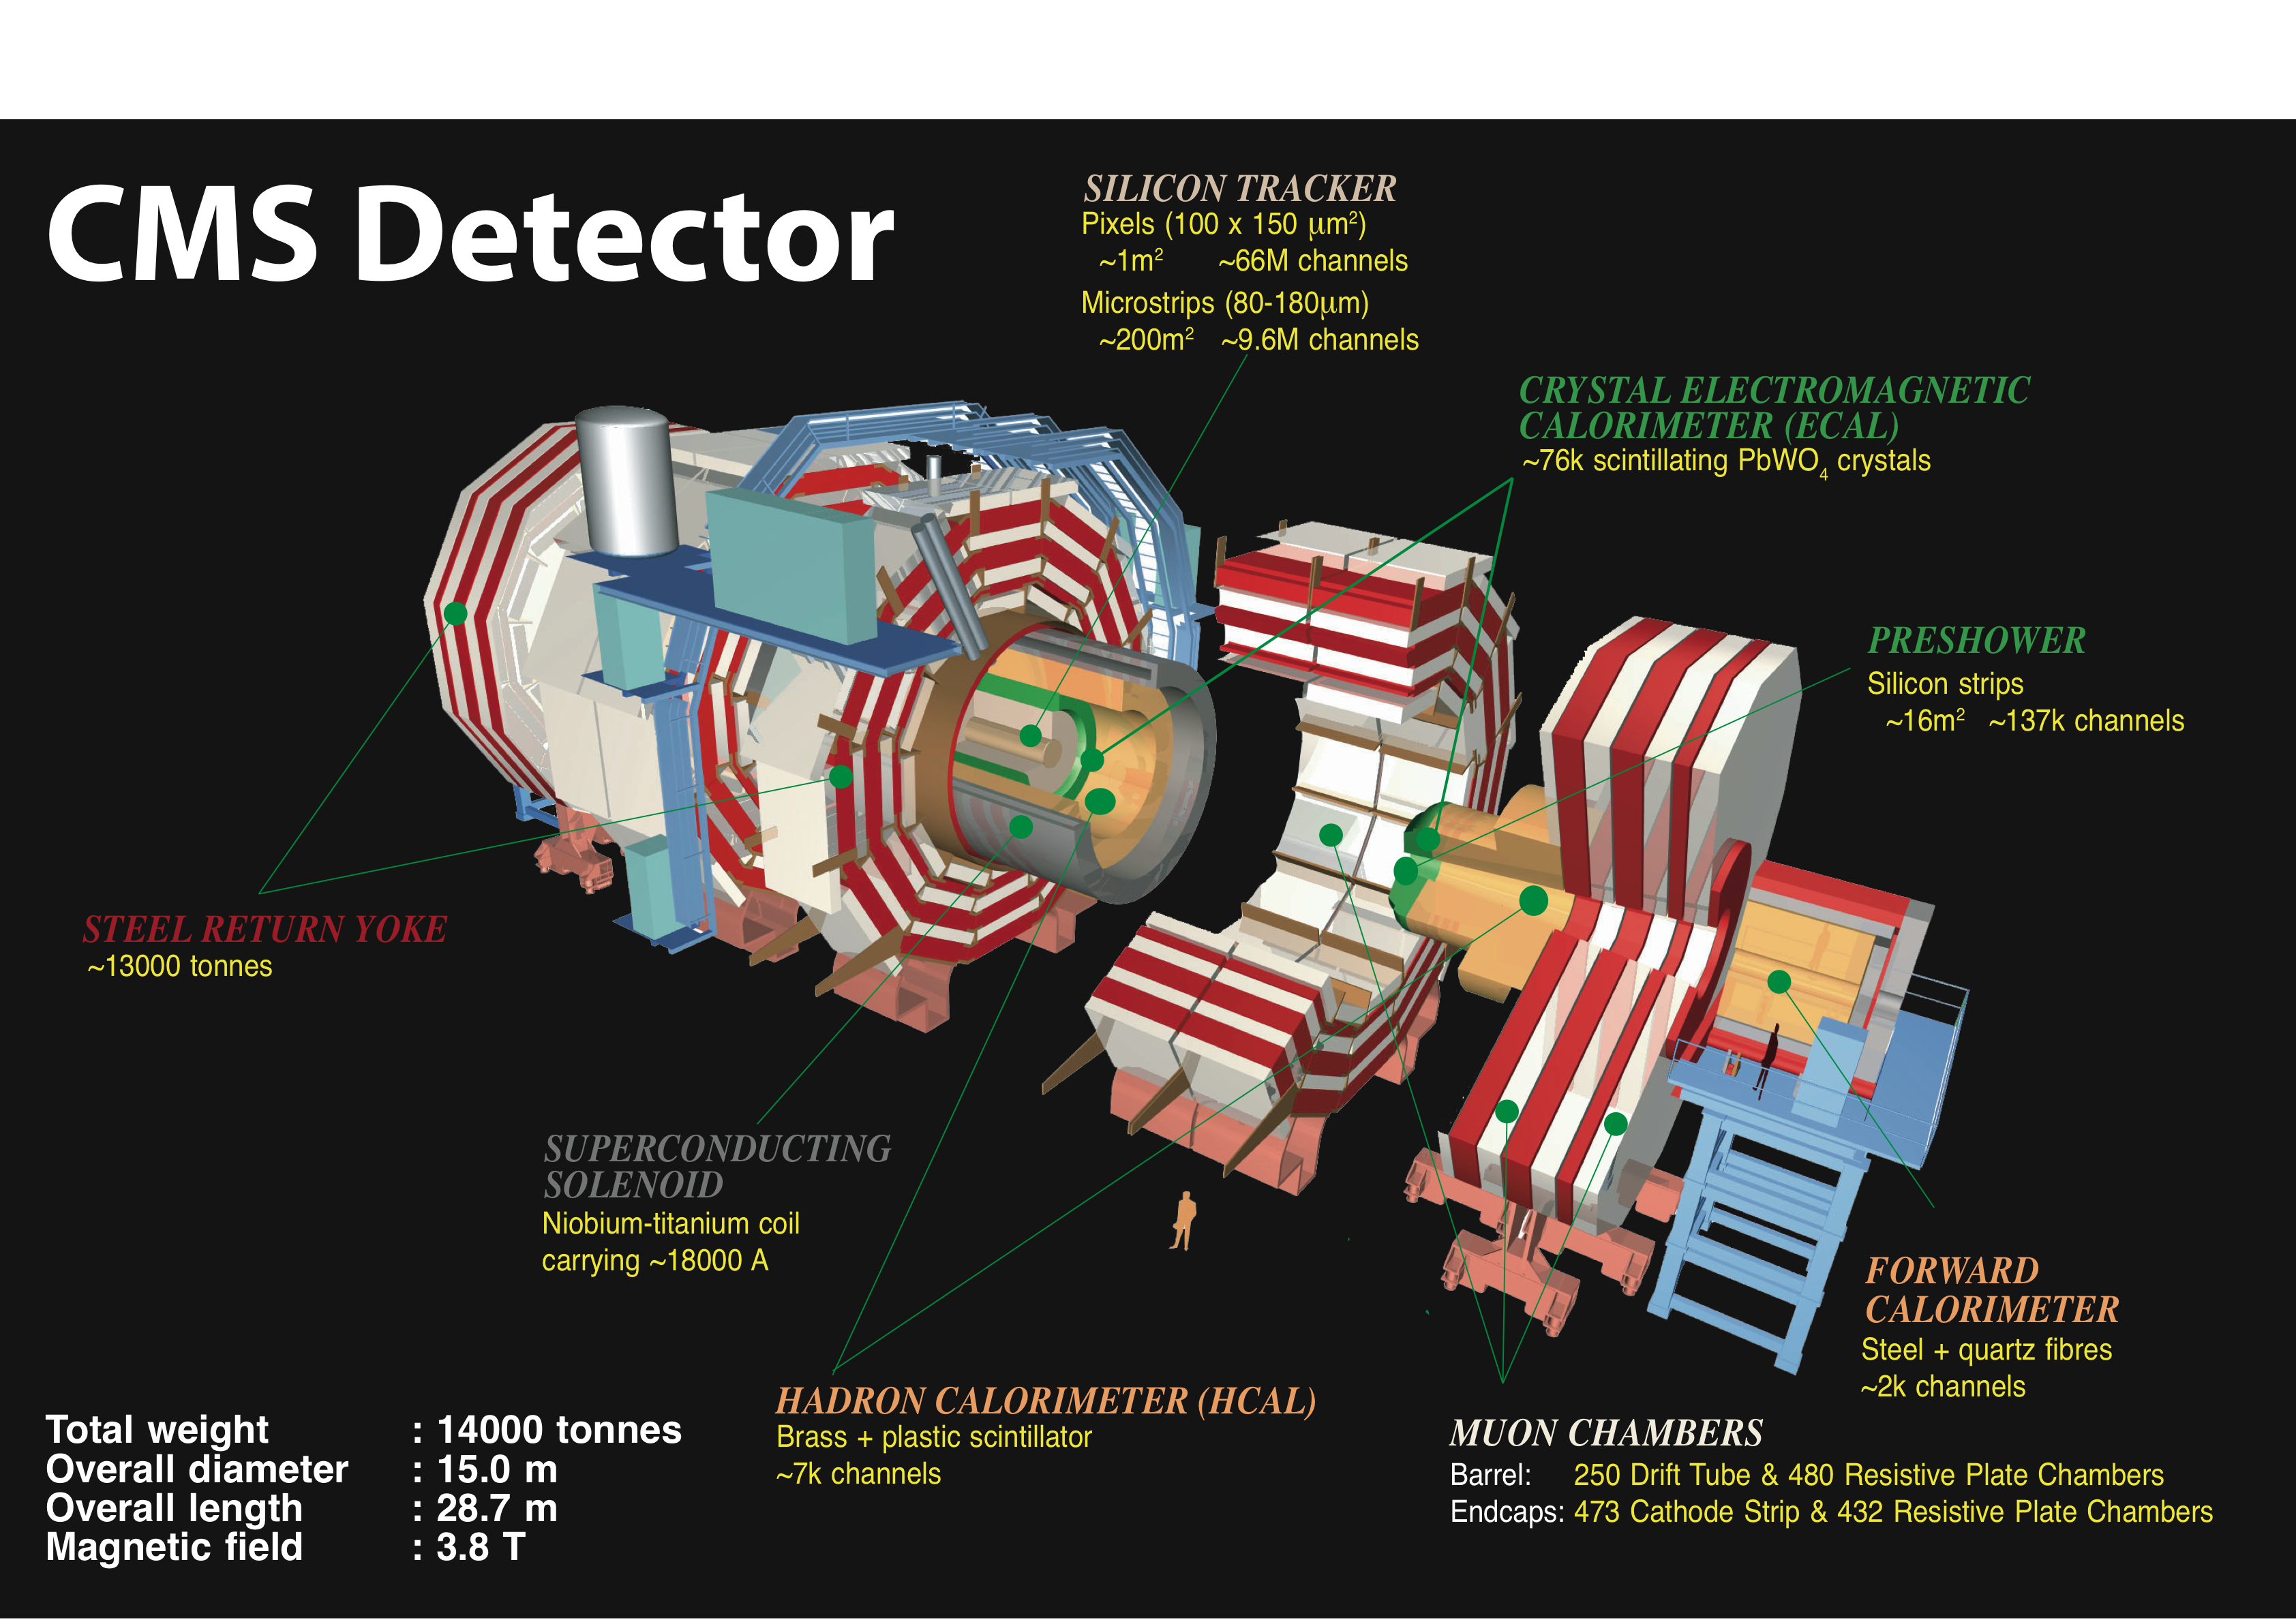
Compact Muon Solenoid
Total weight:
14000 tons
Overall diameter:
15 m
Overall length:
28.7m

Slide 28
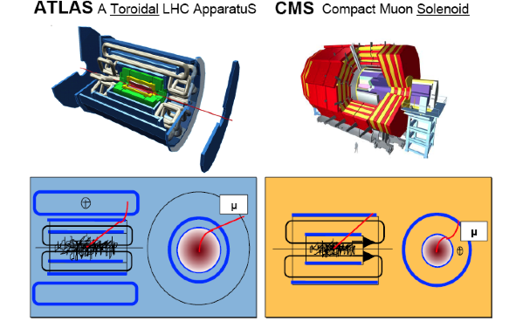
General Purpose Detectors at LHC
In total about
~100 000 000 electronic channels
Each channel checked
40 000 000 times per second (collision rate is 40 MHz)
Amount of data of just one collisions
~1 000 000 Bytes
Trigger (online event selection)
Reduce 40 MHz collision rate to ~1 kHz data recording rate
Readout to disk
O(1000) collisions/sec ⇒ petaBytes of data/year

Slide 29
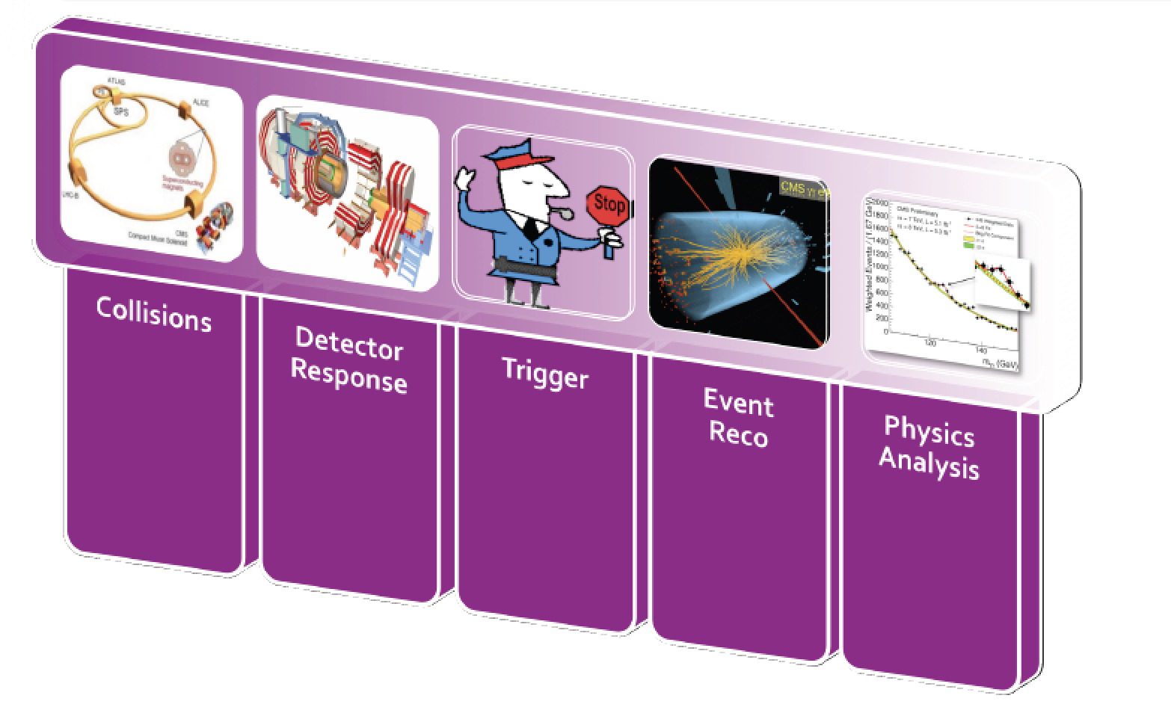
From Collisions to Papers…

Slide 30
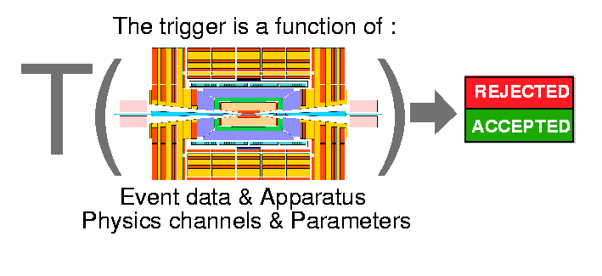
Event Filtering: the Trigger System
Bunch crossing rate is 40 MHz Event size ~1 Mbyte
2007 technology (and budget) allows only to write a ~1 kHz
of events to tape
need a factor ~10⁵ online filtering!!
lost forever!!
written to disk for
offline analysis
The event trigger is one of the biggest challenges at the LHC
⇒ Based on hard scattering signatures: jets, leptons, photons,
missing E_{T},…

Slide 31
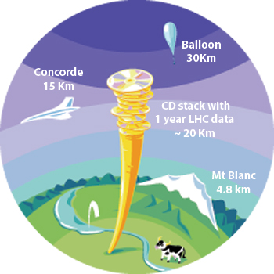
The LHC Data Challenges
Experiments were anticipated to produce about 15 Million Gigabytes of data each year (~20 million CDs!)
The total volume in eg ATLAS is 5 billion detector events and several billion Monte Carlo events amounting to 100 Million Gigabytes of data in 3 years
LHC data analysis requires a computing power equivalent to ~100,000 of today's fastest PC processors
=> Requires many cooperating computer centres, as CERN can only provide ~20% of the capacity
GRID Computing
Notes:
30

Slide 32
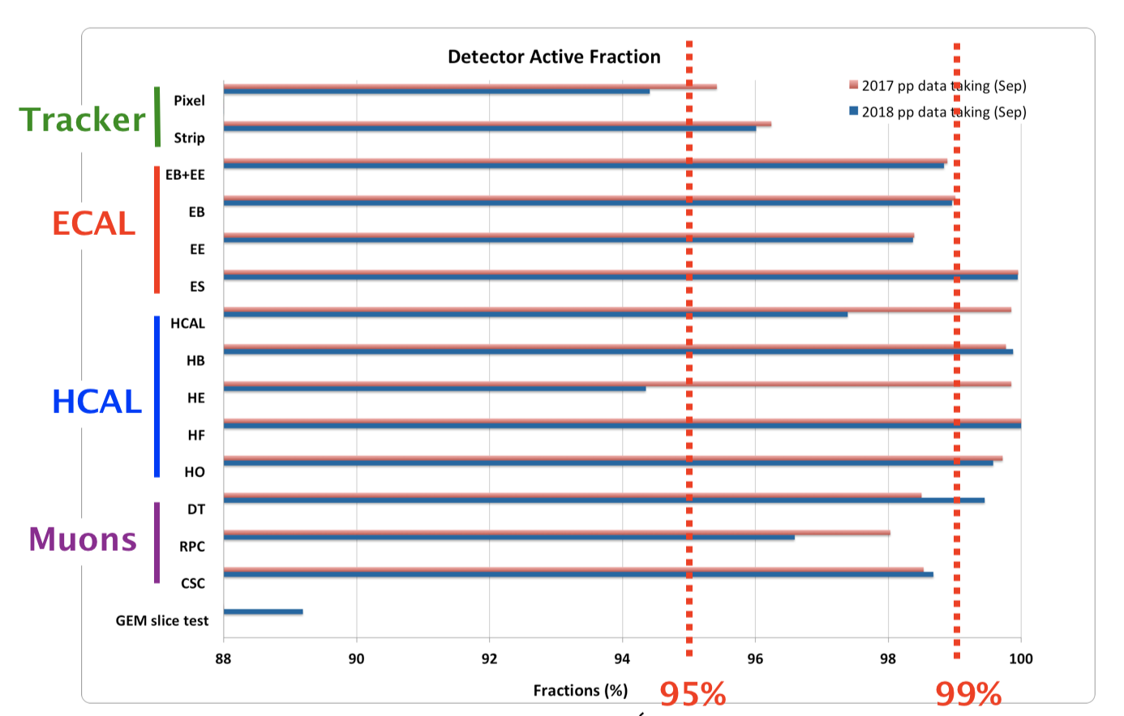
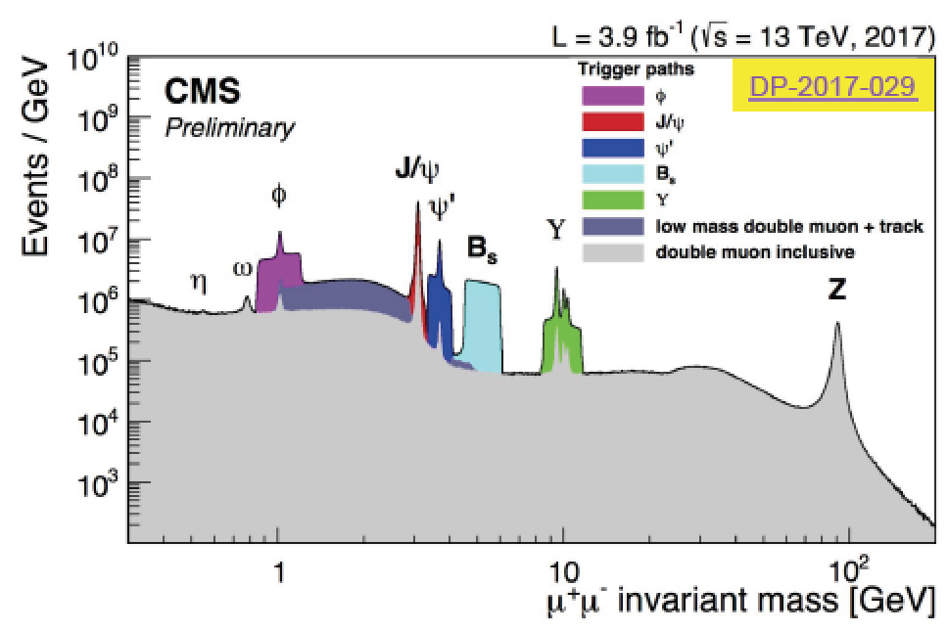
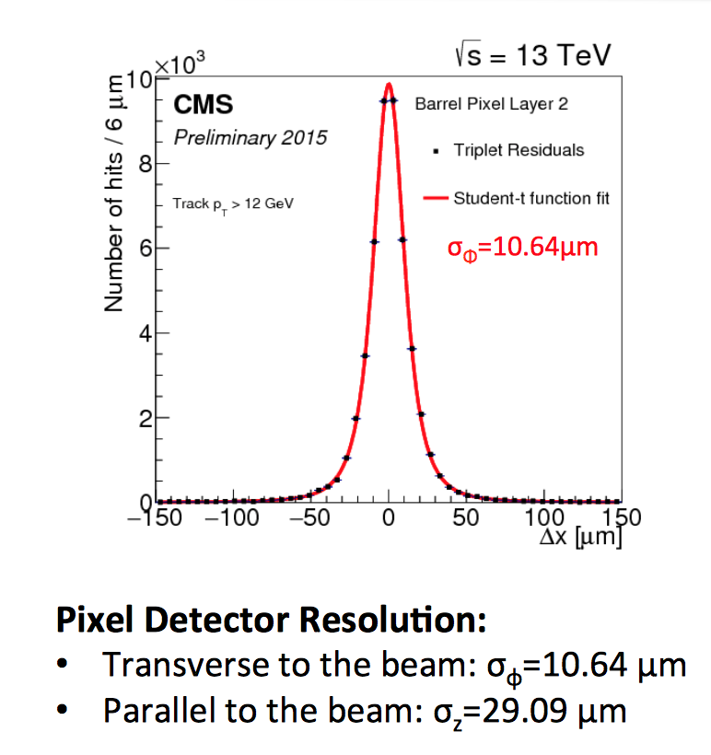
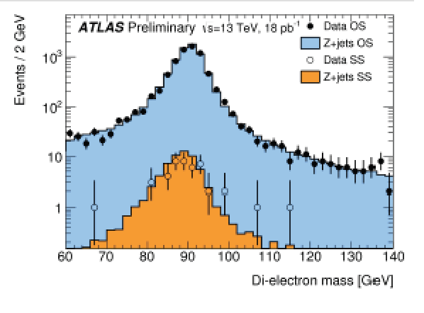
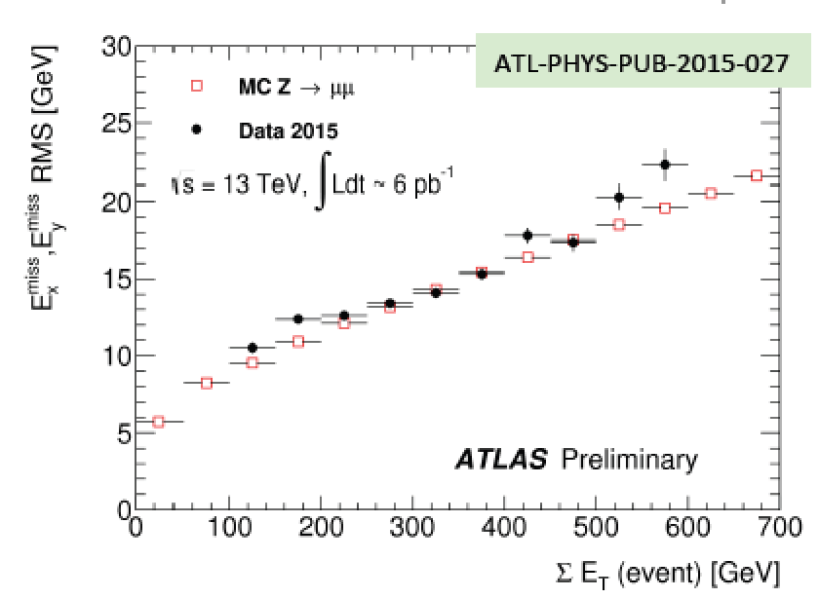
Detector Performance @ 13 TeV
Some examples from the Run-2 data
CMS and ATLAS continue to
have an excellent performance

Slide 33
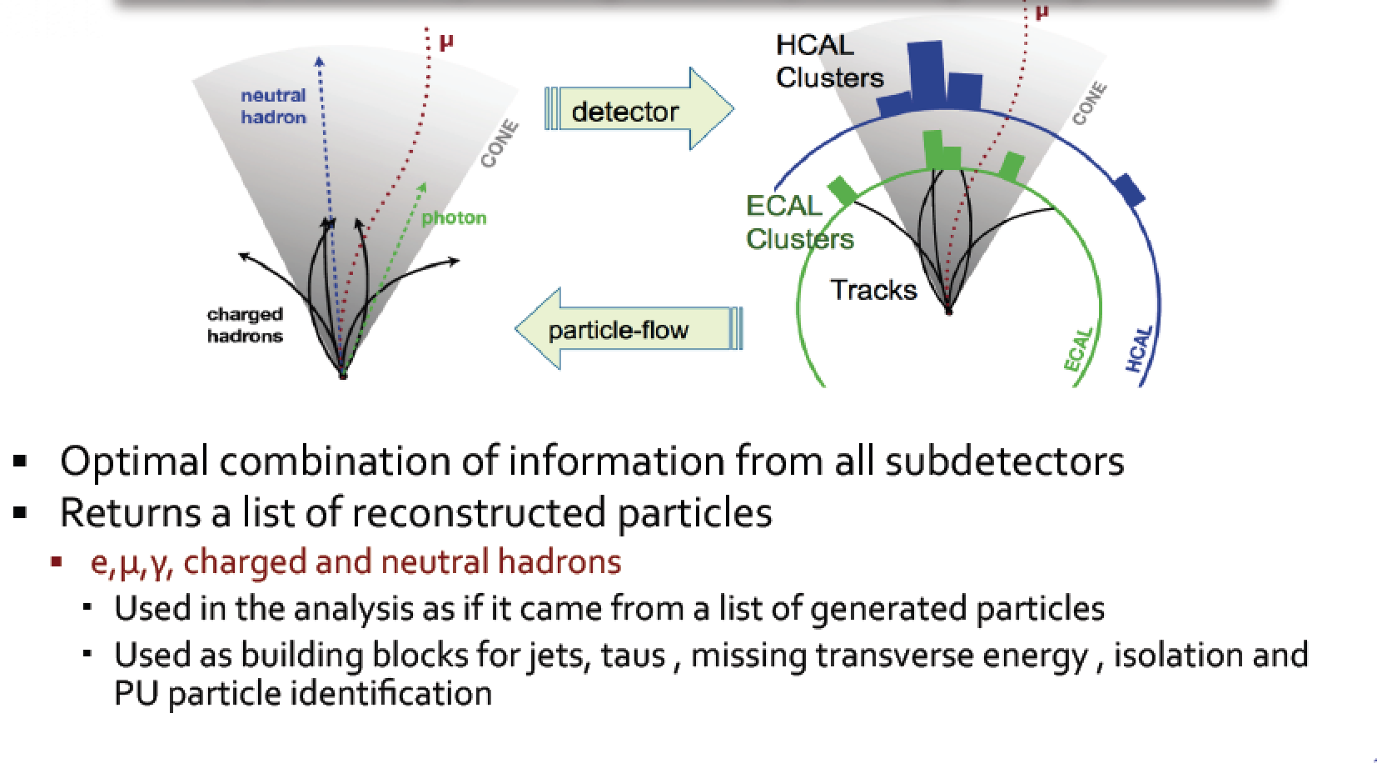
Global Event Reconstruction
Using all information of the detector together for optimal measurement
Adapted in CMS

Slide 34
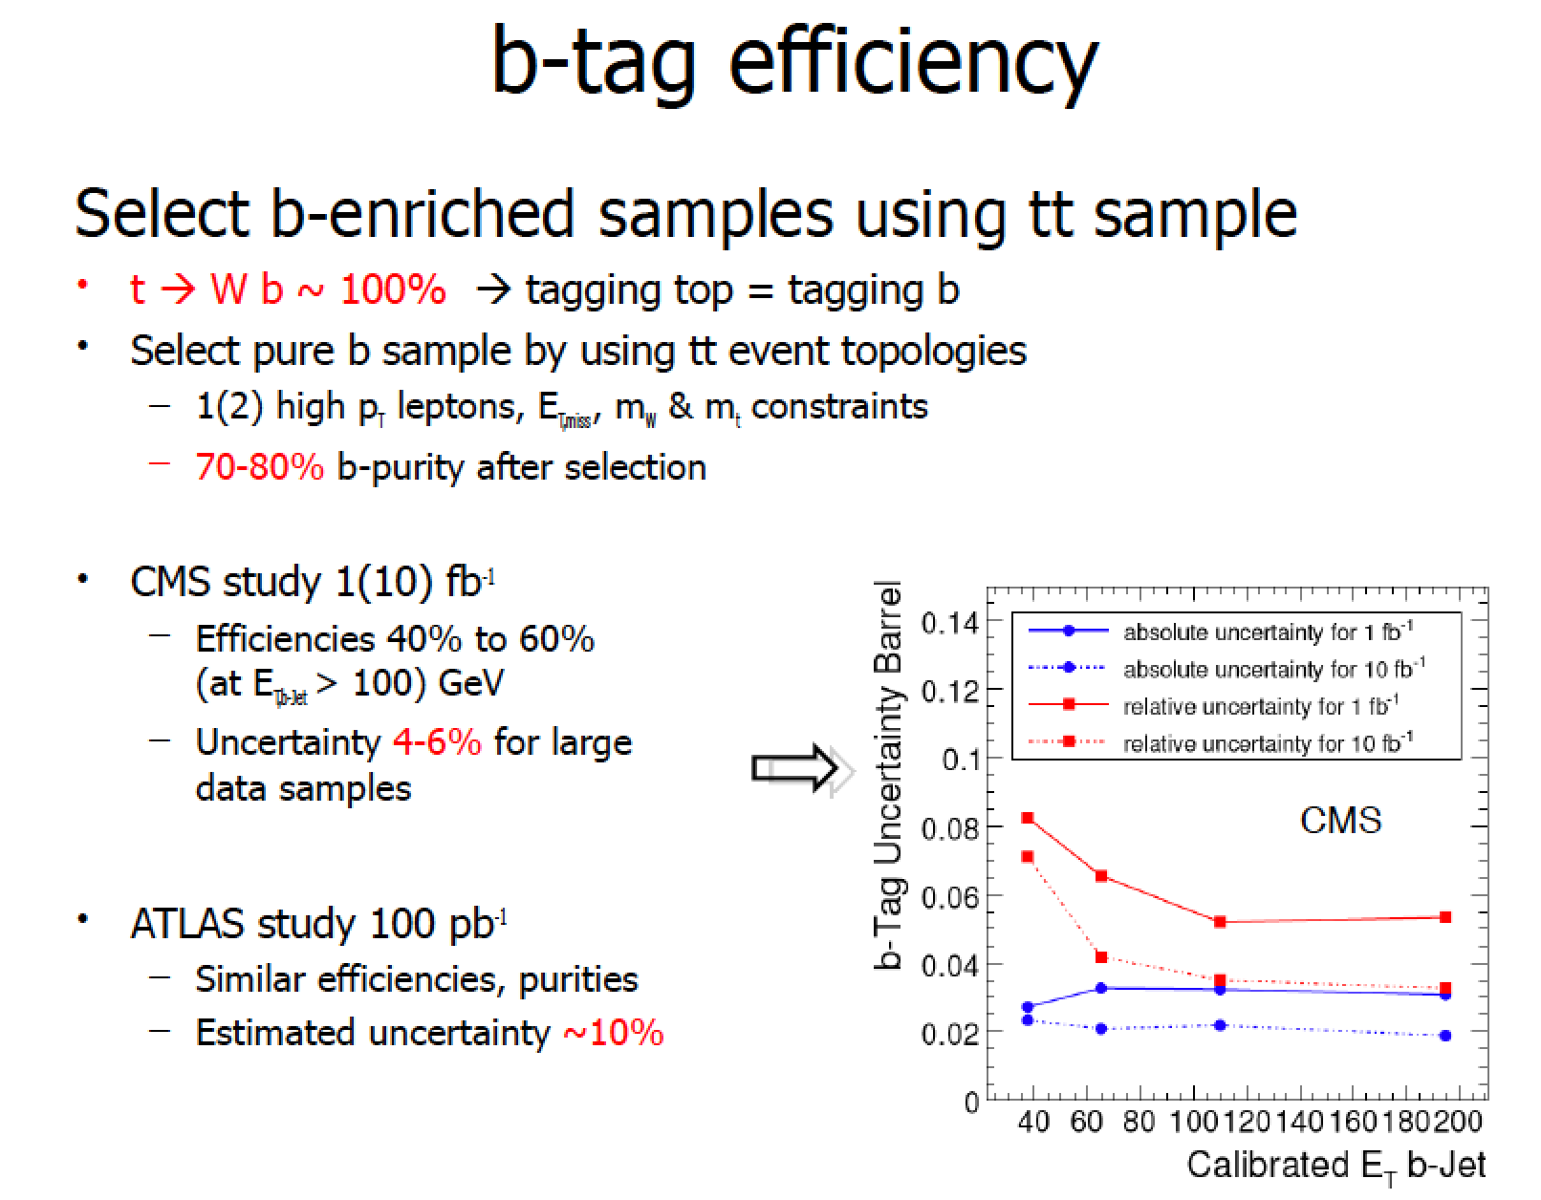
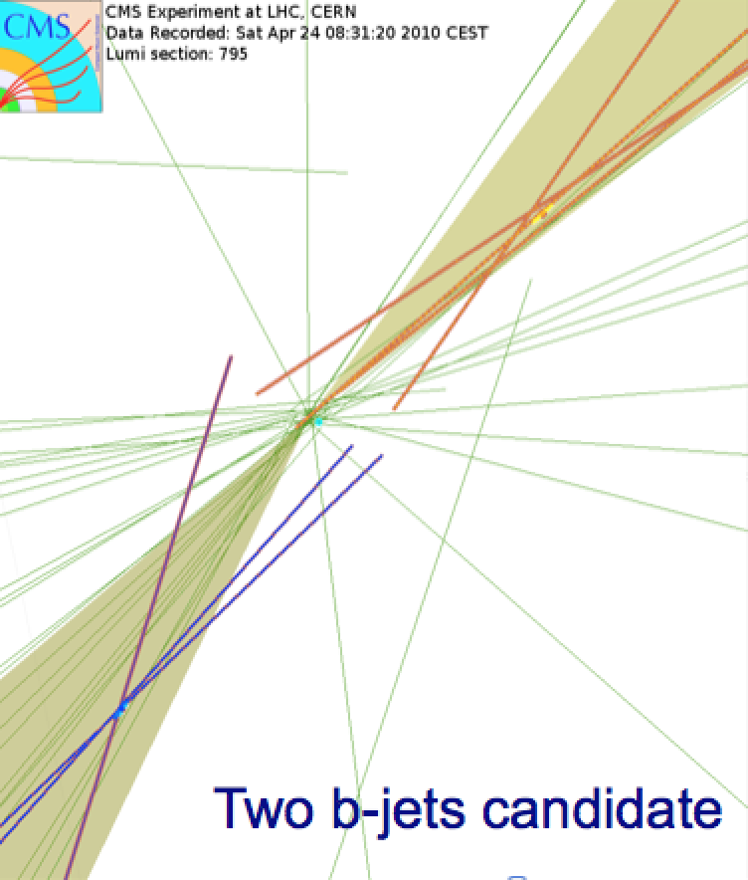
B-quark Tagging
Generally: look for jets with displaced vertices (or leptons) from B-meson decays
New: Deep Learning NNs..

Slide 35
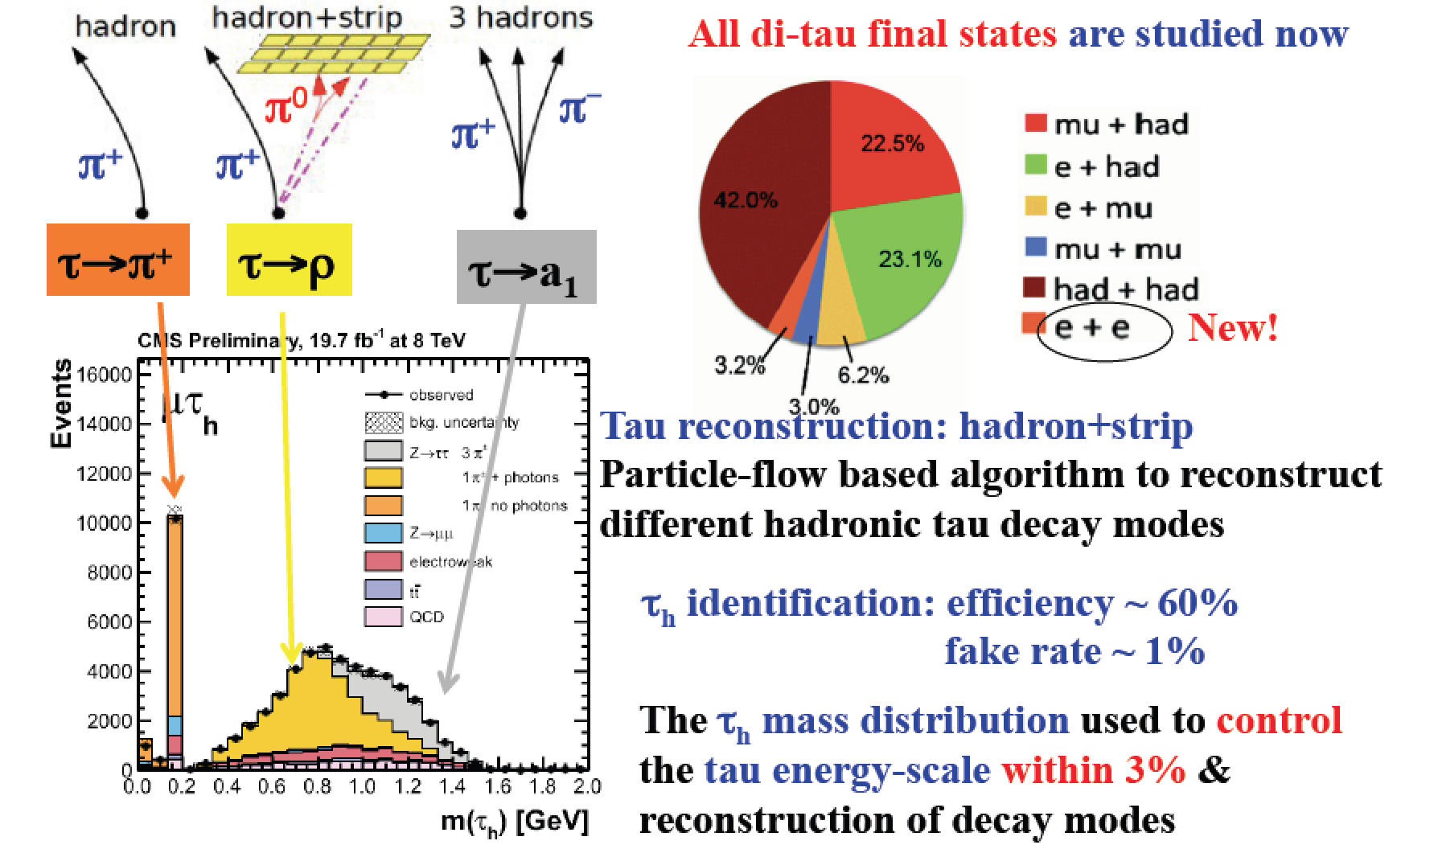
Tau-finding
Hadronic tau decays are narrow low multiplicity ‘jets’
All di-tau final states used in Higgs search

Slide 36
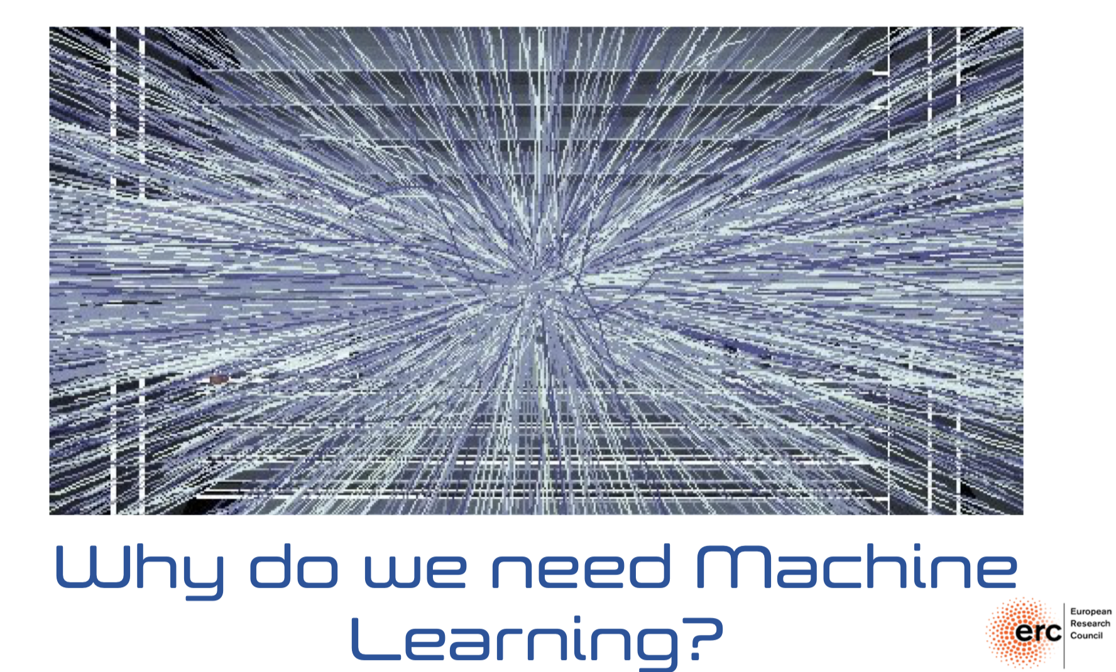
The New Wave: Machine Learning
M. Pierini et al.

Slide 37
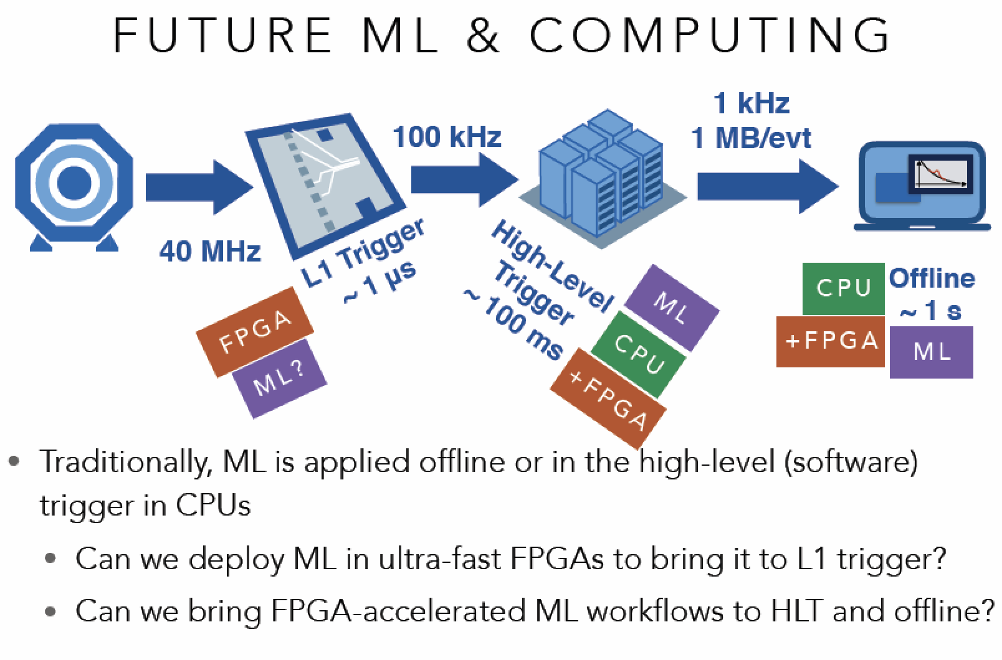
The New Wave: Machine Learning
Field Programable Gate Array

Slide 38
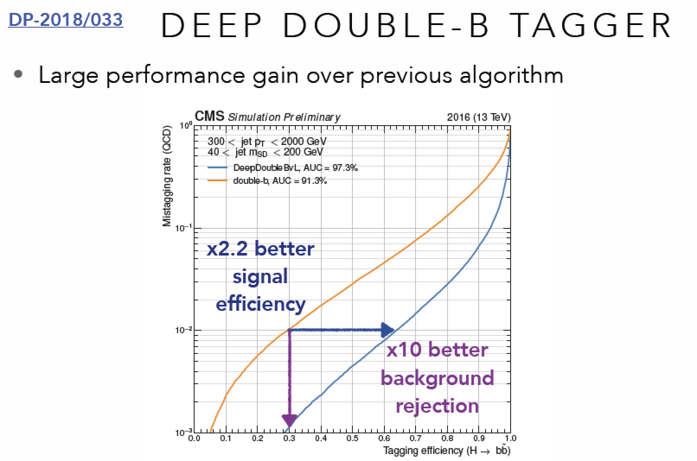
The New Wave: Machine Learning

Slide 39
Other Experiments at the LHC

Slide 40
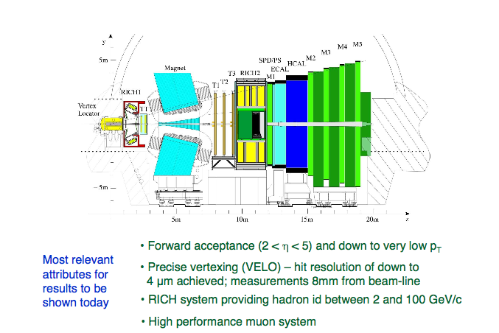
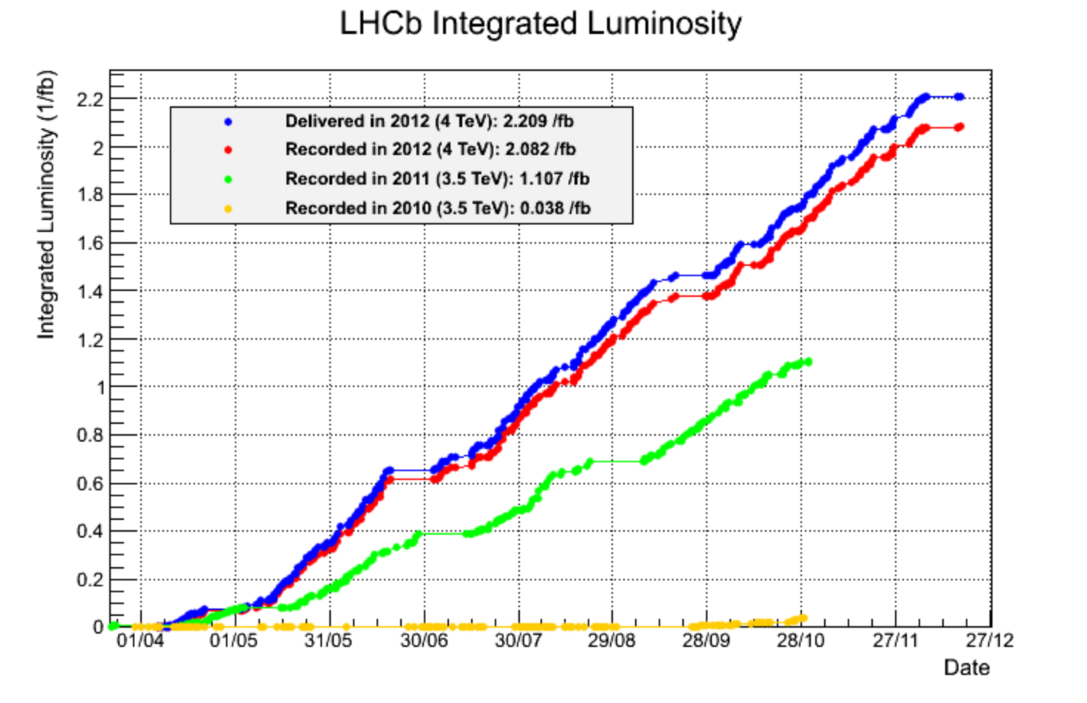
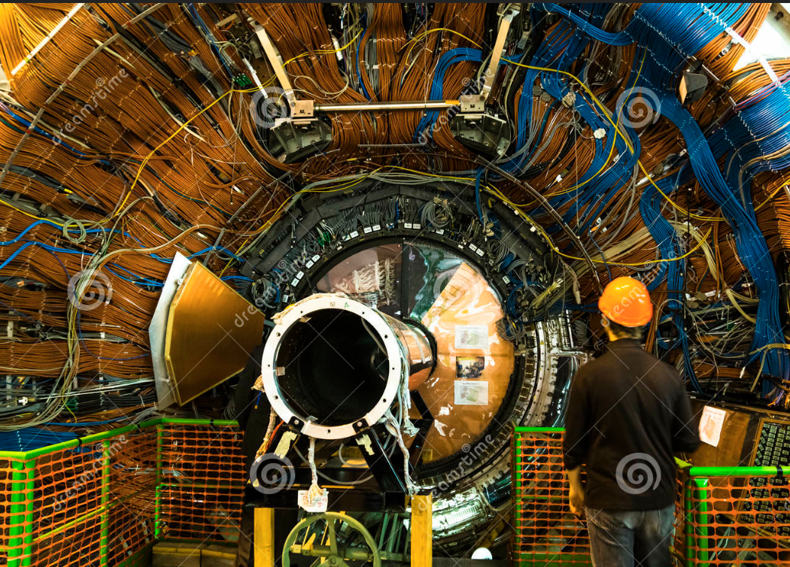
LHCb: Bottom and Charm Physics

Slide 41


ALICE: Heavy Ion Physics at the LHC

Slide 42





A Few Smaller Experiments: TOTEM & LHCf
TOTEM: measuring the total, elastic and
diffractive cross sections
Add Roman Pots (and inelastic telescope)
to CMS interaction regions (200 m from IP)
Recently: common runs with CMS
TOTal and Elastic cross
section Measurement
LHCf: measurement of
photons and neutral pions
in the very forward region
of LHC
Add a EM calorimeter at
140 m from the Interaction
Point (of ATLAS)
Connection with
cosmic rays

Slide 43






MoEDAL: Monopole and Exotics Detector at the LHC
Heavy particles which carry “magnetic charge”
Could eg explain why particles have “integer
electric charge”
Monopole production
Remove the sheets after some
running time and inspect for ‘holes’

Slide 44



The LHC Detectors are Major Challenges
• CMS/ATLAS detectors have about 100 million read-out channels
• Collisions in the detectors happen every 25 nanoseconds
• ATLAS uses over 3000 km of cables in the experiment
• The data volume recorded at the front-end in CMS is 1 TB/second
equivalent to the world wide communication network traffic (2007)
• Data recorded during the 10-20 years of LHC life will be about all the
words spoken by mankind since its appearance on earth
• A worry for the detectors: the kinetic energy of the beam is that of
a small aircraft carrier of 10⁴ tons going 20 miles/ hour
>200 m² of silicon
ATLAS pixel detector
CMS silicon tracker

Slide 45

Summary: Challenges@ LHC
High event rate and pile-up
  High granularity: typically 10x more channels compared to detectors before the LHC
Timing/synchronization of 10⁸ channels is non trivial
Event size (> 1 Mbyte)/Computing
  Limit event rate to a few 100 Hz, use the Grid
Trigger reduce event rate from 40MHz to a few 100 Hz
  Multi-layered trigger system and pipelined electronics
Detectors need excellent hermeticity (missing E_{T}), lepton identification, B & Tau identification, jet measurements…
Detectors must be radiation hard and reliable for ~ 10-20 years…
We have these detectors: Let’s look at physics

Slide 46





pp-Collisions : Complications
Protons have structure
Parton
distributions
Underlying event
Pile-up: approximate 40 collisions per
bunch crossing in 2018 (more in future)
Z→ μμ event with ~20 reconstructed vertices (2012)

Slide 47




Proton-proton collisions and PDFs
Parton Distribution Functions: the probability of finding
a parton with momentum fraction x in the proton
Structure function
measurements eg
from HERA
Simple spread of existing PDFs gives
up to 10% uncertainty on Higgs cross
section. Possible gain ~ factor of 2
with final HERA data (PDF4LHC)
Using also input from LHC data in new fits
Now also LHC pp
data used to
constrain PDFs

Slide 48

Proton-Proton Collisions

Slide 49
Proton-proton Collisions
Most interactions due to collisions at large distance between incoming
protons where protons interact as “ a whole ”
→ small momentum transfer (Δp ≈  /Δx )
particles in final state have large longitudinal momentum but small
transverse momentum (scattering at large angle is small)
< p_{T} > ≈ 500 MeV of charged particles in final state
Most energy escapes down the beam pipe.
These are called soft events…
A minimum bias data event sample is dominated by soft events

Slide 50

Cross sections at the LHC
“Well known” processes, don’t need to keep all of them …
New Physics!!
This we want to keep!!

Slide 51


Standard Model Measurements
Standard Model measurements form an integer part of the physics program of the LHC
Precision measurements allow test for a wide range of SM predictions, and extract fundamental parameters (eg α_{s})
  Requires matching precision at theory prediction side
Important to understand backgrounds for searches for new physics
Cross Sections
Many processes studied: Examples

Slide 52







Inclusive Jet Production (13 TeV)
arXiv:1711.02692
Differential cross sections with R=0.4
Jet p_{T} spectrum consistent with predictions
from NLOJET++
Agreement with NLO calculations over the full range, up to and beyond
2 TeV p_{T} jets… QCD predictions work well over a large range…

Slide 53

W, Z Production

Slide 54


W and Z Boson Production
Select final states with leptons
arXiv:1603.09222
CMS-PAS-SMP-15-011
Missing transverse energy
from the W → μ+ν decays
Z peak (di-muon pair
mass distributions)

Slide 55

W and Z Boson Production
Measurements at 7/8/13 TeV with a precision of 3-4% ->dominated by the luminosity uncertainty!
CMS-PAS-SMP-15-004
Many detailed EWK studies possible –and done-- with the large Z,W samples

Slide 56


W-Mass Determination
Measurement based on 7 TeV data (4.6 fb⁻¹). It takes time to get the systematic uncertainties under control for precision!!
Included ~14.10⁶ W leptonically decaying W candidates
Technique uses template fits to the W p_{T} and m_{T} predictions
Calibration of energy scale, recoil response and efficiency studies using the large Z sample. Modelling of helicity effects constrained by W and Z data.
arXiv:1701.07240

Slide 57

Top Production
•The heaviest known elementary particle: ~173 GeV
•Coupling to the Higgs ~1 → Special role in EWK symmetry breaking?
LHC is a top factory with ~5.10⁶ produced tt-pairs (run-1)
~ 10⁸ produced tt-pairs (run-2)

Slide 58

Top Quark Cross Sections
Good agreement with the SM predictions up to the 13 TeV

Slide 59


Top Mass Determination
Steady improvements during run-1 and run-2
Precision reached now ~0.3%
Hadronization model uncertainties
one of the main limitations
Several alternative methods have
been and are being explored
using J/ψ, secondary vertices,…
This is not the final word yet
Experiment combination under way
Note: the average value LHC
somewhat lower than Tevatron
one: 174.34 ± 0.64 GeV

Slide 60

Summary: Cross Sections 7/8/13 TeV
All measurements in good agreement with the Standard Model predictions!!

Slide 61




Light-by-light Scattering
arXiv:1904.03536
Select ultra-peripheral collisions in PbPb
Exclusive 2-photon final state selection
Small acoplanarity (< 0.01)
Small diphoton p_{T} (< 1 GeV or 2 GeV)
42 events found, 6 background events est.
CMS result: arXiv:1810.04602

Slide 62




Measurements of B_{s(d)} →μμ
arXiv:1411.4413
Published in Nature
•Three B_{s} particles in a billion will decay into two
muons. This decay has been chased for 30 years!!
arXiv:1703.05747
Present most precise results
Significance for B_{s} to muon
decay is 7.8σ
4.4 fb⁻¹

Slide 63





Total and Elastic Cross Sections
TOTEM experiment: Total cross section and elastic/diffractive scattering
New measurements at 13 TeV
arXiv:1712.06153
CERN-EP-2017-335
𝝆: the ratio of the real to imaginary part of the nuclear elastic scattering amplitude at t=0, is lower that expected
First direct evidence for “odderon” exchange in elastic scattering??
+?

Slide 64



Forward Particle Production
arXiv:1808.09877
Forward neutrons
𝜼>10.78
arXiv:1703.07678
Forward Photons
LHCf experiment:
Forward measurements compared to Monte Carlos for Cosmic Ray studies
No model reproduces the data well !!

Slide 65

Summary
The LHC is the highest energy collider built by mankind so far. Seven experiments are currently collecting and analysis proton-proton (and AA) data.
The experiments face huge challenges. A very crucial component is the selection trigger
The physics program at the LHC is very diverse, with general purpose from Standard Model test in the new high energy regime, to searches for new physics
Measurements of Standard Model processes show good agreement with predictions. Precise measurements require precise calculations.
We will look at some specific searches for new physics in the next lecture

