Slide 1
Neptune-Pavia
WP2: imaging and quantification

Slide 2


Neutron autoradiography
Imaging and quantification of ¹⁰B distribution in a biological sample can be obtained by neutron autoradiography:
n
¹⁰B
Li
sample
θ
sensitive film
α
Charged particles leave latent tracks on the sensitive film that are made visible by chemical attack (etching)

Slide 4
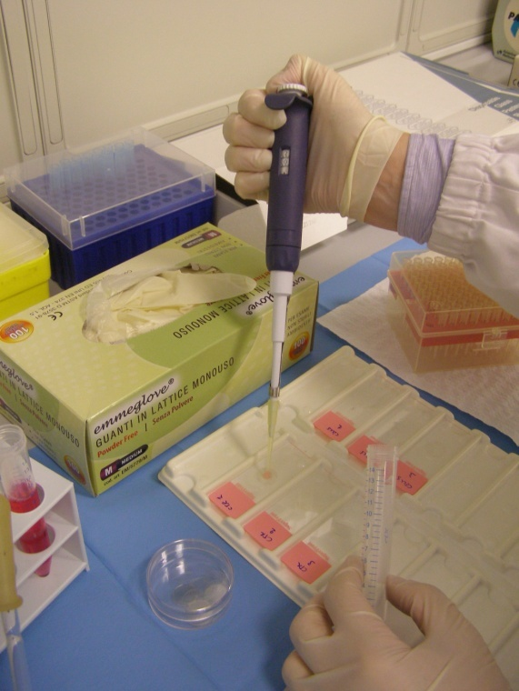
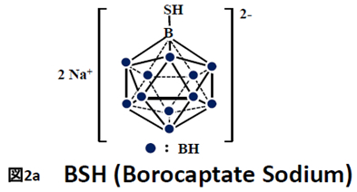
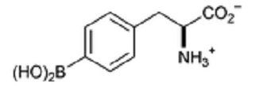
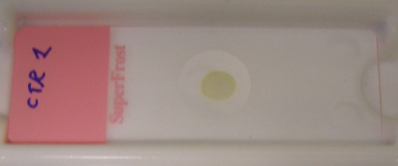
Cell cultures treatment and samples preparation
AND
BPA (Boronophenylalanine)

Slide 5
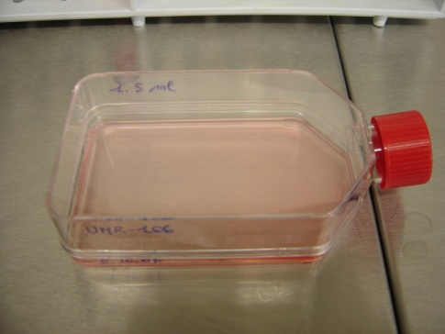
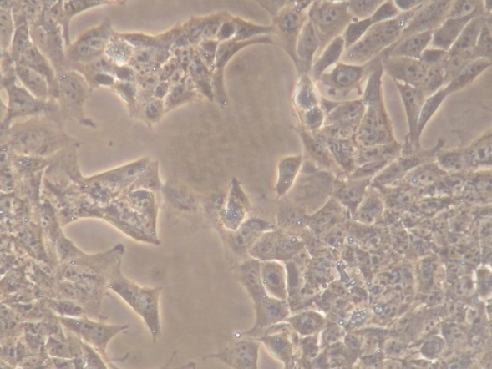
Cell cultures treatment and samples preparation
1. Cells are seeded and allowed growing for 24 h in proper medium.
2. Boron-enriched medium is delivered to cells.
3. At the end of the time of contact (4 h) the ¹⁰B containg medium is replaced and cells are washed three times in PBS, trypsinized, harvested and centrifuged in boron deprived medium and counted.
4. Cells are layered on mylar disks for neutron autoradiography
OR
BPA (Boronophenylalanine)
Notes:
5

Slide 6
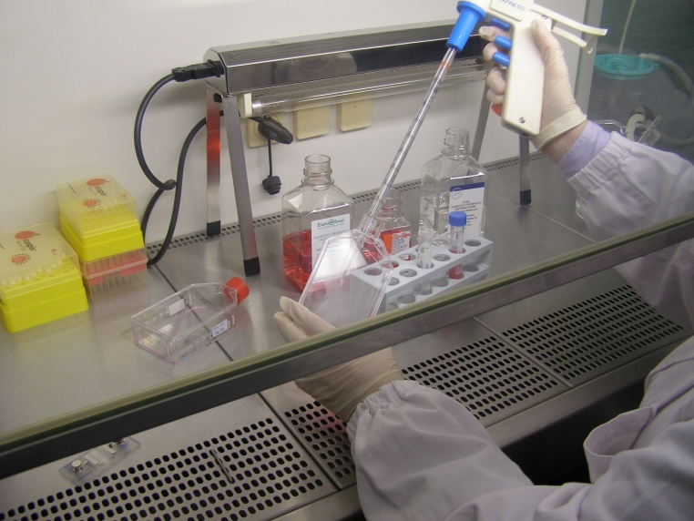
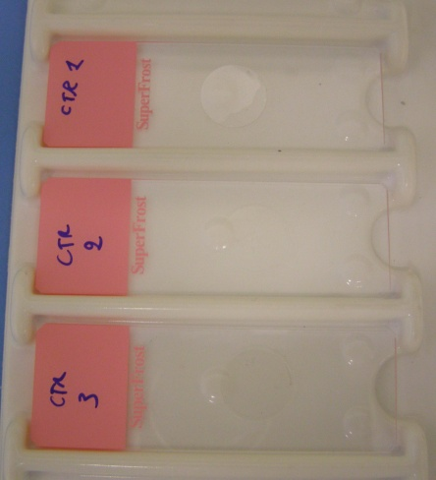
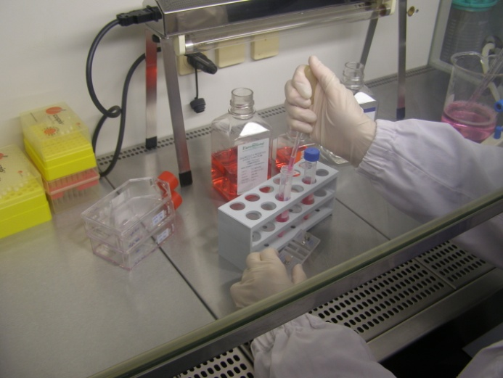
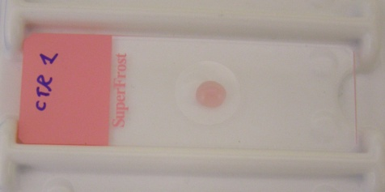
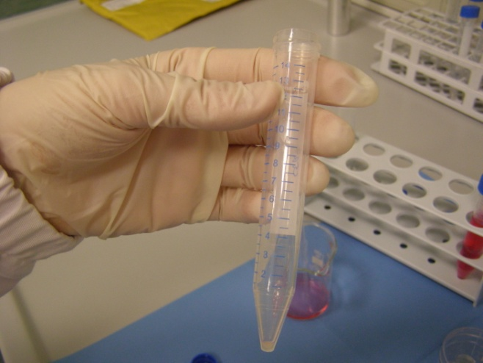

Slide 7

Irradiation and etching - Quantification
Low neutron fluence, low etching with PEW solution
Quantification of boron distribution in the
dried pellet of cells. It evidences how many PPM of 10-B are present inside cells, averaging over the entire sample.
NOTE that boron NOT internalized by cells is not counted here because cells have been washed before measurement!
TRACK DENSITY
PPM

Slide 8
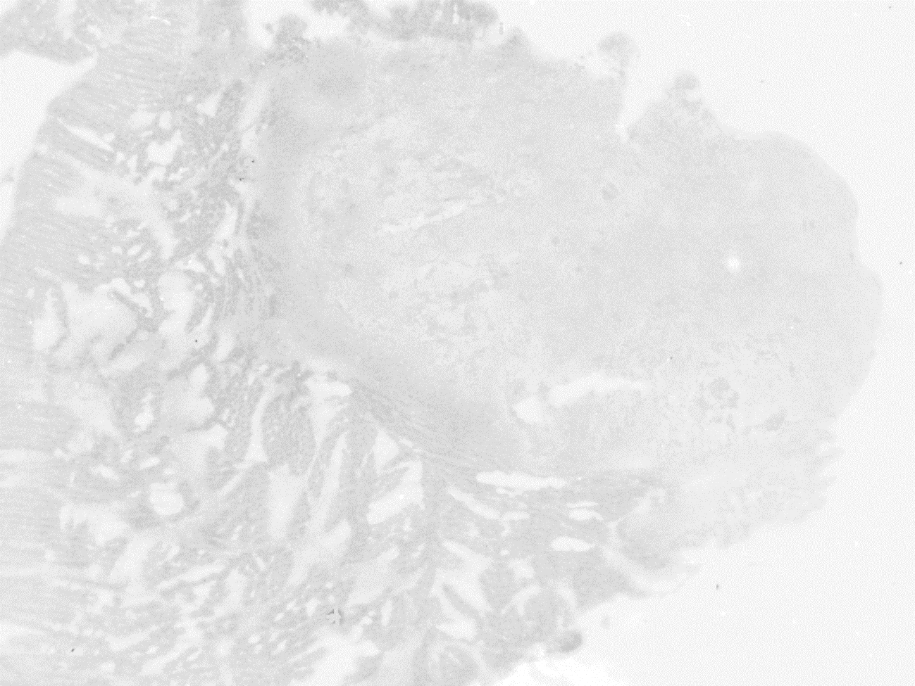
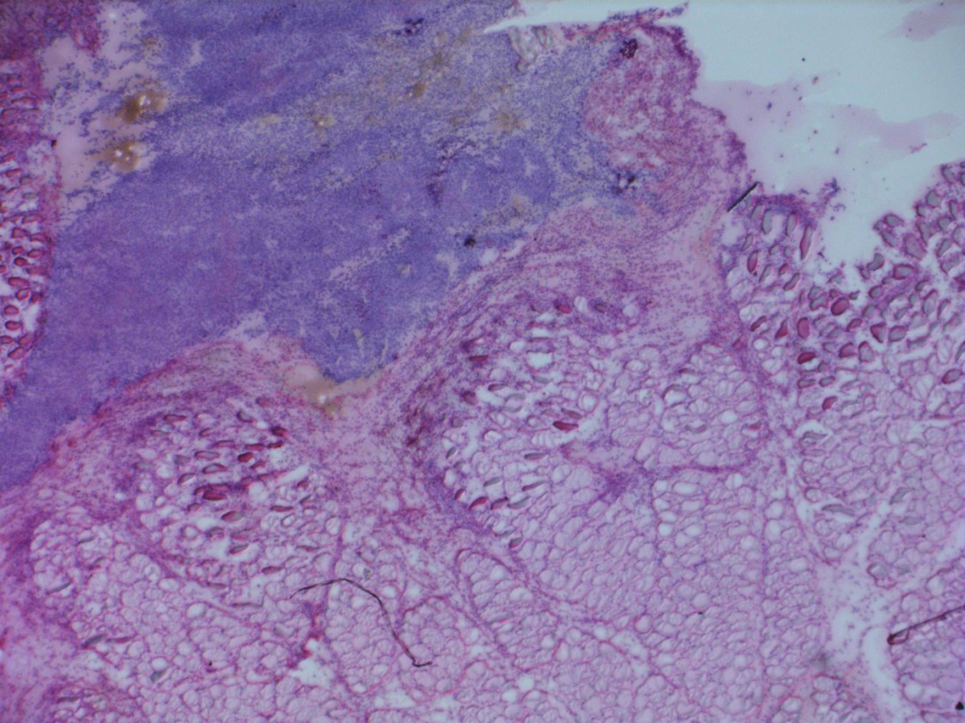
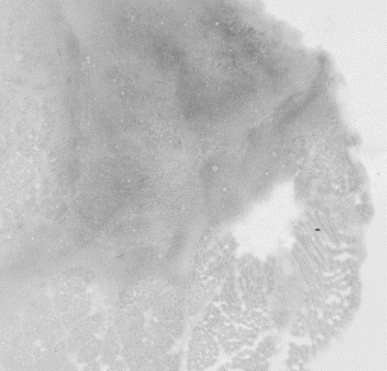
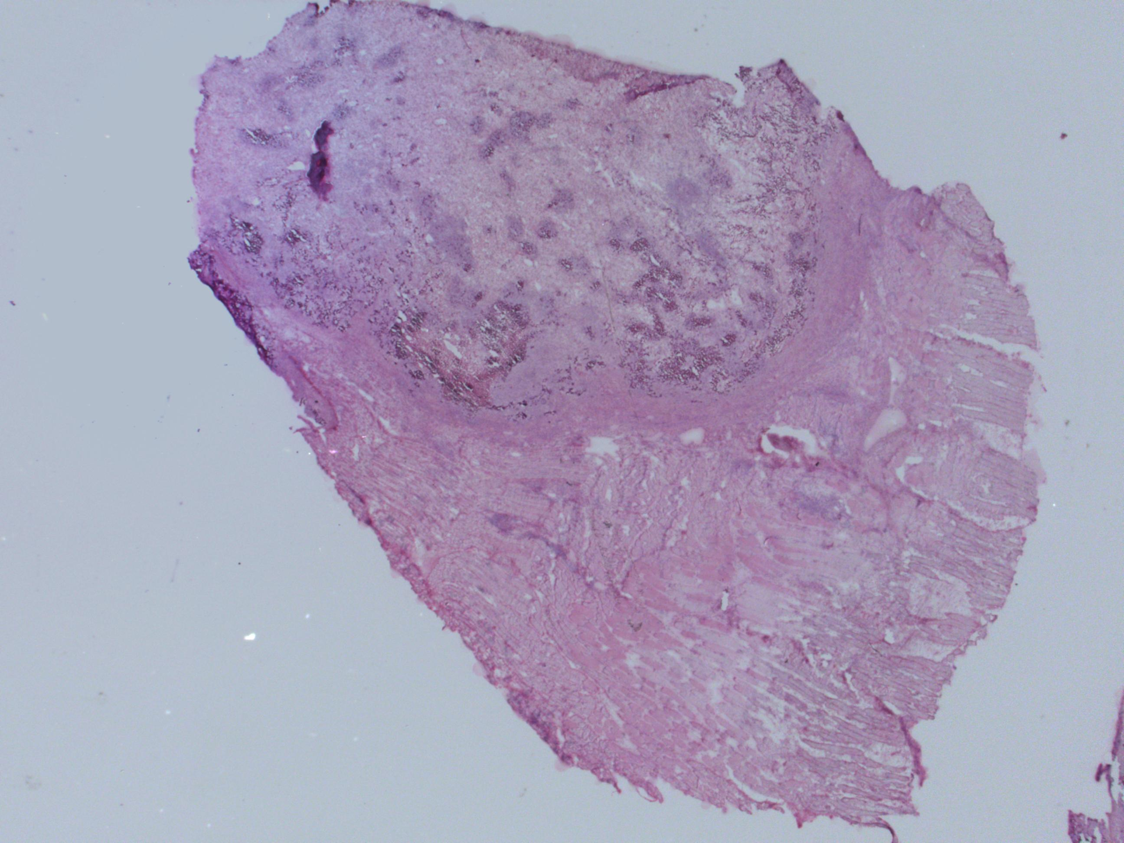
Ex-vivo tissues
I – Qualitative neutron autoradiography
Histology
Autoradiography
Histology
Autoradiography

Slide 9
Ex-vivo tissues
II – Quantative neutron autoradiography

Slide 10
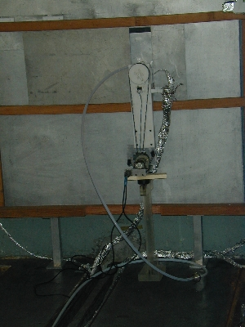
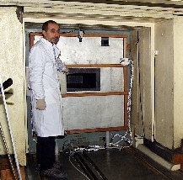
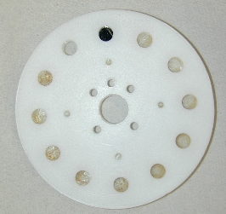
Ex-vivo tissues
III – Alpha Spectrometry
thermal n flux 2 ·10⁹ cm⁻² s⁻¹
collimator
The holder is remotely rotated to acquire the spectra
of the calibration sample (superficial 10B implantation
in Si, by NIST), the background (bare mylar disk)
and 10 tissue samples without opening the TC
detector
mylar support
tissue sample with ¹⁰B

Slide 11
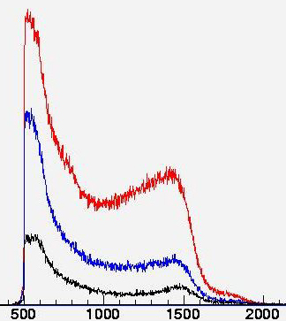
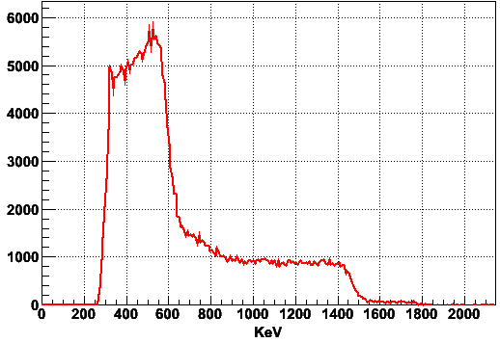
Reconstruction of boron concentration from the analysis of the absorbed spectrum in an energy range where only alpha particle contribute. Coupled with imaging, A.S. can discriminate between healthy tissue and tumour.
#
p⁺ from ¹⁴N(n,p)¹⁴C
tumor
healty tissue
⁷Li
background
α
keV

