Slide 1
HTTP Federations and Caching
Davide Michelino, Bernardino Spisso
On behalf of INFN-Napoli
IDDLS kick-off meeting
GARR 24/01/2019

Slide 2
Outline
Dynafed
DPM Volatile Pool
Belle II Case Study
Atlas Case Study
Possible usage in IDDLS

Slide 3
Context
Activities are carrying on in different context
The "Orio Carlini" scholarships funded by GARR (Davide Michelino)
Senior Fellowship Funded by INFN (Bernardino Spisso)
ATLAS Italia collaboration and Belle II Italia Collaboration

Slide 4
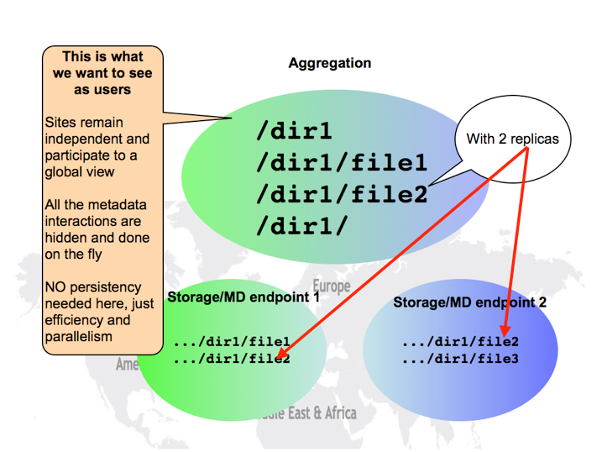
Dynamic Federation with Dynafed
The Dynamic Federations system allows to aggregate remote storage. The aggregation is performed on the fly, by distributing quick WebDAV queries towards the endpoints and scheduling, aggregating and caching the responses.
HTTP and WebDAV clients can browse the Dynamic Federation as if it were a unique partially cached name space, which is able to redirect them to the right host when they ask for a file replica.

Slide 5
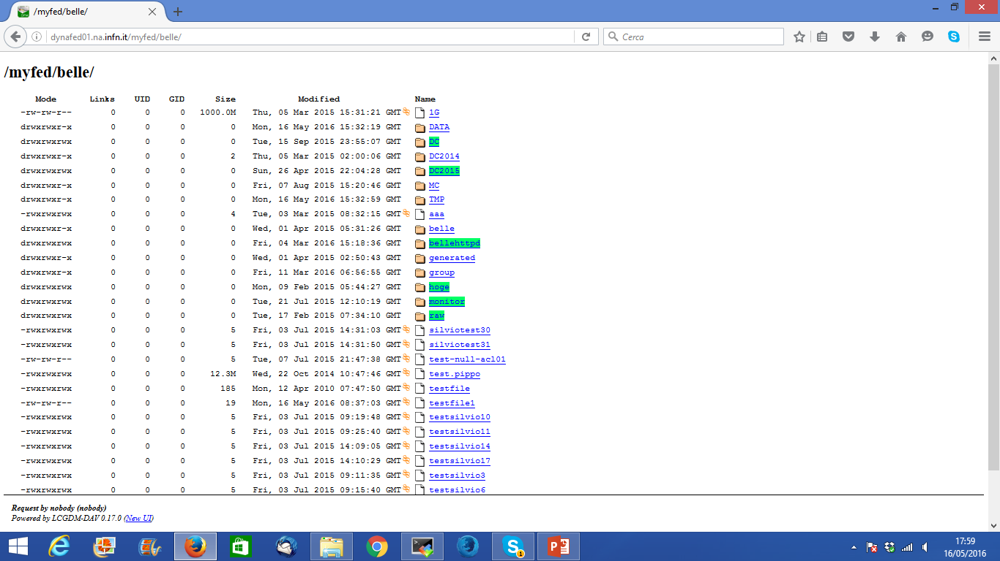
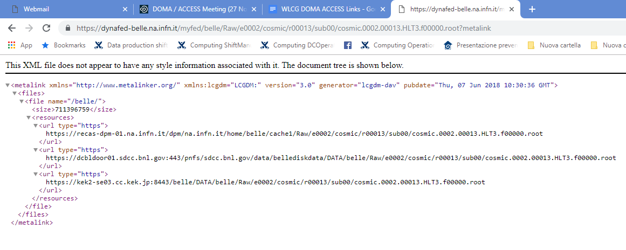
Dynamic Federation with Dynafed
Aggregate view of all the storages via Browser
Each file is represented as a metalink which contain all replicas of the same file
IDDSL Kickoff meeting @ GARR 24/01/2019

Slide 6
Caching laboratory with DPM
CHEP 2016

Slide 7
Concept of DPM Volatile Pool
A Volatile Pool is a special storage area in a DPM system that can download files from external sources when clients ask for them.
Two main scripts configurable by the system admin:
Script running on DPM head node that manage stat operations
Script running in Disk Nodes responsible to get file from external sources

Slide 8
File Stat in a Volatile Pool
Data Grid
Or Any external resources
HEAD NODE
Disk Node
File is there
Stat a File
No
Script simulate file metadata
Yes

Slide 9
File Get in a Volatile Pool
Data Grid
Or Any external resources
File
download
HEAD NODE
DISK NODE
File is there
Get a File
Script
To retrieve file
File ready
File Sender
No
Yes

Slide 10
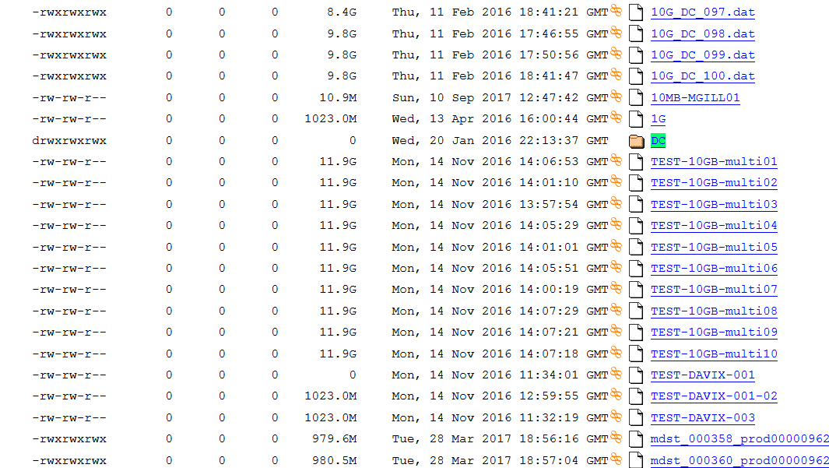
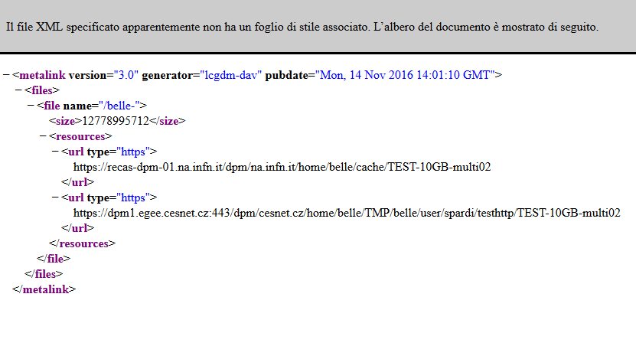
Combining Dynafed and Volatile Pool
What happen if we aggregate a set of standard http endpoints with a DPM Volatile Pool?
When Dynafed stat a file, it receive always a positive answer from the Volatile Pool.
So that the metalink representing a file in Dynafed, will included always at least two link: the real URL and the corresponding virtual copy in the cache (even if the latter does not exist yet)
Moreover thanks to the GeoPlugin, Dynafed prioritize the cache copy if the Volatile Pool is local to the Client or close to it.
This combination allows to create a cache system

Slide 11
FileA
FileB
FileA
FileD
$
HTTP dCache
HTTP dCache
Cloud Storage
FileC
FileB
HTTP DPM
HTTP STORM
DYNAFED FEDERATOR
$$$
FileD
HTTP CACHE
FileA
FileA
Cloud Storage
HTTP STORM

Slide 12
FileA
FileB
FileD
$
$
HTTP dCache
HTTP dCache
CACHING POPULAR FILES
Cloud Storage
FileC
FileC
FileC
FileB
HTTP DPM
HTTP DPM
HTTP STORM
DYNAFED FEDERATOR
DYNAFED FEDERATOR
$$$
HTTP CACHE
FileD
HTTP CACHE
FileC ?
FileC ?
FileA
Cloud Storage
HTTP STORM

Slide 13
FileA
FileB
FileD
$
$
HTTP dCache
HTTP dCache
CACHING POPULAR FILES
Cloud Storage
FileC
FileC
FileC
FileB
HTTP DPM
HTTP DPM
HTTP STORM
DYNAFED FEDERATOR
DYNAFED FEDERATOR
$$$
HTTP CACHE
FileD
HTTP CACHE
FileC ?
FileC ?
FileA
Cloud Storage
HTTP STORM

Slide 14
FileA
FileB
FileD
$
$
HTTP dCache
HTTP dCache
CACHING POPULAR FILES
Cloud Storage
FileC
FileC
FileC
FileB
HTTP DPM
HTTP DPM
HTTP STORM
DYNAFED FEDERATOR
DYNAFED FEDERATOR
FileC
$$$
HTTP CACHE
FileD
HTTP CACHE
FileC ?
FileC ?
FileA
Cloud Storage
HTTP STORM

Slide 15
FileA
FileB
FileD
$
$
HTTP dCache
HTTP dCache
CACHING POPULAR FILES
Cloud Storage
FileC
FileC
FileC
FileB
HTTP DPM
HTTP DPM
HTTP STORM
DYNAFED FEDERATOR
DYNAFED FEDERATOR
$$$
FileC
HTTP CACHE
FileD
HTTP CACHE
FileC ?
FileC ?
FileC DOWLOAD
FileA
Cloud Storage
HTTP STORM

Slide 16
FileA
FileB
FileD
$
$
HTTP dCache
HTTP dCache
CACHING POPULAR FILES
Cloud Storage
FileC
FileC
FileC
FileB
HTTP DPM
HTTP DPM
HTTP STORM
DYNAFED FEDERATOR
DYNAFED FEDERATOR
$$$
FileC
HTTP CACHE
FileD
HTTP CACHE
FileC ?
FileC ?
FileC DOWLOAD
FileA
Cloud Storage
HTTP STORM

Slide 17
FileA
FileB
FileD
$
$
HTTP dCache
HTTP dCache
CACHING POPULAR FILES
Cloud Storage
FileC
FileC
FileC
FileB
HTTP DPM
HTTP DPM
HTTP STORM
DYNAFED FEDERATOR
DYNAFED FEDERATOR
FileC DOWLOAD
FileC ?
$$$
FileC
HTTP CACHE
FileD
HTTP CACHE
FileC ?
FileC ?
FileC DOWLOAD
FileA
Cloud Storage
HTTP STORM

Slide 18
FileA
FileB
FileD
$
$
HTTP dCache
HTTP dCache
CACHING POPULAR FILES
Cloud Storage
FileC
FileC
FileC
FileC
FileC
FileB
HTTP DPM
HTTP DPM
HTTP STORM
DYNAFED FEDERATOR
DYNAFED FEDERATOR
FileC DOWLOAD
FileC ?
$$$
FileC
HTTP CACHE
FileD
HTTP CACHE
FileC ?
FileC ?
FileC DOWLOAD
FileA
Cloud Storage
HTTP STORM

Slide 19
FileA
FileB
FileD
$
$
HTTP dCache
HTTP dCache
CACHING POPULAR FILES
Cloud Storage
FileC
FileC
FileC
FileC
FileC
FileC DOWLOAD
FileB
HTTP DPM
HTTP DPM
HTTP STORM
DYNAFED FEDERATOR
FileC DOWLOAD
DYNAFED FEDERATOR
FileC DOWLOAD
FileC ?
$$$
FileC
HTTP CACHE
FileD
HTTP CACHE
FileC ?
FileC ?
FileC DOWLOAD
FileA
Cloud Storage
HTTP STORM

Slide 20
FileA
FileB
FileD
$
$
HTTP dCache
HTTP dCache
CACHING POPULAR FILES
Cloud Storage
FileC
FileC
FileC
FileC
FileC
FileC DOWLOAD
FileB
HTTP DPM
HTTP DPM
HTTP STORM
DYNAFED FEDERATOR
FileC DOWLOAD
DYNAFED FEDERATOR
FileC DOWLOAD
FileC ?
$$$
FileC
HTTP CACHE
FileD
HTTP CACHE
FileC ?
FileC ?
FileC DOWLOAD
FileA
Cloud Storage
HTTP STORM

Slide 21
FileA
FileB
FileD
$
$
HTTP dCache
HTTP dCache
CACHING POPULAR FILES
Cloud Storage
FileC
FileC
FileC
FileC
FileC
FileB
HTTP DPM
HTTP DPM
HTTP STORM
DYNAFED FEDERATOR
DYNAFED FEDERATOR
FileC DOWLOAD
FileC ?
$$$
FileC
HTTP CACHE
FileD
HTTP CACHE
FileC ?
FileC ?
FileA
Cloud Storage
HTTP STORM

Slide 22
FileA
FileB
FileD
$
$
HTTP dCache
HTTP dCache
CACHING POPULAR FILES
FileC DOWLOAD
Cloud Storage
FileC
FileC
FileC DOWLOAD
FileC
FileC
FileC
FileB
HTTP DPM
HTTP DPM
HTTP STORM
DYNAFED FEDERATOR
DYNAFED FEDERATOR
FileC DOWLOAD
FileC ?
FileC DOWLOAD
$$$
FileC
HTTP CACHE
FileD
HTTP CACHE
FileC ?
FileC ?
FileA
Cloud Storage
HTTP STORM

Slide 23
Belle II Case Study
10Gb/s LAN
SOFTWARE VERSION
dpm-1.10.x
dynafed-1.3.1-2
davix-0.6.6-1
User Interface
DYNAFED
10Gb/s LAN
20Gb/s WAN
DPMHEAD NODE
…
KEK Storage
CESNET Storage
DPMDISK1
DPMDISK2
pool-recas
pool-cache
Private Cloud storage S3

Slide 24
Dynafed Server for Belle II
# | STORGE NAME | HOSTNAME | TYPE
1 | DESY-DE | dcache-belle-webdav.desy.de | DCACHE
2 | GRIDKA-SE | f01-075-140-e.gridka.de | DCACHE
3 | NTU-SE | bgrid3.phys.ntu.edu.tw | DCACHE
4 | SIGNET-SE | dcache.ijs.si | DCACHE
5 | UVic-SE | charon01.westgrid.ca | DCACHE
6 | BNL-SE | dcbldoor01.sdcc.bnl.gov | DCACHE
7 | Adelaide-SE | coepp-dpm-01.ersa.edu.au | DPM
8 | CESNET-SE | dpm1.egee.cesnet.cz | DPM
9 | CYFRONNET-SE | dpm.cyf-kr.edu.pl | DPM
10 | Frascati-SE | atlasse.lnf.infn.it | DPM
11 | HEPHY-SE | hephyse.oeaw.ac.at | DPM
12 | Melbourne-SE | b2se.mel.coepp.org.au | DPM
13 | Napoli-SE | belle-dpm-01.na.infn.it | DPM
14 | ULAKBIM-SE | torik1.ulakbim.gov.tr | DPM
15 | IPHC-SE | sbgse1.in2p3.fr | DPM
16 | CNAF-SE | ds-202-11-01.cr.cnaf.infn.it | STORM
17 | ROMA3-SE | storm-01.roma3.infn.it | STORM
18 | KEK-SE | Kek-se03.cc.kek.jp | STORM
19 | McGill-SE | gridftp02.clumeq.mcgill.ca | STORM
Testing Dynafed server in Napoli since Feb 2016
In January 2018 we installed the new
version of Dynafed on CENTOS-7
https://dynafed-belle.na.infn.it/myfed
19 Storages ( about 75%)
Proxy generated by a robot certificate
Version on SL6 Still available
https://dynafed01.na.infn.it/myfed/

Slide 25
Cache Implementation via DOME in Belle II use case
Script on the Head Node:
The implemented script recognize if the requested path is a file or a directory then reply to the client consequently. The plugin retrieve as well the size of the real copy of the file.
Script on the Disk Node:
When a file is not in the cache, the disk node download the requested file from the datagrid by resolving the location via Dynafed. (Using Robot Certificate registerd in the VO)

Slide 26
Client Behaviour
If the file is not in cache or not ready yet, the client receives a 202 Message that ask for waiting.
Davix or gfal clients will retry after a n-seconds (retry_delay) up to max_retry.
Then the file will be downloaded from the volatile pool

Slide 27
Belle II - Federation Views
With Dynafed is possible to create multiple views by aggregating storage paths in different manner. Two new views as been added
myfed/PerSite/ Shows the file systems of each storage separately (without aggregation)
myfed/belle/ Aggregation of all the directory /DATA/belle and /TMP/belle/ + VOLATILE POOL
myfed/nocache/ Aggregation of all the directory /DATA/belle and /TMP/belle/ + WITHOUT VOLATILE POOL

Slide 28
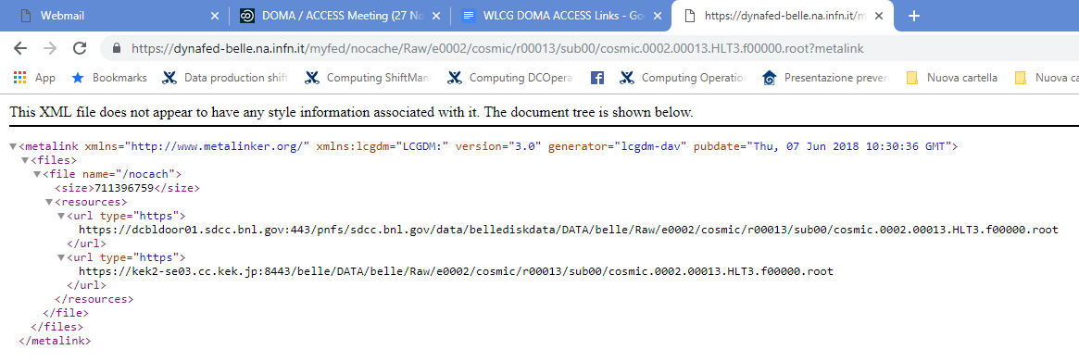
Exa
VOLATILE POOL
FIRST IN THE LIST
RAW DATA FILE METALINK IN THE FULL VIEW
RAW DATA FILE METALINK IN NOCACHE VIEW
IDDSL Kickoff meeting @ GARR 24/01/2019

Slide 29
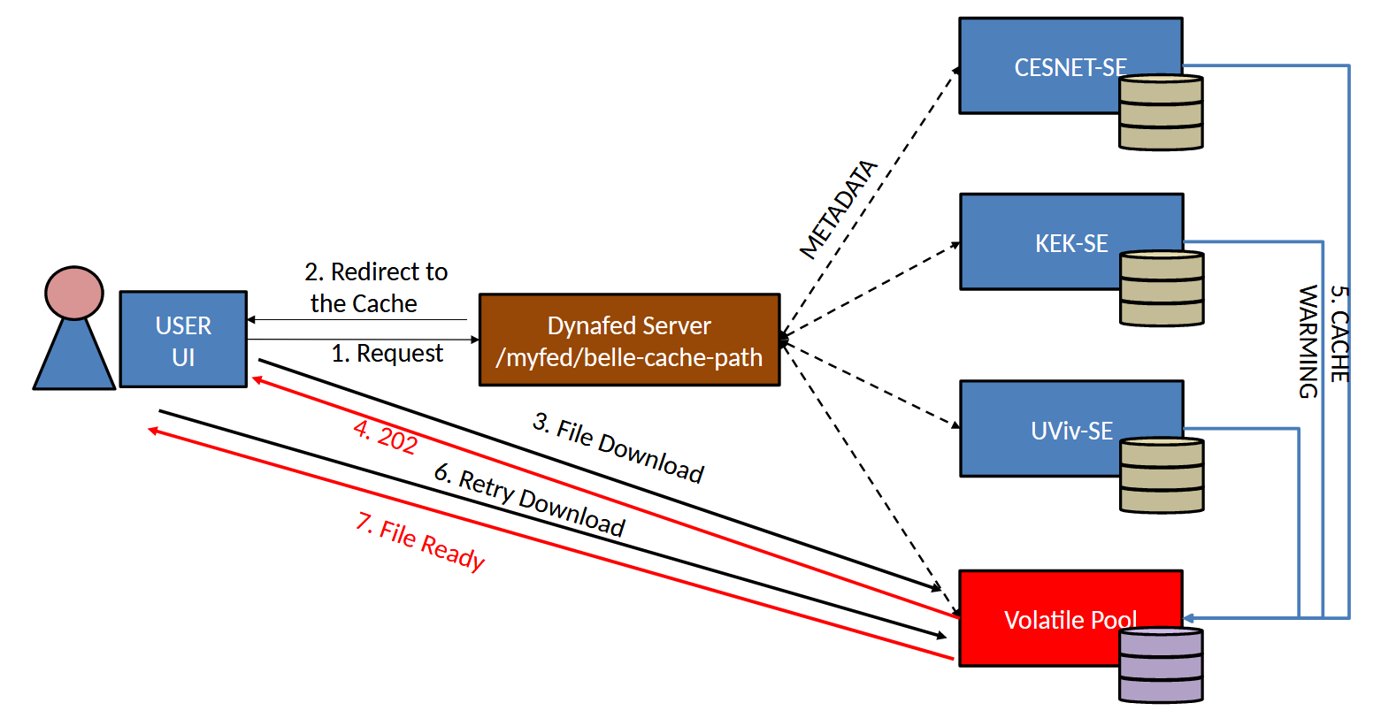
Implementation Detail
Napoli

Slide 30
Belle II Case Study – Ongoing Activities
Performance analisys via grid-hammer tools
Integration with DIRAC Framework
Testing with a full Analysis Workflow
Testing with Cloud Storage

Slide 31
ATLAS Case Study
The current trend in experiments (ATLAS) and WLCG is to optimize storage hardware usage and operational costs .
The keywords in Data Lakes R&D WLCG project are:
Common namespaces
Distributed storage and redundancy
Co-existence of different QoS (storage media)
Geo-awareness
Usage of caches
DPM storage system is used since 2006 in 3 out of 4 ATLAS Tier2 in Italy. Our interest is to keep using DPM in the future and to verify how it fits some/all of this optimization requirements
We tested a DPM setup that allows:
to federate DPM systems distributed over different sites
Use DPM caching features in the environment of ATLAS Distributed Data Management System.

Slide 32
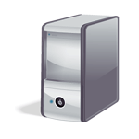
ATLAS Case Study
The testbed is installed with DPM latest releases
Distributed over three Italian INFN sites, namely INFN-NAPOLI, INFN-ROMA1 (Alessandro DeSalvo) and INFN-FRASCATI (Elisabetta Vilucchi)
DPM Head Node and DB in Naples
3 Disk Nodes, one per site.
One permanent pool, made of distributed file systems
3 volatile pools, one cache per site
In our setup the caches interact with Rucio Data Management to get any ATLAS file locally.
DPM head node
Permanent Pool
LNF
Napoli
Napoli
volatile
Roma
LNF Volatile
Roma Volatile

Slide 33
ATLAS Distributed Data Management is based on Rucio.
It manages experiment data in the heterogeneus collection of storage systems distributed over the sites.
Rucio defines the Name Space, manages authentication and provides the tools to catalog, list, transfer and monitor distributed data.
Data files are grouped in datasets , datasets can be grouped in containers and Rucio manages metadata for each entity. Files, datasets and containers follow an identical naming scheme which is composed of two strings: the scope and name.
Rucio handled only permanent data so far, there is an ongoing discussion in ATLAS about managing storage caches in Rucio environment.

Slide 34
Overview
Permanent distributed Pool
LNF
Roma
Napoli
LNF Volatile
Roma Volatile
Local volatile pools
DPM head node
Napoli volatile
Users

Slide 35
Multisite DPM
Permanent distributed Pool
LNF
Roma
Napoli
LNF Volatile
Roma Volatile
Local volatile pools
DPM head node
Napoli volatile
An user can access to the permanent distributed pool via a single common end point specifying “fed-t2.infn.it” in the LFN path.
/dpm/fed-t2.infn.it/home/atlas/…

Slide 36
Multisite DPM
Permanent distributed Pool
LNF
Roma
Napoli
LNF Volatile
Roma Volatile
Local volatile pools
/dpm/fed-t2.infn.it/home/atlas/…
DPM head node
Napoli volatile
The DPM head node manage the request, updating the common namespace and redirecting the user client to the proper disk endpoint.

Slide 37
Cold cache
Permanent distributed Pool
LNF
Roma
Napoli
LNF Volatile
Roma Volatile
Local volatile pools
DPM head node
Napoli volatile
/dpm/roma1.infn.it/home/atlas/
mc15_13TeV/DAOD_EXOT5.10.root
An user can access to a particular local cache via the common end point specifying in the LNF the domain of the specific site i.e. “roma1.infn.it”.

Slide 38
Cold cache
Permanent distributed Pool
LNF
Roma
Napoli
LNF Volatile
Roma Volatile
File already present ?
Local volatile pools
mc15_13TeV/DAOD_EXOT5.10.root
DPM head node
Napoli volatile
After a request to the volatile pool the DPM head checks whether or not the file is already present in the pool.

Slide 39
Cold cache
Permanent distributed Pool
LNF
Roma
Napoli
LNF Volatile
Roma Volatile
File exists ?
Local volatile pools
mc15_13TeV:DAOD_EXOT5.10.root
DPM head node
Napoli volatile
In case the file is not there (cold cache) a custom script in the head is triggered, that checks the existence of the file in RUCIO catalogue. The RUCIO scope is extracted from the user provided path.

Slide 40
Cold cache
Permanent distributed Pool
LNF
Roma
Napoli
LNF Volatile
Download request for mc15_13TeV:DAOD_EXOT5.10.root
Roma Volatile
Local volatile pools
DPM head node
Napoli volatile
If the head script exit code is zero an admin defined script on the particular disk node is triggered. Such script populates the cache downloading the requested file via RUCIO

Slide 41
Cold cache
Permanent distributed Pool
LNF
Roma
Napoli
LNF Volatile
Download
Roma Volatile
Local volatile pools
DPM head node
Napoli volatile
If the head script exit code is zero an admin defined script on the particular disk node is triggered. Such script populates the cache downloading the requested file via RUCIO

Slide 42
Cold cache
Permanent distributed Pool
LNF
Roma
Napoli
LNF Volatile
Roma Volatile
Local volatile pools
Download
DPM head node
Napoli volatile
Finally the requested file is returned to the user from the selected cache.

Slide 43
Warm cache
Permanent distributed Pool
LNF
Roma
Napoli
LNF Volatile
Roma Volatile
Local volatile pools
DPM head node
Napoli volatile
/dpm/roma1.infn.it/home/atlas/
mc15_13TeV/DAOD_EXOT5.10.root
If the same file in the same volatile pool is required the scripts are not triggered (warm cache).

Slide 44
Warm cache
Permanent distributed Pool
LNF
Roma
Napoli
LNF Volatile
Roma Volatile
File already present ?
Local volatile pools
mc15_13TeV/DAOD_EXOT5.10.root
DPM head node
Napoli volatile
If the same file in the same volatile pool is required the scripts are not triggered (warm cache).

Slide 45
Warm cache
Permanent distributed Pool
LNF
Roma
Napoli
LNF Volatile
Roma Volatile
Local volatile pools
DPM head node
Napoli volatile
Download
The requested file is directly returned to the user from the selected site.

Slide 46
ATLAS Case Study
DPM DOME offers the possibility to fill volatile pools with a custom mechanism.
Complex retrieval algorithms can be implemented and the file source can be any other storage system or any kind of Data Federation as Dynafed
In our setup the cache interacts with Rucio Data Management to get the requested file from any ATLAS site, but ATLAS Data Management is not aware of the existence of the local caches, that can be added or removed according to the local needs.
The cache simply acts as a Rucio client to download files. When the cache is not yet populated, its behavior (implemented via DPM DOME) is driven by two scripts that are triggered by the file requests toward a volatile pool.
IDDSL Kickoff meeting @ GARR 24/01/2019

Slide 47
Technologies for IDDLS
DPM Volatile pool can be implemented on a Storage Endpoint directly connected at the IDDLS Network offering Caching service for the community.
Multisite-DPM can be implemented in IDDLS to exploit new setups
DYNAFED Can aggregate different HTTP Storage of the data lake offering a Global-Storage Like view.
IDDSL Kickoff meeting @ GARR 24/01/2019

Slide 48
REFERENCES
A.Doria et al ” Distributed caching system for a multi-site DPM storage “ – CHEP18 Sofia, Bulgaria 2018
D. Michelino et al “An http data-federation eco-system with caching functionality using DPM and Dynafed” – CHEP18 Sofia, Bulgaria 2018

Slide 49
Backup Slide

Slide 50
File Download Test 1GB from a UI in Napoli
Mbit/s (Higher is better)

Slide 51
Local job reading file through dynafed
basf2 B2A602-BestCandidateSelection.py -i dav://dynafed-belle.na.infn.it/myfed/belle/MC/mdst_000028_prod00003102_task00000028.root
USER INTERFACE IN NAPOLI – PHYSICAL COPY AT KEK

Slide 52
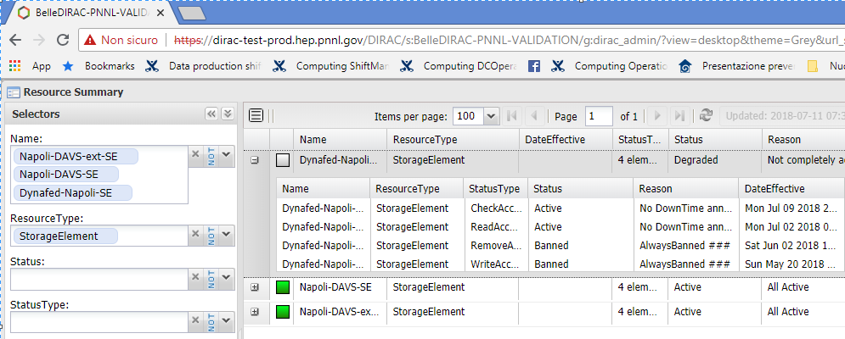
How to use this object?
Using the DIRAC Validation server of Belle II we are investigating different approaches:
Register the Volatile Pool among SEs (in that case we loss the benefit of dynafed)
Register dynafed as a Storage (In that case DIRAC loss the control in writing)
Make a special configuration for the HTTP endpoints registered in DIRAC in order to be used directly in writing and through Dynafed in reading.

Slide 53
How to use this object?
Ongoing test are focussed on three main use-cases:
DAVS protocol in DIRAC
DAVS + Dynafed + DIRAC
DAVS + Dynafed + DPM Volatile Pool (Cache) + DIRAC

Slide 54
How to use this object?
The site VCYCLE.HNSC01.it in PNNL DIRAC has been configured to use the testing http endpoint, included dynafed
We created a set of datasets locally with basf2 then we copied and registered it on KEK-DAVS-SE storage via gb2_ds_put command.

Slide 55
How to use this object?
Submit jobs to DIRAC via gbasf2, taking advantage from the cache.
Early results:
In a protected environment, we replicated datasets to KEK-DAVS-SE and then we ran a set of simple analysis on HNSC resources, reading files from the http storage via Dynafed, using the volatile pool feature as well, experiencing the caching effect.

Slide 56
Dynafed and Cache: Model and implementation
Application
gbasf2
WebDav Client
Federation
Dynafed
Xrootd federation? Rucio?
Cache
DPM Volatile Pool
Xcache ??
Storages
Belle II Https
Endpoints
Belle II Https
Endpoints
Two challenges: User HTTP in the application workflow and implement a caching system

Slide 57
Current Status and ongoing activities
Up to now we manly focussed on setup a working testbed, overcoming the issues and investigating how to introduce the element in a computing model.
Last part 3 months of the SCoRES project will be dedicated in doing performance and resilience tests that should be ready by the end of Febbuary 2018 with the characterization of the testbed.
HammerCloud could be an option in order to produce comparable results.

Slide 58
Additional Initiatives
ATLAS Team of INFN-Napoli are working with similar technologies in the context of ATLAS using Volatile Pool in combination with RUCIO. Preliminary results has been presented at CHEP18, detailed and results will be presented soon.
There are currently a set of new initiatives submitted in different context in Italy to support activities related this topic
Included a research project named “HTTP in Physics (HTTPhy)” submitted within the national call PRIN 2017 (result expected by the end of the year).
I.Bi.S.Co. (Infrastructure for Big Data and Scientific Computing) is a new proposal submitted by several Italian institutions (including INFN and University Federico II) in the contest of the National CALL for datacenter extension. The goal of the project is the creation of a large southern italy distributed infrastructure composed by several sites connected at high speed up to 100Gbp

Slide 59
FileA
FileB
FileA
FileD
FileA DOWLOAD
$
HTTP dCache
HTTP dCache
Cloud Storage
FileA ?
FileC ?
FileA ?
FileC
FileC DOWLOAD
FileB
HTTP DPM
HTTP STORM
DYNAFED FEDERATOR
FileC
FileD ?
$$$
FileD
HTTP CACHE
FileC ?
FileD DOWLOAD
FileC DOWLOAD
FileA
FileA
Cloud Storage
HTTP STORM

Slide 60
Preliminary Tests Details (File Download)
As preliminary test, we download from a User Interface in Napoli a set of Belle II files, stored in CESNET, KEK and UVic . Each file set is downloaded three times as follow:
File Download using the direct link to the remote storage
File Download using Dynafed with Cold cache
File Download using Dynafed with Warm cache
Tests have been performed using files of different size: 50MB, 1GB

Slide 61
Dynafed and Cache: Model and implementation
Application
gbasf2
WebDav Client
Federation
Dynafed
Dynafed
Cache
DPM Volatile Pool
Xcache?
Storages
Belle II Https
Endpoints
Belle II Https
Endpoints
Test this model in Belle II require two steps:
Implement the caching system
Study how to use HTTP/DAV in the application workflow

Slide 62
FileB
FileA
COST EFFECTIVE REPLICA SELETCION
FileD
FileD
$
$
HTTP dCache
HTTP dCache
Cloud Storage
Cloud Storage
FileC DOWLOAD
FileC
FileB
HTTP DPM
HTTP STORM
DYNAFED FEDERATOR
DYNAFED FEDERATOR
FileD ?
FileD ?
$$$
FileD
$$$
HTTP CACHE
FileD
HTTP CACHE
FileD
FileA
Cloud Storage
HTTP STORM
Cloud Storage

Slide 63
FileA
FileB
FileA
FileD
DOWNLOAD DATA FROM THE CLOSEST SERVER
(GEOPLUGIN FEATURE)
FileA DOWLOAD
$
HTTP dCache
FileA DOWLOAD
HTTP dCache
HTTP dCache
Cloud Storage
FileC DOWLOAD
FileA ?
FileB ?
FileA ?
FileC
FileD DOWLOAD
FileB
HTTP DPM
HTTP STORM
DYNAFED FEDERATOR
DYNAFED FEDERATOR
FileC
FileD ?
$$$
FileD
HTTP CACHE
FileC ?
FileC DOWLOAD
FileA
FileA
HTTP STORM
Cloud Storage
HTTP STORM

Slide 64
FileB
FileA
FileB
FileD
$
$
HTTP dCache
FileA DOWLOAD
HTTP dCache
FAILOVER: RESILIENCE TO STORAGE FALUTS
HTTP dCache
Cloud Storage
FileC DOWLOAD
FileC DOWLOAD
FileB ?
FileA ?
FileB ?
FileC
FileB
FileD DOWLOAD
FileB
HTTP DPM
HTTP STORM
HTTP STORM
DYNAFED FEDERATOR
DYNAFED FEDERATOR
FileC
FileD ?
$$$
FileD
HTTP CACHE
FileC ?
FileC DOWLOAD
FileA
Cloud Storage
HTTP STORM

Slide 65
FileA
FileB
FileD
$
FileA DOWLOAD
$
HTTP dCache
HTTP dCache
CACHING POPULAR FILES
Cloud Storage
FileC DOWLOAD
FileA ?
FileC ?
FileC
FileC
FileC
FileD DOWLOAD
FileB
HTTP DPM
HTTP DPM
HTTP STORM
DYNAFED FEDERATOR
FileC DOWLOAD
DYNAFED FEDERATOR
FileC DOWLOAD
FileC
FileC
FileD ?
$$$
HTTP CACHE
FileD
HTTP CACHE
FileC ?
FileC ?
FileC DOWLOAD
FileB DOWLOAD
FileA
Cloud Storage
HTTP STORM

Slide 66
DYNAFED
Dynamic Federations system.
It can aggregate namespaces of different type of storages
HTTP/Webdav Storage
S3 storage
NFS
LFC
Others
Storage aggregation is made on the fly
File metadata are cached on the Dynafed machine.
For the client point of view, Dynafed works as a redirector:
When a client ask for a file to it will be redirect the one of the available replicas.

Slide 67
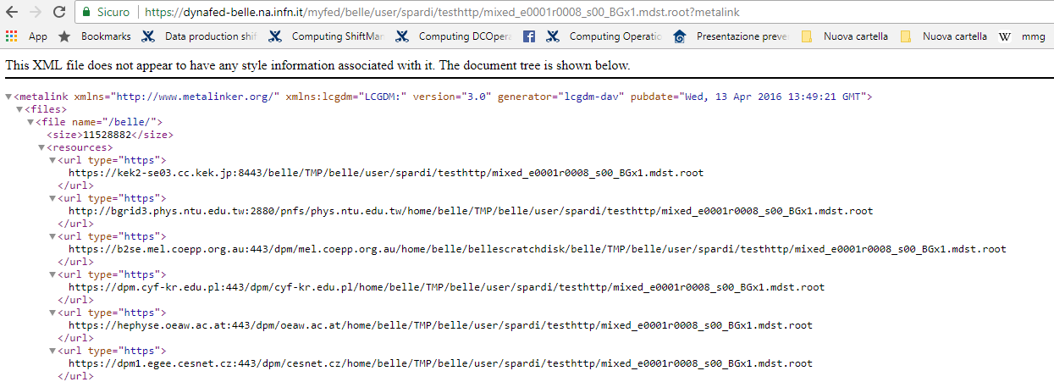
Dynafed file representation: Metalink

Slide 69
Il modello architetturale
Experiment Framework / User Code
HTTP
HTTP
HTTP
HTTP Federation
Caching
HTTP Distributed Storages

Slide 70
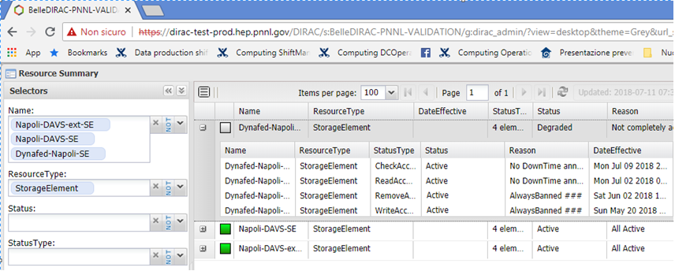
USE CASE Belle II: integrazione in DIRAC 1/3
Configurazioni provate:
Registrare il pool volatile come un SE standard (perdita vantaggi DynaFED)
Registrare DynaFED come SE (perdita controllo delle scrittre)
Configurazione lettura/scrittura “asincrona” degli endpoint HTTP

Slide 71
USE CASE Belle II: integrazione in DIRAC 2/3
Dirac è un framework per la gestione ‘all-in-one’ per il calcolo distributo.
Il sito VCYCLE.HNSC01.it nel DIRAC di PNNL è stato configurato per usare endpoint HTTP, incluso DynaFed.
Sono stati copiati e registrati sullo storage KEK-DAVS-SE dei dataset con il comando gb2_ds_put.

Slide 72
USE CASE Belle II: integrazione in DIRAC 3/3
Sottomissione di job gbasf2 via DIRAC utilizzando la cache.
Dataset replicati a KEK
Job di analisi accedendo a Dynafed via HTTP
Test intero workflow di analisi

Slide 73
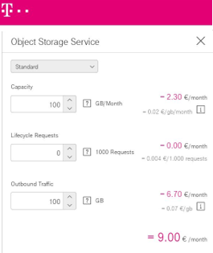
USE CASE Cloud Access: riduzione costi di accesso
Utilizzo del sistema di cache per l’accesso a risorse in cloud
Utilizzate risorse di T-System nell’ambito del progetto HNSC
Stima trasferimento 100GB/mese: 6.7€

Slide 74
USE CASE Cloud Access: nuovi plugin di DynaFED
Necessità di gestire diversamente l’ordine delle repliche dei metalink
Sviluppo di due nuovi plugin per DynaFED:
Price plugin
Default Plugin
L’uso combinato di questi due plugin permette di creare numerosi nuovi scenari!

Slide 75
FileA
FileB
FileA
FileD
$
HTTP dCache
HTTP dCache
Cloud Storage
FileC
HTTP DPM
FileB
HTTP STORM
DYNAFED FEDERATOR
$$$
HTTP CACHE
FileD
FileA
FileA
Cloud Storage
HTTP STORM

Slide 76
FileA
FileB
FileA
FileD
$
HTTP dCache
HTTP dCache
Cloud Storage
FileC
HTTP DPM
FileB
HTTP STORM
DYNAFED FEDERATOR
FileD
$$$
HTTP CACHE
FileD
FileA
FileA
Cloud Storage
HTTP STORM

Slide 77
FileA
FileB
FileA
FileD
$
HTTP dCache
HTTP dCache
Cloud Storage
FileC
HTTP DPM
FileB
HTTP STORM
DYNAFED FEDERATOR
FileD
$$$
HTTP CACHE
FileD
FileA
FileA
Cloud Storage
HTTP STORM

Slide 78
FileA
FileB
FileA
FileD
$
HTTP dCache
HTTP dCache
Cloud Storage
$
FileC
HTTP DPM
FileD DOWLOAD
FileB
HTTP STORM
DYNAFED FEDERATOR
FileD
FileD
FileD DOWLOAD
$$$
HTTP CACHE
FileD
FileA
FileA
Cloud Storage
HTTP STORM

Slide 79
FileA
FileB
FileA
FileD
$
HTTP dCache
HTTP dCache
Cloud Storage
FileC
HTTP DPM
FileB
HTTP STORM
DYNAFED FEDERATOR
1
2
FileD
FileD
FileD DOWLOAD
$$$
HTTP CACHE
FileD DOWLOAD
4
FileD DOWLOAD
FileD
FileA
FileA
Cloud Storage
HTTP STORM

Slide 80
USE CASE Cloud Access: sperimentazione plugin
Stima costi da un client sulla rete DESY (Germania) usando i nuovi plugin:
 | Total Size (GB) | Plugin | Costo I accesso | Costo II accesso | Costo III acceso
CLOUD | 100 | GeoIP | 6,7 € | 6,7 € | 6,7 €
SCORES | 100 | GeoIP+Price/Default | 6,7 € | 0 | 0
Configurazione PRICE Plugin
recas-dpm-01.na.infn.it 0.20
dcache-belle-webdav.desy.de 0.40
kek2-se03.cc.kek.jp 0.50
dcache.ijs.si 0.50
charon01.westgrid.ca 0.50
dpm1.egee.cesnet.cz 0.50
davide.obs.otc.t-systems.com 0.80
Configurazione Default Plugin
131.169.168 recas-dpm-01.na.infn.it
79.23 kek2-se03.cc.kek.jp

