Slide 1

PANDORA meeting
Thursday 31 Jan 2019,
RF and Microwave Plasma Heating:
Modeling and Perspectives
G. Torrisi
INFN - Laboratori Nazionali del Sud, Catania, Italy
Notes:
Since 2012, the INFN ion source group has been undertaking an intense activity on numerical modelling of RF-magnetically confined plasmas interaction. The aim is the development of a predictive tool for the design of Electron Cyclotron Resonance (ECR) Ion Sources ,Traps and ECR-based Charge Breeders, In particular in my talk I will describe our powerful three-dimensional numerical simulations and Radio Frequency (RF) measurements of the EM field in magnetized plasmas of ion sources.

Slide 2
Outline
INTRODUCTION
Microwave-to-plasma coupling “Cavity-dominated” VS “Launching-dominated”
NUMERICAL MODELING
- 3D EM wave propagation in the anisotropic magnetized plasmas (“cold approximation”)
-3D Self-consistent Plasma Model: couple Maxwell’s equations to kinetic Equation
Notes:
To start Here I briefly summarize a table of contents of my talk: So will describe the motivation and the progress made during last years on plasma-wave interaction modeling.

Slide 3
Outline
INTRODUCTION
Microwave-to-plasma coupling “Cavity-dominated” VS “Launching-dominated”
NUMERICAL MODELING
- 3D EM wave propagation in the anisotropic magnetized plasmas (“cold approximation”)
-3D Self-consistent Plasma Model: couple Maxwell’s equations to kinetic Equation
IMPLEMENTATION AND EXPERIMENTAL BENCHMARKS
Simple-mirror axis-symmetric linear device (Flexible Plasma Trap @INFN-LNS)
Notes:
To start Here I briefly summarize a table of contents of my talk: So will describe the motivation and the progress made during last years on plasma-wave interaction modeling.
I will focus especially on our approach to do a microwave measurement in a so electromagnetically complicated scenario such as the compact ion sources.
I will show the most important experimental results. Finally, I'll conclude with some future development/perspectives

Slide 4
Outline
INTRODUCTION
Microwave-to-plasma coupling “Cavity-dominated” VS “Launching-dominated”
NUMERICAL MODELING
- 3D EM wave propagation in the anisotropic magnetized plasmas (“COLD approximation”)
Electron Cyclotron Resonance Heating (ECRH)
- 3D Self-consistent Plasma Model: couple Maxwell’s equations to kinetic Equation
IMPLEMENTATION AND EXPERIMENTAL BENCHMARKS
Simple-mirror axis-symmetric linear device (Flexible Plasma Trap @INFN-LNS)
PERSPECTIVES
1. “HOT tensor” approximation
2. Modeling of Ion dynamics and ion cyclotron resonance heating (ICRH)
Notes:
To start Here I briefly summarize a table of contents of my talk: So will describe the motivation and the progress made during last years on plasma-wave interaction modeling.
I will focus especially on our approach to do a microwave measurement in a so electromagnetically complicated scenario such as the compact ion sources.
I will show the most important experimental results. Finally, I'll conclude with some future development/perspectives

Slide 5
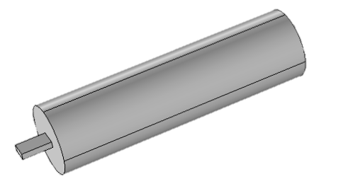
Simulation Setup
Single mode TE₁₀
rectangular Waveguide
Simulation parameter
PARAMETER | VALUE
Cavity length | 450 mm
Cavity radius | 65 mm
Frequency | 8 GHz
Waveguide width | 28.5 mm
Waveguide height | 12.6 mm
RF Power | 100 W
3D cylindrical cavity

Slide 6
Simulation Setup
Single mode TE₁₀
rectangular Waveguide
Simulation parameter
PARAMETER | VALUE
Cavity length | 450 mm
Cavity radius | 65 mm
Frequency | 8 GHz
Waveguide width | 28.5 mm
Waveguide height | 12.6 mm
RF Power | 100 W
3D cylindrical cavity filled by plasma
described by the dielectric tensor

Slide 7
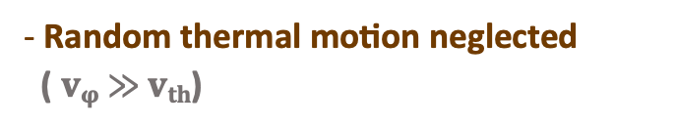
Basic equations of wave propagation in
“cold” plasma
Maxwell’equations
Constitutive relations
DERIVATION OF CONDUCTIVITY TENSOR
3D cold plasma modeling: plasma as a dispersive medium with collisions
Random thermal motion neglected
( v_{φ} $≫$ v_{th})
collision frequency ω_{eff} accounts for the collision friction, models the wave damping and resolves the singularity of some elements of tensor
Notes:
Cold fluid equation is used to compute the electromagnetic field through a FEM strategy (requiring constitutive relations of the medium).

Slide 8
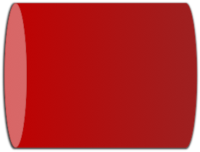
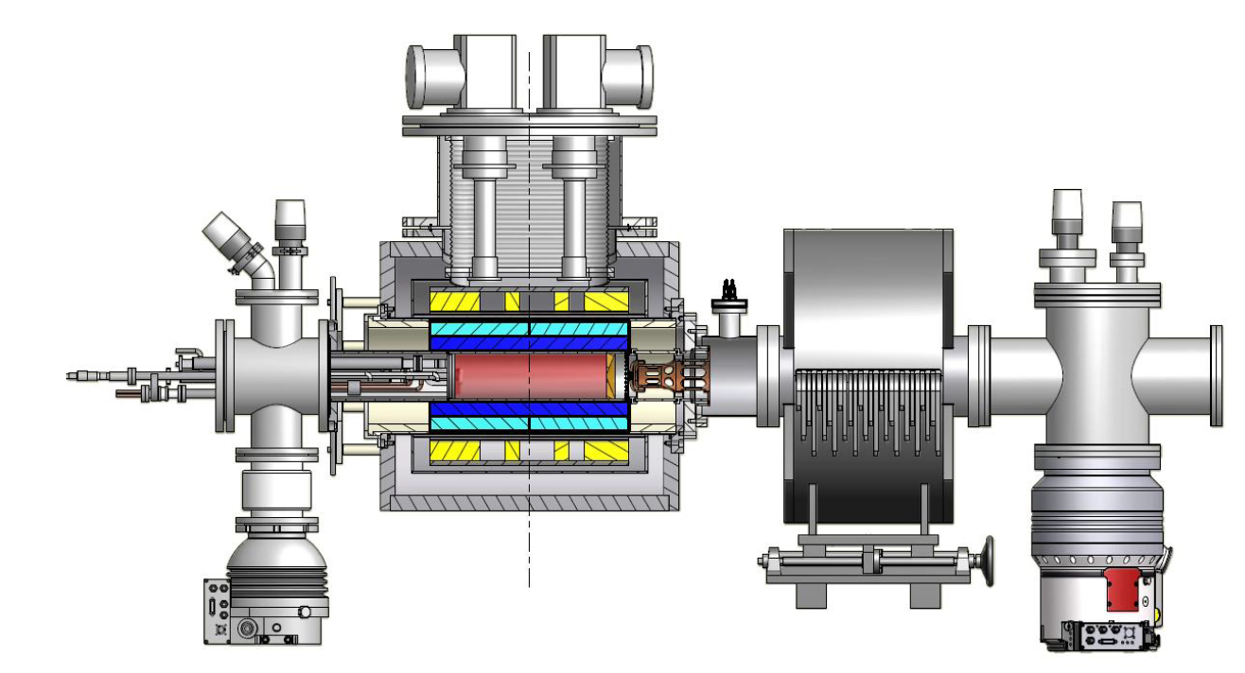
“Launching” vs “Cavity”
Microwave-plasma coupling
JET Tokamak for nuclear fusion
ECR ION Source: extremely compact plasma machine
“Cavity-dominated”
Plasma
chamber
λ≈L_{c,} L_{p}
λ<<L_{c}, L_{p}
Notes:
For densities in the range 1011-1013 cm-3 (plasmas for thermonuclear fusion and/or heavy ion sources for accelerators [2]), the plasma and plasma chamber lengths, and λ0 the RF vacuum wavelengt are approximately equal.
This greatly complicates the measurement due to multi-component signals caused by reflections on the metallic walls of the compact metallic plasma chamber.

Slide 9
“Launching” vs “Cavity”
Microwave-plasma coupling
microwave-to-plasma coupling
“Launching-dominated”
“Cavity-dominated”
    In large-size fusion reactor ray-tracing calculations can be performed
in the ECRIS, ray-tracing approximation is not applicable, and the full-wave calculations have to be applied to simulate the wave behaviour in the plasma
Notes:
This implies that the optical approximation - widely used in large-size fusion reactors where ray-tracing calculations are often performed - cannot be extended to ECR-type ion sources.

Slide 10
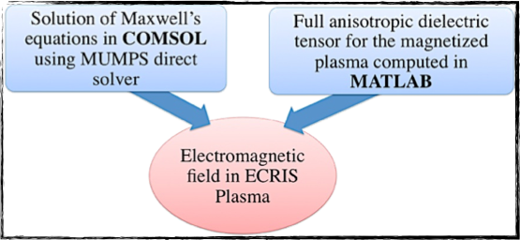
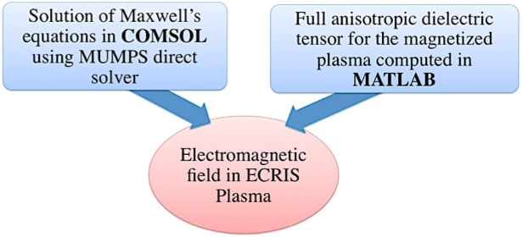
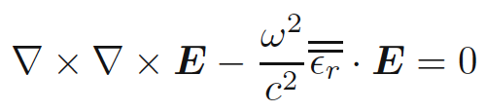
Modeling of wave propagation in
Anisotropic plasma of ECRIS
Wave equation with tensorial permittivity
Fully-3D non homogeneous dielectric permittivity Tensor depends on local electron density and magnetic field B
Notes:
Combining Maxwell’s equations and using the constitutive relations for an anisotropic medium, the
wave equation reads as: The above wave equation can be solved as a driven problem by a FEM solver that supports a non homogeneous tensorial
constitutive relation we used COMSOL and an external MATLAB routine allowing the definition of the full 3D dielectric tensor that we derive for a general non symmetric magnetic field.
The overall simulation strategy is depicted in Figure 1.
The method is based on a strict interplay between COMSOL
solver and the particle mover implemented in MATLAB.
Several loops are expected to be needed in order to
get convergence. Due to huge time-consuming calculations
needed at each loop-step k, hereby we show results up to
step 2, i.e. after evaluation of RF action on electrons and
vice-versa, for two times

Slide 11
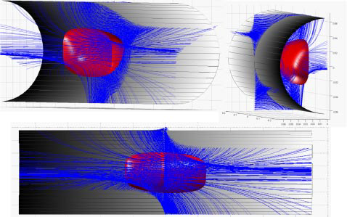
Non-uniform “local” dielectric tensor
Non-symmetric 3D magnetostatic field
Assuming a non uniform magnetostatic field the dielectric tensor is:
Off-diagonal Elements due to 3D Magnetic field

Slide 12
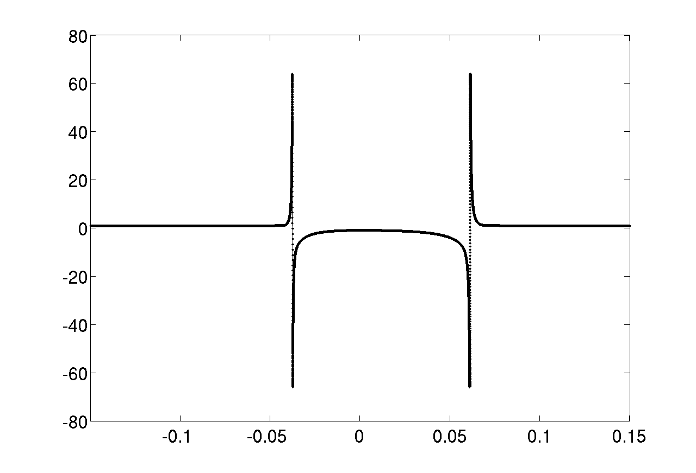
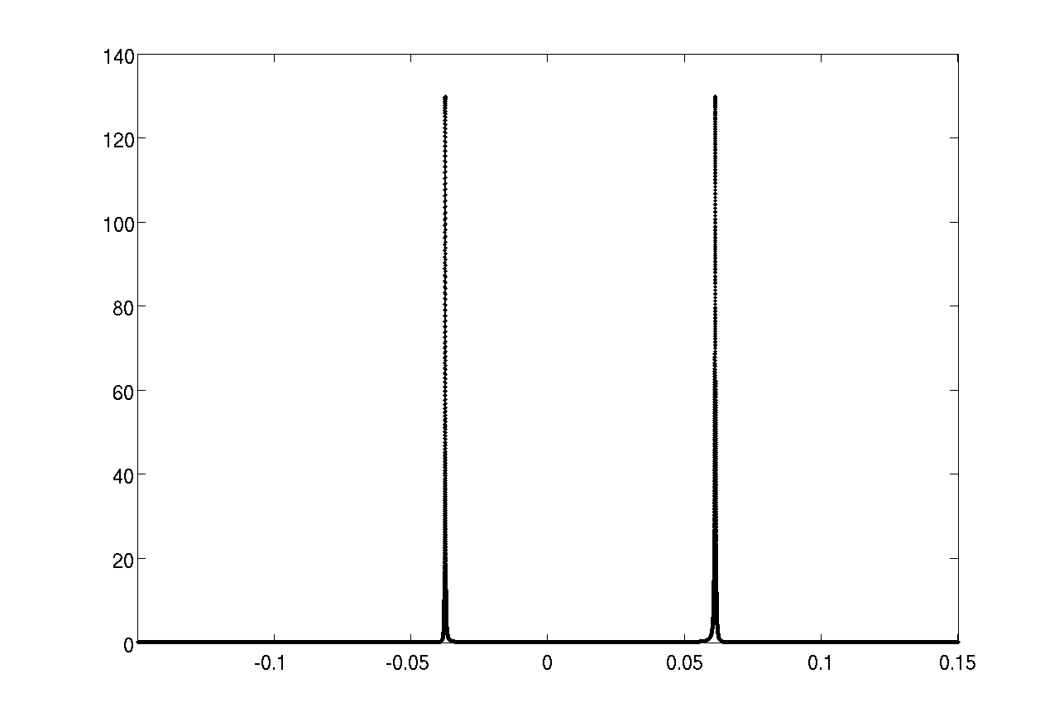
FEM “Full Wave” solution approach
Real part of ε_{r11}
Imaginary part of ε_{r11}
ECR layer
ECR layer
Notes:
– Solve for E-fields everywhere within some volume
– Conducting boundary condition at metal walls
– Use σ tensor

Slide 13
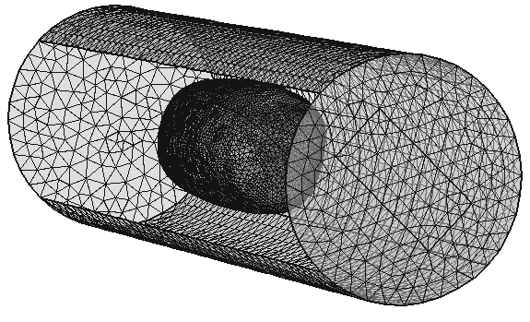
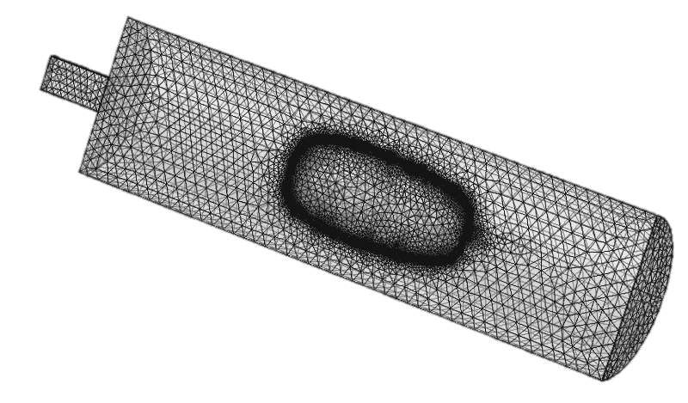
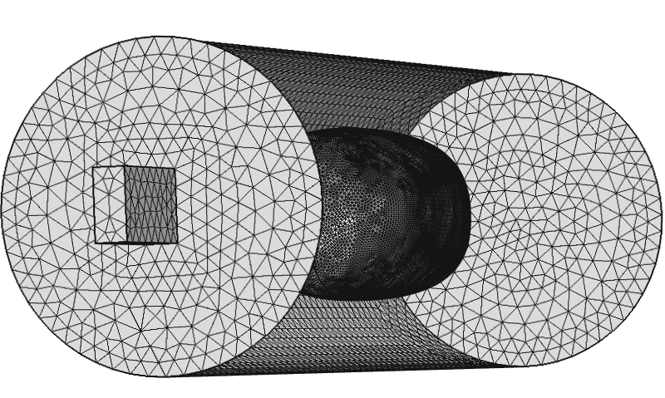
Mesh procedure
ECR-surface-based mesh to create a fine mesh on the ECR surface
The mesh is very fine on the ECR surface and relatively coarser away from the resonance zone.

Slide 14
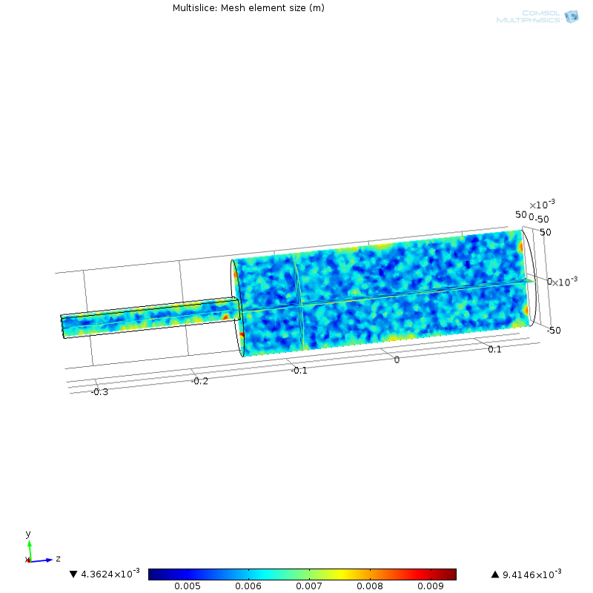
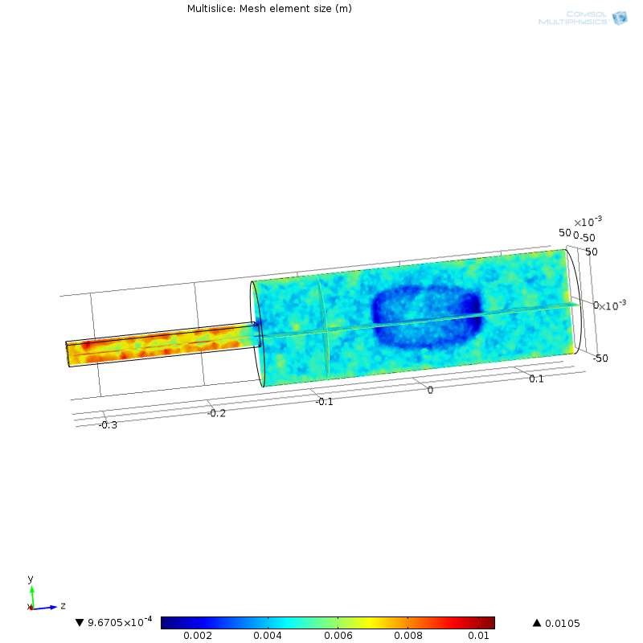
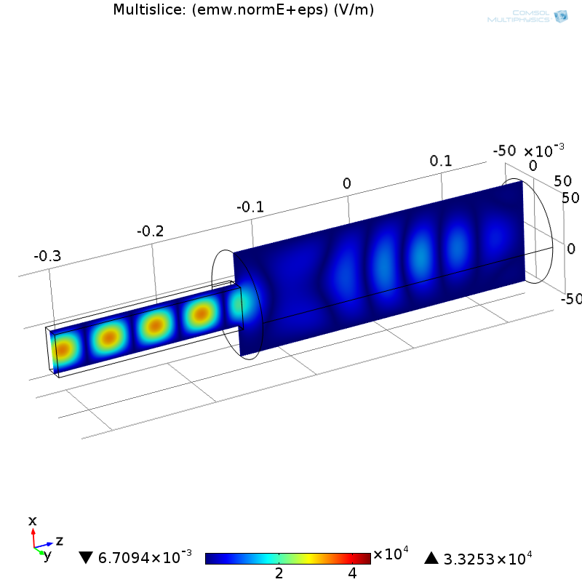
“Standard” vs “Adaptive” MESH
“Standard”Mesh generation
“Adaptive” Mesh refinement

Slide 15
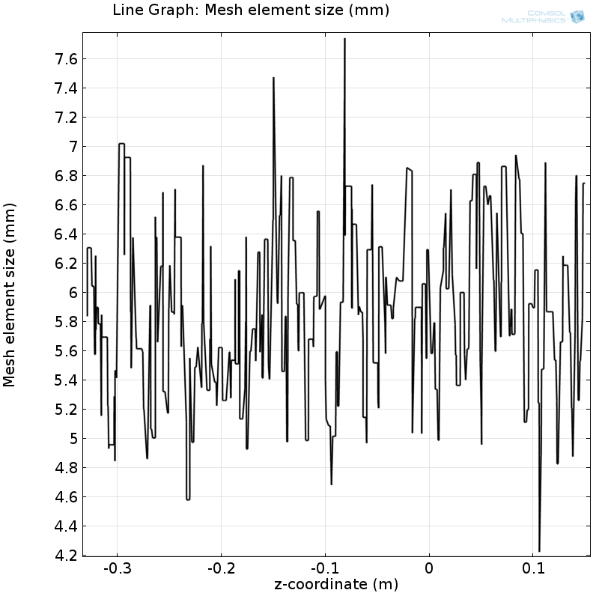
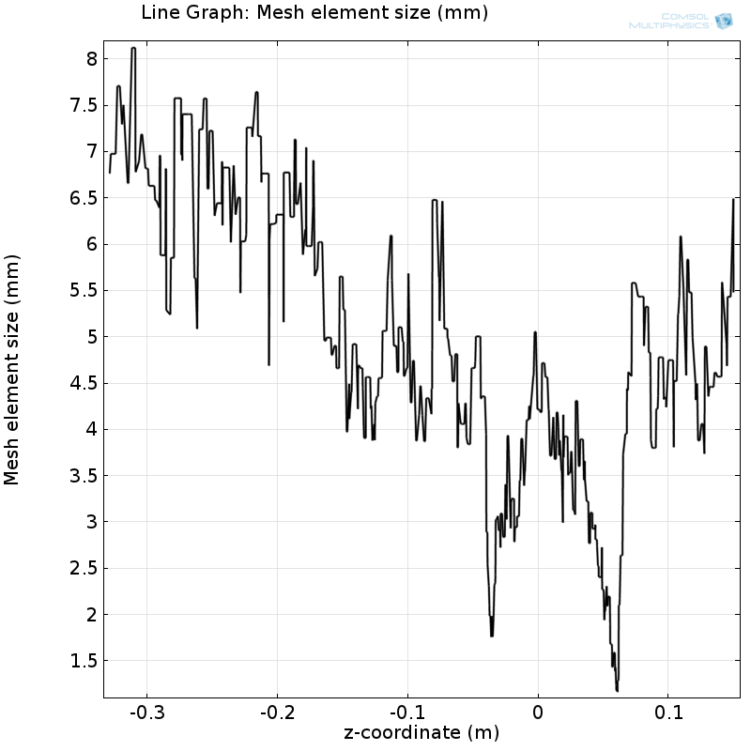
“Standard” vs “Adaptive” MESH
Mesh size along z-axis
Mesh size along z-axis
ECR layer

Slide 16
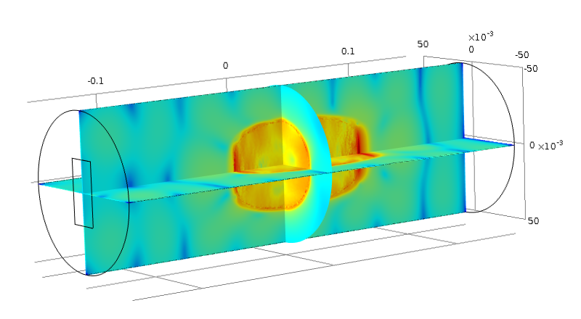
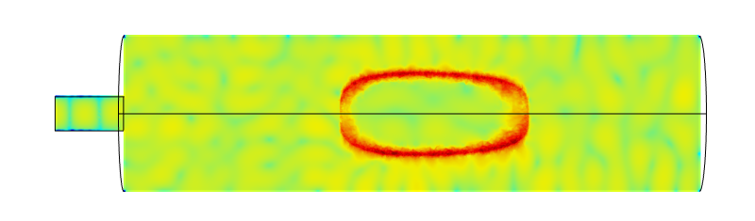
Numerical results: Snapshots of the Electric field and Power loss density on a slice
The largest fraction of energy is absorbed
at the ECR
Intensification of the e.m. field in the near resonance zone
Electromagnetic power loss density [W/m3]
TE₁₀ mode in vacuum WR
Cold Plasma
2÷3 orders of magnitude Difference between Electric field of ECR zone and outer ones
ECR layer
Power deposition : the 55 % of the total input Power is absorbed by the plasma

Slide 17
Numerical results: Snapshots of the Electric field and Power loss density on a slice
The largest fraction of energy is absorbed
at the ECR
Intensification of the e.m. field in the near resonance zone
Electromagnetic power loss density [W/m3]
TE₁₀ mode in vacuum WR
Cold Plasma
2÷3 orders of magnitude Difference between Electric field of ECR zone and outer ones
[G. Torrisi, D. Mascali, G. Sorbello, L. Neri, L. Celona, G. Castro,T. Isernia, and S. Gammino,
"Full-wave FEM simulations of electromagnetic waves in strongly magnetized non-homogeneous plasma",
Journal of Electromagnetic Waves and Application 28(9), 1085-1099 (2014)]
ECR layer

Slide 18
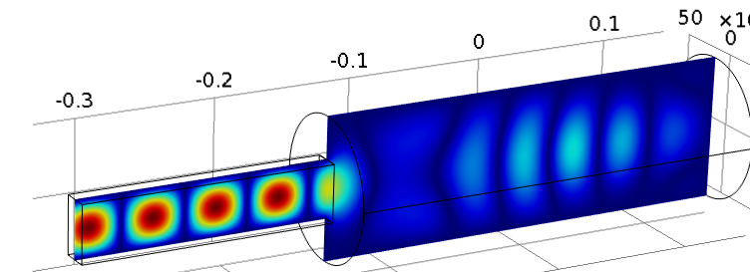
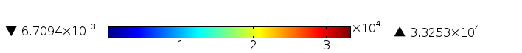
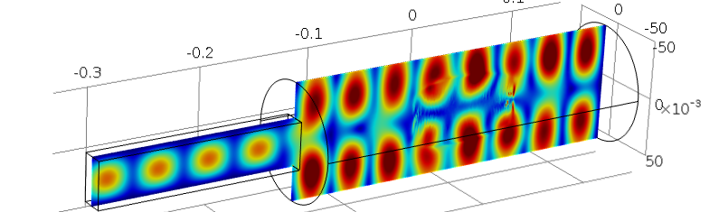
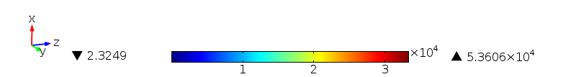
3-D wave fields in the xz:
VACUUM chamber and launching structure RF field
@ f_{RF}= 5 GHz
3-D wave fields in the xz :
PLASMA FILLED chamber and RF launching structure
ECR region
Notes:
The figure shows the electric field distribution inside the cylindrical cavity excited by the rectangular waveguide. The presence of the cavity walls, modeled via the perfect electric conductor boundary condition, makes thenelectromagnetic eld pattern to configure in a cavity mode like structure.

Slide 19
Integrated RF modeling and particle dynamic
✓
3D Maxwell equation
Vlasov equation
Wave propagation
absorption
Plasma response
COMSOL Wave eq. solver
Plasma dynamics ionization, recombination, diffusion losses, collisions
Our goal is to obtain quantitatively accurate, predictive understanding of wave
processes important for heating plasma
Notes:
With respect to the theory and modeling, the problem of electron cyclotron heating may be divided into two different parts: The problem of the wave propagation and absorption (effect of the plasma on the
wave) and the problem of the evolution of the electron distribution function (wave effect on the plasma) [6]. One usually treats each part of the problem separately, while a coupling of the two parts constitutes
the core of a self-consistent treatment (see, e.g., [7, 8]). For our interest, the problem of wave propagation and absorption is straightly connected to the solution of Maxwell's equations. In problems involving realistic
wave and plasma geometry, a numerical treatment is unavoidable due to the complicated form of the associated equations.

Slide 20
Iterative “Stationary” PIC strategy
Diagram
COMSOL as
“3D Maxwell eq.
Solver”
Computing tensor ε
Maxwell eq.
FEM solution of
Maxwell eq.
STOP
In Matlab code
Stationary PIC
“Particle Mover”
NO
YES
Particle
“life”
end
Self-
consistency
check
START
n_{e}=0
YES
NO
“Boris method”
Integration
Collisions by Langevin method
Notes:
More in details, the tensor is introduced into the FEM code to compute RF field. Iterative “Stationary” PIC strategy Diagram. density distribution into the plasma is computed by a kinetic code, then we use the density map to calculate the permittivity tensor; finally, The loop restart by computing once again particles motion with the new field, and it stops (hopefully) when the self-consistent is achieved. The numerical code (written in MATLABr ) uses a
numerical artifice to consider a well defined statistical
sample and accumulate statistical information for all the
life of the sample itself: in other terms, the “Particle
Mover” code solves the equation of motion (3) of each
single macro-particle for its entire life, accumulating the
electron density in 3D grid. In this sense, our approach
can be defined as a “stationary” PIC.
Particles move inside a 3D frame

Slide 21
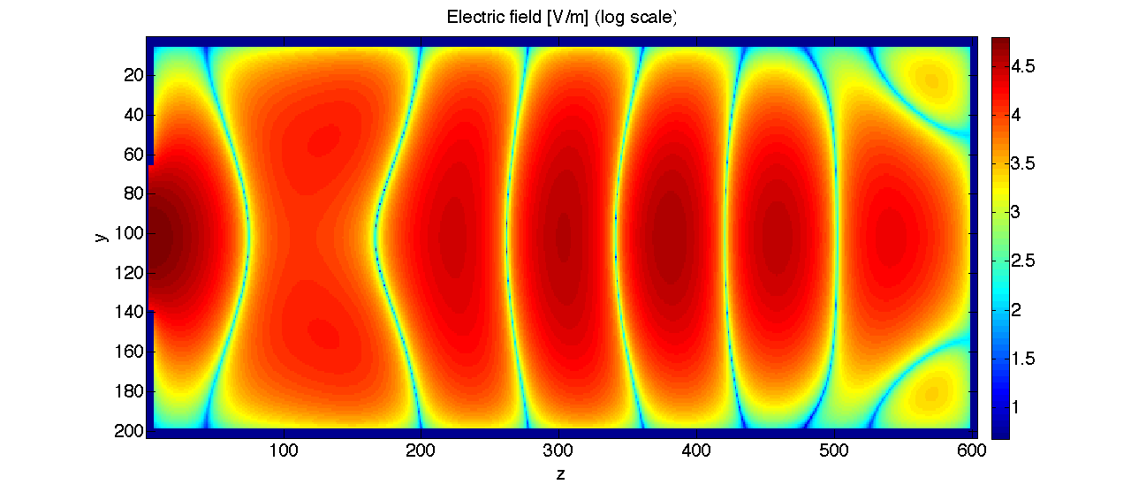
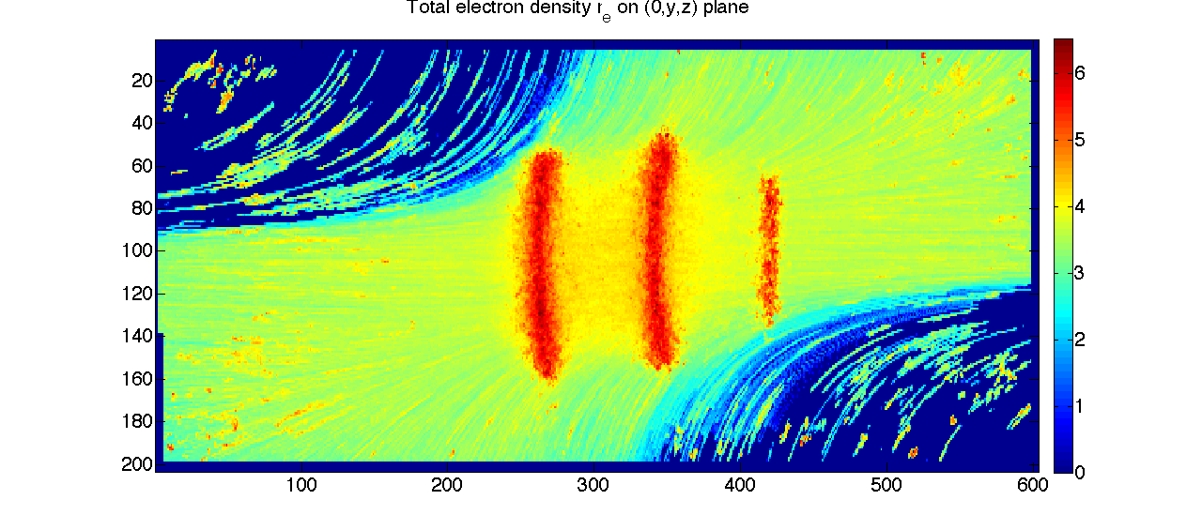
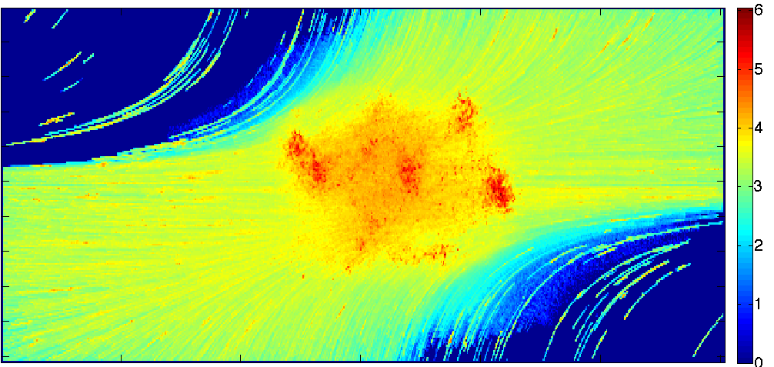
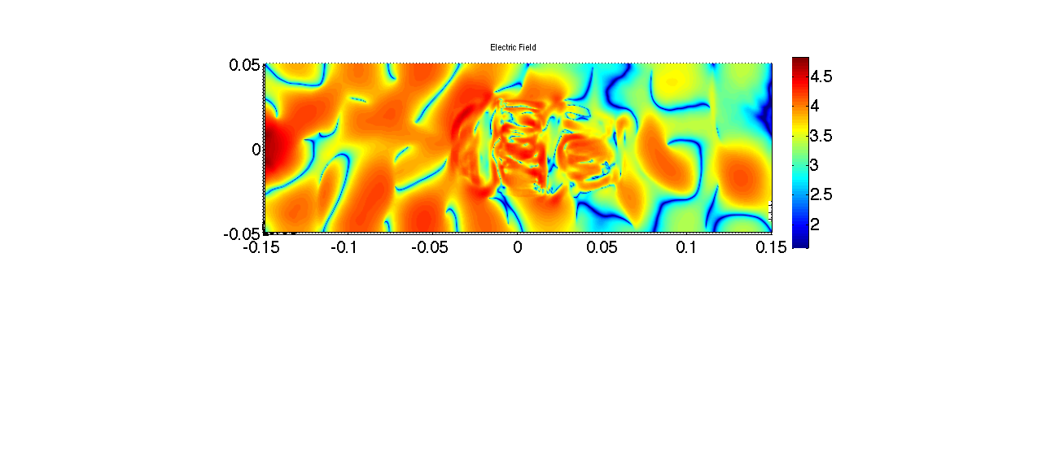
Iterative self consistent approach
|E| field on (0, y, z) plane (log scale)
in vacuum
|E| field on (0, y, z)
plane (log scale)
Electron density on
(0, y, z) plane (log scale)
Electron density on(0, y, z) plane
|E| field on (0, y, z)
plane (log scale)

Slide 22
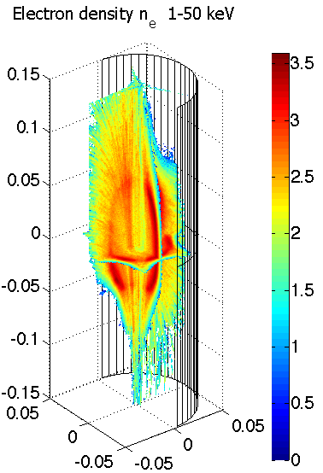
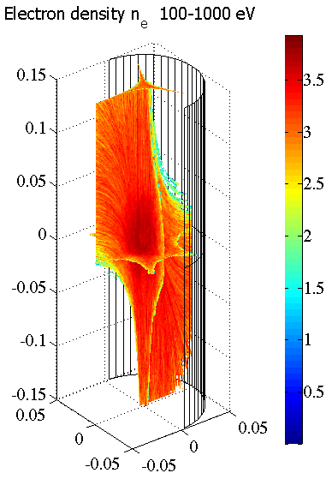
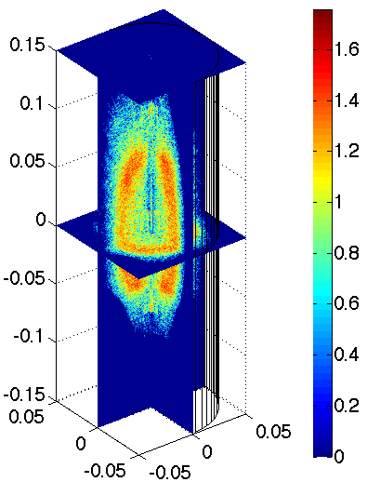
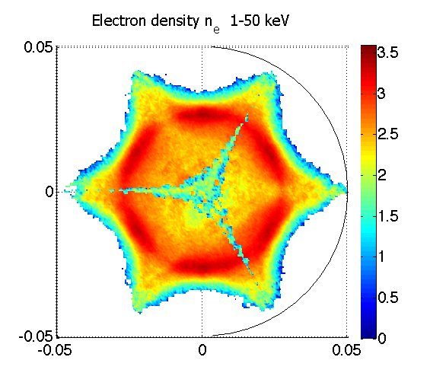
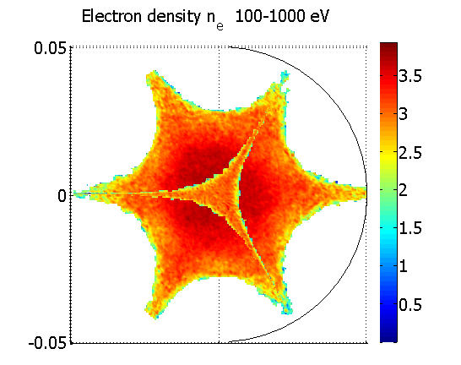
Self-consistent simulations
Simulated electron density distribution at different Energy ranges
Electron density >50 keV
Different space distribution:
cold electrons in the core,
hot ones in near ECR regions
the plasma concentrate mostly in near resonance region:
a dense plasmoid is surrounded by a rarefied halo
PHYSICS addressed
3D Density and Energy map
Relativistic Electrons Dynamics with collisions
N=40000 simulated particles
T_{step}=10⁻¹² s
T_{spam} = 40 µs
f=14.521 GHz
P=100 W
Notes:
proof of principle

Slide 23
Self-consistent simulations
Simulated electron density distribution at different Energy ranges
Electron density >50 keV
Different space distribution:
cold electrons in the core,
hot ones in near ECR regions
the plasma concentrate mostly in near resonance region:
a dense plasmoid is surrounded by a rarefied halo
[D. Mascali, G. Torrisi, L. Neri , G. Sorbello, G. Castro, L. Celona, and S. Gammino. Eur. Phys. J. D (2015) 69: 27 DOI: 10.1140/epjd/e2014-50168-5]
PHYSICS addressed
3D Density and Energy map
Relativistic Electrons Dynamics with collisions
N=40000 simulated particles
T_{step}=10⁻¹² s
T_{spam} = 40 µs
f=14.521 GHz
P=100 W
Notes:
proof of principle

Slide 24
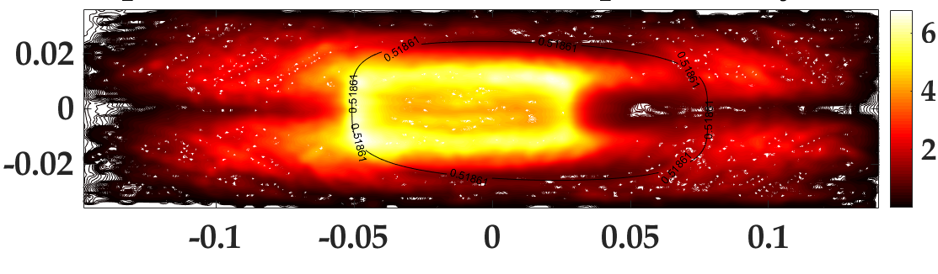
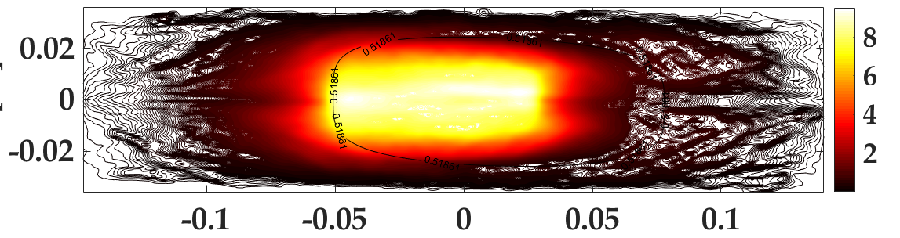
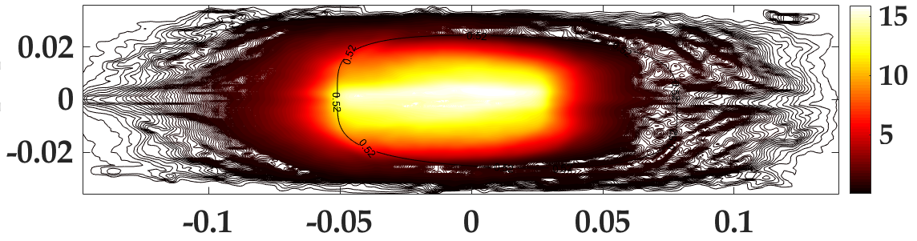
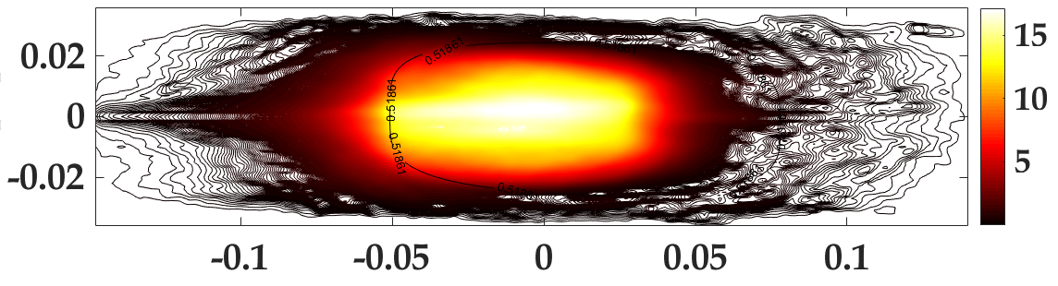
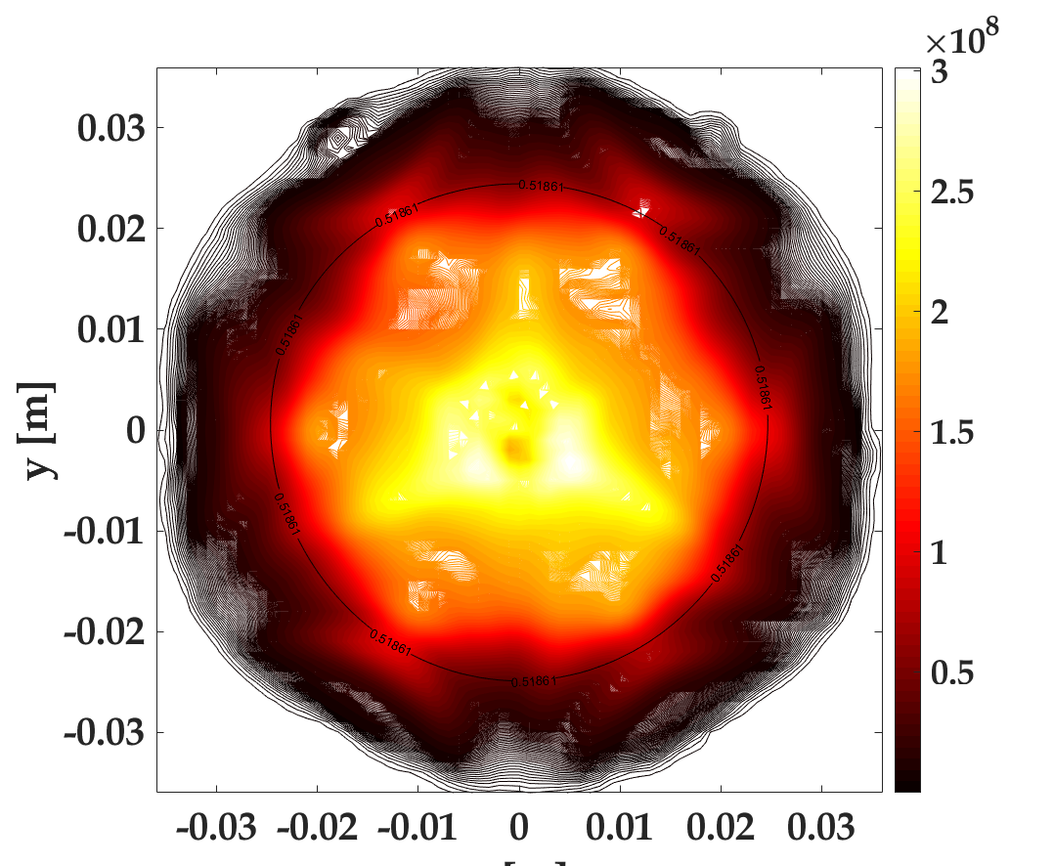
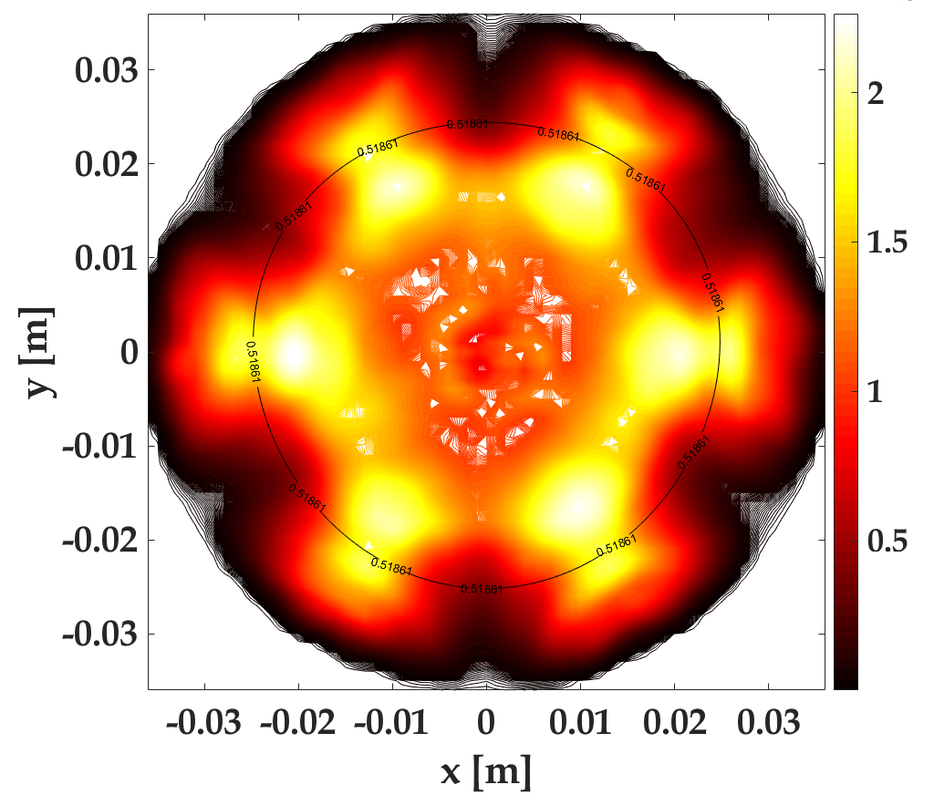
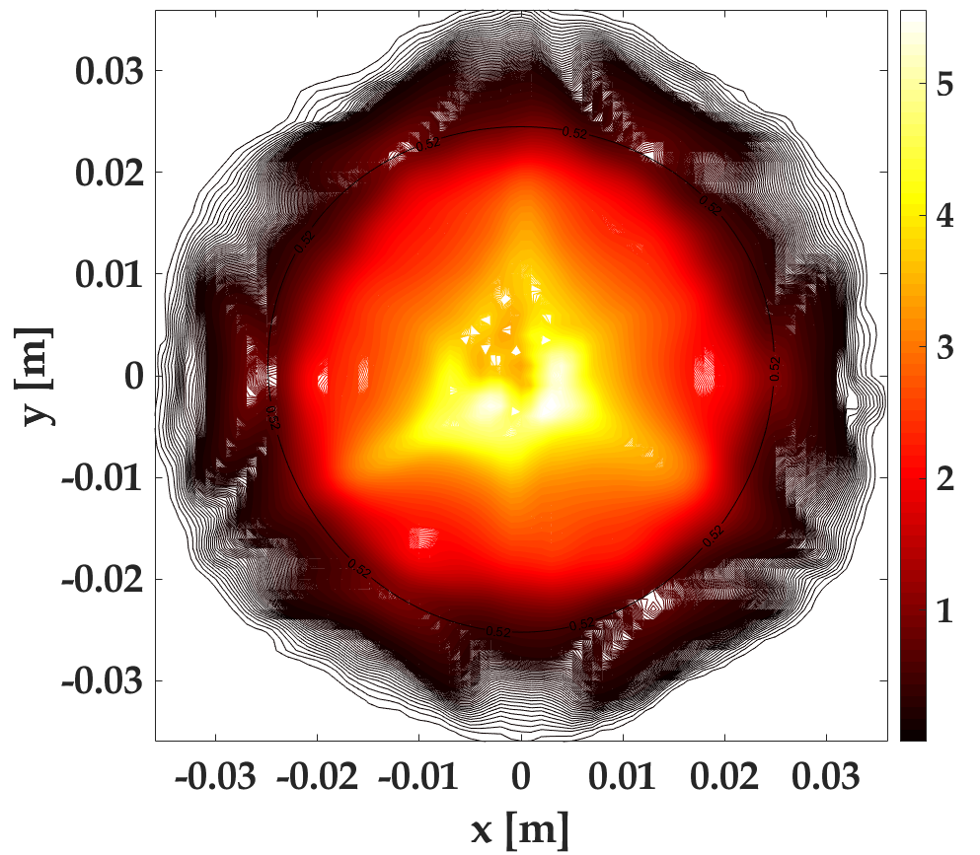
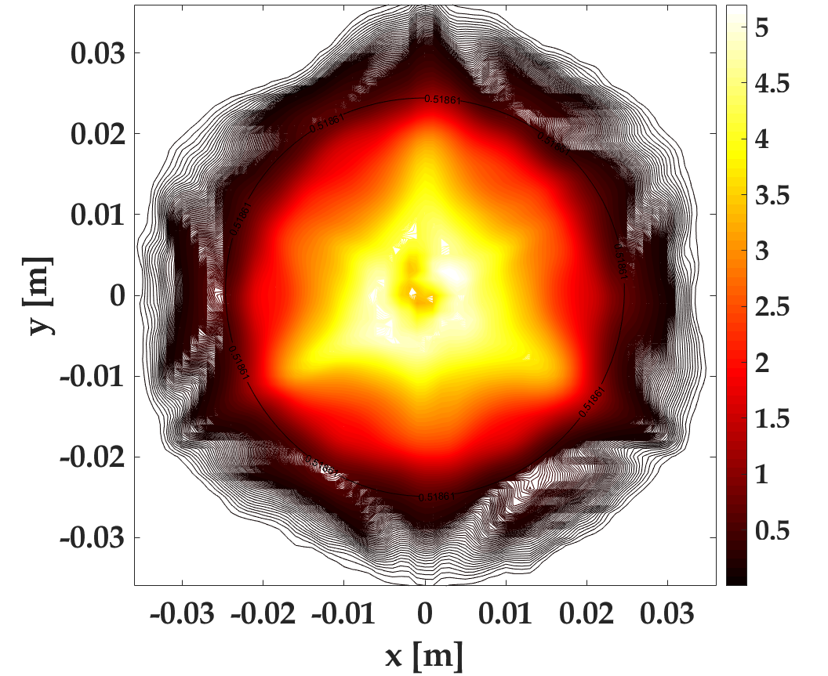
Road Towards Self Consistency…
exit from the loop
Electron Density on xz plane (y=0)
STEP 1
STEP 2
STEP 3
STEP 4
Electron Density on xy plane (z=0)
STEP 1
STEP2
STEP 3
STEP 4

Slide 25
Road Towards Self Consistency…
exit from the loop
✓
Electron Density on xz plane (y=0)
STEP 1
STEP 2
PLASMOID/HALO MODEL CONFIRMED!
DENSIY FINE STRUCTURE
STEP 3
STEP 4
Electron Density on xy plane (z=0)
STEP 1
STEP2
STEP 3
STEP 4

Slide 26
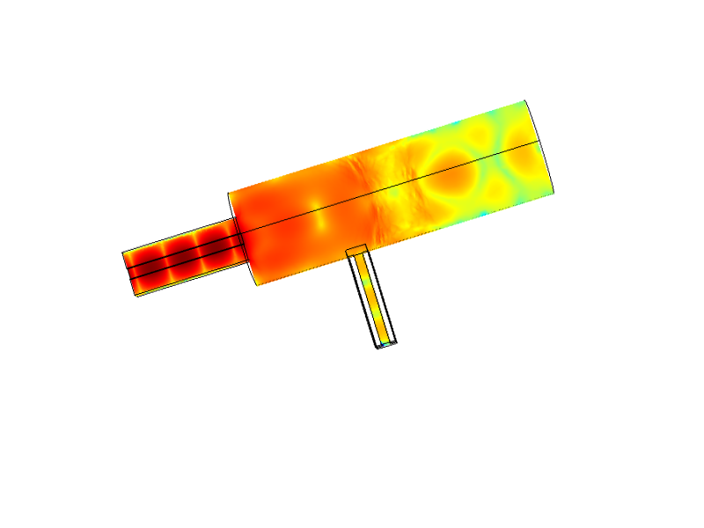
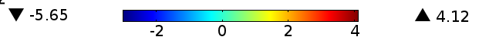
IMPLEMENTATION AND EXPERIMENTAL BENCHMARK
Simple-mirror axis-symmetric linear device (Flexible Plasma Trap @INFN-LNS)
FULL-WAVE SIMULATION OF
WAVES in FPT magnetized
plasma
FPT Plasma Chamber
ECR
ELECTRIC PEAKS
Waveguide
Notes:
meaningful

Slide 27
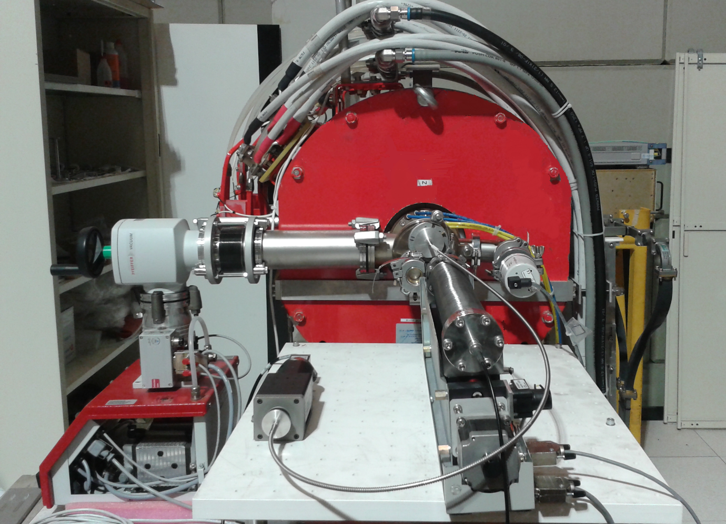
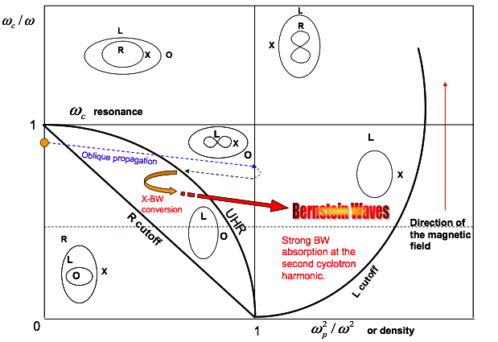
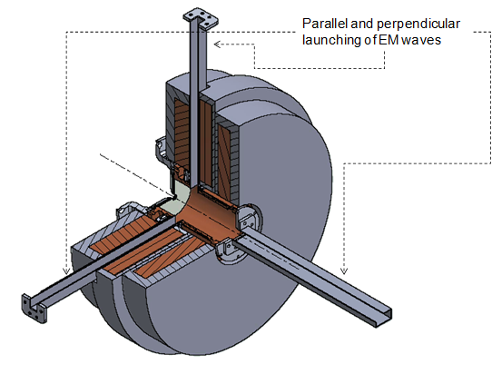
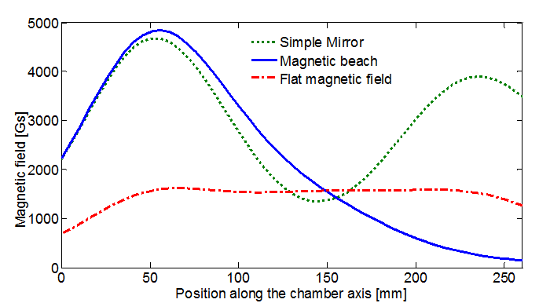
Flexible Plasma Trap (FPT) Setup @INFN-LNS
Flexible magnetic field
Flexible RF injection
Flexible magnetic field generated by three solenoids generator;
Different magnetic field profiles: Simple Mirror & Magnetic Beach
Three microwaves inputs:
1 axial and 2 radial;
Microwave frequency in the range 4-7 GHz
Modal Conversion for overdense plasma production

Slide 28
Measurements of wave in plasma:
Special probes development
sensitive to the short wavelength of longitudinal waves near the resonance layer
polarization sensitive, the electrostatic radial component
small enough to have the desired spatial resolution
Simulated Electric filed profile along longitudinal z-axis and transversal x-axis of FPT
Notes:
fast varying

Slide 29
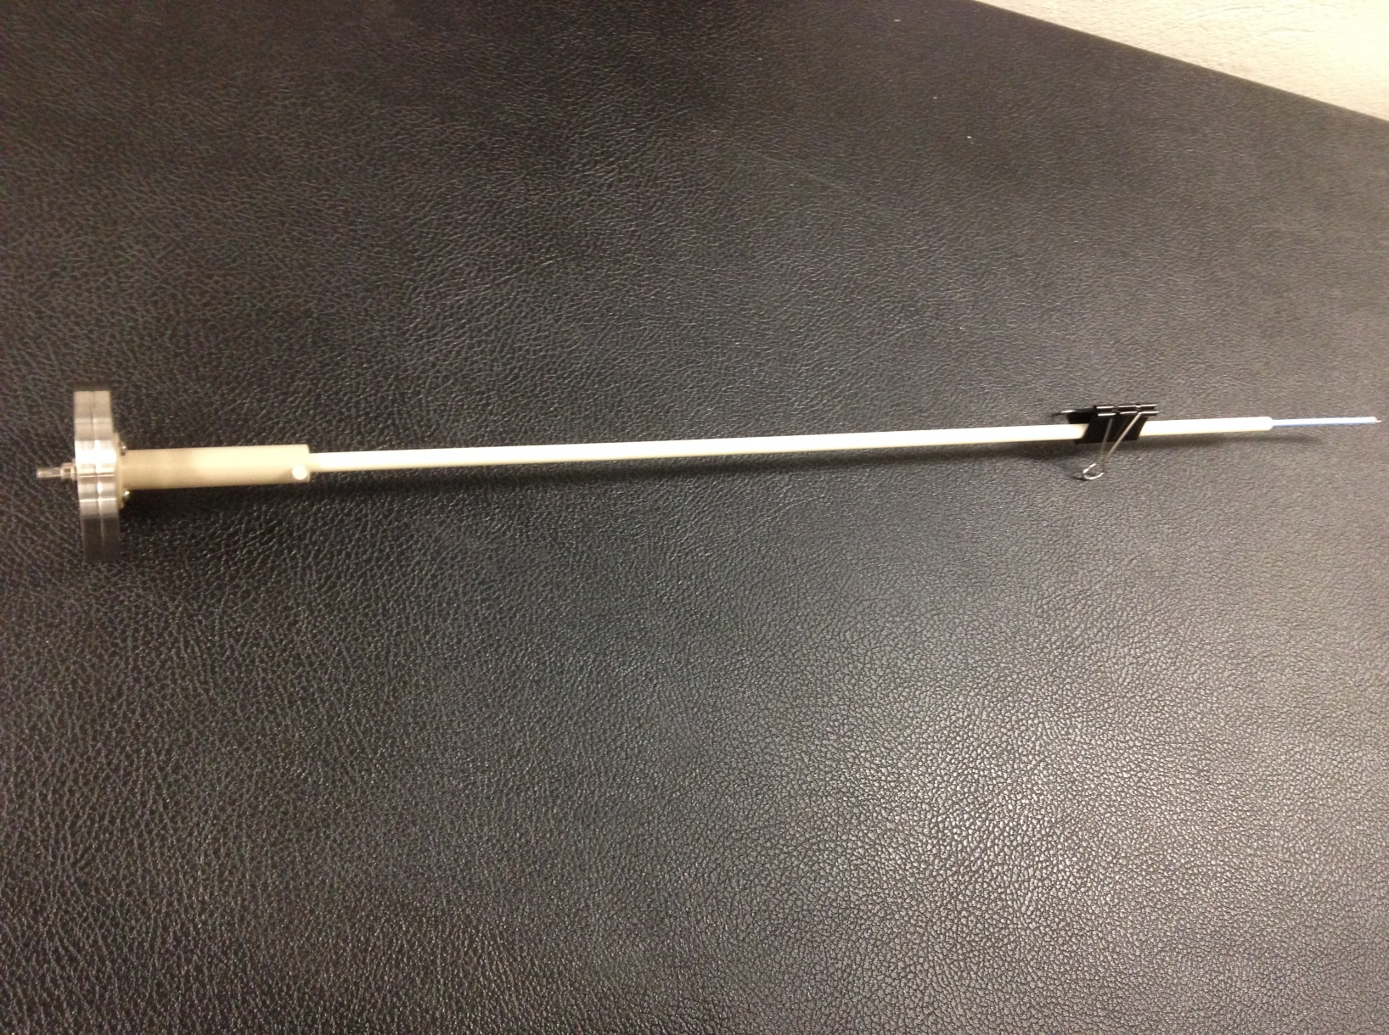
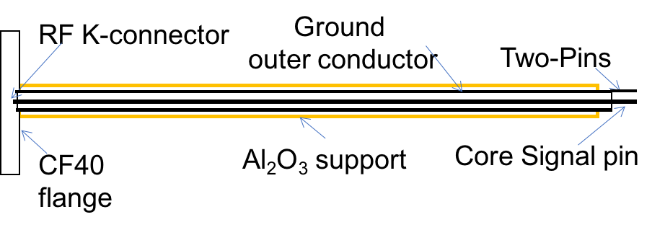
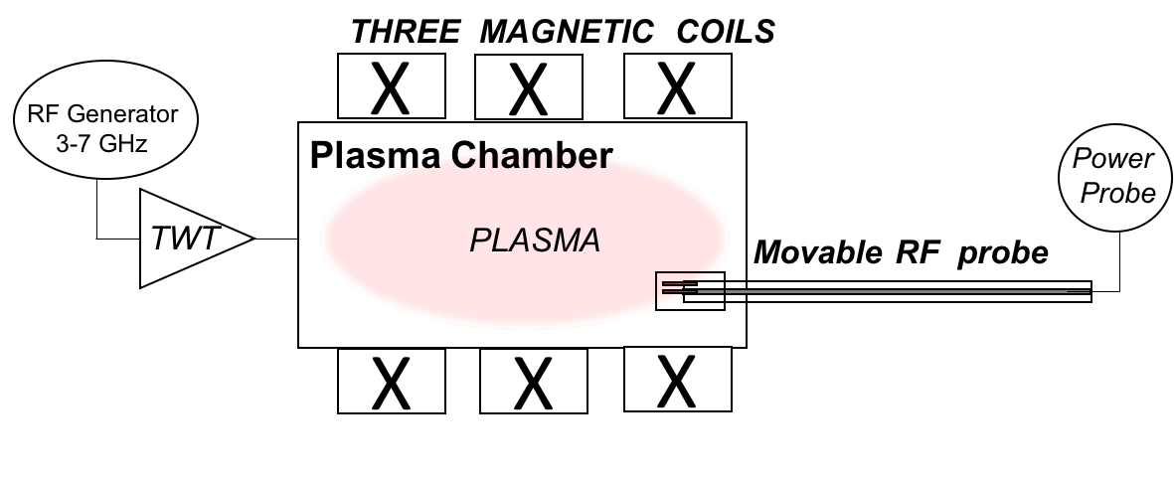

Measurements of waves in plasma SETUP:
High Frequency probes
Two-Pins
length of 3.5 mm
a distance of 2 mm
Al₂O₃
support
“Customized” Microwave coaxial Cable “Sucoflex 102” DC/40 GHz enclosed in Alumina tube
Installation inside the bellow
FPT magnet
sorrounding
Plasma chamber
Schematic of the FPT experimental setup at INFN-LNS
Power
probe
Notes:
A ceramic-coated RF two-pins probe small antenna , with one pin grounded and another connected to the inner wire of a coaxial transmission line, has been developed and used to measure the wave electric field inside FPT plasma chamber. The miniaturized antenna allowed a position resolved measurement of the E-field component perpendicular to the pins thus allowing a polarization selective measurement.
The pins length and distance have been designed to be sensitive to the short wavelengths and small enough to achieve the desired spatial resolution. The probe exposes two linear tips having length of 3.5 mm and a distance of 2 mm, and it is shielded by a high-purity alumina tube allocated parallel
to the longitudinal axis of the plasma chamber.

Slide 30

EXPERIMENTAL RESULTS
Case 1 --> B_{MIN}/B_{ECR}=0.65
Case 2 --> B_{MIN}/B_{ECR}=0.92
Case 3 --> B_{MIN}/B_{ECR}=1
Case 1: w_{ECR}= 70 mm.
The largest plasma volume enclosed by the ECR layers.
There is an excellent agreement between simulated and measured RF field distribution
Case 2: w_{ECR}= 30 mm. The plasma volume is smaller.
The agreement between simulated and measured
RF field distribution is still evident.
Case 3: w_{ECR}→0.
This represents a critical configuration.
General agreement even if locally the two plots deviate somewhere
Notes:
number of peaks, trend

Slide 31
EXPERIMENTAL RESULTS
Case 1 --> B_{MIN}/B_{ECR}=0.65
Case 2 --> B_{MIN}/B_{ECR}=0.92
Case 3 --> B_{MIN}/B_{ECR}=1
[G. Torrisi, D. Mascali, G. Sorbello, G. Castro, L. Celona, S. Gammino;
«Numerical and Experimental Characterization of RF Waves Propagation in Ion Sources Magnetoplasmas», IEEE Transactions on Antennas and Propagation]
Case 1: w_{ECR}= 70 mm.
The largest plasma volume enclosed by the ECR layers.
There is an excellent agreement between simulated and measured RF field distribution
Case 2: w_{ECR}= 30 mm. The plasma volume is smaller.
The agreement between simulated and measured
RF field distribution is still evident.
Case 3: w_{ECR}→0.
This represents a critical configuration.
General agreement even if locally the two plots deviate somewhere
Notes:
number of peaks, trend

Slide 32
The excellent agreement between model predictions and experimental data are very promising for the study and design of future launchers or “exotic” shapes of the plasma chambers in compact machines, such as ECR Ion Sources and other similar devices
Reshaping plasma chambers with non-conventional features;
new launchers based on waveguide arrays,, especially for new schemes of ECR-Heating such as Bernstein Waves, and for ECRIS still fulfilling frequency scaling laws above 28 GHz (quasi-optical approach);
futuristic all-dielectric mm-waves launching structures.
PERSPECTIVES
Notes:
A Roadmap can be envisaged starting form “solid bricks” towards future wave-to-plasma coupling schemes, a
ccounting also for a time-schedule in short-mid-long term

Slide 33

Reshaping plasma chambers with non-conventional features
Sext-in-Sol magnetic field structure
new-shaped" plasma chamber
Notes:
CST MW simulated Reection coecient jS11j: Cylindrical plasma chamber presents a poor RF matching compared with the new shaped-cavity; c) top:\aperture- coupling of the rectangular waveguide with the cylindrical chamber; bottom: new RF launching based on elliptical waveguide on \new-shaped" plasma chamber; d) CST MW simulated Electric eld prole along the plasma chamber extraction end-plate diameter: Cylindrical plasma chamber presents a zero-eld on axis compared with the peak electric eld the "new-shaped" plasma chamber

Slide 34
Reshaping plasma chambers with non-conventional features
Sext-in-Sol magnetic field structure
new-shaped" plasma chamber
Cylindrical symmetry is broken!
RF matching is dramatically improved
CST simulated Reflection coefficient
Notes:
CST MW simulated Reection coecient jS11j: Cylindrical plasma chamber presents a poor RF matching compared with the new shaped-cavity; c) top:\aperture- coupling of the rectangular waveguide with the cylindrical chamber; bottom: new RF launching based on elliptical waveguide on \new-shaped" plasma chamber; d) CST MW simulated Electric eld prole along the plasma chamber extraction end-plate diameter: Cylindrical plasma chamber presents a zero-eld on axis compared with the peak electric eld the "new-shaped" plasma chamber

Slide 35
Reshaping plasma chambers with non-conventional features
Torrisi, Mascali, Sorbello, Castro, Celona, Galatà, Leonardi, Naselli, Gammino, “Non-conventional microwave coupling of RF power in ECRIS plasmas”. AIP Conference Proceedings. 2011. 020014. 10.1063/1.5053256.
Sext-in-Sol magnetic field structure
new-shaped" plasma chamber
Cylindrical symmetry is broken!
RF matching is dramatically improved
CST simulated Reflection coefficient
Notes:
CST MW simulated Reection coecient jS11j: Cylindrical plasma chamber presents a poor RF matching compared with the new shaped-cavity; c) top:\aperture- coupling of the rectangular waveguide with the cylindrical chamber; bottom: new RF launching based on elliptical waveguide on \new-shaped" plasma chamber; d) CST MW simulated Electric eld prole along the plasma chamber extraction end-plate diameter: Cylindrical plasma chamber presents a zero-eld on axis compared with the peak electric eld the "new-shaped" plasma chamber

Slide 36





Electric field plot in presence of Plasma
Preliminary results of Frequency Domain Full-wave Simulation
Electric field plot
in empty cavity
f = 14.022 GHz
P = 100 W
Geometry

Slide 37
Electric field plot in presence of Plasma
Preliminary results of Frequency Domain Full-wave Simulation
Electric field plot
in empty cavity
f = 14.022 GHz
P = 100 W
ongoing PhD activity S. Gallo, LNL-INF
ongoing master Thesis, mechanical engineering F. Russo, UNICT
Geometry

Slide 38
Phased Array
Alternative Microwave-plasma heating
Phased Array on a fusion reactor: waveguide “grill”
Phased Array on a Ion source plasma reactor: two waveguide array
16X4
waveguides
2X1
waveguides
Notes:
something can be improved also concerning the launching system

Slide 39


Phased waveguide array of two elements: FIT FDTD Simulation

Slide 40



Microwave launcher Antenna assembly
Power divider
Phase shifter
Two Cut Waveguides Array as antenna
Microwave launcher Antenna assembly

Slide 41




Radiation Diagrams @ 14 GHz

Slide 42
Radiation Diagrams @ 14 GHz
- G. Torrisi, G. Sorbello, O. Leonardi, D. Mascali, L. Celona, and S. Gammino, “A new launching scheme for ECR plasma based on two-waveguides-array”, Microw. Opt. Technol. Lett., 58: 2629–2634. doi:10.1002/mop.30117

Slide 43


Frequency scaling is roughly correct from 6 to 28 GHz and is expected to work for 4th generation ECR’s at ~50 GHz
The technical challenges at 50 GHz make it attractive to look for new approaches
Conventional RF technology scaled down?
Conventional RF technology scaled down?
$λ\sim [$cm]
$λ\sim$ [sub-mm]
Metal absorbs at higher frequency
Difficult to fabricate
Notes:
we discussed uo to now lower than 28 GHz

Slide 44
Dielectric accelerator structures
Types:
Dielectric wall acceleration
Dielectric wakefield acceleration
Dielectric laser acceleration
Dielectric assisted waveguide
Dielectric loaded waveguides
Advantages:
High breakdown threshold (1-5 GV/m)
High frequency operation
Can reduce wakefields (photonic crystals)
▪ Mature fabrication technologies available
Structure proposed
A range of proposals:
Lin (2001),Mizrahi and Schachter (2004)
Cowan (2008), Naranjo et al. (2012)
First demonstration - Peralta et al. (2013)
Dielectric High Damage threshold
High gradients enable compact linear accelerators
[Wootton, SLAC – 8th Int. Part. Accel. Conf. – WEYB1 – 17th May 2017 7]
Accelerator on a Chip
International Program (ACHIP) Stanford , UCLA, EPFL, TU Darmstadt , Tech-X
Notes:
Accelerator Application: High frequency acceleration can provide high gradient, extremely compact and low cost particle accelerators

Slide 45





All-dielectric structures
Proof-of-concept experiments are taking place @LNS
Al₂O₃ Woodpile structure as a DC-BREAK
[WOODPILE EBG WAVEGUIDE AS A DC ELECTRICAL BREAK
FOR MICROWAVE ION SOURCES, G. S. Mauro, A. Locatelli, G. Torrisi et al; submitted on MOTL]
Electric field intensity
DC break including: (1) Al₂O₃ woodpile structure, (2) metallic waveguides flanges, (3) top and bottom PMMA covers.
[Leonardi, Torrisi et al., «Hollow-core Electromagnetic Band Gap Waveguide as DC-break for Ion Sources», PIERS 2017]
[Locatelli, Sorbello, Torrisi et al., Photonic Crystal Waveguides for Particle Acceleration; 2017]
Dielectric waveguide
electromagnetic field

Slide 46

Dielectric EBG waveguide
Novel electromagnetic structures for high frequency
All-dielectric mm-waves
launching structures
Emerging electromagnetic concepts
Photonic Crystal (PhC) technology
Metamaterials
▪ Engineering of the geometry of the structure allows for creation of “artificial materials” for unusual EM responses
Scalability
Potentially low cost
TM01 mode
periodic dielectric structures
allows Manipulation of the
electromagnetic properties of materials
Reinvent resonant structures using dielectric
dielectric cavity
Periodic arrangement of dielectrics with high contrast of refractive index
Notes:
By perturbing a lattice it is possible obtain a:
dielectric waveguide → Linear defect

Slide 47



PERSPECTIVES
ION DYNAMICS WITH COLLISIONS AND IONIZATIONS
ECR HEATING WITH COULOMB COLLISIONS
SELF-CONSISTENCY: TOOL FOR THE DESIGN OF PANDORA’s TRAP
ELECTROMAGNETIC CALCULATIONS
“Hot” plasma approximation
Alessio Galatà

Slide 48
“Hot” plasma approximation
The nonlocal interaction between spatially separated parts of the materials, leading to what is called
SPATIAL DISPERSION
Dispersive medium»: nonlocal connection between j and E
‘Spatial dispersion’ or ‘nonlocality’manifests itself in the functional dependence of the medium parameter on the wave vector k,
ε (ω, k)
electrostatic plasma oscillations, Ion acoustic waves, ion sound, Alfven waves,
Resonant interactions with particles (damping/instabilities)
Notes:
parallel wave vector (and equilibrium distribution) etermine wave absorption (or growth)
The “local” dielectric tensor in the wave equation includes velocity-space integrals of derivatives of f₀(v⊥,v//) even for infinite-homogeneous Maxwellian plasmas
Infinite sum of modified Bessel functions of argument
This case, the electromagnetic response of the medium fails to depend
only on the position where we apply the external field, but depends
also on the value of this field at other locations.°◊
Thus, when both temporal and spatial dispersion are present, we
write the permittivity and the permeability functions as = (ω, k) and μ = μ(ω, k).
Since the hot-plasma dielectric tensor is also a function of the wave vector

Slide 49
Ongoing development:
Wavelet analysis
Continuous Wavelet Transform (CWT)
for analysing Full wave wavefield data in the
spatial domain to determine the
wavenumber spectrum
electrostatic plasma oscillations, Ion acoustic waves, or ion sound, Alfven waves,
Resonant interactions with particles appear as damping/instabilities
Notes:
The use of 1D CWT is applicable for data obtained along a linear path and the resulting spectrum will contain only the component of wavenumber in the direction of the linear path.

Slide 50
Modeling of Ion dynamic and
ion cyclotron resonance heating
degree of CONTROL of THE ION TEMPERATURE in order to change the Ion Charge State Distributions (CSD) by perturbing both the ionization and recombination processes or by imposing losses for ion of a given charge state
Application of the full wave solver and the kinetic solver for the self-consistent calculations of the wave field and the distribution function of Ions.
Determining the Nuclaer decay rate of excited state and perform Lifetime analysys and measurements of nuclei in excited states
fusion reactions in magnetoplasmas

Slide 51

Recap: Plasma Oscillations –Plasma Frequency
Macroscopic the plasma is charge neutral, microscopic the imbalance of charges leads to micro instabilities, fluctuations and oscillations
Local electric field is created by shifting a charge cloud along distance
The charge unbalance leads to a restoring force –> Equation of and harmonic oscillator of pulsation $ω_{i}=\sqrt{\frac{e^{2}n_{e}}{m_{i}ε_{0}}}$
$f_{ci}=15.2 \left[MHz\right]∙\frac{Q}{A}B [T]$. A atomic mass number, Q charge state
ION FUNDAMENTAL RESONANCE
Plasma frequency MHz range !
● Absorption at ion cyclotron resonance, f ~ [30–50] MHz
Usually heats small fraction of ions (minorities) accelerating
them up to MeV level (similar to alpha particles)
● One can vary ion species to heat and control heating location
● Easy and relative cheap to generate high power waves

Slide 52


Resonant Heating Due to Cyclotron Subharmonic Frequency Waves
Direct ion heating process which is resonant with the wave at the cyclotron subharmonic
frequency ${ω_{RF}=\frac{3}{2}ω}_{i}=\frac{3}{2}\sqrt{\frac{e^{2}n_{e}}{m_{i}ε_{0}}}$ has been demostrated
and discovered through the particle-simulation investigation
Power: 2 MW/antenna strap
frequency: f ≈ 10-100 MHz
Schematic illustration of the mechanical design of typical RF (or ECR) volume production H- ion source.
Helicon plasma source
[H. Abe, H. Okada, and R. Itatani, Kyoto University, Kyoto 606, Japan, M. Ono and H. Okuda, Plasma Physics Laboratory, Princeton University, Princeton, «Resonant Heating Due to Cyclotron Subharmonic Frequency Waves» Vol. 53, 12 PHYSICAL REVIEW LETTERS (1984)]
STRAP antenna

Slide 53
Conclusion
The wave propagation in plasmas has been modelled with a full wave numerical approach under “cold” plasma approximation.
For the first time, the electric field amplitude has been measured by mean of a two-pins RF probe in a compact plasma trap in conditions resembling very closely the features of a common simple-mirror-configuration ECR ion source.
Self-Consistent Solution is “on the right track"
The excellent agreement between model predictions and experimental data are very promising for the study and design of future launchers or “exotic” shapes of the plasma chambers in compact machines, such as ECR Ion Sources and other similar devices
✓
✓
✓….
✓….
Notes:
The numerical results have been successfully validated by measurements. For the first time, the electric field amplitude has been measured (by mean of a two-pins RF probe) in complex scenario such as a compact plasma trap in conditions resembling very closely the features of a common simple-mirror-configuration ECR ion source. The excellent agreement between model predictions and experimental data are very promising for the study and design of future launchers or “exotic” shapes of the plasma chambers in compact machines, such as ECR Ion Sources and other similar devices. Further steps forward
are going to be done as concerning the improvement of the model, including the “hot” plasma tensor: this will perspectively allow to master additional mechanisms such as modal conversion at the hybrid resonance.

Slide 54
The authors wish to thank the 5th Nat. Comm. of INFN, under the Grant PANDORA for the financial support.
Thank You!
G. Torrisi¹, D. Mascali¹, A. Galatà², L. Celona¹, G. Sorbello^{1,3}
G. Castro¹, G. Mauro¹, M. Mazzaglia¹, E. Naselli^{1,4}, S. Gammino¹
INFN - Laboratori Nazionali del Sud, Catania, Italy
INFN- Laboratori Nazionali di Legnaro, Legnaro (Padova), Italy
Università degli Studi di Catania, DIIEI, Catania, Italy
Università degli Studi di Catania, DFA, Catania, Italy

