Slide 1




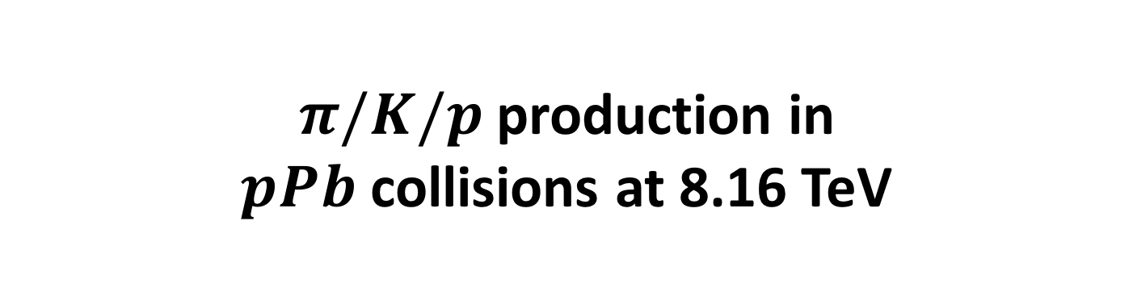
$π/K/p$production in
$pPb$ collisions at 8.16 TeV
Pavel Larionov (ITSsa), Paula Matuoka (TPC), Silvia Pisano (TPC),
Marco Toppi (TOF)
AN: https://aliceinfo.cern.ch/Notes/node/769
ARC: Antonio Ortiz Velasquez
Physics Forum QM 2018 Approval
23° April, 2018

Slide 2
Link to relevant presentations
ITSsa (Pavel): https://indico.cern.ch/event/708519/contributions/2913361/attachments/1606944/2550069/ITSsa_slides_260218.pdf
TOF (Marco): https://indico.cern.ch/event/700770/contributions/2876037/attachments/1591195/2518224/AnalysisTOF_pA8TeV.pdf
TPC (Silvia): https://indico.cern.ch/event/684087/contributions/2804253/attachments/1565576/2466912/Spectra-PAG_Meeting_Nov272017.pdf
ALL – latest summary (Feb. 5°, APW in Frascati): https://indico.cern.ch/event/687851/contributions/2880067/attachments/1594885/2525554/pisanos_APW_Frascati_Feb2018.pdf
Analysis crew:
Pavel → ITSsa Paula→ TPC relativistic rise
Silvia→TPC Marco→ TOF unfolding
The analysis code is not committed yet, but will be done very soon

Slide 3
Poster at QM2018

Slide 4
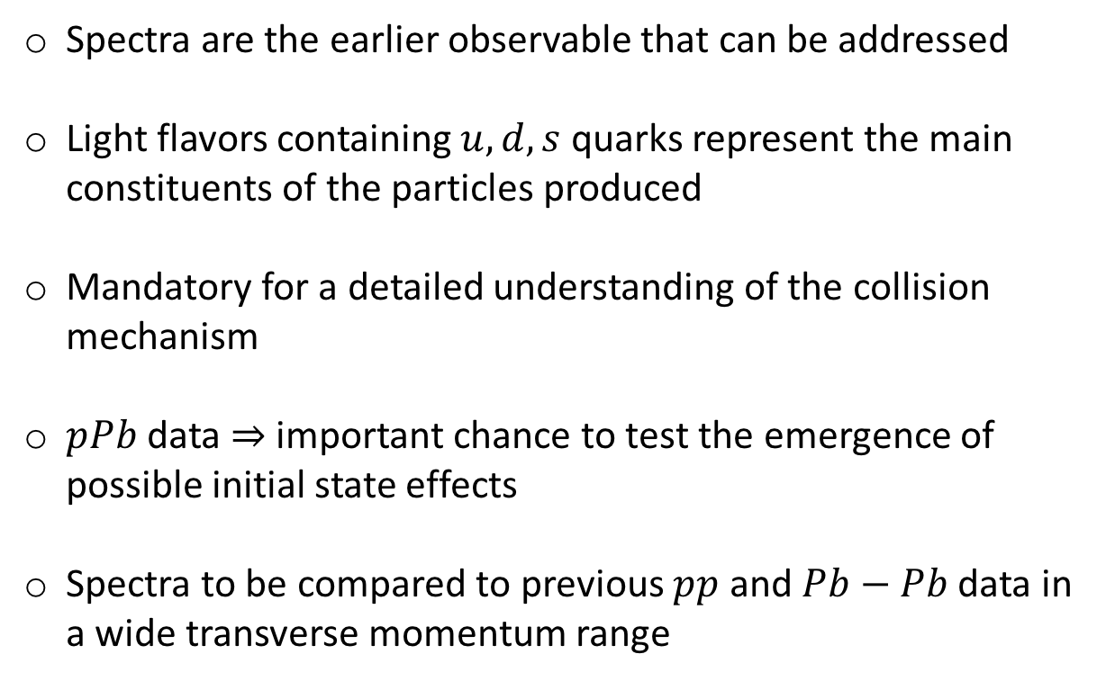
Physics Motivation
Spectra are the earlier observable that can be addressed
Light flavors containing $u, d, s$ quarks represent the main constituents of the particles produced
Mandatory for a detailed understanding of the collision mechanism
$pPb$ data ⇒ important chance to test the emergence of possible initial state effects
Spectra to be compared to previous $pp$ and $Pb−Pb$ data in a wide transverse momentum range

Slide 5
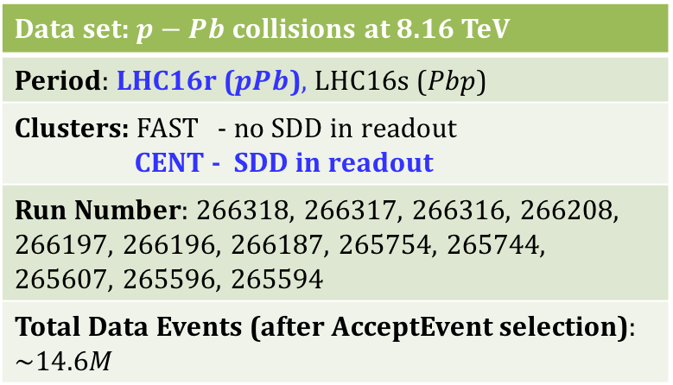
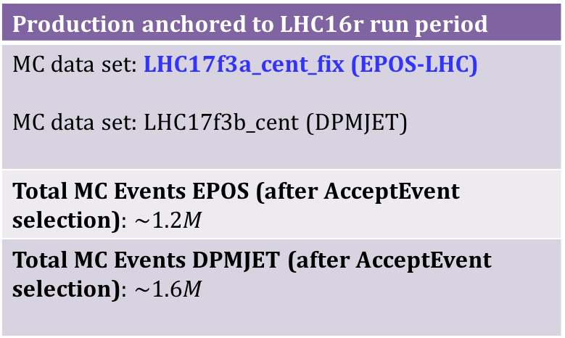

Spectra with the 8.16 TeV $pPb$ data-set
Data set: $p−Pb$ collisions at 8.16 TeV
Period: LHC16r ($pPb$), LHC16s ($Pbp$)
Clusters: FAST - no SDD in readout CENT - SDD in readout
Run Number: 266318, 266317, 266316, 266208, 266197, 266196, 266187, 265754, 265744, 265607, 265596, 265594
Total Data Events (after AcceptEvent selection): $\sim 14.6M$
Production anchored to LHC16r run period
MC data set: LHC17f3a_cent_fix (EPOS-LHC) MC data set: LHC17f3b_cent (DPMJET)
Total MC Events EPOS (after AcceptEvent selection): $\sim 1.2M$
Total MC Events DPMJET (after AcceptEvent selection): $\sim 1.6M$

Slide 6
Event selection common to the analyses
Trigger: AliEvent::kINT7
INEL>0
DAQ rejection: AliESDEvent::IsIncompleteDAQ()
PileUpRejection: AliESDEvent::IsPileupFromSPDInMultBins();
Background rejection: AliAnalysisUtils::IsSPDClusterVsTrackletBG(fESD);
Multiplicity selection: AliMultSelection::GetMultiplicityPercentile("V0M",kFALSE);
Vertex quality: |Z_{SPD}- Z_{Trk}| < 0.5 cm, Z_{SPD} dispersion < 0.04 cm and resolution less than 0.25 cm
Z-vertex selection: | Z_{Vertex}| < 10 cm

Slide 7
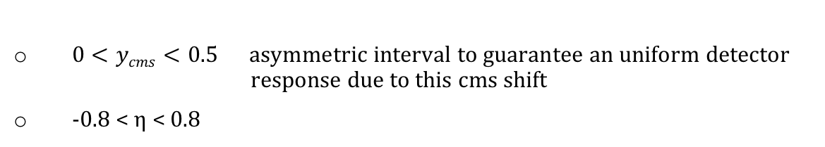
Track selection
Common to the three analyses
$0<ycms<0.5 \text{asymmetric} \text{interval} \text{to} \text{guarantee} \text{an} \text{uniform} \text{detector} \text{response} \text{due} \text{to} \text{this} \text{cms} \text{shift}$
-0.8 < η < 0.8
ITSsa track cuts
Ncls in SPD (>=1) and SDD/SSD (>=3);
χ²/Ncls < 2.5;
DCAxy, DCAz cuts < 7 σ;
TPC and TOF
Implemented the Standard ITS-TPC Track Cuts 2015 (AliESDtrackCuts::AcceptTrack)
Additional cuts for TOF
  Time measurement correctly assigned [TOF selection]
  Match with TOF [TOF selection]

Slide 8
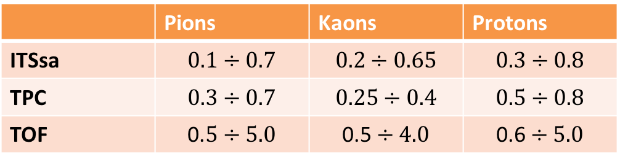

Spectra status and ranges for the different analyses
Raw spectra are corrected for:
Efficiencies
Primary fractions (feed-down)
Geant3/Geant4 for antiprotons and Geant3/Fluka for negative kaons
Number of events per multiplicity class corrected for the vertex finding probability
Ranges in $p_{T} (GeV/c)$
 | Pions | Kaons | Protons
ITSsa | $$0.1÷0.7$$ | $$0.2÷0.65$$ | $$0.3÷0.8$$
TPC | $$0.3÷0.7$$ | $$0.25÷0.4$$ | $$0.5÷0.8$$
TOF | $$\text{0.}5÷5.0$$ | $$\text{0.5}÷4.0$$ | $$\text{0.6}÷5.0$$
Multiplicity classes (V0M estimator)
[0-5]%, [5-10]%, [10-20]%, [20-40]%, [40-60]%, [60-80]%, [80-100]%, MB [0-100]%

Slide 9
ITS standalone analysis

Slide 10
Status
Track selection applied according to standard ITSsa track cuts;
Raw spectra obtained using the truncated mean PID method (asymmetric n-sigma);
Raw spectra corrected for efficiency;
Correction for the feed-down;
Geant3-Geant4, Geant-Fluka corrections for K⁻ and anti-p;
Systematic uncertainties: Bayesian PID, etc.

Slide 11
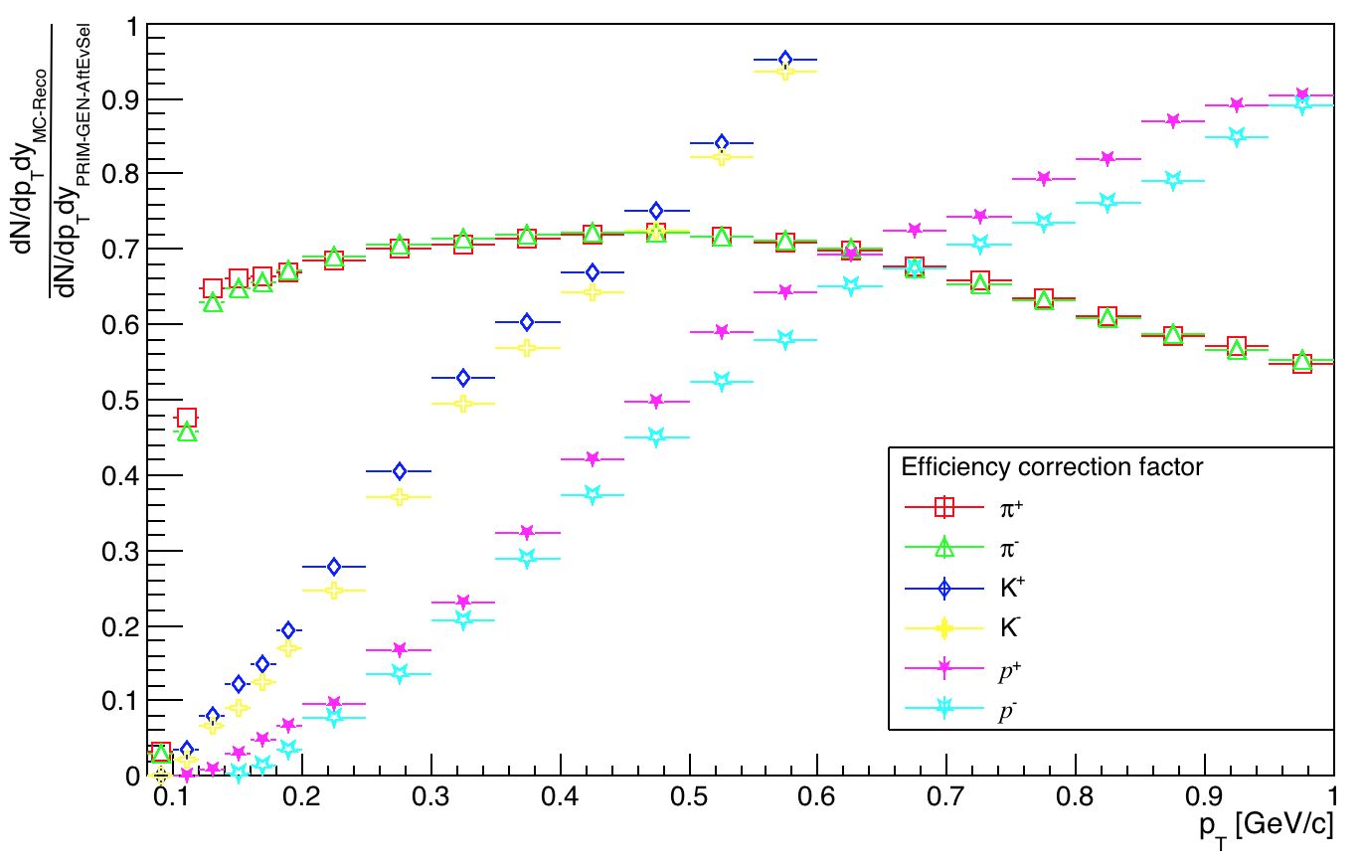
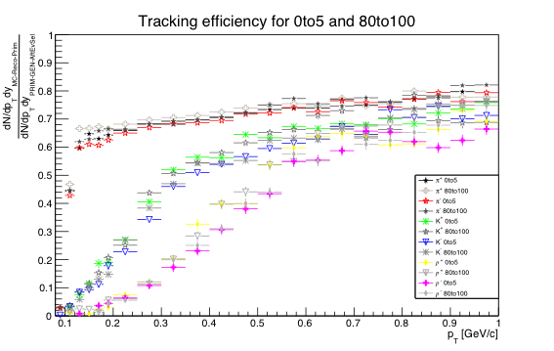
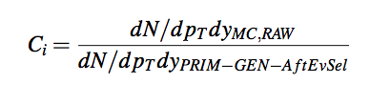
Efficiency correction
Tracking efficiency at the lowest and the highest multiplicity bins

Slide 12
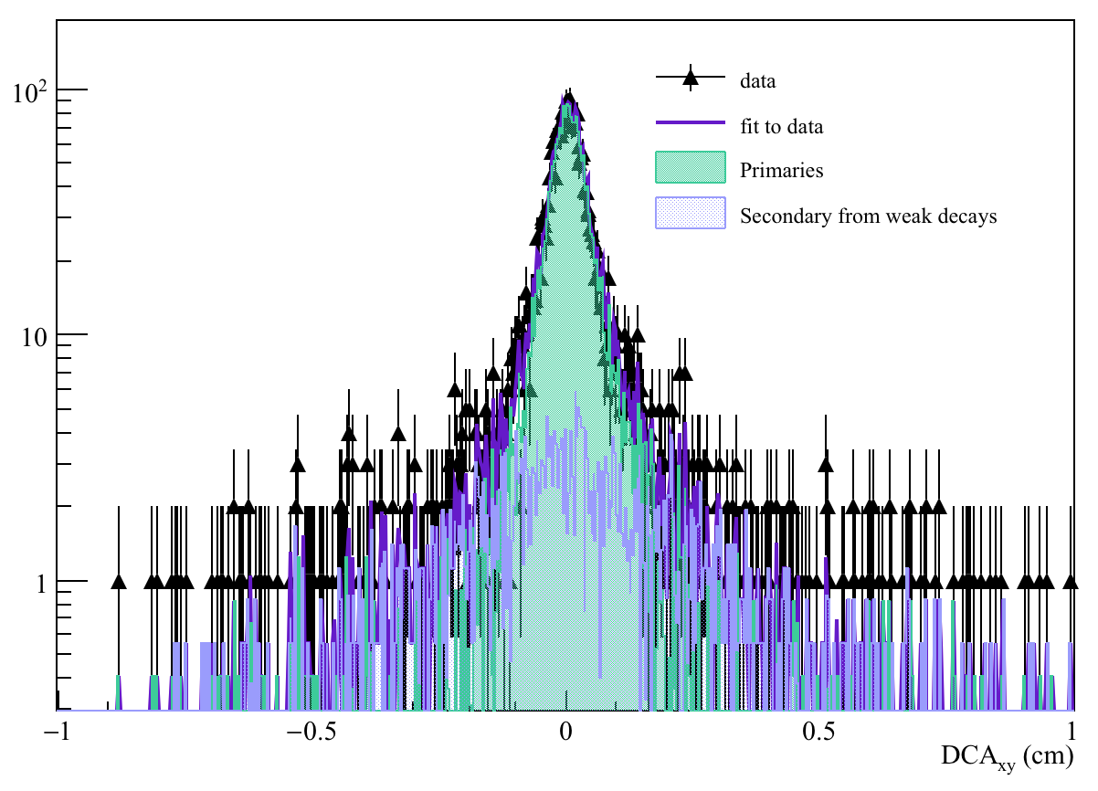
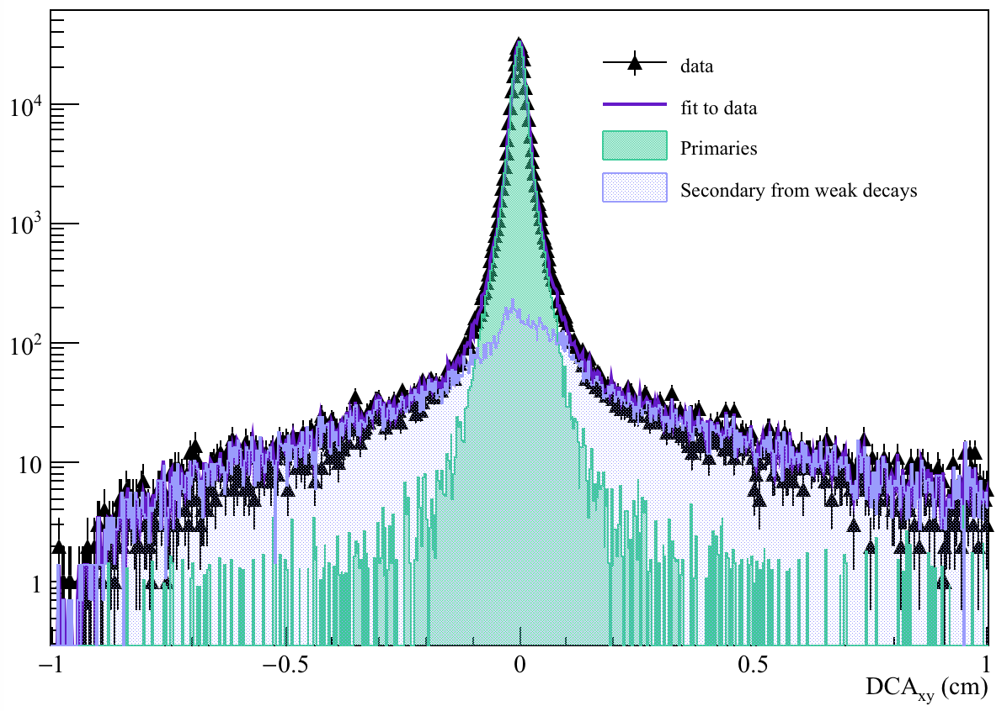
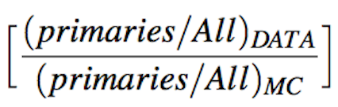
Feed-down correction: DATA
Anti-p, 80to100, 0.3. - 0.35 GeV/c
Pi Neg, 40to60, 0.45 - 0.5 GeV/c
Double ratio for correction:

Slide 13
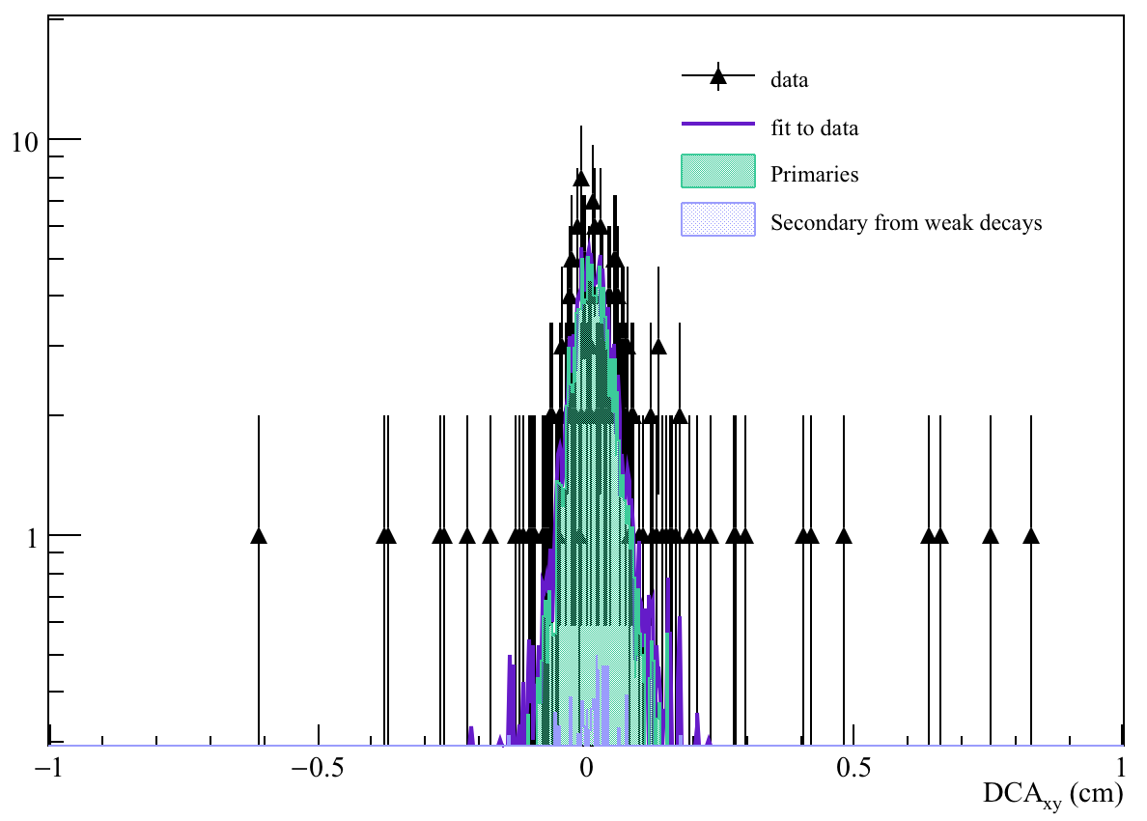
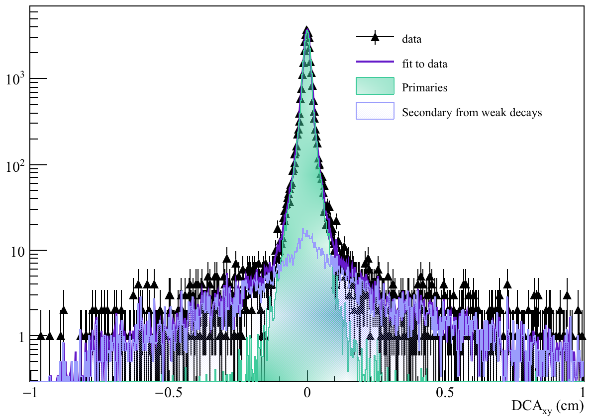
Feed-down correction: MC (reco)
Anti-p, 80to100, 0.3 - 0.35 GeV/c
Pi Neg, 40to60, 0.45 - 0.5 GeV/c
MC reco: very limited statistics -> correction for integrated multiplicity to be used

Slide 14
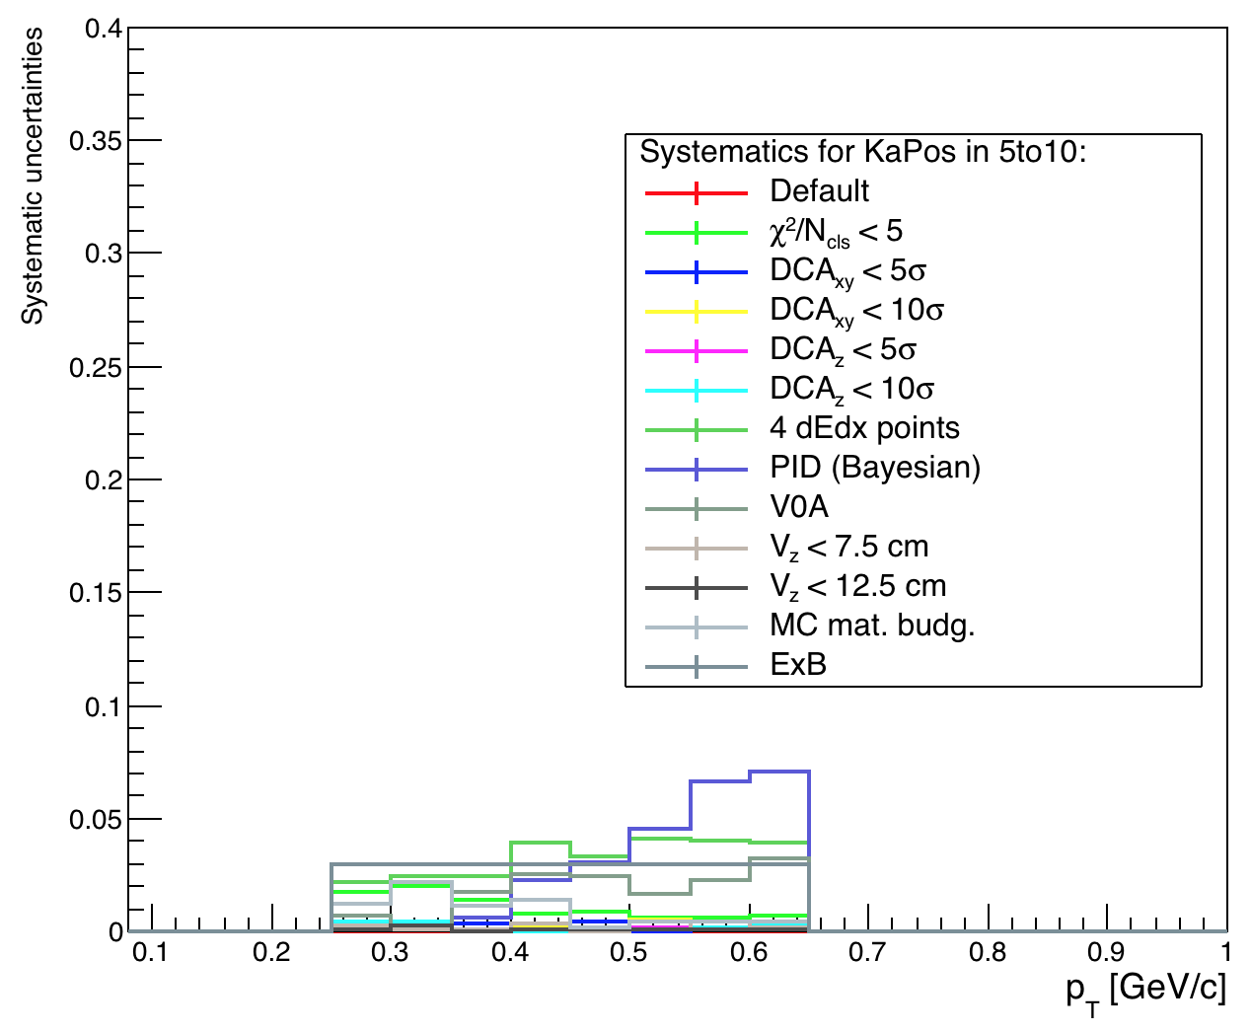
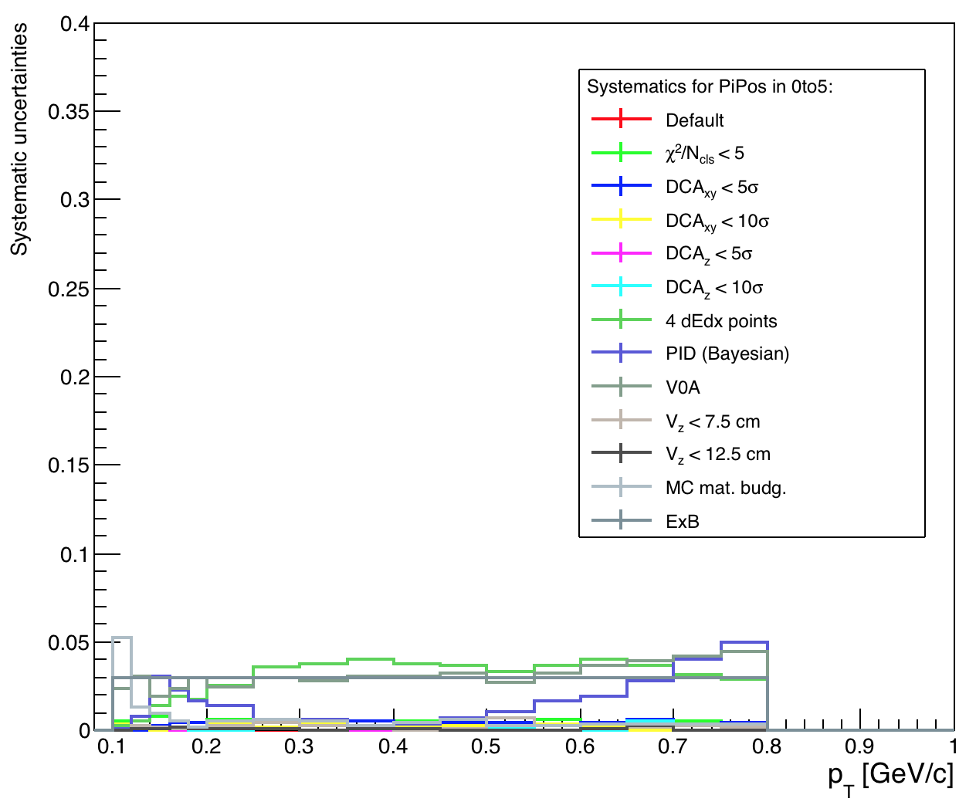
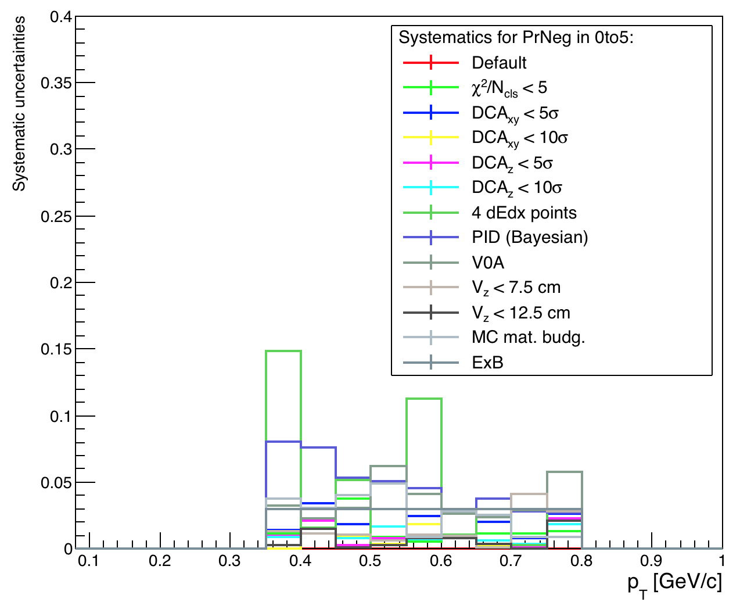
Systematics: 0 to 5
KaPos
PiPos
PrNeg

Slide 15
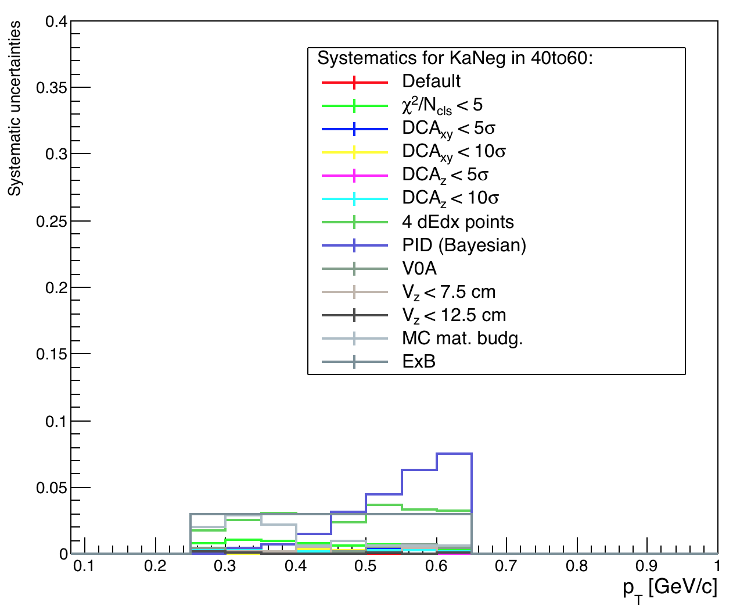
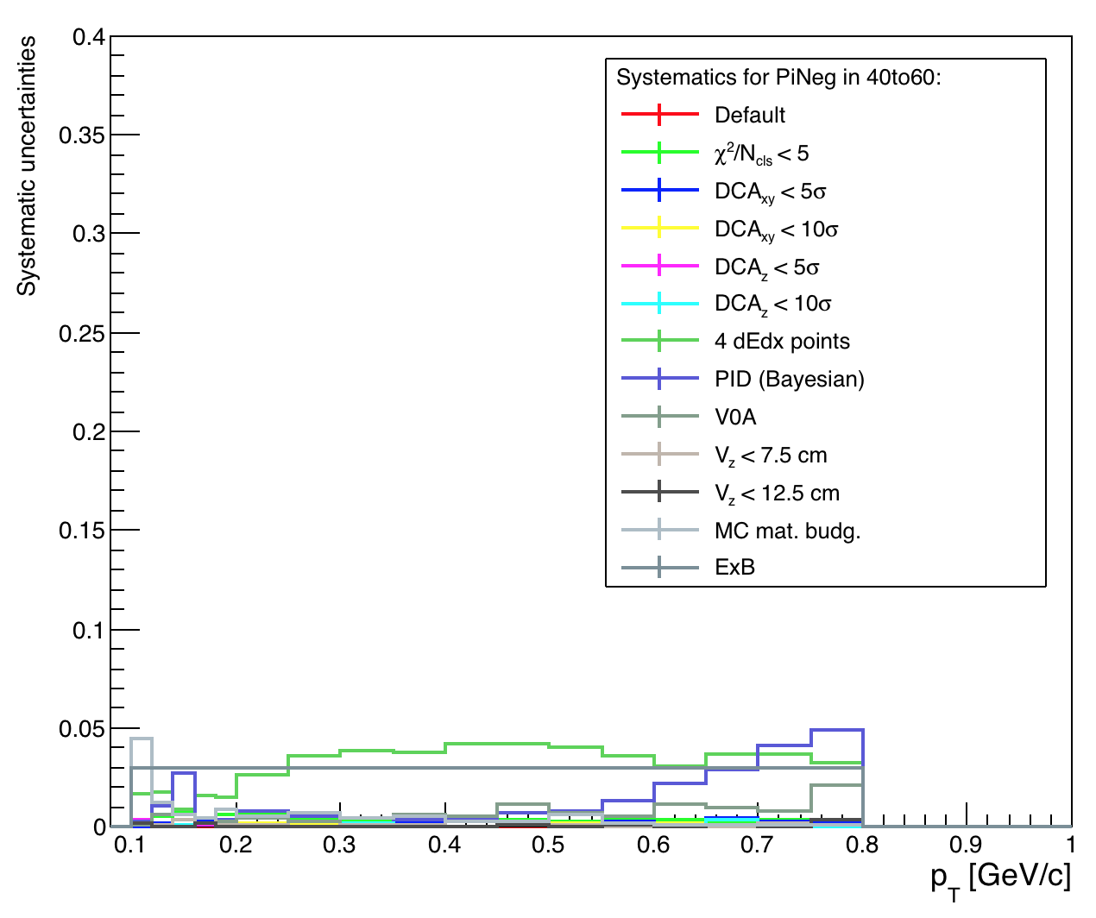
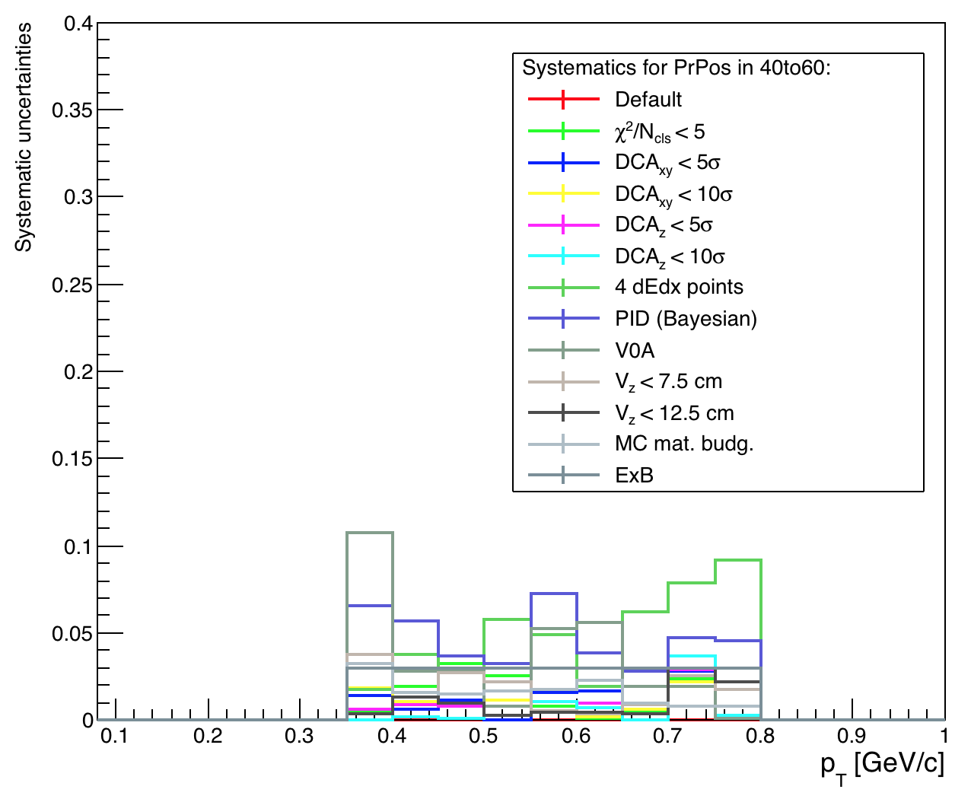
Systematics: 40 to 60
KaNeg
PiNeg
PrPos

Slide 16
Systematics
Cut | Default | Variation | status
Vtx + dEdx its | 1 SPD + 3 SDD/SSD | 1 SPD + 4 SDD/SSD, 2 SPD + 3 SDD/SSD | done
Chi^2 / Ncls | < 2.5 | < 5. | done
DCAxy , DCAz | < 7 σ | < 10 σ | done
PID | Truncated mean | Bayesian approach | done
Systematics for PID and for track selection
Source | status
Vz component (Vtx selection) | done
DCAxy distibution binning | To be done
ExB | 3%
Material budget (MC simulation) | done
Systematics from other sources

Slide 17
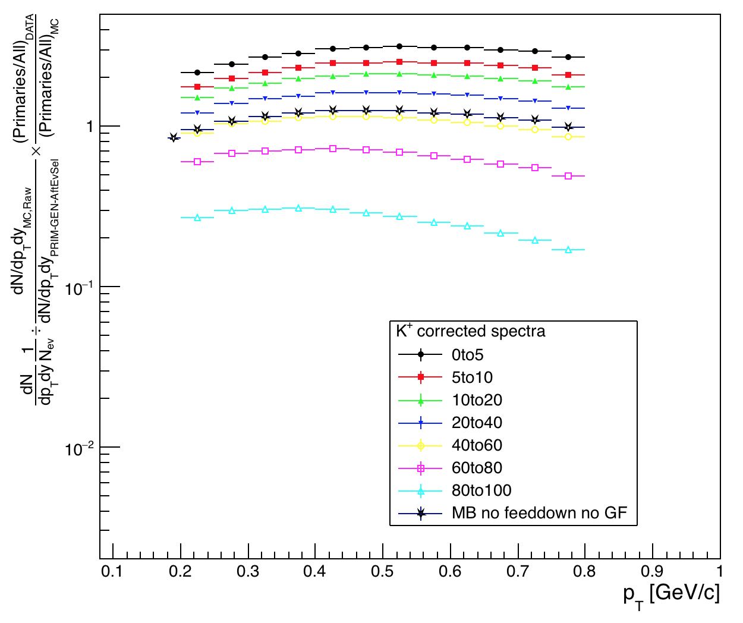
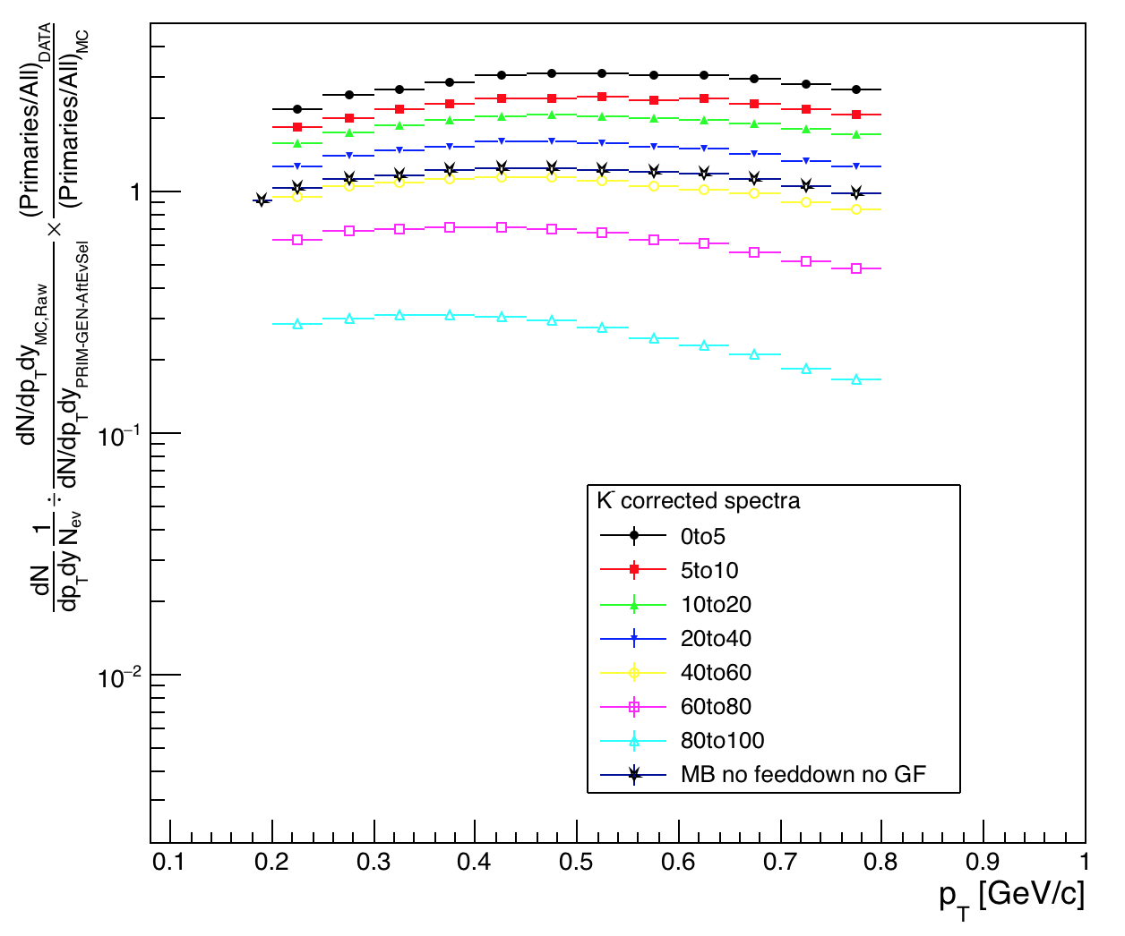
ITSsa corrected spectra
K⁺
K⁻

Slide 18
TPC analysis

Slide 19



Status
Raw yields extracted through the $n_{σ}$ fit
$$π^{+}$$
$$k^{−}$$
$$p$$
example fits for different particle/multiplicity/$p_{T}$

Slide 20
Status
2. Corrected for (multiplicity-dependent) efficiencies
positive
negative
Pions
Kaons
Protons
Pions
Kaons
Protons
P_{T} (GeV/c)
P_{T} (GeV/c)
Correction for antiprotons and K⁻ underestimation by GEANT 3 transport code already included

Slide 21


Status
3. (Pions and protons) corrected for the primary fractions (feed-down corrections)
$$π^{−}$$
$$π^{+}$$

Slide 22


Status
3. (Pions and protons) corrected for the primary fractions (feed-down corrections)
$$p$$
$$\overline{p}$$

Slide 23


Status
4. Anti-protons and negative kaons have been corrected for Geant3/Geant4 and Geant3/Fluka corrections, respectively
$$π^{−}$$
$$p$$

Slide 24
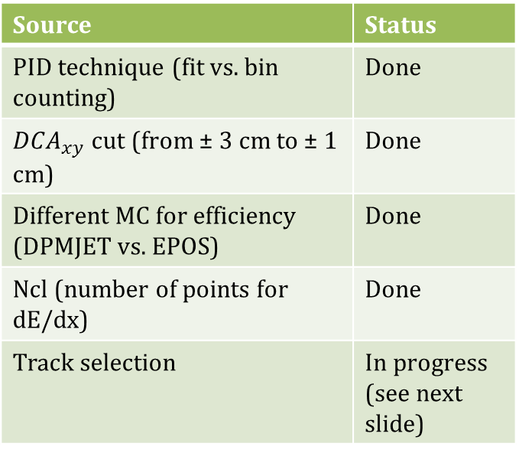

Systematics study
Source | Status
PID technique (fit vs. bin counting) | Done
${DCA}_{xy}$ cut (from ± 3 cm to ± 1 cm) | Done
Different MC for efficiency (DPMJET vs. EPOS) | Done
Ncl (number of points for dE/dx) | Done
Track selection | In progress (see next slide)
$$π^{−}$$

Slide 26
TOF analysis

Slide 27
Status
Raw spectra extracted with unfolding procedure through template fits tuned on data.
Three templates for pions, kaons and protons and one for TOF mismatching background

Slide 28
Status
Raw spectra have been corrected by tracking and TOF matching efficiency
Anti-p and K⁻ tracking efficiency include Geant3/Geant4 and Geant3/FLUKA corrections respectively
Very slight dependence on multiplicity, but big statistical fluctuation: the MB is used to correct the spectra

Slide 29
Status
Primary fraction extracted from DCAxy distributions through template fit with TFF
Done for different multiplicity classes. Exponential fit to smooth and extract the correction at higher P_{T}

Slide 30
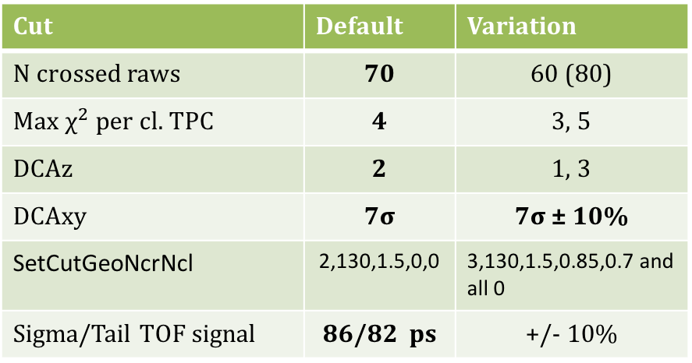
Systematics from track selection and PID
Cut | Default | Variation
N crossed raws | 70 | 60 (80)
Max $χ^{2}$ per cl. TPC | 4 | 3, 5
DCAz | 2 | 1, 3
DCAxy | 7σ | 7σ ± 10%
SetCutGeoNcrNcl | 2,130,1.5,0,0 | 3,130,1.5,0.85,0.7 and all 0
Sigma/Tail TOF signal | 86/82 ps | +/- 10%

Slide 31
Other systematics
Crosschecks | Maximum difference observed
Primary correction: TFractionFitter/Roofit | 2%
Matching efficiency: Data/MC comparison | 5% (pT<1Gev/c) - 2% (pT>1GeV/c)
Matching ITS/TPC | 1%
TFF
RooFit
Data
MC

Slide 32
TOF spectra - pions
electrons
pions
32

Slide 33
Results

Slide 34
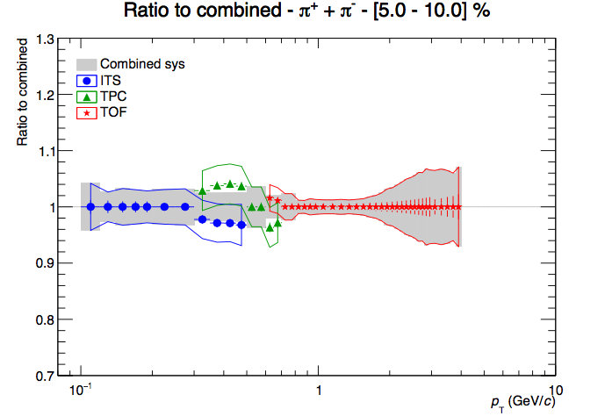
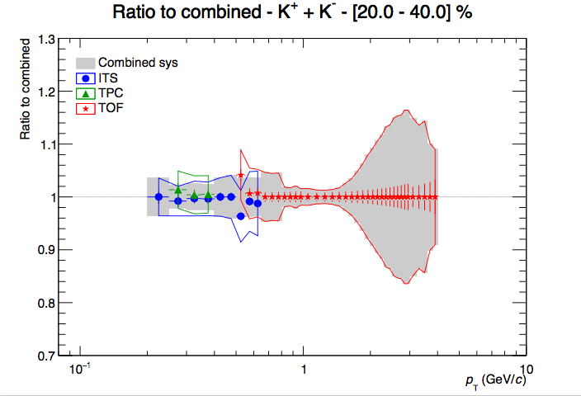
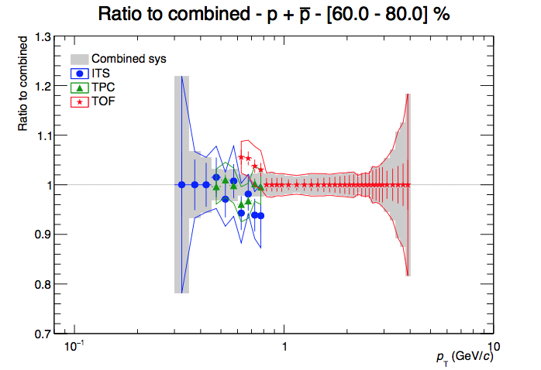
Combined Spectra
Combination strategy: first combined TPC and TOF and then ITS
Correction for event loss applied

Slide 35
Ratio of kaons and protons to pions in pPb @ 8TeV
K/𝜋 : no significant evolution with multiplicity
p/ 𝜋 : the protons production increases with multiplicity at high p_{T}

Slide 36
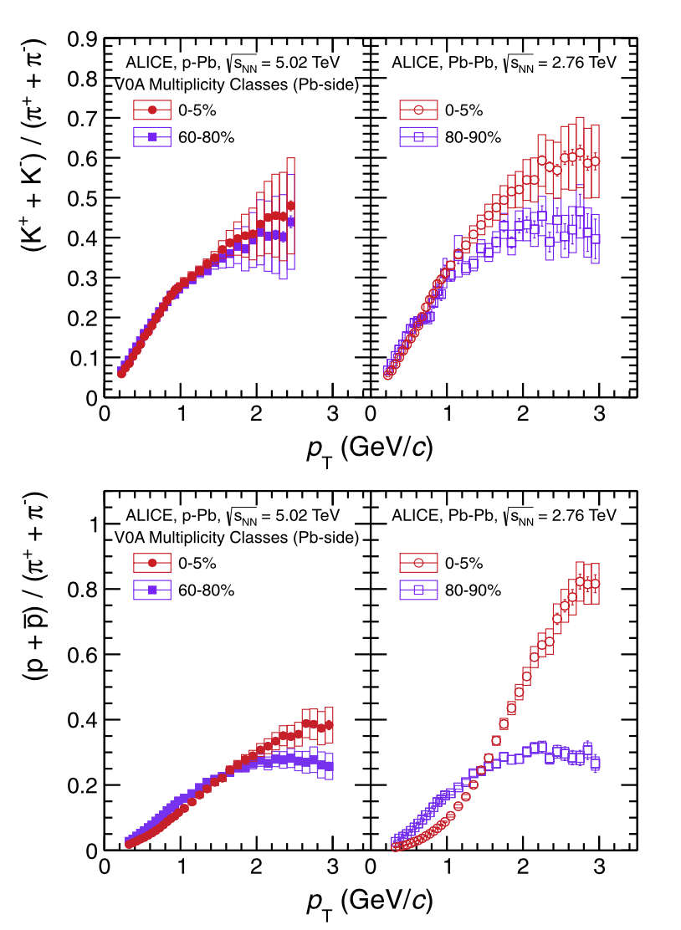
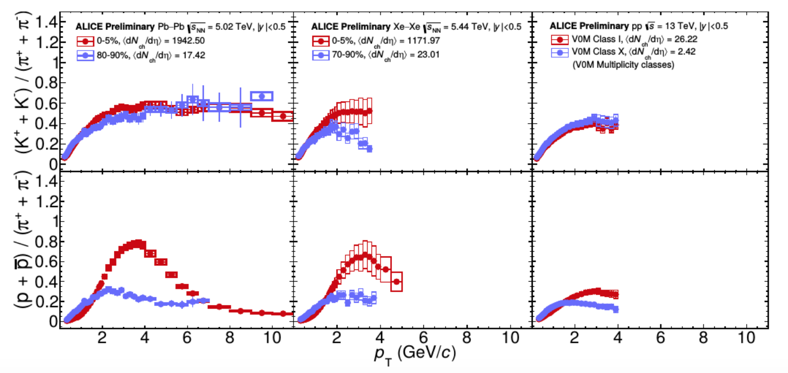
Ratio of kaons and protons to pions in other analysis

Slide 37
Conclusion and next steps
Reported the analisys of 𝜋/K/P spectra for p-Pb @ 8.16 TeV with ITSsa, TPC, TOF up to 4 GeV/c. TPC relativistic rise ongoing (up to 20 GeV/c)
Still missing:
  V0A estimator
  MB spectra
  Systematics [few to be finalized]
  Study a different y_{cms} interval ( |y_{cms}|<0.2) to be compared to the default one (0<y_{cms}<0.5)
  Crosscheck V0M vs V0A estimator
Next (future) steps:
  Integrated spectra
  Blast-wave fits
  Comparison with 𝜋/K/P spectra for p-Pb and PbPb @ 5.02 TeV and pp @ 13 TeV

Slide 38
backup

Slide 39
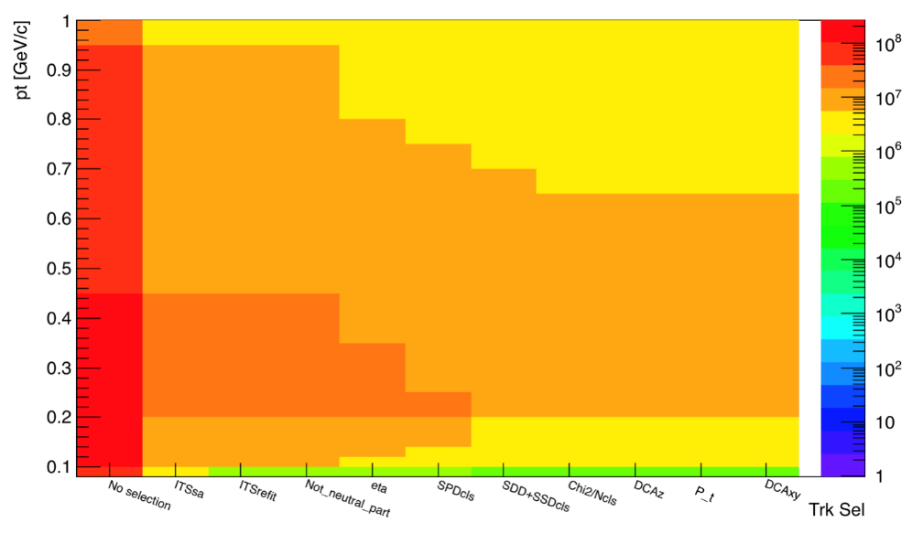
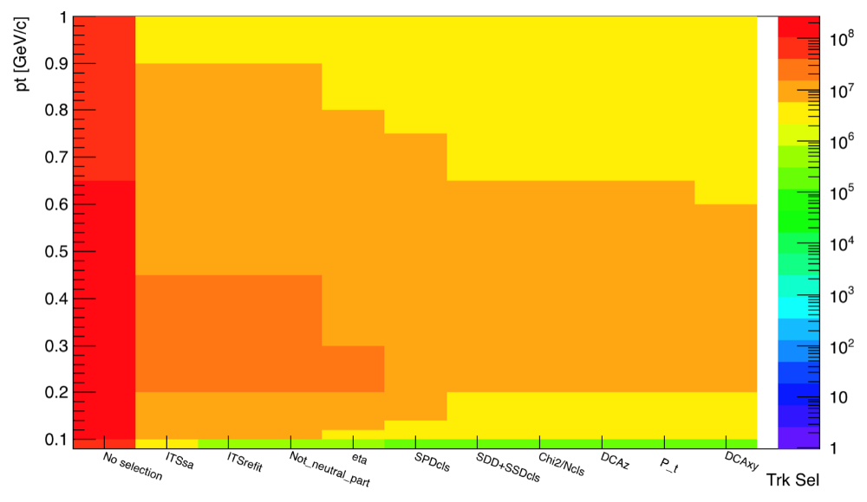
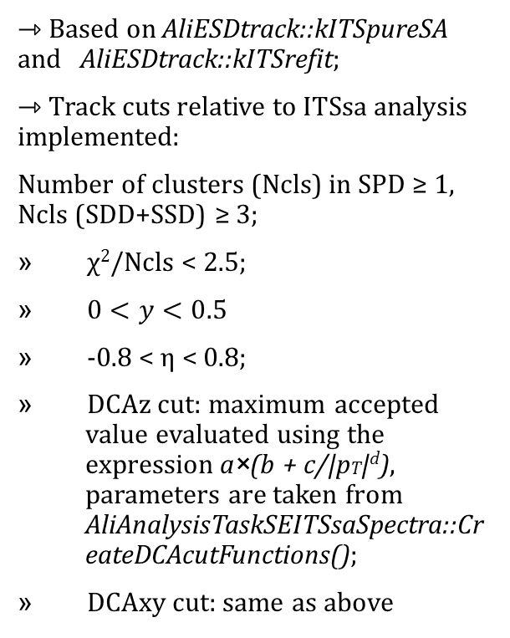
ITSsa analysis: track cuts
⇾ Based on AliESDtrack::kITSpureSA and AliESDtrack::kITSrefit;
⇾ Track cuts relative to ITSsa analysis implemented:
Number of clusters (Ncls) in SPD ≥ 1, Ncls (SDD+SSD) ≥ 3;
χ²/Ncls < 2.5;
$0<y<0.5$
-0.8 < η < 0.8;
DCAz cut: maximum accepted value evaluated using the expression a×(b + c/|pT|^{d}), parameters are taken from AliAnalysisTaskSEITSsaSpectra::CreateDCAcutFunctions();
DCAxy cut: same as above
negative
positive

Slide 40
ITS primaries correction

Slide 41
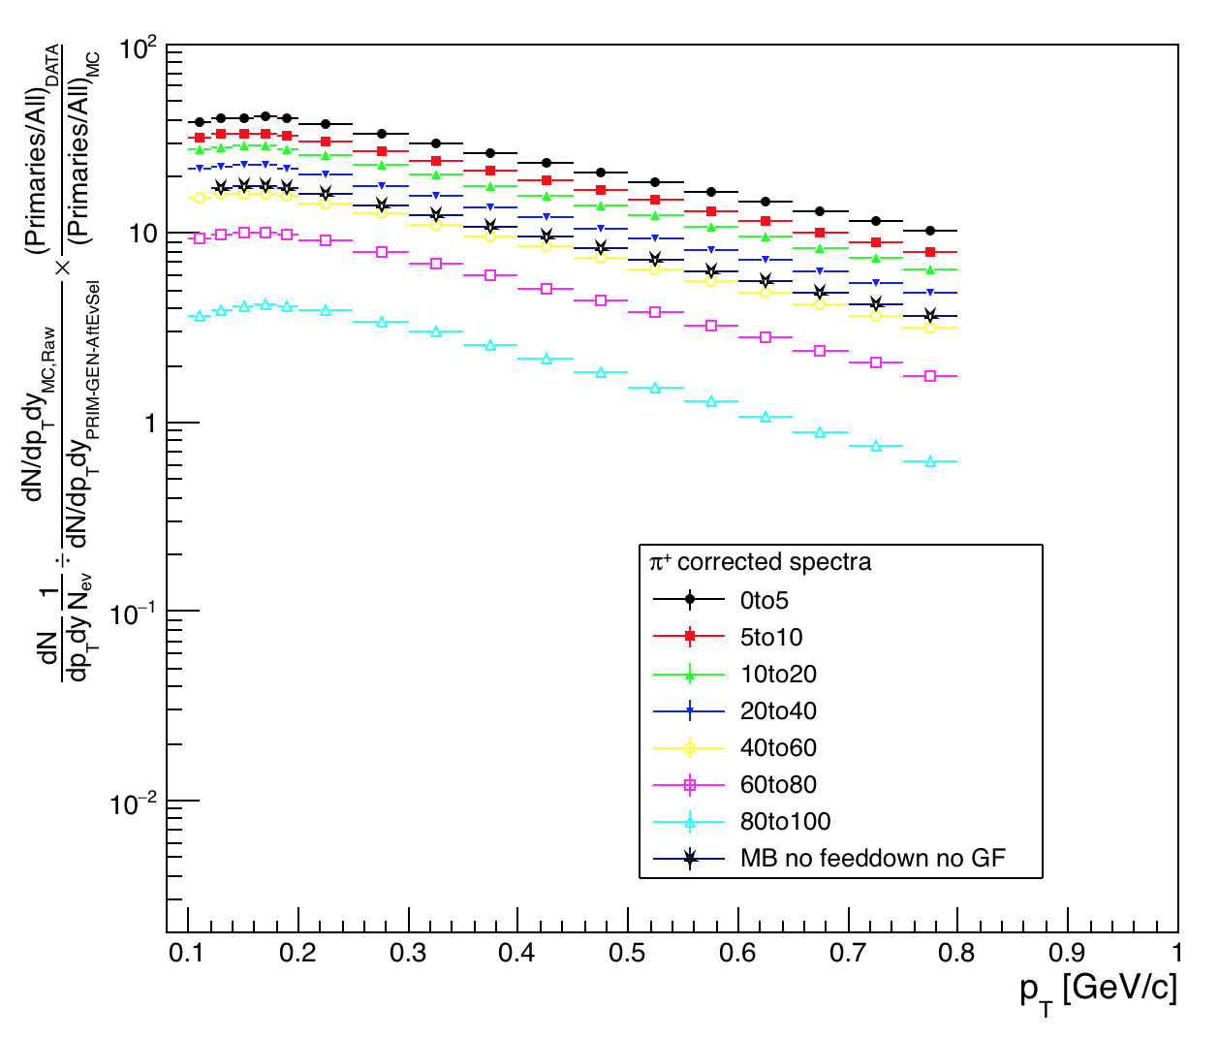
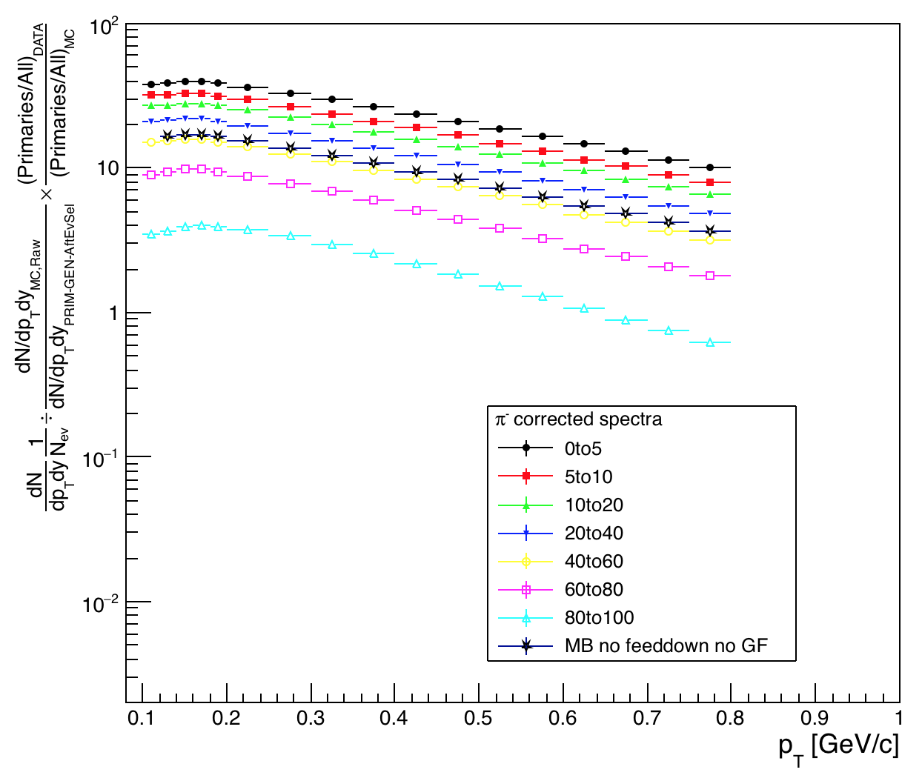
ITSsa corrected spectra
π⁺
π⁻

Slide 42
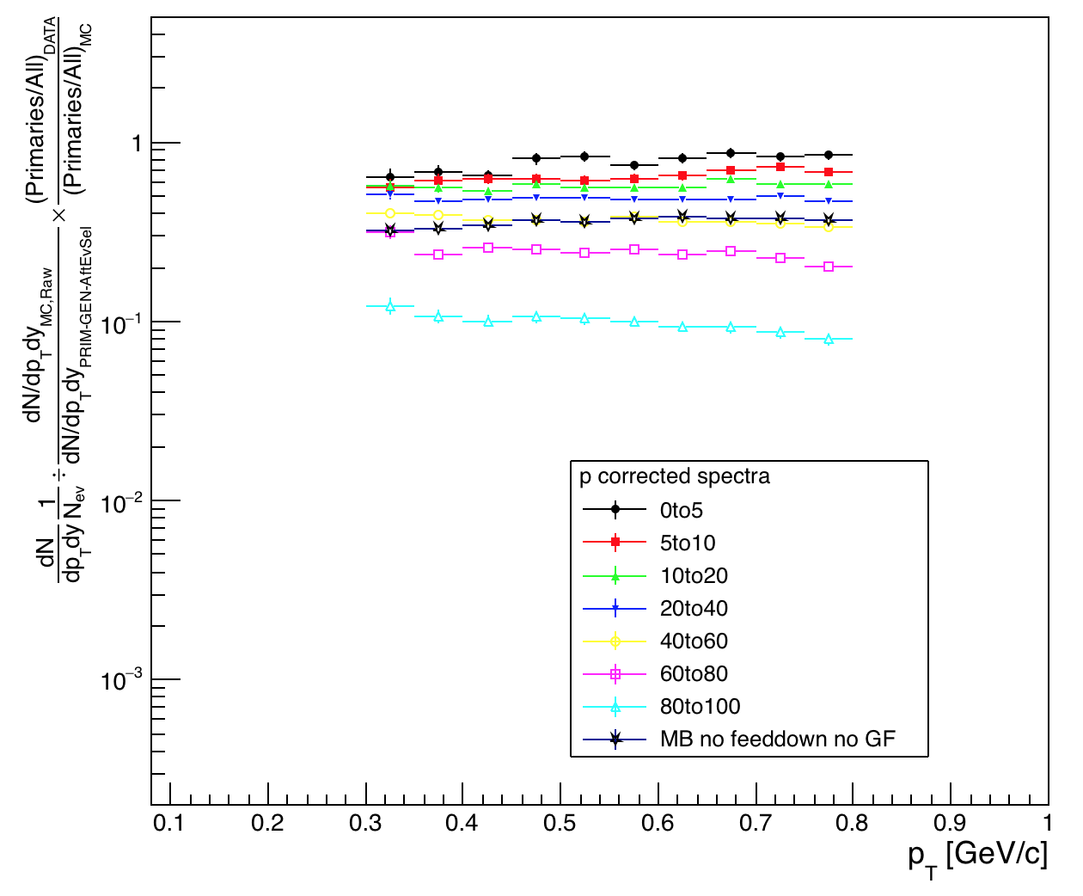
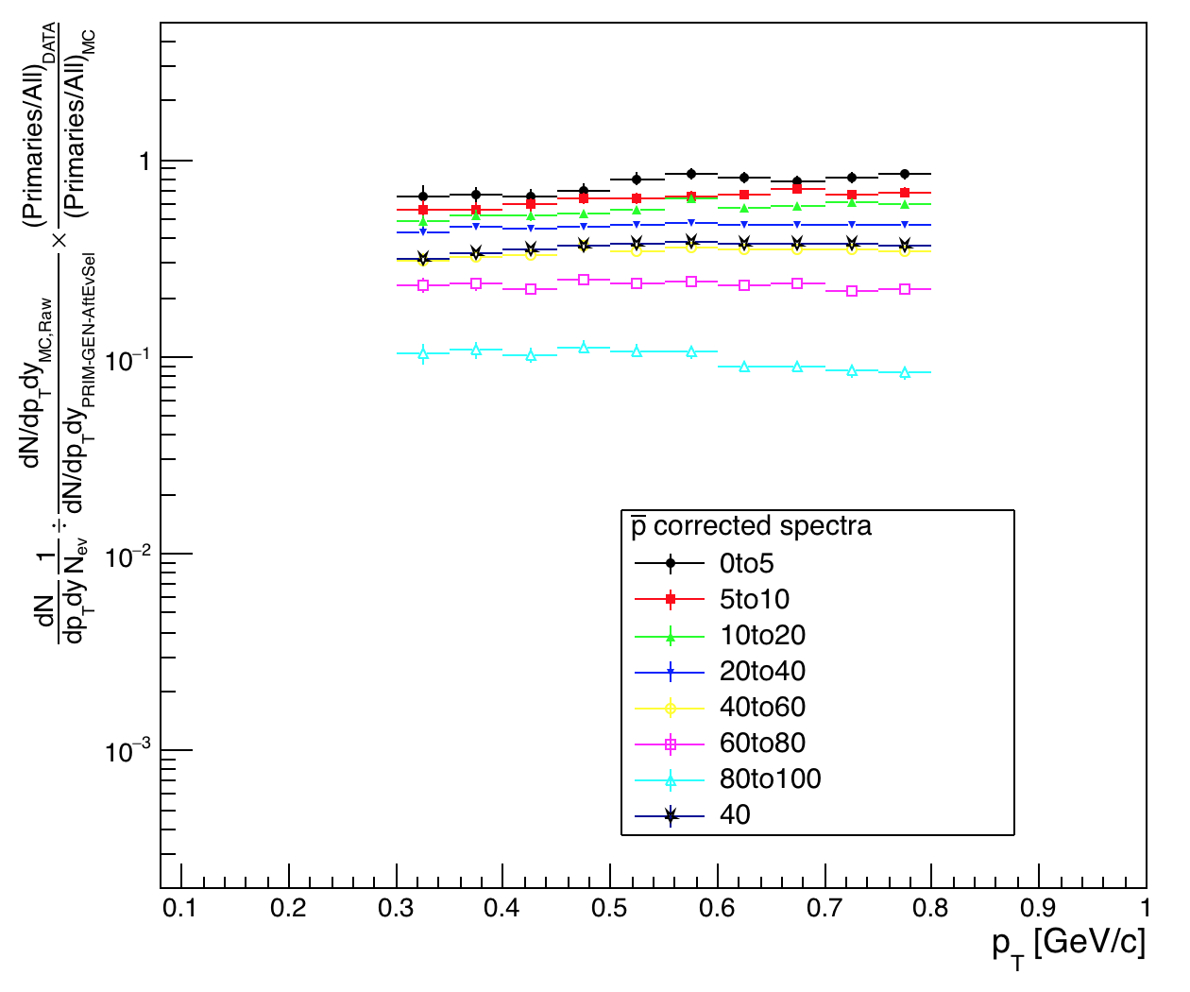
ITSsa corrected spectra
p
anti-p

Slide 43
TOF spectra - kaons

Slide 44
TOF spectra - protons

Slide 45
Combined Spectra
Combination strategy: first combined TPC and TOF and then ITS
Correction for event loss applied

Slide 46
Statistical errors [0-5]% mult - ITS
Pions | Kaons | Protons
pT val e_stat | pT val e_stat | pT val e_stat
0.10 76.69 1.54% 0.12 80.20 1.28% 0.14 80.70 1.24% 0.16 81.11 1.23% 0.18 78.84 1.23% 0.20 73.79 0.78% 0.25 66.24 0.81% 0.30 59.36 0.84% 0.35 53.11 0.89% 0.40 47.55 0.95% 0.45 42.10 1.00% | 0.20 4.37 1.36% 0.25 4.92 1.22% 0.30 5.32 0.96% 0.35 5.69 0.93% 0.40 6.04 0.87% 0.45 6.18 0.84% 0.50 6.20 0.75% 0.55 6.15 0.73% 0.60 6.12 0.71% | 0.30 1.29 9.35% 0.35 1.34 7.26% 0.40 1.30 6.12% 0.45 1.51 5.65% 0.50 1.63 5.21% 0.55 1.60 4.68% 0.60 1.63 4.56% 0.65 1.64 4.42% 0.70 1.64 4.30% 0.75 1.69 4.37%

Slide 47
Statistical errors [0-5]% mult - TPC
Pions | Kaons | Protons
pT val e_stat | pT val e_stat | pT val e_stat
0.30 62.78 1.85% 0.35 54.25 1.74% 0.40 50.56 1.91% 0.45 44.43 1.84% 0.50 39.42 1.82% 0.55 35.57 1.88% 0.60 31.48 2.04% 0.65 29.81 2.49% | 0.25 4.05 16.44% 0.30 4.80 15.54% 0.35 5.81 12.02% | 0.45 1.49 12.81% 0.50 1.42 10.96% 0.55 1.59 9.56% 0.60 1.57 8.00% 0.65 1.54 9.07% 0.70 2.21 15.70% 0.75 1.70 14.32%

Slide 48
Statistical errors [0-5]% mult – TOF
Pions | Kaons | Protons
pT val e_stat | pT val e_stat | pT val e_stat
0.70 27.20 0.32% 0.75 24.47 0.35% 0.80 22.17 0.37% 0.85 20.08 0.40% 0.90 18.03 0.42% 0.95 16.46 0.45% 1.00 14.19 0.36% 1.10 11.58 0.40% 1.20 9.56 0.44% 1.30 7.85 0.49% 1.40 6.46 0.54% 1.50 5.28 0.58% 1.60 4.44 0.63% | 0.50 6.64 1.26% 0.55 6.17 1.12% 0.60 6.08 1.05% 0.65 5.85 1.02% 0.70 5.58 1.02% 0.75 5.32 1.03% 0.80 5.11 1.05% 0.85 4.85 1.08% 0.90 4.67 1.12% 0.95 4.26 1.14% 1.00 3.98 0.85% 1.10 3.64 0.90% 1.20 3.09 0.94% | 0.60 1.61 1.57% 0.65 1.63 1.47% 0.70 1.67 1.39% 0.75 1.66 1.37% 0.80 1.68 1.35% 0.85 1.65 1.36% 0.90 1.64 1.36% 0.95 1.66 1.38% 1.00 1.58 1.02% 1.10 1.53 1.05% 1.20 1.39 1.10% 1.30 1.29 1.14% 1.40 1.18 1.18%

Slide 49
Statistical errors [0-5]% mult - TOF
Pions | Kaons | Protons
pT val e_stat | pT val e_stat | pT val e_stat
1.70 3.72 0.68% 1.80 3.09 0.73% 1.90 2.67 0.80% 2.00 2.26 0.86% 2.10 1.89 0.93% 2.20 1.59 0.99% 2.30 1.38 1.07% 2.40 1.21 1.19% 2.50 1.02 1.33% 2.60 0.89 1.39% 2.70 0.77 1.50% 2.80 0.66 1.59% | 1.20 3.09 0.94% 1.30 2.63 1.00% 1.40 2.21 1.05% 1.50 1.92 1.12% 1.60 1.66 1.18% 1.70 1.46 1.25% 1.80 1.22 1.35% 1.90 1.05 1.43% 2.00 0.88 1.51% 2.10 0.78 1.63% 2.20 0.64 1.73% 2.30 0.55 1.86% | 1.40 1.18 1.18% 1.50 1.06 1.22% 1.60 0.96 1.27% 1.70 0.86 1.33% 1.80 0.76 1.40% 1.90 0.68 1.46% 2.00 0.62 1.53% 2.10 0.54 1.61% 2.20 0.50 1.75% 2.30 0.45 1.80% 2.40 0.37 1.90% 2.50 0.33 2.03%

Slide 50
Statistical errors [0-5]% mult - TOF
Pions | Kaons | Protons
pT val e_stat | pT val e_stat | pT val e_stat
2.90 0.59 1.67% 3.00 0.48 1.35% 3.20 0.37 1.50% 3.40 0.28 1.69% 3.60 0.21 1.88% 3.80 0.20 2.20% 4.00 0.12 1.64% 4.50 0.08 2.07% | 2.40 0.46 1.98% 2.50 0.39 2.15% 2.60 0.35 2.20% 2.70 0.29 2.44% 2.80 0.25 2.59% 2.90 0.19 2.78% 3.00 0.16 2.16% 3.20 0.13 2.47% 3.40 0.08 2.78% 3.60 0.07 3.16% 3.80 0.04 3.84% 4.00 0.03 2.69% 4.50 0.01 3.96% | 2.60 0.29 2.10% 2.70 0.27 2.27% 2.80 0.22 2.39% 2.90 0.19 2.56% 3.00 0.16 1.97% 3.20 0.12 2.24% 3.40 0.09 2.66% 3.60 0.07 3.02% 3.80 0.06 3.45% 4.00 0.03 2.78% 4.50 0.02 3.65%

