Slide 1
Artificial
Intelligence in
Medicine
INFN - CSN5
2019-2021
RN: A. Retico (INFN-PI)
RL: A. Chincarini (GE) / P. Oliva (CA) / D. Remondini (BO) /
S. Tangaro (BA) / M. Marrale (CT) / C. Talamonti (FI) / M.E. Fantacci (PI)

Slide 2
AIM in short
a network of expertise in applied data analysis
focus on medical data & radiomics
AIM: INFN-wide collaboration
PI / GE / CA / BO / BA / CT/ FI / (RM / NA )
Seeks to grow and develop existing and new curriculum in applied data science
Developments are CNTT-oriented (e.g. DORIAN [A. Chincarini], R4I 2019)
INFN CSN5 funded projects
2019-2021

Slide 3
partners & dataset
Clinical partners
IRCCS S. Martino (GE)
IRCCS Stella Maris (PI)
IRCCS Gaslini (GE)
IRCCS Centro S. G. di Dio (BS)
IRCCS G.Paolo II (BA)
IRCCS SDN (NA)
AOUP (PI)
Policlinico (BA)
Policlinico (PA)
Osp. Pediatrico Meyer (FI)
EU / consortia
IMAGO7 (Fondazione di Ricerca)
EADC (EU)
ADNI (US)
ABIDE (EU/US)
ENIGMA (WW)

Slide 4
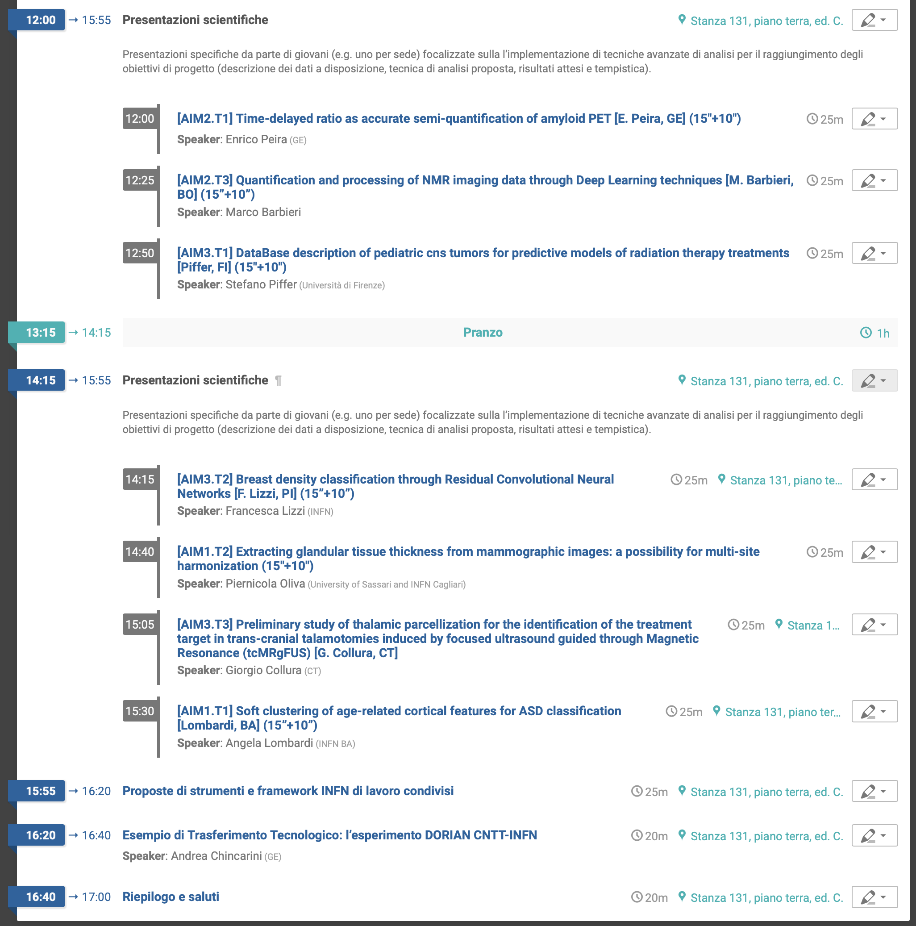
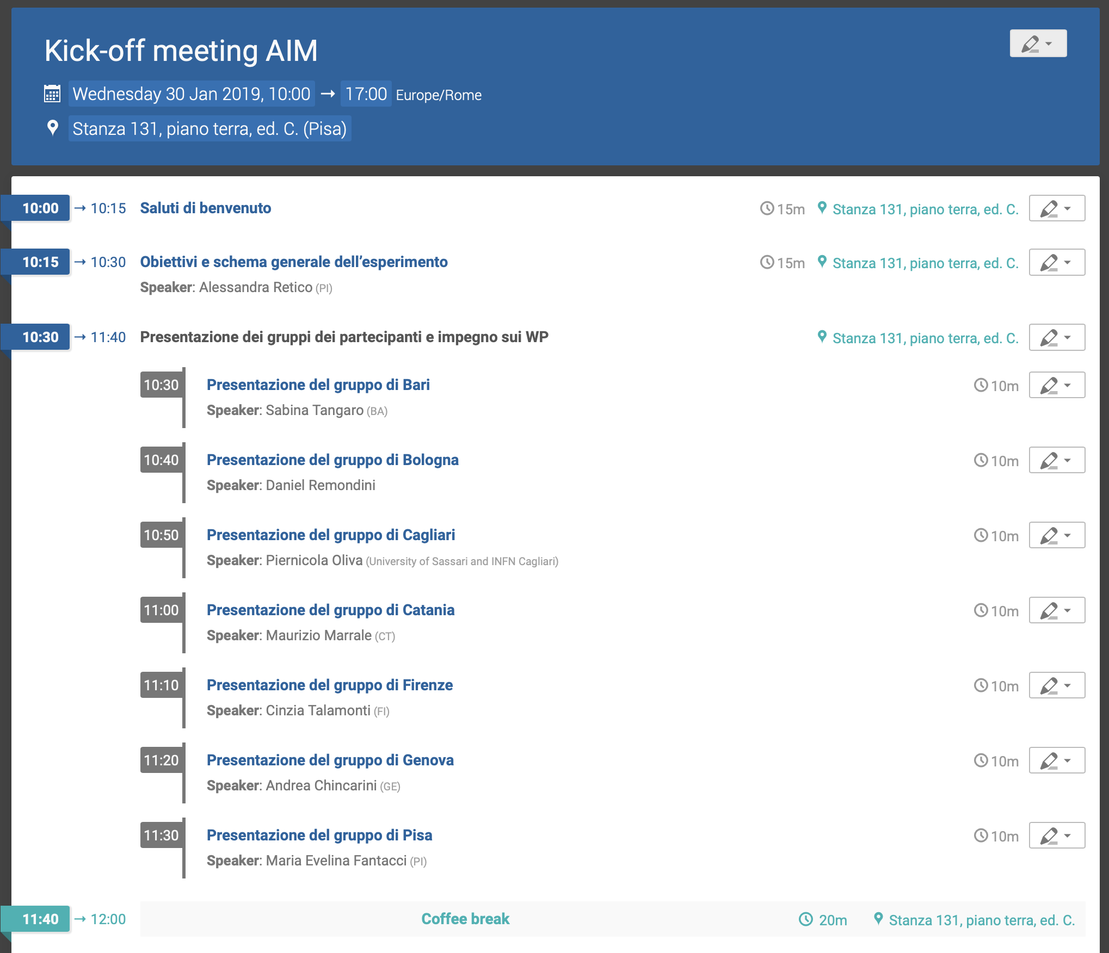

Slide 5
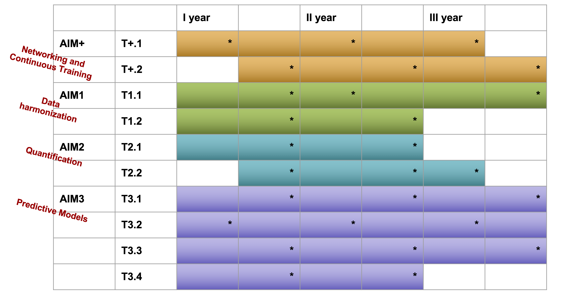
AIM: Project Implementation
AIM+: Networking and Continuous Training
AIM+.T1 - Annual workshop on Methods, Algorithms and Computing Resource Operability, including training for new members (MACRO workshop).
AIM+.T2 - Annual workshop on applications (APP workshop).
AIM 1: Data harmonization
AIM1.T1 - Multi-site data harmonization in MRI (PI, BA, BO) AIM1.T2 - Multi-site data harmonization in mammography (PI, CA)
… AIM1.Tn - future tasks to be added during the project.
AIM 2: Quantification
AIM2.T1 - Quantification models in PET (GE, BO)
AIM2.T2 - Integrated quantification of PET and omics data (BO)
… AIM2.Tn - future tasks to be added during the project.
AIM 3: Predictive models
AIM3.T1 - Predictive models for Radiation Therapy treatments (FI, GE, PI)
AIM3.T2 - Predictive models for mammography and CESM (PI, CA, BA)
AIM3.T3 - Predictive models for transcranial-MR-guided Focused Ultrasound Surgery (tcMRgFUS) (CT, BO)
AIM3.T4 - Predictive models for Systems Medicine (BO)
… AIM3.Tn - future tasks to be added during the project.
… AIM N - future aims to be added during the project.

Slide 6
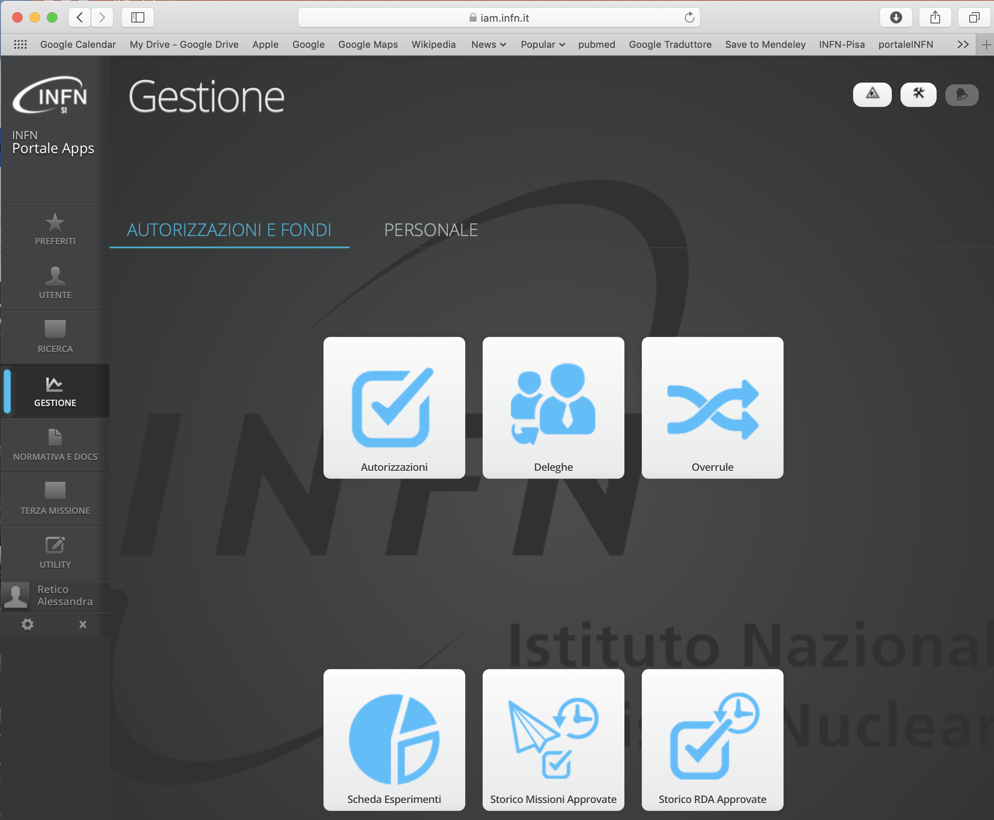
Feedback reviewer
http://www.ac.infn.it/assegnazioni/
https://iam.infn.it/Portale

Slide 7
AIM: Project Implementation
AIM+: Networking and Continuous Training
AIM+.T1 - Annual workshop on Methods, Algorithms and Computing Resource Operability, including training for new members (MACRO workshop).
AIM+.T2 - Annual workshop on applications (APP workshop).
AIM 1: Data harmonization
AIM1.T1 - Multi-site data harmonization in MRI (PI, BA, BO) AIM1.T2 - Multi-site data harmonization in mammography (PI, CA)
… AIM1.Tn - future tasks to be added during the project.
AIM 2: Quantification
AIM2.T1 - Quantification models in PET (GE, BO)
AIM2.T2 - Integrated quantification of PET and omics data (BO)
… AIM2.Tn - future tasks to be added during the project.
AIM 3: Predictive models
AIM3.T1 - Predictive models for Radiation Therapy treatments (FI, GE, PI)
AIM3.T2 - Predictive models for mammography and CESM (PI, CA, BA)
AIM3.T3 - Predictive models for transcranial-MR-guided Focused Ultrasound Surgery (tcMRgFUS) (CT, BO)
AIM3.T4 - Predictive models for Systems Medicine (BO)
… AIM3.Tn - future tasks to be added during the project.
… AIM N - future aims to be added during the project.

Slide 8
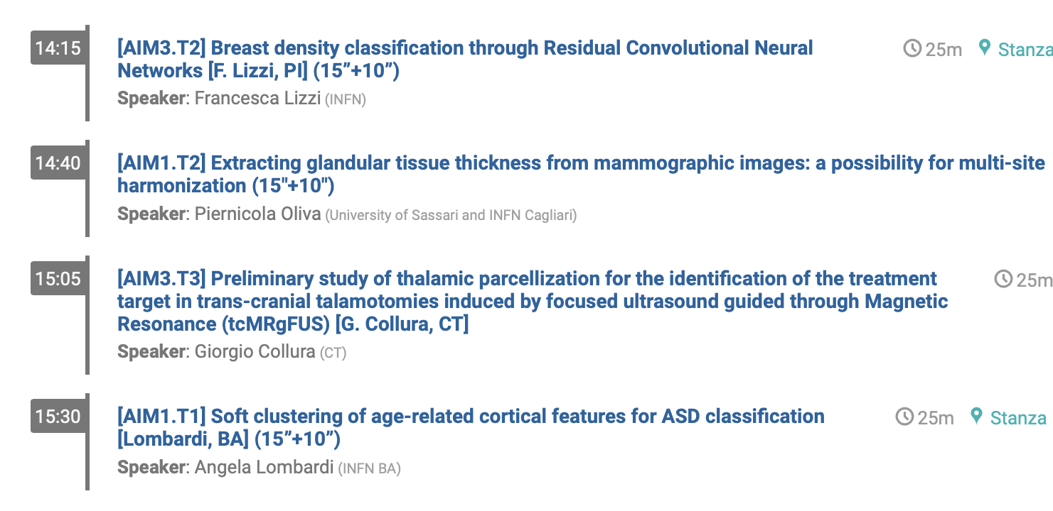
AIM: Project Implementation
AIM 1: Data harmonization
AIM1.T1 - Multi-site data harmonization in MRI (PI, BA, BO)
AIM1.T2 - Multi-site data harmonization in mammography (PI, CA)
AIM 2: Quantification
AIM2.T1 - Quantification models in PET (GE, BO)
AIM2.T2 - Integrated quantification of PET and omics data (BO)
AIM 3: Predictive models
AIM3.T1 - Predictive models for Radiation Therapy treatments (FI, GE, PI)
AIM3.T2 - Predictive models for mammography and CESM (PI, CA, BA)
AIM3.T3 - Predictive models for transcranial-MR- guided Focused Ultrasound Surgery (tcMRgFUS) (CT, BO)
AIM3.T4 - Predictive models for Systems Medicine (BO)

Slide 9
Milestones
 | I year | II year | III year
AIM+ | M+.1 (30-06-2019) Organization of the first MACRO workshop | M+.1 (30-06-2020) Organization of the second MACRO workshop | M+.1 (30-06-2021) Organization of the third MACRO workshop
 | M+.2 (31-12-2019) Organization of the first APP workshop | M+.2 (31-12-2020) Organization of the second APP workshop | M+.2 (31-12-2021) Organization of the third APP workshop
AIM1 | M1.1 (31-12-2019) Identification and coding of Generative Adversarial Network for MRI data harmonization | M1.1 (30-06-2020) Acquisition of suitable MRI data sample for testing (e.g. ABIDE, ADNI, ...), identification of test metrics and validation. | M1.1 (31-12-2021) Comparison with standard techniques and publication
 | M1.2 (31-12-2019) Implementation of first prototype of the harmonization algorithm for mammograms | M1.2 (31-12-2020) Database consolidation and validation of the harmonization algorithm and publication of the results | --
AIM2 | M2.1 (31-12-2019) Paper submitted, describing an innovative method of amyloid- PET quantification | M2.1 (31-12-2020) Method validation on EU multicentric dataset and all fluorinated tracers | --
 | M2.2 (31-12-2019) Characterisation of PET dataset and its association to clinical variables | M2.2 (31-12-2020) Implementation and validation of methods to combine quantitative PET measures and omics data | M2.2 (30-06-2021) Publication of the results

Slide 10
Milestones
 | I year | II year | III year
AIM3 | M3.1 (31-12-2019) Creation of database for predictive models for Radiation Therapy treatments | M3.1 (31-12-2020) Software development for the selection of the most important features and first test on data | M3.1 (31-12-2021) Data analysis and study of results obtained in predicting: overall survival, radiation treatment response, distant metastases, recurrences, and radiation-related toxicity
 | M3.2a (30-06-2019) Development of a CNN for automatic classification of breast density according to the 4 BIRADS classes | M3.2a (30-06-20) Validation of the CNN on the available database | M3.2a (30-06-2021) Development and validation of a CNN for automatic classification of breast density according to the 4 BIRADS classes on the harmonized database
 | M3.2b (31-12-2019) Database creation and development of analysis software for predictive models for Contrast Enhanced Spectral Mammography | M3.2 (31-12-2020) Further patient data acquisition and application of the analysis software on the data acquired on the first year and validation of an automatic classification method | M3.2 (31-12-2021) Application of the analysis software on all data acquired and publication of the results
 | M3.3 (31-12-2019) Database creation and development of analysis software for predictive models for transcranial-MR-guided Focused Ultrasound Surgery | M3.3 (31-12-2020) Further patient data acquisition and application of the analysis software on the data acquired on the first year | M3.3 (31-12-2021) Application of the analysis software on all data acquired and publication of the results
 | M3.4 (31-12-2019) Development of a pipeline for the integration of multiple omics data in relation to drug target identification | M3.4 (31-12-2020) Application of the pipeline to real patient case studies for personalized targeting | --

Slide 11
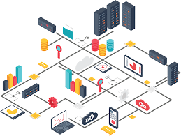
AIM+: sharing the expertise
AIM role is grounded into expertise sharing:
workshops: 2/year (methods, applications)
slots into INFN software schools
shared PhD training
generation of consortia for regional / EU / health-related applications
Connected to CNTT (e.g. DORIAN)
Geared towards an INFN-Medicine infrastructure

Slide 12
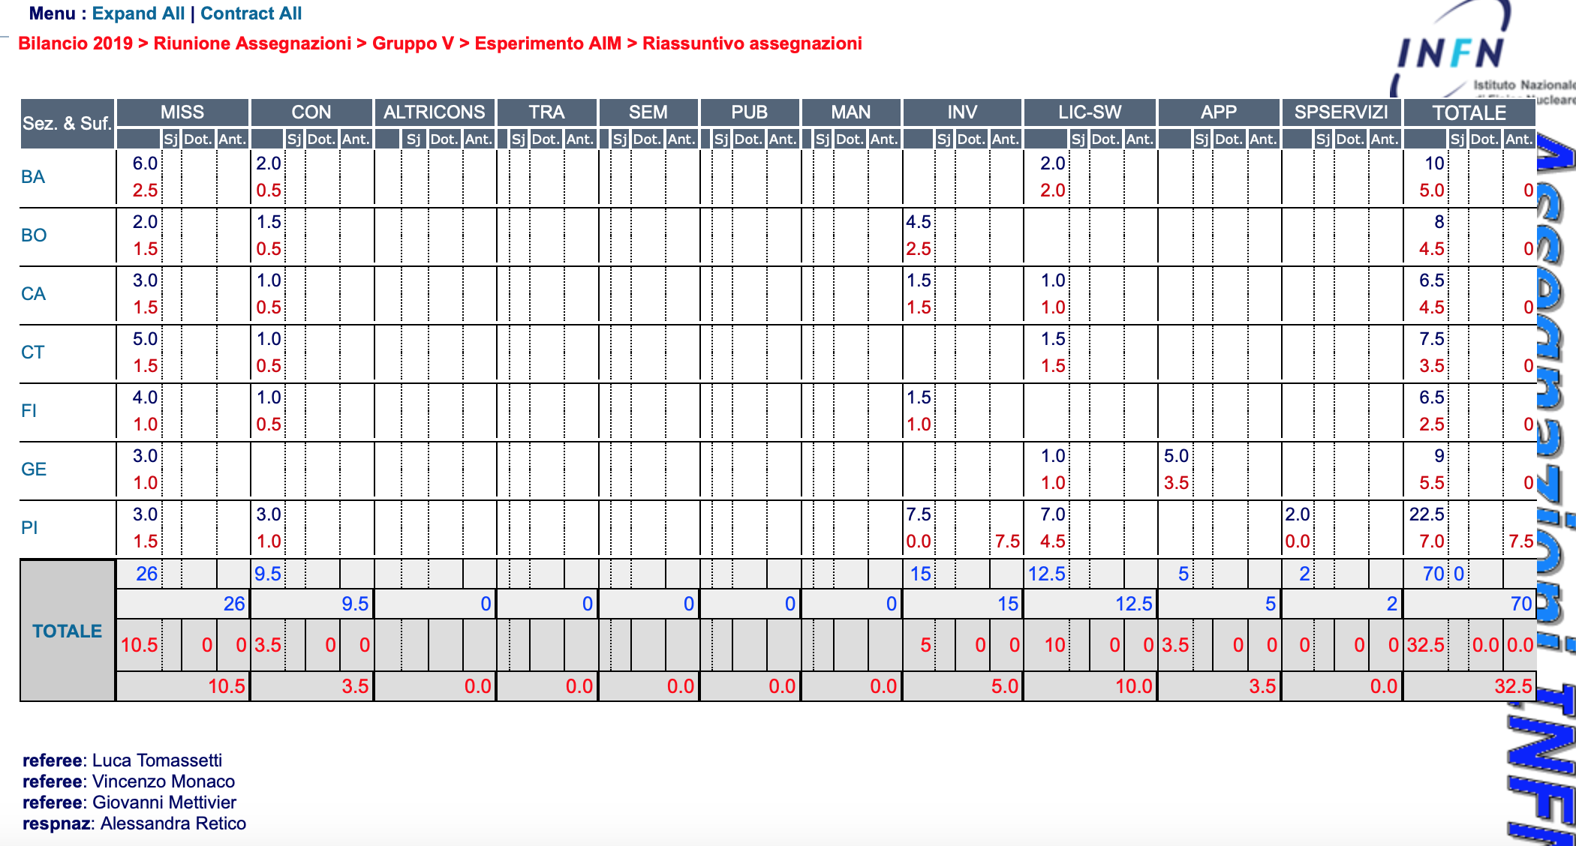
AIM: Budget
People: 20.6 FTE (47 researchers)
mainly Matlab licenses, … to be discussed

Slide 13
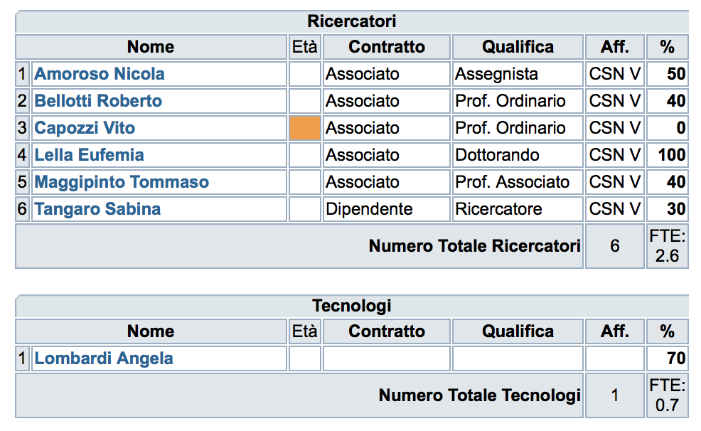
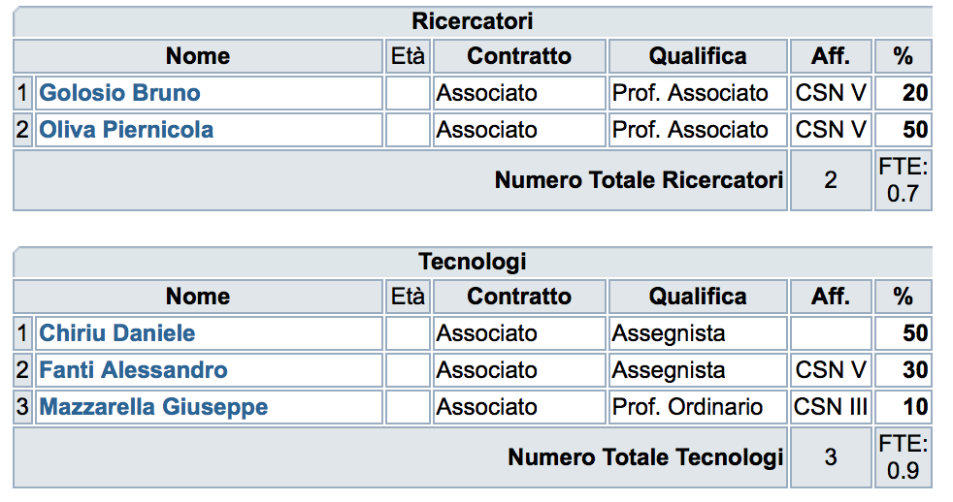
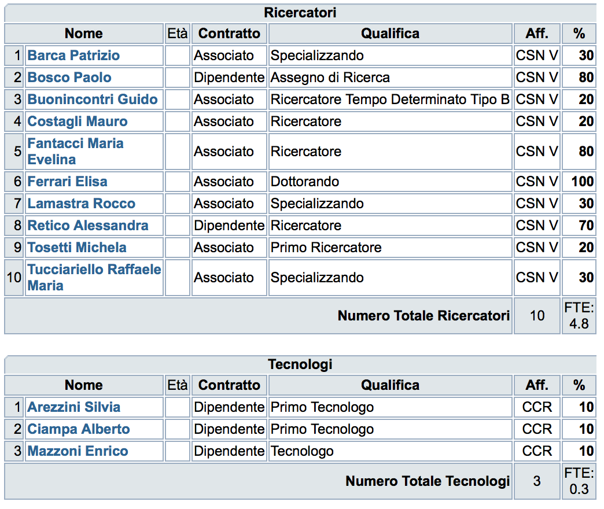
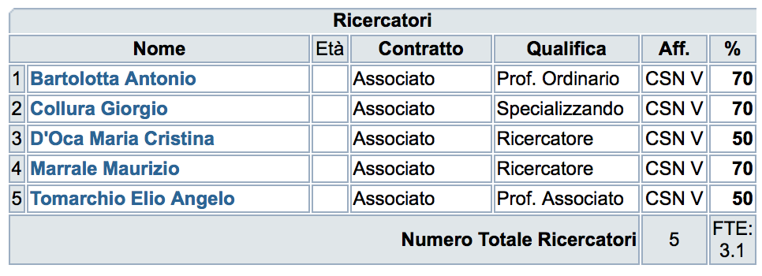
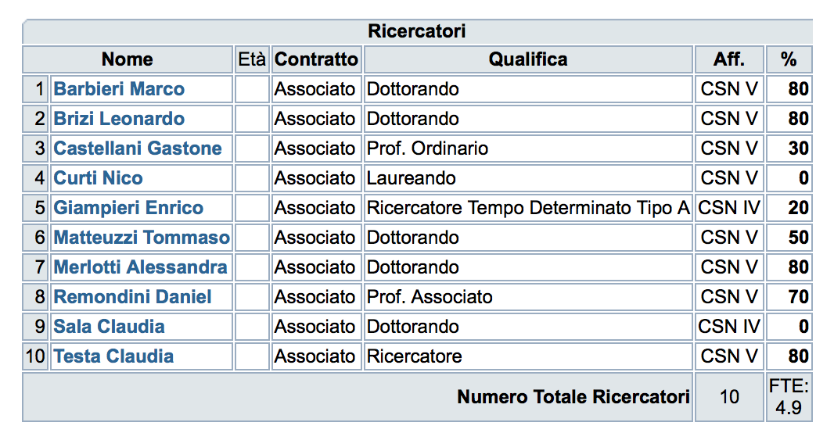
People
BA
CA
People: 20.6 FTE (47 researchers)
GE
PI
CT
BO
FI

Slide 14
Liste mail di AIM
aim-resp@lists.pi.infn.it (Resp locali)
aim-all@lists.pi.infn.it
59 iscritti - 25/01/2019
(PISA) aim-pisa@lists.pi.infn.it
alessandra.retico@pi.infn.it
Elisa Ferrari <elisa.ferrari@sns.it>,
letizia palumbo <letizia.palumbo@pi.infn.it>,
giovanna spera <giovanna.spera@pi.infn.it>,
Paolo Bosco <paolo.bosco@pi.infn.it>,
Michela Tosetti <michela.tosetti@fsm.unipi.it>,
Laura Biagi <laura.biagi@fsm.unipi.it>,
Guido Buonincontri <guido.buonincontri@gmail.com>,
Mauro Costagli <mauro.costagli@fsm.unipi.it>,
Francesca Lizzi <francescalizzi1@gmail.com>
maria.evelina.fantacci@unipi.it
Alessia Alba <alba.ale90@hotmail.it>,
Capanni Leonardo - Polynt Group <Leonardo.Capanni@polynt.com>,
francesco.laruina <francesco.laruina@pi.infn.it>
Davide Barbieri <brbr.davide@gmail.com>
Camilla Scapicchio <camillascapicchio@tiscali.it>
Jan Kurzawski <jan.kurzawski@gmail.com>
matteo.cencini@gmail.com
Silvia Arezzini <silvia.arezzini@pi.infn.it>,
Enrico Mazzoni <enrico.mazzoni@infn.it>,
Alberto Ciampa <alberto.ciampa@pi.infn.it>
(CATANIA)
Maurizio Marrale <maurizio.marrale@unipa.it>
Giorgio Collura <giorgio.collura01@unipa.it>
Elio Tomarchio <elio.tomarchio@unipa.it>
Antonio Bartolotta <antonio.bartolotta@unipa.it>
Maria Cristina D’Oca <mariacristina.doca@unipa.it>
(FIRENZE)
Cinzia Talamonti <cinzia.talamonti@unifi.it>
Stefania Pallotta <stefania.pallotta@unifi.it>
Silvia Calusi <silvia.calusi@gmail.com>
Daniela Greto <daniela.greto@gmail.com>
Silvia Scoccianti <silvia.scoccianti@unifi.it>
Antonio Ciccarone <antonio.ciccarone@meyer.it>
(GENOVA)
Andrea Chincarini andrea.chincarini@ge.infn.it
Enrico Peira enrico.peira@ge.infn.it
Nicola Alchera nicola.alchera@ge.infn.it
Matteo Grazzini matteo.grazzini@gmail.com
(ALTRI GRUPPI INTERESSATI)
Riccardo Faccini riccardo.faccini@roma1.infn.it
Cecilia Voena cecilia.voena@roma1.infn.it
Marco Aiello marcoaiello1978@gmail.com
(BARI)
Sonia Tangaro <sonia.tangaro@ba.infn.it>,
Domenico Diacono domenico.diacono@ba.infn.it
Alfonso Monaco alfonso.monaco@ba.infn.it
Angela Lombardi angela.lombardi@ba.infn.it
Nicola Amoroso nicola.amoroso@ba.infn.it
Eufemia Lella eufemia.lella@ba.infn.it
(BOLOGNA)
Daniel Remondini daniel.remondini@unibo.it
Castellani Gastone gastone.castellani@unibo.it
Testa Claudia claudia.testa@unibo.it
Giampieri Enrico enrico.giampieri@unibo.it
Brizi Leonardo leonardo.brizi2@unibo.it
Vitali Silvia silvia.vitali4@unibo.it
Sala Claudia claudia.sala3@unibo.it
Curti Nico nico.curti2@unibo.it
Merlotti Alessandra alessandra.merlotti2@unibo.it
Barbieri Marco marco.barbieri21@unibo.it
Matteuzzi Tommaso tommaso.matteuzzi2@unibo.it
(CAGLIARI)
Piernicola Oliva <oliva@uniss.it>
Bruno Golosio golosio@unica.it
Alessandro Fanti <alessandro.fanti@diee.unica.it>

Slide 15
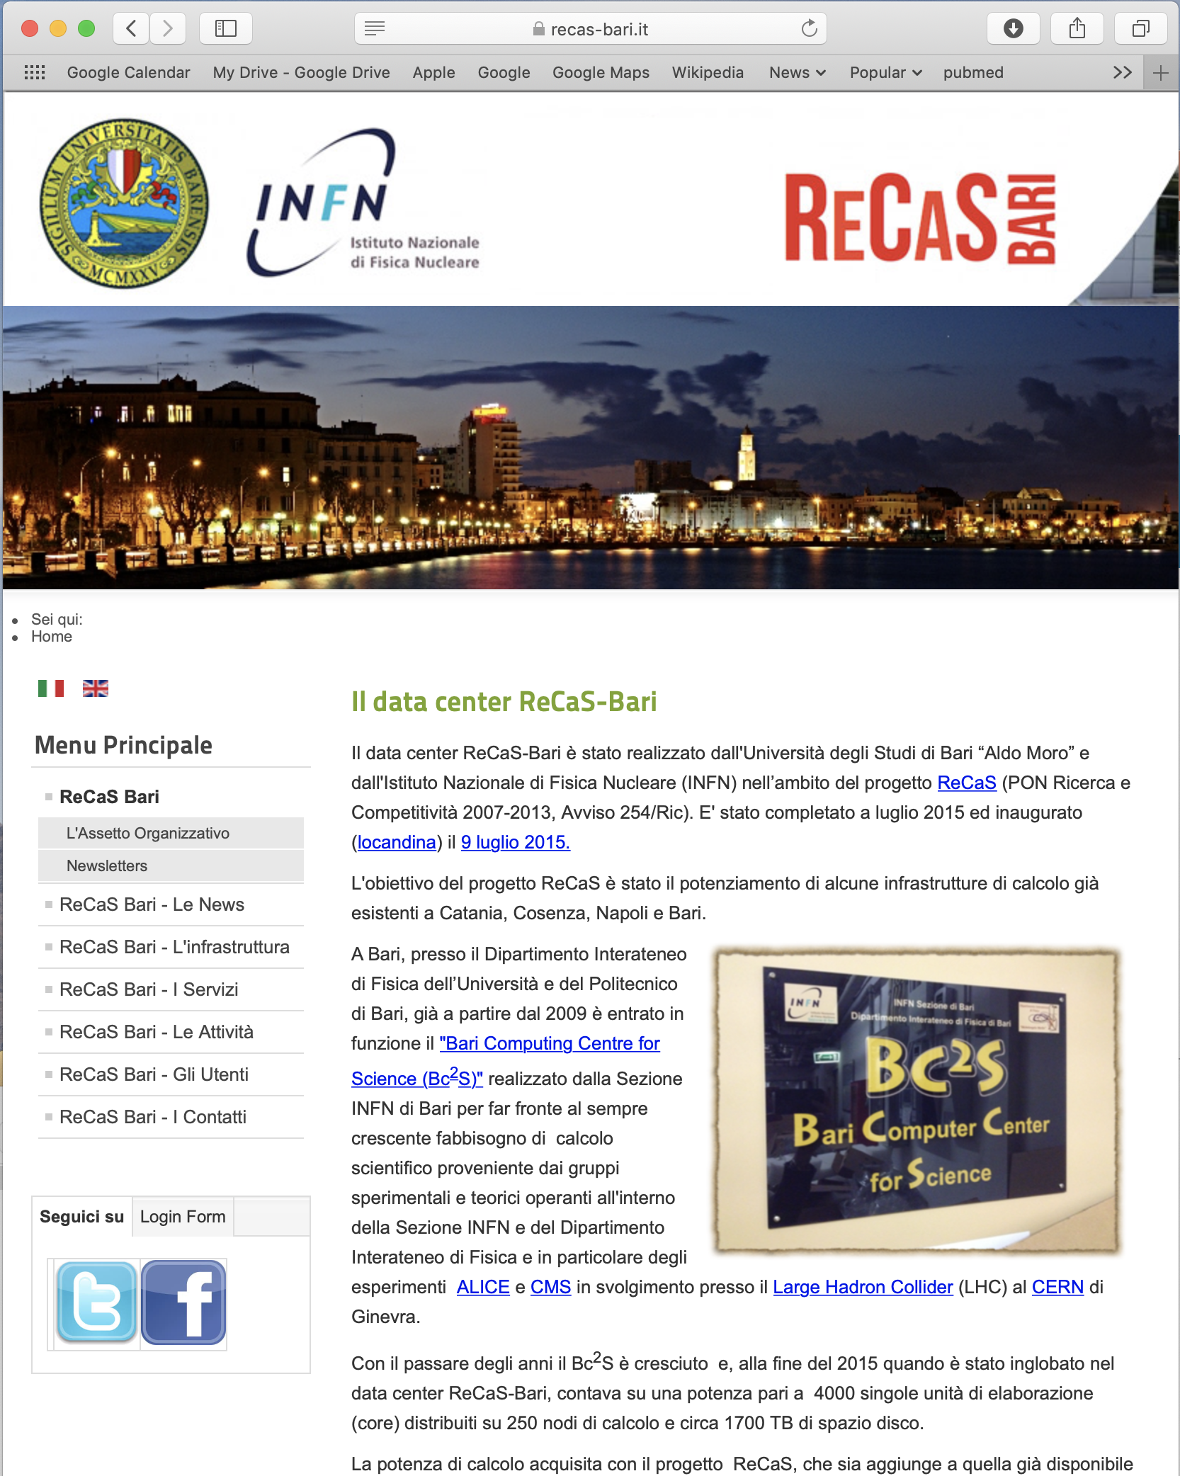
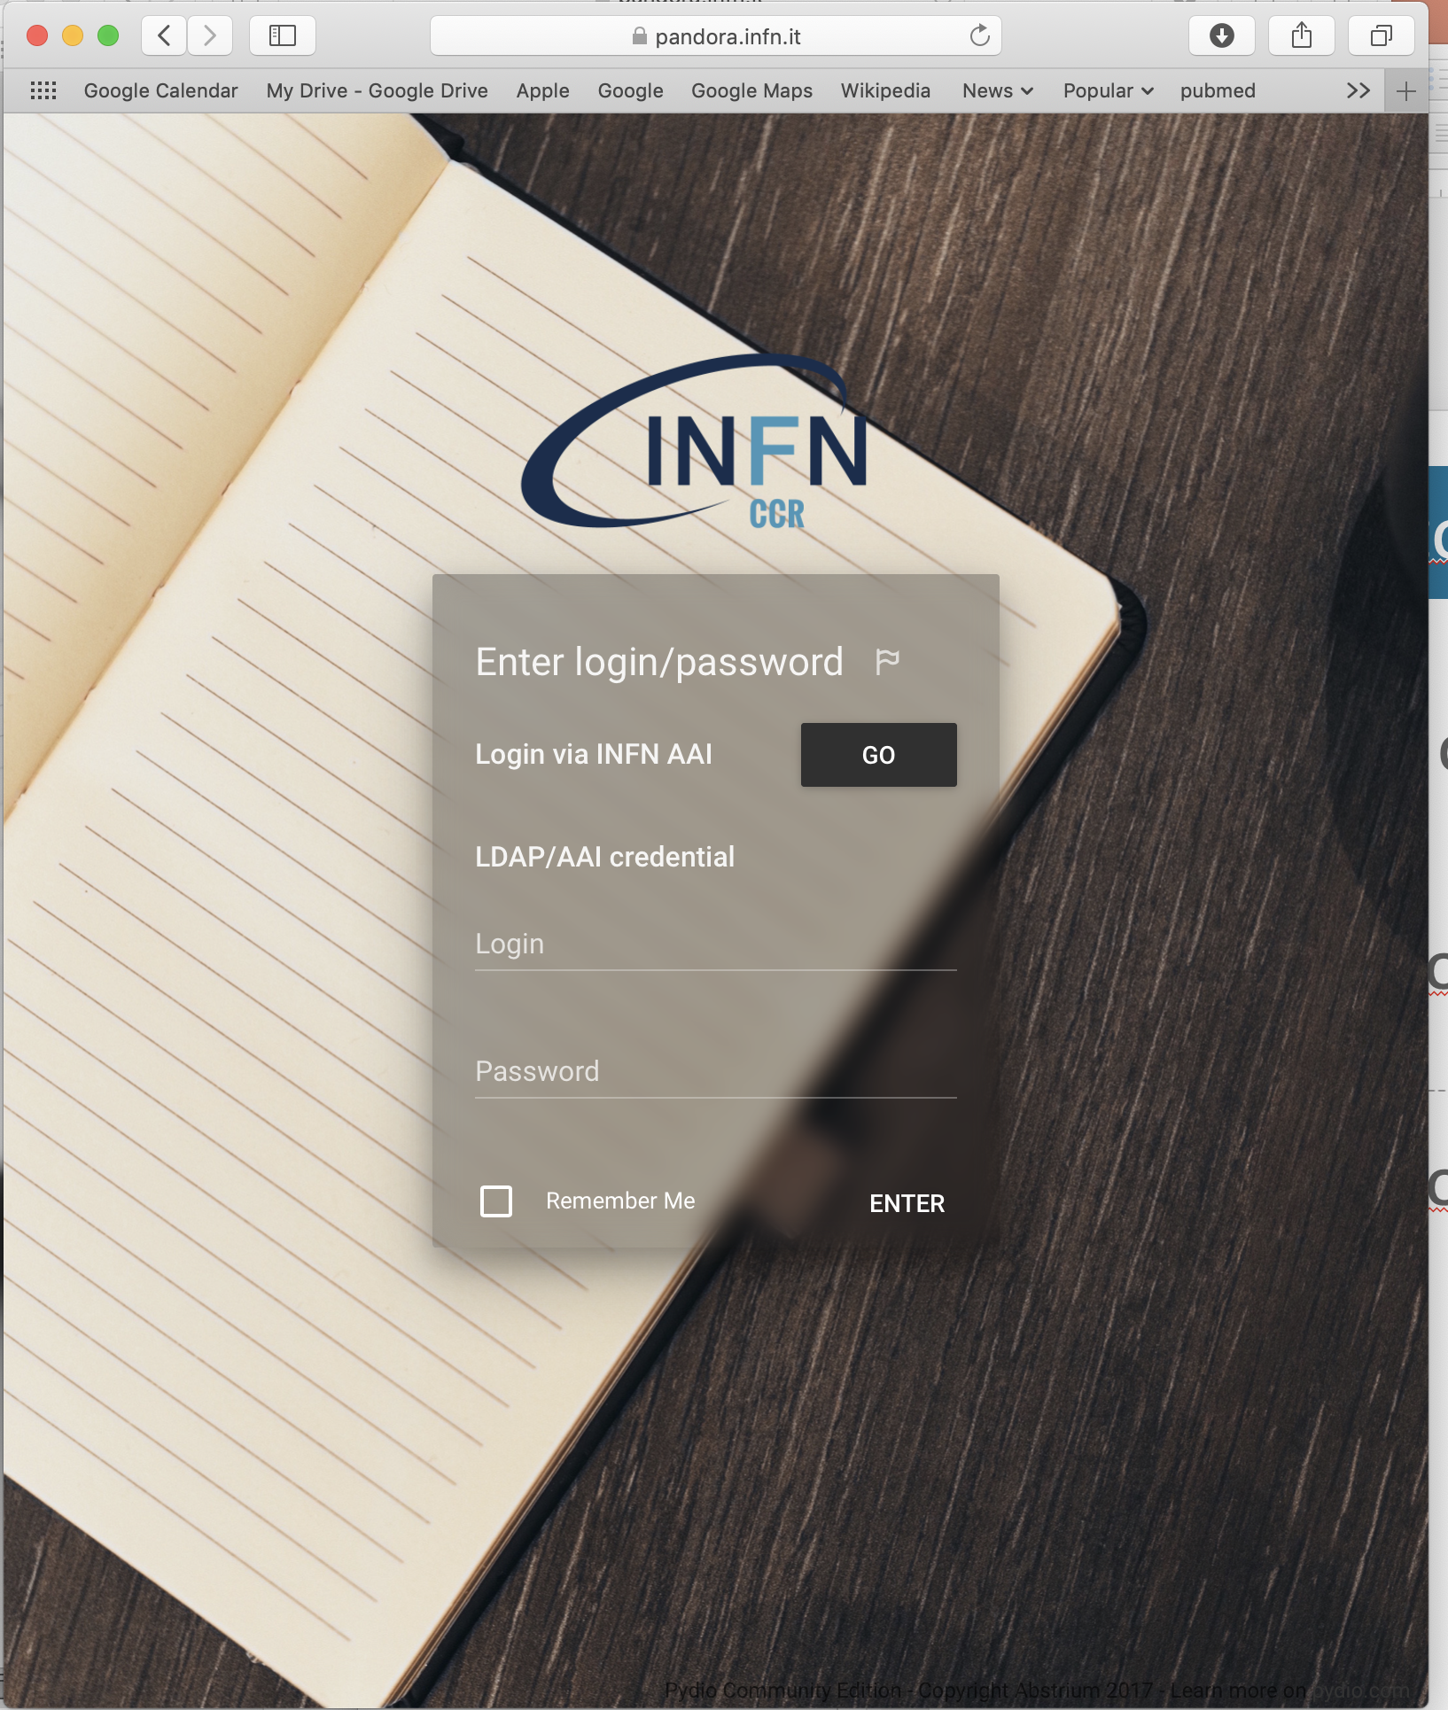
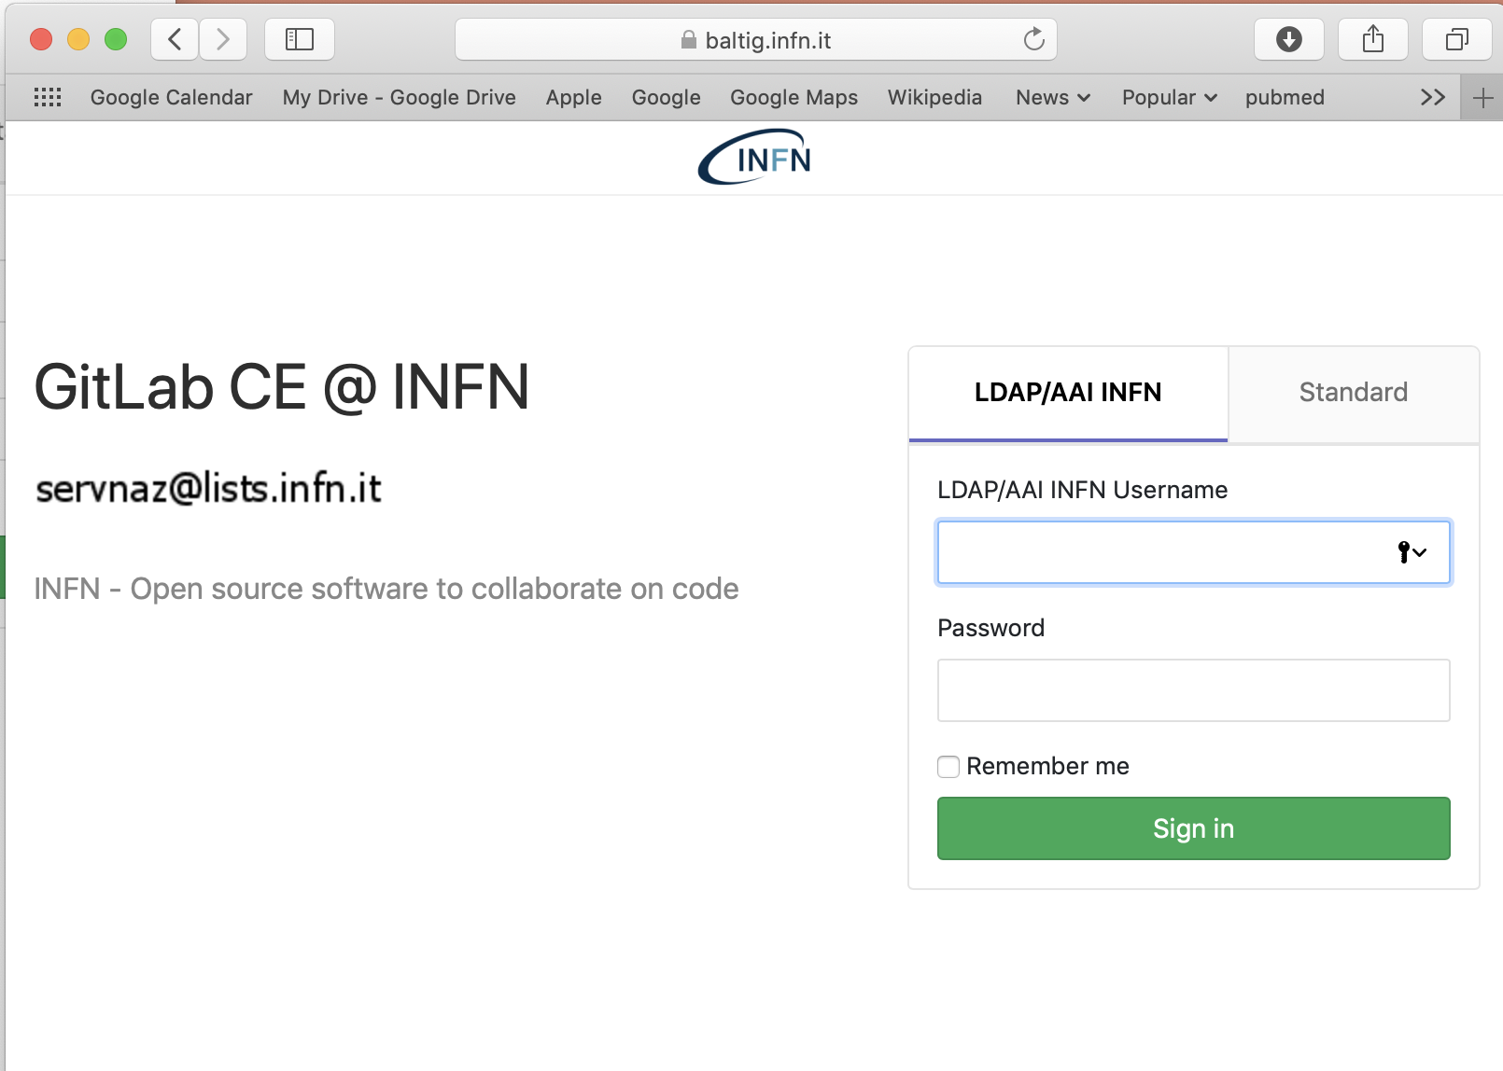
Collaborative tools
Repository of Project Documents => PANDORA, Office 635 (?)
SW repository and versioning => BALTIG
Access to computing resources => RECAS
Collaboration website (?)

Slide 16
Collaboration meetings
Meeting locali
Meeting telematici tra responsabili
eZuce meetings: 1/month
Proposta: primo lunedì del mese dalle 15:00 alle 17:00
[4 Febbraio, 4 Marzo, 2 Aprile (martedi), 6 Maggio, 3 Giigno, 1 Luglio, …)
Meeting di collaborazione
Giugno, alternativa tra:
WS tecnico + training (AIM+), de visu
WS tecnico (AIM+), via eZuce
Novembre - WS con referee e collaboratori clinici (AIM+)

Slide 17
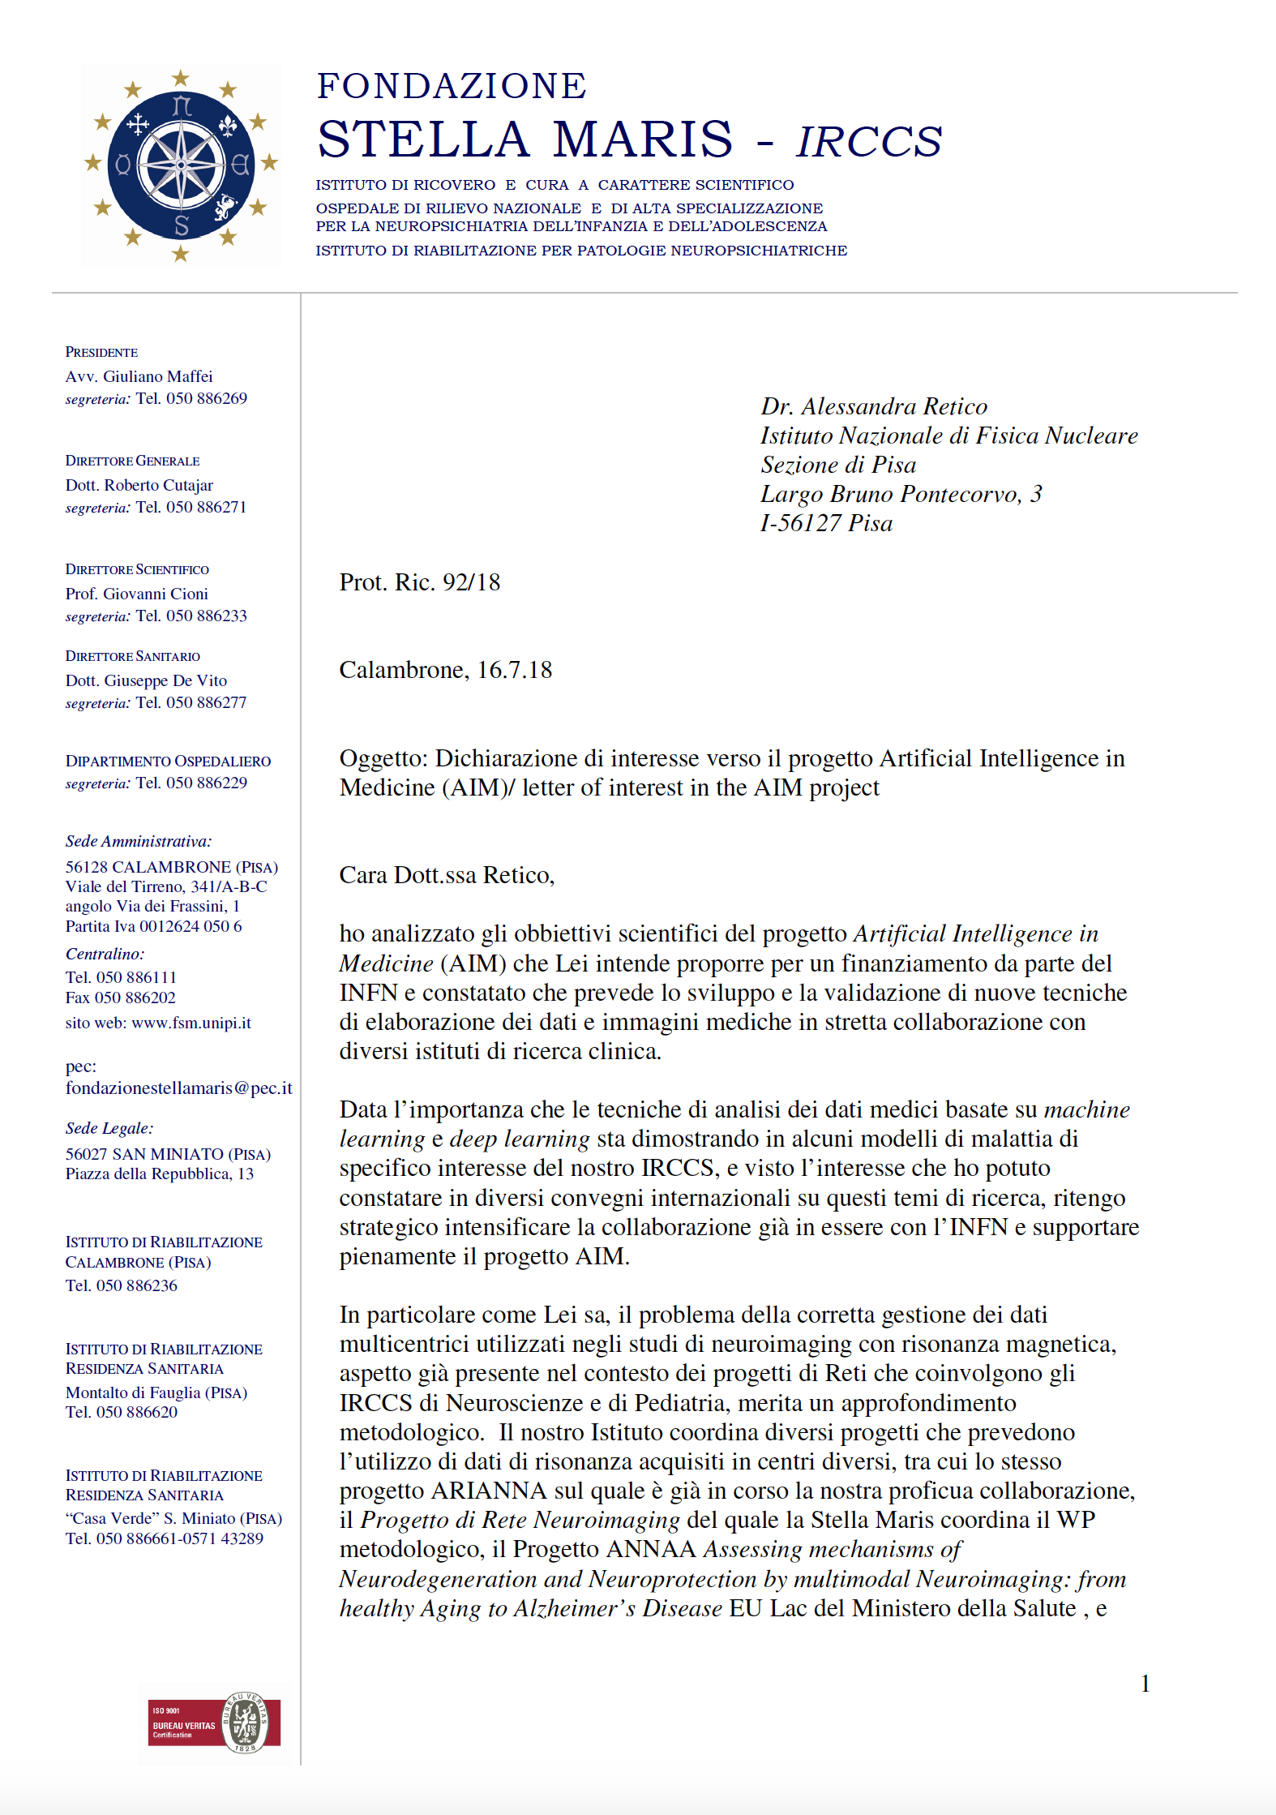
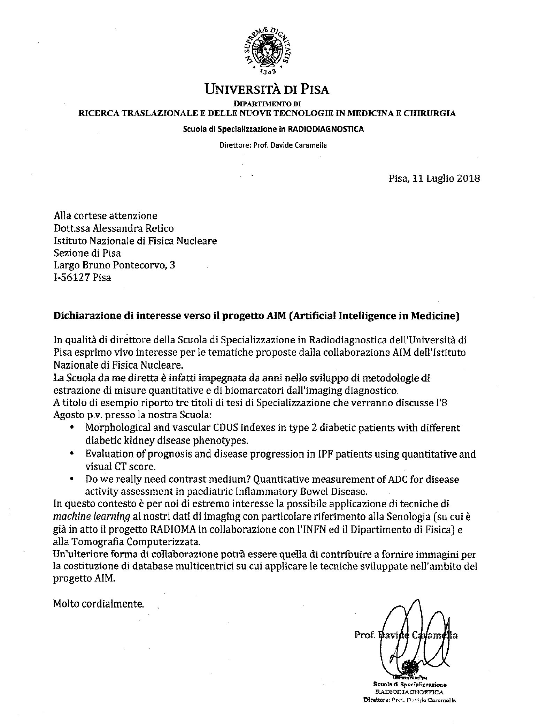
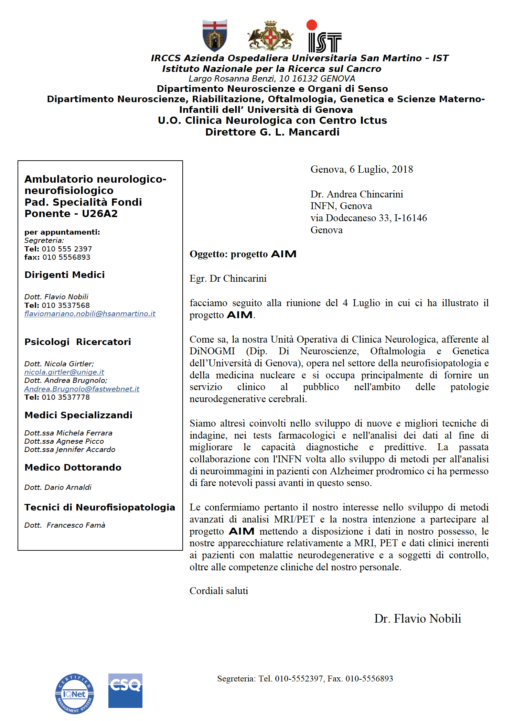
Letters of interests

Slide 18
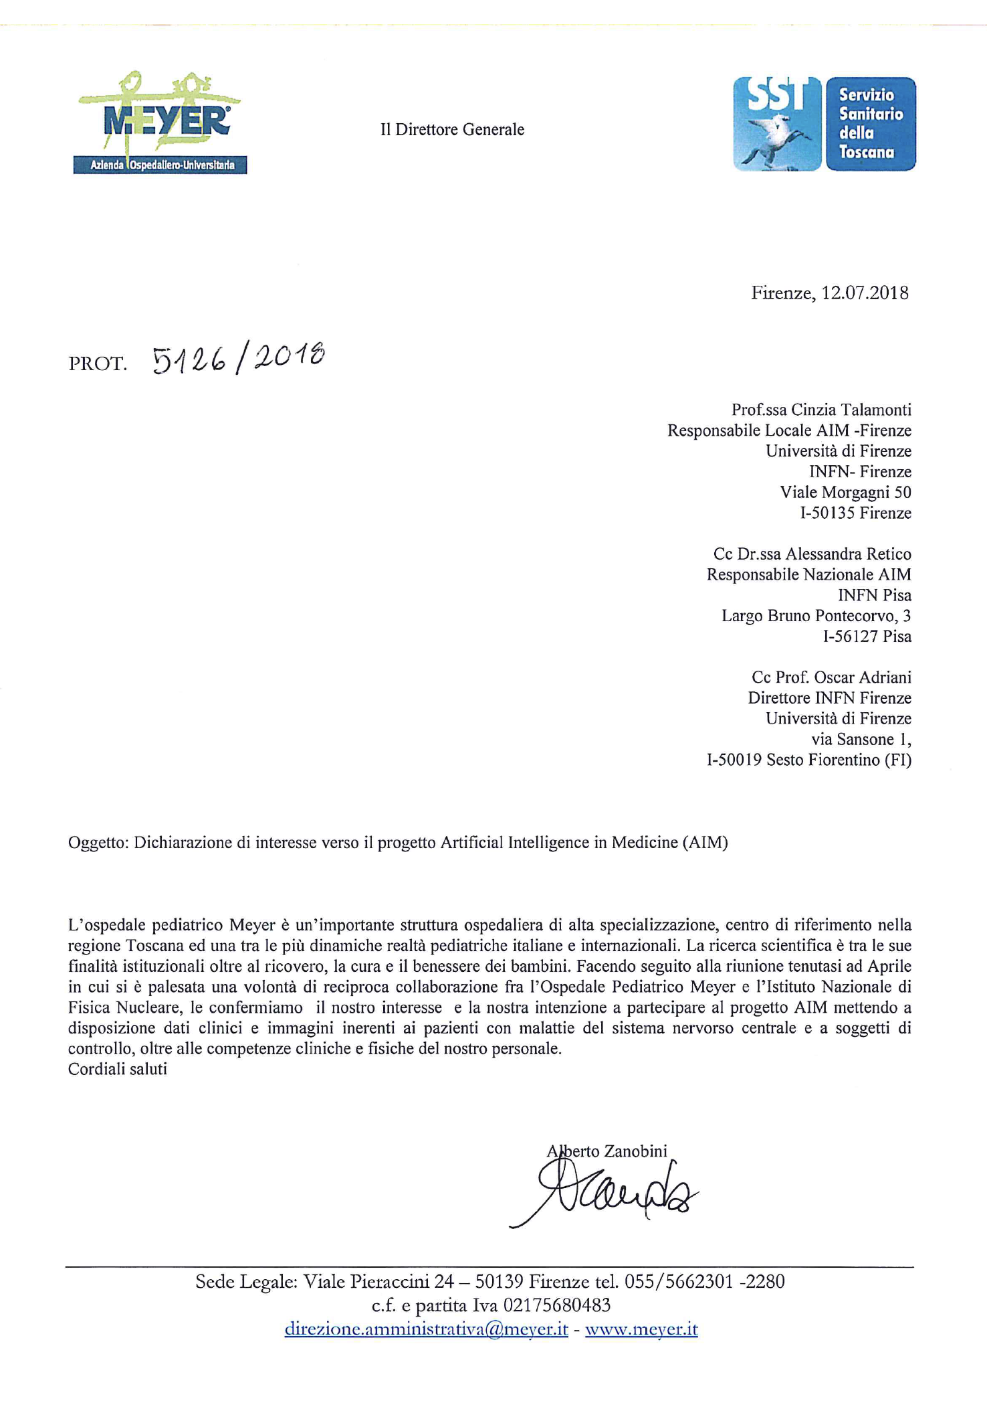
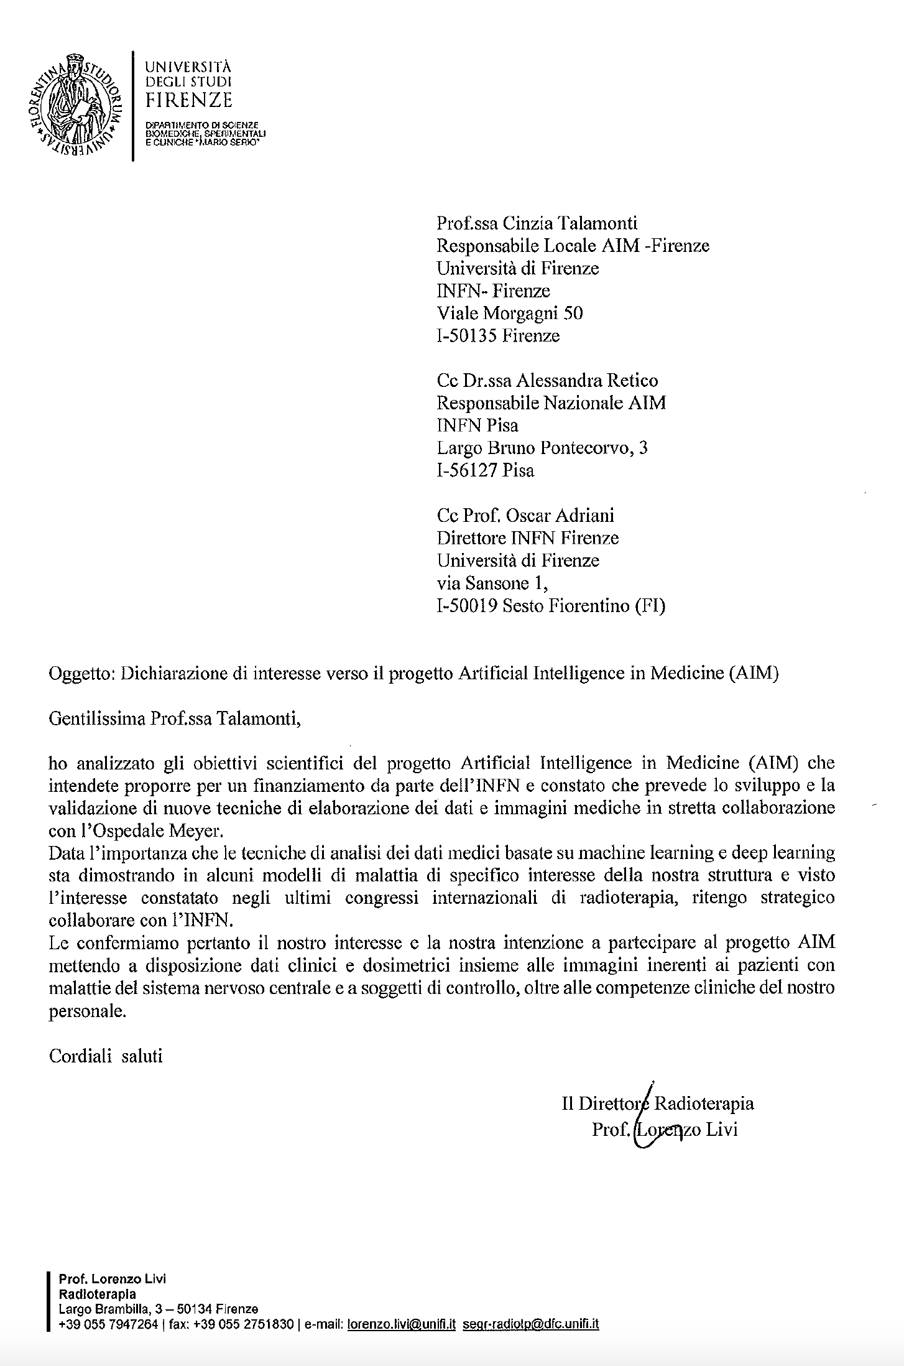
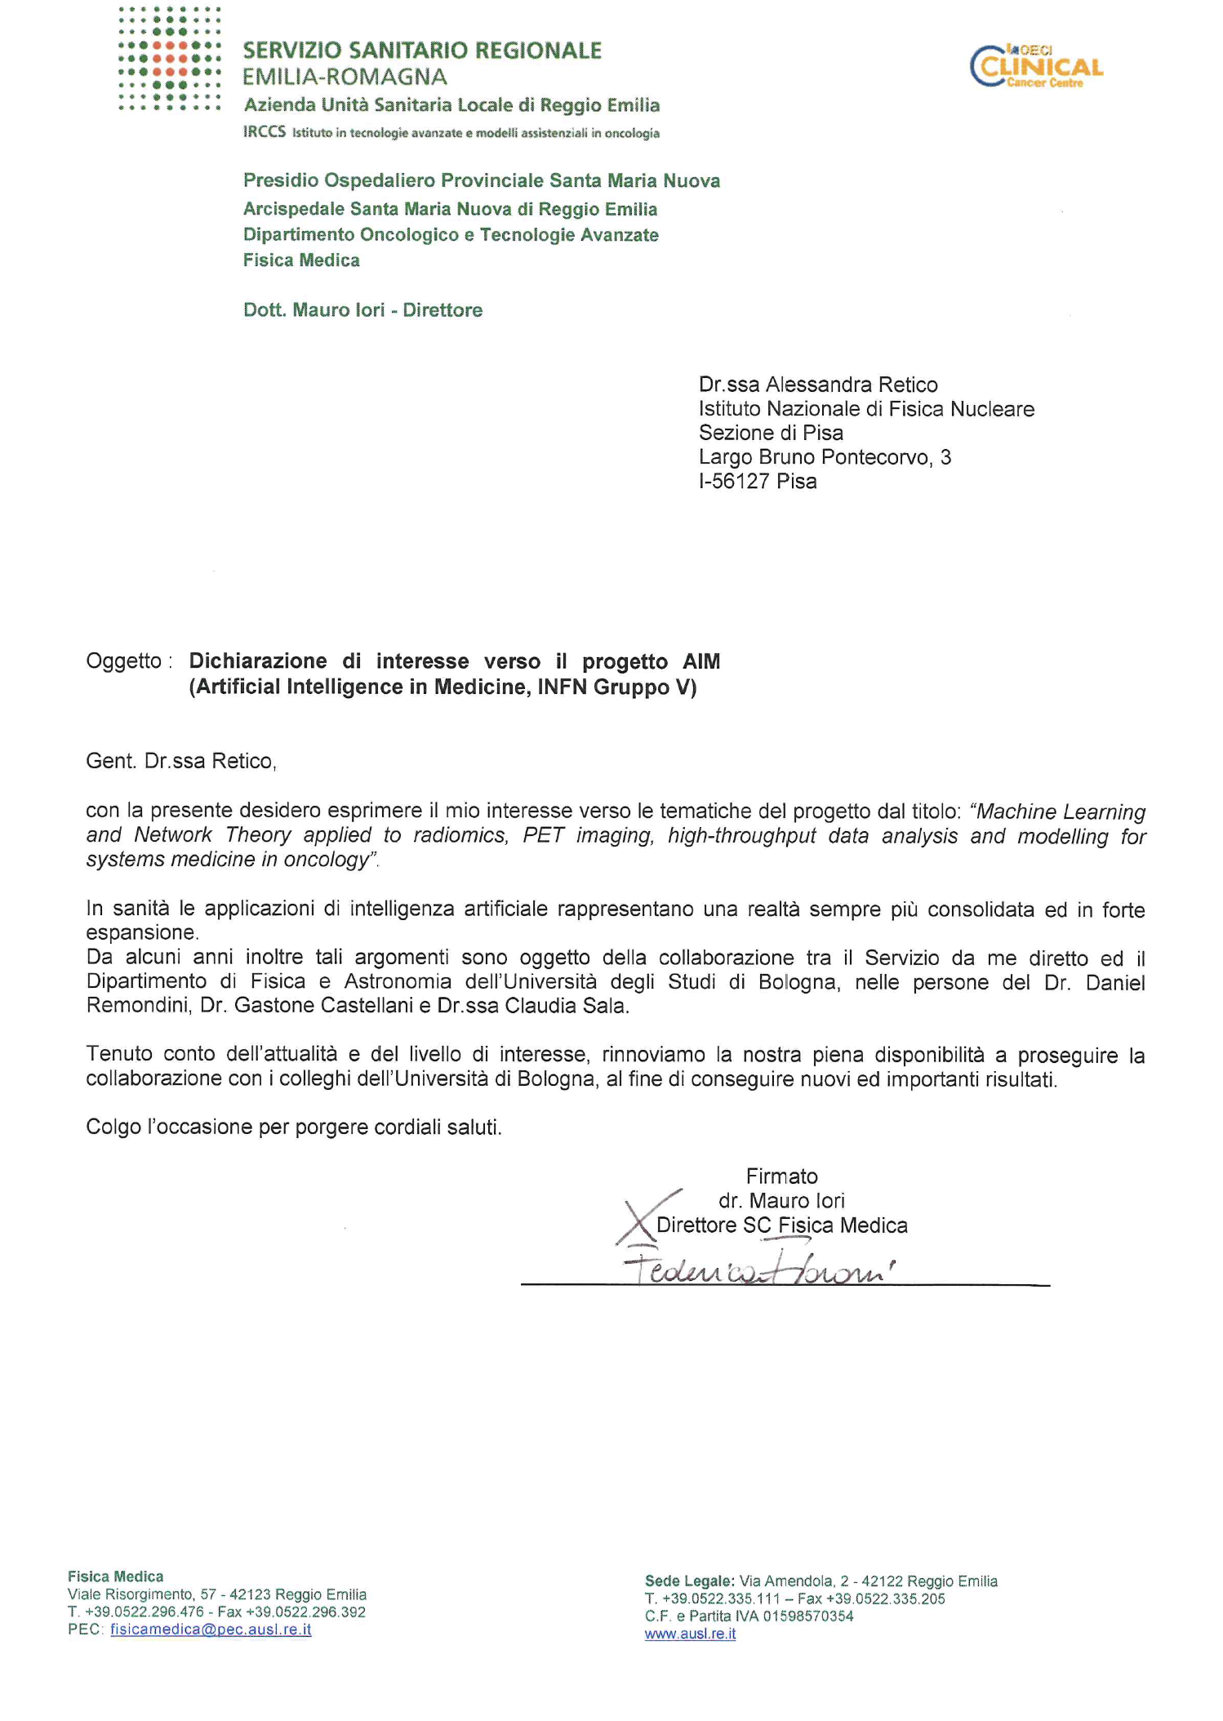
Letters of interests

Slide 19
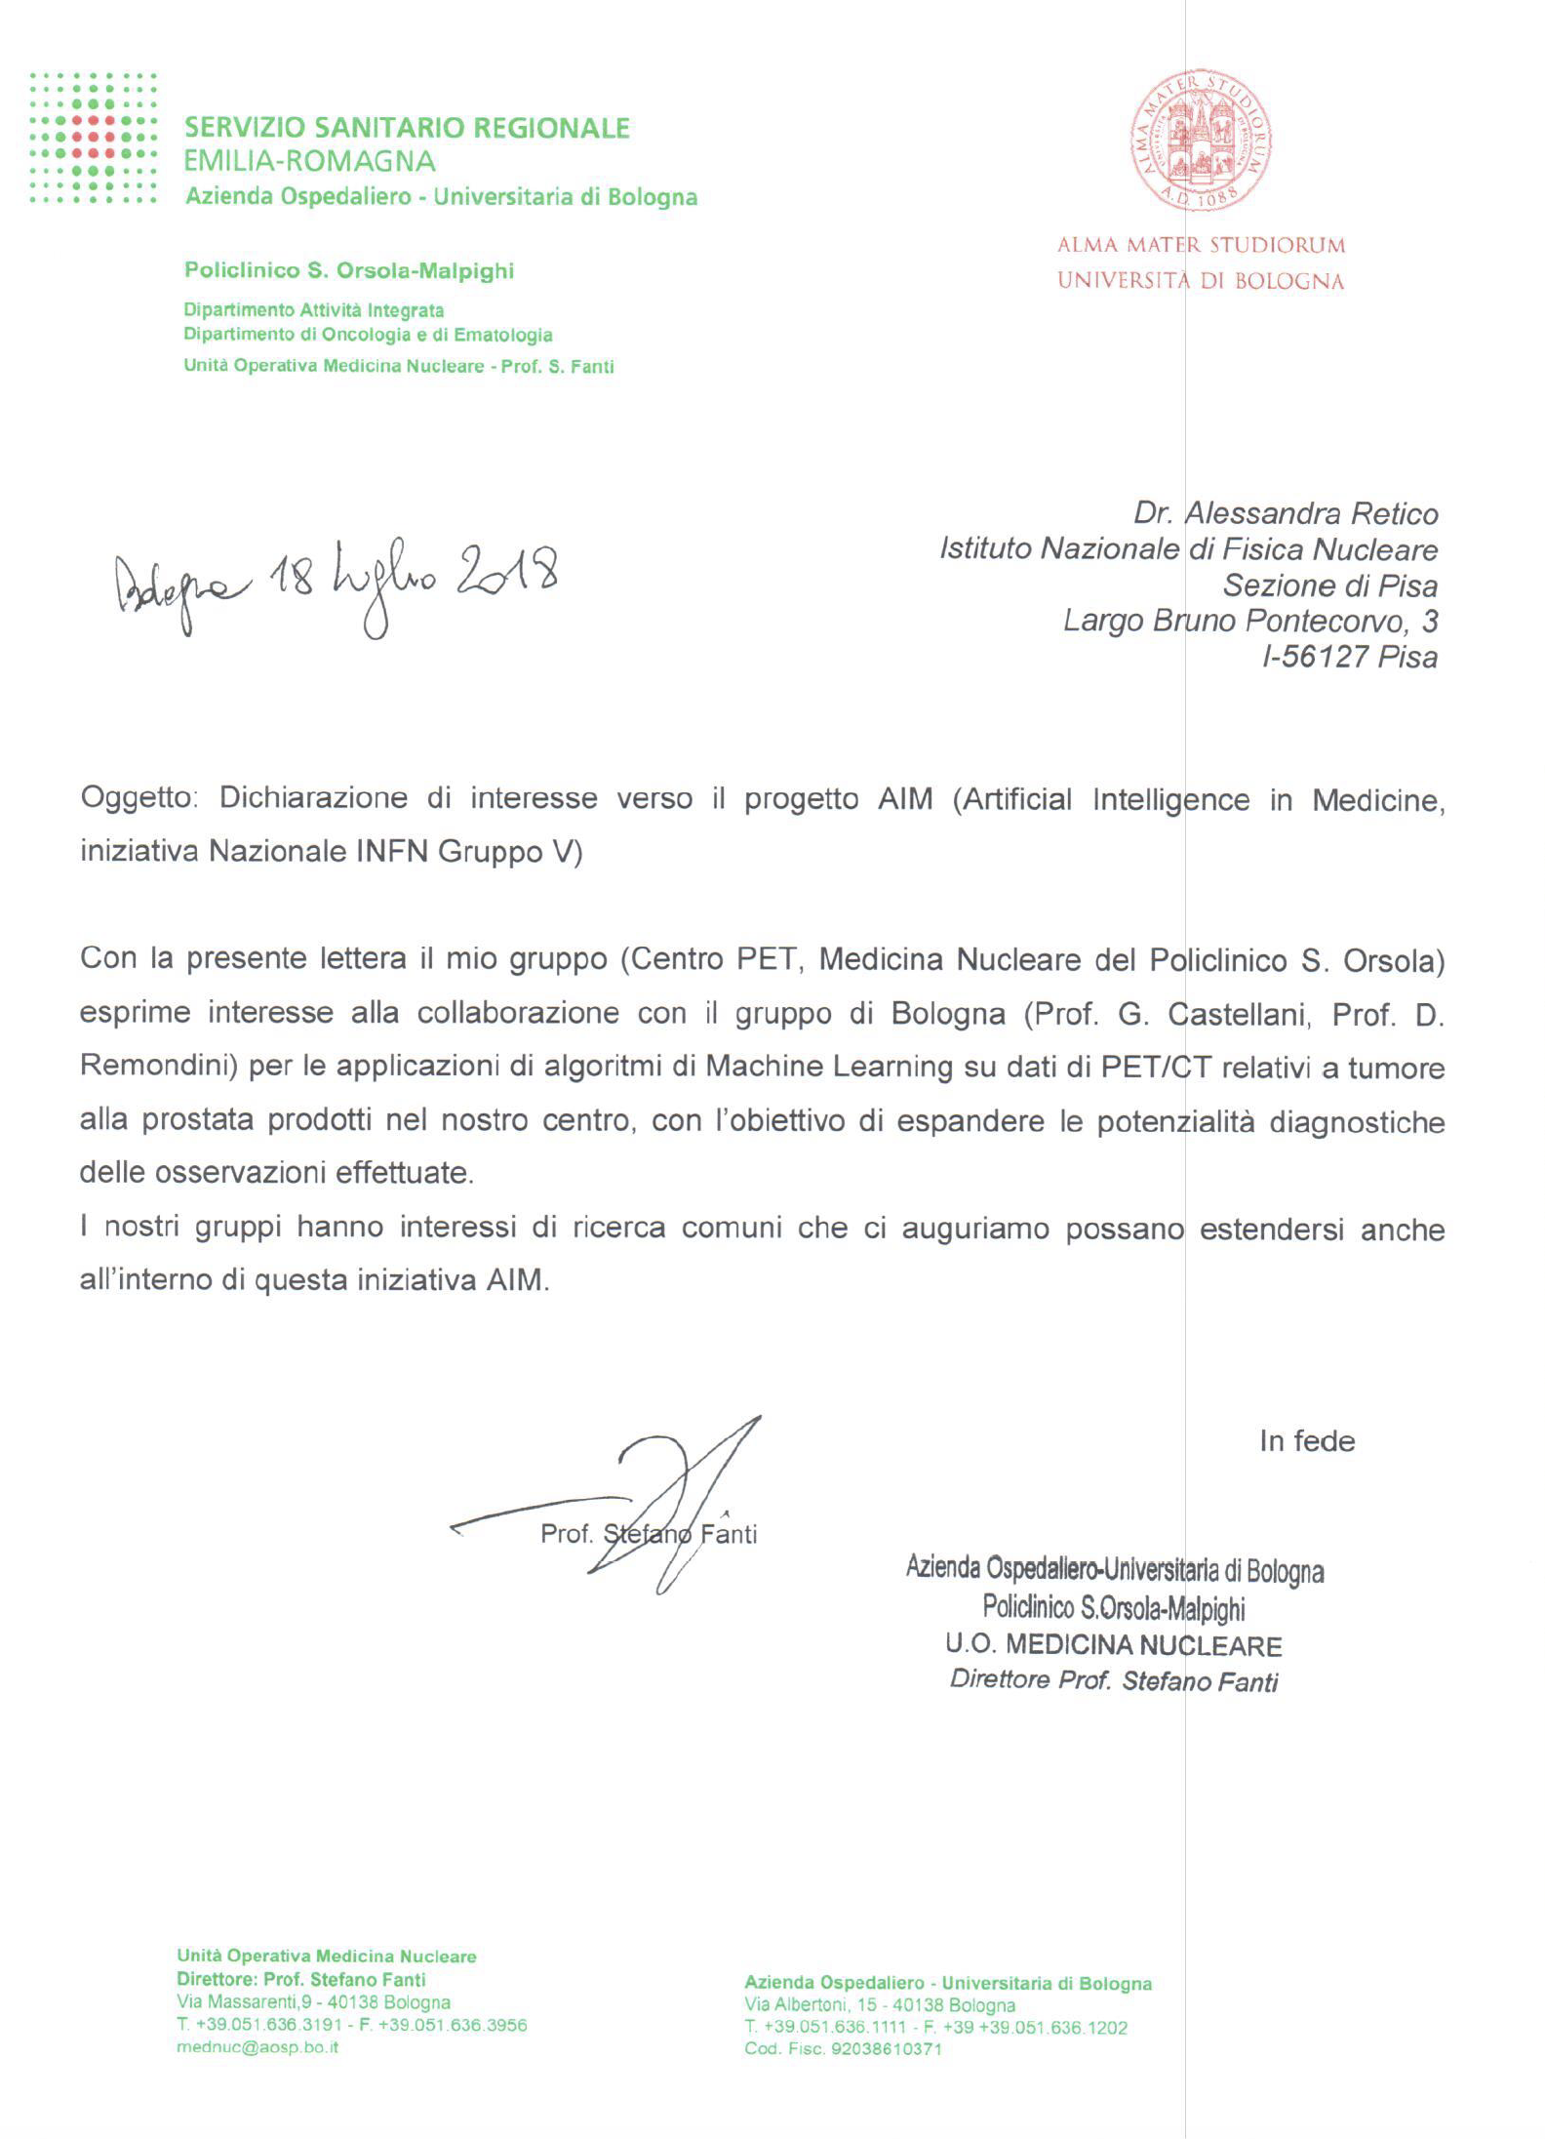
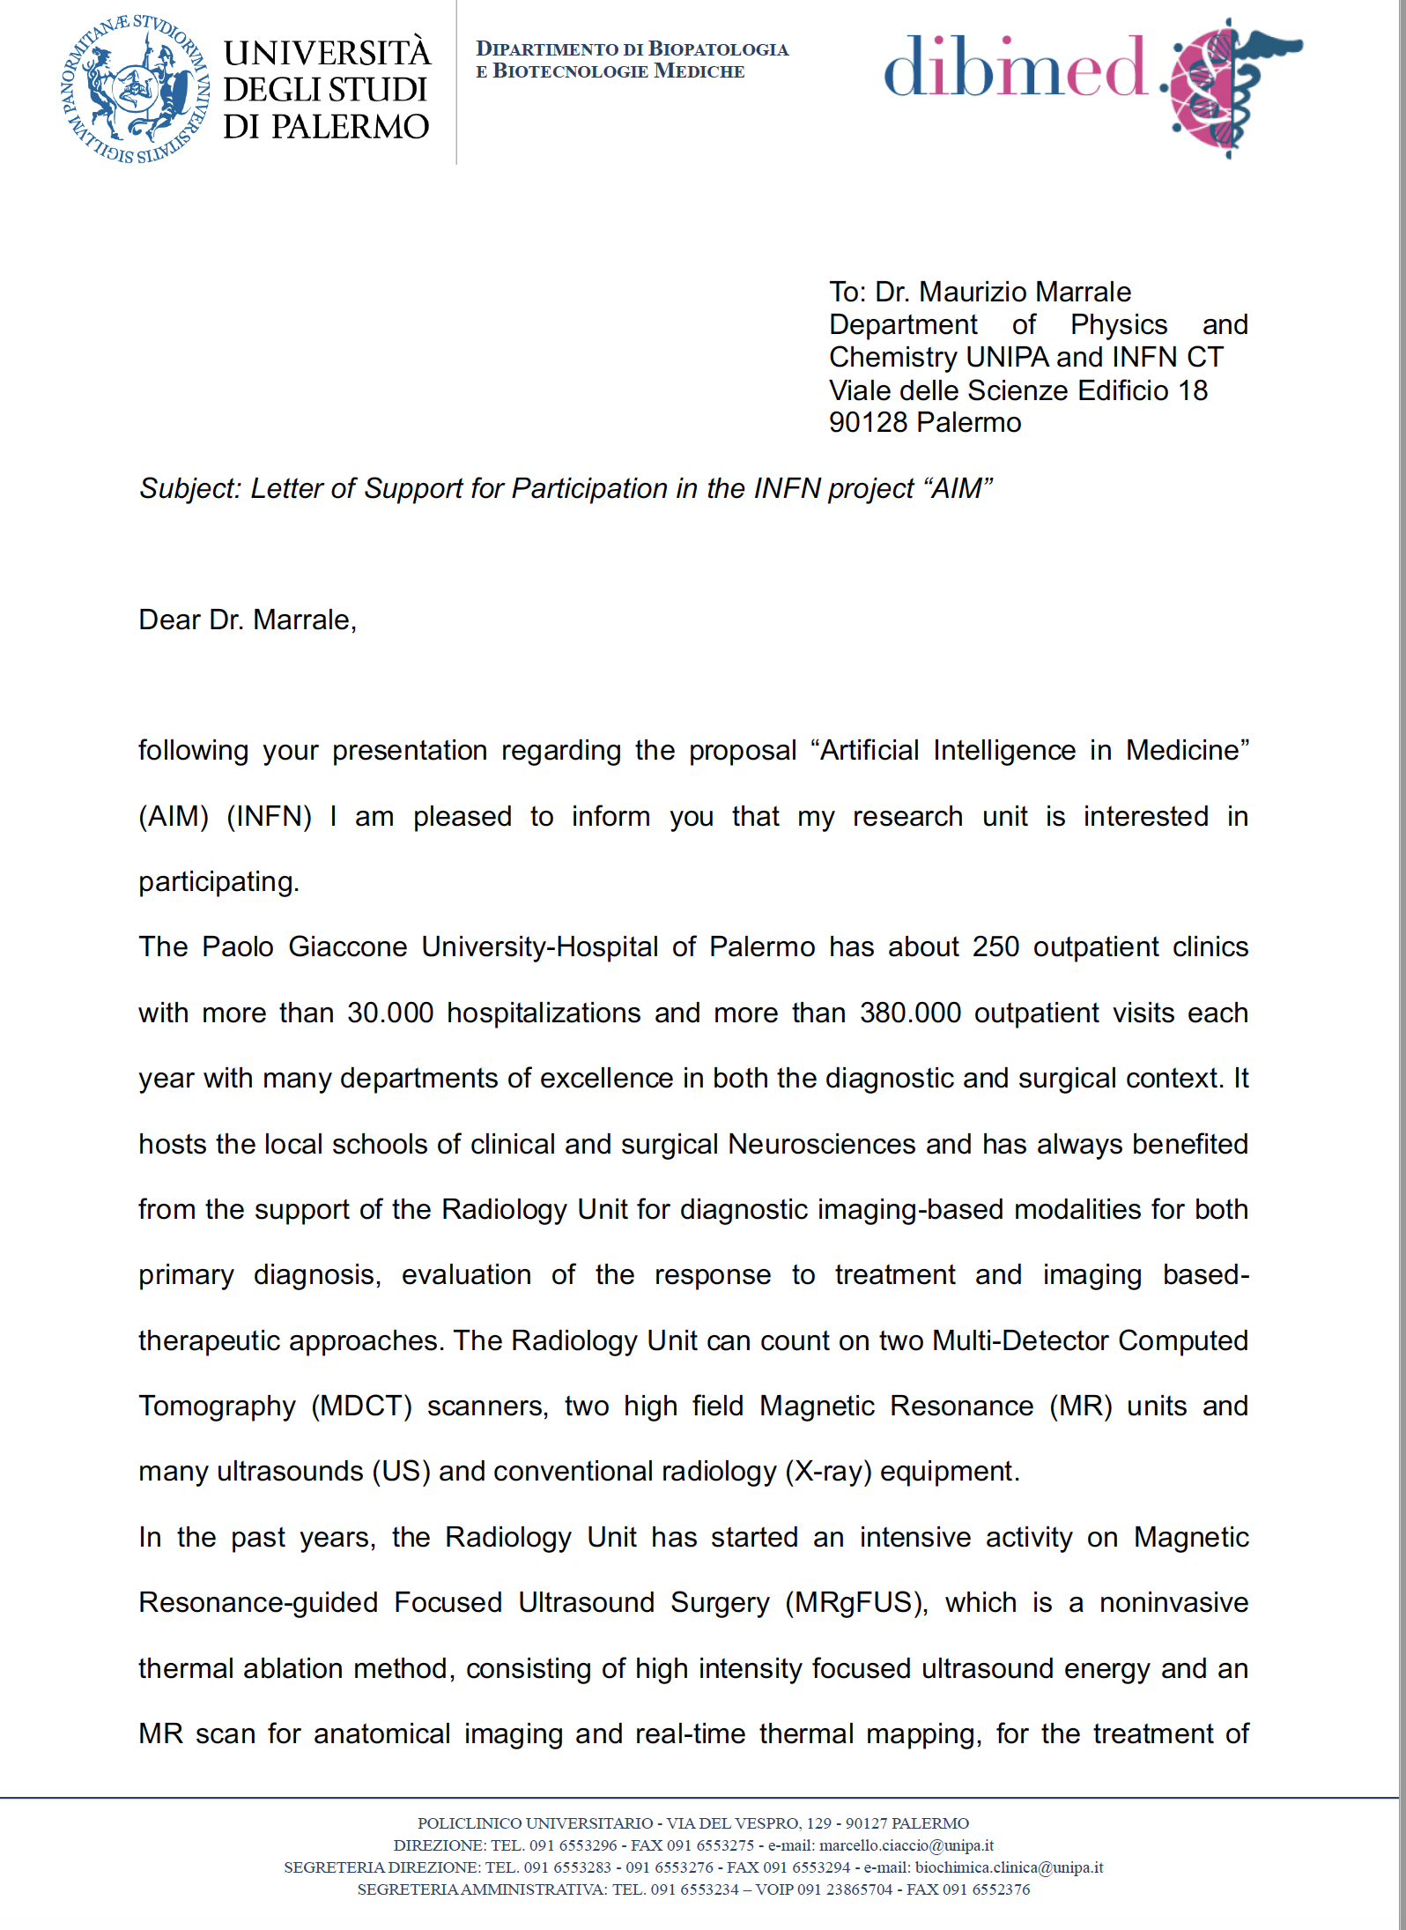
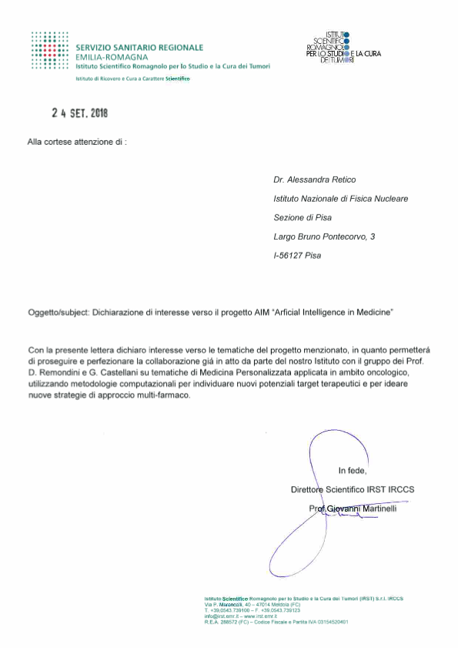
Letters of interests

Slide 20
thank you

