Slide 1
Riunione di fisica applicata a Bologna
Innanzitutto grazie di essere qui
Fisica applicata a Bologna ha diverse realtà → scopo di questa riunione:
  Conoscersi meglio come persone e soprattutto conoscere meglio le aree di ricerca
  Sarebbe bello sentirsi parte di una unità (ovviamente mantenendo le proprie attività)
  Magari in futuro potremo partecipare insieme a qualche ricerca
Le persone coinvolte :
  area fisica medica (ora o in passato)
  Area di fisica nucleare
Settore fortemente in espansione, anche il numero di studenti interessati alle nostre tesi lo dimostrano

Slide 2
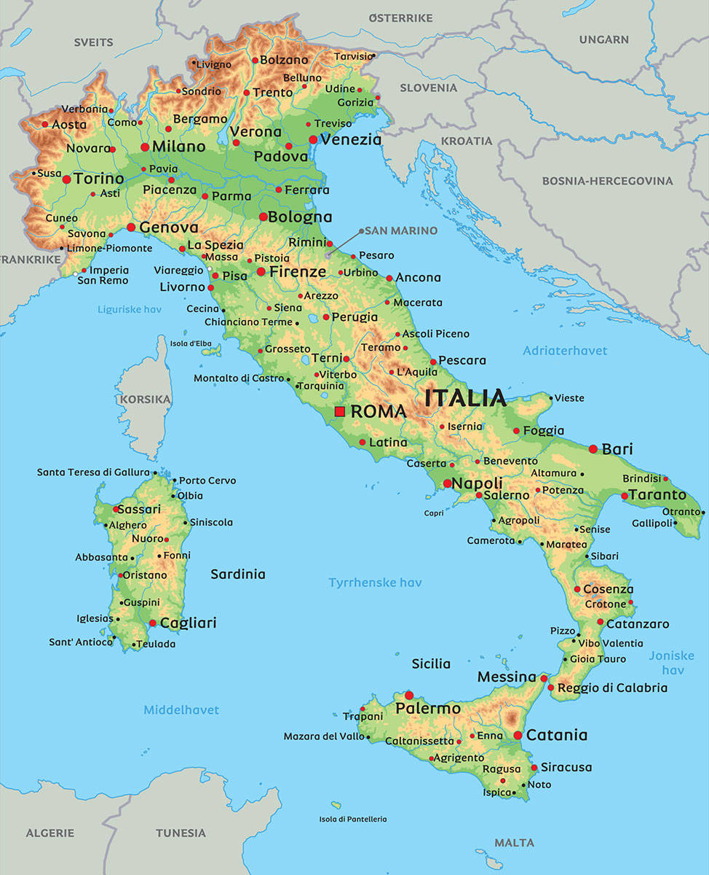

FOOT experiment
approved by the INFN CSN3 on September 2017 (CSN3)
Under construction
Physical data taking in 2020
INFN sections/labs:
101 members (60% staff):
  10 INFN Sections
  5 laboratories: Frascati, CNAO, Trento, GSI,IPHC (Strasbourg)
  12 Italian Universities
  2 foreign Universities: Aachen, Nagoya
  Centro Fermi
Milano
Trento
Torino
Bologna
Pisa
Perugia
Roma 1-2
Frascati
Physics program:
  Hadrontherapy:
    Nuclear fragmentation @ 200 MeV/u
  Radioprotection in Space:
    Nuclear fragmentation @ 700 MeV/u
Napoli

Slide 3
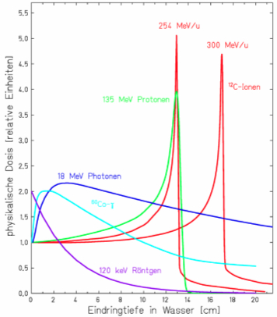
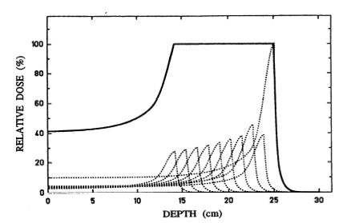
Hadrontherapy vs Radiotherapy
Bragg Peak
C-Ion 254 MeV
Proton/charged ion
Ionization
Excitation
Bremsstrahlung
Fragmentation
C-Ion 300 MeV
Gamma
Photoelectric (~Z⁴/E³)
Compton (~Z/E)
Pair prod (~Z²/lnE)
Proton 135 MeV
Relative dose
Radiotherapy, IMRT 7 fields
Photon 18 MeV
γ ⁶⁰Co
γ 120 KeV
Pros and cons
Depth in water (cm)
dose release maximum at the end
Penetration depends on energy
Hadron > efficient than γ
Hadron < damage outside tumor
MORE expensive than γ
Hadrontherapy, proton

Slide 4
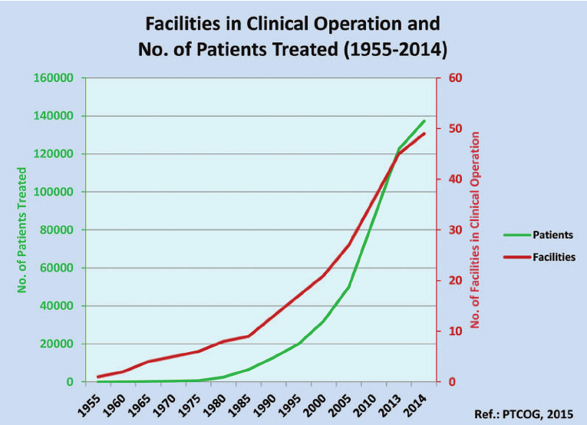
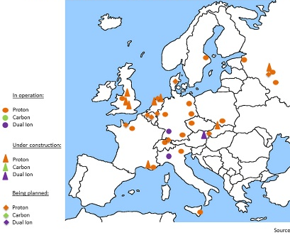
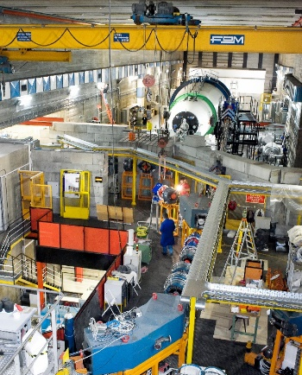
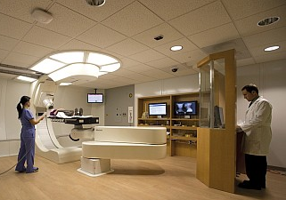
Hadrontherapy in the world
patients
Facility (end of 2016):
  Operative 70
    61 proton
    5 protons and Carbon
    4 Carbon
Fast expansion in the last 50 years
facilities
From 2010:
10000 patients/year
Treated patients (end 2016):
  174512
    149345 with p (in USA 64516)
    21580 with 12C (in Japan 17331)
    The remnants other particles
Italy: 18/3/2017 hadrontherapy in LEA (Livelli Essenziali di Assistenza)
Centers in Europe (2015)
CATANA (LNS)
Proton therapy Center
Trento
CNAO (Pavia)

Slide 5
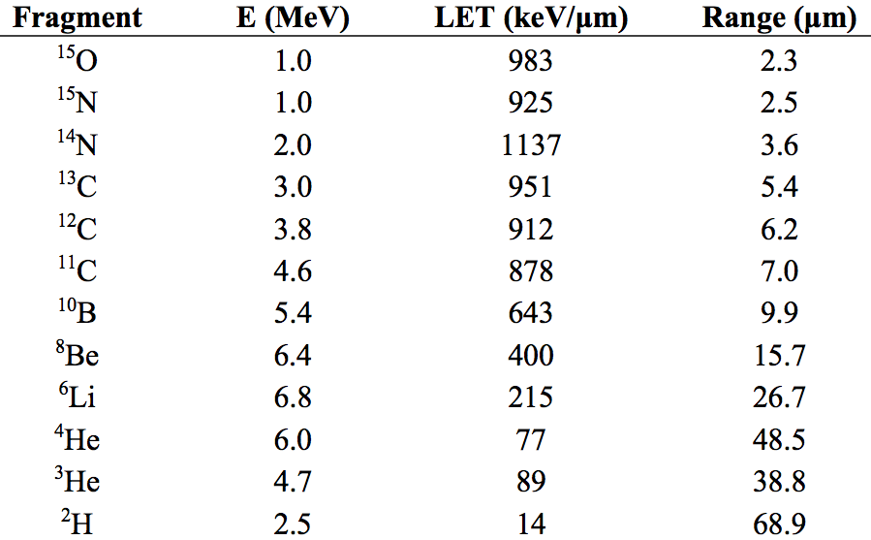

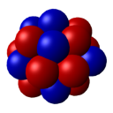
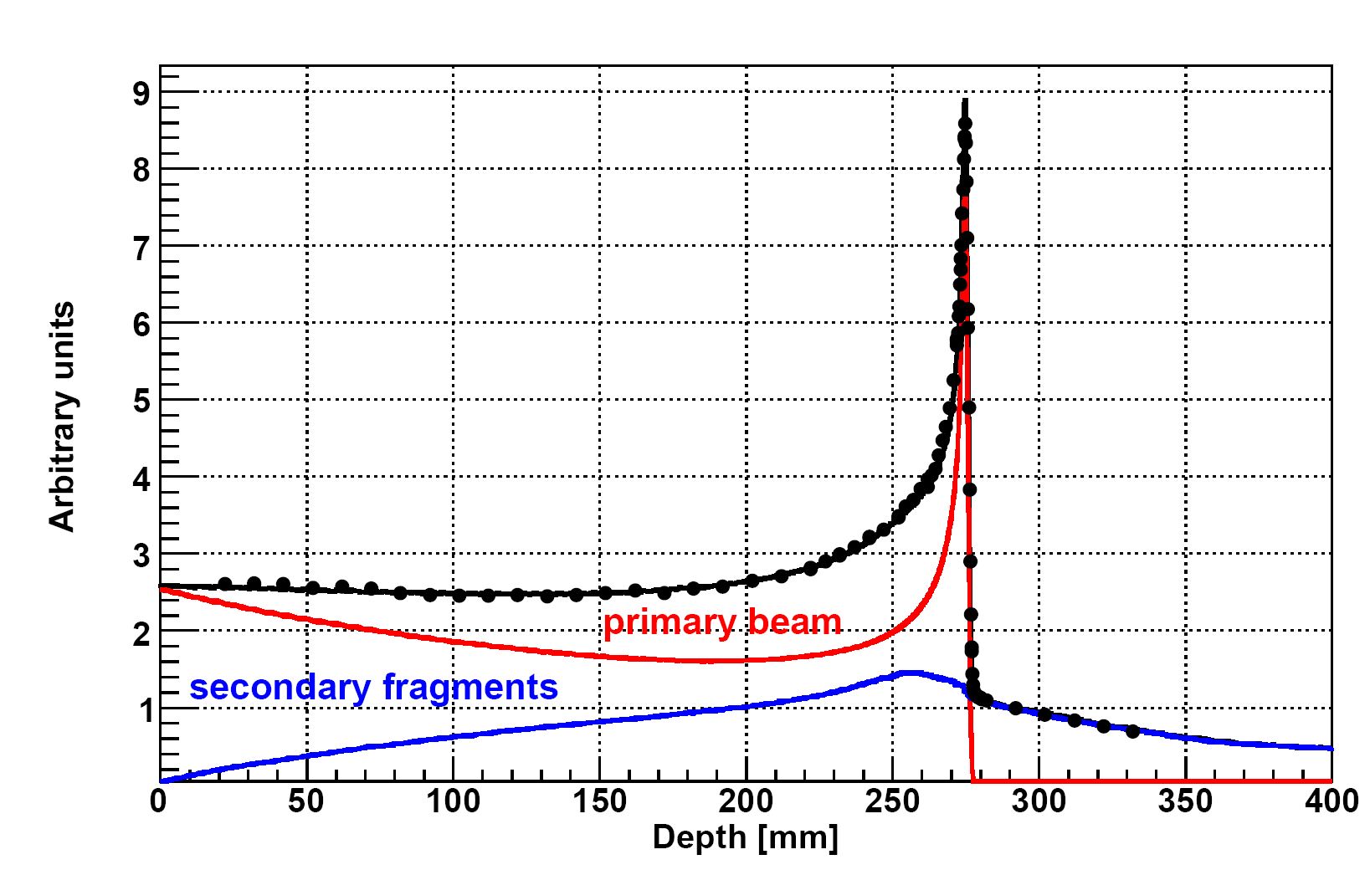
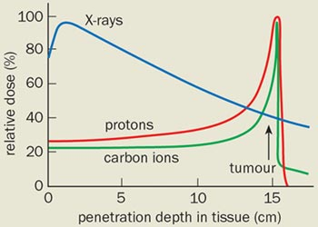

To be studied on hadrontherapy
p + H
No fragmentation
p + C,O →target fragments low Energy →low range
EM and nuclear interactions
Target fragmentation
beam
Proton therapy
p
FOOT goals
C
Ion therapy
H, C, O (95%)
C + H →projectile fragments
High Energy →Long range
Projectile fragmentation
C beam 400 MeV/c
both
Target fragmentation
projectile fragmentation
Tail present only when using Carbon

Slide 6

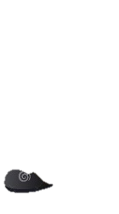
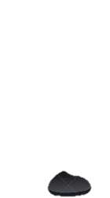
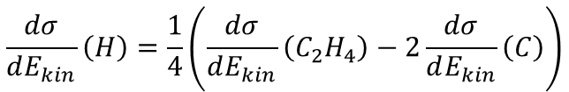
Target fragmentation
C,O at rest
proton
p + C,O → fragments (remain in target)
Target (2mm)
Impossible to detect fragments
C
C₂H₄
INVERSE KINEMATIC
Difficult to use a H target
$$\frac{dσ}{dE_{kin}}\left(H\right)=\frac{1}{4}\left(\frac{dσ}{dE_{kin}}\left(C_{2}H_{4}\right)−2\frac{dσ}{dE_{kin}}\left(C\right)\right)$$
Proton (H)
at rest
A the end Lorentz boost
Target fragmentation
  dσ/dE → 5% in inverse kinematics
Projectile fragmentation
  same but in direct kinematics
C,O 200 MeV/A
C,O + p → fragments

Slide 7
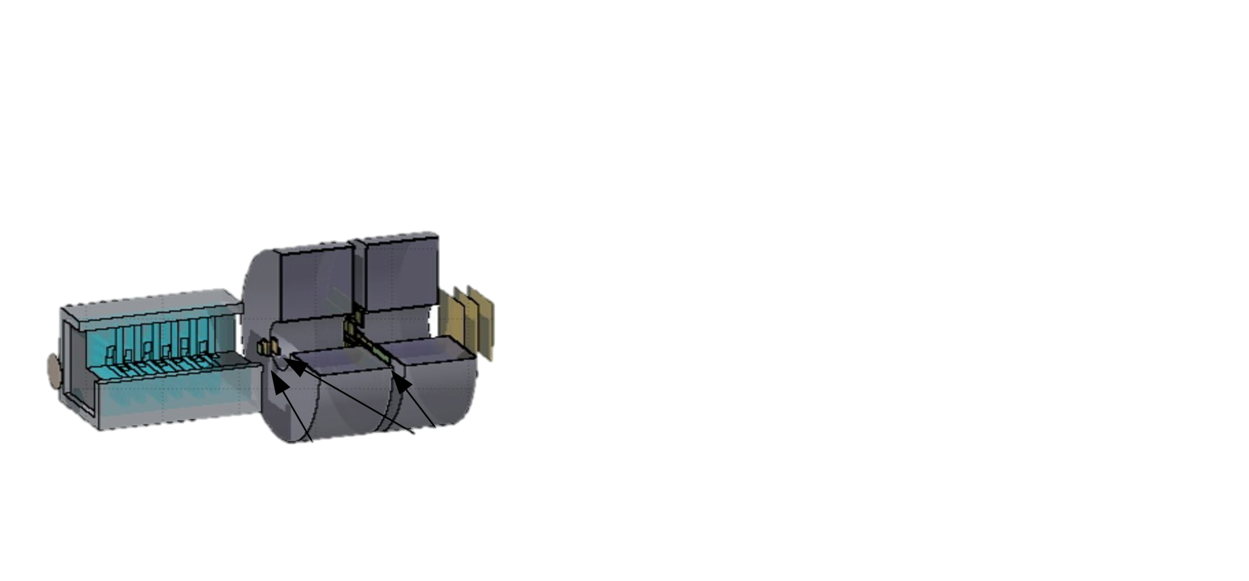
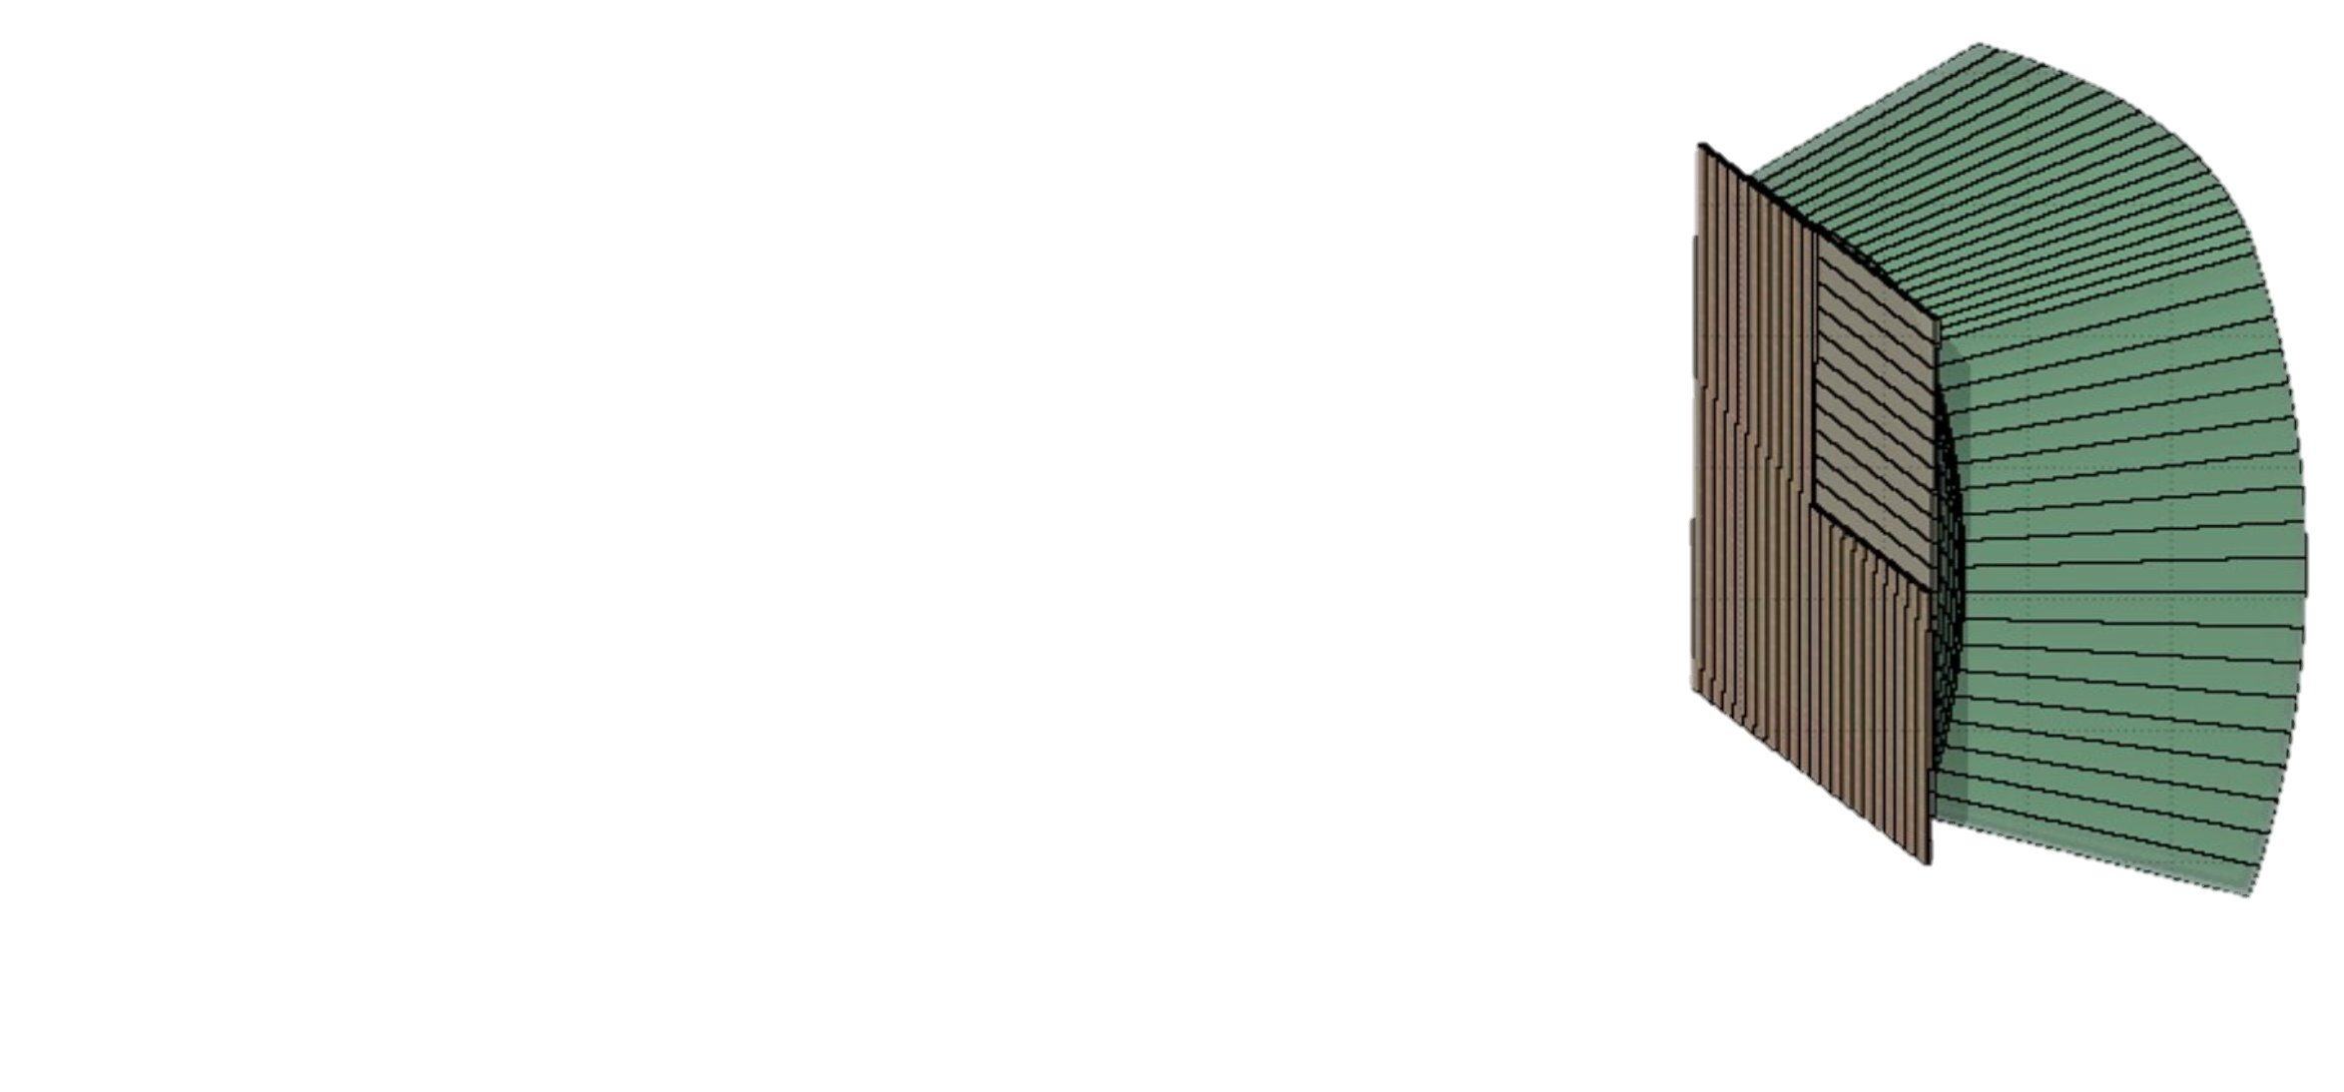
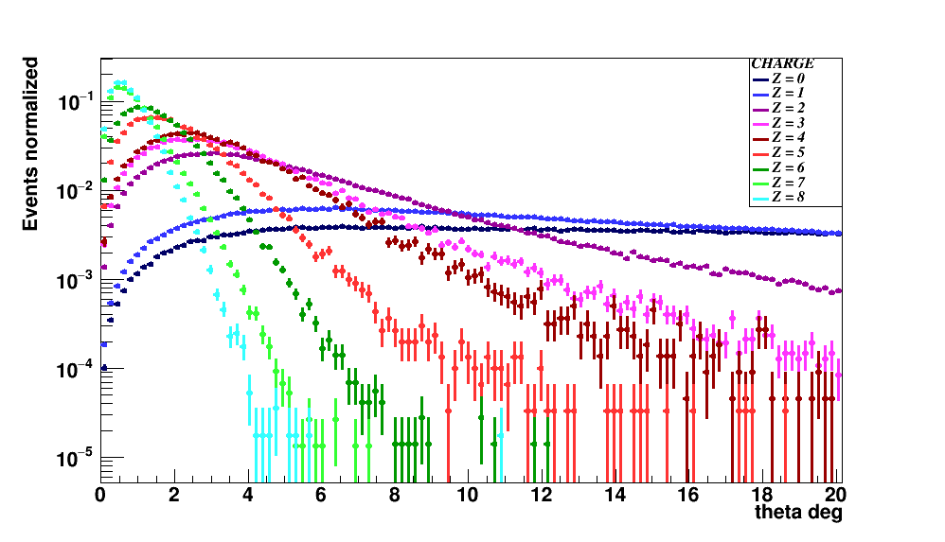
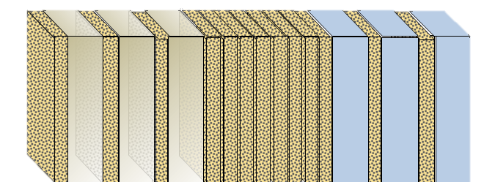
FOOT Detector (in construction)
Calorimeter
BGO
Magnets
Tracker
Silicon Strip
Electronic Setup
Beam Monitor
Target
1 m
Heavy fragments
Start Counter
Tracker
Silicon Pixel
ΔE-TOF
scintillator
Angular open ± 10°
n, p, D, T, He
Pre-target region
Tracking region
downstream region
10 cm
Light fragments
Section 1
vertexing
Section 2
Charge Id
Section 3
momentum
Angular open ± 70°
Emulsion Chamber Setup
300 μm
1 mm
Emulsion layer
1 mm
Emulsion layer
C or C₂H₄
Pb layer

Slide 8


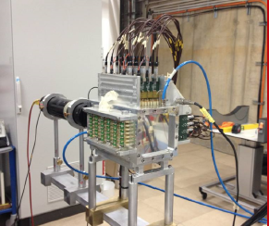
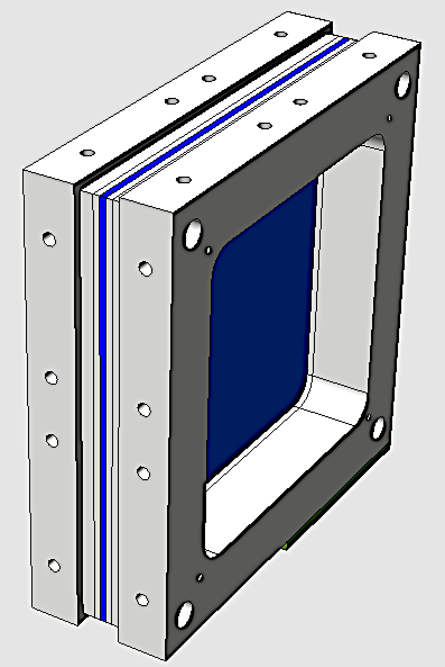
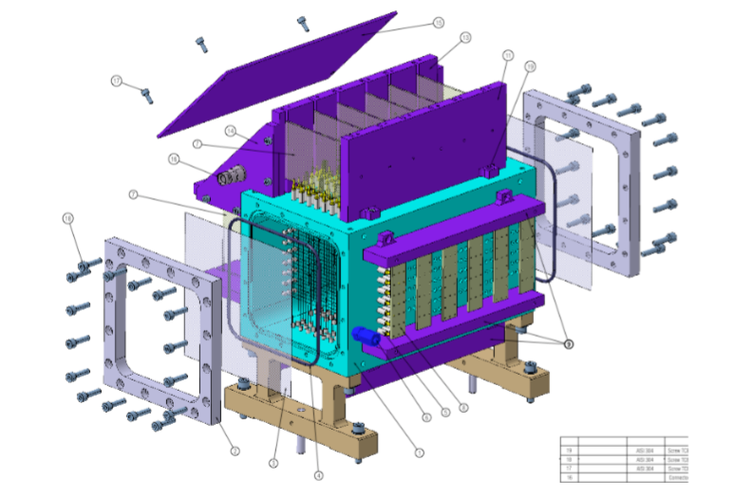
Pre target region
FOOT
SC
BM
. ...
. .
. . .
.......
….
….
. .
. . .
. ...
Start Counter (SC)
Beam monitor
(BM)
Trigger and ToF start
Beam momentum/direction & fragmentation in SC

Slide 9
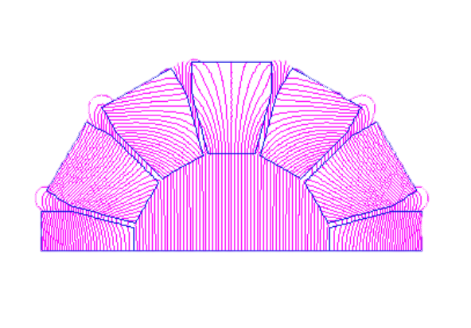
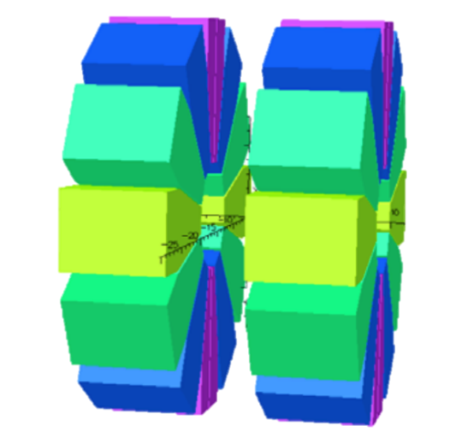
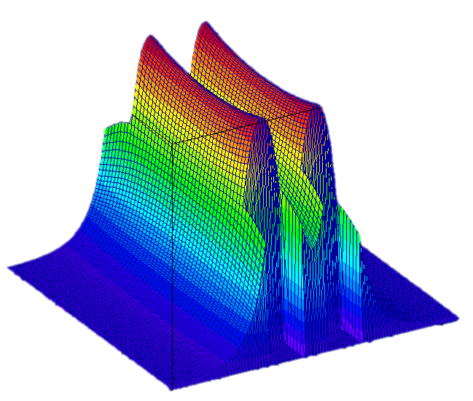
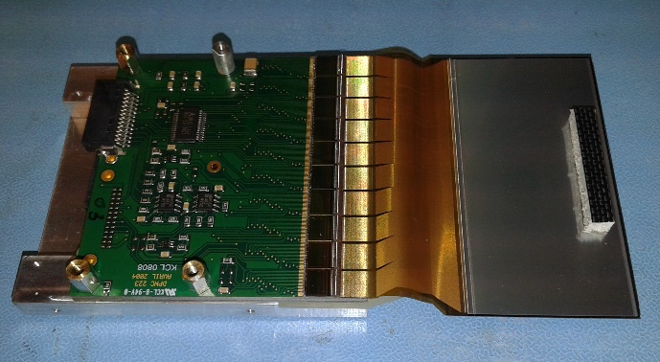
Tracking region
FOOT
VTX
ITR
MSD
. ...
. .
. . .
.......
….
….
. .
. . .
. ...
Vertex & Inner Tracker
B
VTX: 4 layers of Si pixel (20 x 20 μm)
ITR: 2 layers of Si pixel (20 x 20 μm)
x
Micro Strip Detector (MSD)
Magnet
Z: beam direction
MSD:
3 layers of Si strips (120 μm x 9 cm)
2 permanent magnets
Hallbach geometry
B field in y direction (max 0.8 T)

Slide 10
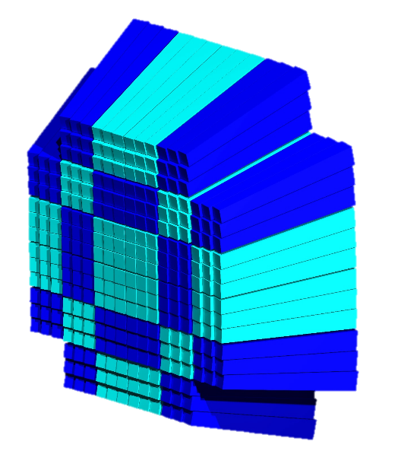
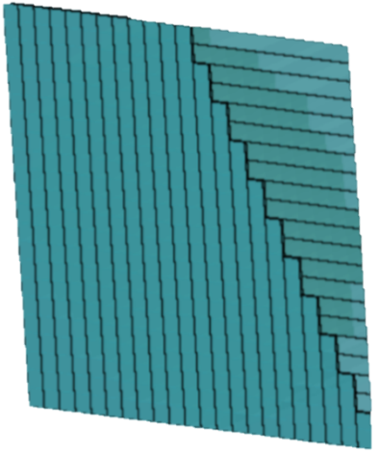
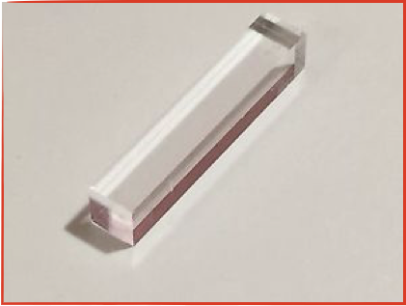
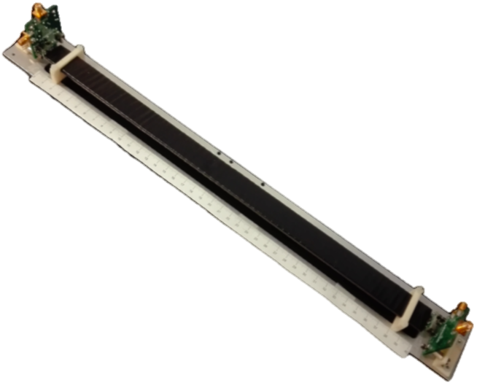
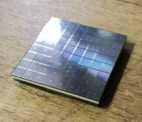
FOOT
SCN
CAL
downstream region
. ...
. .
. . .
.......
….
….
. .
. . .
. ...
Calorimeter (CAL)
3 cm
BGO – (Bi₄Ge₃O₁₂)
Inorganic scintillator
Scintillator (SCN)
24 cm
Z_{Bi} = 83
Ρ_{BGO} = 7.13 g/cm³
Weight = 1.027 kg
Total weight 330 Kg
2 cm
40 x 2 cm plastic scintillator bars
3 mm thickness
2 layers of 20 bars
Silicon PhotoMultiplier (SiPM)
SiPM
Pitch 50 μm
Voltage breakdown 53 V
ΔE-Tof

Slide 11
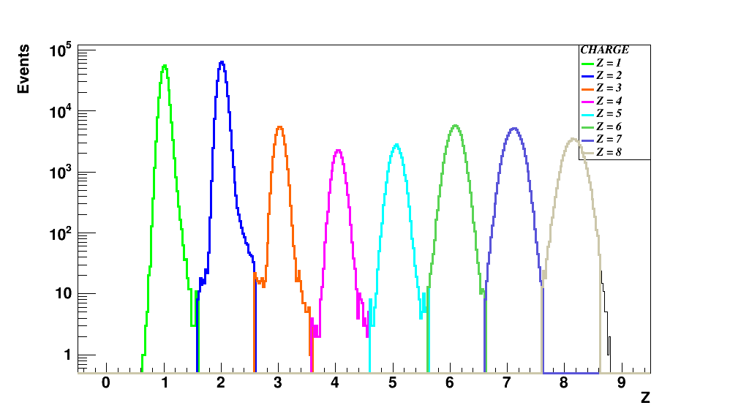
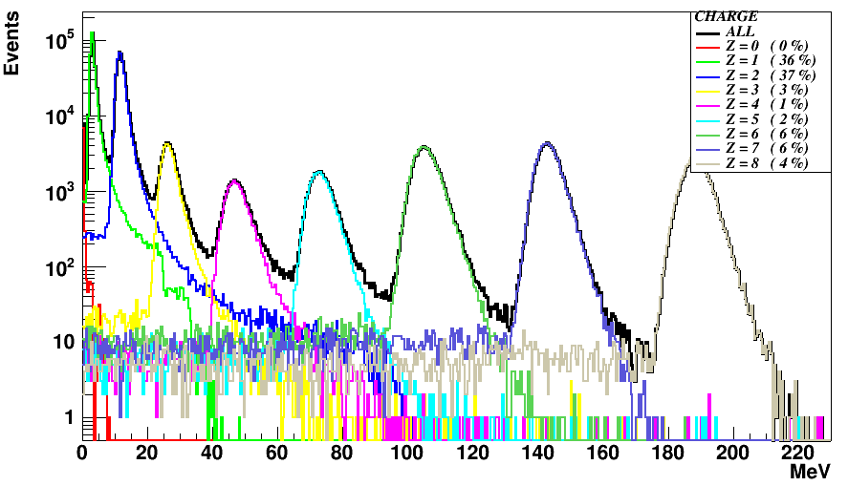

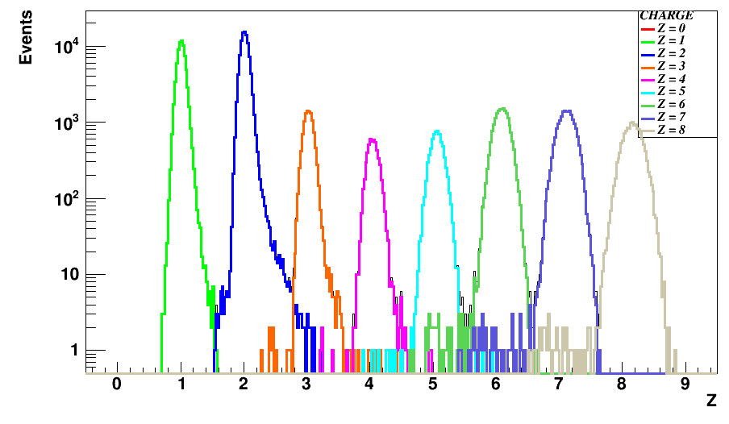
Performances: charge Z reconstruction
Fluka simulation ¹⁶O (200 MeV/u)→ C₂H₄
Fragment univocally defined by Z and A
SCN
TOF
energy deposited in SCN
. . .
. ...
.......
….
. .
….
. .
. . .
. ...
FOOT
reconstructed Z
⁴He | ⁷Li | ⁹Be | ¹¹B | ¹²C | ¹⁴N | ¹⁶O
2 | 3 | 4 | 5 | 6 | 7 | 8
2.01±0.06 | 3.03±0.08 | 4.05±0.09 | 5.06±0.10 | 6.09±0.12 | 7.11±0.14 | 8.15±0.15
Z Resolution heavy fragments : 2-3%
wrong charge assignment < 1%

Slide 12
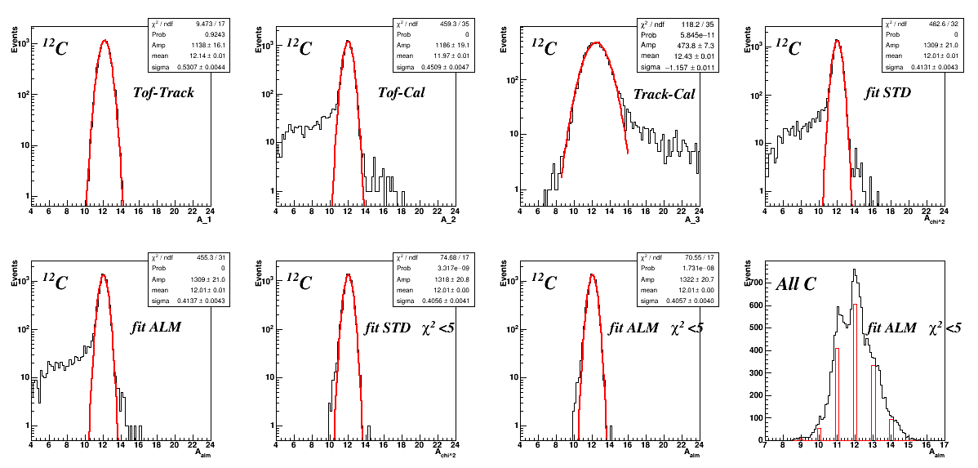
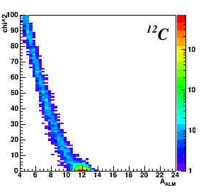
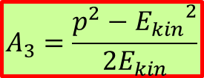


Performances: Number of mass A (ex of ¹²C)
Fluka simul ¹⁶O (200 MeV/u)→ C₂H₄
REDUNDANT Detector → different ways to determine A
TOF & TRACKER
TRACKER & CALO
TOF & CALO
$$A_{1}=\frac{p}{U β γ}$$
$$A_{2}=\frac{E_{kin}}{U\left(γ−1\right)}$$
$$A_{3}=\frac{p^{2}−{E_{kin}}^{2}}{2E_{kin}}$$
12.4 ± 1.2
12.14 ± 0.53
11.97 ± 0.45
ALM
ALM χ²<5
χ²
FIT Methods:
Standard χ²
Augmented Lagrangian (ALM)
12.01 ± 0.41
12.01 ± 0.41
A
Fit cut the wrong reconstructed fragments

Slide 13
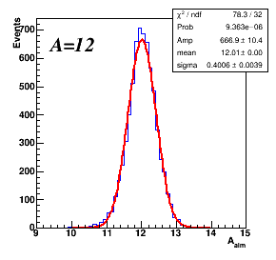
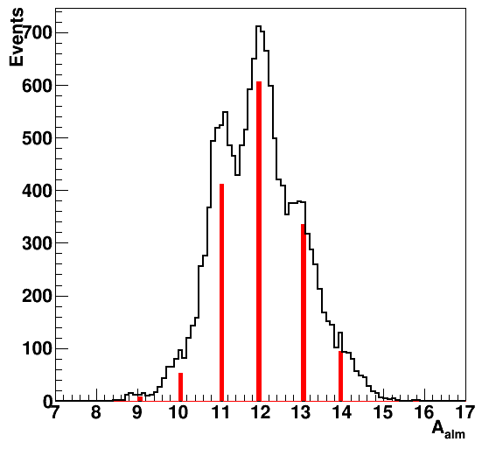
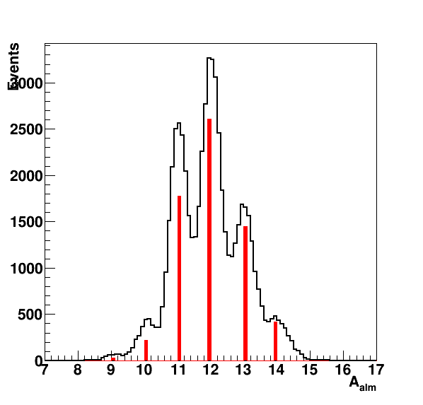
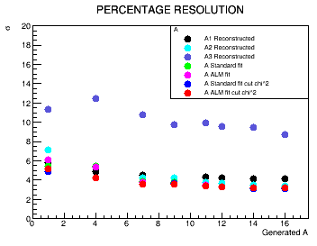
FOOT Performances: Number of mass
¹⁶O (200 MeV/u)→ C₂H₄
Simulation by Fluka
Conservative Resolutions
  Δp/p → 4%
  ΔE_{kin}/E_{kin} → 1.5%
  Δtof → 70 – 140 ps
  Δ(dE)/dE→ 3 -10%
¹²C
Resolutions from Test Beam
  Δp/p → 4%
  ΔE_{kin}/E_{kin} → 1.0%
  Δtof → 50 – 100 ps
  Δ(dE)/dE→ 3-10%
A = 12.0 ± 0.4
¹²C
¹¹C
¹²C
¹³C
¹¹C
¹⁰C
¹⁴C
¹³C
¹⁰C
¹⁴C
Possibility to disentangle isotopes
Mass Resolution ~ 3-4%

Slide 14
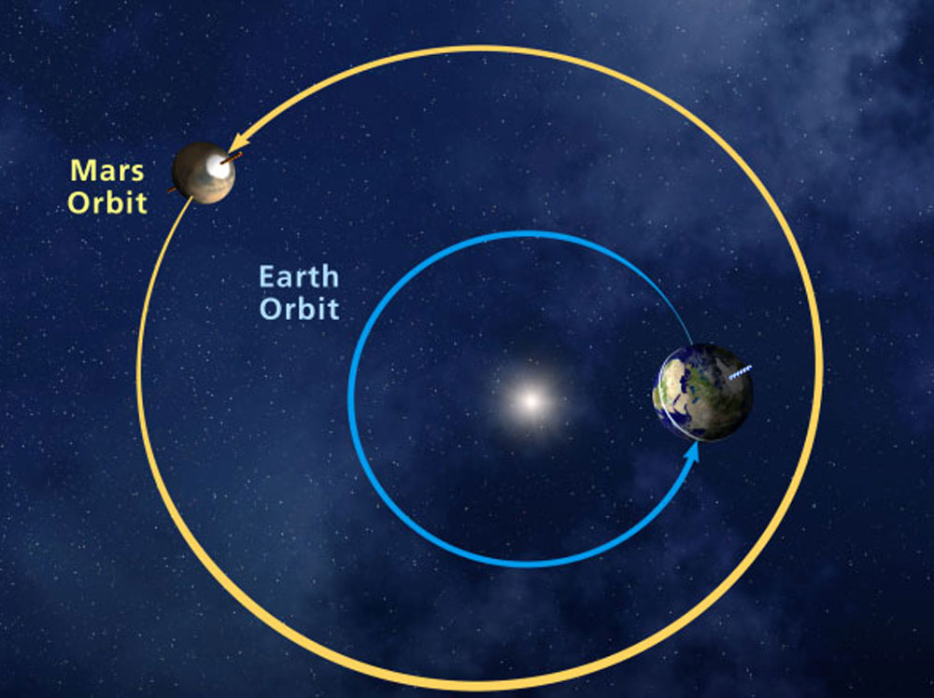
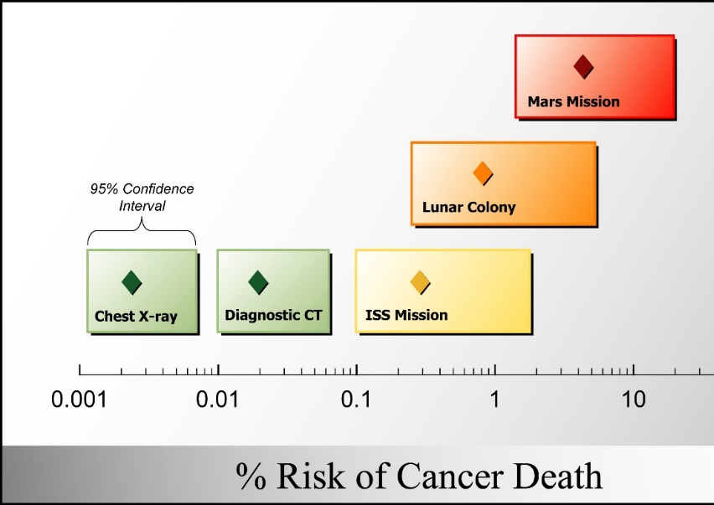
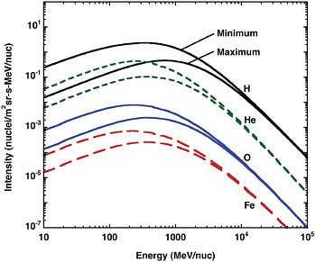

Mars mission: radio protection in space
Period 1.9 year
Mars: NO magnetosphere and very thin atmosphere
Period 1 year
no protection from GCR and SPE
Radiation:
  Travel: 1.8 mSv/day (GCR + SPE)
  On Mars: 0.64 mSv/day
  On earth: 2.64 mSv/year
~ 1 Sv (increase the cancer probability of ~3%)
<Travel time> ~ 270 days
Durante & Cucinotta, Nature Rev. Cancer (2008)
Solar Minimum
$$\frac{Rad on Mars}{Rad on Earth}= \sim 280$$
Maximum
shielding is needed (interaction on it?)
90% of particles are proton (9% ⁴He, …)
GCR (Galactic Cosmic Rays)
Large Intersection with the hadrontherapy measures but higher energy

Slide 15
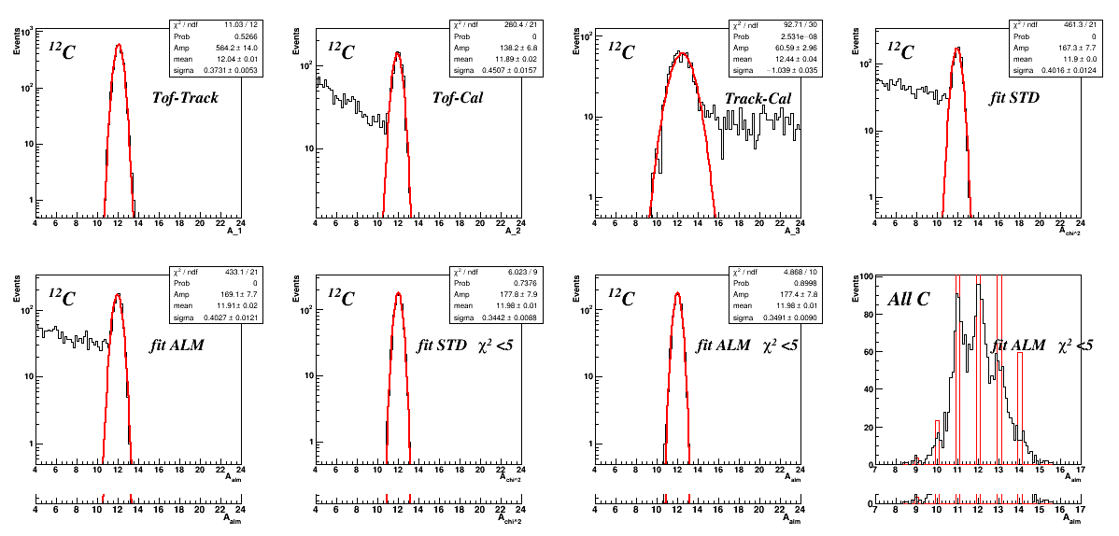
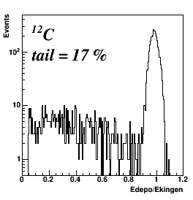
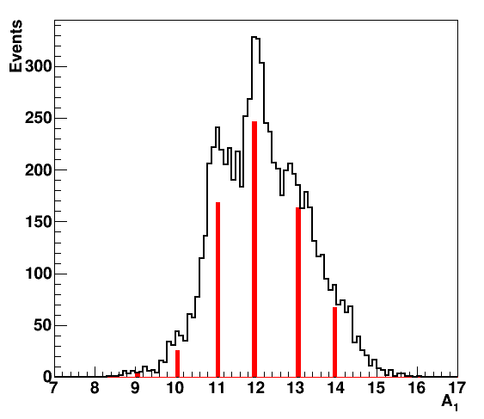
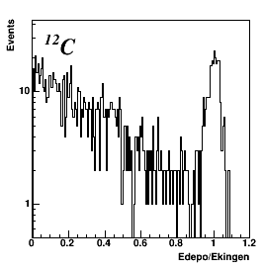
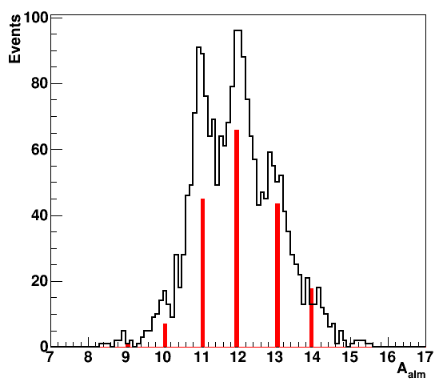


Problems with higher energy: example of ¹²C
Res: ~3%
Fragments with larger energy → higher probability to fragment in CALO
Fraction of deposited energy
200 MeV/u
$$A_{1}=\frac{p}{U β γ}$$
Larger neutrons production
tail = 17%
A with Tof & Tracker
missed energy in CAL
FOOT redundancy
700 MeV/u
Res:~ 4%
tail = 77%
~ performance @ 700 MeV/u
$$A_{2}=\frac{E_{kin}}{U\left(γ−1\right)}$$
20% of well reconstructed

Slide 16
FOOT in Bologna
Tracks Reconstruction: M. Franchini, A. Mengarelli and R. Ridolfi
FOOT
. ...
. .
. . .
11 people involved
.......
….
….
. .
. . .
. ...
NOME | RUOLO | FTE
S. Biondi | Ass. di Ricerca | 0.3
G. Bruni | Dirigente Ricerca | 0.2
M. Franchini | Ass. di Ricerca | 0.3
M. Garbini | Ric. Centro Fermi | 0.2
A. Mengarelli | Ass. di Ricerca | 1.0
G. Sartorelli | Prof. Ord. | 0.2
R. Ridolfi | PhD | 1.0
M. Selvi | Ric. INFN III | 0.2
R Spighi | Ric. INFN II | 1.0
M. Villa | Prof. Ord. | 0.3
A. Zoccoli | Prof. Ord. | 0.2
TOTALE (2019) |  | 4.9
Totale (2018) |  | 2.1
Analysis (fragment identification): R. Spighi
FOOT
. ...
. .
. . .
.......
….
….
. .
. . .
. ...
Global data acquisition: M. Villa, S. Biondi and R. Ridolfi
FOOT
. ...
. .
. . .
.......
….
….
. .
. . .
. ...
Global daq and trigger

Slide 17
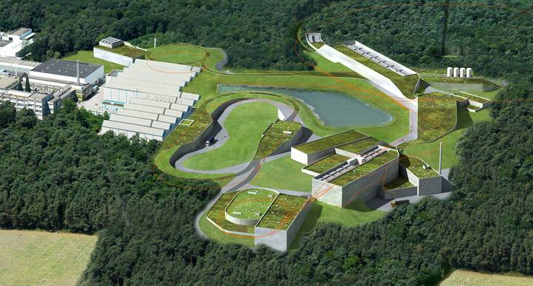

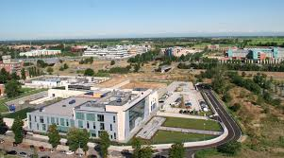





Future perspective
Test Beam / Data Taking
Test beam during 2018-2019 at CNAO, Trento, Catania to finalize the detector
GSI: 4/2019 Data taking with almost complete apparatus (~ first data taking)
2020-21 Data taking with the complete apparatus
Publications
SCN detector in publication on NIM
EMC detector submitted to Open Physics Journal.
General Apparatus Paper: in preparation
Trento Proton Therapy Center

Slide 18
Backup slides

Slide 19

Hadrontherapy in Italy
CATANA Proton Therapy beam line
Proton therapy Center - Trento
CNAO Pavia
Centro Nazionale Terapia Oncologica
proton beam till 250 MeV
Carbon beam till 400 MeV
Active since 2011
First 5 years → 828 patients (70-90% success)
Till now 1200 patients
Active since 2015
Proton beam (60-230 MeV)
Full body treatment
Experimental halls
Proton beam (till 60 MeV)
Active since 2002
Eye tumour: 363 patients (98% survived)

Slide 20
brief experimental panorama on proton cross section
Reaction | E_{Kin} MeV | σ_{TOT} (mb)
p → p | 10 | 300
 | 100 | 30
 | 180-500 | 25-35
 | 600-2000 | 45-50
P → ⁴He | 150-600 | 110-120
P → ⁹Be | 200-600 | 230-250
P → ¹²C | 50 | 450
 | 100-200 | 230
 | 200-1000 | 280-350
P → ¹⁶O | 20 | 550
 | 50 | 400
 | 200 | 350
 | 200-600 | 350-400
P → ⁴⁰Ca | 30 | 900
 | 100-200 | 500

Slide 21
brief experimental panorama on p → ¹²C differential cross section
⁶Li
⁷Li
⁷Be
n
p
D
⁹Be
¹⁰Be
¹⁰B
T
³He
³He
¹¹B
¹⁰C
¹¹C

Slide 22




FOOT: Emulsion chamber setup
C on C @ 200 MeV/nucl FLUKA
Light fragments (Z<3) produced at wide angle (~75°)
Beam monitor
n, p, D, T, He
Start counter
Emulsion Chamber
Beam
High speed
automated scanning
movement to avoid pile-up
10 cm
Section 1
vertexing
Section 2
Charge Identification
Section 3
momentum
300 μm
1 mm
Emulsion layer
1 mm
Emulsion layer
C or C₂H₄
Pb layer
G. De Lellis et al. JINST 2, 2007, P06004

