Slide 1
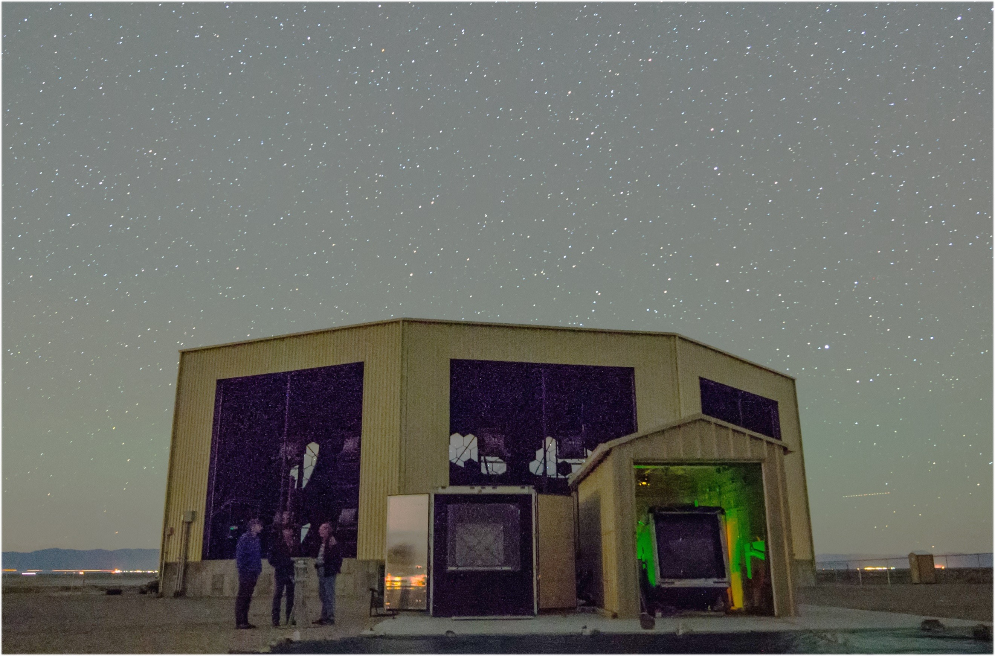
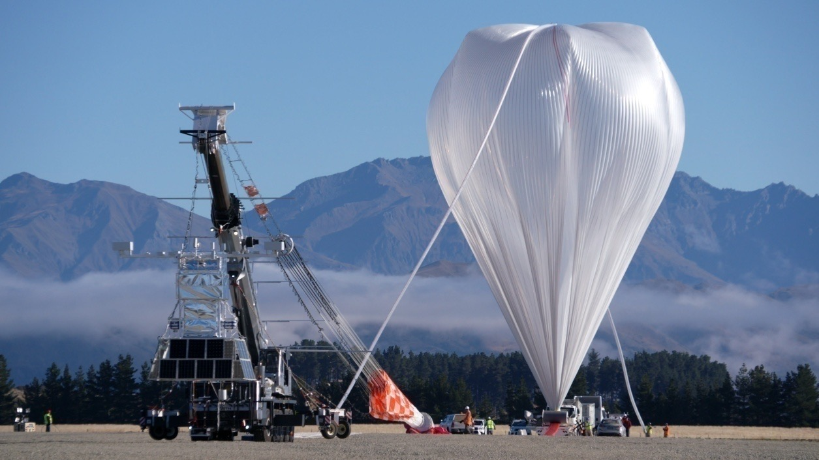
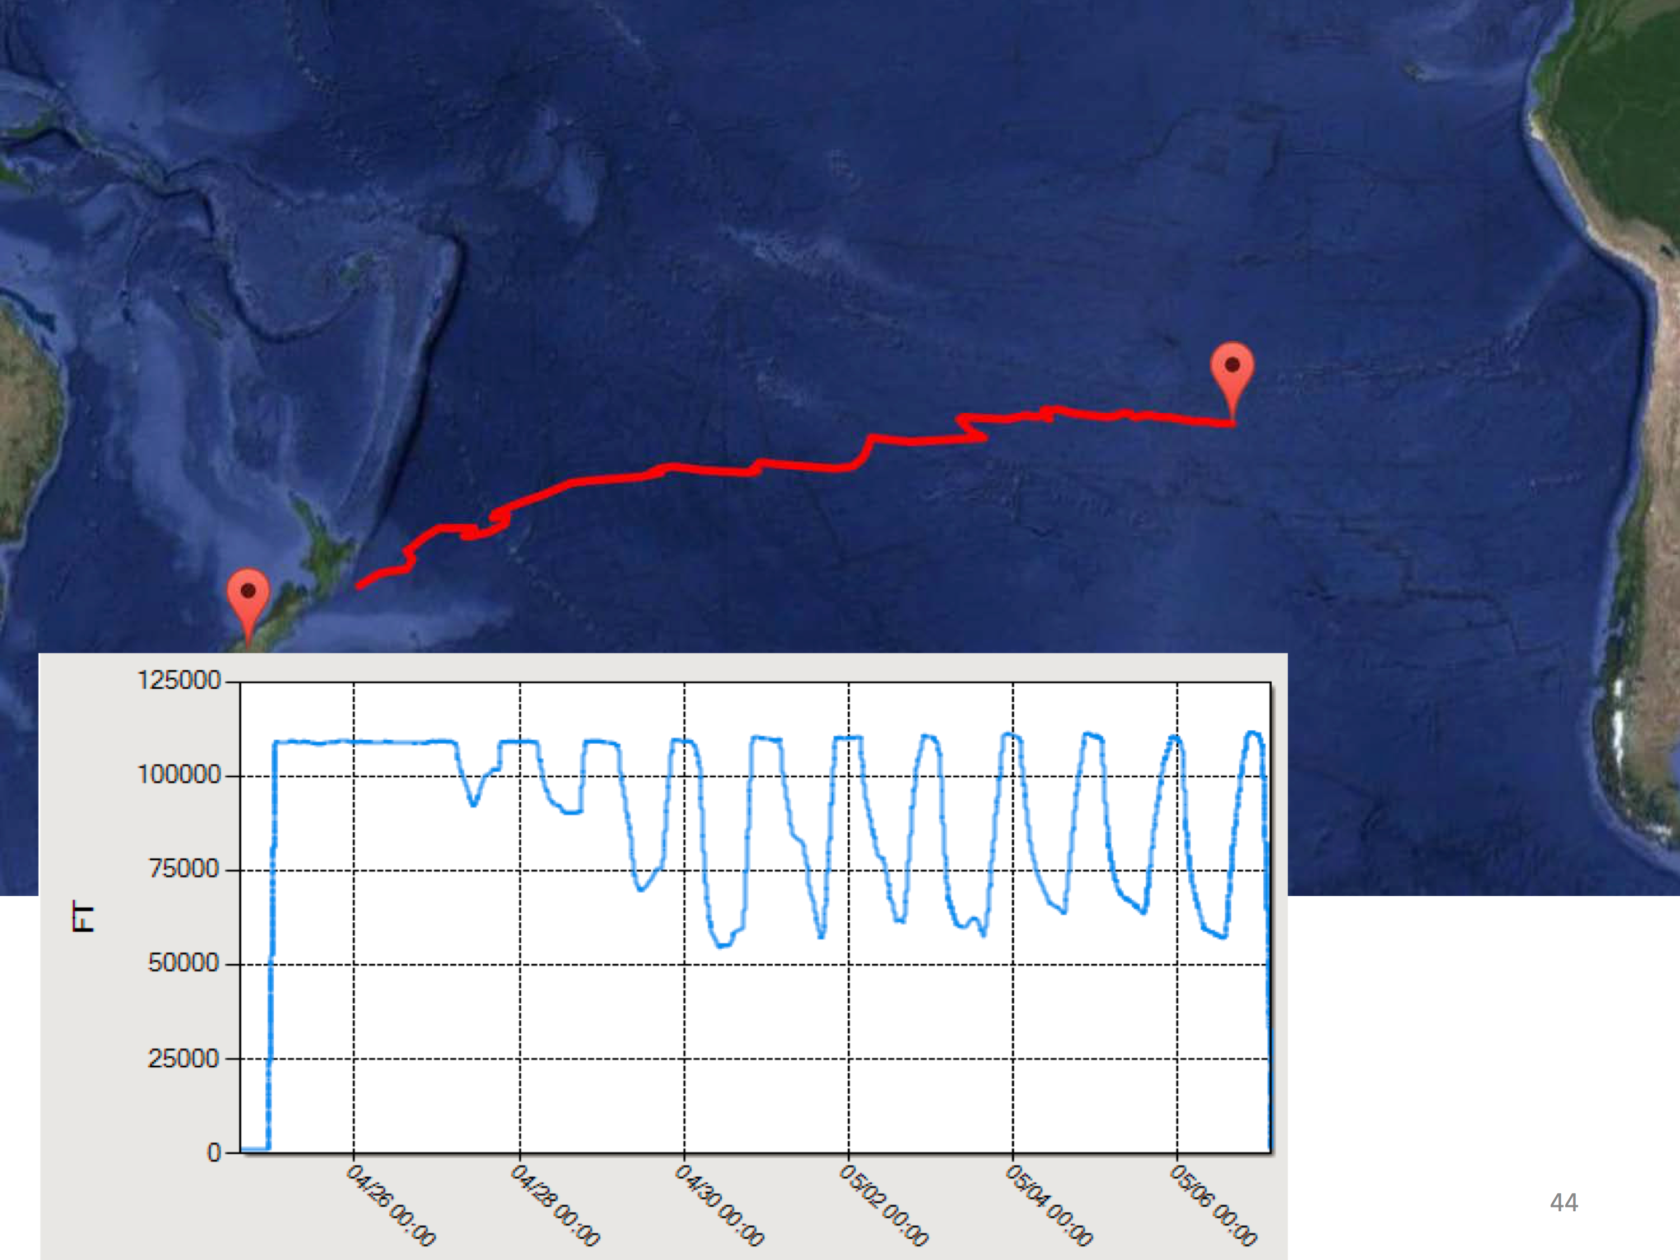
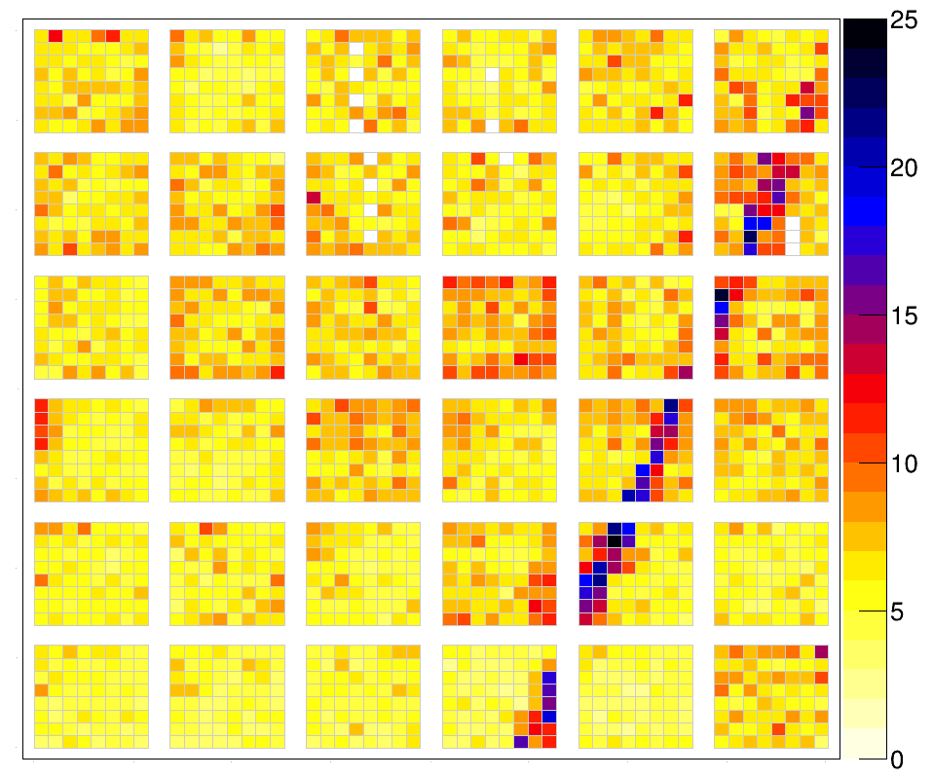
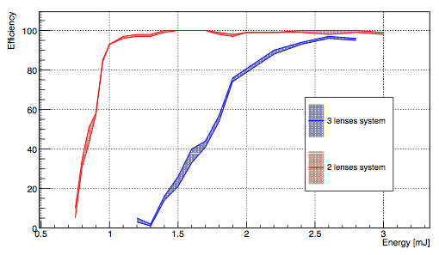
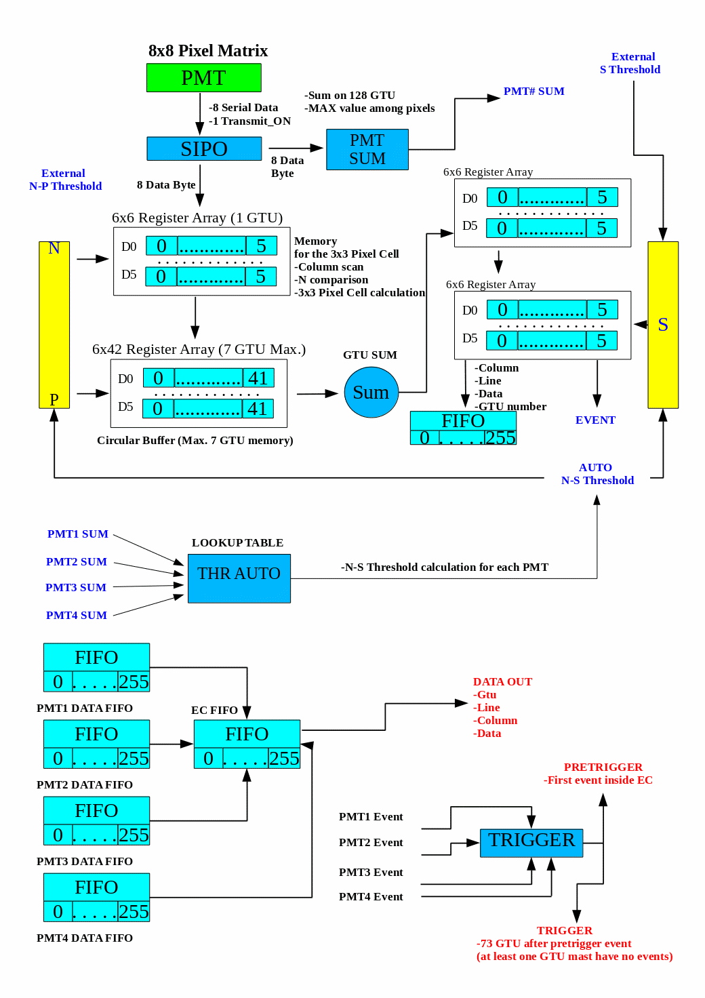
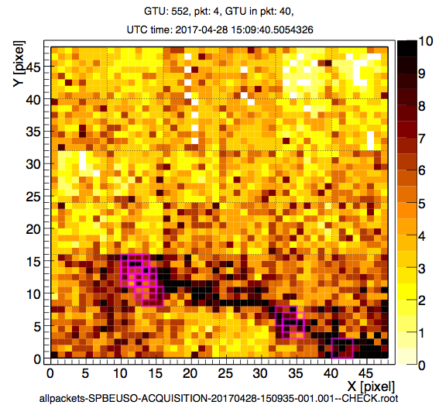
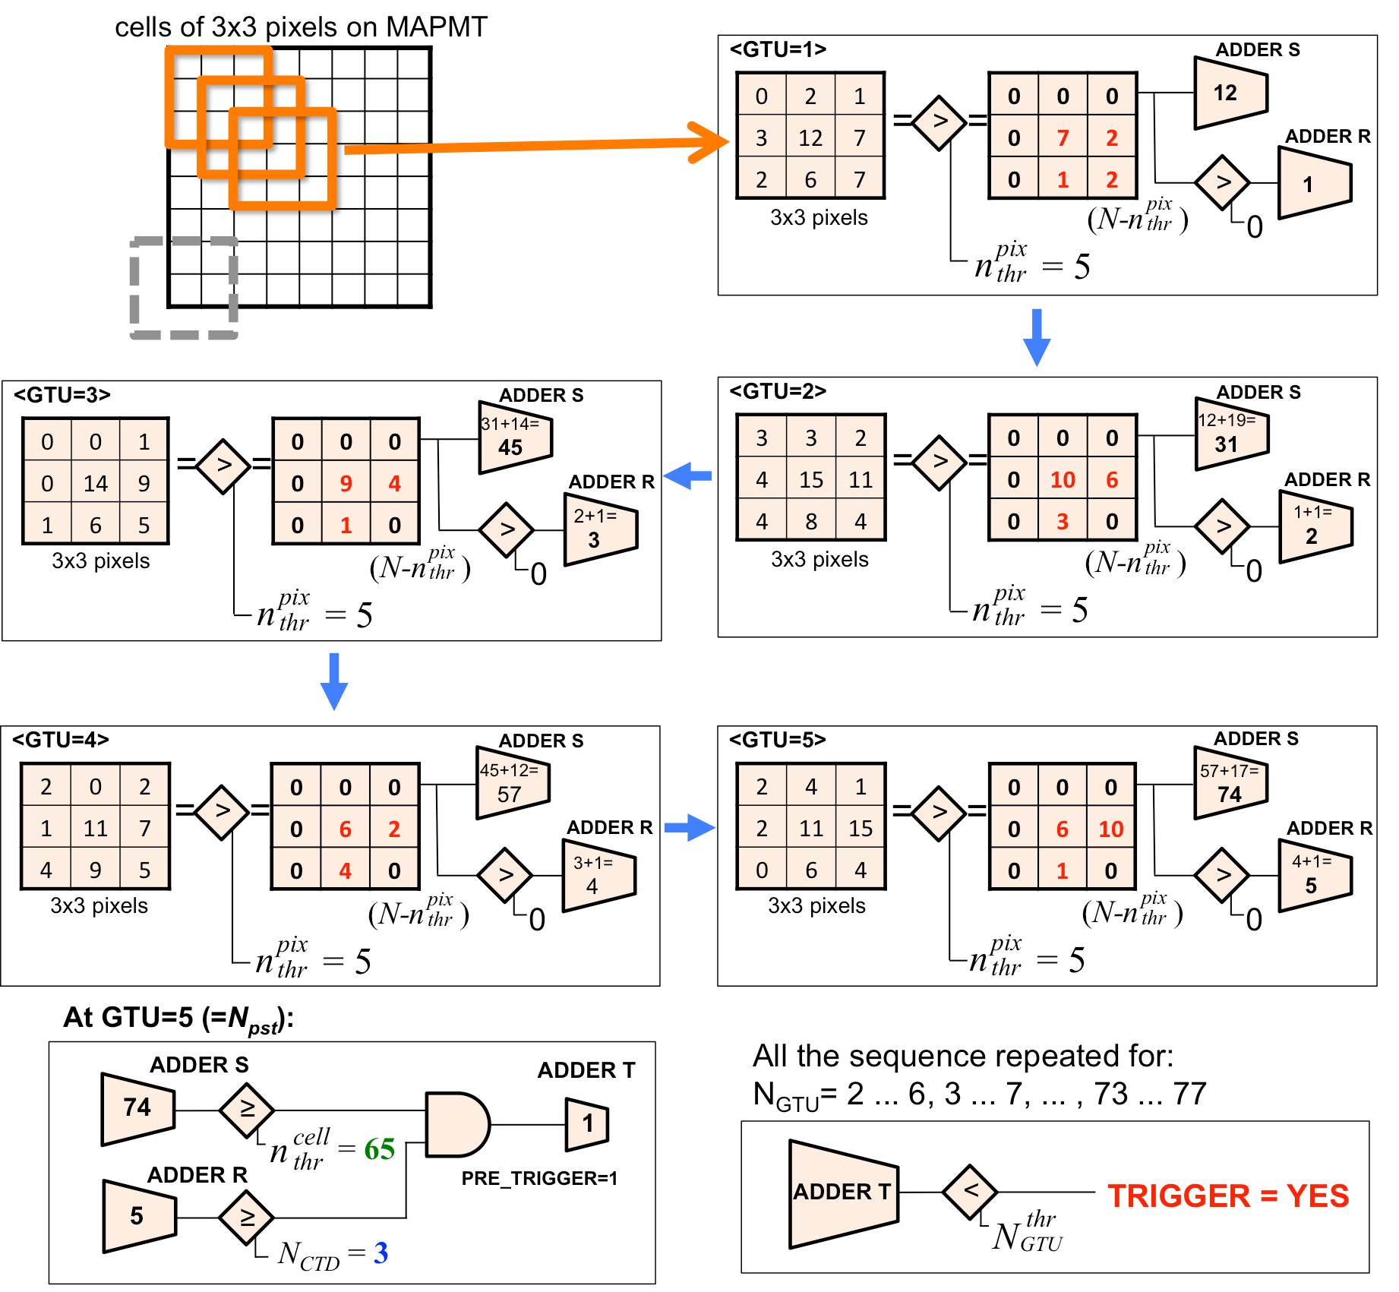
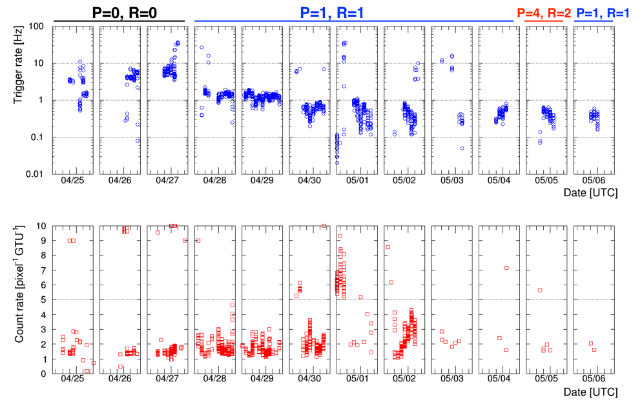
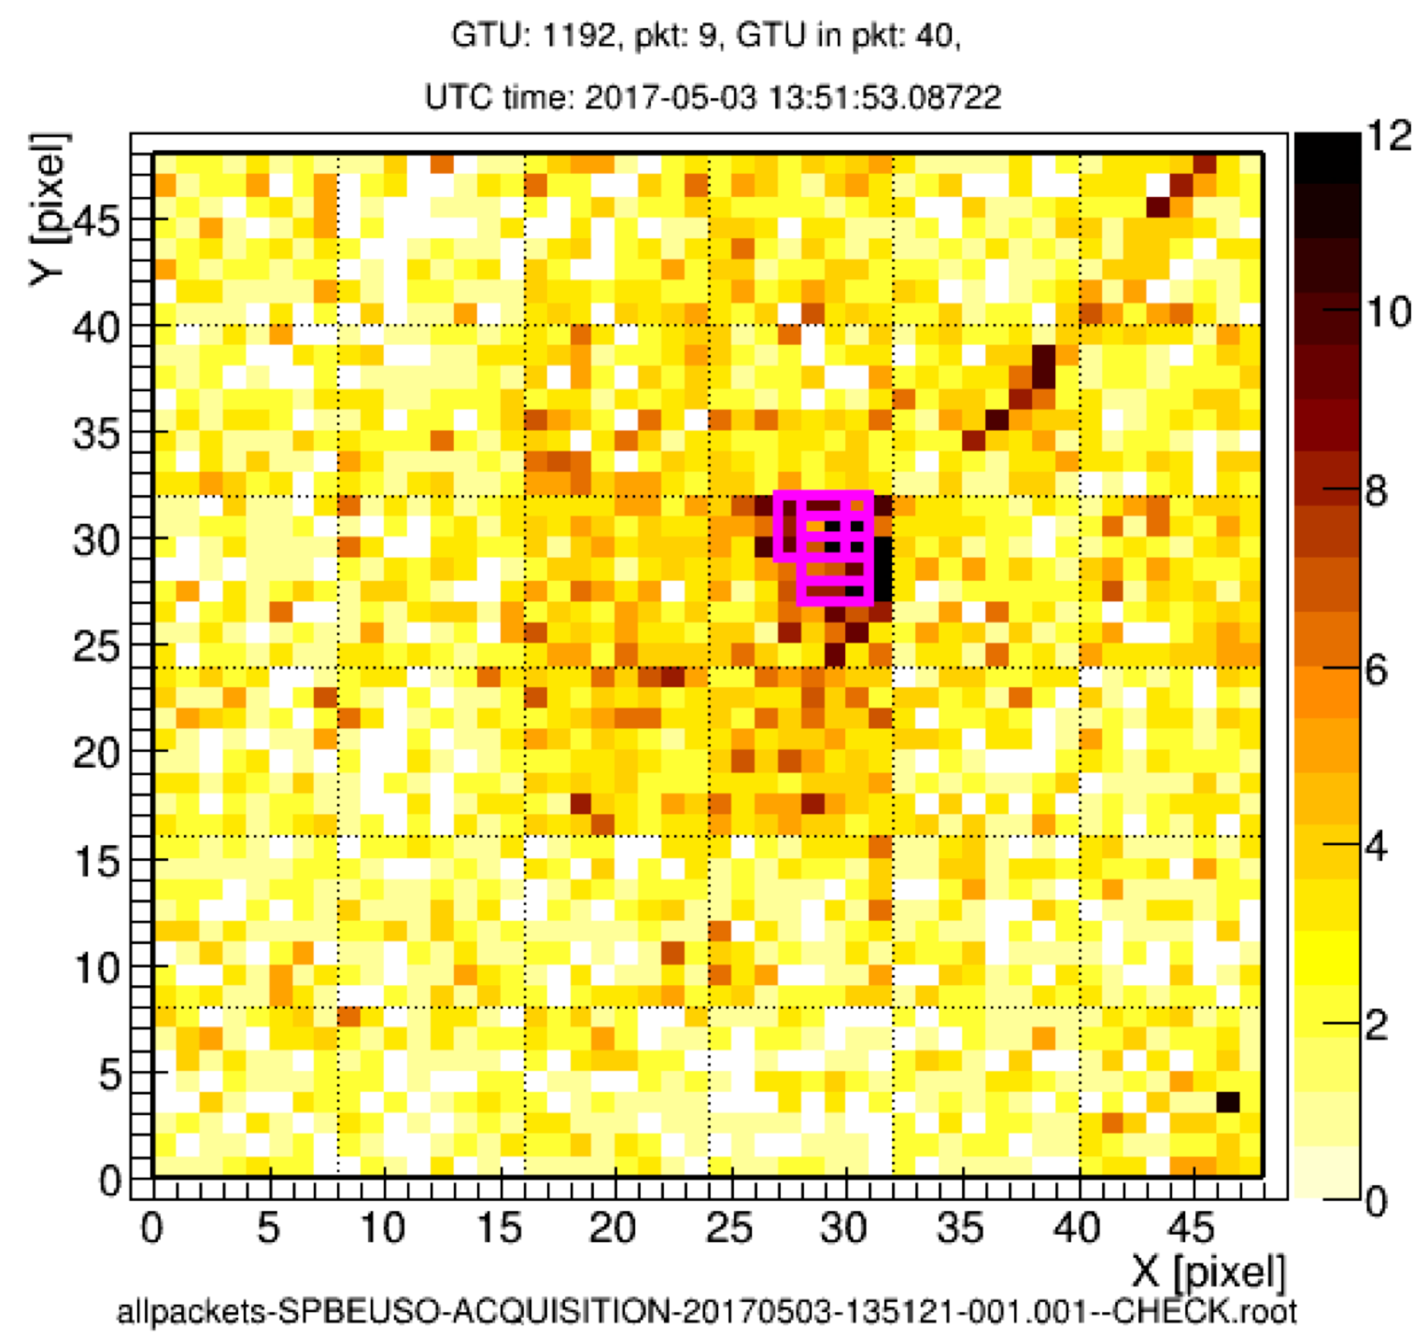
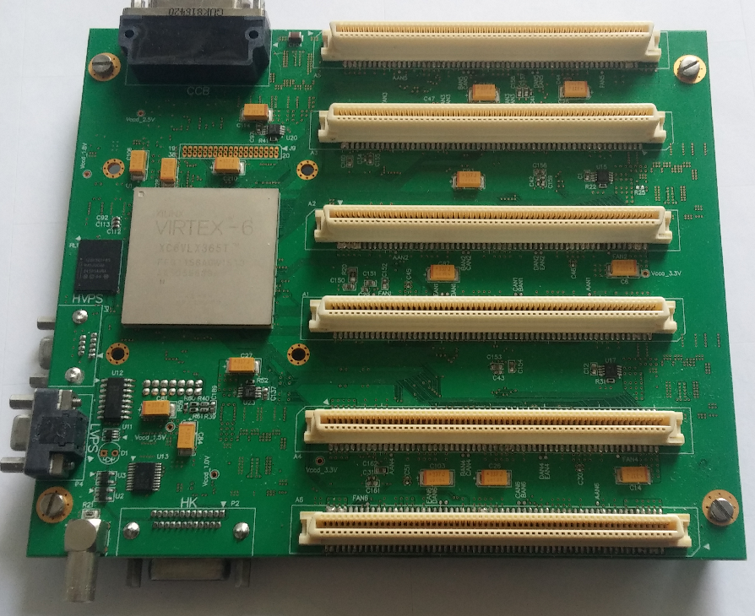
Performance results of the trigger logic implemented in EUSO-SPB
J. Bayerª , M. Bertaina^{b}, A. Cummings^{c}, J. Eser^{c}, F. Fenu^{b}, A. Jung^{d}, M. Mignone^{b}, H. Miyamoto^{b}, K. Shinozaki^{b} for the JEM-EUSO Collaboration
a) IAAT Tuebingen - Germany, b) University & INFN Torino – Italy, c) Colorado School of Mines - US, d) APC Univ. Paris Diderot - France
FLIGHT CAMPAIGN from Wanaka, New Zealand
TEST CAMPAIGN in Utah
TRIGGER LOGIC and PDM board
Figure 2: GLS laser event (2 mJ) going through the FoV of the PDM adopting the 2 lens system (left) and trigger efficiency as a function of laser energy (right) with 2 and 3 lens system for vertical shots. The 3 lens system was only tested up to 2.7 mJ.
Figure 1: Top: Schema of the VHDL implementation of the FLT logic.
Top right: The FLT trigger logic. Bottom right: PDM board.
Figure 4: Examples of CRs interacting in the detector.
Figure 3: Top: EUSO-SPB trigger rate in flight. Bottom: average count rate measured at pixel level.

