Slide 1
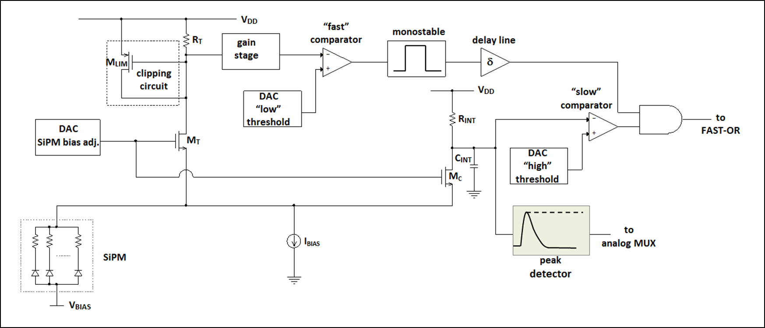
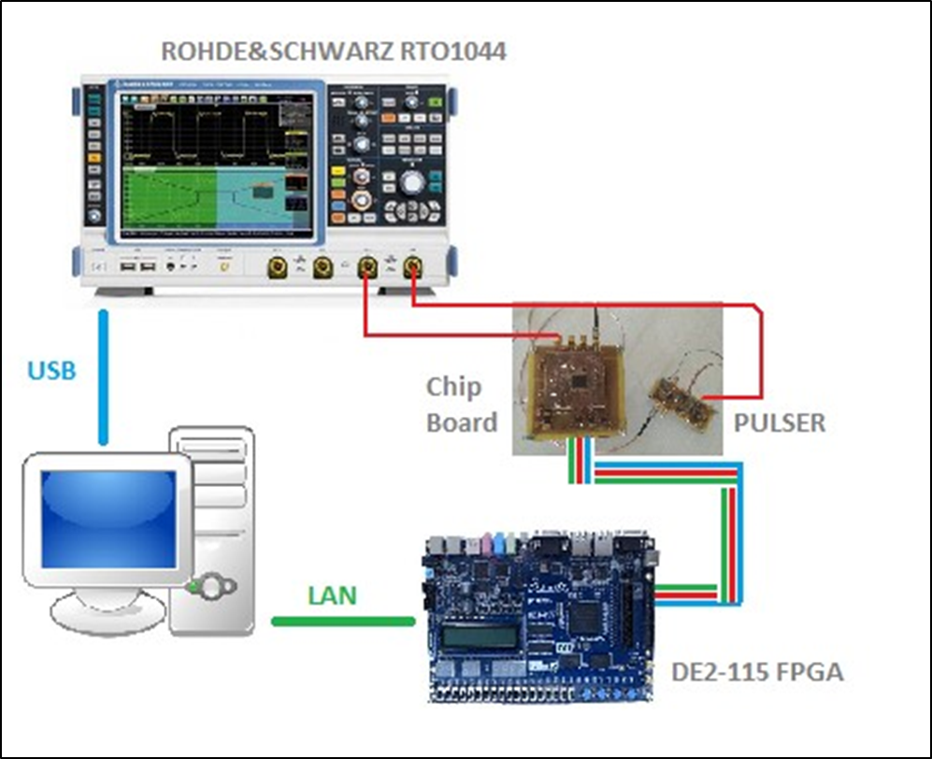
Experimental Test and Characterization of “BASIC64”, a New Mixed-Signal Front-End ASIC for SiPM Detectors
M. G. Bisogni¹, P. A. P. Calò^{2*}, F. Ciciriello², F. Corsi², C. Marzocca², G. Matarrese², S. Petrignani²
We present a CMOS current-mode read-out ASIC for Silicon Photomultipliers, designed for time and energy measurements in PET application systems.
The $100 nH$ parasitic inductance between SiPM and electronics has resulted in the choice of a preamplifier with relaxed constraints for $R_{in}$ and BW as one viable solution to the issue of reduced output signal slope.
BASIC64 features:
Analog channel suitable for both n-on-p and p-on-n SiPMs
SiPM bias voltage adjustable (8 bit DAC)
Trigger disabled for signals under a selectable charge threshold
Internal 10 bit ADC for charge measurements
¹ INFN – Sezione di Pisa, Italy
² DEI – Politecnico di Bari, Bari, Italy
* Presenting author
MEASUREMENTS RESULTS
PARAMETER | VALUE
Timing jitter rms | $$40 ps$$
Gain | $$3 mV/pC$$
Maximum Input Charge | $$5800 pC$$
Non-Linearity Error | $$1.5 \%$$
Architecture of the analog channel
Measurements setup
La Biodola, Isola D’Elba, 27 May – 02 June 2018
14th Pisa Meeting on Advanced Detectors
Frontier Detectors for Frontier Physics

