Slide 1
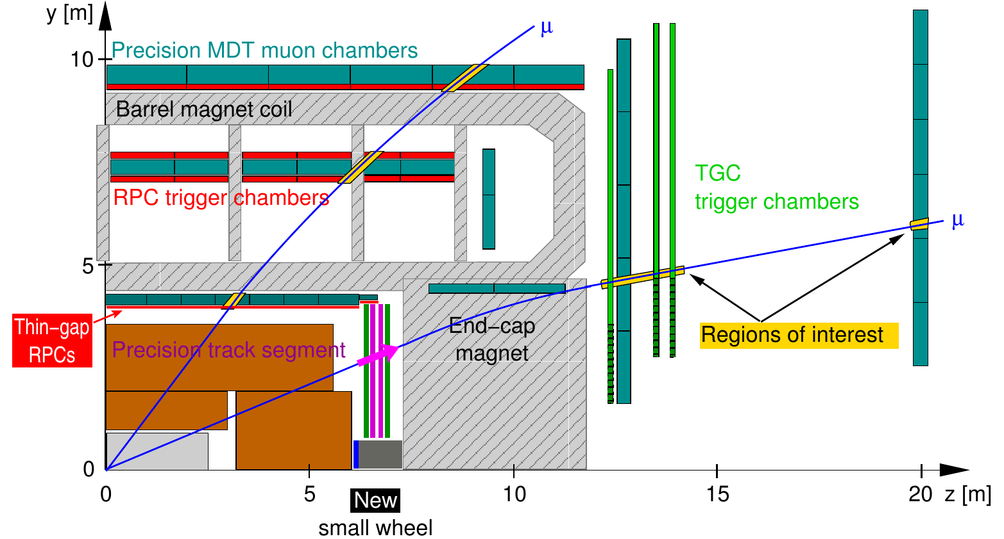
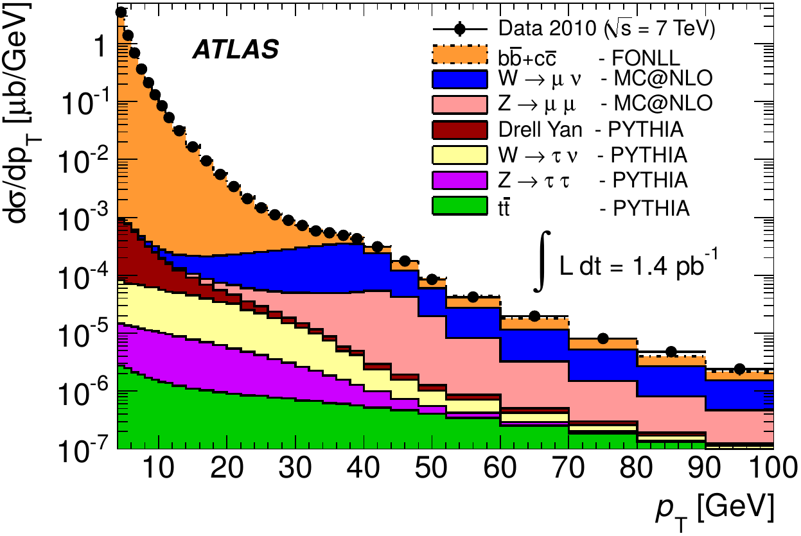
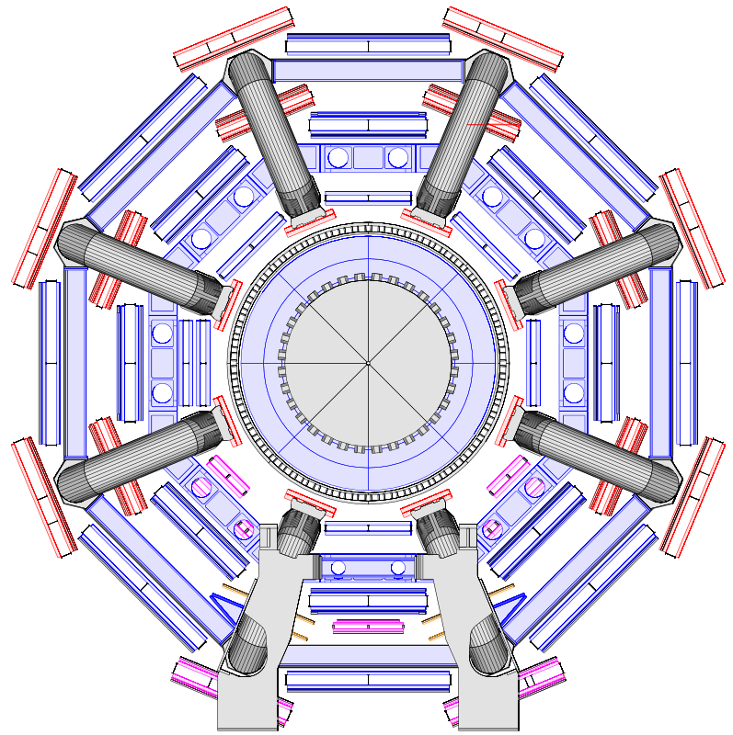
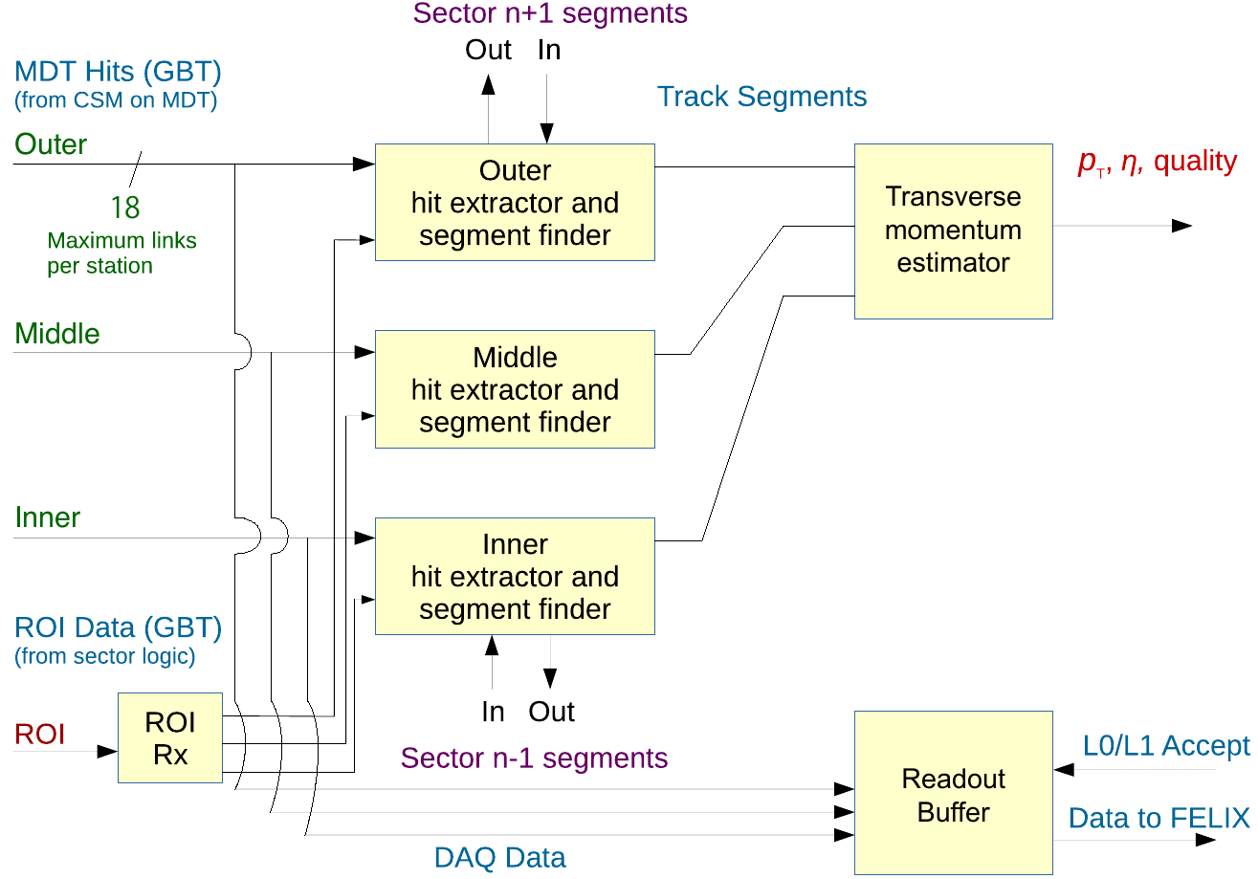
Development of a Highly Selective Muon Trigger Exploiting the High Spatial Resolution of Monitored Drift-Tube Chambers for the ATLAS Experiment at the HL-LHC
Oliver Kortner (MPI for Physics Munich, Germany) on behalf of the ATLAS Collaboration
Muon trigger at the HL-LHC
2-level trigger system: Hardware based level 0 (L0), software based high-level trigger (HLT).
L0 muon trigger:
Pretrigger: Coincidence of RPC or TGC hits.
→ pp collision time (BCID) + η and φ position of the muon
(spatial region of interest (RoI)). p_{T} measurement with low resolution.
Final trigger: Use of precision hits of monitored drift-tube (MDT) chambers for precise p_{T} measurement.
Sagitta
Reason for MDT trigger
The interesting electroweak physics is mainly at p_{T}>20 GeV.
The inclusive muon cross section is very steeply rising with decreasing p_{T}.
Muon pretrigger without MDT data accepts a lot of muons with 10 GeV<p_{T}<20 GeV.
→Reduction of the trigger rate due to sharpening of the turn-on curve and
the rejection of accidental pretriggers:
Rate without MDTs Rate with MDTs
Barrel (|η|<1.05) 45-85 kHz ~15 kHz
End caps (1.05<|η|<2.4) 15-20 kHz ~10 kHz
MDT trigger hardware and data flow
Continuous streams of
Implementation on ATCA blades.
Data flow:
Segment reconstruction in each chamber only in the ROI performed on a FPGA with the option of an associative memory chip for pattern recognition.
Momentum determination from segment positions and segment angles.
Total muon trigger latency < 4.2 µs
MDT hits
Input from pretrigger
ROI
BCID

