Slide 1
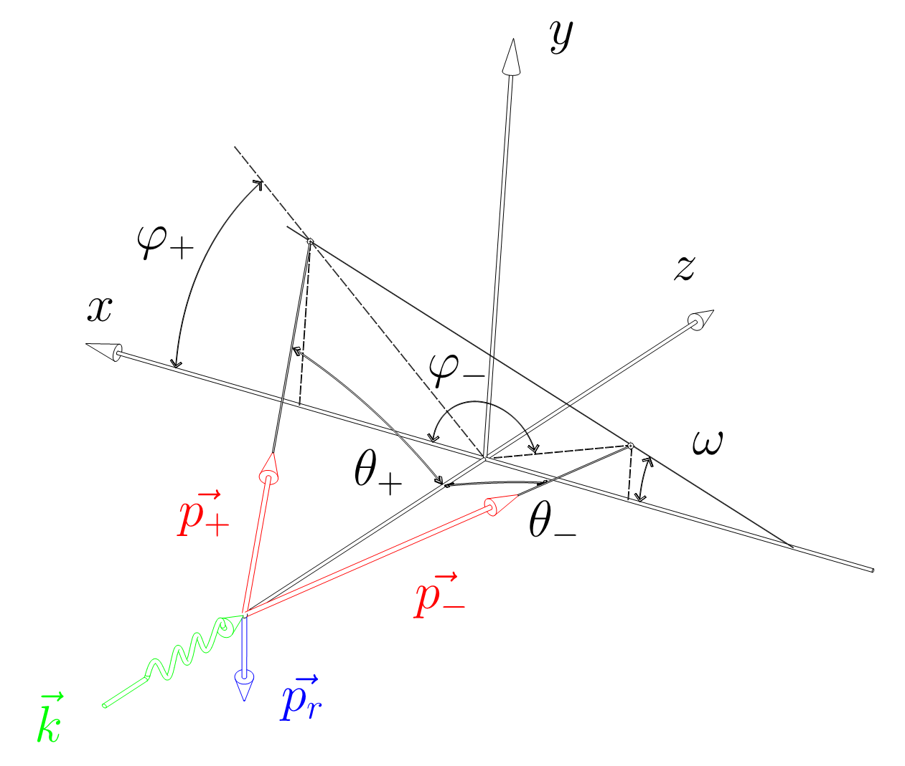
“C++ implementation of Bethe-Heitler, 5D, Polarized, γ ➛ e⁺ e⁻ Pair Conversion Event Generator”
I. Semeniouk, D. Bernard
LLR, Ecole Polytechnique, CNRS/IN2P3
Implemented as Geant4 G4BetheHeitler5DModel
Yielding a sampling of the five-dimensional Bethe-Heitler differential cross section
Exact down to threshold, without any low-energy nor small-angle approximations
Nuclear or electron (``triplet'') conversion target
Detailed kinematic of gamma conversion
Polarization asymmetry consistent with asymptotic values
Linear polarized or non polarized beam
The code was submitted to Geant4 EM group as a possible physics model of polarized gamma conversion in Geant4 framework and will be available in future release of Geant4.
Igor.semeniouk@llr.in2p3.fr

