Slide 1
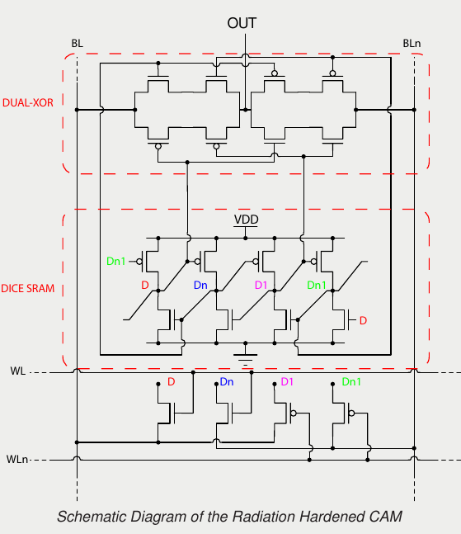
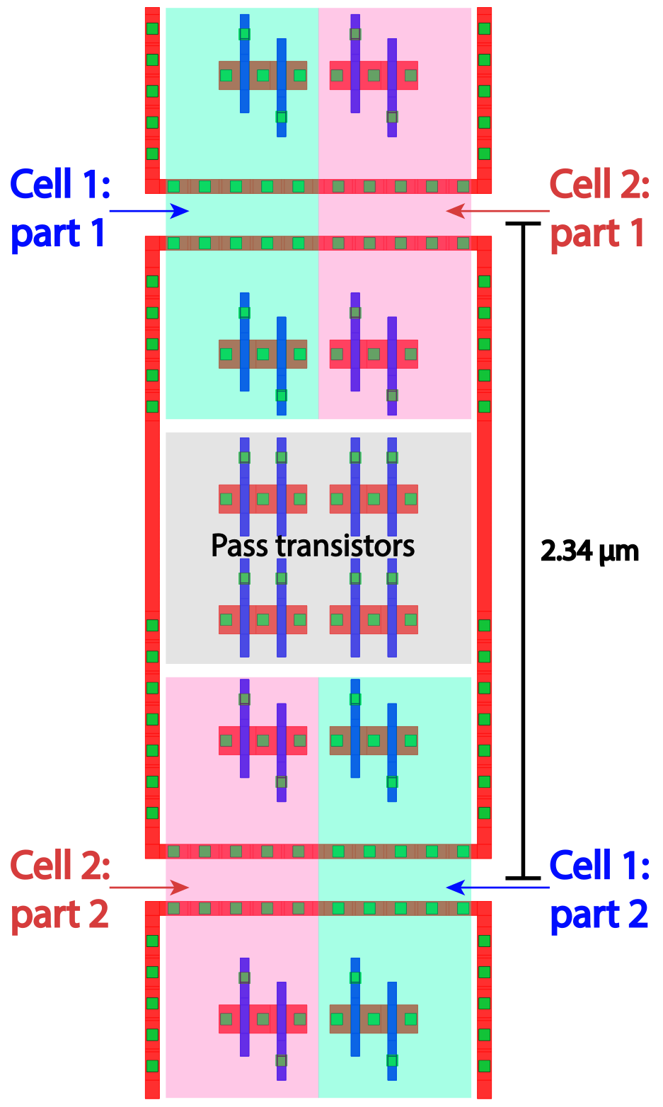
A Novel Radiation Hardened CAM
O. Anagnostou¹, V. Liberali², M. Mews¹, S. Shojaii¹
1) The University of Melbourne
2) INFN and university of Milan
This poster describes an innovative Content Addressable Memory cell with radiation hardened (RH-CAM) architecture.
An array of proposed architecture can perform on-time pattern recognition tasks in harsh environments, such as front-end electronics in hadron colliders and in space applications.
The RH-CAM is designed in a commercial 28 nm CMOS technology.
The circuit has been simulated in worst-case conditions, and the effects due to single particles are analyzed by injecting a fault current into a circuit node.
RH-CAM layout in 28 nm CMOS technology
(two interleaved cells)

