Slide 1
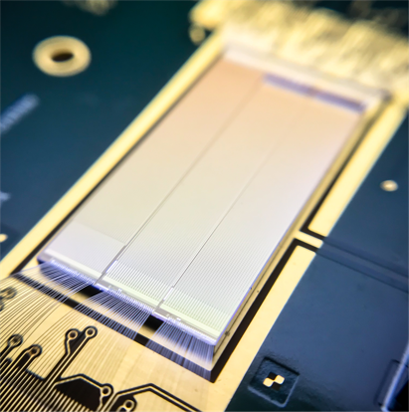
Towards the large area HVCMOS demonstrator for ATLAS ITk
M. Prathapan⁶, M. Benoit⁴, R. Casanova³, D. Dannheim¹, F. Ehrler⁶, E. Vilella⁷, M. Kiehn⁴,
A. Nürnberg⁶, P. Pangaud², R. Schimassek⁶, A. Weber^{5,6}, W. Wong⁴, H. Zhang⁶, I. Perić⁶
¹CERN, ²CPPM Marseille, ³IFAE Barcelona, ⁴University of Geneva, ⁵University of Heidelberg, ⁶KIT Karlsruhe, ⁷University of Liverpool
High Voltage CMOS sensors use commercial CMOS technology for particle detection which makes them cost effective in comparison to the hybrid sensors.
HVCMOS sensors are fully monolithic, which means the readout electronics is embedded in the sensor chip.
This contribution presents the progress that has been made towards the final HVCMOS demonstrator targeting the requirements of ATLAS inner tracker
ATLASpix1 is the first large area prototype in 0.18µm process.
ATLASpix1_M2 is the proof-of-concept for a novel readout scheme called “Content Addressable hit Buffer (CAB)” readout. The design details of ATLASPix1_M2 will be presented in this contribution.
ATLASPix2 introduces new ideas for smart pixel grouping to achieve higher spatial resolution. The control unit of ATLASPix2 has several new features such as partial sorting algorithm for excellent readout efficiency at high particle hit rates.
ATLASpix3 is the planned to be the sensor chip which will be used for module construction. ATLASpix3 test chip introduces double ToT storage concept per hit buffer.
This poster gives an insight into the design details of ATLASPix series. The test beam measurements on ATLASpix1 shows 99.5% detection efficiency.

