Slide 1
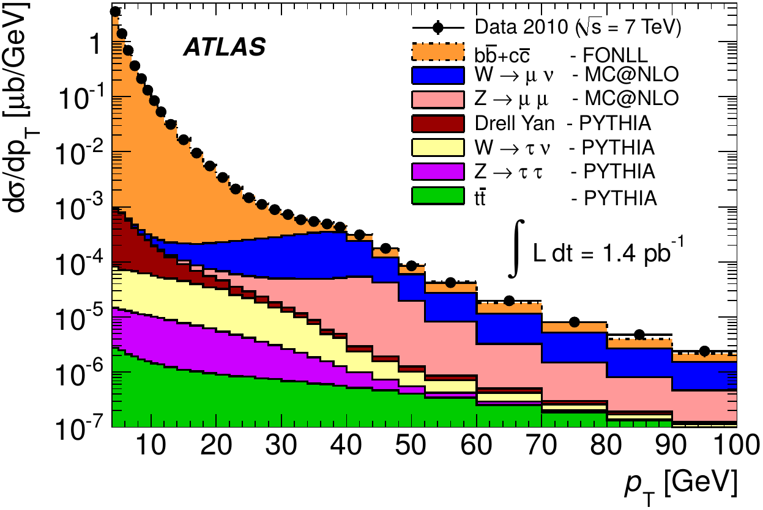
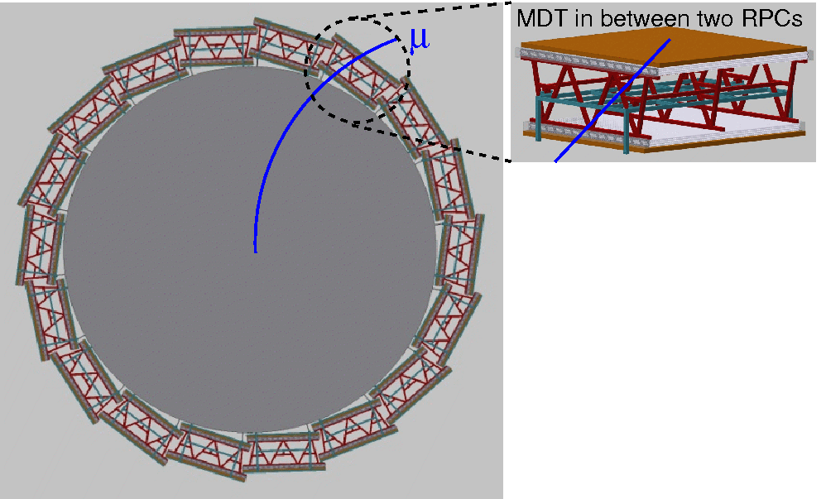
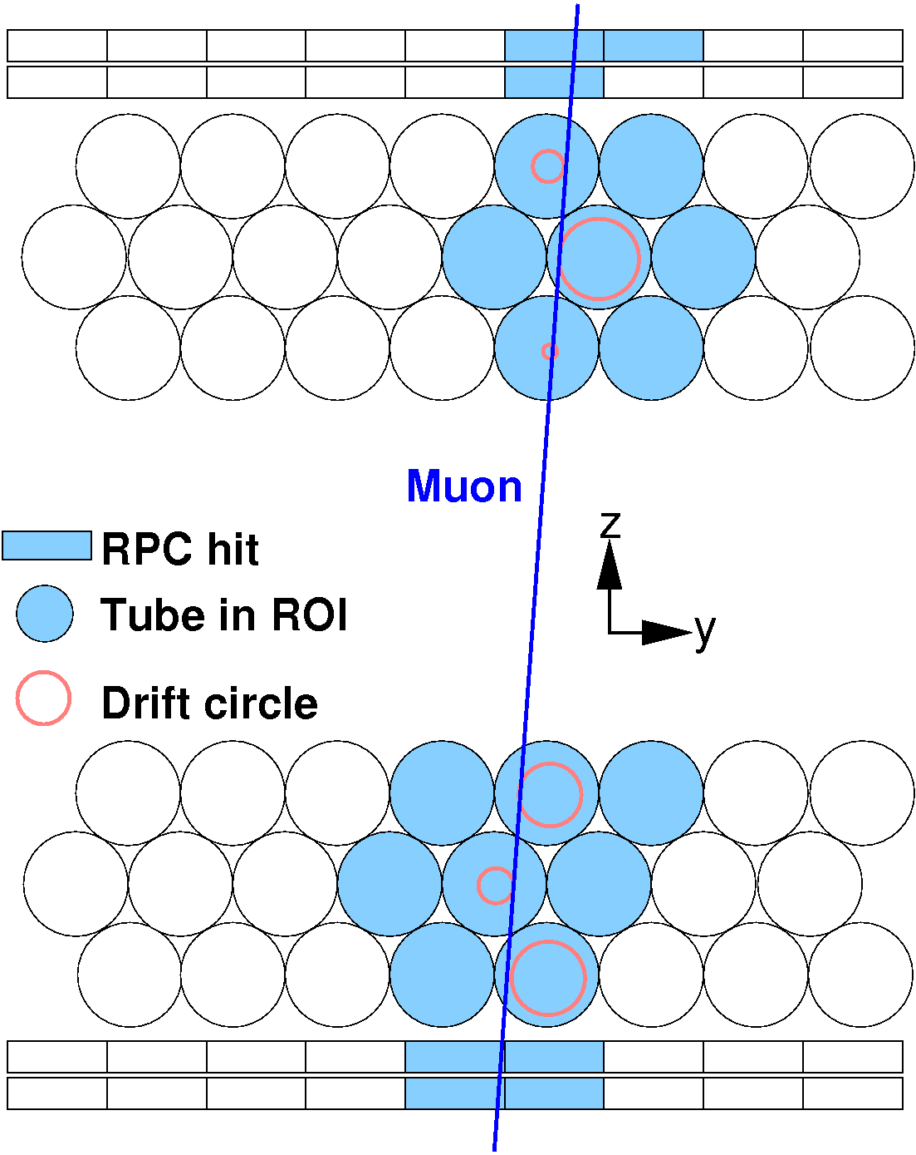
First-Level Muon Track Trigger for Future Hadron Collider Experiments
S. Abovyan, D. Cieri, M. Fras, Ph. Gadow, O. Kortner, S. Kortner, H. Kroha, F. Müller, S. Nowak, R. Richter, K. Schmidt-Sommerfeld
Max-Planck Institute for Physics, Munich, Germany
Importance of low p_{T} single-muon triggers at pp colliders
Example: Proposed FCC muon system
The interesting electroweak physics is mainly at p_{T}>20 GeV.
The inclusive muon cross section is very steeply rising with decreasing p_{T}.
In order to limit the single muon rate at low transverse momenta, good momentum resolution at the trigger threshold is mandatory.
Compact muon finder algorithm for fast track reconstruction
Work only in the ROI from the RPC system.
Pattern recognition with a 1-D Hough transform (estimate for track angle from RPCs).
Segment fit by linear regression to the hits found in the pattern recognition step.
Algorithm successfully tested on a Zynq 7045 FPGA.
Latency: 250 ns at 240 MHz clock frequency.
Xilinx evaluation board ZC706 with Zynq SoC 7045

