Slide 1
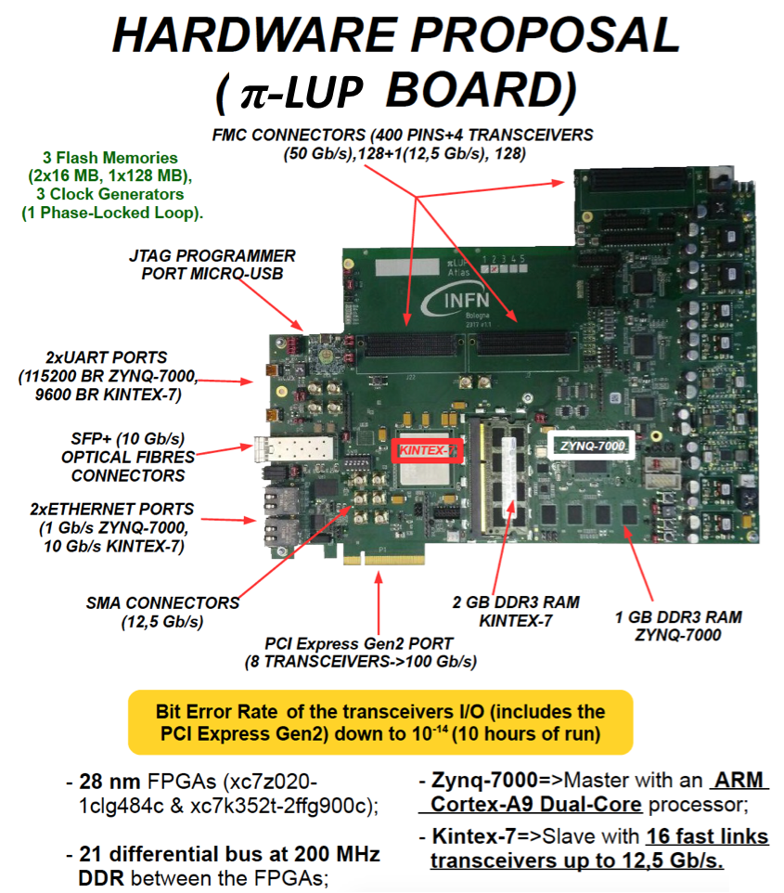
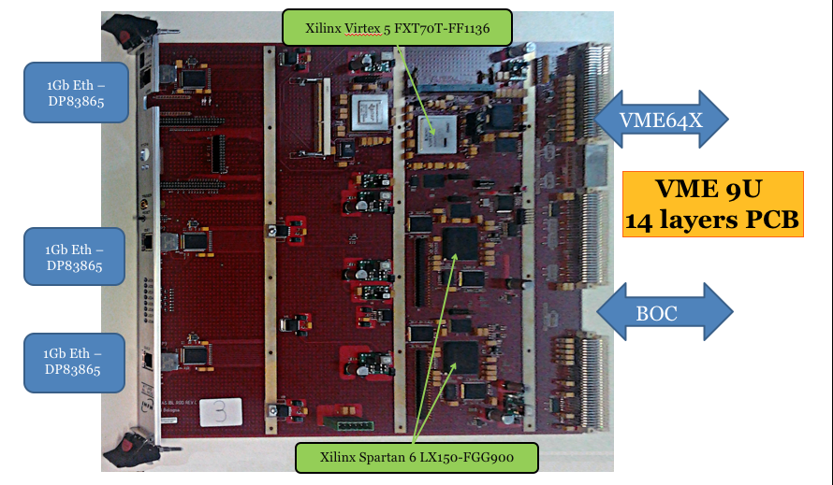
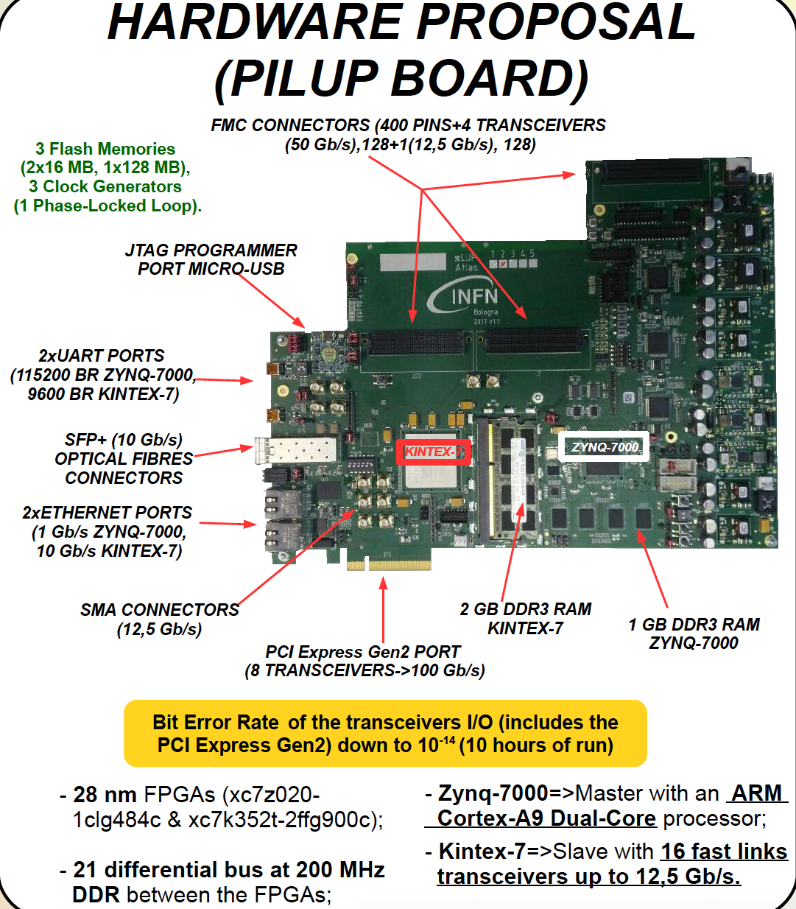
From the Phase-0 DAQ upgrade of entire ATLAS
Pixel Detector towards the Phase-2 electronics upgrade
A. Gabrielli^{1,2}, F. Alfonsi^{1,2}, G. Balbi¹, G. D’Amen^{1,2}, D. Falchieri¹, N. Giangiacomi^{1,2}, R. Travaglini¹
¹INFN Bologna, ² Physics and Astronomy Department University of Bologna (alessandro.gabrielli@bo.infn.it)
From → To
Readout Hardware Upgrade for the ATLAS (Pixel but not only) detector from Pahse-0 towards Phase-2

