Slide 1
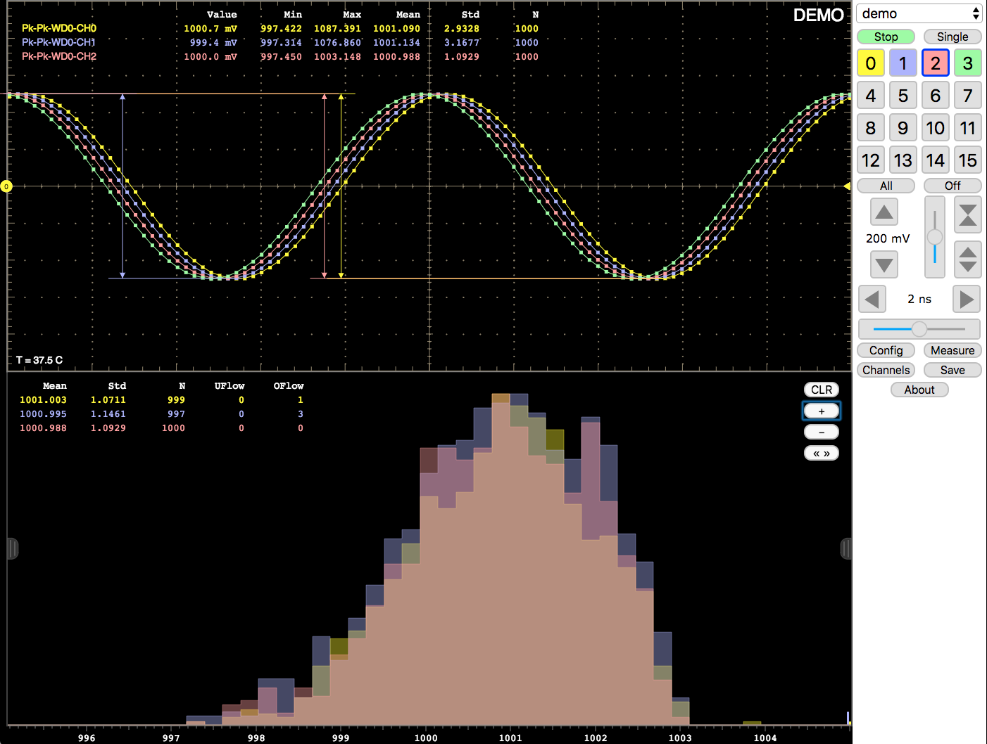
Web-based Experiment Monitoring with HTML5
Modern web technologies are the future of control and monitoring:
JavsScript inside a browser renders graphics as fast as native applications a few years ago
Operating system independent
Runs on PCs, tablets, smartphones
Remote access, no installation required
Automatic software updates
Try yourself:
http://elog.psi.ch/scope
Covered technologies:
Mongoose web server
JSON, JSON-RPC, Typed Arrays
HTML5 canvas rendering
Custom controls
Live demo of DRS4-based WaveDREAM oscilloscope running in browser
Stefan Ritt, PSI

