Slide 1
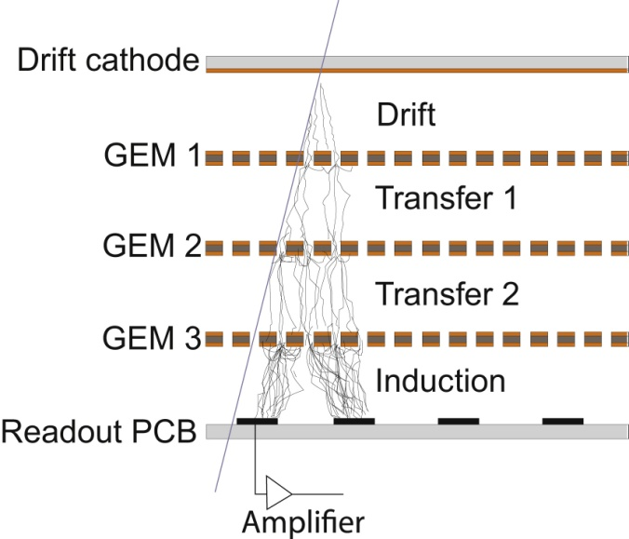
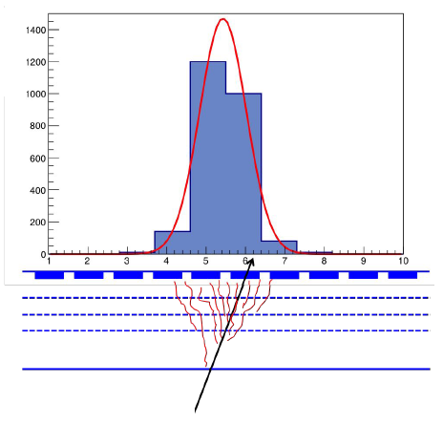
Implementation of the code for the simulation
of the response of a triple-GEM tracker
and its comparison to the experimental data
Lia Lavezzi
for the CGEM-IT group
IHEP - INFN Torino
simulate the tripleGEM response to the passage of the ionizing particle
from the generation of the electrons...
...to the signal formation
Primary Ionization
GEM properties
Drift properties
Signal formation
# clusters
# electrons/cluster
Gain
Transparency
Lorentz angle &
Diffusion
[in the four gaps]
Induction
Readout
A digitization standalone code has been implemented, based on GARFIELD/ANSYS simulations
The simulated data have been TUNED to MATCH EXPERIMENTAL data from testbeams

