Slide 1
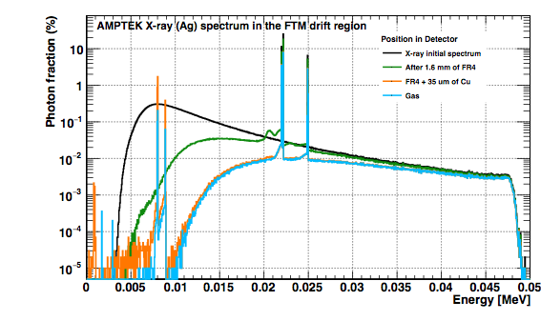
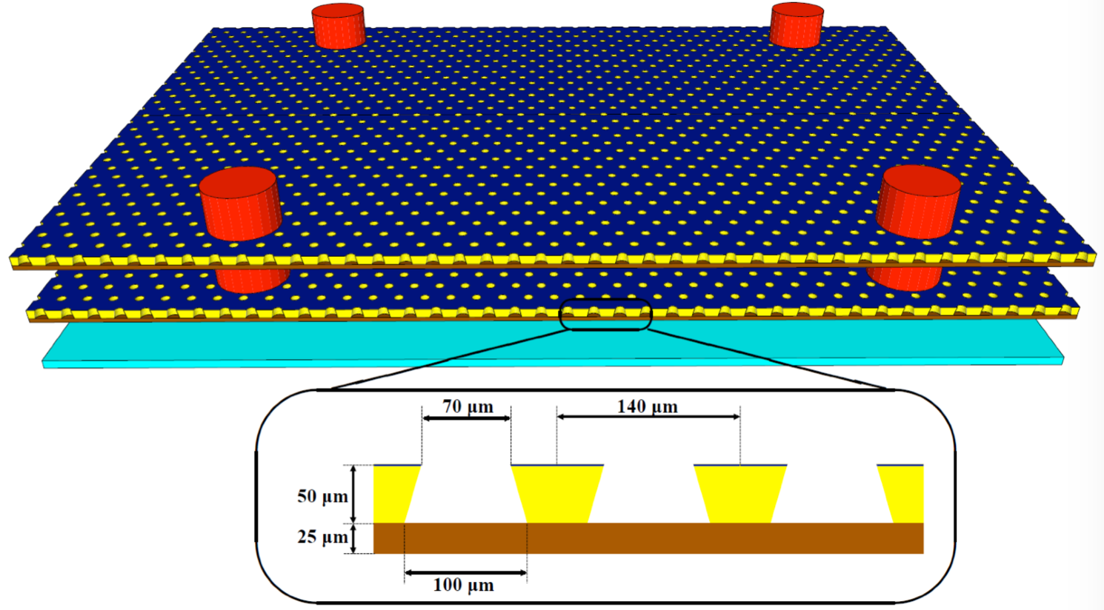
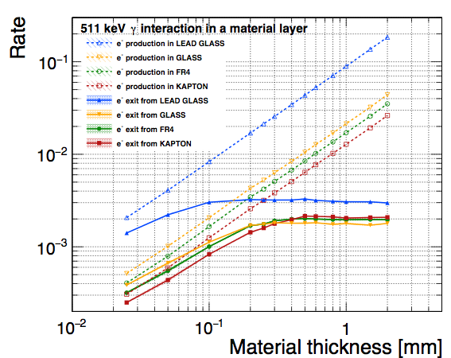
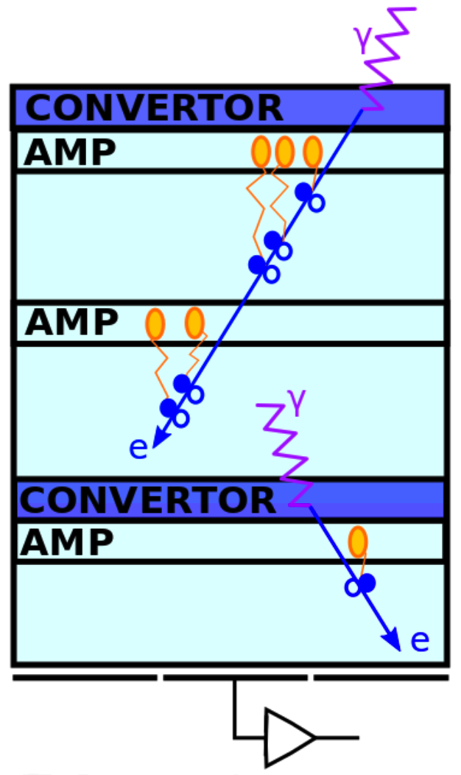
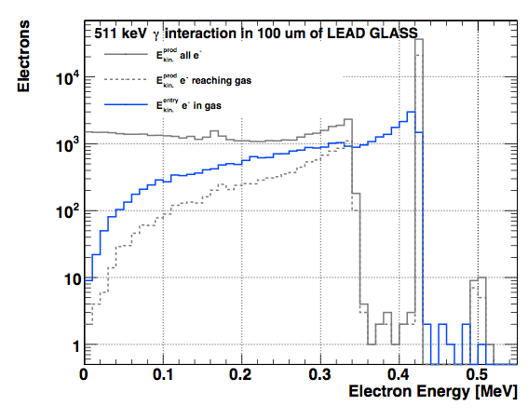
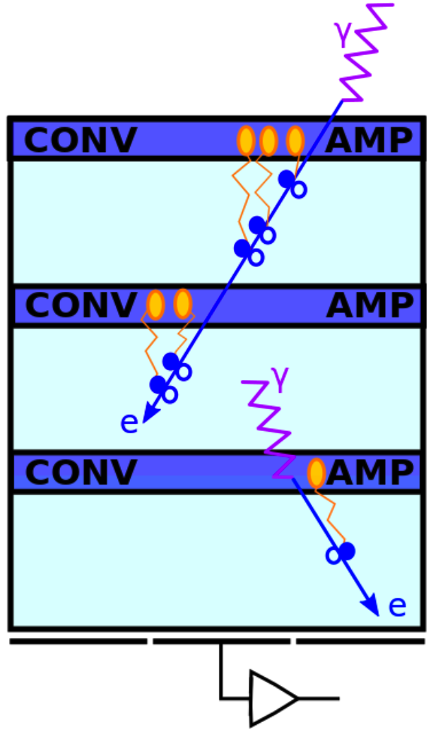
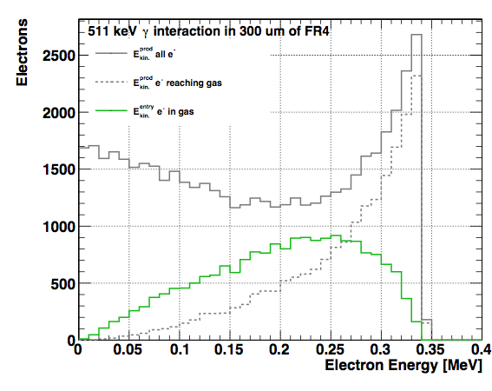
A FAST TIMING MICRO-PATTERN GASEOUS DETECTOR FOR TOF-PET
Raffaella Radogna, Piet Verwilligen, Marcello Maggi
INFN- Bari, Italy
Fast Timing Micro Pattern Gaseous Detector
Simulation of AMPTEK X-ray (Ag) passing the drift board
A new detector layout, named Fast Timing MPGD (FTM), has been recently proposed. The FTM would combine both the high spatial resolution (100um) and high rate capability (100MHz/cm^2) of the MPGDs with a high time resolution of 100ps. This new technology consists of a stack of several coupled layers where drift and multiplication stages alternate in the structure, yielding a significant improvement in timing properties due to competing ionization processes in the different drift regions. This contribution introduces the FTM technology as an innovative PET imaging device concept
arXiv:1503.05330
Photon Conversion
Adapt structure to detect 511 keV γ from PET
GEANT4.10.03 Simulation of 511 keV γ interaction in different materials and thicknesses: PCB (FR4), kapton, glass, lead glass
Electron production rate.
FTM for photons proposals
Scheme A: photon converted in high-Z resistive material + several thin amplification layers
Scheme B: photon can convert in each amp. layer (only resistive material allowed)
Charged particles ionize the gas in the drift region producing e⁻ multiplied in the gain region
Improve time resolution by reducing distance to the gain region + resistive structure→ split drift volume in N layers, each with own amp.
sub-relativistic e⁻ has high ionization density
Electron energy spectra.
Electron energy spectra.

