Slide 1
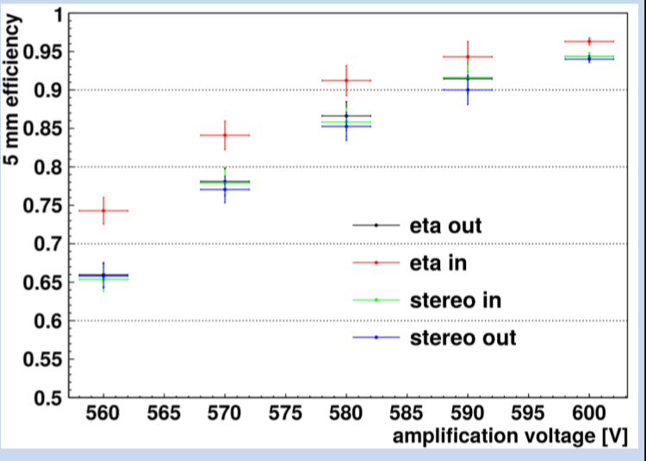
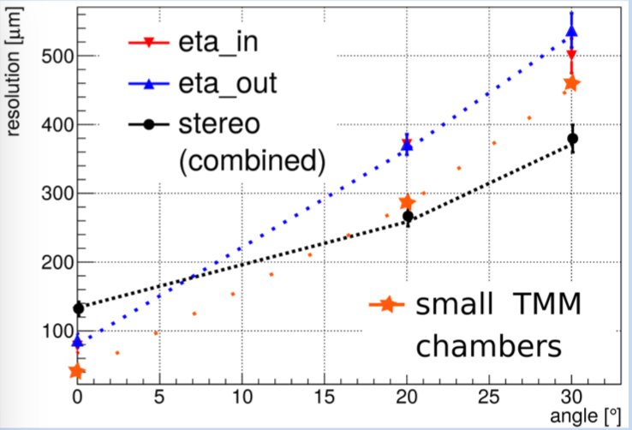
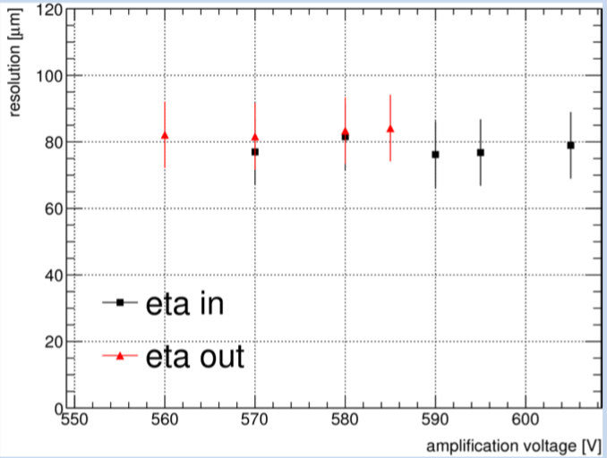
Performance and Calibration of 2 Micromegas Detectors for the ATLAS Muon Spectrometer Upgrade 1'
The steadily increasing luminosity of LHC requires an upgrade to high rate and high resolution capable detector technology for the inner end cap of the muon spectrometer of the ATLAS experiment.
For precision tracking 4 types of 2 and 3 micromegas quadruplets will provide 8 consecutive active layers, each with 100 μm spatial resolution per individual plane.
120 GeV SPS muon and pion data from Aug. 2017
Charge weighted position reconstruction
The full active area of the SM2 prototype quadruplet has been calibrated in the Munich Cosmic Ray Facility.
Large Area Pulse Height and Efficiency Scans for all 4 Layers
Spatial Resolution Using Charge Weighted Position Reconstruction
Ioannis Maniatis, Aristotle University of Thessaloniki, for the ATLAS Muon Collaboration

