Slide 1
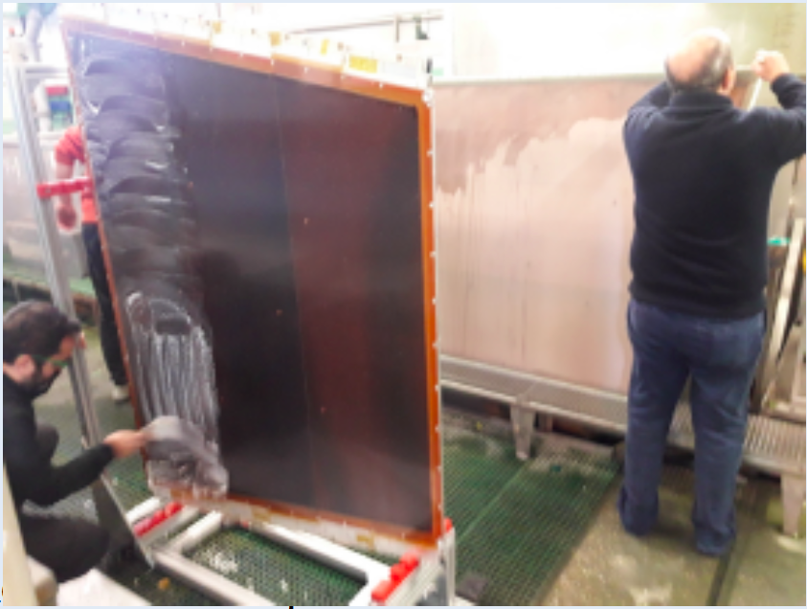
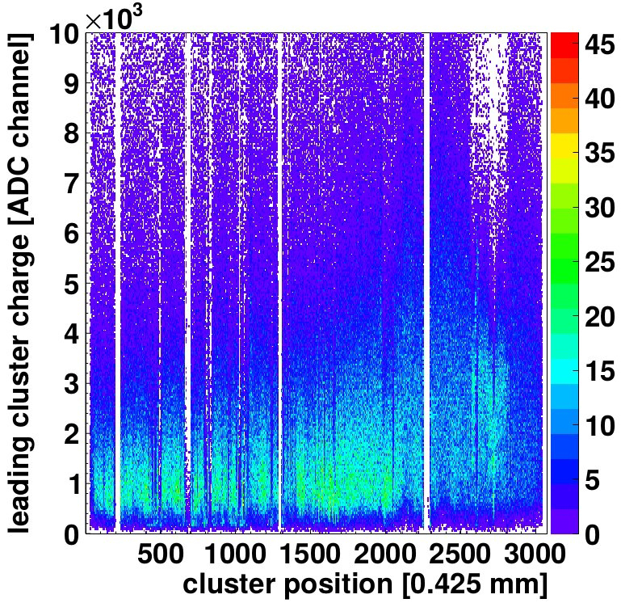
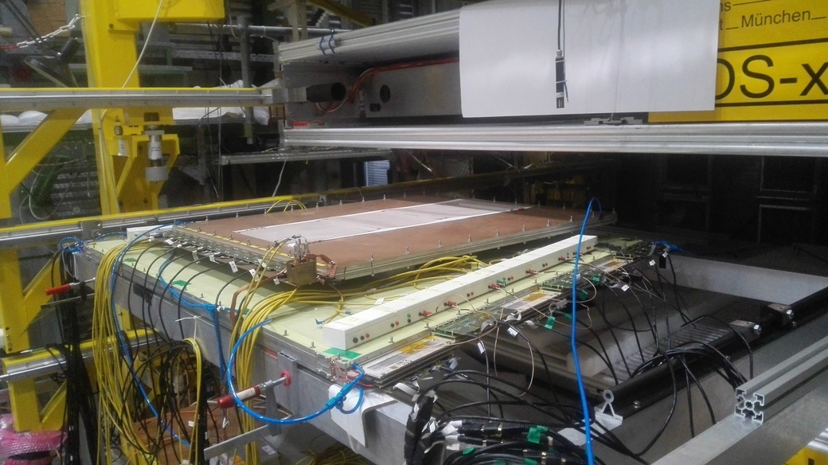
High Voltage stability and Cleaning procedure of 2m² Resistive Strip MicroMegas Detectors Paolo Massarotti (University of Naples Federico II and INFN Naples) on behalf of the ATLAS Muon Collaboration :
The cleaning procedure of the 5 drift and readout panels directly before assembly removes all disturbing dust, dirt or lithographic remnants
HV qualification: As the assembly happens in air the 1st step of qualification is performed under dry air while the 2nd step of qualification is performed under Ar/CO₂ 93:7 Vol%.
Is there any correspondence?
LMU Cosmic Ray Facility experimental setup for cosmic testing SM2 at Munich
SM2

