Slide 1
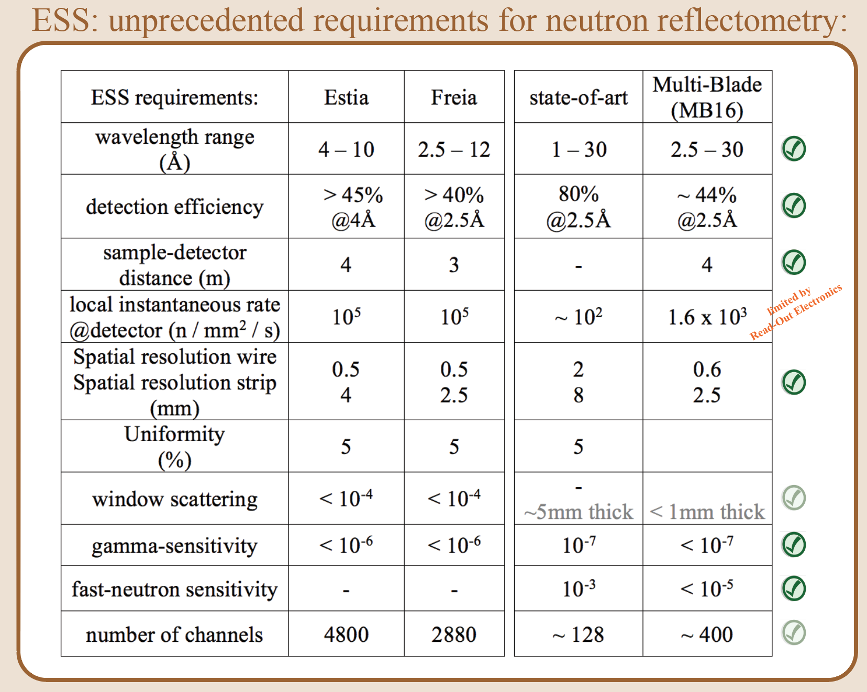
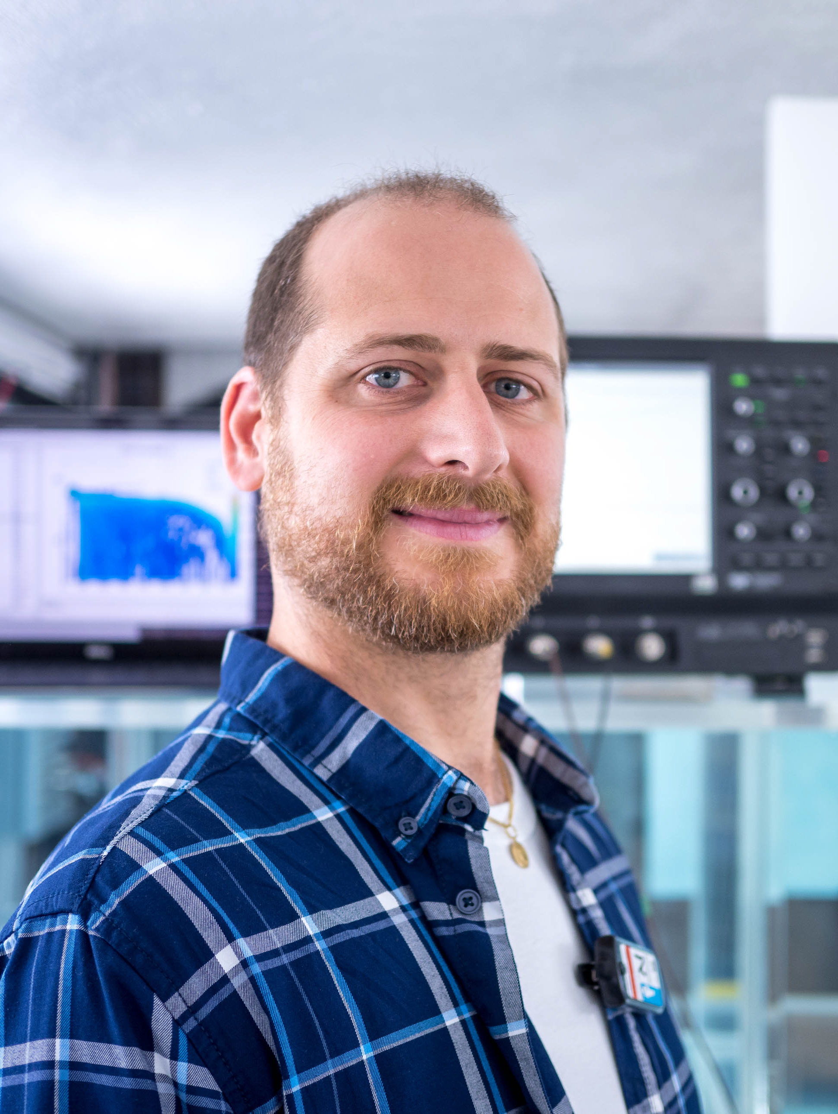
Multi-Blade
The ¹⁰B-based neutron detector for reflectometry at ESS
F. Messi^{1,2}, G. Mauri^{3,2}, F. Piscitelli²
¹Division of Nuclear Physics Lund University, ²European Spallation Source ERIC, ³Department of Physics University of Perugia
Multi-Blade:
- a 10B-based neutron detector conceived to face the arising challenge
in neutron reflectometry at the European Spallation Source (ESS).
- high counting rate
- sub-millimetre spatial resolution
- a stack of Multi Wire Proportional Chambers
- operated at atmospheric pressure with continuous gas flow (Ar/Co2 80/20)
- with a 10B4C neutron converter and a 2D read-out system
- inclined by 5 degrees with respect to the incoming neutron beam
Author: Francesco Messi
francesco.messi@nuclear.lu.se

