Slide 1
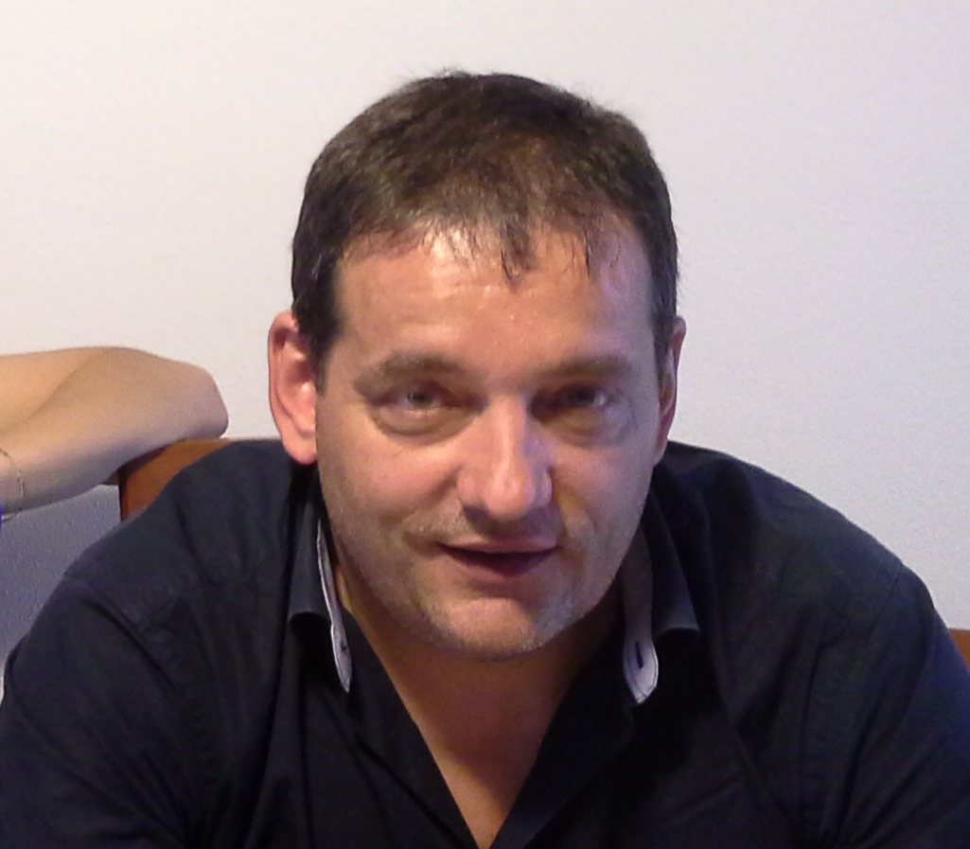
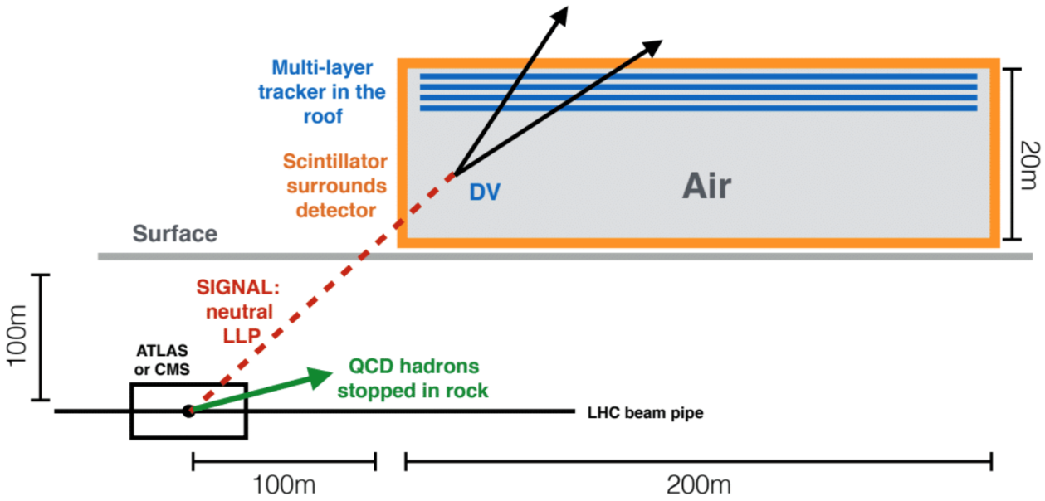
Ultra long-lived particles searches with MATHUSLA G. Marsella on behalf of MATHUSLA Coll.
Many extensions of the Standard Model (SM) include particles that are neutral, weakly coupled, and long-lived that can decay to hadronic and leptonic final states. Long-lived particles (LLPs) can be detected at colliders as displaced decays from the interaction point (IP), or missing energy if they escape. ATLAS, CMS, and LHCb have performed searches at the LHC and significant exclusion limits have been set in recent years.
In this poster, we describe the MATHUSLA surface detector
(MAssive Timing Hodoscope for Ultra Stable neutraL pArticles) ^{[1]},
which can be implemented with existing technology in time for the
turn-on of the high luminosity LHC (HL-LHC). The MATHUSLA detector will consist of an air-filled decay volume surrounded by charged particles detectors (top, bottom, and sides) that provide timing and a robust multilayer tracking system located in the upper region. Ref. [1] proposes covering a total sensitive area of 200 x 200 square meters on the surface in the region near the interaction point of ATLAS or CMS detectors for the beginning of the HL-LHC run.
Contact: mathusla.experiment@cern.ch
[1] New Detectors to Explore the Lifetime Frontier, J. P. Chou, D. Curtin, H. J. Lubatti, arXiv:1606.06298 [hep-ph]

