Slide 1
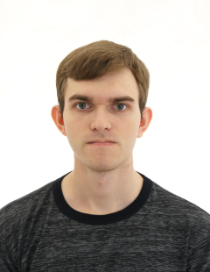
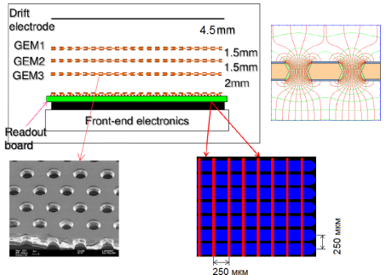
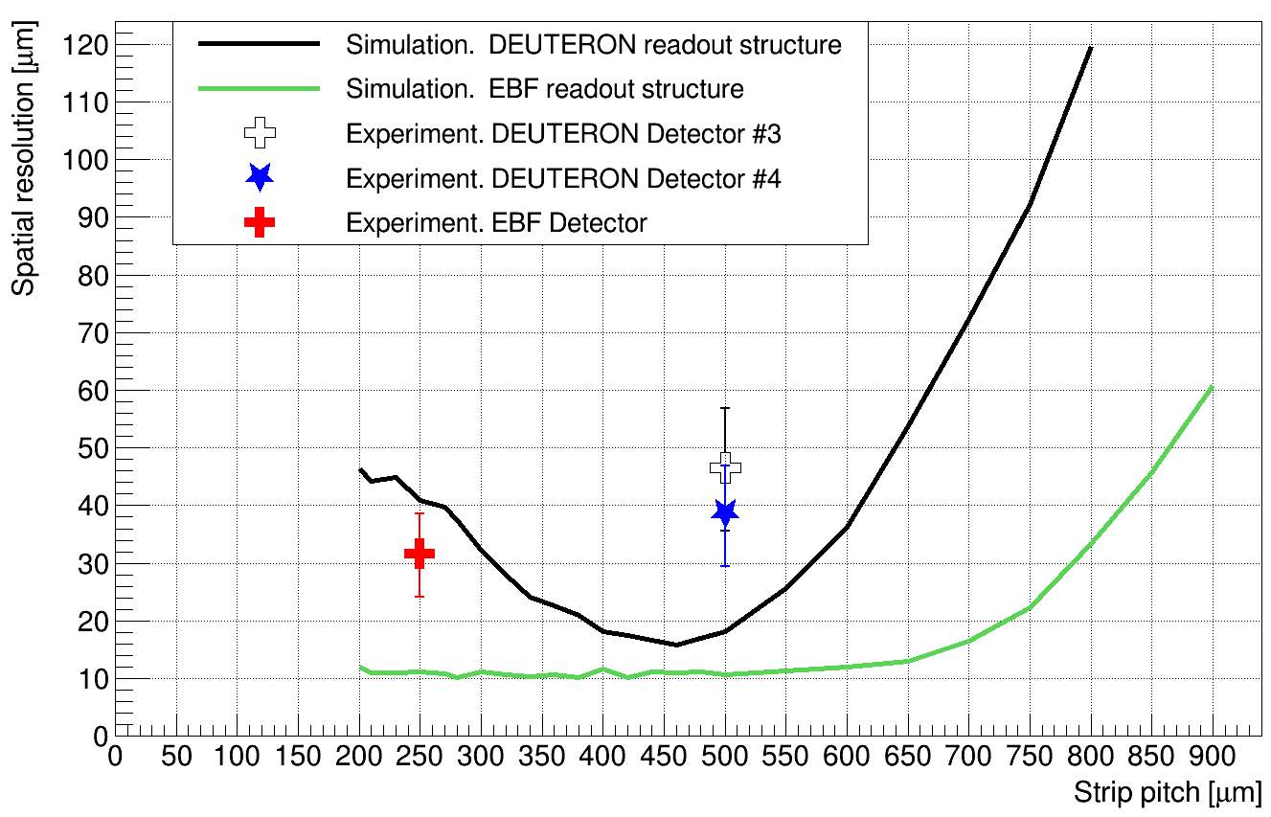
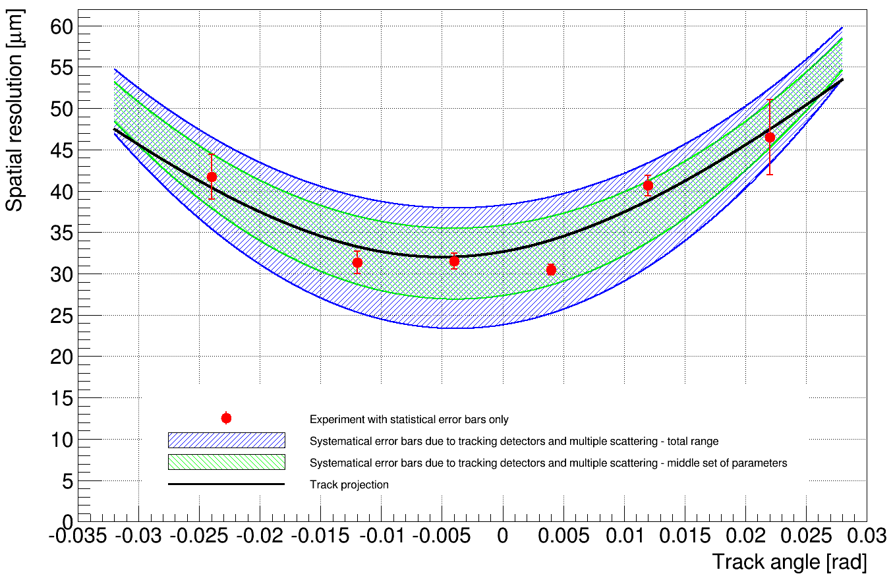
Spatial resolution of triple-GEM detectors
V. N. Kudryavtsev, T. V. Maltsev, L. I. Shekhtman
Budker Institute of Nuclear Physics, Novosibirsk State University, Russia
PM2018 - 14th Pisa Meeting on Advanced Detectors, Isola d’Elba, Italy
General results
Detailed simulation of electron transport in the triple-GEM detector, filled with Ar-CO₂(25%), performed with ANSYS and Garfield++, demonstrates that coefficient of effective transverse diffusion is 300±20 ${μm}/{\sqrt{cm}}$.
Effect of electron cloud compression due to GEM operation up to 15% in comparison with uniform electric field was observed.
Simulation of detector response with GEANT4 and HEED shows essential influence of Centre Of Gravity calculation on the counted spatial resolution. At the same time, physical minimum of 10 – 15 μm spatial resolution level is determined by delta-electrons space distribution.
Assembled triple-GEM detector with 250 μm strip pitch for Extracted Beam Facility (EBF) at BINP demonstrates stable operation with gas gain up to 5×10⁴ and the detection efficiency exceeding 99.5% for gain higher than 3×10⁴.
Spatial resolution of EBF-detector for orthogonal electron tracks is measured as
$$σ_{EBF−detector}=31.5±0.9 \left(stat.\right){}_{−7.5}^{+6.9}{\left(syst.\right)} μm$$
Triple-GEM detector spatial resolution as a function of strip pitch for the readout structure of DEUTERON and EBF detector types, obtained in the simulation for SNR = 150, in comparison with the experimental results
Spatial resolution as a function of track angle, determined in the experiments with 1 GeV electrons after correction for multiple scattering and limited resolution of the tracking detectors

