Slide 1
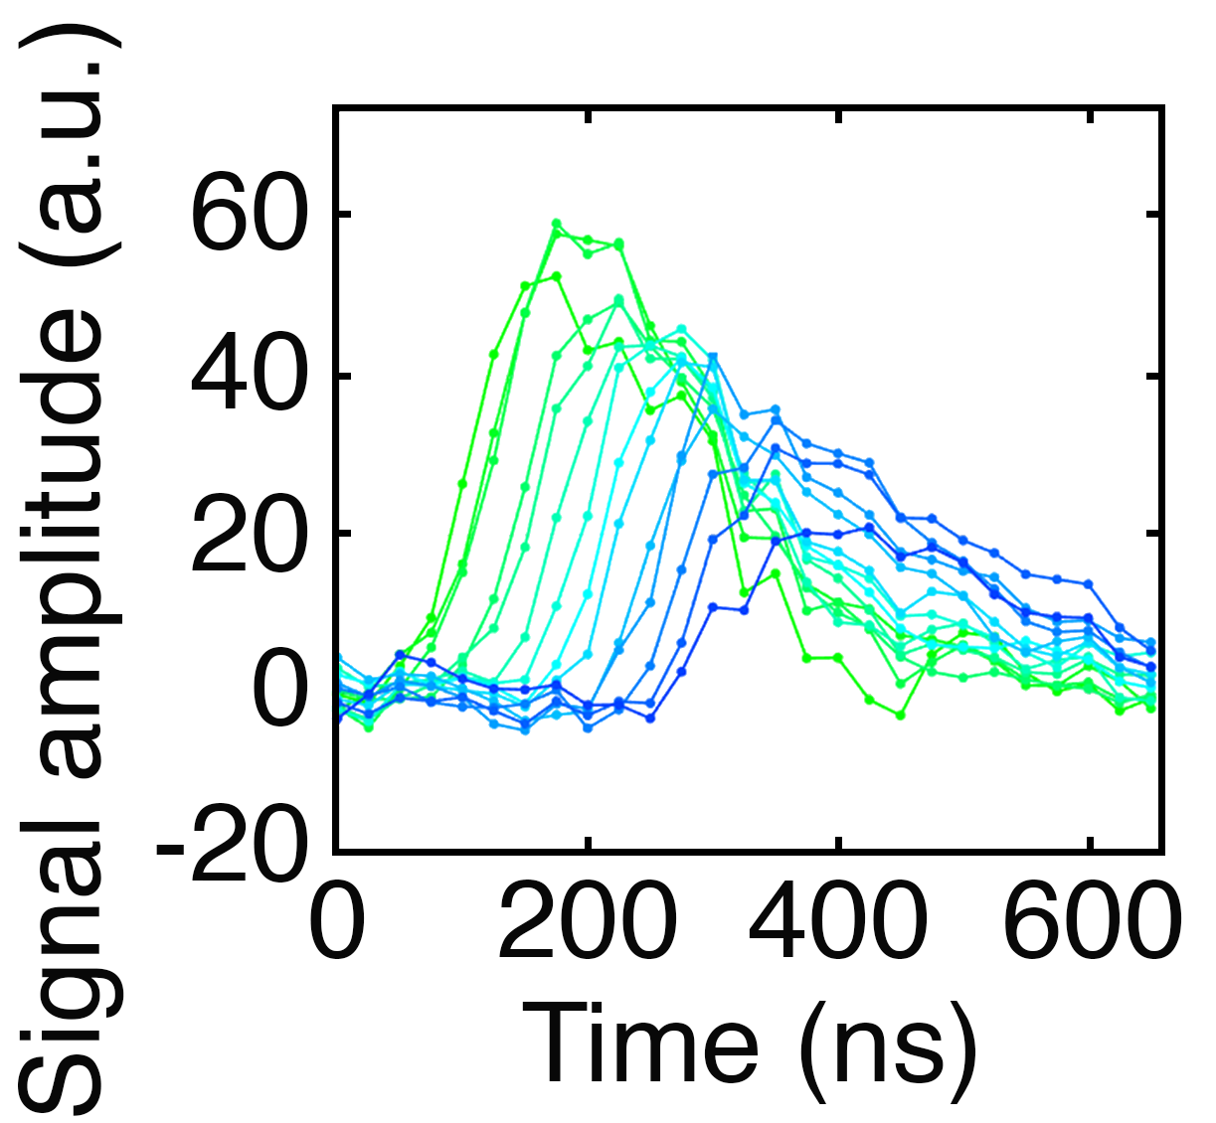
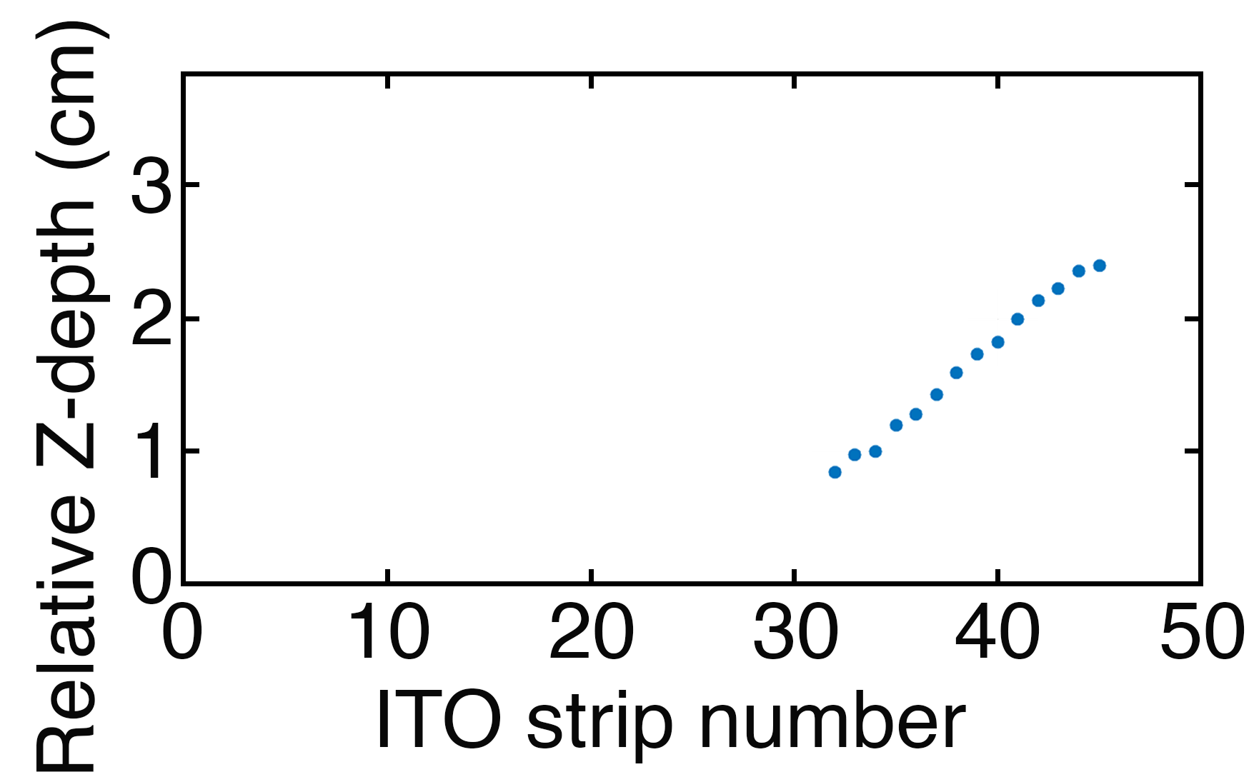
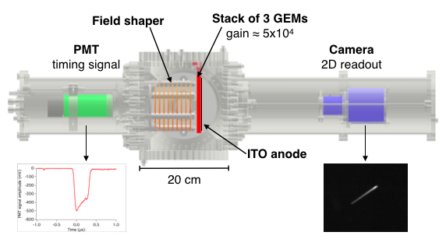
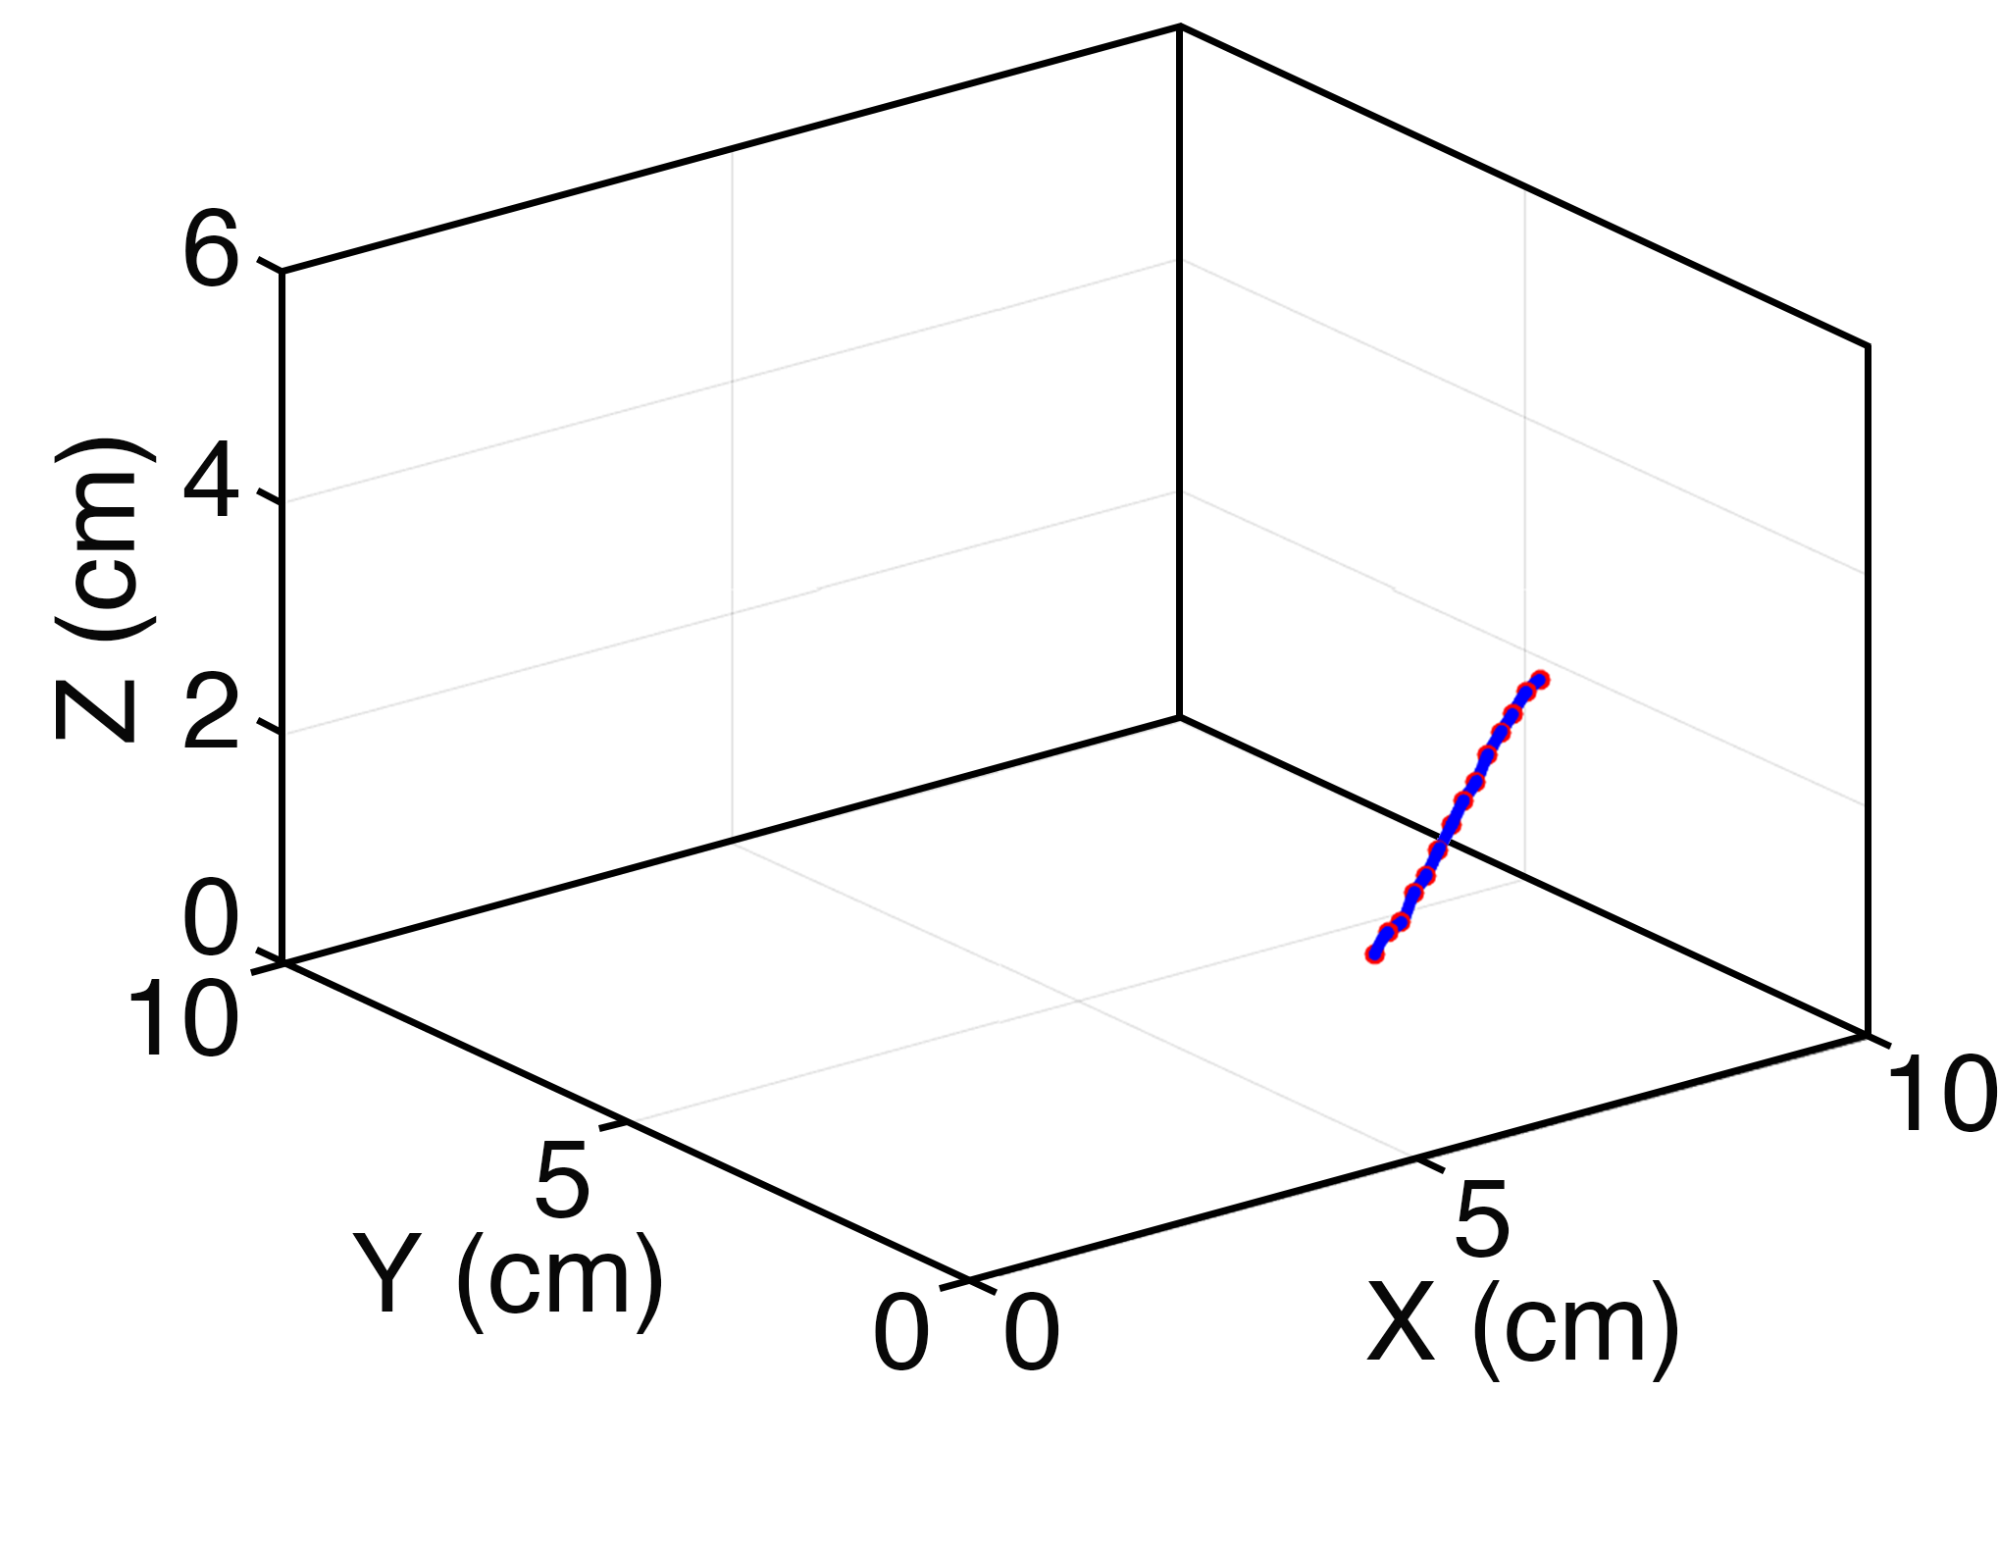
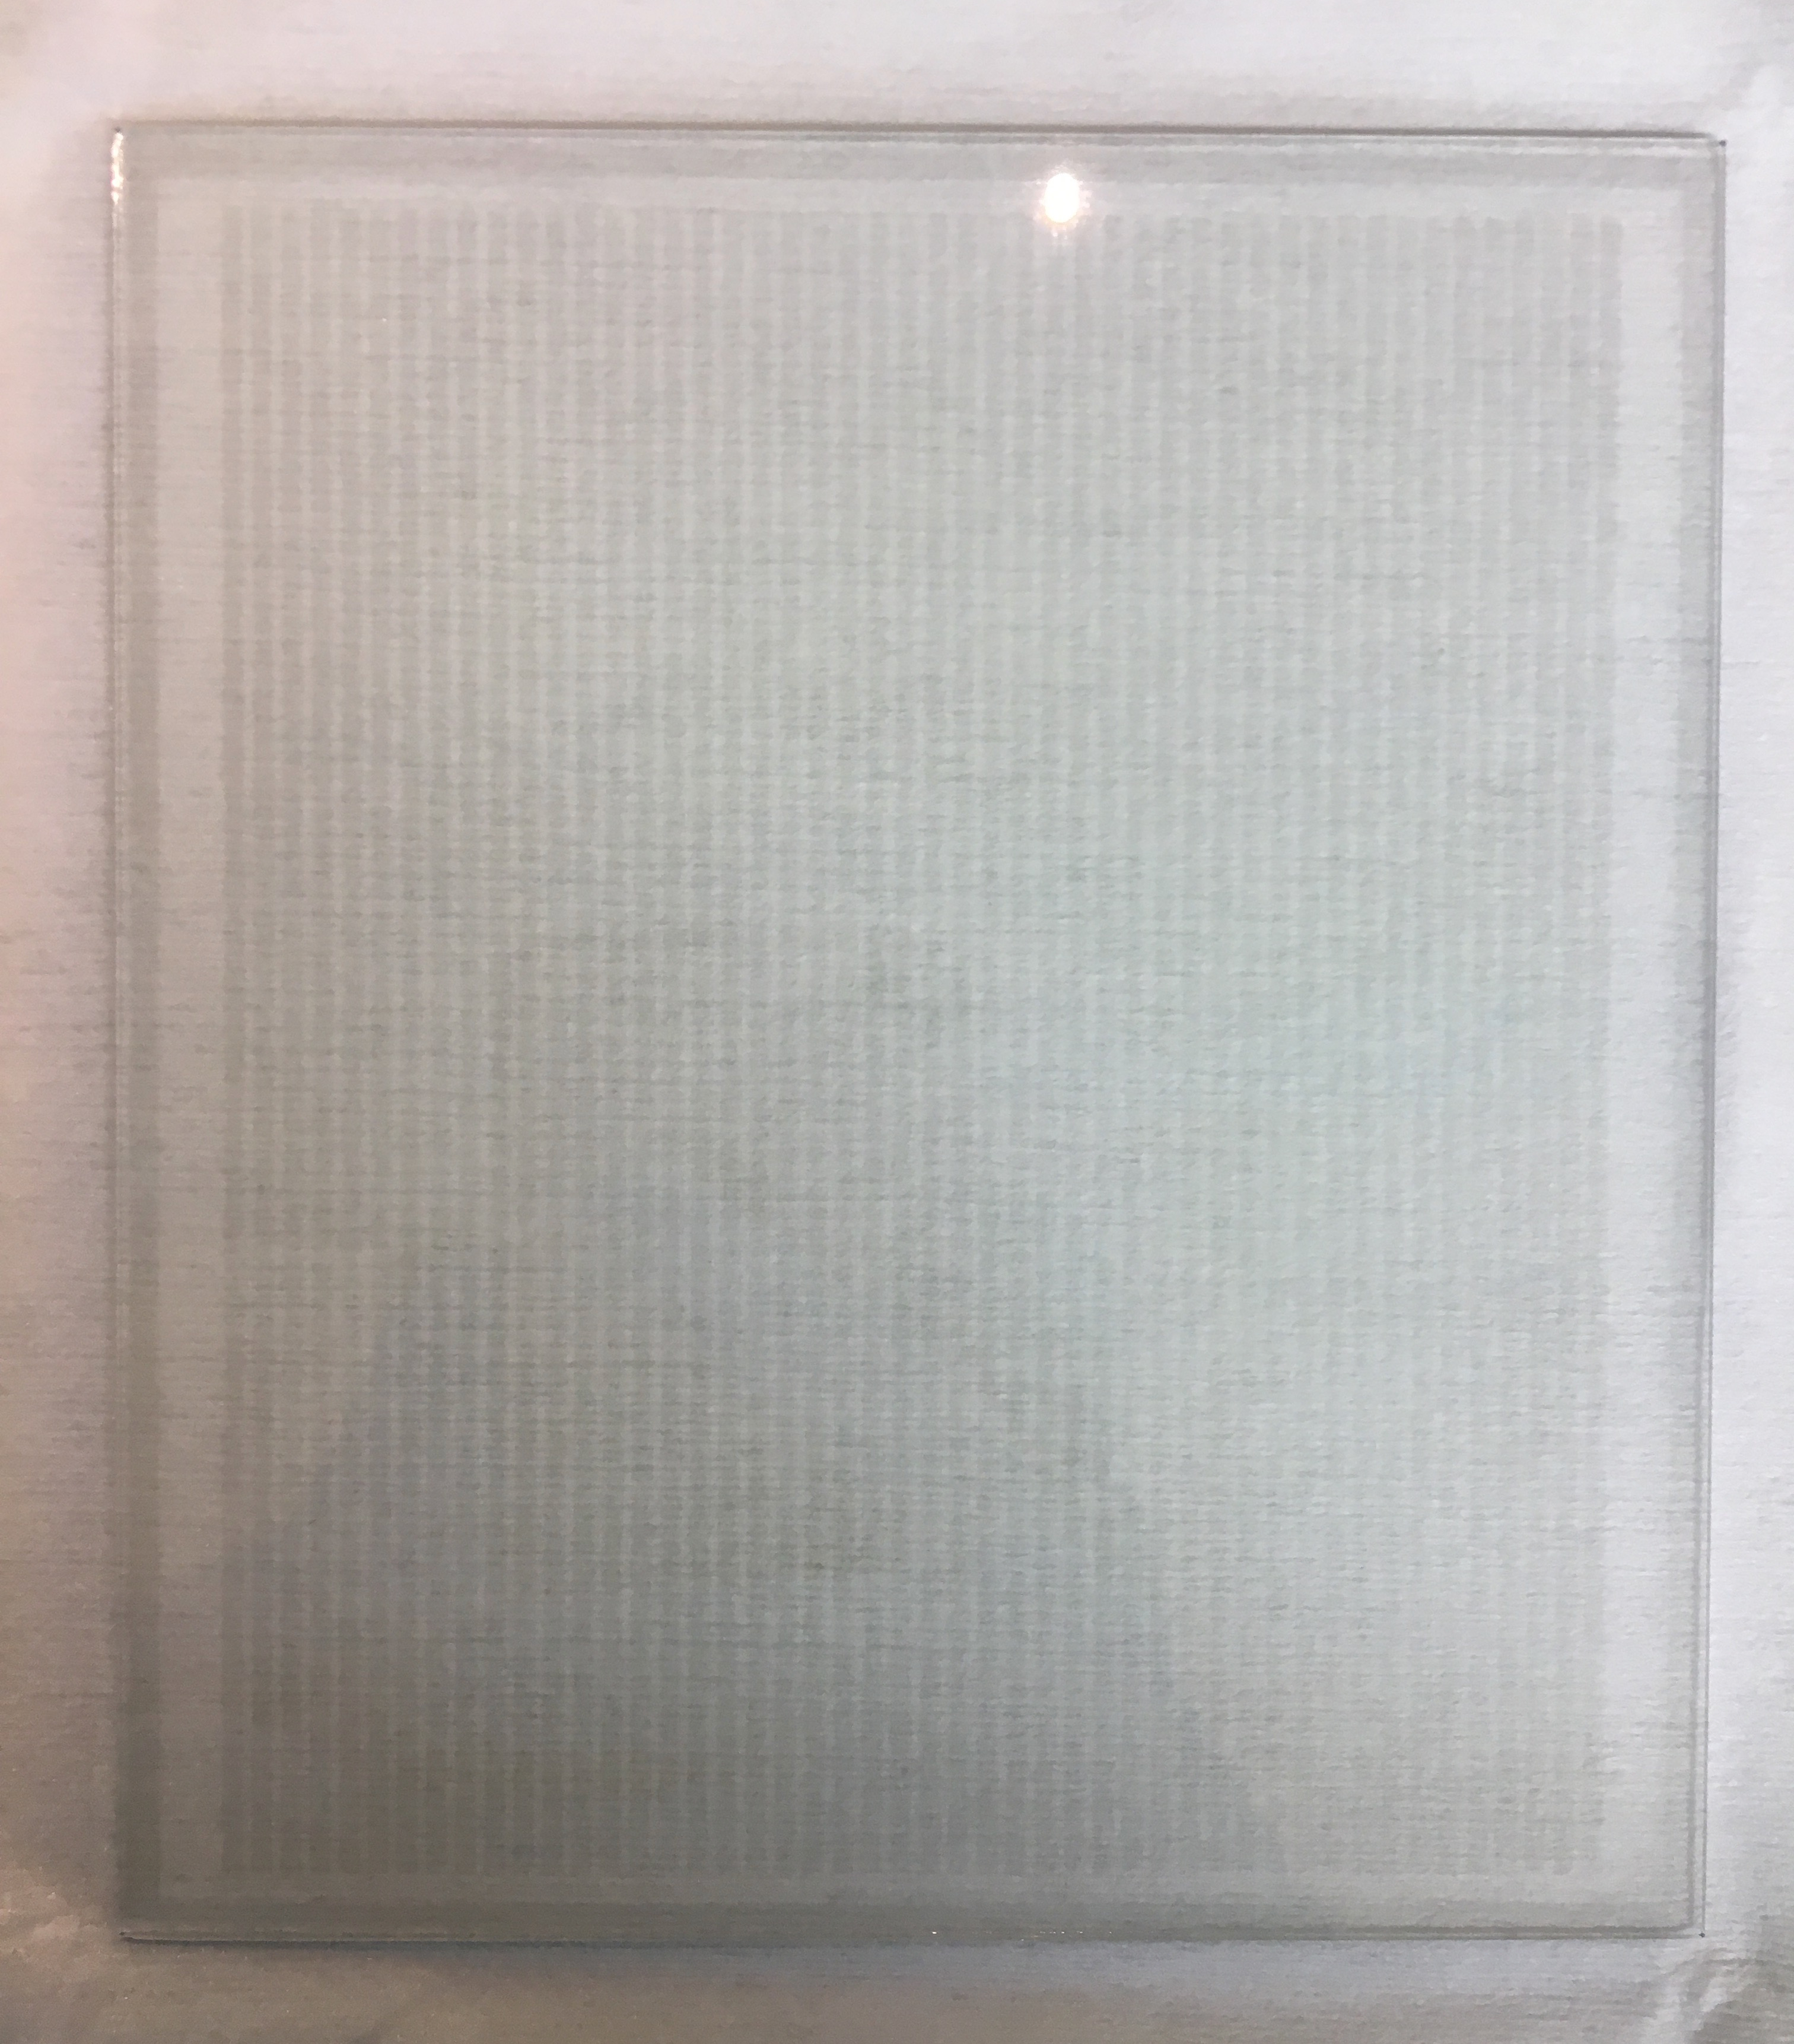
Combined Optical and Electronic Readout for Event Reconstruction in a GEM-based TPC
Authors: F. M. Brunbauer, F. García, M. Lupberger, E. Oliveri, D. Pfeiffer, L. Ropelewski, P. Thuiner, and M. van Stenis¹
Presented by
F. M. Brunbauer
Depth information from electron arrival times
Optically read out 2D projection
Optically transparent ITO strip anode permits simultaneous readout of electronic signals and secondary scintillation light.
ITO can be structured with photolithography and etching in HCl.
Combined optical and electronic readout extends 3D reconstruction capabilities to complex track geometries.
10x10 cm² active area

