Slide 1
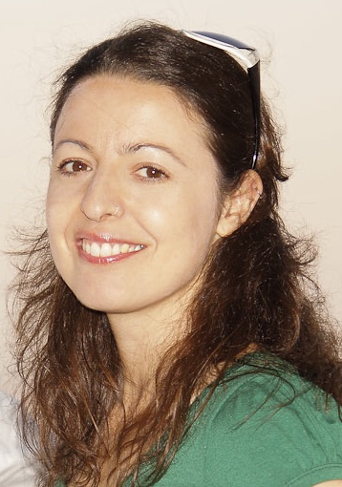
Recent achievements in Life Sciences of the TwinMic soft spectromicroscopy beamline at Elettra
A. Gianoncelli¹, M. Altissimo¹, D.E. Bedolla¹, G. Kourousias¹
¹Elettra, Sincrotrone Trieste, Strada Statale 149, 34149 Basovizza, Trieste, Italy
Synchrotron facilities provide the scientific community with an incredible the variety of techniques, thanks to the properties of the X-ray source and the variety of detectors available
Simultaneous soft X-ray transmission and emission microscopy, as available at TwinMic beamline (Elettra Sincrotrone Trieste) [1] can be a suited complementary tool especially for life science applications: it provides simultaneous morphological and chemical information
X-ray spectro-microscopy has proven to be a valuable tool for exploring morphologically complex matter, including bio-systems at cellular and sub-cellular level
Correlative research is essential (FTIR, PIXE, EM, lab-related bulk analysis & others)
[1] A. Gianoncelli et al., Synchrotron Radiation, vol. 23, 2016

