Slide 1
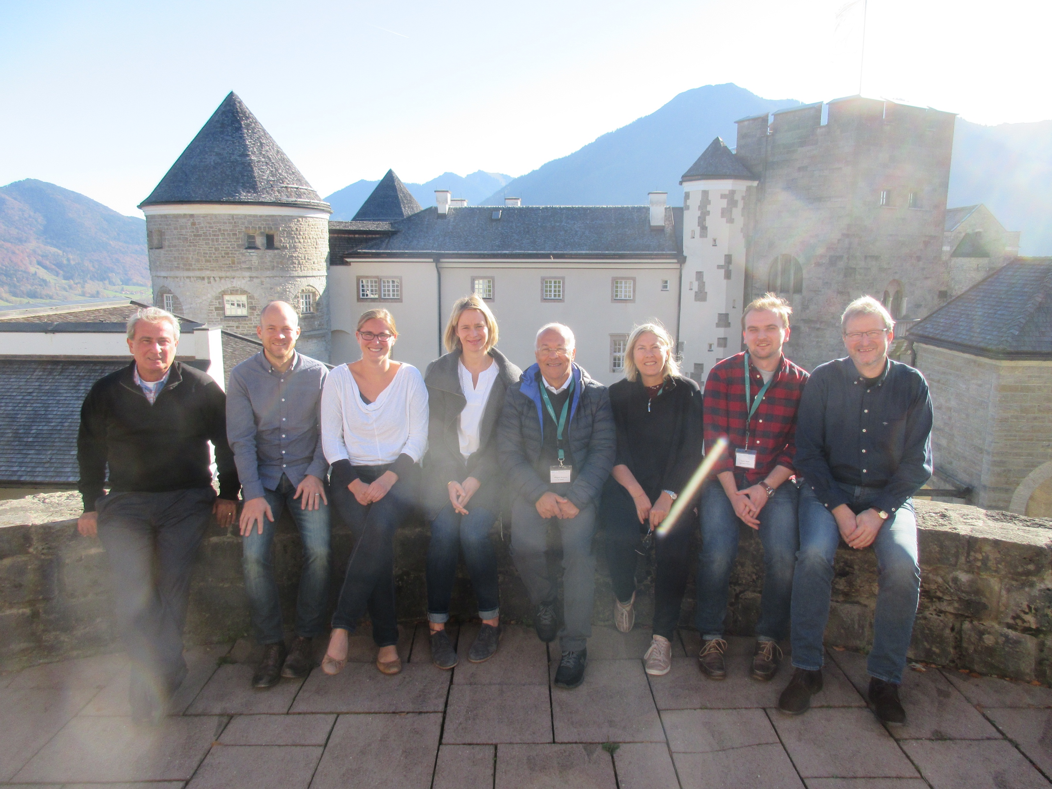
SENSE - low light level sensor development
SENSE is a project funded by the EC under FET Open Coordination and Support Action (CSA)
aims at coordinating, monitoring, and evaluating the R&D efforts of research groups and industry in advancing low light level (LLL) sensors
Consortium:
HAUNGS, Andreas (Karlsruhe Institute of Technology - KIT)
HENJES-KUNST, Katharina (DESY)
LINK, Katrin (KIT)
MIRZOYAN, Razmik (Max-Planck-Institute for Physics)
MONTARULI, Teresa (UNIGE)
NAGAI, Andrii (UNIGE)
STROM, Derek (Max Planck Institute for Physics)

