Slide 1
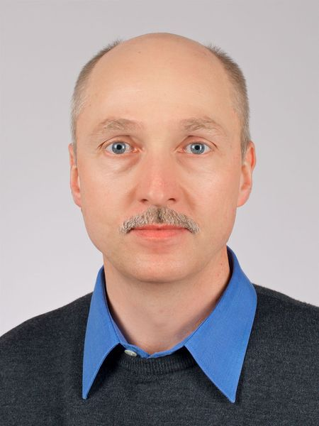
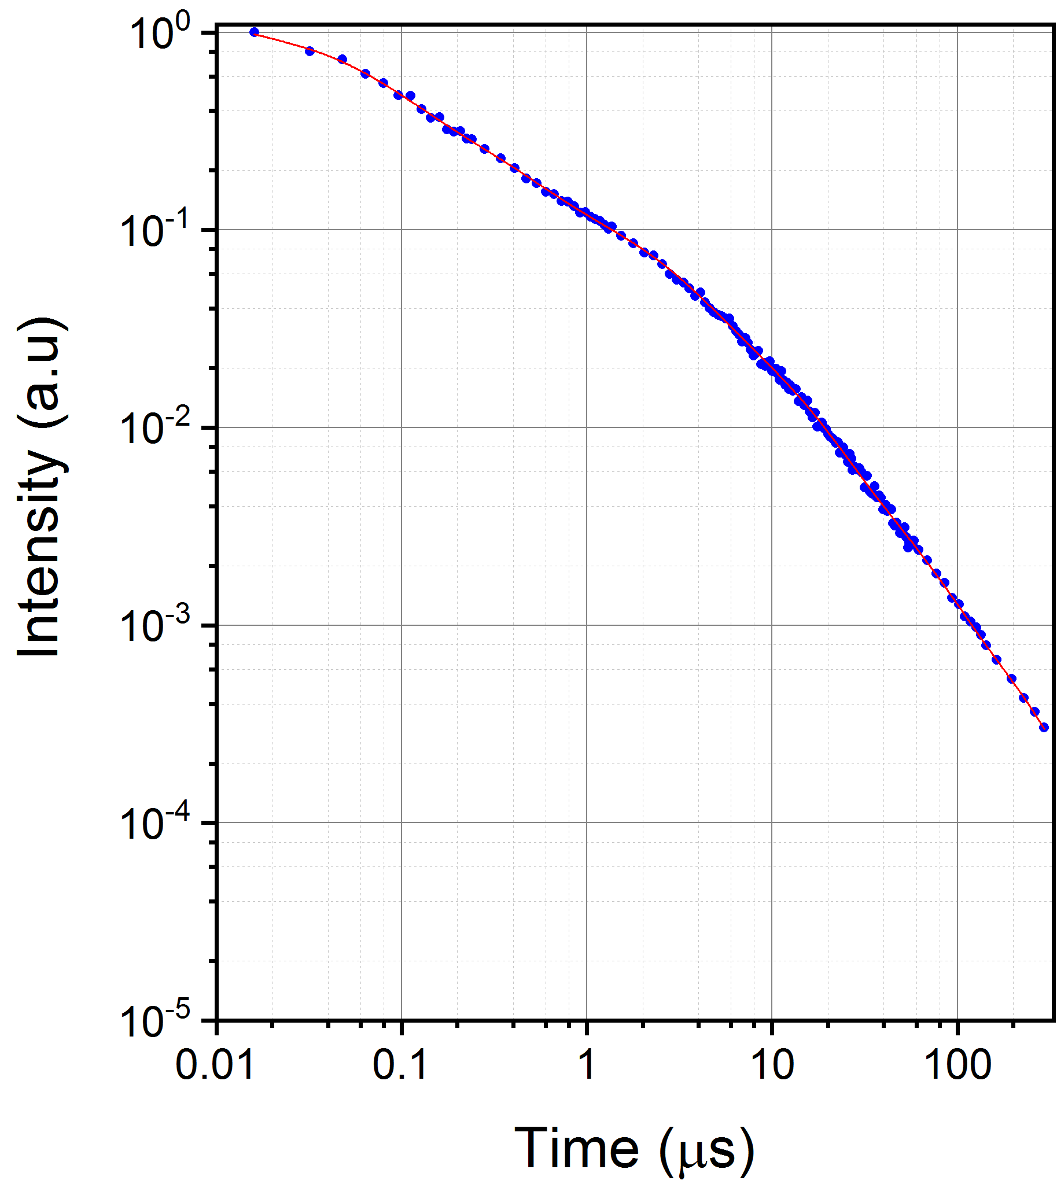
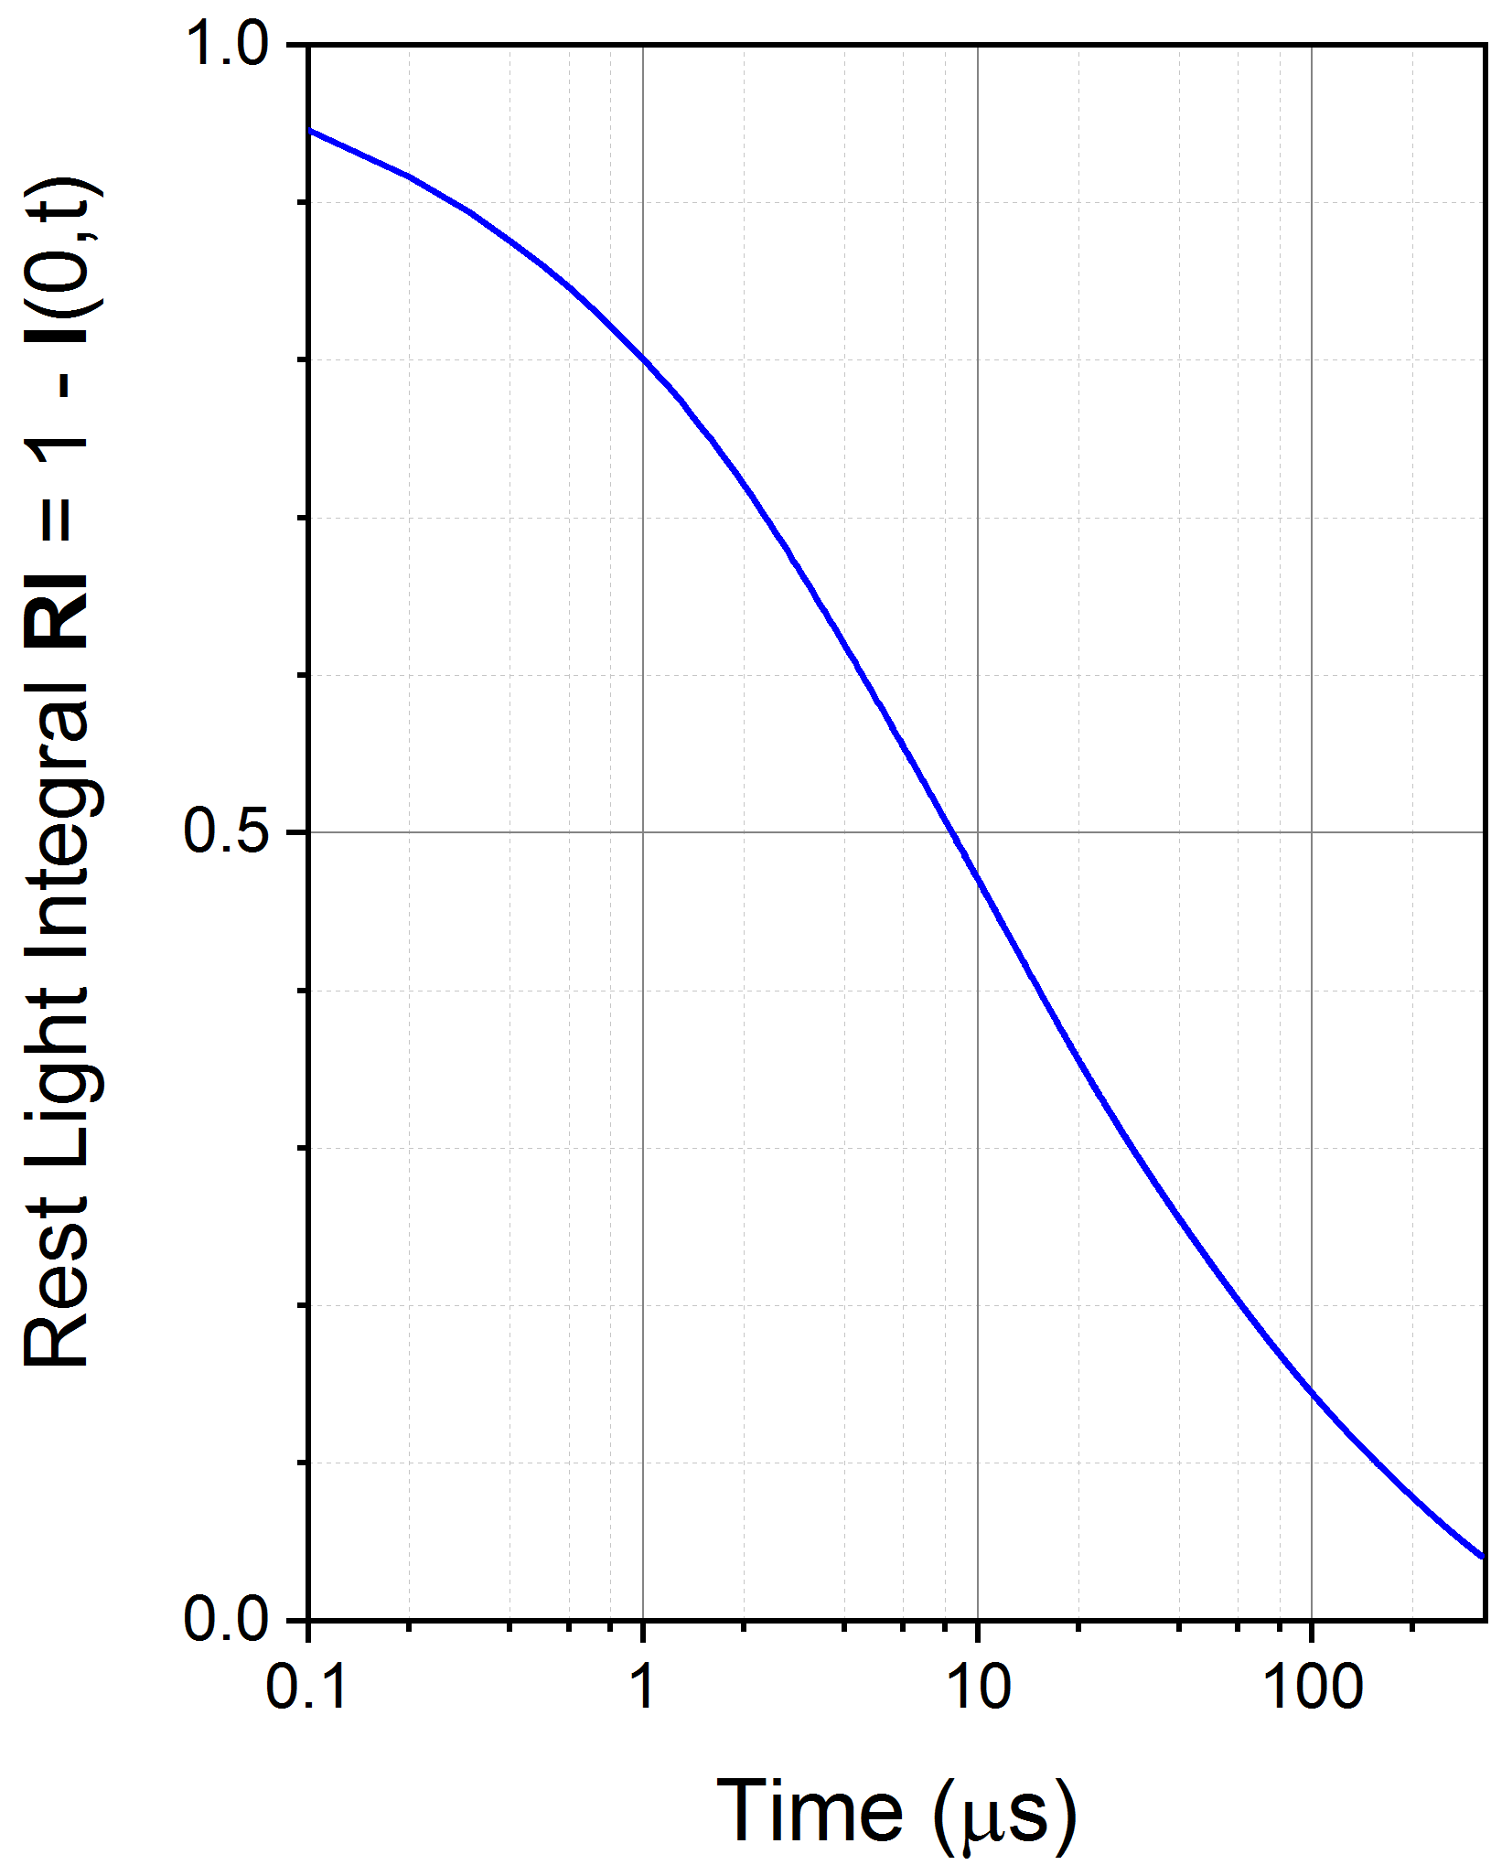
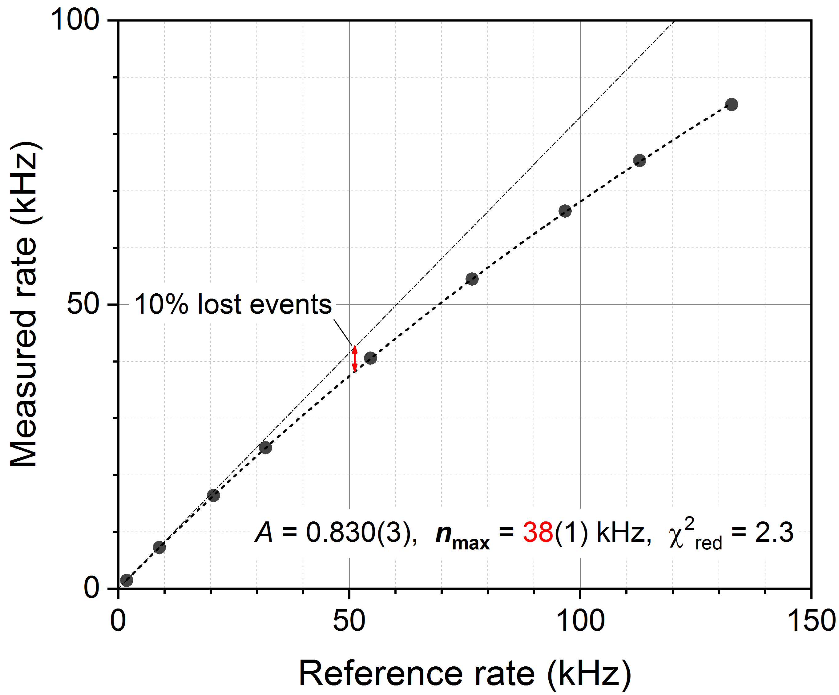
Evaluation of a ZnS:⁶LiF based scintillation neutron detector at high counting rates
A. Stoykov, J.-B. Mosset, M. Hildebrandt
Paul Scherrer Institut PSI, Villigen, Switzerland
▪ ZnS:⁶LiF scintillator has long afterglow of up to ~100 μs
→ common opinion: count rate capability strongly limited
▪ nevertheless: using optimised detection unit and dedicated signal processing
system allows count rates up to ~40kHz (@ 10% event loss and ~80% ε_{trigger})
poster presenter:
M. Hildebrandt
Light decay of ZnS(Ag):⁶LiF in response to thermal neutrons
rate capability of thermal neutron detection unit

