Slide 1
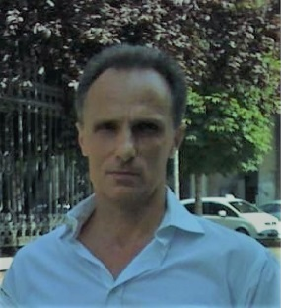
Radiation and Thermal Stress Tests on Diamond Detectors for the Radial Neutron Camera of ITER*
F. Pompili¹, B. Esposito¹, D. Marocco¹, S. Podda¹, M. Riva¹, S.Baccaro², A.Cemmi², I. Di Sarcina², L.Quintieri², D. Bocian³, K. Drozdowicz³, M. Curylo³, J. Dankowski³, J. Kotula³, W. Maciocha³, T. Nowak³, J. Swierblewsk³, V.Ludo⁴, W.Leysen⁴
¹ENEA C. R. Frascati, Department for Fusion and Nuclear Safety Technologies, via E. Fermi, 45 Frascati, Italy.
²ENEA C.R. Casaccia, Department for Fusion and Nuclear Safety Technologies, via Anguillarese, 301, Roma, Italy.
³Institute of Nuclear Physics Polish Academy of Sciences, Kraków, Poland.
⁴SCK•CEN Belgian Nuclear Research Centre, Boeretang 200 - BE-2400 Mol.
Presented by Fulvio Pompili
Single crystal Diamond (sCD) detectors are very interesting and promising devices to be used as neutron flux monitors in high power fusion experiments, thanks to their capability to operate in harsh environments characterized by high levels of radiation, temperature, and magnetic field. Their high energy resolution, low gamma sensitivity and compact size make them as almost ideal candidates for compact neutron spectrometers like the ITER Radial Neutron Camera.
Commercial diamond detectors have never been tested at the levels of temperature and radiation (neutron and gamma) foreseen in ITER; therefore, the innovative contribution of this work is to provide new information on the behaviour of diamond detectors in extreme conditions.
* International Thermonuclear Experimental Reactor

