Slide 1
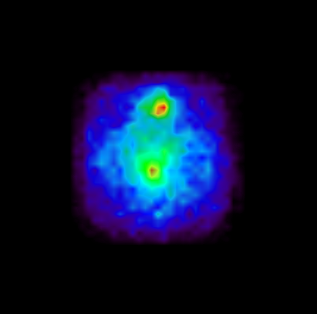
Evaluation of LFS continuous scintillation crystals for PET
Authors: A. Ros, L. Barrientos, J. Barrio, J. Bernabéu, M. Borja-Lloret, A. Etxebeste, L. Gabarda, C. Lacasta, E. Muñoz, J. F. Oliver, J. Roser,
C. Solaz and G. Llosá
Summary: A study to determine the feasibility of using LFS scintillation crystals for PET found that LFS is a valid substitute for LYSO.
Crystal types characterisation
²²Na position reconstruction
Position estimation ²²Na source
Three crystal types has been tested:
• LYSO white coating
• LFS white coating (LFS-W)
• LFS specular coating (LFS-S).
LFS-S VS1
LFS-S VS1
SiPM
transverse
SiPM

