Slide 1
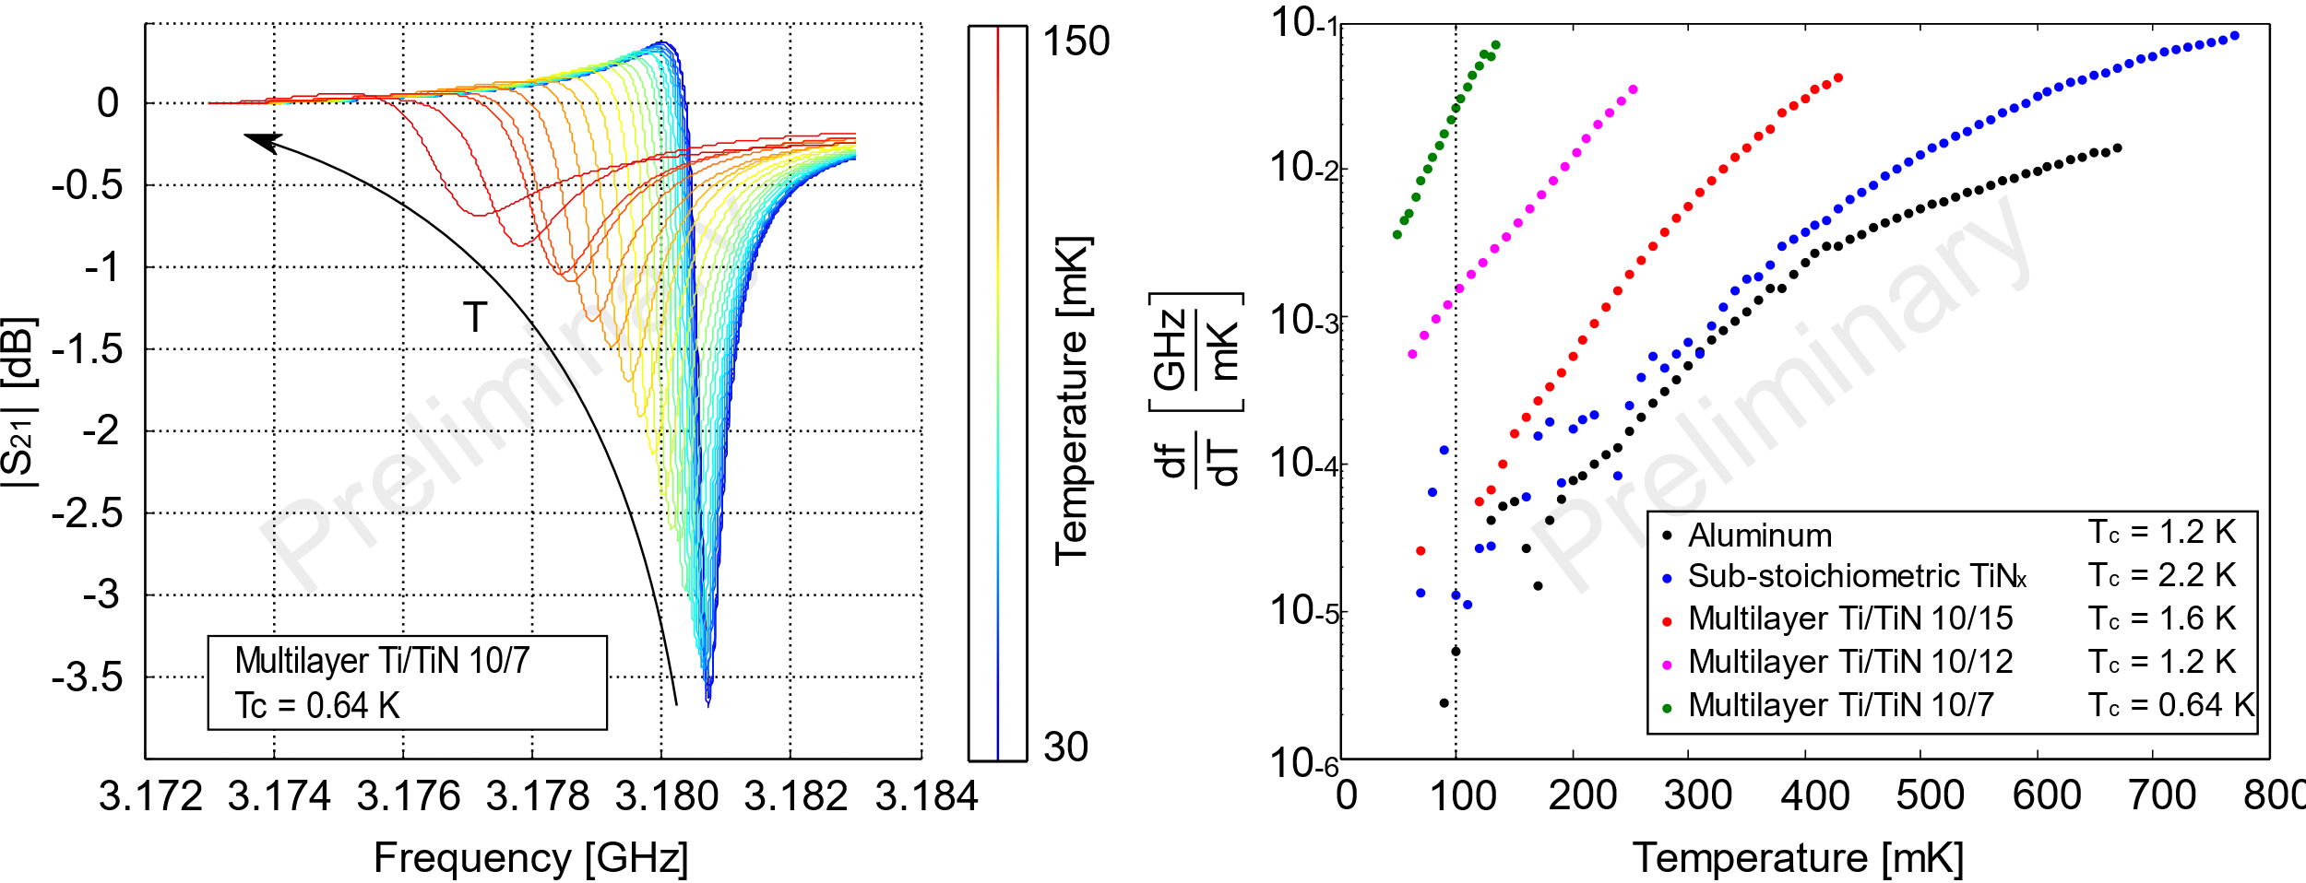
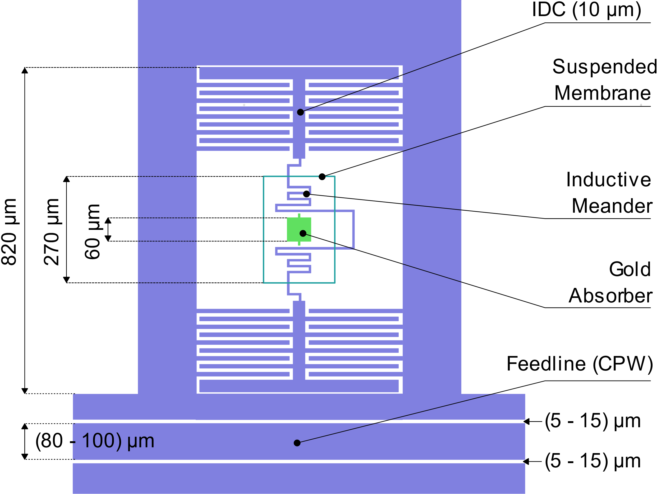
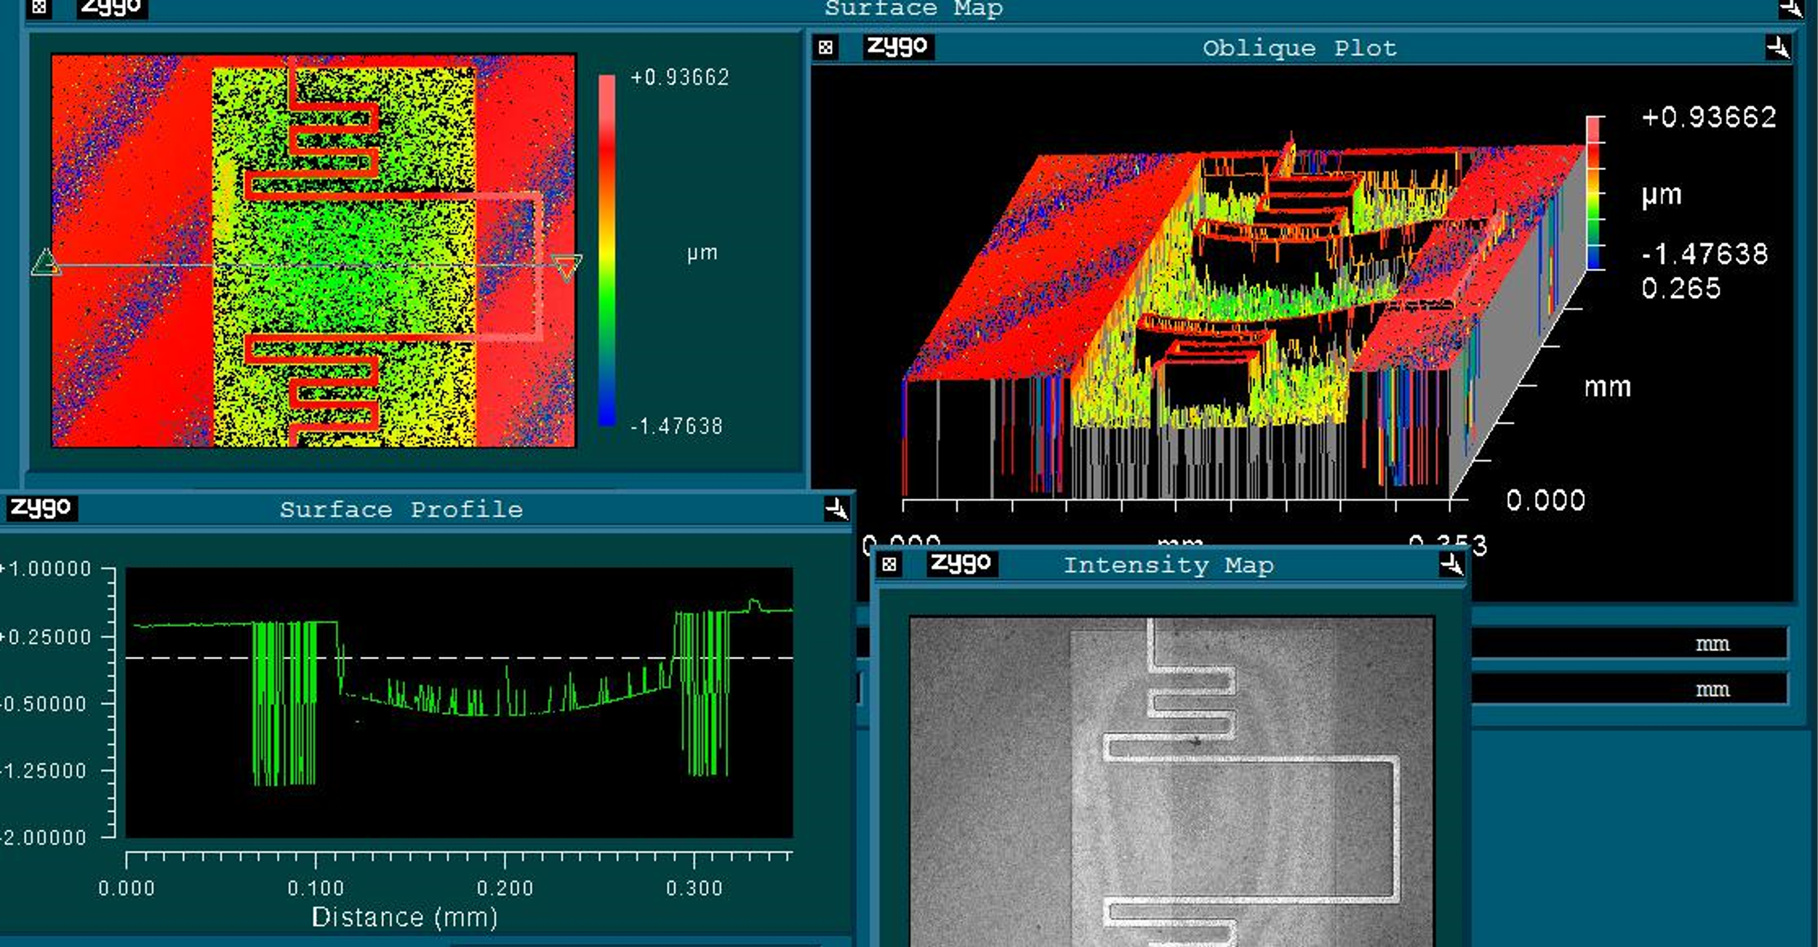
Thermal kinetic inductance detectors for soft X-ray spectroscopy
M. Faverzani
Aim: combine mutiplexability of microwave kinetic inductance detectors (MKIDs) with the high sensitivity of quasi-thermal equilibrium low temperature detectors
operate the resonators in their temperature-sensitive region to use them as sensitive thermometers of an absorbing material
First prototypes have been produced and are in the testing phase

