Slide 1
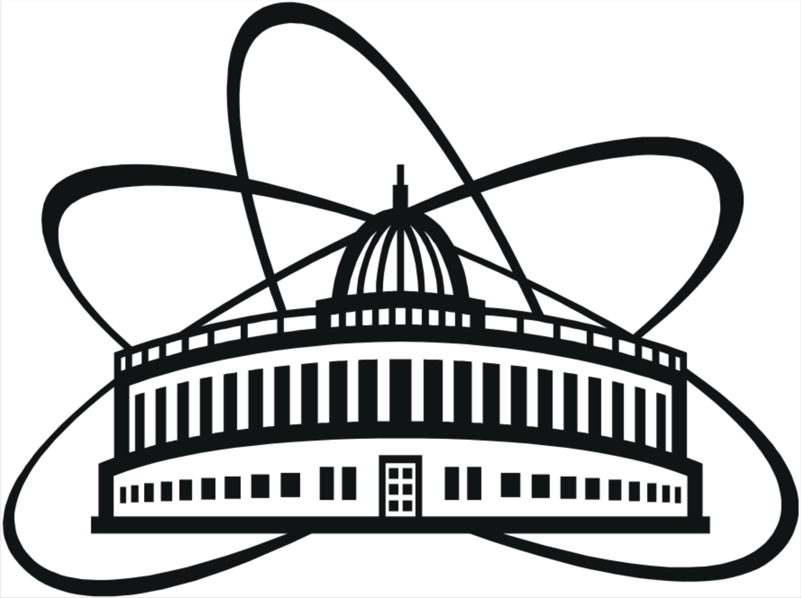
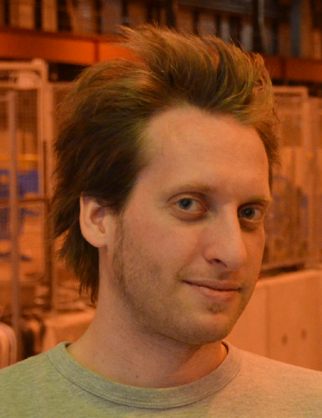
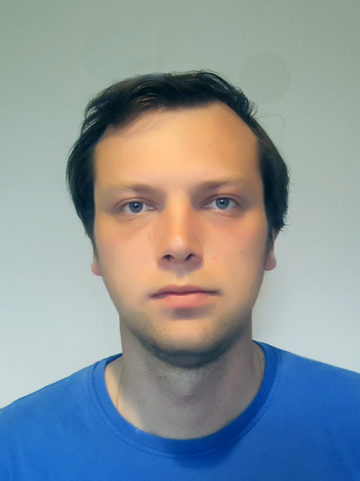
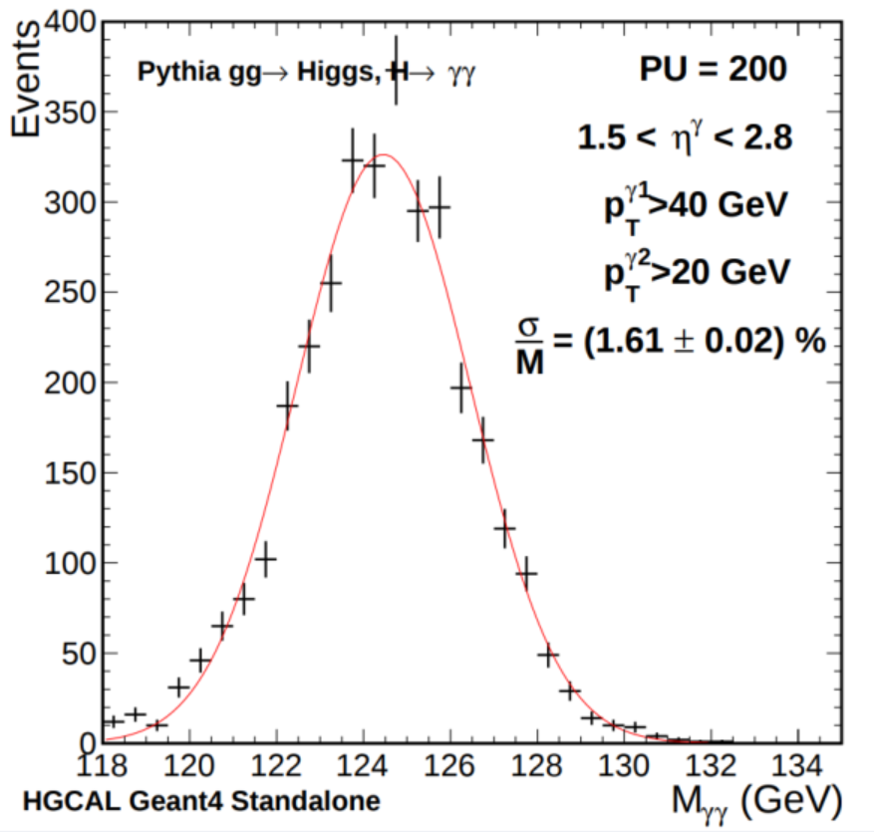
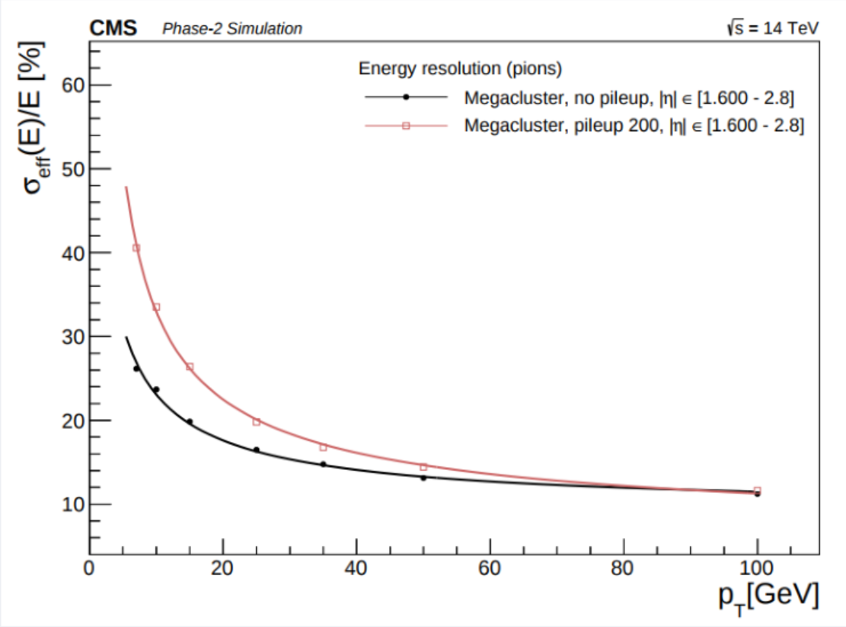
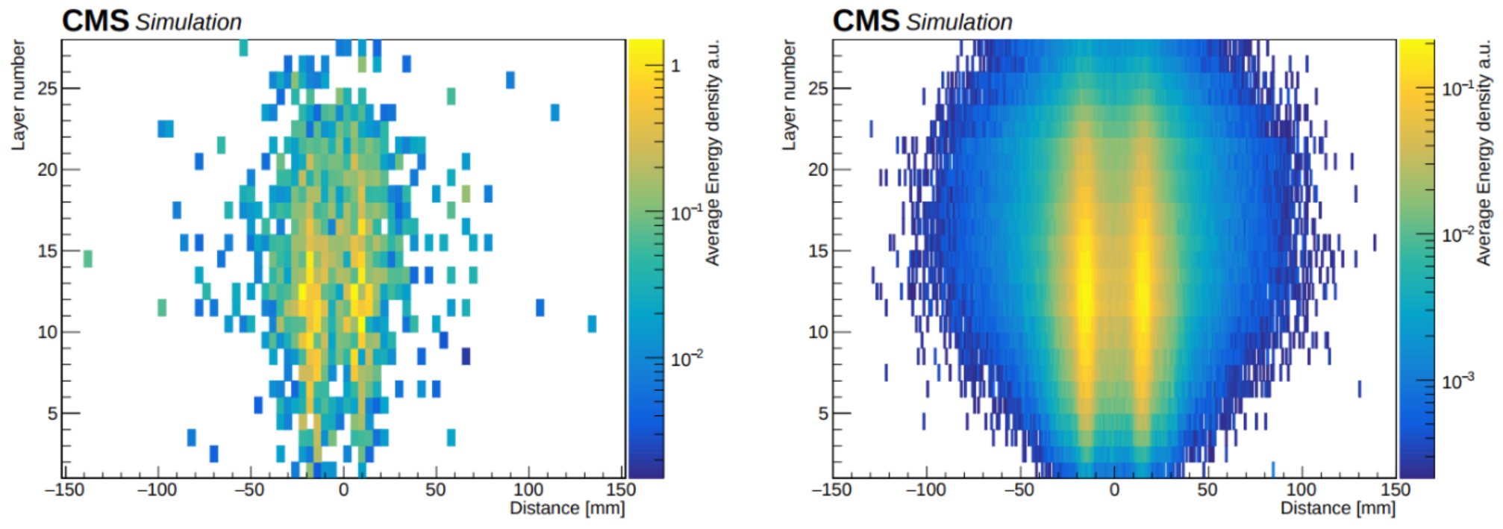
Detector performance studies for the CMS High Granularity Calorimeter
The existing CMS endcap calorimeters (E and H) will be replaced by the sampling “High Granularity Calorimeter” (HGCAL), which features unprecedented transverse and longitudinal granularity.
This will facilitate particle-flow reconstruction in the harsh radiation and pileup environment of High-Luminosity-LHC collisions.
Exploiting the high granularity in this environment requires advances in reconstruction techniques beyond those that have been used in present experiments and particle-flow detectors being designed for future linear colliders.
This work will continue throughout the design/construction phase, but many studies have already made excellent progress. We report on the reconstruction and clustering algorithms, and the simulated performance for particle identification and energy/position resolution.
← Manfred Valentan
on behalf of
Ilya Gorbunov →
Pion energy resolution
Photon separation
Higgs mass
reconstruction

