Slide 1

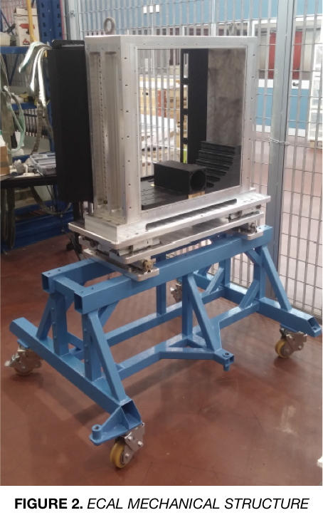
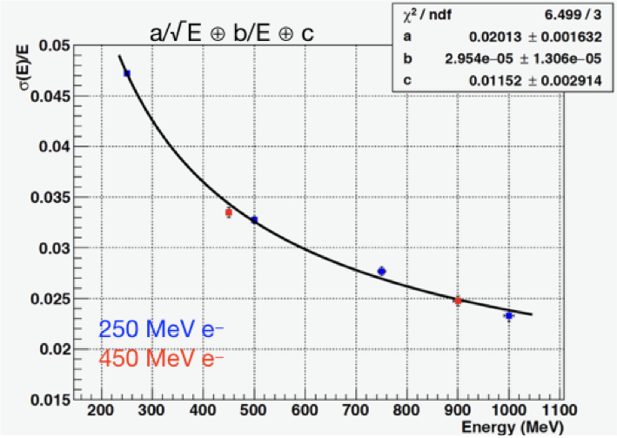
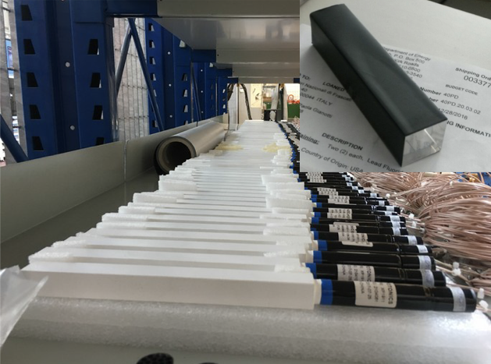

The calorimeters of the PADME experiment
Summary
The PADME experiment [1] will be held at Laboratori Nazionali di Frascati (LNF) of INFN to explore the coupling between ordinary and dark matter (DM). This will be done by detecting the Standard Model (SM) photons produced in the reaction e+e− →γA’ [2]. The measurement of the 4-momentum of the SM photon allows to reconstruct the missing mass spectrum of the process, where the dark photon A' could appear as a peak. Positrons accelerated by the LNF's LINAC at 550 MeV collide with a diamond target, possibly producing γ and A', with M_{A'} ≤ 23.7 MeV. The Electromagnetic Calorimeter (ECAL), made of 616 21×21×230 mm³ BGO crystals, is devoted to the γ detection and measurement. The scintillating units composing ECAL are arranged in a cylindrical structure with a central hole. This allows the passage of Bremsstrahlung photons, that otherwise would over-trigger the calorimeter. These photons are then detected by a faster calorimeter (time resolution ~ 90 ps), the Small Angle Calorimeter (SAC), made of 25 30×30×140 mm³ PbF₂ crystals. The two calorimeters are presently under construction. In this work are presented the results obtained with prototypes tested during test beams performed at the Beam Test Facility (BTF) of LNF to evaluate the performance of the calorimeter's units.
References
[1] M. Raggi e V. Kozhuharov, Adv. High Energy Phys. 2014 (2014) 959802.
[2] B. Holdom., Phys. Lett. B 166 (1986) 196.
[3] M. Raggi et al., Nucl. Instrum. Meth. A 862 (2017) 31.

