Slide 1
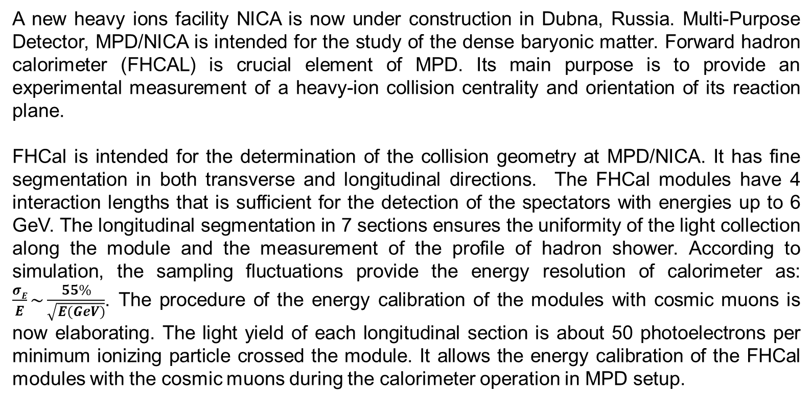
Forward Hadron Calorimeter (FHCal) at MPD/NICA
A.Timoshenko, D.Finogeev, M.Golubeva, F.Guber, A.Ivashkin, A.Izvestny, S.Morozov and O.Petukhov
A new heavy ions facility NICA is now under construction in Dubna, Russia. Multi-Purpose Detector, MPD/NICA is intended for the study of the dense baryonic matter. Forward hadron calorimeter (FHCAL) is crucial element of MPD. Its main purpose is to provide an experimental measurement of a heavy-ion collision centrality and orientation of its reaction plane.
FHCal is intended for the determination of the collision geometry at MPD/NICA. It has fine segmentation in both transverse and longitudinal directions. The FHCal modules have 4 interaction lengths that is sufficient for the detection of the spectators with energies up to 6 GeV. The longitudinal segmentation in 7 sections ensures the uniformity of the light collection along the module and the measurement of the profile of hadron shower. According to simulation, the sampling fluctuations provide the energy resolution of calorimeter as: $\frac{σE}{E}\sim \frac{55\%}{\sqrt{E(GeV)}}$. The procedure of the energy calibration of the modules with cosmic muons is now elaborating. The light yield of each longitudinal section is about 50 photoelectrons per minimum ionizing particle crossed the module. It allows the energy calibration of the FHCal modules with the cosmic muons during the calorimeter operation in MPD setup.

