Slide 1
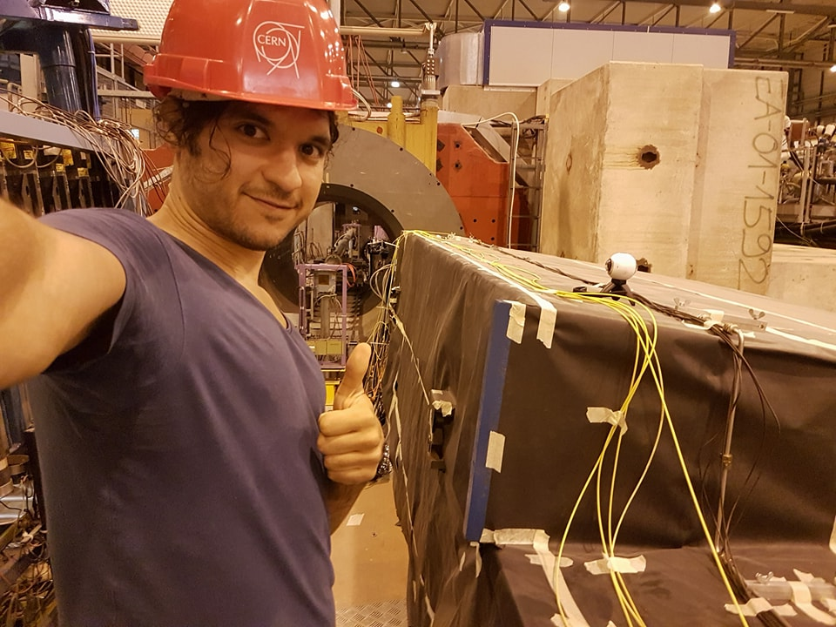
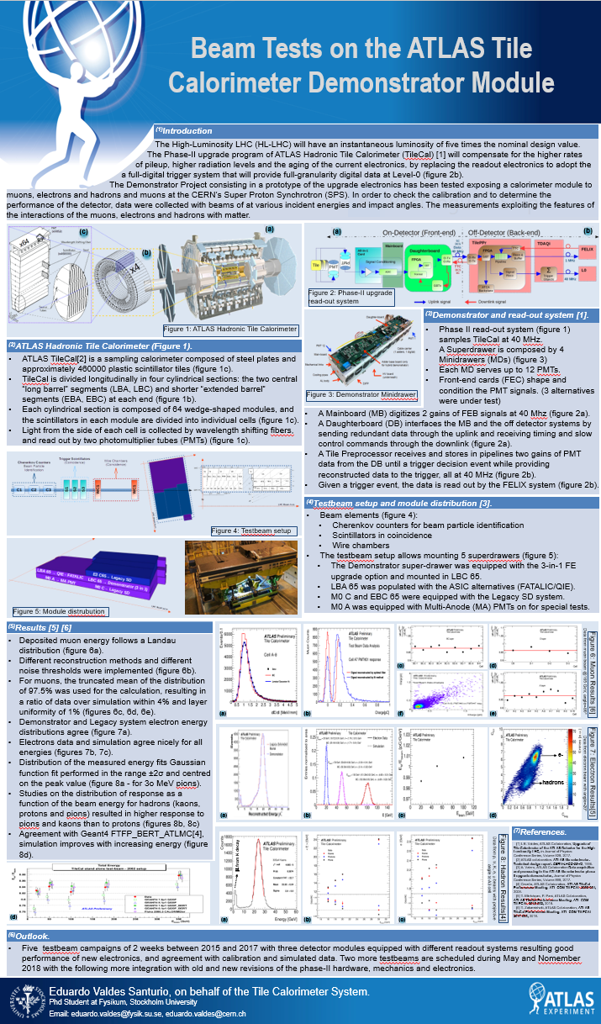
!
Heading the HL-LHC, the Phase-II
upgrade program of the Hadronic
ATLAS Tile Calorimeter (TileCal) aims to
compensate for the higher rates of pileup, higher radiation levels and the aging of the current electronics, by replacing the readout electronics to adopt a full-digital trigger where full-granularity digital data will be delivered to the off-detectors systems at 40 MHz. As part of the Demonstrator project, prototype of the new electronics has been tested at CERN SPS.
We present:
A brief description of TileCal Phase-II upgrade read out system within the Demonstrator project framework.
A description of the testbeam setup and module distribution for testing the new electronics.
The current status and results where the new electronics were situated in calorimeter modules and exposed to beams of muons, electrons and hadrons with different energies and impact angles.

