Slide 1
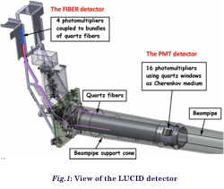
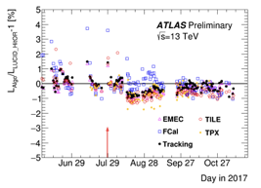
The LUCID-2 Detector
Upgrade of main ATLAS luminosity monitor, targeted for LHC run II and III (25 ns bunch spacing, large pileup):
Use quartz fibers + quartz window of PMTs as Cherenkov radiator
Custom electronics for early signal digitalization, discrimination and integration
PMT gain calibration based on ²⁰⁷Bi sources placed on the PMT window (~1 MeV electrons from internal conversion)
Response stability over wide pileup range and time by comparing different algorithms and detectors → precision on integrated luminosity measurement better than 2.5%

