Slide 1
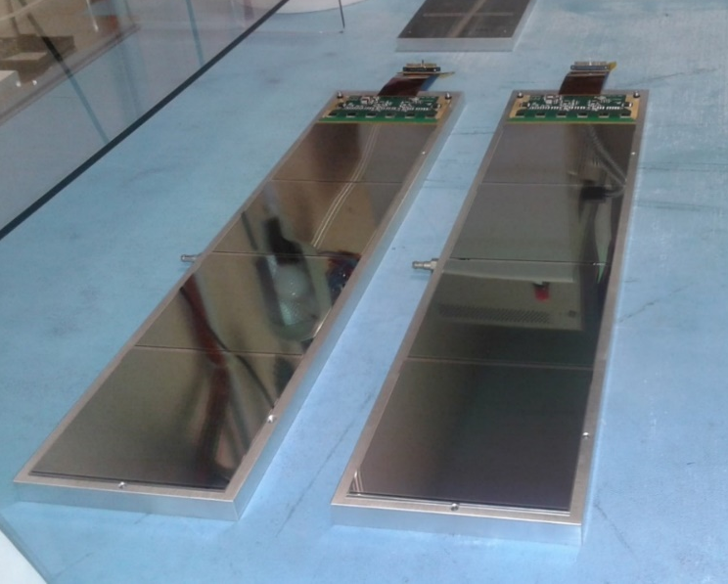
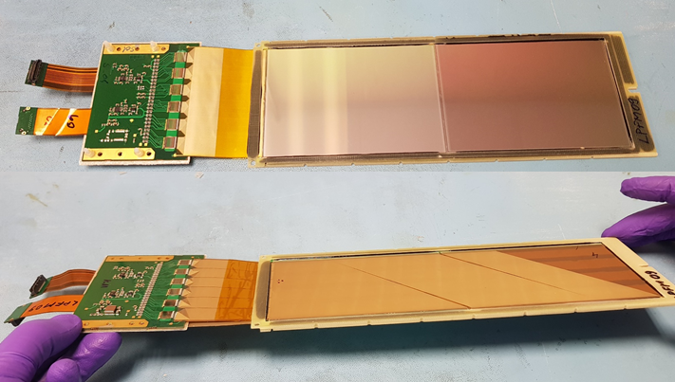
Technological Experience in the Construction of Silicon Trackers Detectors for Space Experiments
Maria Movileanu-Ionica
INFN Sezione di Perugia, Via A.Pascoli, 06100 Perugia, Italy
The Silicon Trackers for DAMPE and CSES/LIMADOU experiments have been designed and built following the very stringent requirements typically to the space experiments such as: resistance to the mechanical stress during launch (vibrations and shocks), thermo-mechanical stability in a large temperature range, low power consumption, low weight, traceability of the quality of the components through documentations on design, tests, assembly, and integration, reliability under space conditions.
DAMPE single side silicon detectors
For each experiment the Thermo-Mechanical Model, Engineering Qualification Model and Flight Model have been built and completely tested in conformity with the requests from the space environmental conditions.
In the present work are presented the technological choices for the construction and test of the DAMPE and, respectively CSES/LIMADOU silicon tracker and the assembly quality results. The space qualification tests done on both trackers are presented and some Quality Assurance issues followed for both trackers assembly are mentioned.
LIMADOU double side silicon detectors

