Slide 1
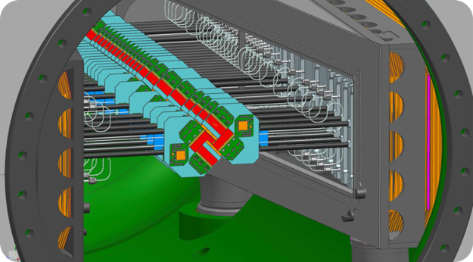
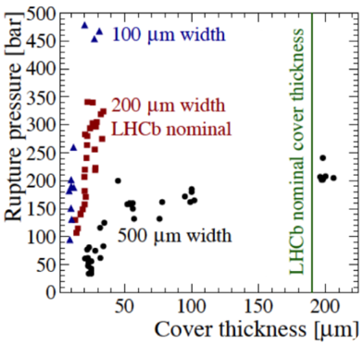
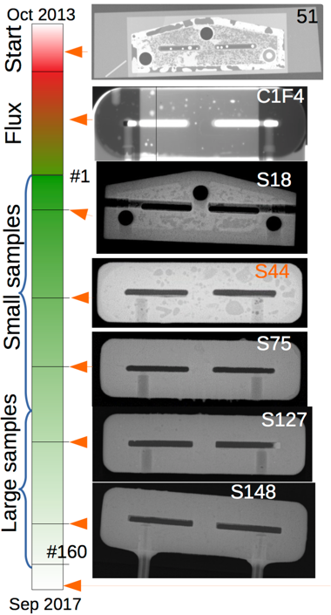
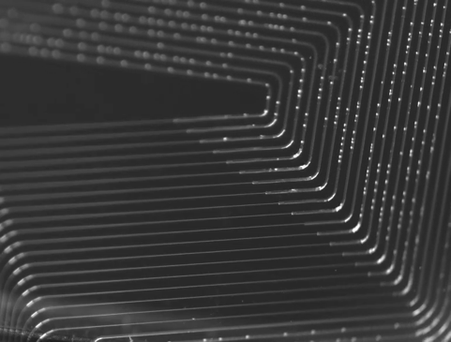
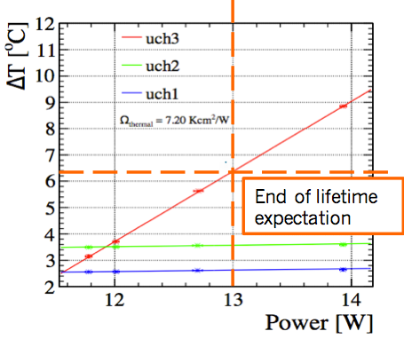
R&D on CO2 Cooling using a Silicon Microchannel Substrate for the LHCb VELO Upgrade
Reliability Tests
Fluxless Solder Technique
CO2 Bubbles!
Vinícius Franco Lima
On Behalf of the LHCb VELO Upgrade

