Slide 1
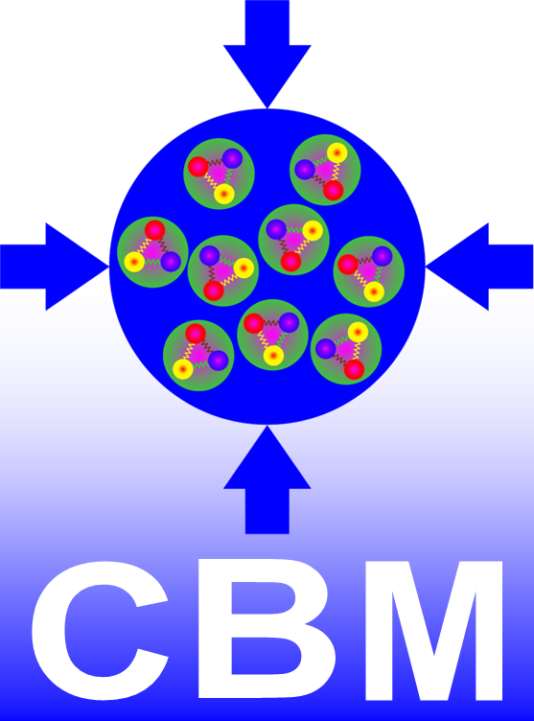
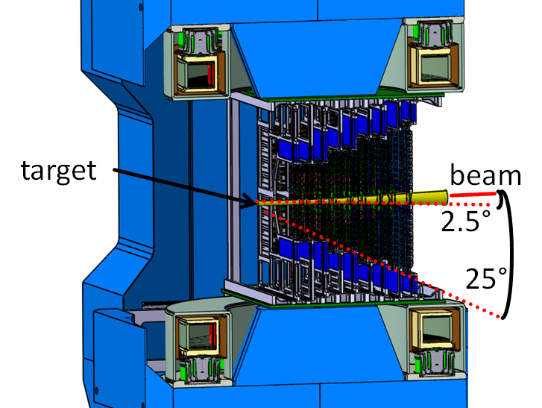
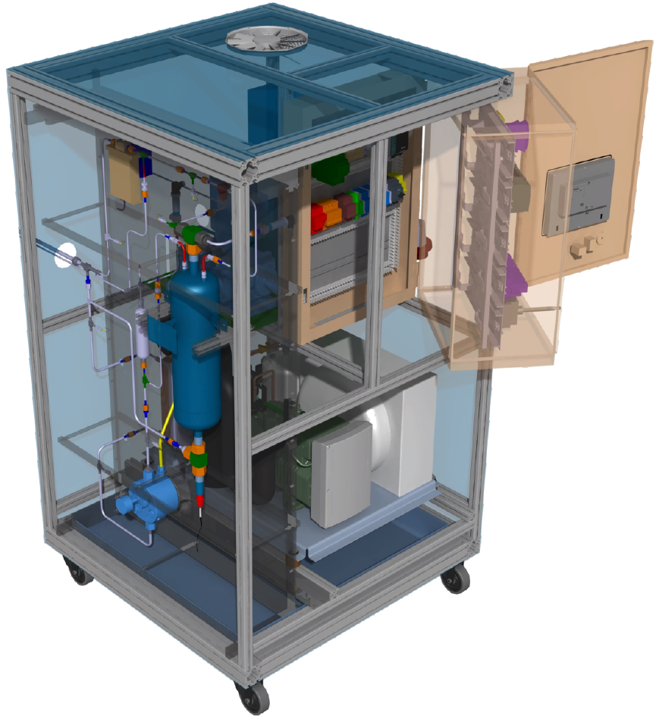
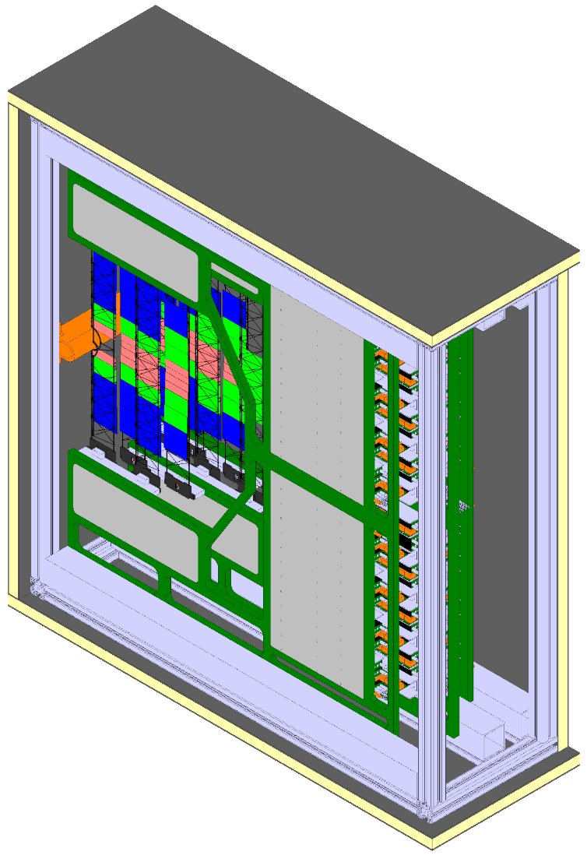
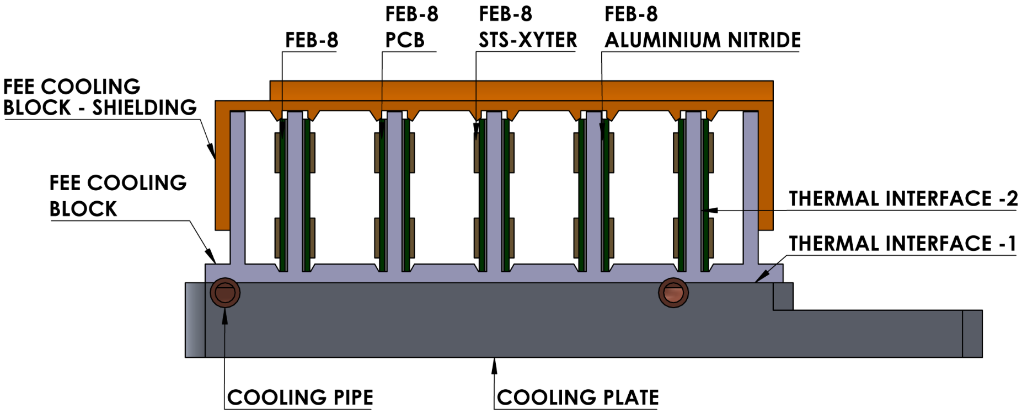
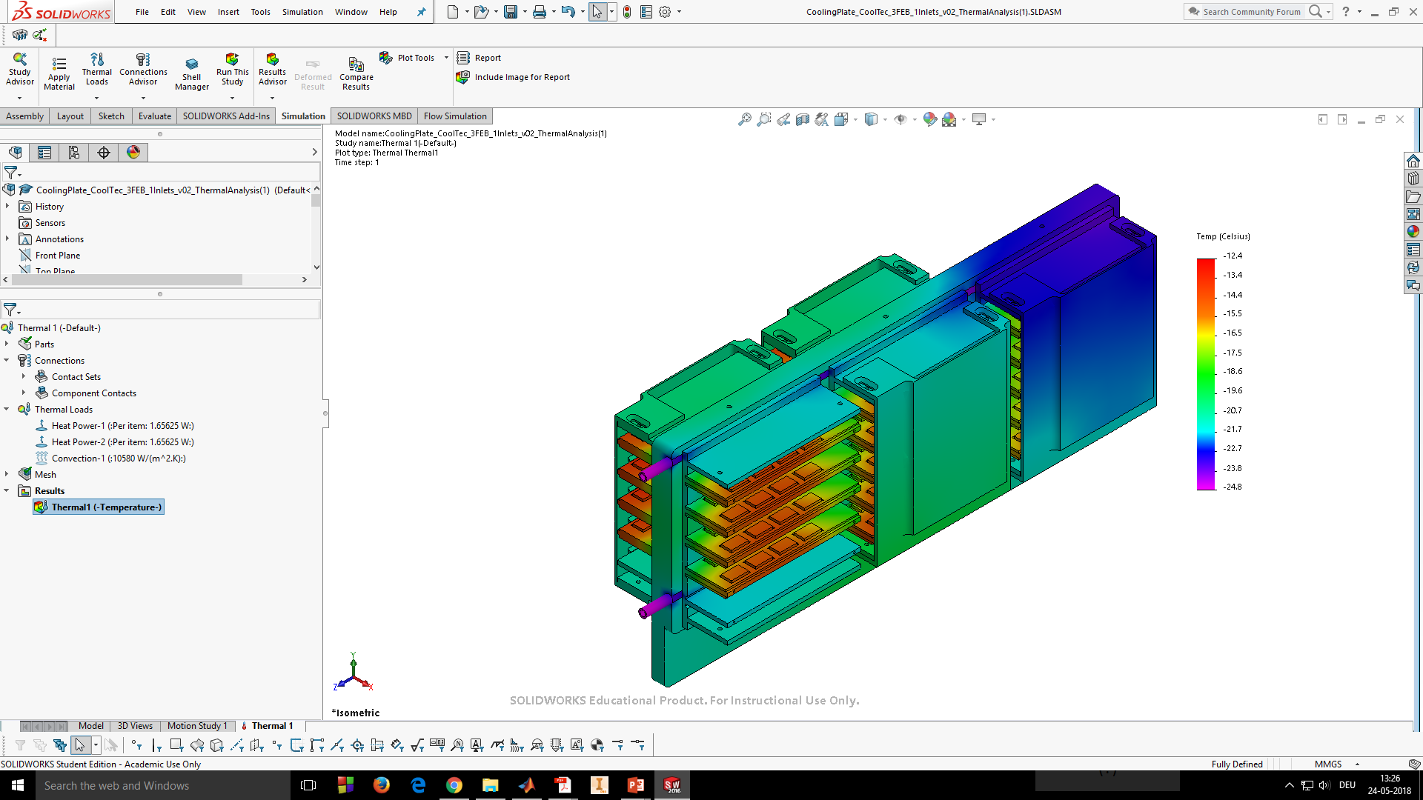
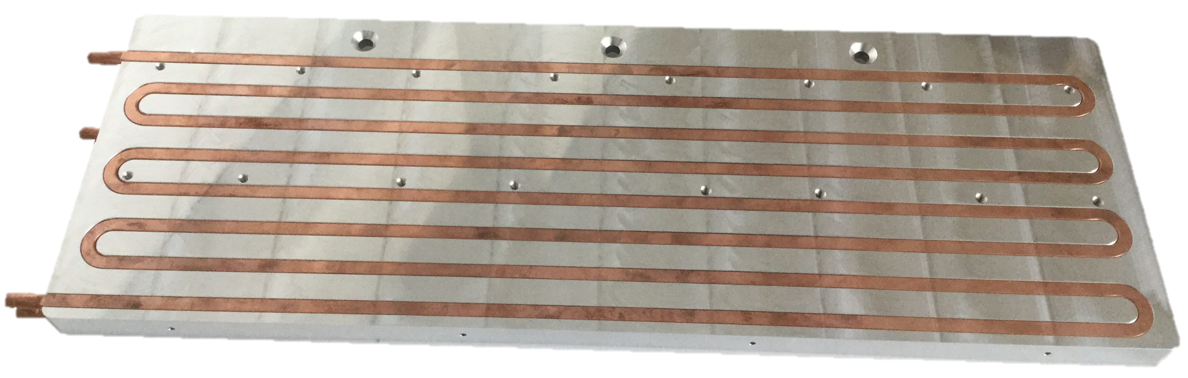
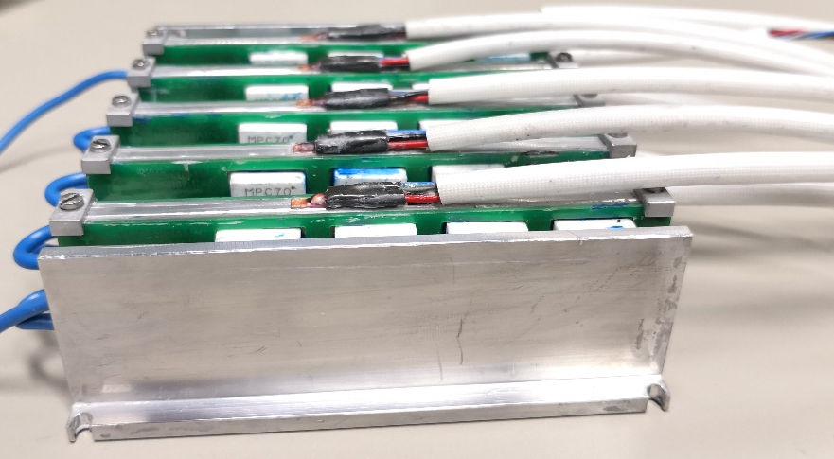
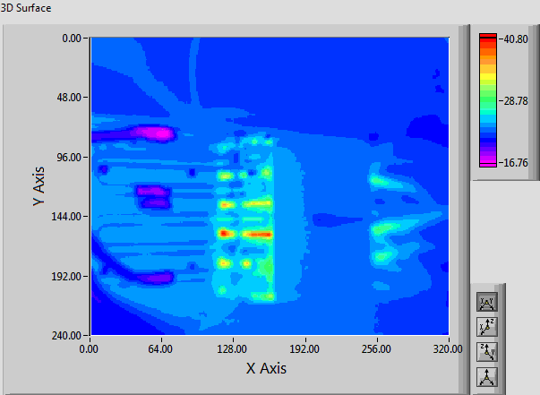


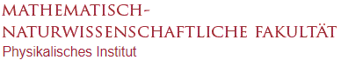


Progress Towards the Development of Cooling Demonstrator of the CBM Silicon Tracking System
Kshitij Agarwal, for the CBM Collaboration
Eberhard Karls Universität Tübingen, Tübingen, Germany
CBM Silicon Tracking System
Cooling Demonstrator
CBM aims to explore regions of high-baryonic densities of QCD phase diagram
Requires detection of rare probes
→ 10⁵ – 10⁷ collisions/sec (Au-Au)
→ Momentum Resolution Δp/p ≈ 1-2%
→ High track reconstruction efficiency with
pile-up free track point determination
Silicon Tracking Station: Key to CBM Physics
→ 8 Tracking Stations inside 1Tm field
→ 896 double-sided micro-strip sensors
→ Low Material Budget: 0.3% - 1.5% X₀/station
→ Radiation tolerance: ≤ 10¹⁴ n_{eq} cm⁻²
→ Signal-to-noise ≥ 10
→ Self-triggering front-end electronics located outside acceptance
→ ∼1.8 million r/o channels + ∼16000 r/o ASICs “STS-XYTER”
Thermal Enclosure
(CF Sandwich)
Distribution system
Cold N₂ Flushing
FEE Boards
Read-Out + Power-Out Boards
Sensor temp.
≤ -10°C
STS in Dipole Magnet
CO₂ Cooling Plant
(TRACI-XL @ GSI - Darmstadt)
Cooling Demonstrator
(2 STS Half-Stations)
Power dissipation ∼40kW in ∼2m³
Why Bi-Phase CO₂ ?
High volumetric HTC → Smaller tubes
Isothermal evaporation
High pressure → Thermal Stability
Cooling & Integration Challenges
Sensor cooling with least X₀/station
RH << 1% @ 25°C to avoid condensation
High-density feedthroughs, transfer lines
Bi-Phase CO₂ cooling at -25°C for FEE
Forced N₂ cooling directly for sensors
Front-End Electronics Cooling
Optimisation of CO₂ Operational Parameters
T-p v/s L Analysis
Flow Pattern Map
(MATLAB + REFPROP)
STS Unit 01
Compressed Baryonic Matter experiment at FAIR
Thermal FEA
(SolidWorks)
Front-End Electronics Cooling Concept
Max. FEE temp. < -10°C 
Cooling Demonstrator FEE Operational Parameters
T_{CO2} = -25°C, Tube D_{eq} = 3.6mm (O.D. 6mm), L = 2m
Quarter-Station # |  | P_{FEE} (W) | Fr (g/s) | ΔP (bar)
1 | Unit 0 | 265 | 3 | 0.0342
 | Unit 1 | 609.5 | 7 | 0.1127
2
 | Unit 2 | 344.5 | 3 | 0.0459
FEE Cooling Plate (Press-Fitted Tube Channels)
PED Compliant @ 100bars
FEE Cooling Block with dummy FEB-8 & PT100 sensors
Optimisation of Thermal Interfaces
Conclusion and Outlook
Thermal Interface Materials (TIMs)
→ Increase area of contact & thermal conductivity
Relative measurements with water as coolant
→ Flattening the interfaces (∼10µm) improves the results substantially
→ Good agreement (± 10%) b/w exp. – FEA
Ongoing R&D for cooling demonstrator with 2 STS Half-Stations
Bi-Phase CO₂ cooling is an optimal solution for cooling the STS electronics
→ T-p v/s L analysis + Thermal FEA model developed to computationally characterise FEE cooling setup
→ Characterization parameters for FEE cooling of first 2 STS Half-Stations with press- fitted tube channels obtained
→ Experimental verification with CO₂ needed upon cooling plant completion
→ Thermal interface optimisation shows that using grease increases thermal efficiency
→ Further options (e.g. Graphite tapes etc) will also be studied
Forced N₂ cooling on sensors needed to minimise radiation damage
→ Realisitc mechanical setup with minimum material budget inclusion is desired
Thermal characterization of HV-LV, optical etc connectors is foreseen
Operational experiences from mSTS@SIS18 (Aug-Sep‘18) for demonstrator integration
TIM Optimisation
T_{H2O} = 15°C, Q̇ = 160W, Fr = 11.1g/s
Interface #1 | Interface #2 | Maximum Fin Temp. (°C)
 |  | Exp. (PT100) | Thermal FEA
Grease | Grease | 29.7 | 32.0
 | C-Foil | 29.6 | 32.0
C-Foil | Grease | 33.7 | 32.1
 | C-Foil | 33.9 | 32.1
TIM Properties
 | k (W/m∙K) | d (µm) | R_{Ѳ} (d/k; m²∙K/W)
Grease | 5.0 | 30 | 6.0 x 10⁻⁶
C-Foil | 16.0 | 125 | 7.8 x 10⁻⁶
Viscous TIM (grease) is better 
FEE shielding works 
References
J. Heuser et al., Technical Design Report for the CBM Silicon Tracking System (STS) (2013)
E. Lavrik, ‘Development of quality assurance procedures and methods for the CBM Silicon Tracking System’, PhD Thesis, Uni. Tübigen (2017)
B. Verlaat et al., Proceedings of 10th IIR Gustav Lorentzen Conference on Natural Refrigerants (2012), GL-209
Z. Zhang, CERN-THESIS-2015-320 (2015)
M. Rauch, CERN-THESIS-2015-247 (2015)

