Slide 1
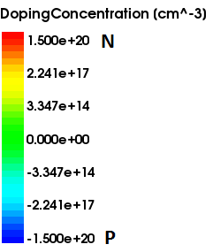
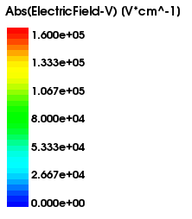
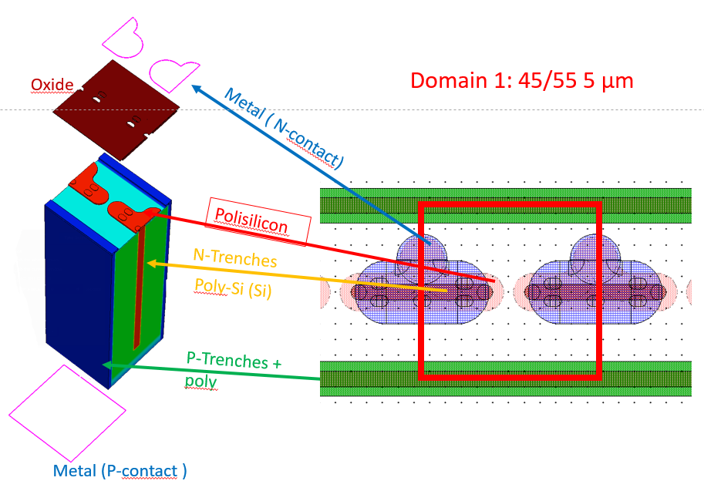
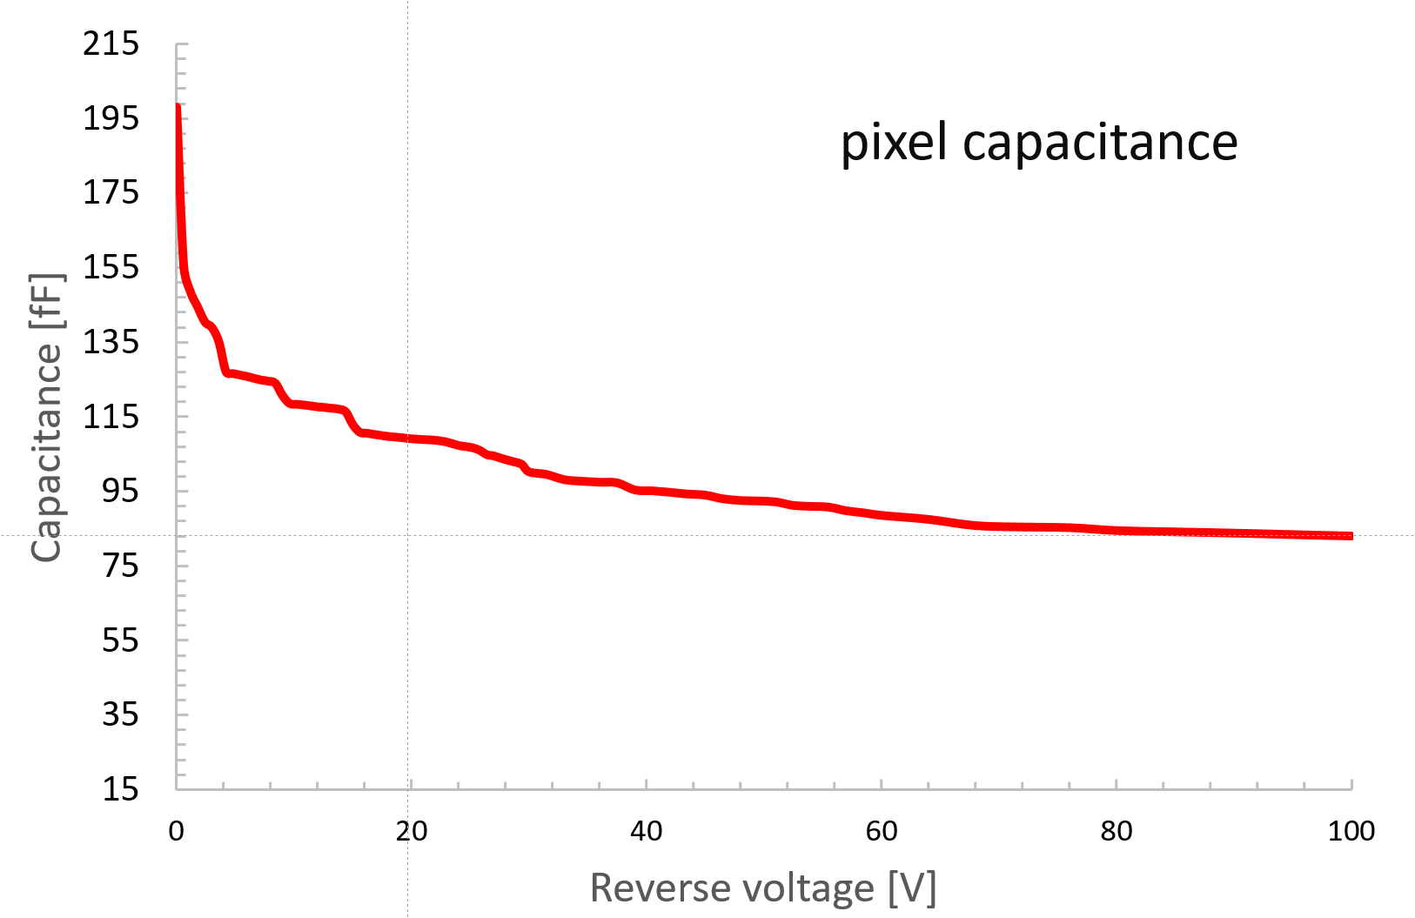
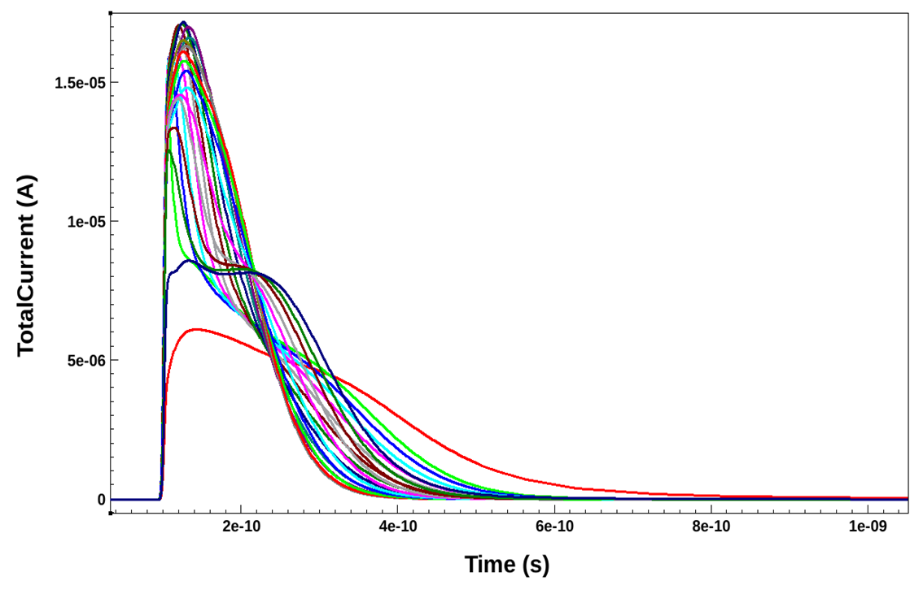
Simulation of 3D-Silicon Sensors for the TIMESPOT project
${Angelo Loi}^{1,2}$, Adriano Lai², Gian-Franco Dalla Betta³ ⁴, Roberto Mendicino³ ⁴, Stefania Vecchi⁵
1. University of Cagliari, Department of Physics, Monserrato, Italy
2. Istituto Nazionale di Fisica Nucleare, Sezione Cagliari, Monserrato, Italy
3. University of Trento, Department of Industrial Engeniering, Trento, Italy
4. TIFPA-INFN, Department of Physics, Trento, Italy
5. Istituto Nazionale di fisica Nucleare, Sezione Ferrara, Ferrara, Italy
(TIME and SPace real-time Operating Tracker) is a a INFN-CSN5 initiative which aims at the development and realization of a complete particle space and time tracking system for future high luminosity experiments.
Angelo Loi
(a)
Modelling and simulation of timing specific 3D silicon pixel sensors:
Electrode geometry for fast timing measurements was explored and defined
A 3D model of the pixel was designed for first electrical and signal simulation
,
,
(b)
Sensor response and first electrical parameter were simulated:
Sensor Capacity around 100 fF
Charge collection time below 400 ps
Self standing signal simulator which uses the Nvidia CUDA Toolkit based Hydra Multithreading data Analysis Framework is under development.
PM2018 – 14° Pisa Meeting on Advanced Detectors
La Biodola – Isola d’Elba – June 2018

