Slide 1



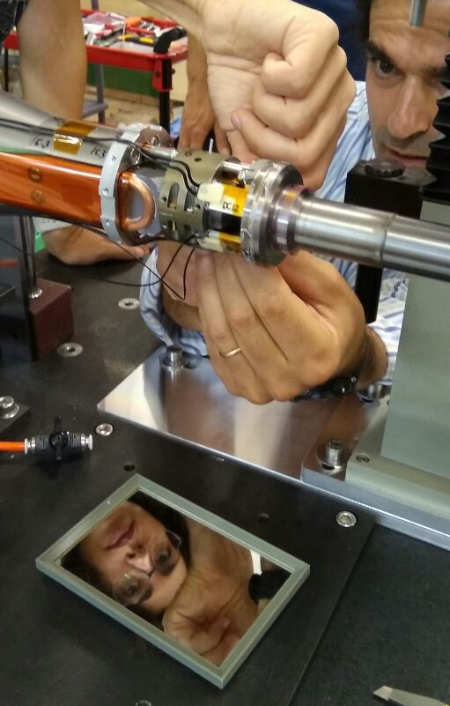
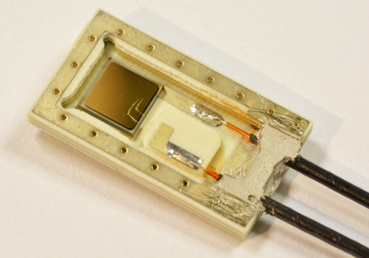
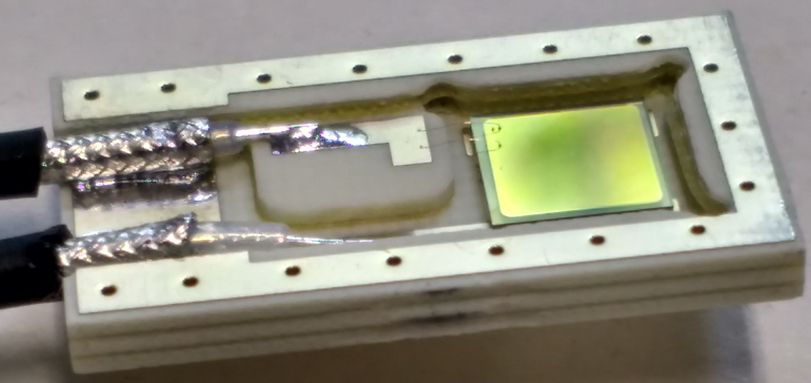
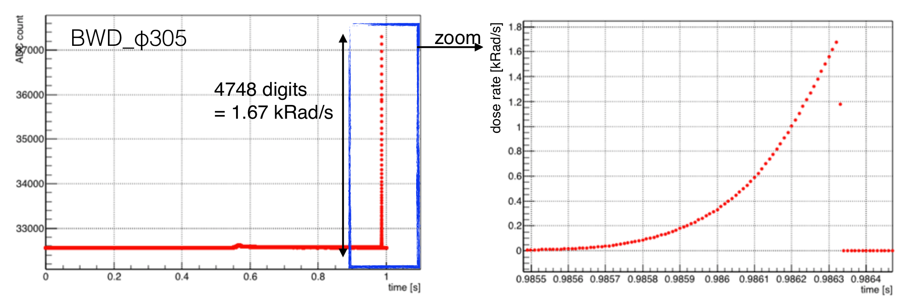
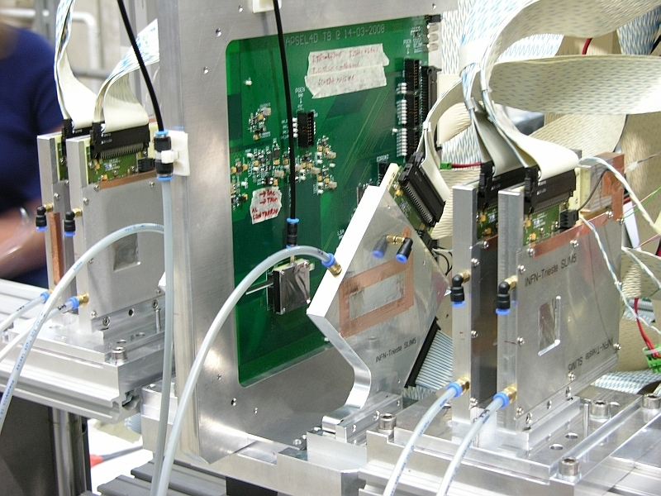
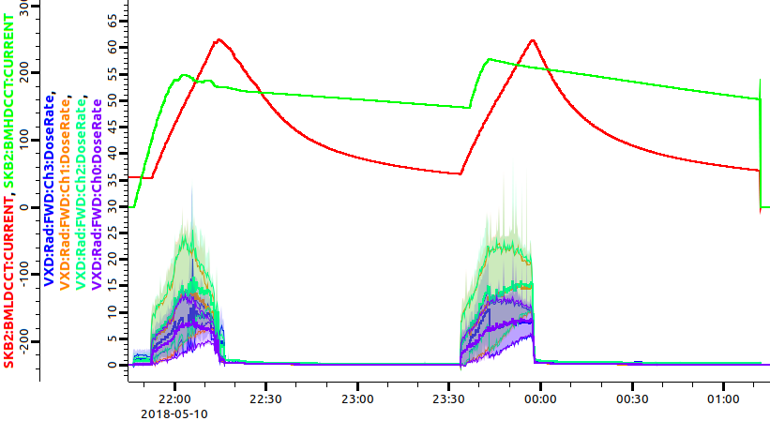
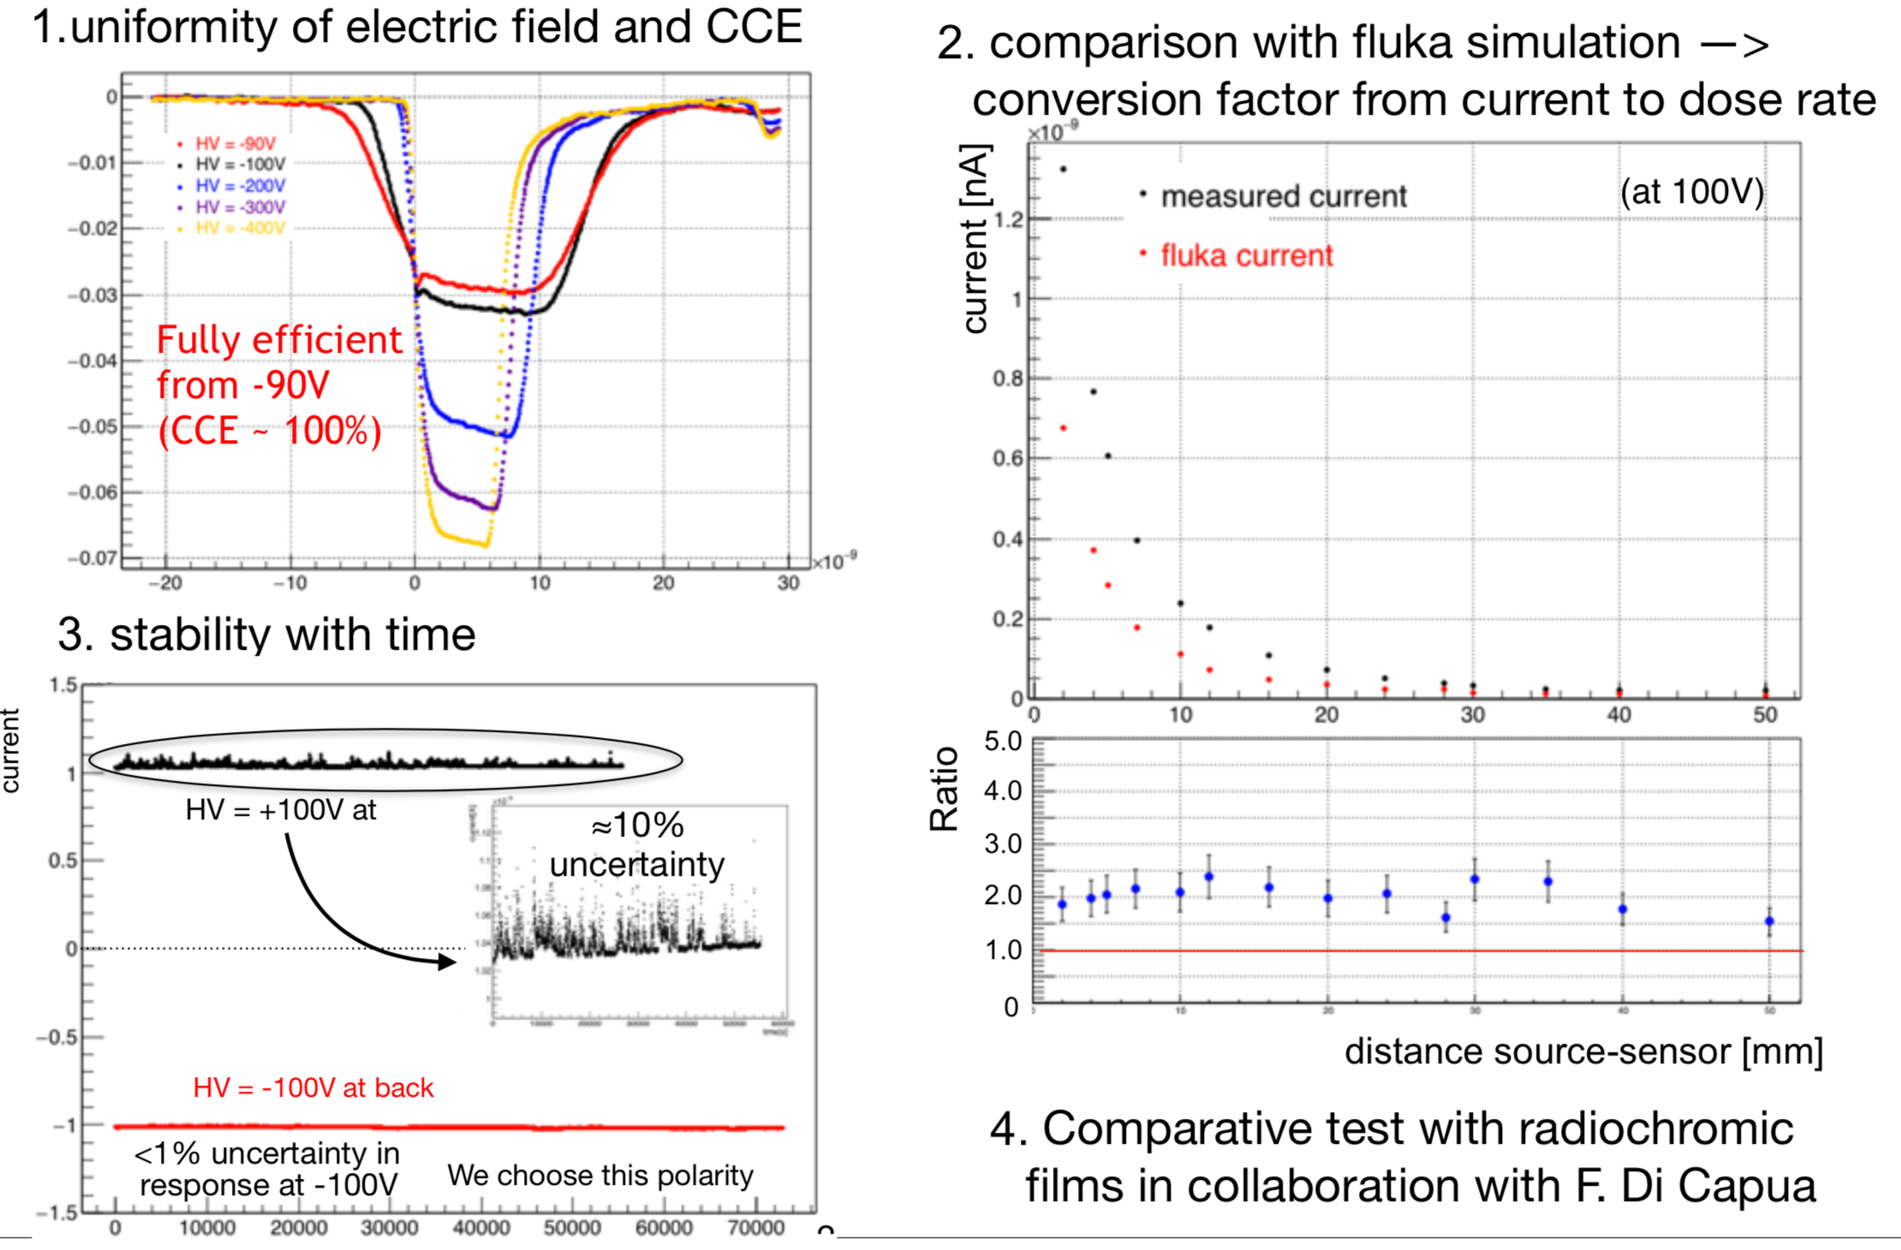
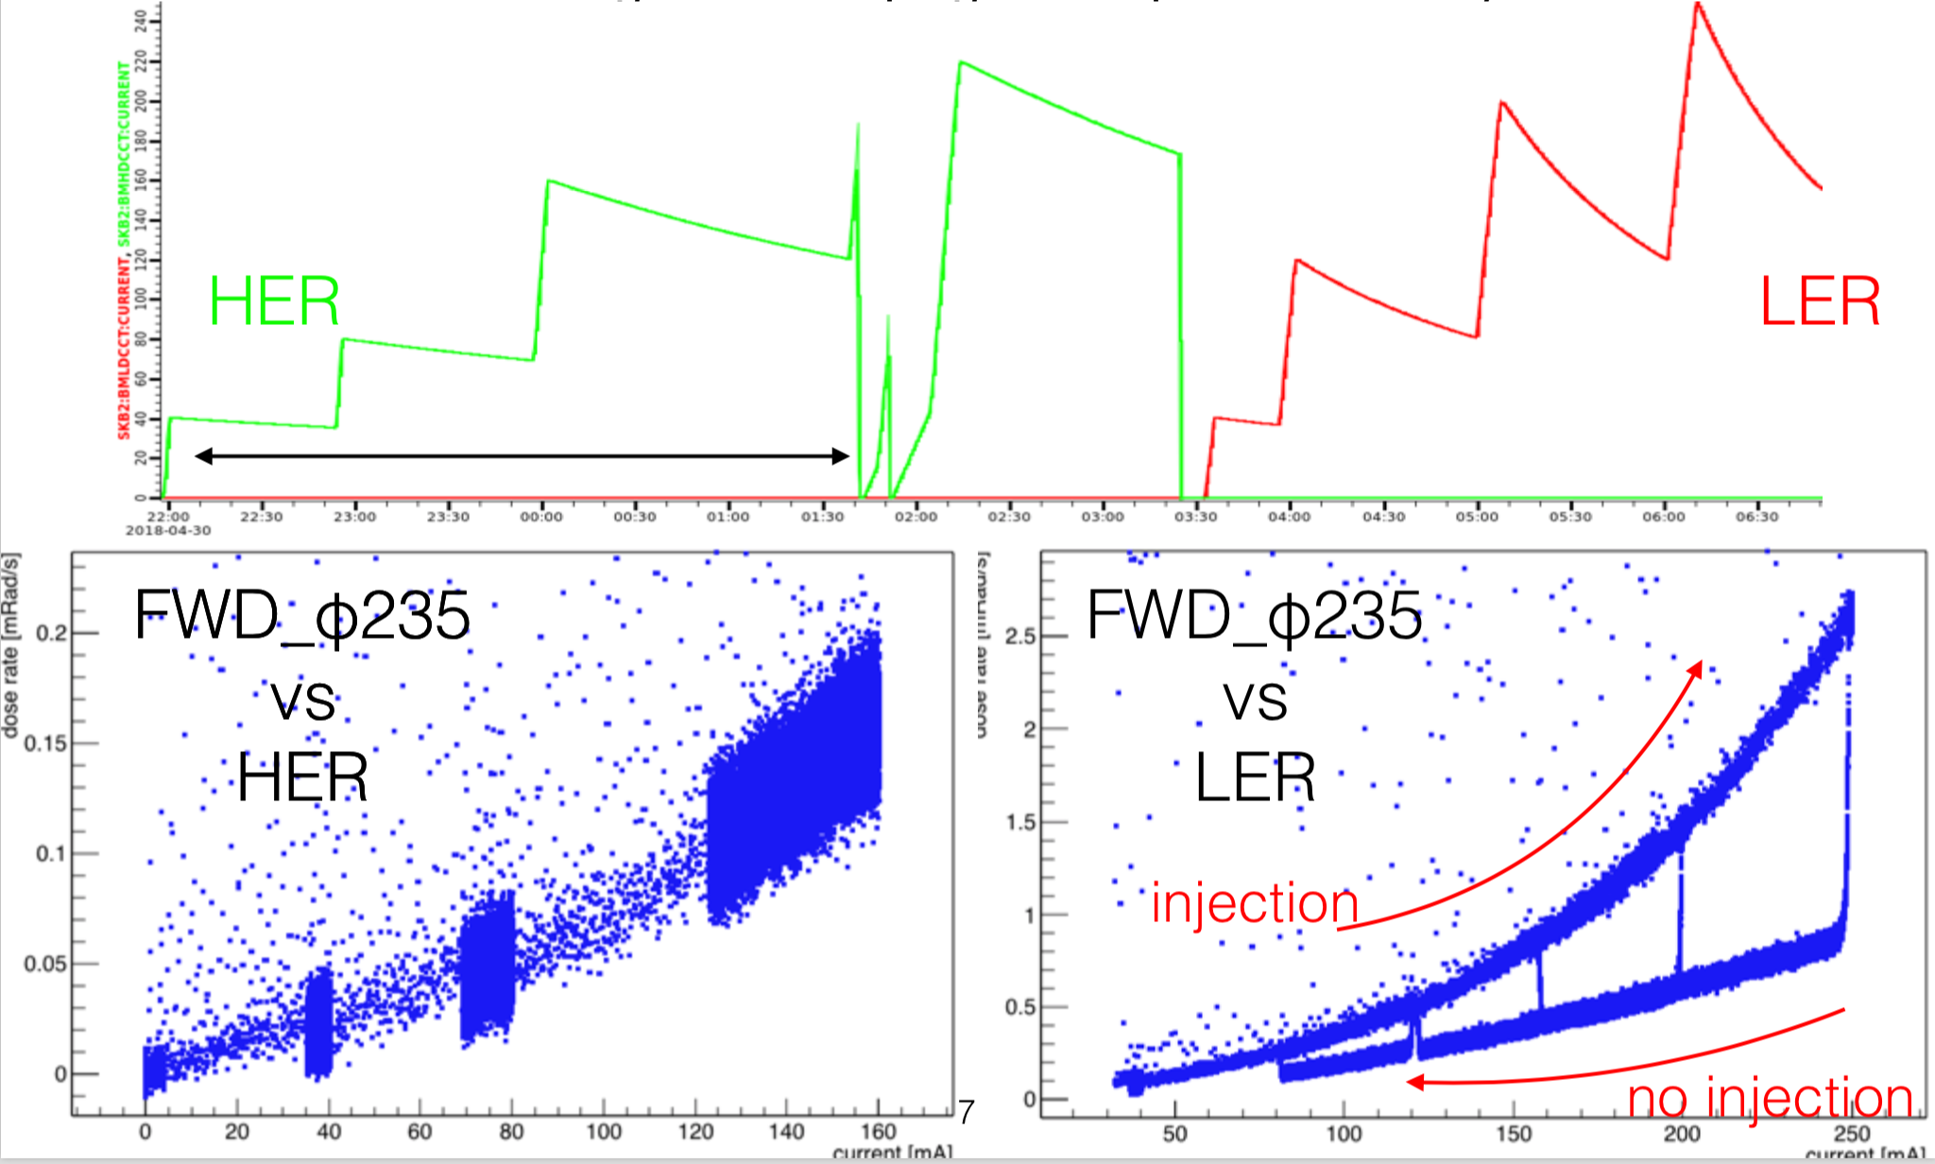
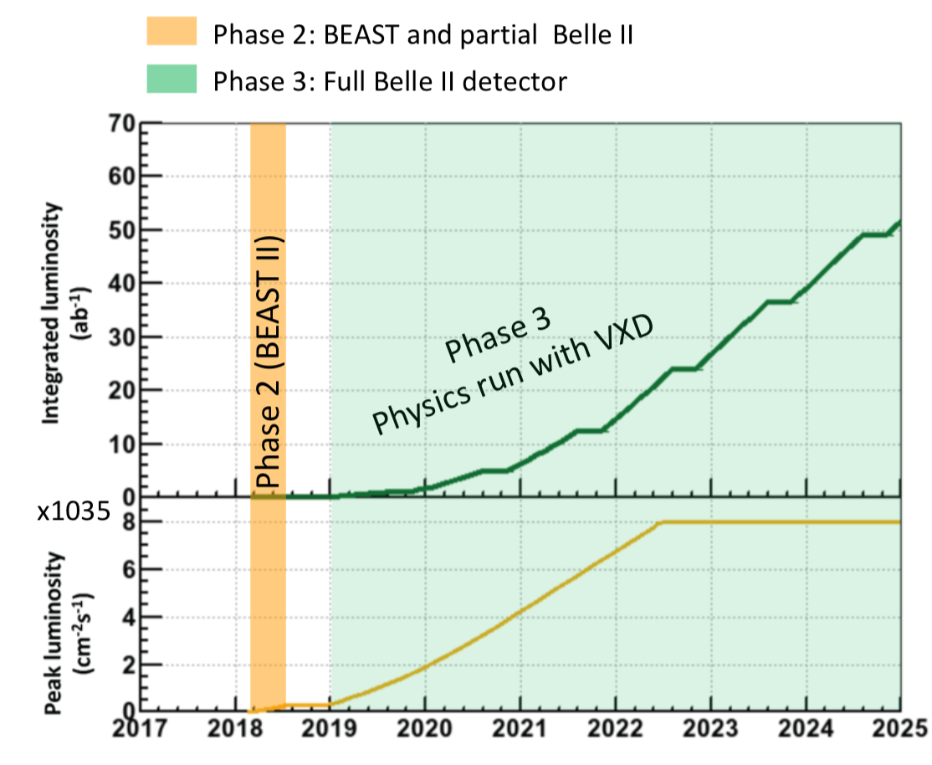
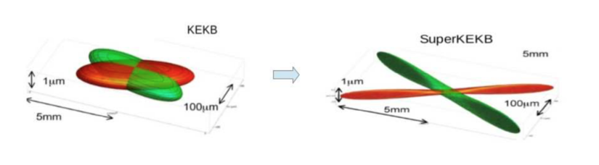
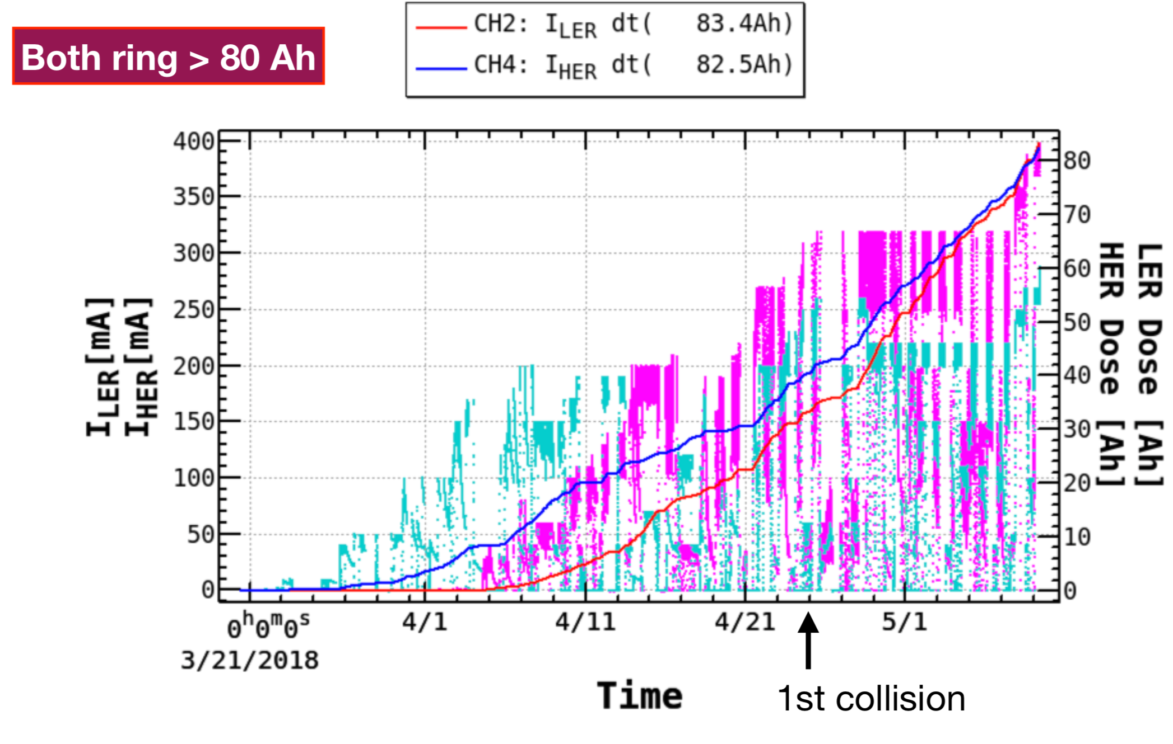
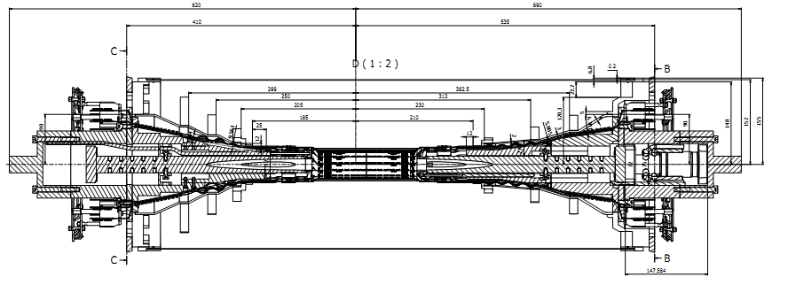
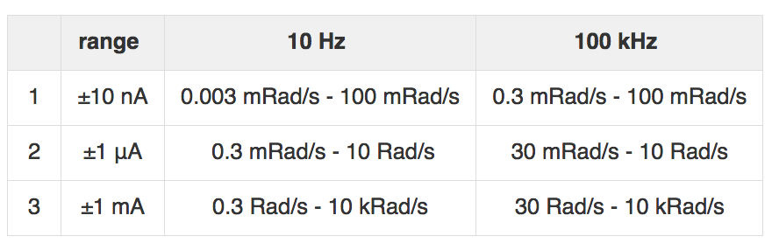
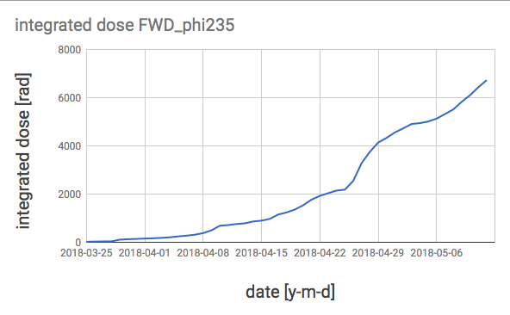
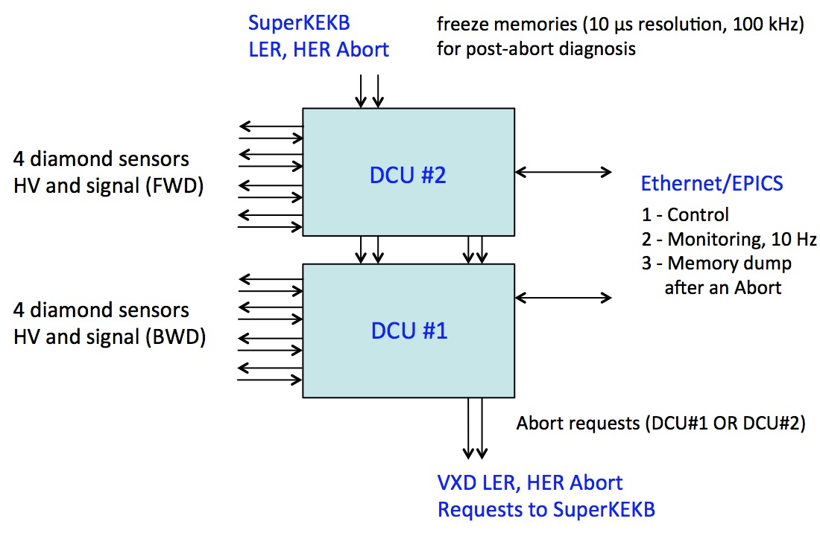
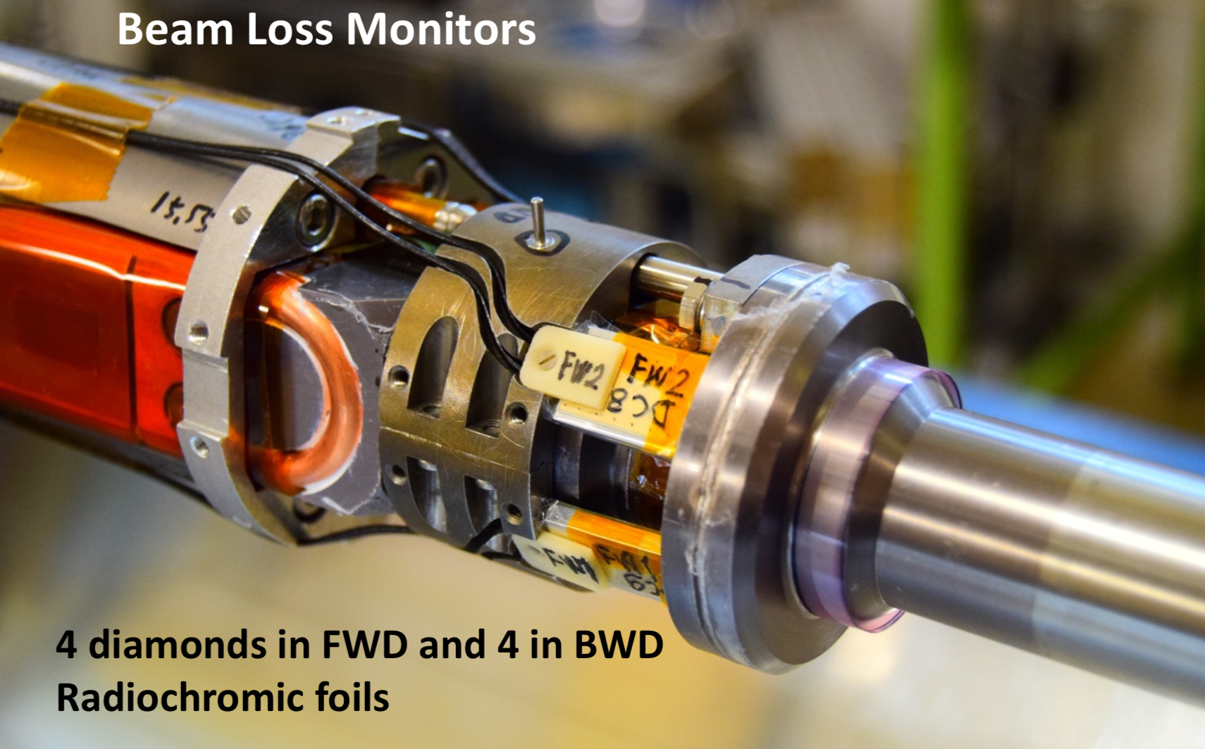
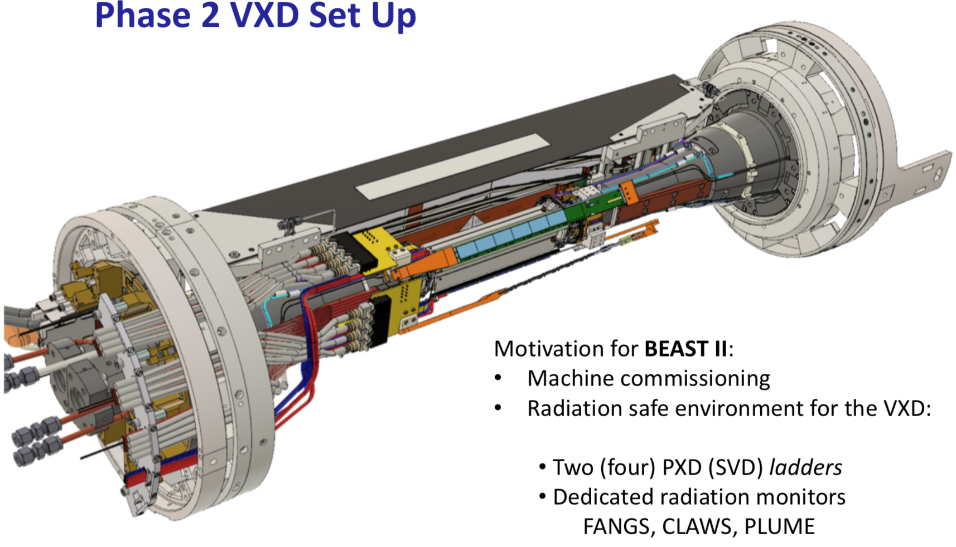
First experience with the Belle II
radiation monitoring based on diamonds
Lorenzo Vitale on behalf of Belle-II SVD collaboration
INFN and Univ. Trieste, ITALY
Abstract
The Belle II detector at the SuperKEKB e+e- collider is undergoing first commissioning with beams until mid 2018.
The outer detector is complete and only an azimuthal portion of the silicon vertex detector is installed.
A radiation monitoring and beam abort system is essential for safe operation of the Belle II detector, given the unprecedented luminosity planned for SuperKEKB.
Belle II will employ 20 single-crystal, CVD diamond sensors, appropriately installed in close to the beam and to the tracking volume.
The diamond current will be continuously sampled at 10 Hz to record the average radiation dose accumulated through the life of the experiment, and recursively sampled at 100 kHz to monitor the instantaneous radiation rate and to deliver a fast abort signal if sudden radiation spikes occur.
We report the status, and first measurements with beams, of a preliminary configuration of the system based on the eight innermost diamond sensors, installed directly on the beam pipe and read by the final readout system.
Diamond sensors
Radiation-hard single-crystal Chemical Vapour Deposition diamond sensors 4.5x4.5x0.5 mm³ mounted in a compact and shielded package 18x12x3.1 mm³
8 now in use for Phase 2
20 for Phase 3:
12 already installed, 8 in June 2018
Characterization and calibration
0 – “dark” I-V <1 pA up to 500V & I-V with light exposure
1 – TCT transient current technique with α source for charge collection efficiency (CCE)
2 – β source vs distance + FLUKA simulation
3 – Long time > 1⨉10⁵s stability with β souce
4 – Radiochromic films comparison
Preliminary Phase 2 results
Radiation system always operational.
All ranges used to accommodate goals 1 2 3.
One DCU for fast abort threshold: 1rad in 1ms
The other DCU usually set to the highest sensitivity range for background studies in different beam conditions
Example of
injection
background
Quadratic dependence of dose rate on beam currents:
Example of a radiation spike (~1ms zoom)
HER current
LER current
Radiation environment
SuperKEKB asymmetric e⁺e⁻ collider
Design luminosity 8x10³⁵ cm⁻²s⁻¹ → 40×KEKB!
with ≳ beam currents, ≪ beams size at interaction
⇒ severe beam-induced bkg & radiation doses
Mainly e⁺, e⁻, γ, from:
e⁺e⁻ pair production in γγ scattering,
Radiative Bhabha, Touschek,
Off-momentum particles from beam-gas,
Synchrotron radiation.
Diamonds dose rates
Schematic view of the SLIM5 beam test and picture of the experimental setup
Phase 2 = Commissioning
Phase 3 = Physics
HER = High Energy Ring
LER = Low Energy Ring
Main goals:
→ 1 Fast beam-abort signal to SuperKEKB in conditions potentially damaging for VXD sensors, Front End electronics and other components.
→ 2 Real time monitoring of dose rate
→ 3 Integrated dose
Electronics
In collaboration with Elettra-Sincrotrone S.C.p.A. Trieste.
Trans-impedance amplifiers. 16 bit ADC oversampling at 50 MHz. FPGA sums 500 samples and performs operations at 100 kHz. Data displayed at 10 Hz.
High Voltage individually supplied to sensors.
Three selectable current digitization ranges.
2 Diamond
Control
Units
(DCU)
Radiation monitoring
Belle II vertex detector (VXD):
PXD: pixel detector, 2 layers of DEPFET pixels
SVD: silicon-strip vertex detector, 4 layers of double-sided silicon strips
Monitoring: 20 diamonds
During Phase 2: horizontal sector of VXD
- 8 diamonds around beam pipe (as for physics)
- Other dedicated detectors for background studies
Integrated beam currents and doses
Both rings > 80 Ah
4 + 4 sensors
PXD-beam pipe
6 + 6 sensors
close to SVD L3 support rings
All FWD ~4-7 krad
Lorenzo Vitale
Email: vitale@ts.infn.it
Notes:
PXD r = 1.4, 2.2 cm
SVD r = 3.8, 8.0, 10.4, 13.5 cm
Mostly energy losses will be from electrons.
Each PXD layer will consist of only 75 μm of thickness in the active area (in average about 0.2% radiation length X₀ per layer) and SVD 0.6%X₀ per layer in average.
The space available for radiation sensors, cables and front-end electronics is extremely tight.

