Slide 1
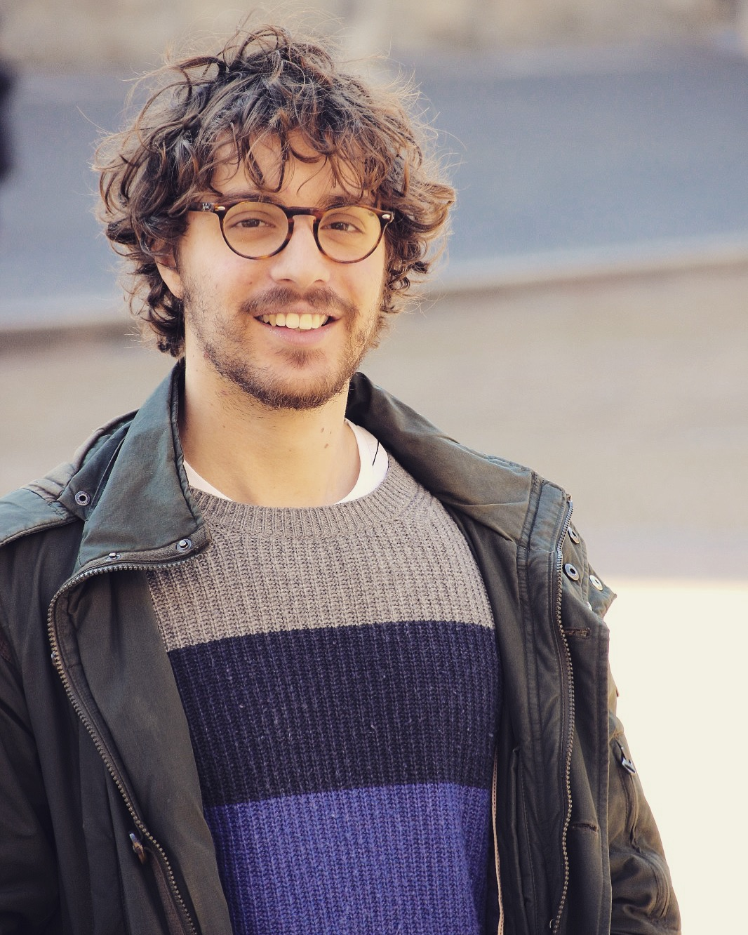
PM2018 – 14° Pisa Meeting on Advanced Detector, 27 May – 2 June 2018, La Biodola, Isola d’Elba, Italy
Radiation tolerance characterization of Geiger-mode CMOS
avalanche diodes for a dual-layer particle detector
M. Musacci , G. Bigongiari , P. Brogi, C. Checchia, G. Collazuol, G.-F. Dalla Betta, A. Ficorella, P.S. Marrocchesi, S. Mattiazzo, F.Morsani, S. Noli, L. Pancheri, A. Savoy Navarro, L. Silvestrin, F. Stolzi, A. Sulaj, J. Suh, L. Ratti, C. Vacchi, M. Zanoli, M. Zarghami
A dual-tier detector for charged particles has been designed, in two mirrored version ready to be bump bonded in view of their vertical integration, starting from the radiation tolerance characterization of an array fabricated in a 180 nm high voltage CMOS technology. In particular, two different irradiation campaigns have been carried out involving ionizing and non-ionizing radiation.
The results are presented and discussed together with the main features and improvements of the new designed chip.
marco.musacci01@universitadipavia.it

