Slide 1
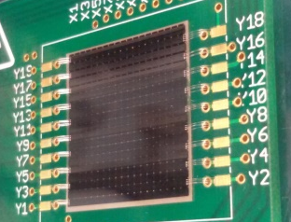
PM2018
14th Pisa Meeting
“Searching for a dark photon with PADME at LNF:
status of the active diamond target”
Federica Oliva on behalf of the PADME Collaboration
The PADME experiment¹ at the DAΦNE Beam-Test Facility (BTF) will search for the dark photon production in the annihilation , using the intense positron beam hitting a diamond target.
A target for PADME?
Two Active Diamond Targets 2 × 2 cm² area and 100 μm thickness with 19X+19Y strip (1mm pitch) electrodes assembled: one with metallic strips (produced directly by Applied Diamond) and one with graphitic strips (produced by means of an excimer laser ArF in the L3 Laser Laboratory in Lecce ).
ACTIVE TARGET
The missing mass resolution improves with the spatial resolution on the beam-target interaction point, needed to measure the direction of the photon
DIAMOND TARGET
Active Diamond Target DCS, DAQ and mechanical support in vacuum ready
Low Z (=6) improves Signal/Background
BACKGROUND
The very first prototype with graphitic strips was
tested and characterized in November 2015 during a beam test at the BTF (LNF), using the e± beam of the DAΦNE Linac ² .
2 × 2 cm² area, 50 µm thickness
18x18 strips 1mm pitch
X Charge Centroid Distribution
Federica Oliva
PhD student
University of Salento, Lecce, Italy
INFN Lecce
federica.oliva@le.infn.it
spatial X resolution ≈ 0.2 mm
spatial Y resolution ≈ 0.3 mm
Charge Collection Distance ≈ 11-12 μm
X-Y beam profiles reconstructed
good time resolution (0.7ns)
X
For more info on the PADME experiment:
http://www.lnf.infn.it/acceleratori/padme/
https://web.le.infn.it/padme/
¹M. Raggi and V. Kozhuharov, “Proposal to Search for a Dark Photon in Positron on Target Collisions at DAΦNE Linac”, Adv. High Energy Phys., 2014;
²The Active Target PADME group, “Performance of the diamond active target prototype for the PADME experiment at the DAΦNE BTF”, NIM A 898 105–110 (2018).
TURN THE DARK ON!

