Slide 1
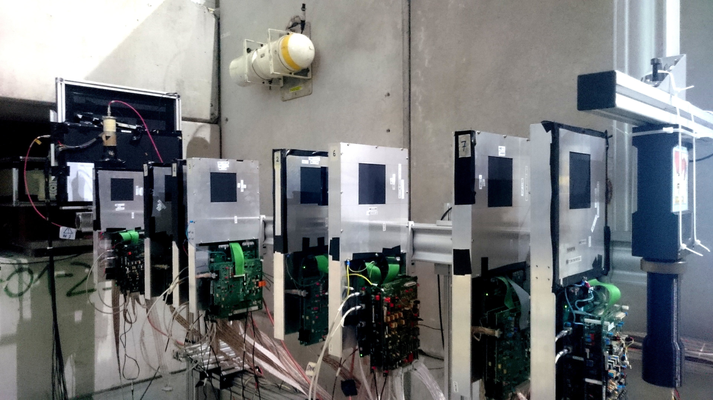
A feasibility test run
for the MUonE project
Giovanni Ballerini
(gio.ballerini94@gmail.com)
on behalf of the MUonE collaboration
Modern measurements of the muon anomalous magnetic moment g-2 stand more than 3-4σ away from the Standard Model prediction: hint of new physics?
The MUonE project aims to measure the Hadronic Leading Order (HLO) contribution to the muon g-2 by scattering high energy (150 GeV, from CERN-SPS beam) muons off the atomic electrons of a low-Z target through the elastic process μ+e → μ+e
MODULE n
MODULE n+1
To exploit the kinematical correlation of the μ - e collision → need for precise measurements in a as thin as possible detector
A modular target is foreseen, consisting of 60 low-Z layers each sandwiched in layers of Si-microstrip detectors
16 9.5x9.5 cm² Si-microstrip detectors
In April-May 2018 a reduced experimental setup was installed, running parasitically on the beamline behind the COMPASS experiment
→ find more on the experimental setup
& the Daq system on the poster ←

