Slide 1
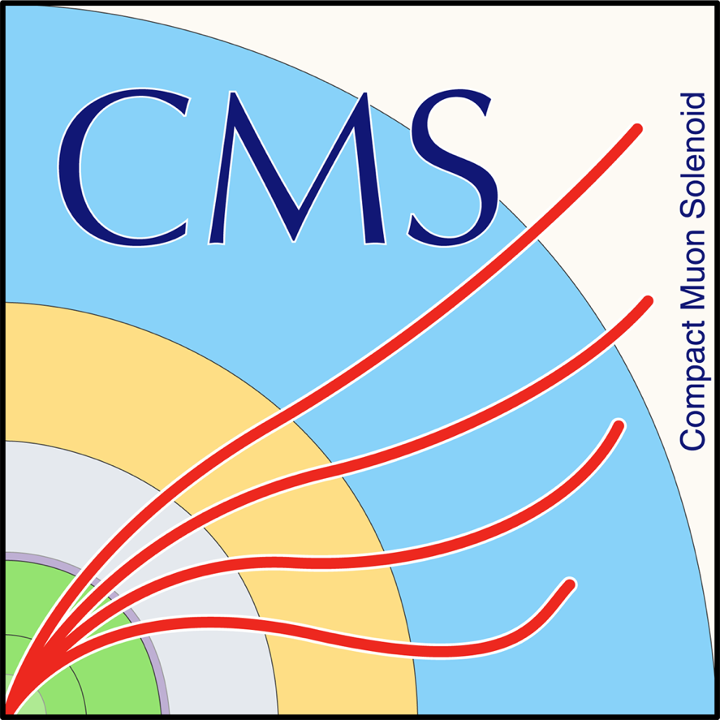

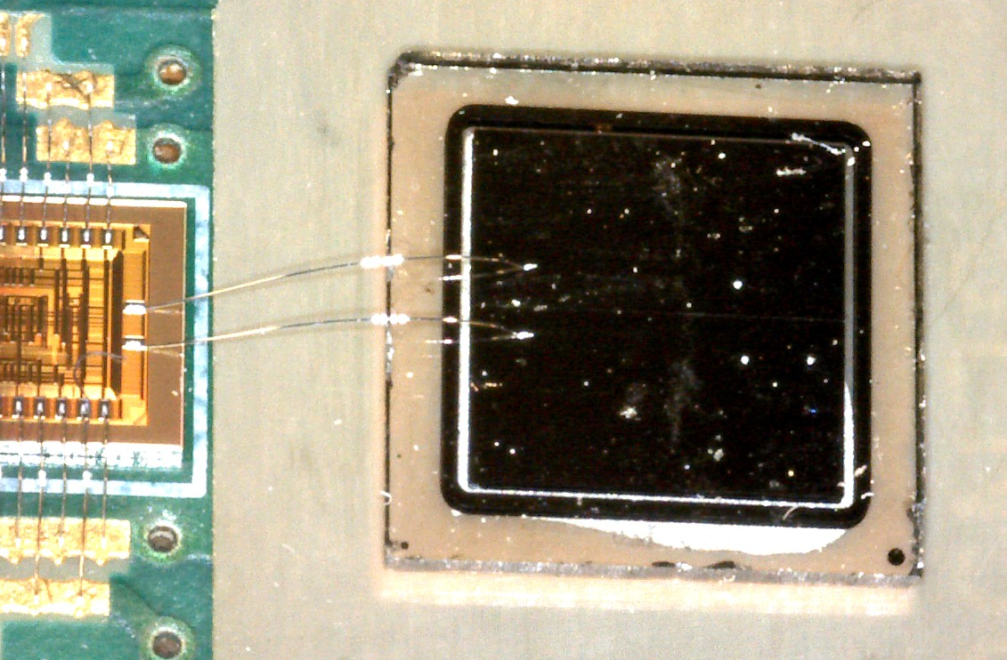
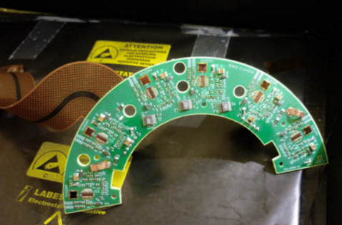
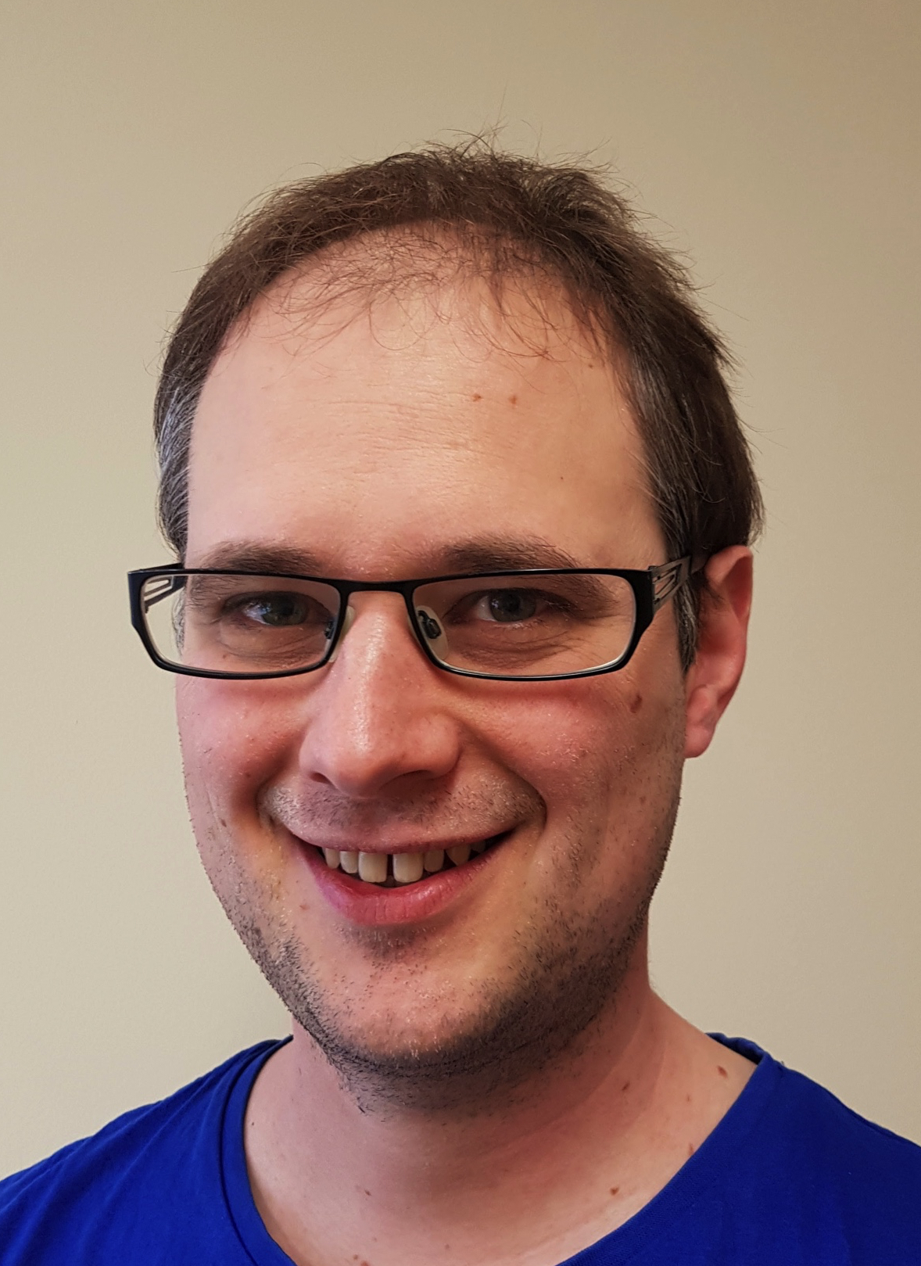
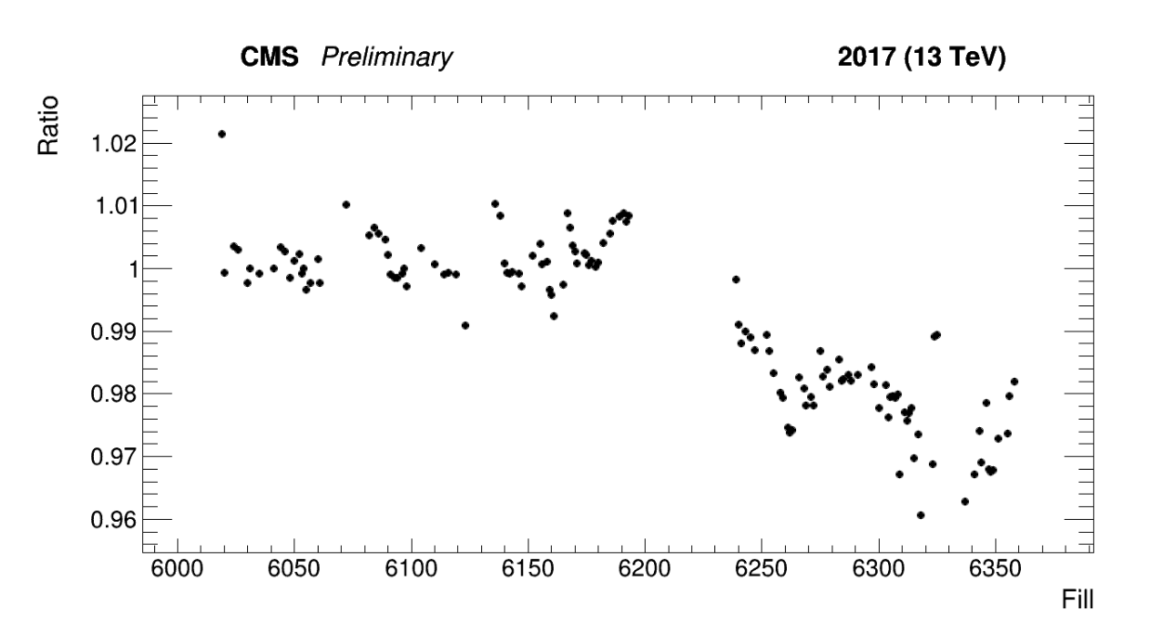
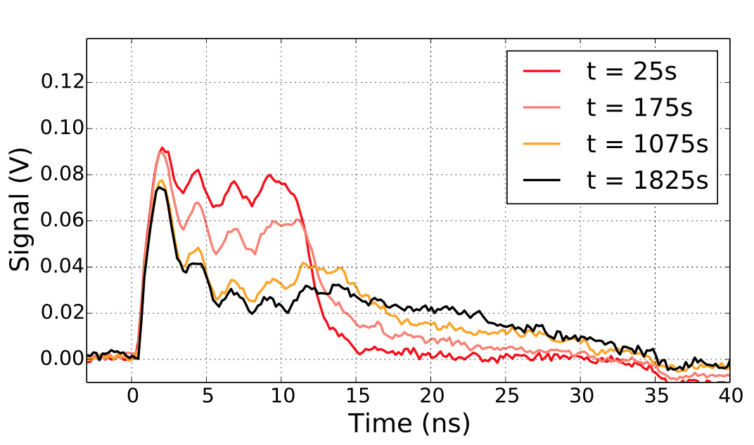
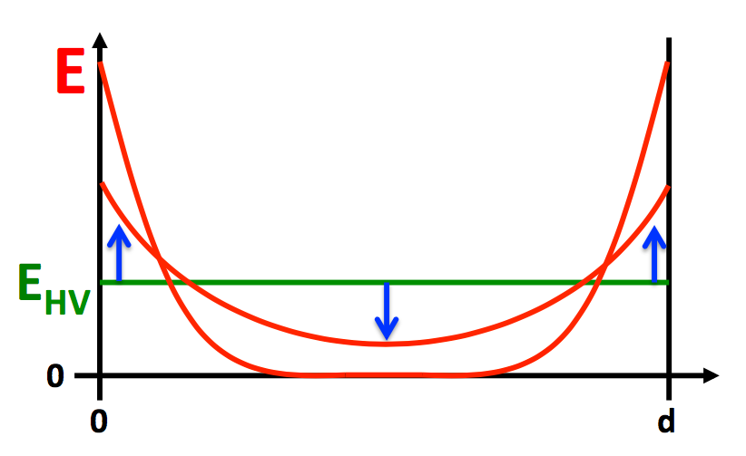
The new Fast Beam Condition Monitor using diamond sensors for luminosity measurement at CMS.
Moritz Guthoff (DESY, Hamburg, Germany) on behalf of the CMS collaboration
CVD diamond based particle detector
Metallization
Optical signal output
Diamond
Analog to optical signal conversion
Fast front end amplifier
High Voltage
Ionizing particle
Original system
2015/16
single-crystal diamonds
New replacement
2017/18
poly-crystal diamonds
HV trips after irradiation at high particle rates.
Unstable operation.
Stably operation at sufficient HV
Good quality luminosity measurement
Increased E-field on surface
irradiated
1.8 x 10¹³ n/cm²
Reduced field in center of the bulk
Transient current technique measurements show bulk polarization after irradiation as likely cause for instabilities.
pCVD lab tests:
Stable operation at 1000V for many hours
Luminosity 2017:
BCM1F within 2% of reference measurement

